Slide 1

MCA Major Project Presentation
MUJ Unite
Under the guidance of
Dr. Monika Jyotiyana
Department of Computer Applications
Faculty of Science, Technology and Architecture
Manipal University Jaipur
By
Rohan Nigam
23FS20MCA00087
2023-25

Slide 2
Outline
Introduction
Motivation
Process Model
Software Requirement Specification (SRS)
Data Flow Diagram (DFD)
Results
Conclusions
Future Scope
Slide-2

Slide 3
1. Introduction
MUJ-Unite is a web application made specifically for the Manipal University Jaipur community.
MUJ-Unite is an interactive platform for the student seeking career guidance, an alumni seeking to give back, or a teacher seeking to remain connected with former students.
MUJ Unite aim to create practical connections and a user-friendly environment for growth and mentorship.
The core idea of MUJ Unite is to help students, teachers, and alumni feel more connected in a shared space for communication and growth.
Easy for all to remain connected, share their experiences, and assist one another to grow together.
Slide-3

Slide 4
2. Motivation
To bridge the gap between students, alumni, and faculty.
To ensure important announcements are not missed.
To provide a platform for alumni to share guidance and job opportunities.
To help faculty engage with students beyond the classroom.
To foster a supportive and connected university community.
Slide-4

Slide 5
3. Process Model
In MUJ Unite, we followed the Agile development model because it allowed me to work step-by-step while building the platform.
Unlike traditional models, Agile gave me the freedom to develop features in small parts (called sprints), which helped me stay flexible and make improvements as I went along.
How Agile Worked in MUJ Unite ?
I broke the project into 8 weekly sprints. Each sprint had a specific goal. For example:
In Sprint 2, I worked on user authentication.
In Sprint 4, I developed the posting system.
In Sprint 7, I added QR code scanning.
After finishing each sprint:
I tested what I had built
Fixed bugs or UI issues
Adjusted the next sprint based on feedback or what needed more work
This made development smoother and more realistic, especially since I was building a full web app alone.
Slide-5

Slide 6
Why Agile Was the Right Choice for MUJ Unite?
At first, I didn’t plan every single feature—stuff like the QR profile scan or announcement board actually came up later during development. Agile let me add those easily without having to start from scratch.
I worked in weekly sprints, so after each one, I could test what I built right away. That helped me catch small issues early, before they turned into bigger problems.
For example, during the messaging feature (Sprint 5), I realized the Inbox layout wasn’t great. Thanks to Agile, I just improved it in the next sprint—no need to wait till the end.
Agile gave me the freedom to build, test, and fix as I went, which worked really well for a solo project like this.
It made the whole process feel more natural and less stressful, since I could focus on one part at a time and see progress every week.
Slide-6

Slide 7
4. Software Requirement Specification (SRS)
Functional Requirements:
Functional Requirements are as follows:
User Authentication and Role Management: Users can register and log in using their official university email address.
Post Creation and Engagement: All users can create text or image-based posts.
Announcement System: Faculty and alumni have the ability to post official announcements.
Messaging System: A one-on-one private messaging feature allows direct communication between any two users
User Profile Management: Each user has a personal profile with editable fields.
Slide-7

Slide 8
Non-Functional Requirements:
Non-Functional Requirements are as follows:
Security: All passwords are stored securely using hashing techniques.
Usability: The interface is designed to be user-friendly and intuitive.
Maintainability: The codebase follows modular design principles to make future updates, debugging, and feature additions easy and efficient.
Scalability: The system architecture supports future enhancements like, Resume/job posting features, Internship board & Integration of mobile applications for iOS and Android.
Slide-8

Slide 9
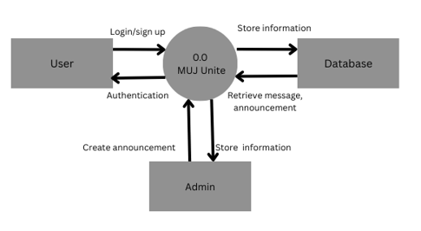
5. Data Flow Diagram (DFD)
Context Level DFD :
The Level 0 DFD, also called the context diagram, gives a basic snapshot of how the MUJ Unite platform works from the outside. It doesn’t go into the technical stuff or what's happening behind the scenes—instead, it just shows the whole system as one big process and how it connects with different users.
Figure 1. Context Level DFD for MUJ Unite
Slide-9

Slide 10
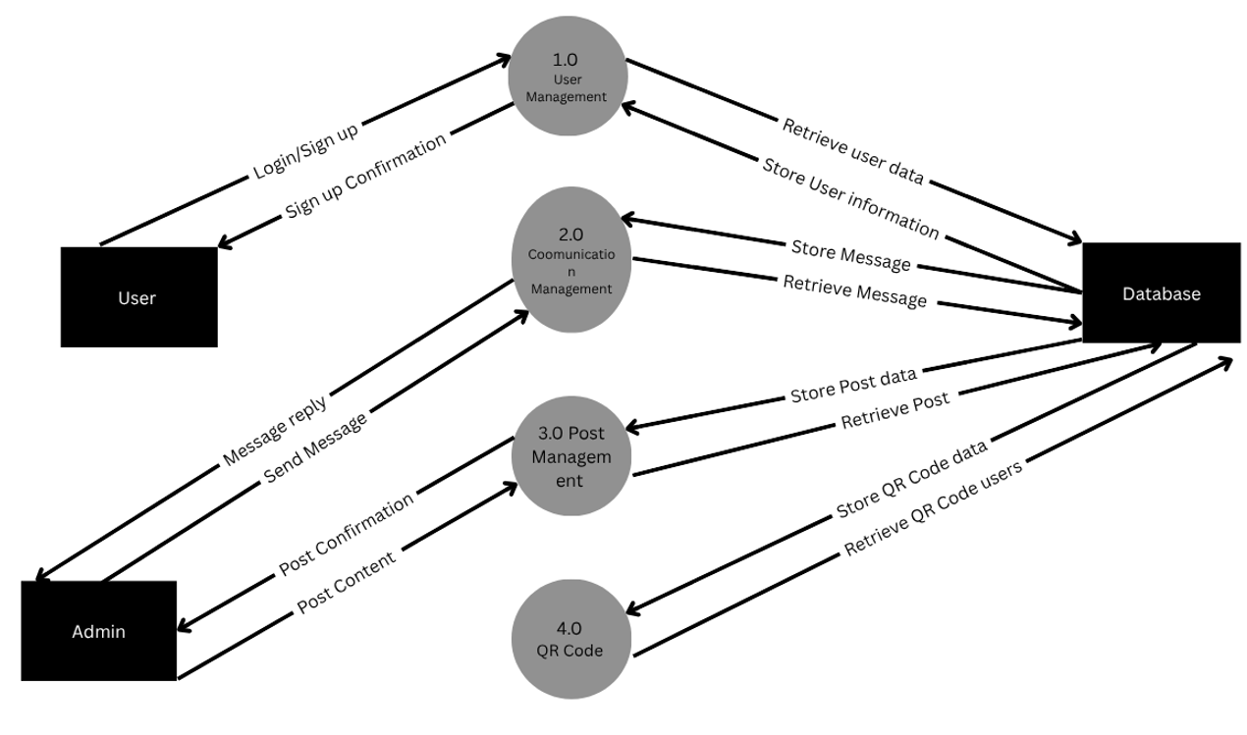
Level 1 DFD :
The Level 1 Data Flow Diagram for MUJ Unite provides a deeper view of how the platform operates by breaking down the overall system into its major functional parts.
Figure 2. Level 1 DFD for MUJ Unite
Slide-10

Slide 11
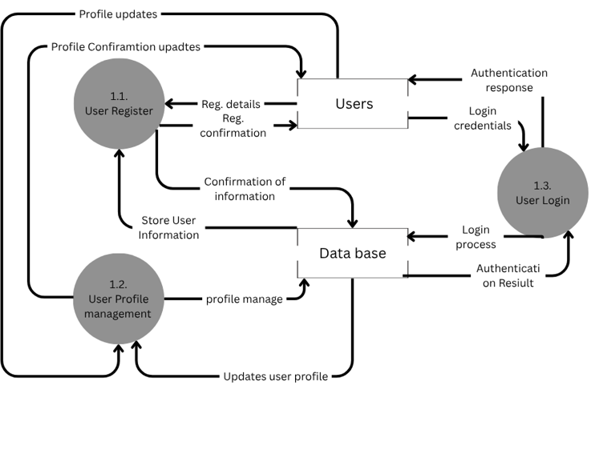
Level 2 DFD :
The Level 2 Data Flow Diagram basically goes deeper than Level 1 by breaking bigger tasks into smaller, more detailed steps.
Figure 3. User Management Module Level 2 DFD
Slide-11

Slide 12
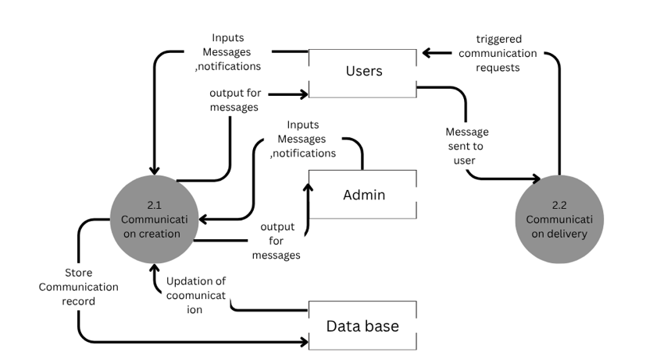
Figure 4. Communication Management Module Level 2 DFD
Slide-12

Slide 13
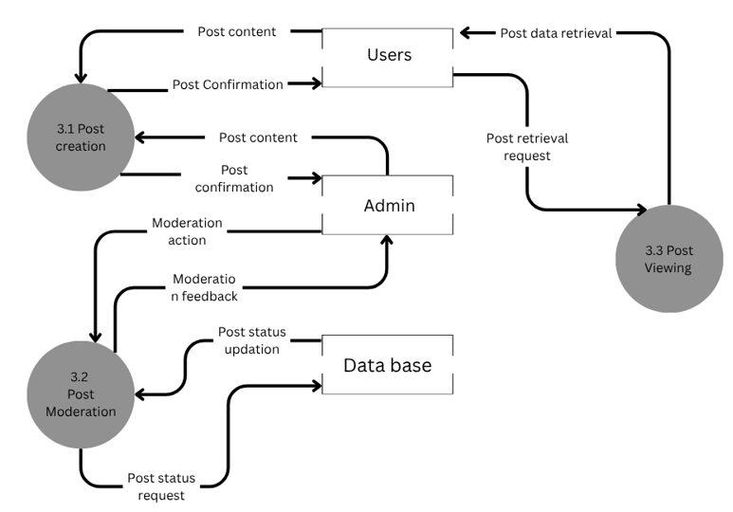
Figure 5. Post Management Module Level 2 DFD
Slide-13

Slide 14
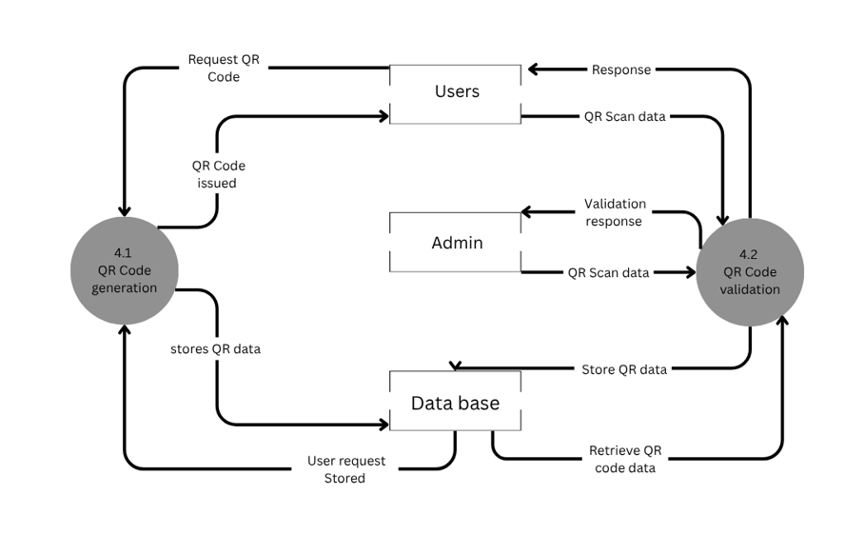
Figure 6. QR Code Management Module Level 2 DFD
Slide-14

Slide 15
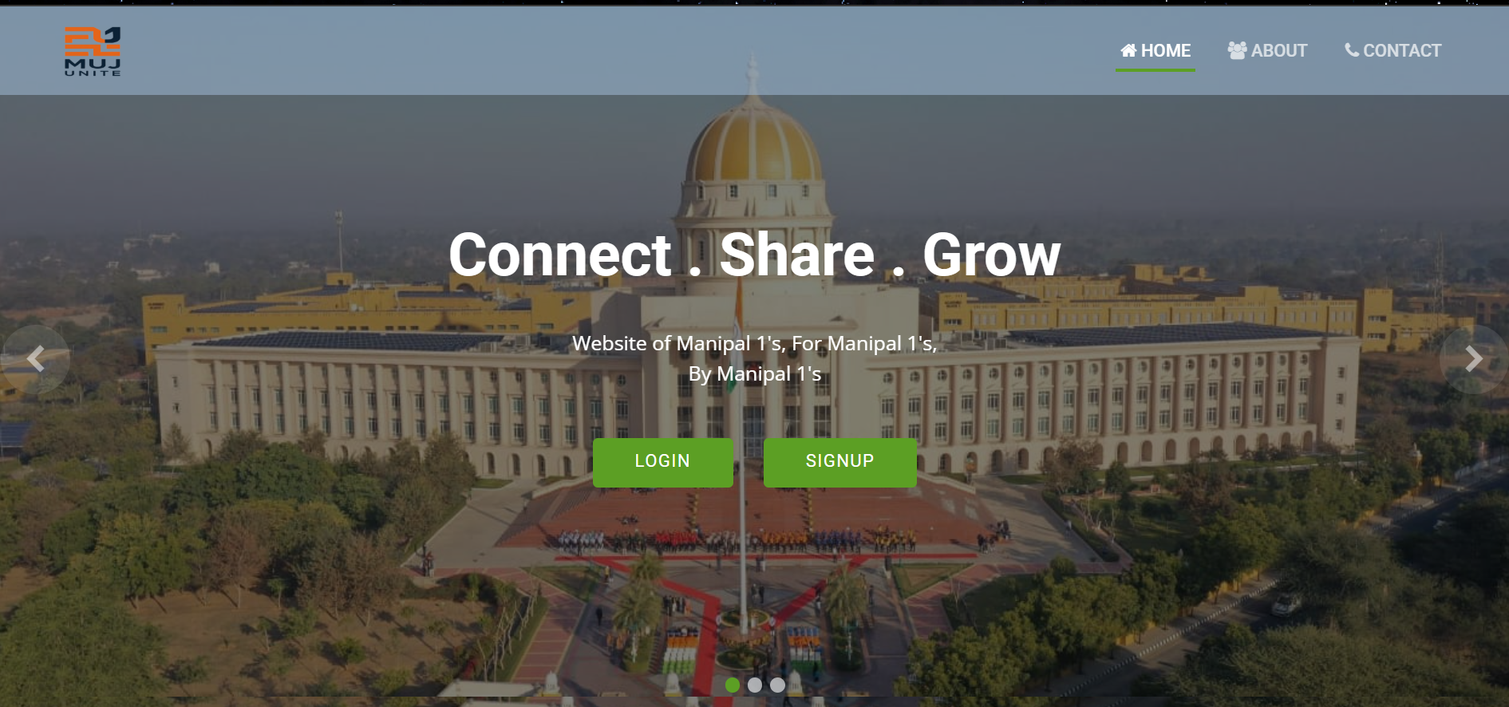
6. Results
Results of MUJ Unite are as follows:
The Home Page is central to user engagement and was prototyped to feature recent posts, announcements, and a navigation bar with quick links to all other modules.
Figure 7. Home Page
Slide-15

Slide 16
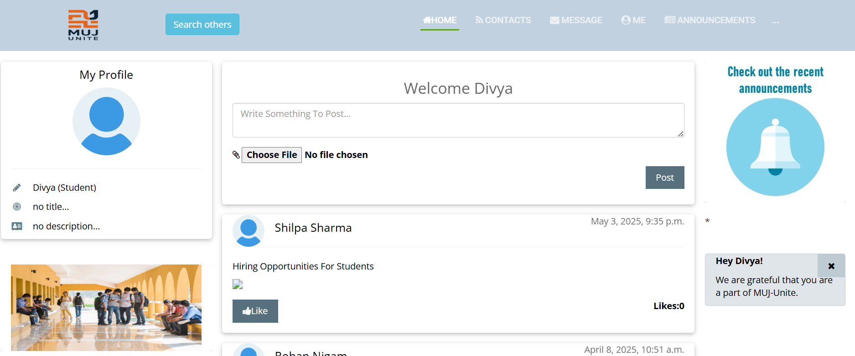
Figure 8. Home Page after Login
Slide-16

Slide 17
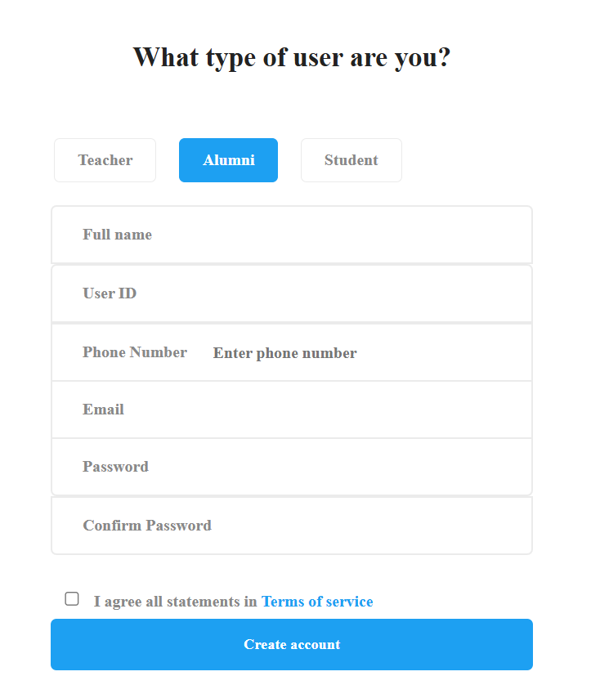
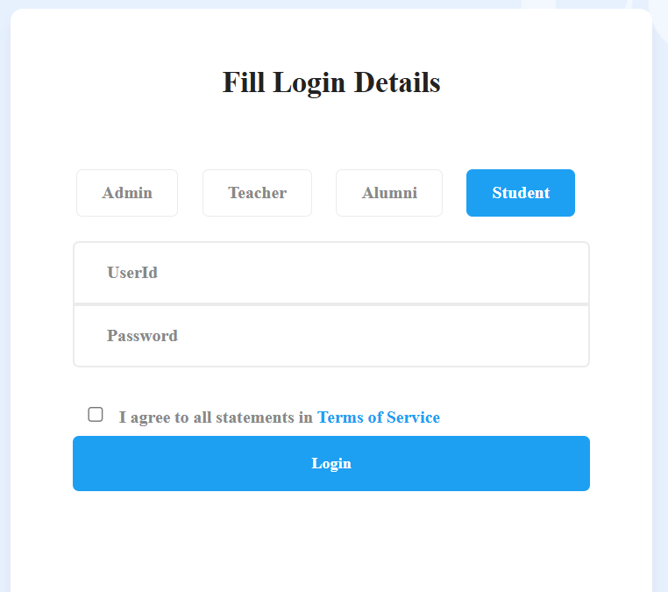
The login and sign-up pages were designed with a focus on simplicity and usability. The login interface includes fields for username and password, along with proper error messages for invalid credentials. The sign-up form collects basic details such as name, email, and password, and includes password confirmation with validation checks
Figure 9. Login & Sign up Page
Slide-17

Slide 18
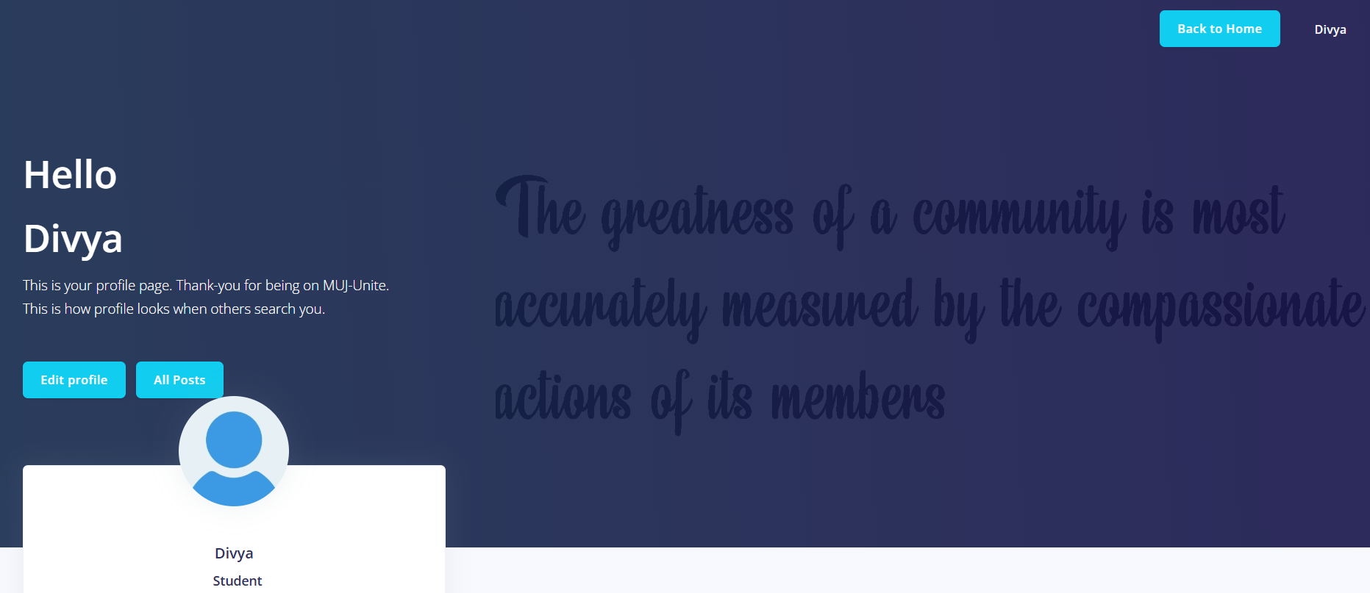
The Profile Page prototype shows the profile of the user which gets login successfully. It shows the name of the user and the user has the option to edit profile, edit post. This profile page also contains the QR Code option for each user.
Figure 10. Profile Page
Slide-18

Slide 19
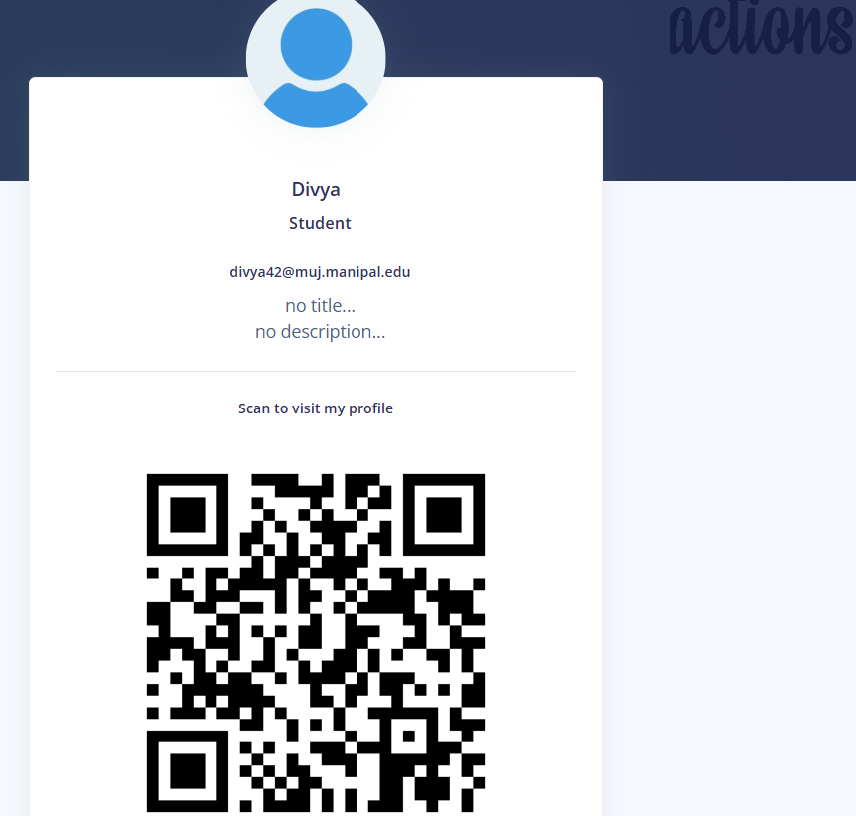
Figure 11. QR Code For Scanning Profile
Slide-19

Slide 20
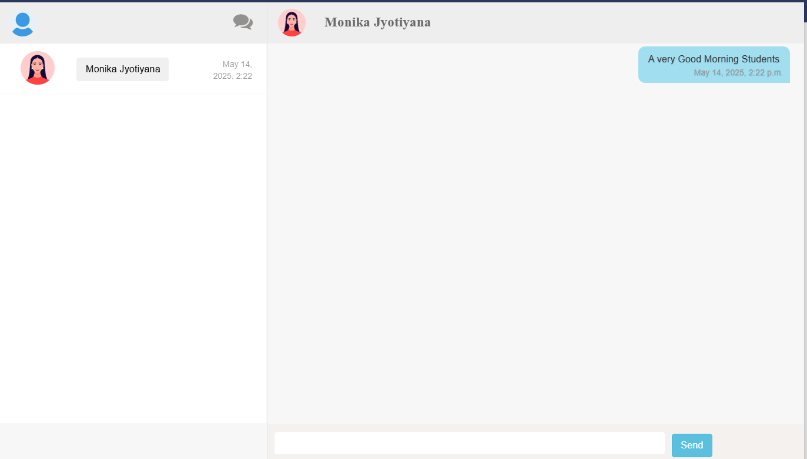
The Messaging Module includes the privately messaging option for the user.
Figure 12. Messaging Module
Slide-20

Slide 21
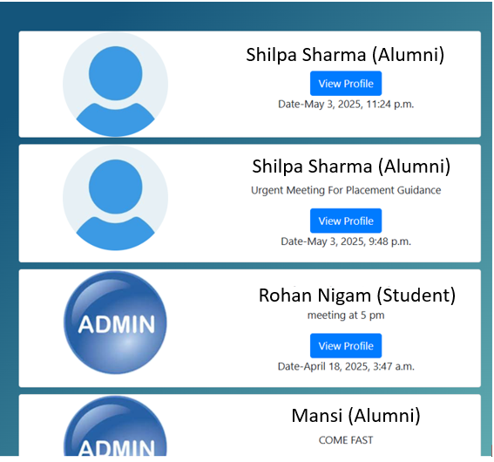
The Announcement Module shows the user the announcement which is add by the other user. The announcement basically includes useful information which is posted by the other users.
Figure 13. Announcement Module
Slide-21

Slide 22
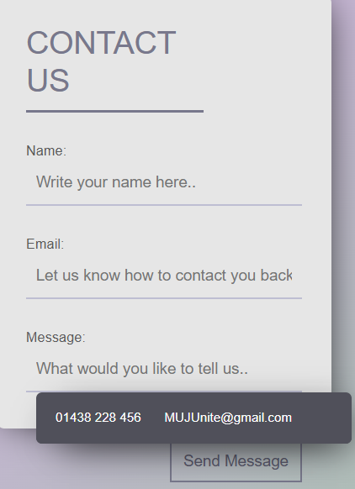
The Contact Us Page is designed as a communication between users and the platform administrators. This module is kept visually and simple but functionally complete, as it plays an important role in platform support.
Figure 14. Contact Us
Slide-22

Slide 23
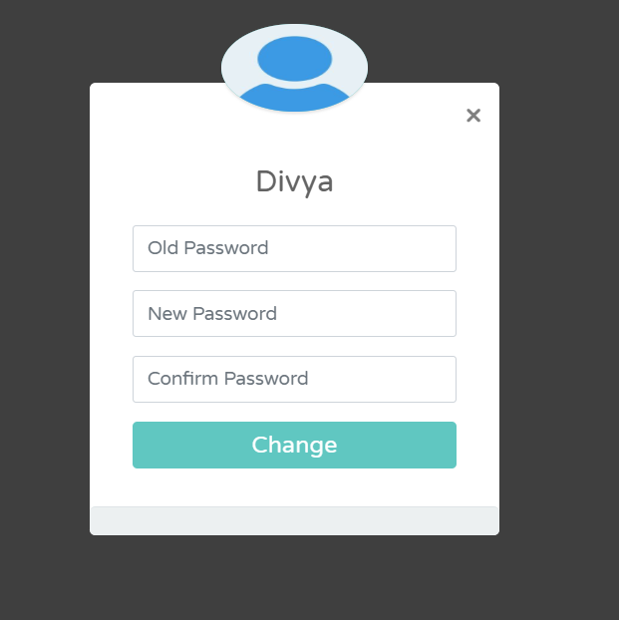
The Change Password Module, enhances user control and account security. It includes fields for entering the current password, new password, and password confirmation. Real-time validation ensures that the new password meets required criteria (e.g., minimum length, use of symbols or numbers). Feedback messages are displayed for both errors (e.g., incorrect current password) and successful updates.
Figure 15. Change Password Module
Slide-23

Slide 24
7. Conclusions
Strengthens connection between students, teachers, and alumni.
Provides a secure and user-friendly interface.
Supports academics and social interactions.
Thoroughly tested across different user roles.
Designed for future upgrades and institutional deployment.
Encourages collaboration.
Fosters a stronger university community bond.
Slide-24

Slide 25
8. Future Scope
Real-time chat integration using Web Sockets (Django Channels).
Support for group chats and instant chat notifications.
Email and SMS notifications for messages and announcements.
Real-time pop-up alerts for in-platform events.
Integrated alumni job portal with application and notification features.
UI/UX enhancements including dark mode, font resizing, and multilingual support.
Improved visual experience using animations and transitions.
Development of a mobile application for Android and iOS platforms.
Slide-25

Slide 26
References
[1]Conallen, Jim. "Modeling web application architectures with UML." Communications of the ACM 42.10 (1999): 63-70.
[2] Rustagi, Palak, and Yugal Kumar. "Mvc architecture and its application." (2022).
[3] Truica, Ciprian-Octavian, et al. "Performance evaluation for CRUD operations in asynchronously replicated document oriented database." 2015 20th International Conference on Control Systems and Computer Science. IEEE, 2015.
[4] Grüner, Sten, Julius Pfrommer, and Florian Palm. "RESTful industrial communication with OPC UA." IEEE Transactions on Industrial Informatics 12.5 (2016): 1832-1841.
[5] Gancheva, Veska. "data security and validation framework for a scientific data processing SOA based system." 2011 Developments in E-systems Engineering. IEEE, 2011.
[6] Aronson, Larry. HTML Manual of Style: A Clear, Concise Reference for Hypertext Markup Language (including HTML5). Pearson Education, 2010.
[7] Sharma, T. N., Priyanka Bhardwaj, and Manish Bhardwaj. "Differences between HTML and HTML 5." International Journal Of Computational Engineering Research 2.5 (2012): 1430-1437.
[8] Schengili-Roberts, Keith. Core CSS: Cascading style sheets. Prentice Hall Professional, 2004.
[9] Bos, Bert, et al. "Cascading style sheets level 2 revision 1 (css 2.1) specification." W3C working draft, W3C, June (2005).
[10] Lunn, Ian. CSS3 foundations. John Wiley & Sons, 2012.
[11] Crockford, Douglas. JavaScript: The Good Parts: The Good Parts. " O'Reilly Media, Inc.", 2008.
[12] Guha, Arjun, Claudiu Saftoiu, and Shriram Krishnamurthi. "The essence of JavaScript." ECOOP 2010–Object-Oriented Programming: 24th European Conference, Maribor, Slovenia, June 21-25, 2010. Proceedings 24. Springer Berlin Heidelberg, 2010.
[13] Jensen, Simon Holm, Magnus Madsen, and Anders Møller. "Modeling the HTML DOM and browser API in static analysis of JavaScript web applications." Proceedings of the 19th ACM SIGSOFT symposium and the 13th European conference on Foundations of software engineering. 2011.
Slide-26

Slide 27
[14] Hesterberg, Tim. "Bootstrap." Wiley Interdisciplinary Reviews: Computational Statistics 3.6 (2011): 497-526.
[15] Python, Why. "Python." Python releases for windows 24 (2021).
[16] Thoutam, Vivek. "A study on python web application framework." Journal of E1ectronics, Computer Networking and Applied mathematics 1.01 (2021).
[17] Burch, Carl. "Django, a web framework using python: Tutorial presentation." Journal of Computing Sciences in Colleges 25.5 (2010): 154-155.
[18] Torres, Alexandre, et al. "Twenty years of object-relational mapping: A survey on patterns, solutions, and their implications on application design." information and software technology 82 (2017): 1-18.
[19] Chandiramani, Ashish, and Pawan Singh. "Management of Django web development in Python." Journal of Management and Service Science (JMSS) 1.2 (2021): 1-17.
[20] Kreibich, Jay. Using SQLite. " O'Reilly Media, Inc.", 2010.
[21] Erickson, John, Kalle Lyytinen, and Keng Siau. "Agile modeling, agile software development, and extreme programming: the state of research." Journal of Database Management (JDM) 16.4 (2005): 88-100.
[22] Bastos, Ricardo Melo, and Duncan Dubugras A. Ruiz. "Extending UML activity diagram for workflow modeling in production systems." Proceedings of the 35th Annual Hawaii International Conference on System Sciences. IEEE, 2002.
[23] Li, Qing, and Yu-Liu Chen. "Data flow diagram." Modeling and Analysis of Enterprise and Information Systems. Springer, Berlin, Heidelberg, 2009. 85-97.
[24] Song, Il-Yeol, Mary Evans, and Eun K. Park. "A comparative analysis of entity-relationship diagrams." Journal of Computer and Software Engineering 3.4 (1995): 427-459.
[25] Ganney, Paul S., Sandhya Pisharody, and Ed McDonagh. "Web development." Clinical Engineering. Academic Press, 2014. 171-190.
[26] Sabale, R. Ganpatrao, and A. R. Dani. "Comparative study of prototype model for software engineering with system development life cycle." IOSR Journal of Engineering 2.7 (2012): 21-24
Slide-27

Slide 28
THANK YOU
Slide -28

