Slide 1
Ray Tracing Project
Group 42

Slide 2
What we have implemented
Shadows
Interpolated normals
Interactive display
Performance metric + multicore support
Anti-Aliasing (SSAA)

Slide 3
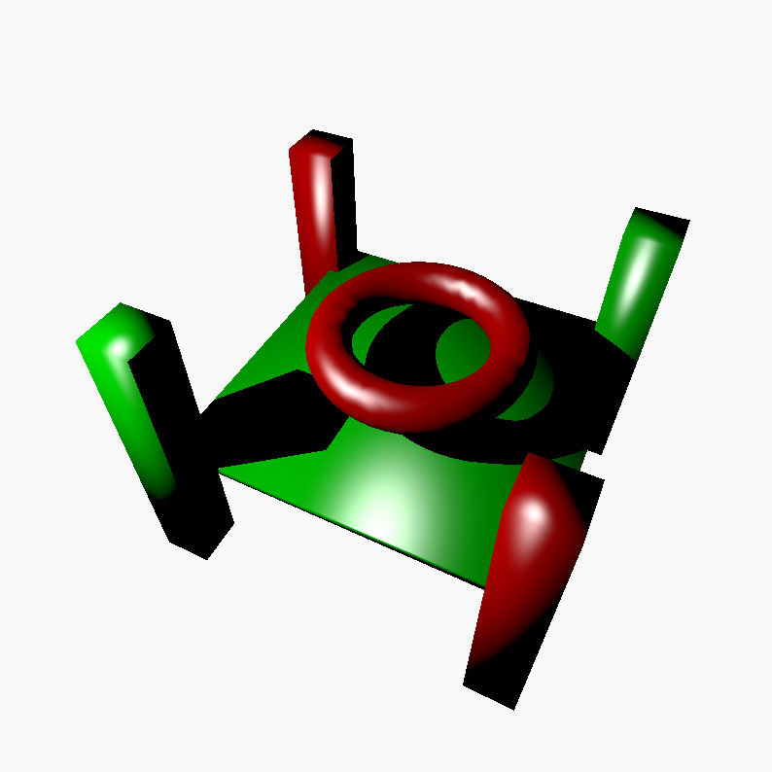
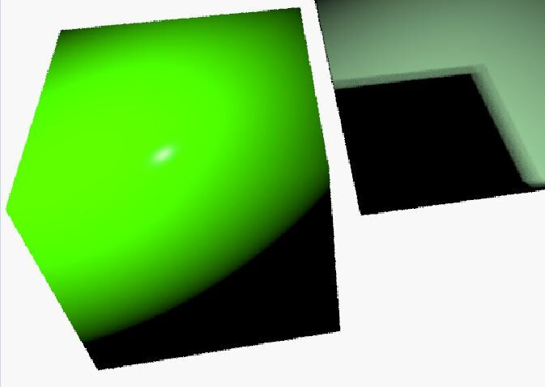
Shadows

Slide 4
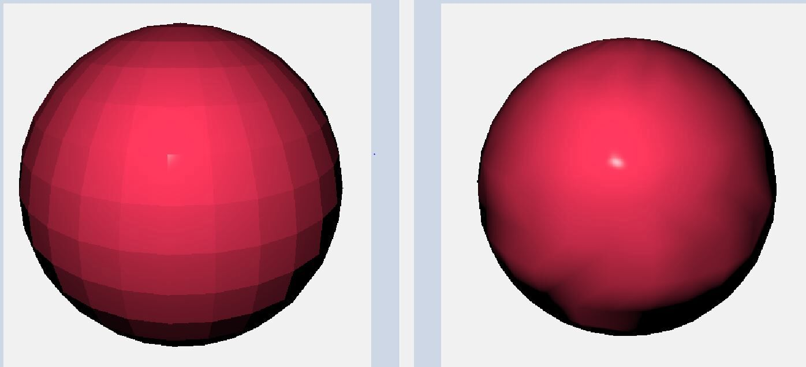
Interpolated normals

Slide 5
Interactive display

Slide 6
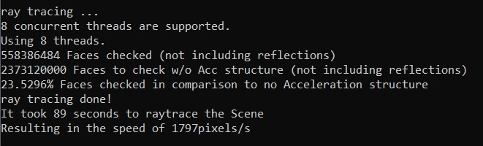
Performance metric + Multicore support
Real-time progress indicator implemented

Slide 7
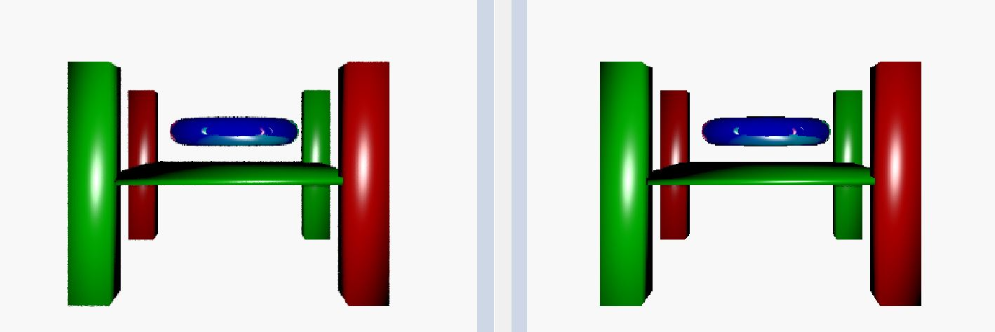
Anti-Aliasing

Slide 8
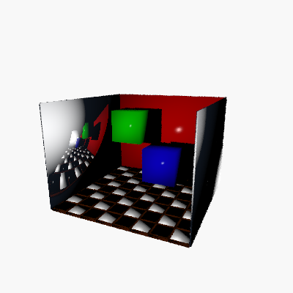
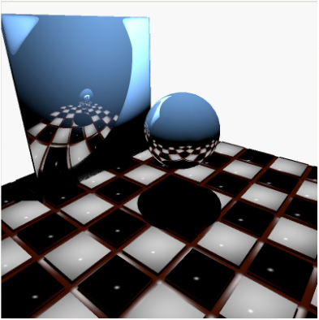
Our best scenes

