Slide 1
Time domain / volume discretisation
Discretisation schemes
Explicit, implicit, and stability
Numerical Accuracy
Sources and boundary conditions
Perfectly absorbing layers
Handling additional terms in the equation
Grid refinement and subgridscale models
Implementation aspects

Slide 2
1. Discretisation schemes
Cartesian grids, collocated and staggered
Extended stencils
Non-Cartesian structured grids
Non-structured grids
Notes:
First we study the options for spatial discretisation and the corresponding approximation for the spatial derivatives in the wave equation. In part 2 the discretisation in time and resulting approximations for the time derivatives in the wave equation will be studied. The choice of discretisation in space and time is nevertheless not fully independent.

Slide 3
1.a) Cartesian grids
Collocated grids = all field variables discretised at same location (i,j,k) -> x=i dx, y=j dy, z=k dz
Popular in for example CFD (computational fluid dynamics)
Consider the spatial derivatives in
Without loss of generality we can limit the discussion to one dimension (x)
Expand around (i,j,k), x₀=i dx, in the x direction
Notes:
Collocated grids are very popular in computational fluid dynamics because they are well suited when transport terms in the equations become important. Conceptually it is also simpler to use the same grid to discretise all unknown fields. We therefore derive a suitable approximation for the spatial derivatives in this grid first.
It is a straightforward task to write a Taylor expansion of a field p in x₀+dx and x₀-dx around x₀.

Slide 4
1.a) Cartesian grids
Collocated (continued)
Subtracting gives
In this central differences approach, the second order derivative and corresponding first order dependence on dx drops out.
This scheme is second order accurate.
The spatial derivative at x₀ only depends on values in the next and previous cell.
It is easy to see that odd index p only depend on even index o values and vice versa.
Small spatial changes in sources or structure cause problems.
Notes:
By subtracting the expansions, an approximation for the first order spatial derivative is obtained. It contains the discretised values of p and terms in dx² and higher power of dx. By neglecting these terms, a second order accurate scheme for approximating the first order spatial derivative is obtained.
Note that the scheme is compact: only nearest neighbor values are needed to calculate the spatial derivative.
When inserting the approximation of the derivatives in the equation for o_{x} at x₀, it becomes clear that the change in o at even index locations will depend on p values at odd index locations only. A material change, a source or a boundary feature that extends not more than one p cell e.g. at an even index location will not affect the odd index o-field values. The scheme is thus “blind” for small features which is a definite disadvantage in many wave propagation situation.
Note that in CFD sometimes asymmetric schemes are used (e.g. Upwind schemes).

Slide 5
1.a) Cartesian grids
Staggered grid
p and o-components discretised at locations shifted by half a grid step
For updating o_{x}, time derivative at (i+1/2, j, k)
Via equation -> spatial derivative
Smaller error!
Nearest neighbors used -> no gaps -> small size problem eliminated
Miss-fit for some additional terms
y
x
p
o_{x}
o_{y}
(see later)
Notes:
A grid where p and components of the o-field are discretised at locations that are shifted compared to each other by half of a grid step, is called a staggered grid. We will show that such a grid is a natural choice for discretising wave equations.
The wave equations show that for calculating the change in o_{x} at (i+1/2, j, k) (this is based on the time derivative at this location) the spatial derivative in the x-direction of p is required. Again using a Taylor series expansion, an approximation for the first order spatial derivative is found. The scheme is also second order accurate, but the approximation error is smaller. This scheme is also very compact. This scheme is not blind for small spatial changes as the scheme based on a collocated grid.
A disadvantage of using staggered grids is that some additional terms in the wave equations that will be introduced later are not easily discretised. In general these terms are however only of secondary importance for the propagation problem.

Slide 6
1.a) Cartesian grids
Staggered grids in 3D
General equation & acoustic
Notes:
This picture shows a unit cell in the staggered grid configuration that is the natural choice for discretising the acoustic and vibration wave equations and the general set of equation in o and p.

Slide 7
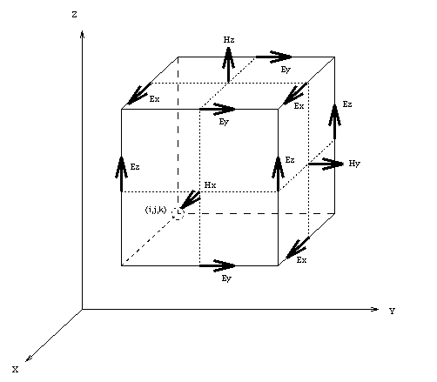
1.a) Cartesian grids
Electromagnetic using E and H
Yee-cell
Look at to see that discretisation fits!
Notes:
For direct discretisation of the equations of Maxwell the staggered grid shown above is more suitable. This can easily be seen by approximating the spatial derivatives in the wave equations.

Slide 8
1.b) Extended stencils
Idea: improve accuracy of numerical approximation to spatial derivative
By including more terms in the series expansion and including points that are further away, one can easily derive higher order approximations for the spatial derivatives
E.g. 7 points in collocated grid
The phase error of this scheme can further be improved by minimizing phase error by tuning a_{i}. This leads to Dispersion Relation Preserving (DRP) schemes.
Problem: boundaries, sources, ... so only useful for simple geometry.
Notes:
The accuracy of the approximation to the spatial derivative can be increased by reducing the discretisation step but this implies storing more discretised field values (3rd power of change in three dimensions).
A straight forward generalization consists in combining series expansions in more neighboring locations for obtaining higher order approximations for the first order spatial derivative. A 7 point stencil thus obtained neglects terms in dx⁶ or higher order only. A further generalization optimizes the coefficients in the approximation to maximally reduce the phase error within a predefined frequency range. This scheme is called dispersion relation preserving. It will be further discussed later in this chapter.
Extended stencils have one big disadvantage. They are not compact. Thus special formulations are needed for several layers of cells near interfaces and boundaries. This complicates implementing the scheme efficiently unless the geometry studied is rather simple.

Slide 9
1.b) Extended stencils
Finite element time domain (FETD) methods also aim at reducing the spatial sampling rate.
For a discussion on FE see next chapter.
Notes:
One can also try to improve accuracy at a given spatial discretisation step by using finite element time domain approximations. We refer to the chapter on Finite Element techniques for further discussion.

Slide 10
1.b) Extended stencils
Pseudo Spectral Time Domain
Projection of p(x,t) on set of orthogonal basis functions
Fourier Pseudo Spectral Time Domain
Basis functions are sine functions and Fourier transform can be used
Spatial derivative can be calculated as
After discretisation
with
Notes:
The PSTD method projects the spatial series of data on an orthogonal set of basis functions and calculates the derivatives for these basis functions analytically. Note that these basis functions could be confined to a subdomain but could also span the whole simulation domain.
The Fourier PSTD is a special case where sine functions are used as basis functions. FFT allows to quickly calculate the projection, yet these basis functions cover the whole spatial simulation domain and thus couple the whole problem including all boundary conditions, sources, etc.

Slide 11
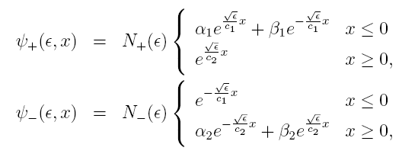

1.b) Extended stencils
Fourier Pseudo Spectral Time Domain
Accurate until Nyquist sampling limit (2 point per λ)
Extended scheme complicates implementation boundary conditions
Gibbs phenomenon at sharp discontinuities between materials
Extended Fourier PS method
Alternative basis functions to avoid Gibbs phenomenon
Assuming interface between materials at x=0
α and β follow from continuity condition at x=0; N from orthogonality
FFT can still be used, thus fast, but method is less general
plane waves!
Notes:
A particular problem with Fourier PSTD is the emergence of a Gibbs phenomenon at sharp discontinuities in material characteristics.
As an illustration of possible extensions of the Fourier PSTD method we discuss the introduction of the discontinuity at an infinitely extended flat interface between materials. The new basis functions that are proposed for this case include an incoming and reflected plane wave. The discontinuity is explicitly embedded in the basis functions by adapting αλπηα and βετα.

Slide 12
1.c) Non-Cartesian structured grids
Structured grids
Can be mapped one-to-one on Cartesian
Curvilinear grids
Coordinates u, v, (w)
Vector can be expanded in covariant e_{u}, … and in contravariant unit vectors e^{u}, ...
Component are related via the metric coefficients + interpolation
p
o_{u} and o_{v}
o^{u} and o^{v}
Notes:
Until now we only discussed discretisation in Cartesian grids. This resulted in very compact formulations of the approximation to the spatial derivatives and very efficient calculations. The most important reason to consider alternative types of grids is the presence of non-Cartesian boundary conditions or material transitions.
One distinguishes between structured grids that can be mapped to a Cartesian grid and can thus also be stored in a matrix, and non-structured grids.
We consider curvilinear grids (in two dimensions) as a first generalisation. At every location in the curvilinear grid, a covariant (subscript) and a contravariant (superscript) basis can be defined and every vector field can be expanded in these two bases. The components of the vector in both field are related by space dependent metric coefficients. In case of a staggered grid, additional (linear) interpolation is needed to obtain the appropriate field components at every location where the are needed.

Slide 13
1.c) Non-Cartesian structured grids
Curvilinear grids (continued)
Covariant components are naturally derived from
Contravariant components (orthogonal to grid planes) are needed to calculate
Simplest approach:
Calculate covariant components of o using a first order finite difference discretisation of spatial derivatives
Transform to contravariant
Calculate p
Several variants were developed
Notes:
The spatial derivative of p along a grid line in a natural way yields the component of o along this covariant direction. However, to calculate ∇.o contravariant components (orthogonal to the grid lines are needed). The latter can be recognized for example by integrating over the cell and transforming the surface integral of ∇.o to a line integral of the normal component of o over the cell boundaries (or equivalent in three dimensions). Thus, the first equation calculates the change of covariant components, the second equation uses the contravarient components to obtain the change in p. The standard FDTD scheme alternatively uses the two equations to step in time. Thus the simplest calculation procedure consists in transforming covarant to contravariant components each time the first equation is used to update o-field components to the next time step.

Slide 14
1.c) Non-Cartesian structured grids
Curvilinear grid for E and H fields
Looking at the Maxwell’s equations
if components of E and H are chosen along covariant
D and B components along contravariant is natural choice
Notes:
If one wants to discretise Maxwell’s equations directly in a curvilinear grid, components of E and H can be chosen along covariant directions and components of D and B along contravariant directions.

Slide 15
1.d) Non-structured grids
Problem: objects with complicated form
Proposed approach: finite volume
Resolve one of the two equations by definition of unknowns
Conservation form by integrating over one cell
With new unknowns
p_{i}
n_{ik}
Notes:
Structured grids can not easily be used to envelope objects of complex form (except if one is willing to add several non-used variables). Then non-structured grids may be a solution. One approach is know as a finite volume time domain method. By careful definition of the unknown field values, one of the two first order equations becomes particularly simple. Let us first integrate the first equation over a single cell. Using the Gauss’ theorem the volume integration in transformed to a surface integration of the orthogonal component of the o-field over the surface defining the cell. This surface is a combination of small plane surfaces bounded by a polygon. Thus the overall surface integration can be replaced by a sum of surface integration over the flat parts of the surface. As discretised p-field unknowns the average value of p over a cell is used. As discretised components of o-field unknowns, the average of the orthogonal component over a partial surface is used. With this choice, the first equation is a simple sum, not much more complicated than the discretised equation in a Cartesian grid.

Slide 16
1.d) Non-structured grids
Proposed approach (continued)
Integrate orthogonal component of over surface S_{im}
Which reduces the problem to approximating the p field locally by an analytical function and calculating the normal derivative.
The lowest order approximation = linear gradient in the direction n_{im}
This results in
With d_{i} and d_{m} the distance between the center of gravity of cell i and m and the plane of S_{im}
p_{i}
o_{im}
p_{m}
Notes:
The second equation is now integrated over each of the surfaces limiting the cells. The left hand side of the equation is precisely the time derivative of the newly defined unknown component of the o field. The right hand side does not match. The orthogonal derivative of p has to be derived from knowledge of the cell-averaged value for the neighboring cells. This can be done by approximating the local p-field by an analytical function. The lowest order approximation is a linear gradient in the direction orthogonal to the surface under consideration. After some calculations extracting the 2 constants in the linear relation from the cell averaged p-values, the equation in the red rectangular is obtained. Again, this is a fairly simple equation similar to the equation obtained in a Cartesian grid.
Note that the volumes, surfaces, and distances needed in these equations need considerable cpu-time to be calculated but this calculation need not be repeated every time step. Additional memory is however required to store these grid descriptors.
see also: D. Botteldooren, “Acoustical FDTD simulation in a quasi-Cartesian grid,” J. Acoust. Soc. Am. 95(5), 1994, p. 2313

Slide 17
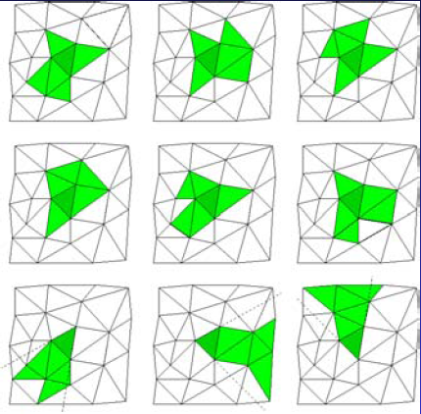
1.d) Non-structured grids
Proposed approach (continued)
Higher order approximations expand p in polynomial around S_{im}
Match with suitable neighboring cells = stencil
E.g.
This leads to ENO (Essentially Non-Oscillating) and WENO (Weighted ...) schemes. Very popular when shock needs to be captured
Notes:
Higher order approximations expand p in higher order polynomials around the surface of a cell. The unknown coefficients in this polynome are found by matching the average field over a larger number of neighboring cells to the unknowns (which are as we remember from the previous slide the average of p over a cell). The schemes become less compact but more accurate. This approach is sometimes referred to as an ENO or WENO scheme and is used to capture acoustic shocks in sound propagation problems.
See also: G. Jiang & C.W. Shu (1996), “efficient implementation od weighted ENO schemes”, J. Comput.Phys. 126, 202-228

Slide 18
2. Explicit, implicit, and stability
Explicit, leap-frog, staggered in time
Stability, Courant limit
Explicit Runge Kutta
Implicit time stepping, Crank Nicolson
Closure
Notes:
We now turn to the time discretisation. Several approaches for approximating the time derivative in the equations will be discussed.

Slide 19
2.a) Explicit, leap-frog, staggered in time
The time dimension is investigated for Cartesian grid and staggered in space discretisation
Time discretisation
Collocated in time: p and o are discretised at t=l dt
Staggered in time: p is discretised at t=l dt and o at t=(l+1/2) dt
As for spatial derivatives, approximating time derivatives by central differences based on a staggered grid is advantageous
Solution mechanism: explicit, leap-frog
Notes:
Independently of the choice of spatial discretisation scheme and approximation of the spatial derivative, a time discretisation and approximation to the time derivative can be chosen.
Again, there are two options: collocated grids for p and o and staggered grids. Approximating time derivatives by central differences (using the same Taylor series expansion as for the spatial derivative) leads to an approximation that is second order accurate in time step dt. The staggered grid gives also for the time discretisation slightly higher accuracy.
This approximation of the time derivative immediately leads to a solution mechanism: explicit time stepping, sometimes also called the leap-frog scheme.
Note that in the last set of equations above, the spatial derivative is to be replaced by an approximate spatially discretised form (Section 1). Most commonly though, this temporal scheme is combined with a staggered grid in space and a first order approximation to the spatial derivatives, at least for solving wave propagation problems.

Slide 20
2.a) Explicit, leap-frog, staggered in time
Solution mechanism: explicit, leap-frog (continued)
The algorithm results in in-place computation = new values can replace old ones in computer memory. Huge advantage!
In natural way, left hand side is known (occurs earlier in time) before new values are calculated.
Additional terms in the equation may cause problem.
Stability not automatically guaranteed!
Notes:
The explicit scheme has some particular advantages: It results in an in place computation which means that newly calculated values can immediately overwrite older ones since they are no longer needed as they do not appear in the right hand side of the equation at another location; right hand sight terms are needed at an instant in time, t=(l+1/2)dt, that is prior to the current time calculated t=(l+1)dt thus there is no problem to have them readily available.
The scheme however also has some disadvantages: When additional terms appear in the wave equations, e.g. Due to moving medium or damping, the above mentioned advantages may get lost; most importantly however, stability is not automatically guaranteed.

Slide 21
2.b) Stability, Courant limit
The equations derived above are a special case of a Linear Time Invariant (LTI) system in discrete time
Assume only one time step delay
Or after Z-transform
This system is stable if the poles fall inside the unit circle or equivalently if all eigenvalues, λ_{i}, of A fulfill |λ_{i}|≤1
For explicit (FDTD) scheme the matrix A can be constructed, and stability analyzed
Y is the vector of p and components of o at each discretisation point.
It is possible to include boundaries and additional terms
Notes:
Let us consider in detail the stability problem for the case of an explicit time stepping scheme combined with a first orde staggered spatial derivative.
A reminder. A discrete Linear Time Invariant system with a single time step delay can in general by written in matrix form as above, where X represent the array of input variables (here sources) and Y represent the matrix of output variables (here discretised p and o field values). Such a system can also be characterised by its Z-transform. Remember from previous courses that z is the independent variable in the Z-domain and that z⁻¹ indicates a single time delay. An LTI-system is stable if its poles all fall inside the unit circle or in other words if the eigenvalues of the matrix A all have modulus smaller than one.
We now apply this knowledge to study the stability of the explicit scheme. Define the vector Y as the vector of discretised p-values at (l+1)dt and components of o at (l+1/2)dt. The matrix A can be constructed based on the equations given in the previous slides. Note that additional boundary conditions, damping, etc. can also be included in the equations while constructing the matrix A that relates the current field values to the prior ones.

Slide 22
2.b) Stability, Courant limit
Basic stability requirement for infinitely extended simulation area
Solve matrix with periodic extension
Analytical expression for stability condition can be derived easier based on spatial Fourier transform.
Stability can be guaranteed by guaranteeing it for the integrand (every k)
Substitute in FDTD equations (Cartesian, staggered)
After reduction
Notes:
The explicit scheme on itself requires a stability condition to be fulfilled before it can be used. It is not necessary to use the general formulation that describes the numerical scheme as a LTI system, given on the previous page, to derive this basic condition. Since the condition is independent on boundaries, we assume an infinitely extended region. This would potentially allow us to solve the matrix A for eigenvalues using a periodic extension of a limited simulation area. However, we are not going to follow this path because it is far easier to base the derivation on a spatial Fourier transform.
If stability is guaranteed for the integrand, for every k, than it will automatically be guaranteed for all solutions. Thus the integrand is substituted in the FDTD equations using a staggered grid in space and time and a first order approximation to the spatial and time derivatives. The continuation mark “...” refers to similar terms for y and z direction.

Slide 23
2.b) Stability, Courant limit
Basic stability requirement (continued)
Similarly for o_{x}, o_{y}, ...
We define the vector of discrete variables as
Resulting in the system matrix
Notes:
Now we also substitude the integrand of the spatial Fourier transform on the previous page in the second FDTD equation. Only the equation for o_{x} is shown.
The four resulting equations can now be summarised in matrix form by defining a suitable vector Y for the time-discretised version of the ^ variables (the ^ being omitted). The resulting system matrix connecting Y(i) to Y(i-1) can now be compiled. While doing so the definition of the sine function as a sum of two exponential functions is used.

Slide 24
2.b) Stability, Courant limit
Basic stability requirement (continued)
One easily verifies that the eigenvalues of A are 1 or solution of
These solutions are
If , the eigenvalues are real and one of them is smaller than -1 so the system is unstable
If , the eigenvalues are complex conjugate with product equal to 1 so the system is stable
For the equality both eigenvalues are -1 also resulting in a stable system
Since should hold for all k,
This is Courant stability condition
Notes:
To guarantee stability, the eigenvalues of this system matrix must lie within the unit circle in the z-plane. The eigenvalues are obtained by expressing det(A-λI)=0, where I is the unity diagonal matrix and λ are the eigenvalues we are looking for. Since the matrix contains a number of zeros, it is easy to calculate its determinant analytically. It turns out this is (λ -1)² times the second order equation show above. Thus A has four eigenvalues: twice 1 and the two roots of this equation. 1 is on the unit circle so this eigenvalue always corresponds to a stable pole. The other two eigenvalues can be obtained by solving the second order equation.
To analyze where these roots are located in the complex z-plane, one has to look at the sign of what is below the square root sign.
If it is positive, both roots are real but at the same time the sum of alphas is larger than 4 and thus the term outside the square root is already below -1. At least for the – sign the λ will be somewhere on the real axis below -1 thus the system is unstable.
If it is negative, the result of the square root is purely imaginary and both roots are complex conjugate. We also know that their product is 1 because the λ−φρεε τερμ ιν τηε σεχονδ ορδερ εθυατιον ισ 1. Τηυσ τηεσε ροοτσ μυστ λψ ον τηε υνιτ χιρχλε ανδ τηε σψστεμ ισ σταβλε.
Φιναλλψ ιφ τηε εθυαλιτψ ηολδσ, τηε ροοτσ αρε βοτη −1 ανδ τηε σψστεμ ισ σταβλε αγαιν.
The condition that follows has to hold for all values of k. The worst case that can occur is when all sine functions are 1 since we are summing positive terms multiplied by a sine function. This finally leads to the stability condition.
The square root of the left hand side of the Courant condition is called the Courant number (CN) or the CFL number.
For those familiar with discrete, digital systems: the fact that the poles of the system (eigenvalues of A) lie ON the unit circle implies a lossless system, thus a lossless discretisation scheme.

Slide 25
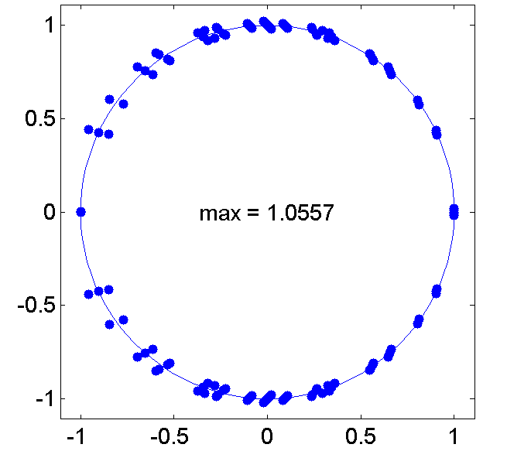
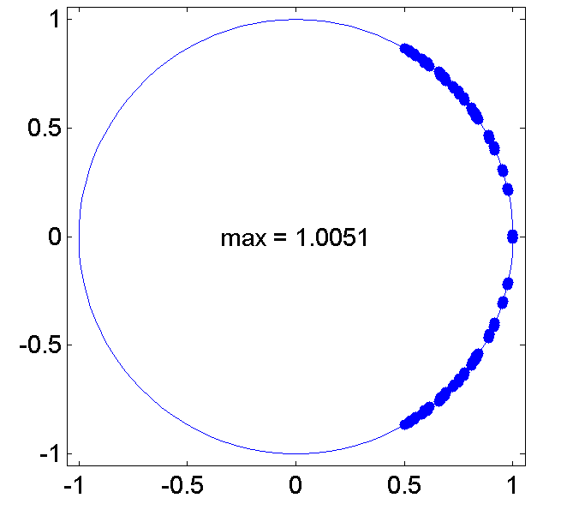
2.b) Stability, Courant limit
Example of application of stability analyses
Slightly unstable due to moving system, M=0.05, CN=1
Improved stability by reducing CN, M=0.05, CN=0.5
Notes:
The stability condition derived on the previous slide no longer holds if additional terms are present in the equations. As an example we consider the moving medium that will be explained in 6.c) discretised on a staggered grid in space and time. This discretisation is no longer unconditionally stable. This can be seen when constructing the A-matrix of the system (including a periodic extension of a finite grid). The poles plotted below are for a low mach number M (‘M=v₀/c). Stability can be improved by reducing the CN-number as can be seen on the right pole-diagram, but still we have no completely stable system. Nevertheless the simulation can be workable if time stepping is stopped before instability starts growing.

Slide 26
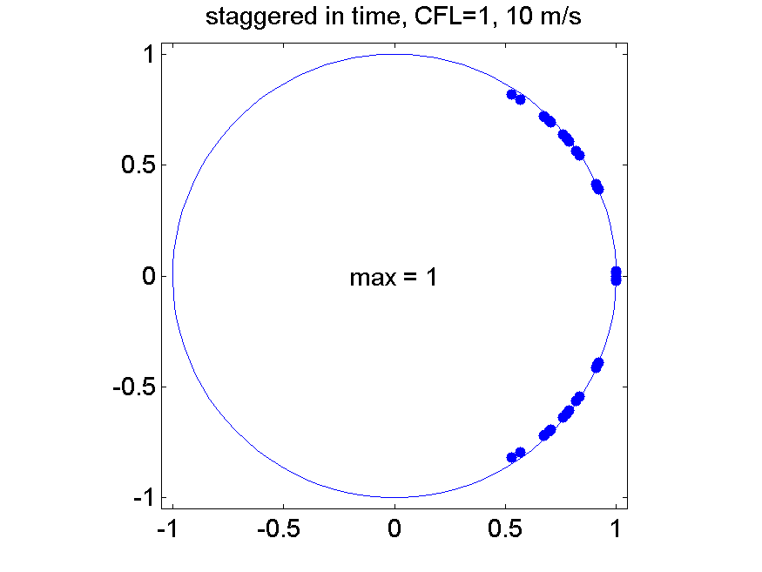
2.c) Explicit Runge Kutta
Higher order approximation to time integration
Dual to higher order approximation to spatial derivative
After spatial discretisation, equations can be written as
Runge-Kutta introduces several intermediate steps in one step dt
RK of order three (for example)
Time step is usually small enough
Stability slightly better in some cases
Notes:
Let us now turn to an alternative time discretisation scheme that is sometimes used. Its aim is to improve accuracy of the time integration of the system of equations.
Assume that the spatial discretisation of the equations has been performed. The system of discrete equations can than be written in matrix form where Y is the vector of discretised field values and X is the vector of inputs (sources). Note that the matrix B is different from A introduced earlier. For convenience we used the same notation for the vector Y of unknown discretised field variables and for the source vector X in continous time as in sampled time.
This matrix equation can now be used to advance one time step dt. In a Runge Kutta integration scheme this is done in multiple approximations. As an example we show the RK formula of order 3 here. Note that this scheme requires additional storage for all unknowns. This additional memory stores the first approximation and later the second approximation since during the iteration Y can not be overwritten yet.
The system is slightly more stable than the basic leap-frog discretisation. On the other hand the stability condition often imposes a time step that is small enough for a first order leap-frog system to be accurate enough.

Slide 27
2.d) Implicit time stepping, Crank Nicolson
Crank Nicolson time discretisation
After spatial discretisation of the wave equations, the continuous time system can be written as
In Laplace domain the system is described by
This system is stable (since it is a physical system) thus the poles of
are located left of the imaginary axes or on it
Could one find a time sampling of this system that maps the left of the imaginary axes inside the unit circle and thus results in an unconditionally stable system?
Notes:
Implicit time stepping forms a valid alternative to explicit time stepping with its particular advantages and disadvantages.
To derive the implicit time stepping solution due to Crank Nicolson, we start again from the matrix representations of the set of equations already discretised in time. Let us Laplace transform this set of equations. Remember that the Laplace transform of the time derivative of a variable is s times the laplace transform of this variable, where s is the index in the Laplace domain. This original continuous physical system is stable thus the poles are found in the left half of the Laplace plane.
A time sampling that would correspond to a transformation between s and z that moves the left hand side of the s-plane to inside the unit circle in the z-plane would unconditionally conserve this stability.

Slide 28
2.d) Implicit time stepping, Crank Nicolson
Crank Nicolson time discretisation (continued)
Suggested transform to Z-domain
Check that pole at s=-|r|+jω corresponds to point inside unit circle in Z-domain after this transform!
Time discretisation (using this technique) of wave equation results in
or
And in discrete time
Notes:
The transformation given above does precisely what we were looking for on the previous page. It is sometimes referred to as a bilinear transformation and is also very popular in digital filter design.
This can easily be checked by inserting a position on the left of the imaginary axes in the Laplace domain in the inverse of the transformation. The point in Z-domain lies inside the unit circle.
It now remains to find what is the time discretisation that corresponds to this transformation. For this we insert the expression for s in the Laplace transformed matrix equation and for short rename Y(s(z)) as Y(z) and X(s(z)) as X(z).
After reorganizing the terms in the equation and applying an inverse Z-transform we finally find the time discretised form of the set of equation in matrix form.

Slide 29
2.d) Implicit time stepping, Crank Nicolson
Implicit scheme
The matrix preceding Y is sparse and therefore the set of equations can be solved efficiently
Slightly more memory than explicit scheme
CPU-time comparison depends on various factors
Structure
Required accuracy
Notes:
The matrix preceding Y is not diagonal so it is no longer possible to explicitly calculate a value of a discretised field at a particular point from the values of its neighbors. However, the matrix is still sparse and hence very efficient methods for solving this linear set of equations are available. Some are discussed in the chapter on mathematics.
The Crank Nicholson scheme is slightly more memory consuming than the explicit scheme and constructing the matrix B is not that simple. In terms of calculation speed, it is not so easy to compare both schemes since the comparison depends on the structure to be calculated and on the required accuracy.

Slide 30
2.e) Closure
Staggered Cartesian grid with first order finite-difference in space and time
Is in many aspects an optimal point
Is very popular because of the beauty that lies in its simplicity
Other schemes should be investigated for specific purposes
Notes:
As an overall conclusion on the choice of spatial and temporal discretisation schemes, it should be recognized that for wave propagation problems the staggered Cartesian grid with first order discretisation both in space and time is in many aspects and optimal point. For a given CPU-time and CPU memory consumption, the scheme produces the least error. The approach is also very popular because of the beauty that lies in its simplicity.
Other schemes should nevertheless be investigated for specific purposes: additional terms in the equations, absence of boundaries, ...

Slide 31
3. Numerical accuracy
Accuracy of basic FDTD scheme
DRP schemes
Notes:
We will now study numerical accuracy. The accuracy for overall problems, including boundary conditions and sources has to be studied by comparing for example to analytical or experimental data. However for the discretisation scheme itself in an infinite environment, some analytical error estimates are possible.

Slide 32
3.a) accuracy of basic FDTD scheme
Analytical expression for FDTD in staggered Cartesian grid
Amplitude and phase error for plane wave
Since poles of A are located on the unit circle, the system is all-pass, so amplitude is conserved.
This is easily verified by proposing
Note that ϕ(t)=ωt if no phase error would occur
Substitution in the general system equation results in
With Δϕ the change in phase during one time step
This homogeneous equation has a solution if
Precisely the eigenvalue equation, thus
Notes:
Let us consider a plane wave in free space and investigate how accurate the explicit FDTD scheme in a staggered Cartesian grid reproduces the known amplitude and phase.
As already mentioned, from discrete system theory it follows that there is no amplitude error since the poles of the transfer matrix A are located on the unit circle. Nevertheless this will be verified by assuming there is no amplitude error and finding out that the proposed solution fits the scheme.
During the analyses of stability, we have inserted the partial solution for different k in the discrete equations. The spatial variation of these solutions is that of a plane wave. For the temporal variation we than used the general form p(t), etc. Let us now assume that all field variables p and the component of o have the same temporal variation. Without any loss of generality we can write this temporal variation as an exponential function where φ(t) could be complex if the amplitude changes over time.
In the ideal case where the plane wave is recovered without numerical error the phase is well known.
By substituting the proposed solution in the wave equation without source terms and discretising time, a matrix equation is recovered with A the matrix defined on page 21. For this homogeneous matrix equation to have a non-zero solution, the determinant of the matrix of coefficients of the set of linear equations must be zero (see elementary algebra). This is precisely the eigenvalue equation that we have already encountered and solved. The interesting solutions are written above.

Slide 33
3.a) accuracy of basic FDTD scheme
Analytical expression (continued)
To extract phase, add complex conjugate
Note that the phase is exactly ωdt for CN=1 and diagonal propagation
In general: compare to amplitude and phase of known solution
Notes:
To get rid of the ± sign, we sum the solution and its complex conjugate. Since we know that in case stability is guaranteed, the square root in this solution is purely imaginary, this term drops out no matter which sign is chosen.
Using cos(a)-1=2sin²(a/2), the equation can be transformed to a simpler form and finally the sine function can be inverted to yield the final expression for Δφ.
The square root is taken of a positive number and is therefore always real. Thus the arcsin is real as well and so is Δφ. Hence we have proven that the basic FDTD scheme introduces no amplitude error. The phase error can be plotted by comparing Δφ to ωdt. It depends on the CN number and the direction of propagation (k_{x}, k_{y}, k_{z}). In general, the higher CN, the lower the phase error, however CN is limited to 1 by the stability condition. For CN=1, there is one propagation direction where the phase error completely vanishes, that is along the cell diagonal where k_{x}~1/dx, etc. This can easily be proven taking into account that k=ω/c. It is also worth noting that the phase error drops as the spatial step dx, dy, dz goes to zero (and because of stability requirement also dt goes to zero).

Slide 34
3.b) DRP scheme
Consider again the extended stencil for spatial discretisation
Apply spatial Fourier transform to both sides
Call α the FDTD approximation to the wave number k
We can now minimize the difference between k and α in a given interval
This gives a set of equations that can be solved for a_{i} (assume a_{i}=-a_{-i})
Notes:
The so called dispersion relation preserving (DRP) scheme is designed in particular to minimize phase error. It is based on explicit minimization of the phase error in a frequency region of interest. The procedure is inspired by a higher order Fourier expansion in the neighborhood of the location where the first order derivative has to be calculated. Rather than calculating the coefficients ai from Fourier series, they are however obtained by minimizing the error introduced by the finite difference approximation.
Here this procedure is applied for a collocated spatial grid but it can also be adapted to staggered grids.
We assume one dimension thus the spatial Fourier transform of the equation introduces a factor jk for the spatial derivative to x. The right hand side of the second equation on this page can be interpreted as the FDTD approximation to the wave number k. We call it α. The quadratic error can be integrated over an interval of choice, here all frequencies lower than the limit determined by kdx=π/2 or λ=4dx or f=c/4dx.
Minimizing this error is rather easy because this error surface has exactly one minimum where the derivatives to the unknowns vanish. Thus by taking these derivatives a set of linear equations is retrieved that can easily be solved for a_{i}.

Slide 35
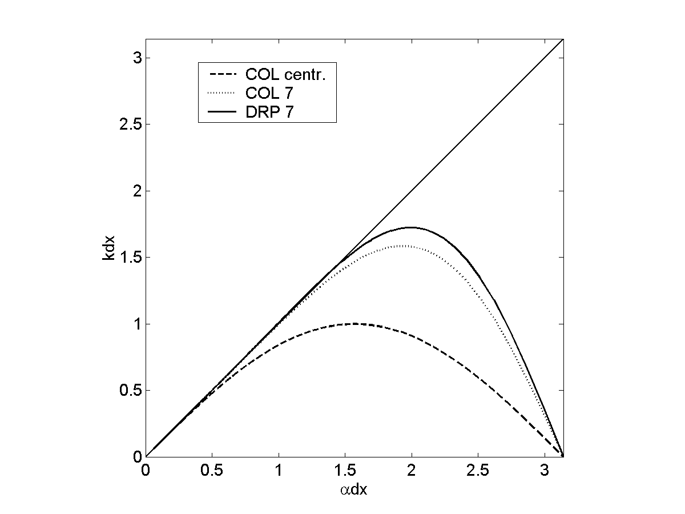
3.b) DRP scheme
Example: n=3, 7-point stencil in collocated grid
αdx
kdx
Notes:
Here is an example for n=3 leading to a 7-point stencil (thus considering 7 points near the place where the derivative needs to be known). In the chart the resulting relationship between FDTD approximation to k and actual k is shown for three stencils: a first order central difference scheme, a 7th order central difference scheme and the 7th order DRP scheme.

Slide 36
4. Sources and boundary conditions
Non-transparent sources
Transparent sources
Impedance boundary conditions
Notes:
In the previous sections we considered only propagation in free space, not worrying about boundary conditions or sources. In this section we will investigate how the additional terms due to sources and boundary conditions can be cast into the numerical framework.

Slide 37
4.a) non-transparent sources
Orthogonal component of o forced
Example: vibrating surface as acoustic source
Easy to implement o_{n}=f(t) if surface is grid plane
Note that the boundary correspond to hard boundary o_{n}=0 for incoming wave
Tangential component of electric field (o_{t} or p in 2D problem)
Example: electric field in slot or via-hole
PEC for incoming wave
Example: voltage at start of interconnect
Short circuit for incoming wave
Tangential magnetic field
Example: current in conductor
E
H
Notes:
Non transparent sources are sources that do not allow an incoming wave to pass through them. The source itself in general is perfectly reflecting for incoming waves.
A few examples are given above.
For sound propagation in fluids, a vibrating surface can easily be implemented by setting the orthogonal component of velocity equal to a fixed function of time. The surface is hard for incoming waves.
Prescribing the electric field in a slot or via hole or enforcing the voltage at the entry of an interconnect are examples for electromagnetic wave propagation. They are implemented on tangential components. For incoming waves they act as an electric short circuit.
Enforcing the tangential component of a magnetic field can be used to describe a known current in a conductor.

Slide 38
4.b) transparent sources
Added to p update equation
Monopole point source
Note that source size is actually one grid cell volume
Added to update equation for one of the components of o
Dipole point source
Note that source size is actually one grid cell surface
Add current to E update equation
Initial field
Example incoming plane wave of finite duration
Notes:
Transparent sources have no effect at all on incoming waves, they are transparent for this wave.
A transparent source is implemented by adding a function of time to the calculated field values. When the function is added to a scalar field (p), the source is a monopole source that radiates waves in all directions. Due to the discretisation, what is actually implemented is a very small (compared to the wavelength) beam-form source.
Adding the function to one of the components of the vector field results in a dipole source. The actual discretised source is a small rectangle of size one grid cell surface.
Other options are available. In the electromagnetic equations, a current can be added to the E update equation corresponding to the source term in Maxwell’s equations.
A slightly different approach that is sometimes used, is the formulation of an initial field, e.g. an incoming plane wave of finite duration in part of the discretised variables.

Slide 39
4. sources
Which time dependence should be used if interest is in frequency response
Problem: strong peaks outside area of interest may show side lobes due to finite length of time sequence that is Fourier transformed (FFT)
Limit stimulus energy outside region of interest
Example
No DC
σ² allows to tune bandwidth
Example
“narrow” band centered around f₀
Notes:
Time domain numerical simulation is often used if there is an interest in a broad frequency range. Thus it makes sense to simulate some kind of impulse response. The simplest way one could think of is to approximate an impulse by putting the signal equal to one for a single time step and keeping it zero for the rest of the time. However this approach has some disadvantages:
This impulse contains also frequencies that are too high to be modeled correctly by the discrete system. In principle this is no problem in a LTI system. In practice one will use a FFT to obtain the frequency response from the time signal. This transformation may cause side lobes that come in to the region of interest. Thus it should be avoided to excite them from the beginning.
The single step impulse also contains DC. This is no problem for the numerical scheme in itself, but some boundaries may be inaccurate when frequency approaches zero.
The proposed impulse is asymmetric and thus contains no DC. Moreover it has a limited bandwidth that can be tuned as desired.
The second example has a narrow bandwidth around the frequency f₀.

Slide 40
4.c) impedance boundary
Real surface impedance
Implemented at plane where o_{n} is discretised, assume o_{x} with impedance for larger x, boundary at i₀+1/2
Shift unknown p to surface
Resolve unknown p at half grid step using impedance condition
Resolve time mismatch for o_{x} by linear interpolation in time
This approach does not restrict stability condition (as long as Z_{R}≥0)
Z_{R}=0 is equivalent to p=0 and results in perfect reflection
Z_{R}=∞ is equivalent to o_{x}=0 and results in perfect reflection
Z_{R}=characteristic impedance (=c) absorbs an orthogonal plane wave
Notes:
The structure that lies beyond the boundary of the simulation domain can be translated to a boundary impedance if the boundary is locally reacting.
In general this surface impedance will be a complex function of frequency. We will first study the special case of a real surface impedance.
Without loss of generality we can assume that the boundary is oriented orthogonal to the x-axis. It will turn out that it is useful to make it coincide with a plane where o_{x} is discretised. At this boundary the standard scheme cannot be used to update the value of o_{x} because p(i₀+1) is unknown (outside the simulation region). We thus start by using the value at i₀+1/2 in an asymmetric finite difference approximation to the spatial derivative. The value of p on the boundary can be obtained from the definition of the boundary impedance and the value of o_{x}. The latter is however not known at the correct time step because of the staggered discretisation in time. This mismatch is resolved by linear interpolation between the old, known value and the new value that we are calculating. Since the latter is unknown, we have to move this term to the left hand side. This eventually leads to the adapted explicit scheme near the boundary.
A few special cases are of interest.

Slide 41
4.c) impedance boundary
Complex surface impedance
Explicit convolution
In most cases slow and memory consuming
Exception:
Series expansion
In time domain
In a similar way as for a real impedance one obtains
Notes:
Let us now consider the more general case of a complex surface impedance.
A first straight forward option to translate this relationship to time domain is direct convolution involving the inverse Fourier transform of the impedance. The convolution in time domain indeed corresponds to a product in frequency domain. In most cases the direct convolution is extremely slow and memory consuming. One of the few exception is a convolution with the exponential decaying function that can be resolved iteratively with little memory.
A number of approximations have been proposed for limiting the computational effort needed to implement the complex boundary impedance in time domain. A first approximation consists in writing the complex function as a series in jω and 1/jω. A term in jω translates to a time derivative in time domain while a term in 1/jω translates to an integration over time. We already know how to discretise a time derivative and an integral can be calculated iteratively.

Slide 42
4.c) impedance boundary
Complex surface impedance (continued)
Digital filter design
In Z-domain, fit
Which corresponds in time domain to
Several techniques are available to fit the constants a & b to a known spectral dependence
One option is to use bilinear transformation on frequency domain function
Notes:
A second approximating uses the knowledge from digital filter design to approximate a complex function of ω. The function that is fitted to the z-domain impedance is a quotient of two polygons in z. Once the coefficients in this fit are obtained, the corresponding time domain relationship can be obtained by inverse z-transform. This eventually yields p^{ℓ} as a function of old values of p and o_{n}. This expansion can be inserted in a derivation of the explicit scheme for the boundary similar to the one on page 38.
It only remains to be determined how the coefficients a and b can be obtained. One option is to use a bilineair transformation to translate the frequency dependent impedance to the z-domain function describing its discrete equivalent. In some cases this will immediately give the required quotient of polygons, in other cases, an additional curve fit will be necessary.

Slide 43
5. Perfectly absorbing layers
A simple first order approach
Perfectly matched layers (PML)
Notes:
A boundary condition of particular interest is the perfectly absorbing boundary. It absorbs all incoming waves and can be used to simulate an infinitely extended open area.

Slide 44
5.a) A simple first order approach
Consider a plane wave hitting the surface at orthogonal direction
If Z_{R}=Z_{c}, the characteristic impedance of the medium, then reflection coefficient is zero
But this does not work when angle of incidence is different
Notes:
If the surface impedance is equal to the characteristic impedance of the propagation medium, plane waves hitting the surface orthogonally will not be reflected (R=0). Implementing this real impedance (as discussed before) immediately gives a quite strong absorption. It is however not perfect if the incident wave differs from an orthogonal plane wave.

Slide 45
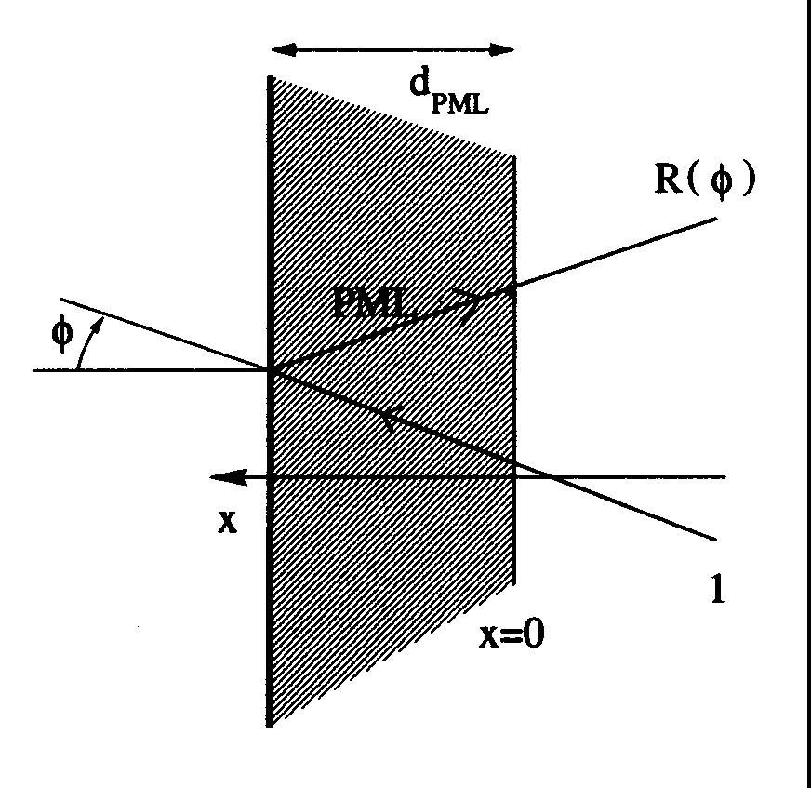
5.b) Perfectly matched layers (PML)
Underlying idea
Include a layer with (increasing) damping but make sure no waves are reflected at its interface
Normally damping introduces Z, k different from free space and reflections occur
Additional freedom by splitting p
Assuming α orthogonal to PML
(1)
(2)
(3)
(4)
Notes:
In an effort to optimally terminate a simulation area with a perfectly absorbing boundary, a special non physical material was designed and implemented. It is now commonly known as the perfectly matched layer (PML).
Our goal: to design a material with gradually increasing damping (a known principle in designing anechoic rooms) but at the same time make sure that no waves are reflected at the material interface. In physical materials, the damping introduces a difference in characteristic impedance and a wave vector that differs from free space. This causes partial reflection.
In order to allow tuning a non-physical material to our desires, we need additional degrees of freedom. This is realized by splitting p in two components, an “orthogonal” one and a “parallel” one. This allows us to split the update equation for p in two separate equations, which in turns gives the freedom to choose different damping coefficients in both equations. At the same time the damping coefficients in the update equations for orthogonal and parallel components of o are assumed different.

Slide 46
5.b) Perfectly matched layers (PML)
Perfect matching
All plane waves propagate undisturbed through the interface
Outside PML
Inside PML
(3)
(4)
(1)
(2)
Notes:
Now the requirements on the material constants that result in perfect matching are derived. Any incoming wave can be expanded in plane waves at different angles and hence it is sufficient to require that none of these plane waves is reflected.
The p and o_{α} for a plane wave hitting the PML at an angle θ can immediately be written down.
Inside the PML the wave number and propagation angle may change and an additional damping will be present. All of these factors are grouped in an exponential function with γ that could be complex. This assumed behavior is inserted in the wave equations summarized on the previous page. Equations (3) and (4) allow to express the amplitude of the o-field. These expressions are immediately used to eliminate the amplitude of the o-field from the equations obtained by inserting the assumed wave behavior in (1) and (2). This gives a system of two equations in two unknowns p_{1//} and p_{1┴}.

Slide 47
5.b) Perfectly matched layers (PML)
Perfect matching (continued)
This system of equations has a solution different from 0 only if the following determinant is zero
Continuity at the interface of normal component of o and p
thus
Notes:
This system of equations has a non-trivial solution only if the determinant of the coefficient matrix is zero.
Thus far we did not use the continuity equations at the interface: normal component of o and p should be continuous. For simplicity we assume that the boundary is at α=0. Expressing that for every β the exponential function has the same value inside and outside the PML leads to the right side equation while expressing that the amplitude o_{1α} = o_{0α} leads to the left side equation. This allows to eliminate γ_{α} and γ_{β} from the determinant.

Slide 48
5.b) Perfectly matched layers (PML)
Perfect matching (continued)
This must hold for all angles of the incident wave
It can be verified by matching terms or by just putting a few test values for θ (θ=0, θ=π/2)
Damping inside PML
m=3 to 4 seems to work well
10 to 40 layers
Notes:
The determinant must be zero for all angles of incidence to guarantee a finite amplitude wave for all angles of incidence. The easiest way forward is to plug in a few test values for θ and derive conditions from that. The determinant must also be zero for all frequencies. Thus the conditions in red rectangle are obtained. It is easy to verify by inserting these conditions in the determinant on the previous page that this determinant is indeed zero for all frequencies and all angles of incidence.
Inside the PML the damping coefficient can take any value. However it turns out that the best choice is a damping coefficient that increases with the depth in the PML layer. Often a quite high order m of the exponent is useful. The PML should be between 10 and 40 layers thick. A PML that is too thin does not introduce enough damping for the wave passing it. A PML that is too thick requires too much cpu-time and memory. In general damping should be slightly higher in thinner layers.

Slide 49
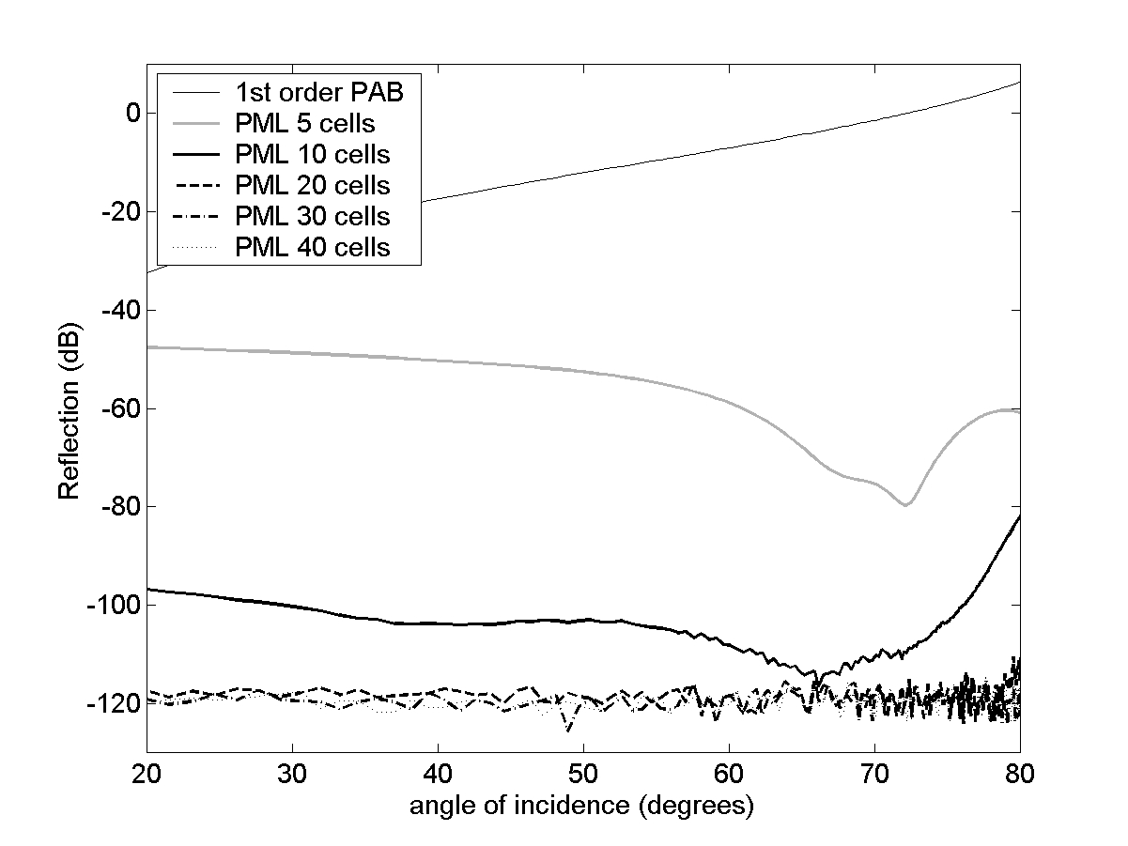
5.b) Perfectly matched layers (PML)
Numerical example
Notes:
The example shows the reflection of a plane wave on a perfectly absorbing layer as a function of the angle of incidence. The first order PAB (a surface impedance corresponding to the characteristic impedance) starts to reflect quite strongly as the angle increases. A PML suppresses reflection at all angles of incidence. As the number of layers in the PML increases, the reflection eventually reaches the limit imposed by numerical accuracy of the simulation used in this experiment.

Slide 50
6. Handling additional terms in the equation
Damping proportional to field
Damping proportional to derivative
Moving media
Notes:
By way of example we will look into the problem of discretising additional terms that may occur in the wave equations.

Slide 51
6.a) Damping proportional to field
Discretise keeping in mind the staggering
Notes:
A damping term proportional to a field value should be discretised in a staggered grid by linear interpolation to avoid temporal mismatch. This however introduces the unknown value. Grouping unknown field values in the left hand side leads to the explicit time stepping equation. This way of discretising the additional damping term does not influence the stability condition.

Slide 52
6.b) Damping proportional to derivative
Discretisation of second order derivative involves neighboring field values
Explicit scheme is not possible in staggered grid unless time discretisation is violated
Notes:
Damping can also be expressed by a term proportional to the second order spatial derivative. For example damping by viscosity of a fluid in acoustic wave propagation. An explicit scheme in a staggered grid does not allow to discretise this term easily. Discretising the spatial derivative requires the use of the o-field components near to the component where the update is done. When one tries to resolve the temporal mismatch, the system matrix becomes tri-diagonal and the scheme is no longer explicit.
Alternatively, one can ignore the temporal mismatch and just use the old value of the o-field at t=(l-1/2)dt to calculate the additional term. Even in this case, the second order derivative has to be calculated and stored before the old o-field values can be overwritten by the update equation.

Slide 53
6.c) Moving media
Uniform movement or first approximation to general flow
Staggered grid does not result in explicit scheme unless discretisation strategy is violated, but this results in (slightly) unstable system
Collocation in time solves the problem, but more memory needed
and simular for p
and simular for p
Notes:
In a medium moving with velocity v₀, the time derivative in the wave equation has to be replaced by a derivative in moving coordinate system. This leads to an additional term in the wave equation. Discretising this term in a staggered grid introduces the same problem as explained on the previous page. The scheme is no longer explicit. Again one can opt for using old values of the o-field to approximate the additional term. This however leads to a marginally instable discrete system.
When fields are discretised collocated in time, the above mentioned problems are avoided. The explicit update equation for o_{x} is shown, equivalent equations can be written for the other components.

Slide 54
7. Grid refinement and subgridscale models
Problem statement
Cartesian refinement
Non-Cartesian matching
Small objects and openings
Boundary layers
Notes:
In this section, a few methods are described to tackle the problem of small structures or small scale effects that influence wave propagation on a larger scale.
To describe such features, the grid can be refined, but this solution is very computationally intensive. Thus alternatives have to be found.

Slide 55
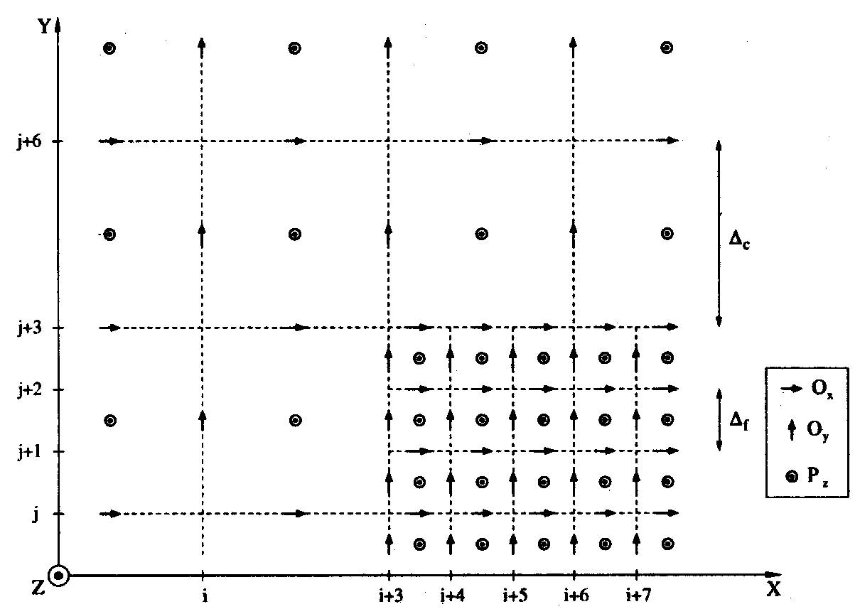
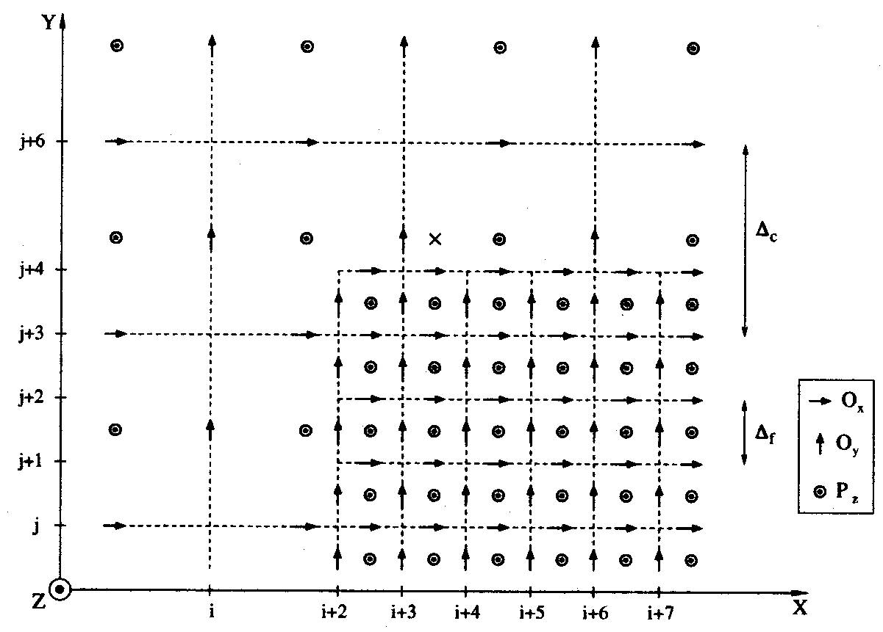
7.b) Cartesian refinement
Odd refinement ratios provide value in center of coarse cell so standard central difference is still possible in coarse grid cell close to interface
Shifted fine grid also results in central difference approach for at least central cell
Linear interpolation can be used as a first approach to calculate missing values, e.g.
Notes:
As a first approach, we discuss Cartesian grid refinement. Close to small features, the grid is refined using an integer refinement ratio. It is useful to chose an odd refinement since this leads to known values of the field in the center of the underlying coarse grid. Thus, just outside the refinement, the basic update formula can still be used to calculate the field in the centre of the cell.
If at the same time, the fine grid is slightly shifted, one can also use a standard update formula to calculate the o-field in the central cell. For the remaining o-fields on the interface between both grids, linear interpolation can be used to find the p field at spatial locations where they are missing. One example of a derivative calculated on the basis of interpolation is shown.

Slide 56
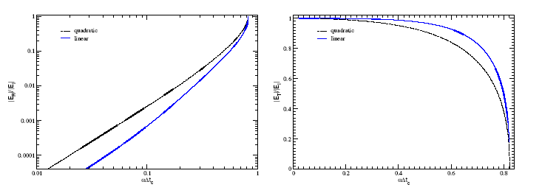
7.b) Cartesian refinement
Problem with local Cartesian grid refinement is spureous reflection at interface
Numerical impedance differs. Although k dx is the same over the whole area, α dx changes.
Reflection coarse to fine
Transmission coarse to fine
Notes:
Cartesian grid refinement can lead to spureous reflections on the interface between the coarse and the fine grid. This can be understood based on the observation that the wave vector k is not modeled accurately by the FDTD scheme but approximated (we defined the approximation as α in previous slides). Thus at the interface the virtual change in wave number which can be interpreted as a virtual change in propagation speed c of the waves and thus as a change in characteristic impedance. We know from other courses that waves reflect on such changes in characteristic impedance.
The example shows the reflection and the transmission when an electric field wave propagates from the coarse to the fine grid as a function of frequency multiplied by time step. It can be seen that the reflection increases strongly with frequency which can be expected as the phase error (difference between α and k) increases with frequency and so does the difference in virtual impedance between the two grids.
See also: Bart Denecker, “The subdomain FDTD method”, PhD dissertation, INTEC, UGent, 2002-2003

Slide 57
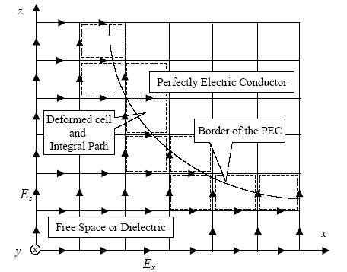
7.c) Non-Cartesian adaptation
Introduce non-Cartesian cells near the curved surface
Non-Cartesian cells are best handled using finite volume based approach
The approach is sometimes referred to as conformal FDTD
Notes:
An alternative approach that allows to include more accurately interfaces and surfaces that do not coincide with a Cartesian grid boundary consist in using deformed cells close to the boundary only. This approach does not however allow to include strong local changes in the fields themselves as grid refinement does.
The figure shows a situation that might occur in an electromagnetic problem when Cartesian cells close to the curved surface of an electric conductor do not allow to accurately describe the curvature.
The wave equation in the deformed cell can best be derived using an integral formulation leading to what is sometimes called a finite volume technique (See Section 1).

Slide 58
7.d) Small objects and openings
Opening or object is small compared to wavelength
Local problem is quasi-static
Solve local problem (analytical or numerical) for different excitation (p_{QS}(m)=1, others=0)
Extract surface averaged
and p_{QS} in close by cells
Modified FDTD approximation
Input for QS
Modified FDTD equation
Notes:
Consider a small gap or tiny object that influences wave propagation. Note that on itself such a structure has little influence on the wave propagation but if many small objects are considered or if the small gap is part of a Helmholtz resonator, the influence can indeed be considerable.
As the structure is small compared to the wavelength, the local problem is a quasi-static one. Thus it can be considered to solve this problem beforehand, either by numerical simulation or analytically and extract the relevant local field profile from this QS solution, also in the wave propagation problem.
Let us consider a small opening half a cell wide to concretize this idea. In this case, the problem consists in finding a more detailed update equation for the o-field in the opening (green arrows) given the typical behavior of a static p in the neighborhood. Two quasi-static problems need to be solved: (1) the upper red p value equal to 1 and the lower red p value equal to zero; (2) the upper red p value equal to 0 and the lower red p value equal to 1. The static problem yields a p value everywhere near the opening under these excitations. In the update equation for the orthogonal component of o-field (green arrow) the spatial derivative of p appears. Rather than using a first order finite difference to approximate it, we now use the average of the field obtained in the QS simulation. It is noted above with the subscript QS.
In the modified FDTD equation, a correction term is added to the finite difference approximation. The summation in this term runs over all neighboring cells that have been considered in the QS problem. Note that m could take other values than i and i+1 as well. The weights a_{m,i+1/2} express the difference between the QS approximation to the spatial derivative at location i+1/2 for excitation m (p_{QS}(m)=1, others=0) and the finite difference approximation calculated based on the QS field.
See also: J. De Poorter and D. Botteldooren, “Acoustical finite-difference time-domain simulations of subwavelength geometries,” J. Acoust. Soc. Am. 104 (3), 1998, p. 1171

Slide 59
7.e) Boundary layers
What?
Very local surface effect that has nevertheless a significant effect on sound propagation
Analytical solution in boundary layer
Second derivative term is dominant in BL, neglect everywhere else
Average this term over cell and approximate considering δ <<dn
Additional term in o_{t} update equation
Note that must be transformed to time and discretized in time!
Notes:
Boundary layers are very local surface or interface effects that have nevertheless a significant influence on wave propagation. Since the boundary layer effects depend on the underlying physics, we will discuss them for acoustic wave propagation in a fluid.
If viscosity of the fluid is considered, the equation that expresses conservation of momentum must be adapted to account for friction forces. The simplest approximation is added in the equation for the tangential component of the o-field above. On a hard surface o_{t}=0 and it turns out that the effect of viscosity is limited to an extremely thin layer near this surface. Making some mild assumptions, it is possible to find an analytical solution of the field in this boundary layer. The exponential decay orthogonal (indicated as n) to the surface is very strong due to the small value of δ. Thus the second order derivative of o_{t} in the equation above will be very big in the boundary layer and can even be neglected outside this BL. Assuming this exponential behavior in the BL the equation can be averaged over a Cartesian cell. Making use of the smallness of δ compared to the grid cell, it can be found that the additional term that must be added to the FDTD update equations of the o_{t} near the boundary (green arrows) is simply proportional to o_{t}. We have already discussed how to discretize such a term.
BUT, there is a problem: δ depends on the square root of frequency. This complicates matters considerably. The special approach using digital IIR filters that was discussed for adding general surface impedance to the FDTD equations is one option.
See also: D. Botteldooren, “Vorticity and entropy boundary conditions for Acoustical finite-difference time-domain simulations,” J. Acoust. Soc. Am. 102 (1) 1997, p. 170

Slide 60
8. Implementation aspects
Matrix implementation for structured grids
A linked-list solution
Parallelization
Moving grids
Solution methods for implicit schemes
Notes:
In a final section, some implementation issues are discussed.

Slide 61
8.a) Matrix implementation for structured grids
What?
p, o_{x}, o_{y}, o_{z} in separate matrices
Additional matrix for material data and choice of equation
Pro
Little memory overhead
Fast addressing
Contra
Conditional use of different update equations results in overhead
Cartesian bounding box may result in large number of non-used data fields if geometry contains a large number of non-propagating cells
Notes:
If a structured grid is used (most often a Cartesian grid), the data can be stored in matrices. It makes sense to store each unknown in a separate matrix. In addition one may have to add a matrix for storing material properties and maybe also for storing a choice of FDTD equation if these change with location.
This approach has some advantages: it is minimal in memory requirement and values can be retrieved very fast from storage.
The disadvantages: if a lot of different equations have to be used in the modelling region, some calculation overhead is needed to select the appropriate equation; also when the modelled region deviates strongly from a beam, some memory is used to store zeros, which is not very efficient.

Slide 62
8.b) A linked list solution
What?
p/o objects linked by pointers
Pro
Non-structured possible
No overhead for non-propagating
Different equations included naturally
Contra
Memory usage
o-object
p-object
o-object
p-object
o-object
Notes:
An alternative consists in using a linked list and to store the data in objects. The objects in an object-oriented implementation contain also a pointer to the neighbor fields needed in the update equations and the method (equation) needed to calculate the new values of the field.
Advantages include the possibility to use non-structured grids, the limited overhead for non beam like simulation areas and the ease in implementing different update equations in different areas.
The main but important disadvantage is the inefficient use of computer memory.

Slide 63
8.c) Parallelization
Low order (staggered or not) time domain method allows for easy parallelization
Amount of communication between CPUs is of the order n² in n³ number of unknowns
Notes:
A low order explicit time domain scheme lends itself particularly well for parallelization. Different CPUs or computers in a grid can handle part of the simulation area without interfering with other parts. The communication between them is limited to the interfaces between sub-areas of the simulation domain. The number of variables that need to be exchanged between CPUs is typically of the order of n² for a n³ problem.

Slide 64
8.d) Moving grids
Memory usage may be considerably reduced
If pulse is short (broadband)
If propagation is essentially in one direction (non-resonant)
Allocate memory only when p/o starts to rise and deallocate once the field is below a given threshold
Region a
Region b
Region c
Notes:
In some situations, memory usage (and CPU-time) can be reduced a lot in low order time domain schemes. This situation occurs when the time domain pulse is short, and propagation is essentially in one direction. In that case, field values will be close to zero in large areas of the simulation domain. It makes no sense to allocate memory for storing these zero, or close to zero values. Thus once local energy in the wave drops below a predefined value the memory can be deallocated.
One rather straightforward way of implementing these moving calculation windows is based on sparse matrices. In such matrices zero is not stored automatically. Thus it essentially only remains to implement the heuristics to replace very small field values by zero.

Slide 65
8.e) Solution methods for implicit schemes
Implicit schemes result in sparse matrix
Various methods available for solving matrix equation, e.g. biconjugate gradient
See chapter on mathematics
Notes:
Implicit schemes requre to solve sparse matrix systems. Methods for solving such matrix equations have been discussed in a previous chapter.

