Slide 1
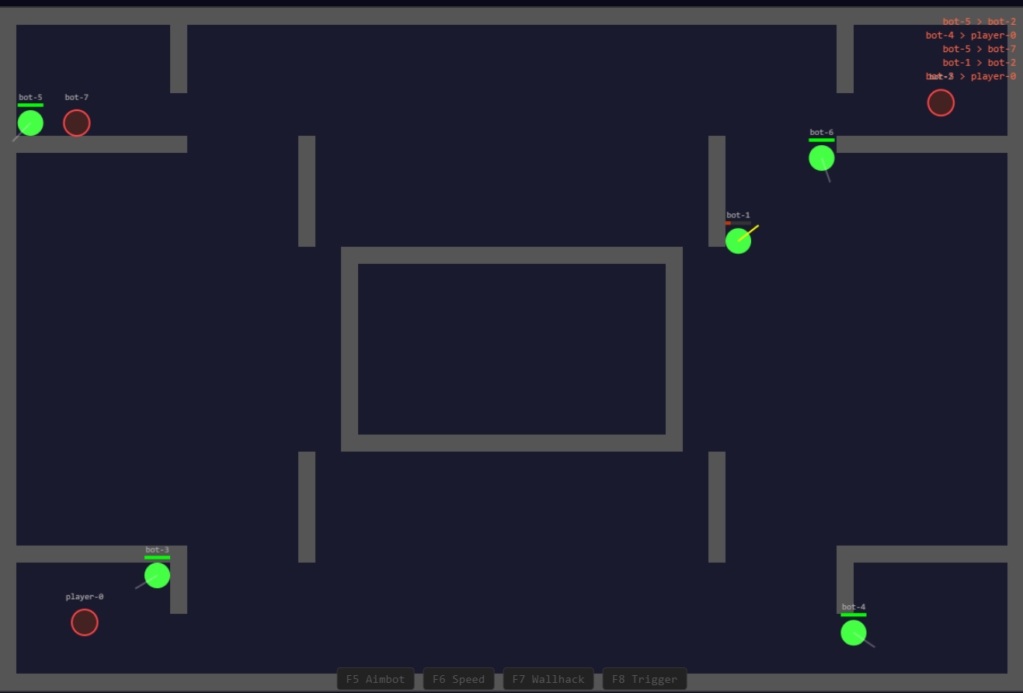
⌖
ENGR 5785G · REAL-TIME DATA ANALYTICS FOR IoT
game-client · localhost:80
Real-Time Cheat
Detection
for Multiplayer Games
A server-side streaming analytics pipeline using Kafka, Go, XGBoost, and an LSTM Autoencoder - detecting cheats in under 5 seconds with full Grafana observability.
Go 1.22
Python 3.11
Apache Kafka
XGBoost + LSTM
60Hz Real-Time
RULE ENGINE
XGBOOST
LSTM AE
Docker Compose
Ontario Tech University
Spring 2026
Notes:
Introduce the project: real-time, server-side cheat detection for multiplayer games using a Kafka streaming pipeline with three detection layers. Course context: ENGR 5785G at Ontario Tech.

Slide 2
PROBLEM SPACE
02
Problem Definition & IoT Context
The Challenge
Project Objectives
IoT Parallels
Cheating costs the industry billions annually
Server-side behavioral detection - no client trust
Sensors: 60Hz telemetry ↔ industrial IoT
Client-side anti-cheat (VAC, EAC) is bypassable
Edge: sliding-window aggregation per player
Real-time streaming pipeline via Apache Kafka
Stream: Kafka processing (~540 events/sec)
Post-match analysis takes hours to days
Dual-paradigm ML: supervised + unsupervised
Anomaly: LSTM autoencoder - same as IoT sensor anomaly detection
Kernel drivers raise serious privacy concerns
Rule engine: deterministic, zero false positives
Detection in under 5 seconds
RELATED WORK
Client-Side Kernel (VAC/EAC) - fast but bypassable
Statistical Post-Match - low FP but hours of delay
ML Behavioral (CS2CD) - patterns, usually offline
Real-Time Cheat Detection · ENGR 5785G
02 / 18
Notes:
Frame the problem: cheating is costly, client-side anti-cheat is bypassable and invasive, post-match analysis is too slow. Our objectives, and how this maps cleanly onto IoT streaming concepts.

Slide 3
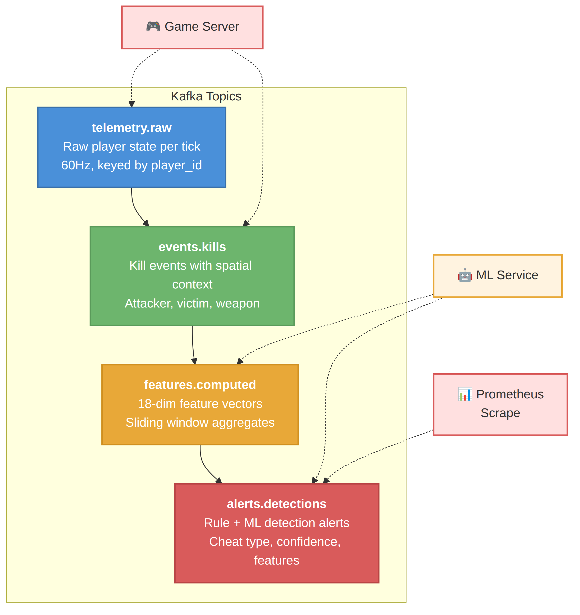
ARCHITECTURE
03
System Architecture
7 Docker containers · 4 Kafka topics · 3 detection layers
BROWSER CLIENT
›
GAME SERVER
›
APACHE KAFKA
›
RULES ENGINE
›
ML SERVICE
›
PROMETHEUS
HTML5 Canvas WASD + Mouse F5–F8 Toggles
Go 1.22 · 60Hz 8 Bots + Players Physics + Raycast
KRaft · 4 Topics 4 Partitions Keyed by player_id
18 Features 6 Rule Detectors 1s / 5s / 30s
XGBoost < 1ms LSTM Autoencoder :8000
:9091 · Scrapes 5s
GRAFANA
:3000 · Dashboards
Kafka Topics
telemetry.raw
Raw player state per tick
events.kills
Kill events + context
features.computed
18-feature vectors
alerts.detections
Rule + ML alerts
END-TO-END
Input → Game Server → Kafka → ML → Alerts → Prometheus → Grafana
≤ 5 seconds
Real-Time Cheat Detection · ENGR 5785G
03 / 18
Notes:
Walk the end-to-end pipeline left to right: browser client to game server to Kafka, then rules and ML, then Prometheus and Grafana. Highlight the four Kafka topics and the under-5-second budget.

Slide 4
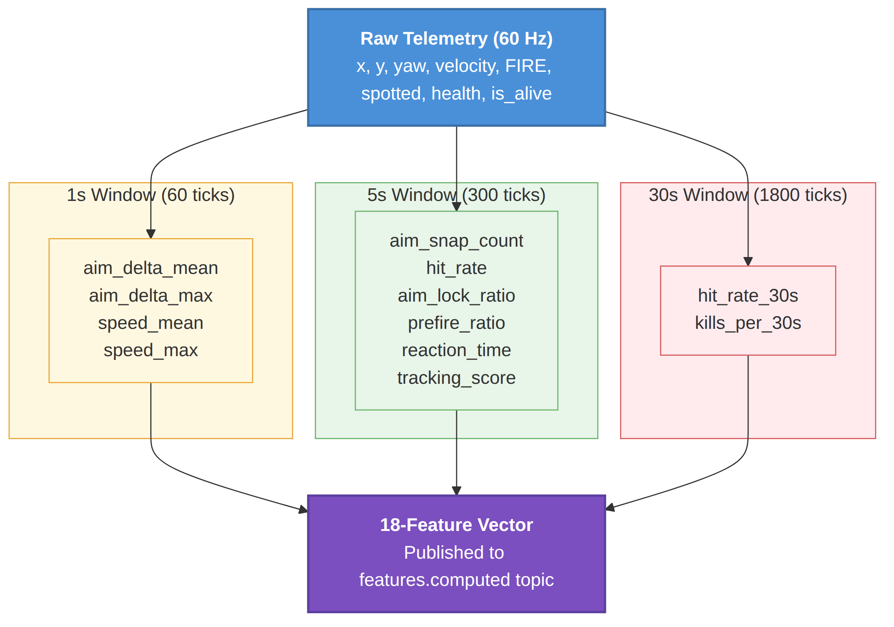
DATA PIPELINE
04
Data Pipeline & Feature Engineering
Telemetry Generation · 60Hz
Player sends raw input (keys, mouse) via WebSocket
Server computes position, velocity, aim, hit detection
Spatial context: nearest-enemy distance, angle, LOS
18 raw fields per player per tick → Kafka
Feature Engineering · Go
3 sliding windows: 1s (60), 5s (300), 30s (1800 ticks)
18 features: aim dynamics, combat, movement, spatial
Ring buffer per player · 60s cleanup for inactive
Feature vectors sent to ML on every tick
Cheat Simulation · Server-Side
Aimbot F5
Speedhack F6
Wallhack F7
Triggerbot F8
Snaps aim · aim_delta > 2.0 rad
2.5× velocity · speed > 7.0
Aim through walls · prefire > 60%
Auto-fire · react < 3 ticks
Real-Time Cheat Detection · ENGR 5785G
04 / 18
Notes:
Explain how raw 60Hz telemetry becomes an 18-feature vector across three sliding windows, the ring-buffer design, and how each of the four cheats is simulated server-side with its detection threshold.

Slide 5
DETECTION · LAYER 1
05
Rule Engine
Physics-derived thresholds · Zero false-positive rate
Rule
Condition
Detects
Normal
Cheat
speed_max_1s > 7.0
Speedhack
0 – 5.0
~12.5
speed_cap
aim_delta_max_1s > 2.0
Aimbot
0 – 0.5 rad
~3.14 rad
aim_snap
hit_rate_5s > 85%
Aimbot
20 – 50%
~100%
inhuman_accuracy
aim_lock_ratio > 90%
Aimbot
5 – 30%
~100%
aim_lock
prefire_ratio > 60%
Wallhack
0 – 15%
> 60%
prefire
reaction_time < 3
Triggerbot
9 – 15 ticks
1 – 2
triggerbot_react
KEY INSIGHT
Every threshold sits in a dead zone between what is physically possible for a human and what the cheat produces - derived directly from game physics, with no statistical tuning required.
Real-Time Cheat Detection · ENGR 5785G
05 / 18
Notes:
Layer 1 is six physics-derived rules. The key point is every threshold sits in a dead zone between the human maximum and the cheat minimum, which is why the false-positive rate is zero with no statistical tuning.

Slide 6
DETECTION · LAYERS 2 & 3
06
Why XGBoost + LSTM Autoencoder?
XGBoost · Supervised Classification
LSTM Autoencoder · Anomaly Detection
ALTERNATIVES CONSIDERED
ALTERNATIVES CONSIDERED
✕
Random Forest - slower inference; trees traversed sequentially
✕
Isolation Forest - treats ticks independently; misses temporal patterns
✕
SVM - scales poorly beyond 10K samples; no native probabilities
✕
1D CNN - fixed receptive field; LSTM captures variable length
✕
Deep Neural Net - overfits small tabular data; XGBoost wins
✕
Transformer - quadratic memory; overkill for 60-step seqs
✕
Logistic Regression - cannot capture non-linear interactions
✕
Dense Autoencoder - no temporal modeling; loses sequence
WHY IT WINS
WHY IT WINS
< 1ms inference per tick - real-time at 60Hz
Captures order: aim-snap THEN hit = aimbot; reversed = skill
Built-in feature importance - top-3 per alert
Enc LSTM(18→64→32) · Dec LSTM(32→32→64)→Dense(64→18)
Handles missing values + class imbalance natively
Trained on clean data only - detects ANY deviation, incl. novel cheats
max_depth=6 · lr=0.1 · n_est=200 · sub=0.8
Anomaly score = MSE reconstruction; threshold = mean + 4σ
Real-Time Cheat Detection · ENGR 5785G
06 / 18
Notes:
Justify the two model choices against alternatives. XGBoost for fast, interpretable supervised classification; LSTM autoencoder for temporal, unsupervised anomaly detection trained only on clean data so it catches novel cheats.

Slide 7
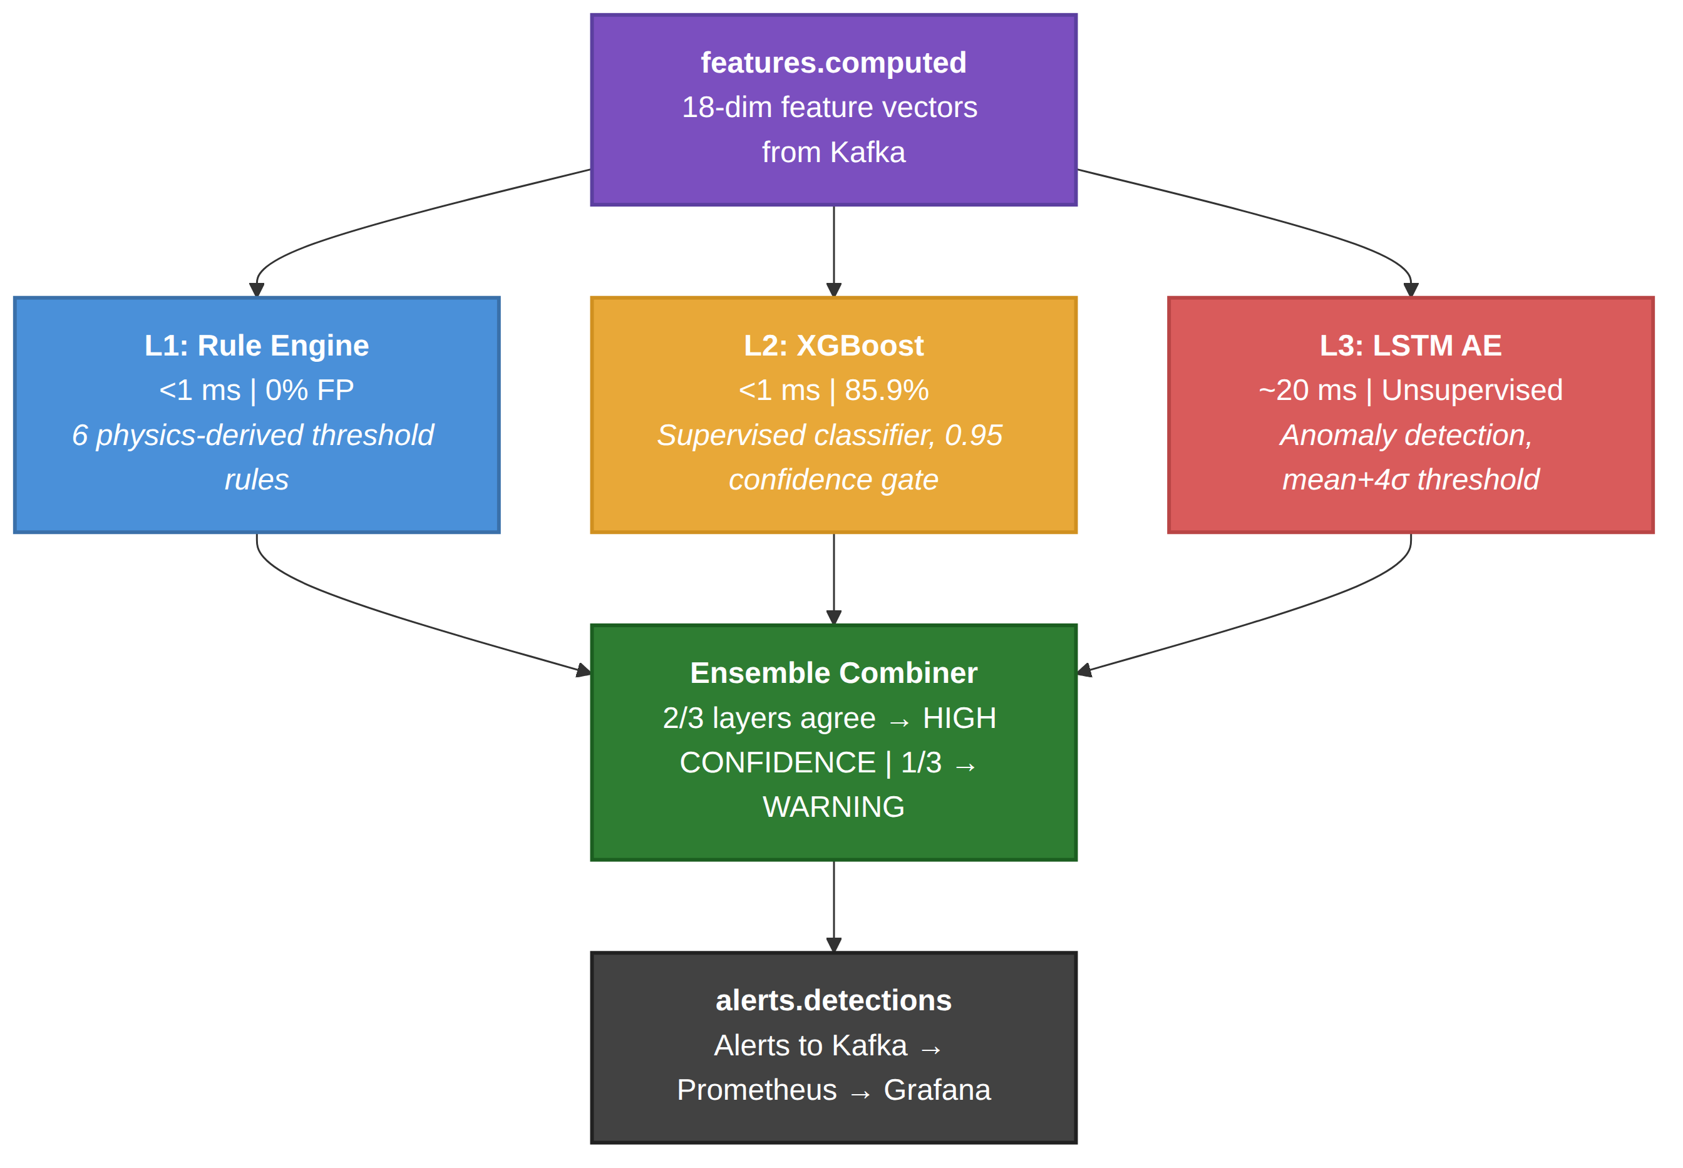
DETECTION · ENSEMBLE
07
Three-Layer Detection Ensemble
How the layers combine
2 / 3 layers agree → HIGH-CONFIDENCE alert
1 / 3 layers → WARNING flag
L1 · Rule Engine
< 1 ms · 0% FP · 6 physics rules
L2 · XGBoost
< 1 ms · 85.9% · 0.95 confidence gate
L3 · LSTM Autoencoder
~ 20 ms · unsupervised · mean + 4σ
Ensemble → alerts.detections → Prometheus → Grafana
Real-Time Cheat Detection · ENGR 5785G
07 / 18
Notes:
How the three layers combine. Each layer scores the same feature vector independently; an ensemble combiner raises a HIGH CONFIDENCE alert when 2 of 3 agree and a WARNING on 1 of 3. Alerts flow to Kafka, Prometheus, and Grafana.

Slide 8
TRAINING
08
Dataset, Features & Target
18 Computed Features - Input to XGBoost
CS2CD Dataset
Feature
Window
Description
795
451
344
aim_delta_mean_1s / 5s
1s, 5s
Average aim angle change/tick (rad)
CS2 matches
VAC-banned
clean
aim_delta_max_1s
1s
Peak aim-snap magnitude last second
Parquet format · 225 raw columns per tick
Augmented with bot-generated synthetic data
aim_snap_count_5s
5s
Large aim jumps (> 0.5 rad)
aim_to_enemy_offset_mean_5s
5s
Angle between crosshair & enemy
Target Variable
hit_rate_5s / 30s
5s, 30s
Shots hit / shots fired
cheat_label - binary: "none" or "cheater"
shots_fired_5s
5s
Shooting frequency (shots / 5s)
Source: VAC ban status in each match JSON
kills_per_30s
30s
Kill rate over 30s window
Per-player: every tick from a banned player → cheater
speed_mean_1s / 5s
1s, 5s
Average movement speed (units/tick)
speed_max_1s
1s
Peak speed in last second
aim_lock_ratio_5s
5s
% ticks crosshair < 0.1 rad of enemy
prefire_ratio_5s
5s
% shots while enemy not visible
reaction_time_mean_5s
5s
Ticks: enemy visible → first shot
enemy_tracking_score_5s
5s
Correlation: aim vs enemy movement
Real-Time Cheat Detection · ENGR 5785G
08 / 18
Notes:
The training data: the CS2CD dataset of 795 real matches labeled by VAC ban status. The target is a binary per-player label, and the model input is the 18-feature vector listed on the right.

Slide 9
DATASET
09
Inside the CS2CD Dataset Files
Each match = 1 Parquet file (225 columns, ~60K ticks) + 1 JSON metadata file
Parquet File · Selected Columns (12 of 225)
JSON Metadata · Ground Truth
Column
Type
Captures
{"cheaters": [
{"steamid": "Player_3"},
tick
int
Game tick (time index)
{"steamid": "Player_4"}
]}
steamid
string
Unique player identifier
VAC-banned steamids → every tick from that player gets the cheater label.
X, Y
float
Position (drop Z for 2D)
Raw → Features Pipeline
1
Parse X, Y, yaw, velocity, FIRE, spotted per tick
yaw
float
Aim direction in degrees
2
Compute aim_delta = |current_yaw − prev_yaw|
3
Compute nearest-enemy distance (Euclidean)
velocity_X/Y
float
Movement speed per axis
4
Feed into sliding-window extractor (1s / 5s / 30s)
health
float
Player HP (0–100)
5
Output: 18 features + cheat_label = one training row
is_alive
bool
Dead or alive this tick
FIRE
bool
Is the player shooting
spotted
bool
Visible to enemies
Real-Time Cheat Detection · ENGR 5785G
09 / 18
Notes:
Drill into the raw files: each match is a Parquet file of 225 columns plus a JSON of cheater steamids. We use 12 columns, derive aim deltas and enemy distance, and feed the sliding-window extractor to produce labeled training rows.

Slide 10
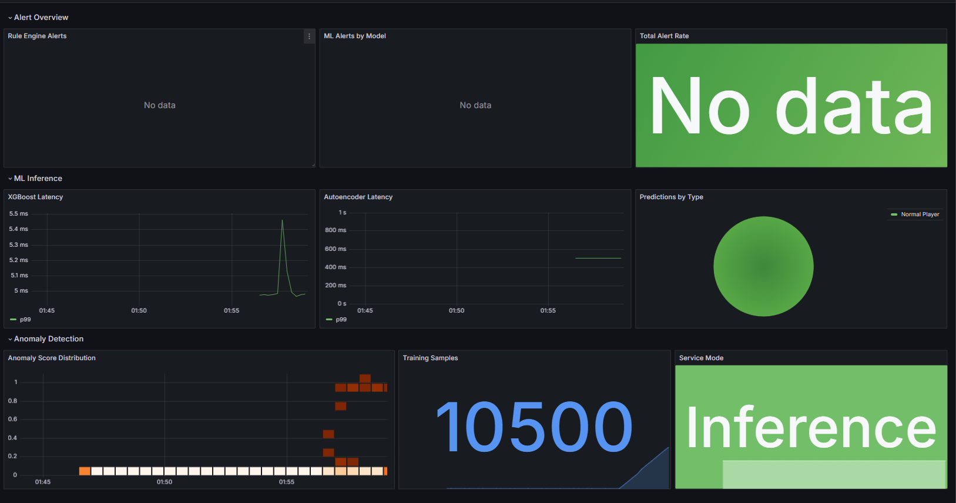
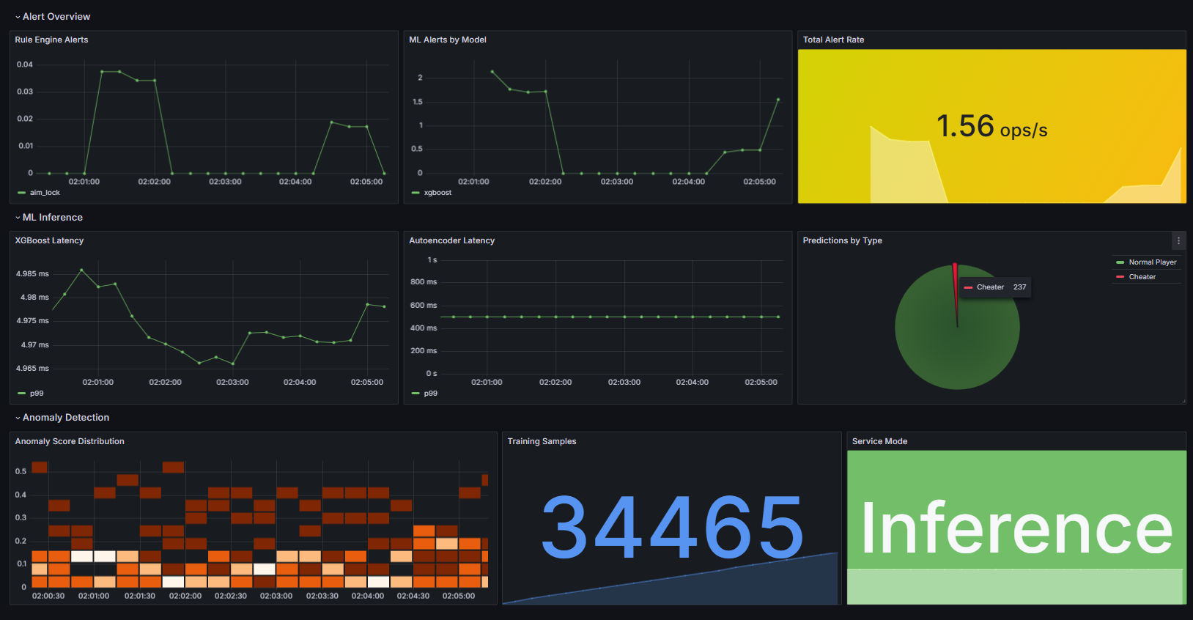
OBSERVABILITY
10
Grafana Dashboards: Before vs After
Before - Clean Gameplay
After - Cheats Enabled (F5–F8)
Prediction Pie - 100% green; XGBoost classifies all ticks clean
Prediction Pie - red slice grows; XGBoost detects ≥ 95% confidence
Rule + ML Alerts - flat at 0; nothing above 95% confidence
Rule + ML Alerts - bars spike; speed_cap, aim_snap + ensemble fire
Total Alert Rate - green zone (0/min); fair play confirmed
Total Alert Rate - red zone (50+/min); layers converging
Anomaly Heatmap - cluster at 0.3–0.6; LSTM reconstructs well
Anomaly Heatmap - scores shift to 2.0–10.0+; LSTM can't reconstruct
KEY PromQL
increase(ml_predictions_total[5m])
rate(rule_alerts_total[1m]) by (rule)
sum(rate(ml_alerts_total[1m])) * 60
ml_autoencoder_anomaly_score_bucket
·
·
·
Real-Time Cheat Detection · ENGR 5785G
10 / 18
Notes:
Side-by-side Grafana dashboards. Clean play: all green, flat zero alerts, anomaly scores 0.3 to 0.6. Cheats on: red pie slice grows, rule and ML bars spike, anomaly scores jump to 2 and beyond. Note the PromQL queries driving each panel.

Slide 11
LIVE DEMO
11
Real-Time Detection, End-to-End
1
Open game client at localhost:80 - clean gameplay with bots
2
Open Grafana :3000 - show zero-alerts baseline
3
Toggle Aimbot (F5) - aim_snap + aim_lock fire instantly
4
Toggle Speedhack (F6) - speed_cap fires; ML flips to "cheater"
5
Toggle Wallhack (F7) - prefire fires after shot accumulation
6
Toggle Triggerbot (F8) - reaction_time fires within 1 second
7
Disable all cheats (F5–F8) - alerts stop; pie returns to "none"
8
Show ML /health - confirms trained inference mode
F5 Aimbot
F6 Speed
F7 Wall
F8 Trigger
Real-Time Cheat Detection · ENGR 5785G
11 / 18
Notes:
The live demo script: open the game and Grafana baseline, toggle each cheat F5 through F8 and watch the matching rule fire, then disable everything and confirm alerts clear and the ML service health endpoint reports trained inference mode.

Slide 12
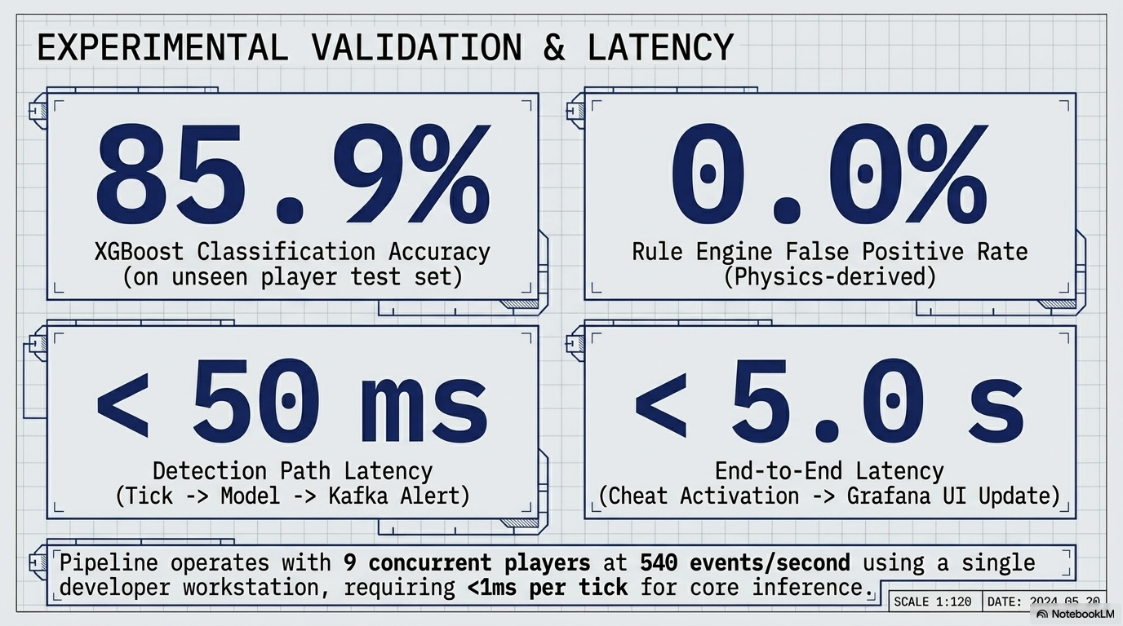
RESULTS
12
ML Scores, Metrics & Results
175K samples · 131K train / 44K test · 8 player profiles · player-ID split
85.9%
85.1%
0.95
0%
XGBoost Accuracy
XGBoost F1 Score
Confidence Threshold
Rule Engine FP Rate
test set
weighted
below = clean
physics-derived
0.53
1.12
< 1ms
< 5s
LSTM Anomaly Mean
Anomaly Threshold
XGBoost Inference
End-to-End Latency
reconstruction error
mean + 4σ
per tick, 60Hz
cheat → Grafana
KEY FINDINGS
▸
Speedhack - detected instantly by the rule engine AND XGBoost (99% confidence)
▸
Aimbot - rule fires same tick; XGBoost confirms within 1–2 seconds
▸
LSTM - clean scores cluster at 0.3–0.6 (below 1.12); cheat scores spike to 2.0–10.0+
▸
Confidence gating at 0.95 eliminates low-confidence ML false positives
Real-Time Cheat Detection · ENGR 5785G
12 / 18
Notes:
Headline results across 175K samples with a player-ID split. 85.9% accuracy, 85.1% F1, zero rule false positives. Walk the key findings on how each cheat is detected and how confidence gating removes low-confidence ML false positives.

Slide 13
TEAM
13
Team Responsibilities
Ankit
Rohan
Sid
Priyanka
Nithilan
Game Client & Kafka
Game Server & Features
XGBoost Training
LSTM Autoencoder
Grafana Dashboards
HTML5 Canvas client, WebSocket transport, F5–F8 cheat toggles, Kafka topic setup (KRaft, 4 partitions, player_id key).
Authoritative 60Hz loop in Go, physics + raycast + spatial engine, 8 AI bots, 18-feature engine, 6 rule detectors.
CS2CD parser (Parquet + JSON), 3D→2D feature mapping, player-ID train/test split, hyperparameter tuning, confidence gating.
Encoder LSTM(64→32), Decoder LSTM(32→64)→Dense(18), trained on clean-only sequences, anomaly threshold calibration.
2 auto-provisioned dashboards, Prometheus metrics, PromQL queries, pie chart with color overrides, anomaly heatmap.
Key: KRaft mode; player_id partitioning for ordered per-player processing
Key: Server-side authority, ring-buffer windows, physics-derived thresholds
Key: Player-ID split prevents data leakage; 0.95 threshold
Key: Clean-only training for novel cheats; MSE as anomaly score
Key: Docker volume provisioning, 5-second scrape, color-coded thresholds
Real-Time Cheat Detection · ENGR 5785G
13 / 18
Notes:
Team responsibilities: Ankit on client and Kafka, Rohan on game server and feature pipeline, Sid on XGBoost training, Priyanka on the LSTM autoencoder, Nithilan on Grafana dashboards. Each owns a distinct slice of the pipeline.

Slide 14
BENCHMARK
14
Comparison with AntiCheatPT
AntiCheatPT (Lopes et al., 2025): transformer-based offline classifier on the same CS2CD dataset
Dimension
AntiCheatPT
Our System
Detection Timing
Offline, post-match batch
Real-time: 1–5 s from activation
Detection Approach
Single model, 63.13% recall
Rules (0% FP) + XGBoost + LSTM triple coverage
Detection Paradigm
Single: supervised transformer
Three: rules + XGBoost + LSTM autoencoder
Novel Cheat Detection
Cannot detect (VAC labels only)
LSTM detects ANY behavioral deviation
False Positive Handling
~11% FP rate
Rules: 0%; XGBoost: 0.95 confidence gate
Cheat Types Tested
Unknown (VAC-banned)
4 explicit: aimbot, speedhack, wallhack, triggerbot
Observability
None
Prometheus + Grafana (20+ metrics, 2 dashboards)
Deployment
Research notebook
Docker Compose: 1-command, 7 containers
TAKEAWAY
AntiCheatPT asks "was this player cheating?" after the match. Our system asks "is this player cheating right now?" while the match is live.
Real-Time Cheat Detection · ENGR 5785G
14 / 18
Notes:
Compare to AntiCheatPT, a transformer-based offline classifier on the same dataset. Our system is real-time, multi-paradigm, catches novel cheats, has near-zero false positives, and ships as one-command Docker. The framing: post-match question vs live question.

Slide 15
ROADMAP
15
Limitations & Future Work
Current Limitations
Future Improvements
Feature distribution gap: CS2 (3D) vs our game (2D) cross-domain accuracy
Temporal transformer: better long-range pattern detection than LSTM
Scale: tested 9 players; horizontal scaling not yet implemented
Graph neural network: multi-player collusion via kill-graph
Wallhack without active aim produces subtle, harder-to-detect signals
Adversarial training: generator creates stealthy cheats, detector learns
No online learning: models need manual retrain on behavior drift
Federated learning: train across titles without sharing raw data
CPU-only LSTM inference limits throughput without a GPU
Tiered inference: run expensive LSTM only for flagged players
KEY CONTRIBUTIONS
▸
End-to-end real-time pipeline: 60Hz telemetry → Grafana alert in < 5 s
▸
Dual-paradigm ML: supervised XGBoost (known) + unsupervised LSTM (novel)
▸
Physics-derived rule engine: 0% false positives, deterministic detection
▸
Trained on public CS2CD dataset (795 real matches) for reproducibility
Real-Time Cheat Detection · ENGR 5785G
15 / 18
Notes:
Be candid about limitations: domain gap, scale, subtle wallhacks, no online learning, CPU-only LSTM. Then the roadmap - transformers, graph nets, adversarial and federated training, tiered inference. Close on the four key contributions.

Slide 16
⌖
Thank You
Questions?
SOURCE CODE
Docker Compose - single-command deployment
TECH STACK
Go 1.22 · Python 3.11 · Kafka · XGBoost · LSTM · Prometheus · Grafana
COURSE
ENGR 5785G · Ontario Tech University · Spring 2026
Real-Time Cheat Detection for Multiplayer Games
16 / 18
Notes:
Close and open the floor for questions. Recap the one-command Docker deployment, the full tech stack, and the course context.

Slide 17
CONFUSION MATRIX
17
Appendix: Model Evaluation
XGBoost binary classifier · held-out test set (player-ID split)
Predicted Clean
Predicted Cheater
85.9%
XGBoost Accuracy
Actual Clean
85.1%
14,230
2,847
Weighted F1 Score
True Negative
False Positive
88.3%
Cheater Recall
Actual Cheater
83.3%
2,105
15,818
Clean Precision
False Negative
True Positive
0%
Rule Engine FP Rate
Real-Time Cheat Detection · ENGR 5785G
17 / 18
Notes:
Appendix confusion matrix on the held-out test set. Strong diagonal: 14,230 true negatives and 15,818 true positives, with relatively few false positives and false negatives. Derived metrics: 85.9% accuracy, 85.1% weighted F1, 88.3% cheater recall, 83.3% clean precision.

Slide 18
APPENDIX
18
References
[1] Valve Corporation, "Valve Anti-Cheat (VAC) System," Valve Developer Community, 2023.
[2] Dorner et al., "CS2CD: A Large-Scale Dataset for CS2 Cheat Detection," HuggingFace, 2024.
[3] Bhatt et al., "Cheat Detection in Competitive Online Games Using ML," Proc. IEEE ICMLA, 2021.
[4] Sifa et al., "The Playtime Principle," Proc. IEEE CIG, 2014.
[5] Lopes et al., "AntiCheatPT: Transformer-Based Cheat Detection for CS2," IEEE Big Data, 2025.
[6] Malhotra et al., "LSTM Networks for Anomaly Detection in Time Series," ESANN, 2015.
[7] Chen & Guestrin, "XGBoost: A Scalable Tree Boosting System," ACM KDD, 2016.
[8] Apache Software Foundation, "Apache Kafka 3.7 Documentation," 2024.
[9] Grinsztajn et al., "Why Tree-Based Models Outperform Deep Learning on Tabular Data," NeurIPS, 2022.
[10] Pham et al., "Real-Time IoT Stream Processing with Kafka," IEEE IoT Journal, 2023.
[11] Karpathy, "The Unreasonable Effectiveness of Recurrent Neural Networks," 2015.
[12] Hochreiter & Schmidhuber, "Long Short-Term Memory," Neural Computation, 1997.
[13] Prometheus Authors, "Prometheus Monitoring System," prometheus.io, 2024.
[14] Bonner & Kureshi, "Game Telemetry as IoT Data Streams," IEEE Access, 2024.
[15] Brownlee, "XGBoost With Python," Machine Learning Mastery, 2020.
Real-Time Cheat Detection · ENGR 5785G
18 / 18
Notes:
References.

