Slide 1

Lockr: Protect Your Digital Identity with a Password Manager
SUBMITTED BY
ROHAN DILIP NAIR
ROLL NO-63
REGISTRATION NO-12110392

Slide 2

TABLE OF CONTENTS
INTRODUCTION
OBJECTIVE
PROBLEM STATEMENT
VISUAL REPRESENTATION
SYSTEM SPECIFICATION
SIMULATION
CONCLUSION
FUTURE SCOPE
REFERENCES

Slide 3

INTRODUCTION
PASSWORD MANAGEMENT SYSTEM IN JAVA FOR MANAGEMENT OF THE USERS PASSWORDS.
IT CONTAINS A LOGIN PAGE, A PASSWORD GENERATOR AND MECHANISMS TO STORE, ADD AND DELETE PASSWORDS.
FILE BASED STORAGE FOR THE PASSWORDS MAKE IT AN EASY TO USE SOLUTION FOR PASSWORD MANAGEMENT.

Slide 4

OBJECTIVE
TO CREATE A SIMPLE PASSWORD MANAGEMENT SYSTEM.
TO PROVIDE AND INTERFACE FOR USERS TO VIEW, STORE AND DELETE PASSWORDS.
TO GENERATE SECURE PASSWORDS FOR THE USER.
TO IMPLEMENT A GRAPHICAL USER INTERFACE FOR THE SYSTEM.

Slide 5

PROBLEM STATEMENT
To ensure security, users require a reliable way to store multiple passwords. Password managers provide encrypted storage with a strong master password, guarding against unauthorized access.
A password manager with the ability to generate random passwords is necessary to ensure unique and complex passwords for each account, with options to customize length, character types, and complexity.
The user should have the ability to change stored passwords easily, with password manager prompting weak passwords to ensure security. Reusing or creating similar passwords should be avoided.

Slide 6
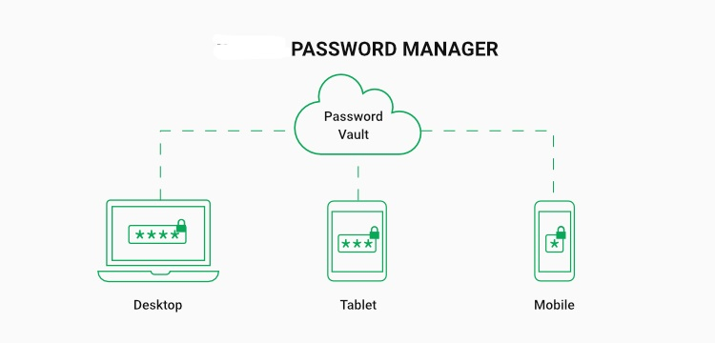
VISUAL REPRESENTATION

Slide 7
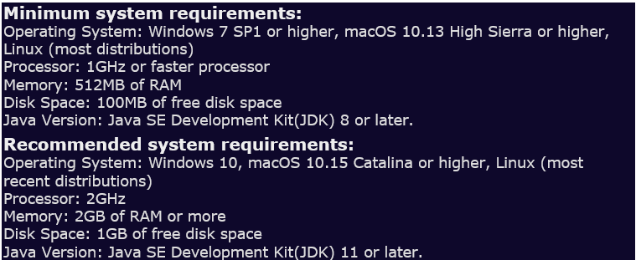
SYSTEM SPECIFICATION

Slide 8
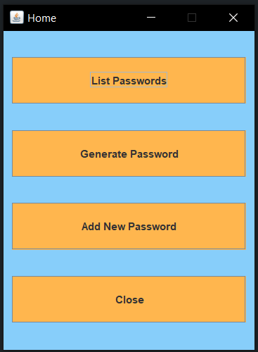
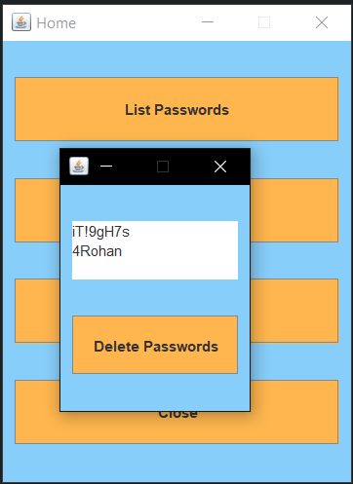
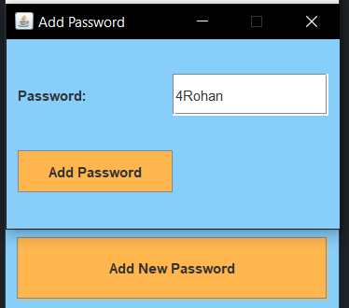
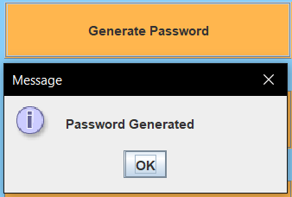
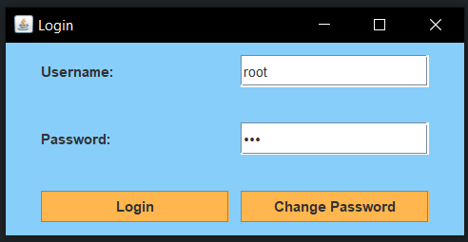
SIMULATION

Slide 9

CONCLUSION
THE PROJECT PROVIDES A SIMPLE GRAPHICAL USER INTERFACE TO STORE AND MANAGE PASSWORDS.
THE USERS CAN CHANGE THEIR LOGIN CREDENTIALS AND ACCESS THE STORED PASSWORDS.
THE THREE MAIN FUNCTIONALITIES OF THE PROJECT ARE LOGIN, STORING PASSWORDS AND GENERATING PASSWORDS FOR THE USER.
THE PROJECT WAS MADE INTERACTIVE AND SIMPLE USING JAVA SWING AND AWT.
THE PROJECT PROVIDES A SIMPLE AND EASY TO USE SOLUTION FOR PASSWORD MANAGEMENT WHICH CAN BE A USEFUL TOOL FOR THE USERS.

Slide 10
FUTURE SCOPE
IMPLEMENTING DATABASE INTEGRATION TO STORE AND RETRIEVE USER DATA AND PASSWORDS. ADDING ENCRYPTION AND DECRYTION METHODS TO MAKE THE APPLICATION MORE SECURE.
ADDING A PASSWORD STRENGTH CHECKER TO HELP USERS SET STRONG PASSWORDS.
ADDING PASSWORD EXPIRATION POLICIES.

Slide 11


REFERENCES
YouTube
JAVA ORACLE DOCS.

Slide 12
THANKYOU

