Slide 1

ADVANCED MACHINE LEARNING
& PATTERN RECOGNITION
Kernel Density-Based Linear Regression
conclusion
motivation
application
terminology
algorithm
solution
A Superior Approach To Handle Outliers and Data Patterns
Roshan Niranjan Kalpavruksha
RK68465N

Slide 2

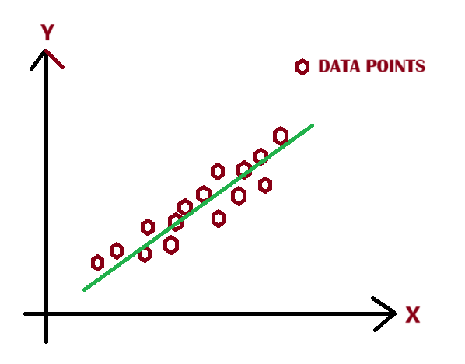
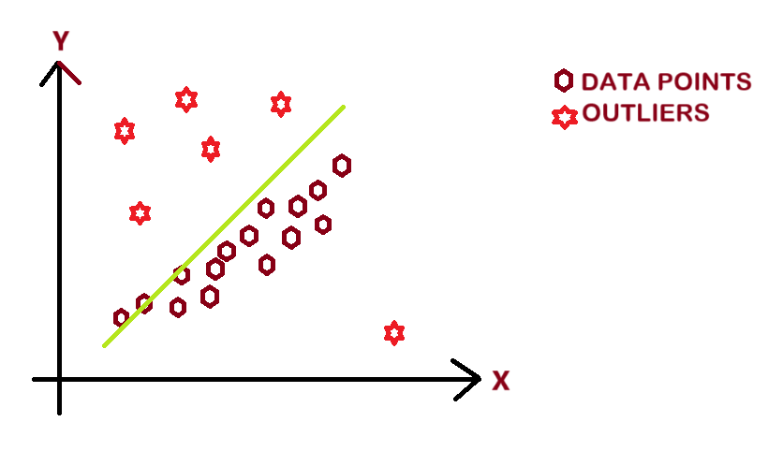

Why Linear Regression Falls Short:
Assumes that all data points are equally significant, which doesn't reflect the complexity of real-world data.
Struggles with outliers and fails to identify underlying patterns in datasets.
The Real Challenge:
Real-world datasets often have dense clusters of information mixed with sparse or noisy outliers.
Ignoring density-driven patterns leads to inaccurate models
that miss critical insights
SCALABLE DATABASE
MIDTERM PROJECT
BRAINSTORM BUDDIES
conclusion
algorithm
application
terminology
motivation
solution
Rohan Niranjan Kalpavruksha Roshan Niranjan Kalpavruksha Srimanth Madira Vaishnavi Koya
Motivating Question:
How to emphasize the true patterns in the data while ignoring noise so that we have more accurate pattern recognition?
Can we create a regression method that not only fits the data better but also learns the structure and resists noise?

Slide 3
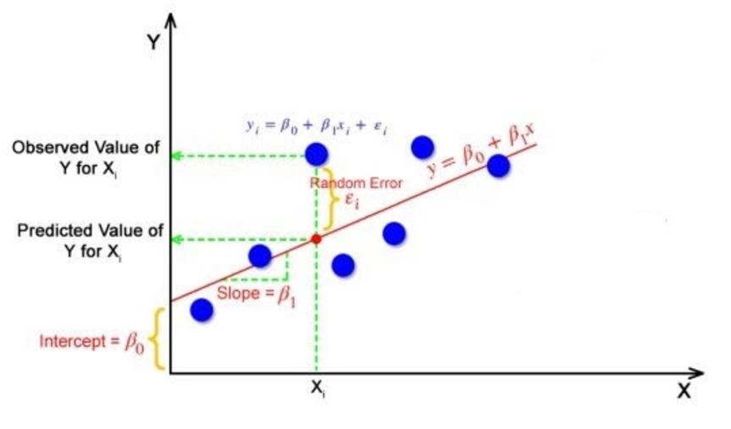
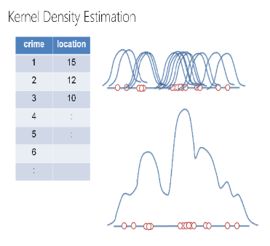
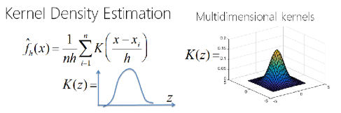
Linear Regression:
Fits a line by minimizing the residual sum of squares
Equal weight to all data points, making it susceptible to noise and outliers
Kernel Density:
Estimates the probability density function of the data
Provides a measure of data density, enabling differential weighting
SCALABLE DATABASE
MIDTERM PROJECT
BRAINSTORM BUDDIES
conclusion
algorithm
motivation
application
terminology
solution
Rohan Niranjan Kalpavruksha Roshan Niranjan Kalpavruksha Srimanth Madira Vaishnavi Koya
Kernel Density Based Linear Regression:
Combines kernel density estimation and regression by assigning higher weights to denser data points

Slide 4


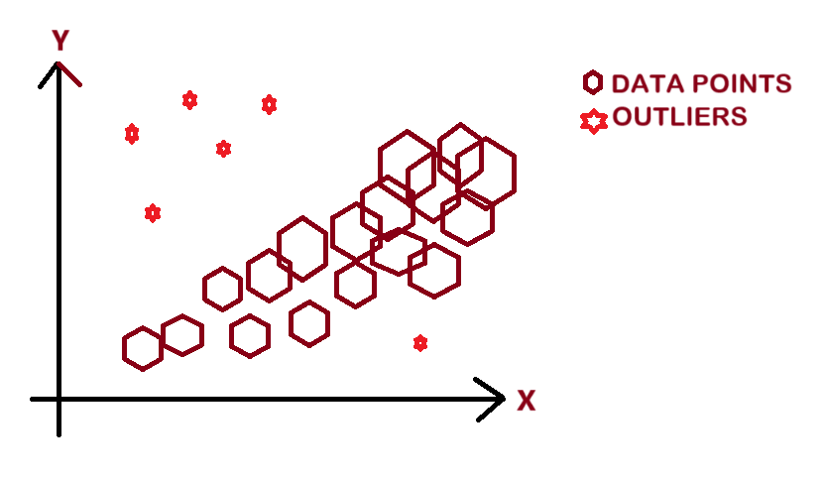
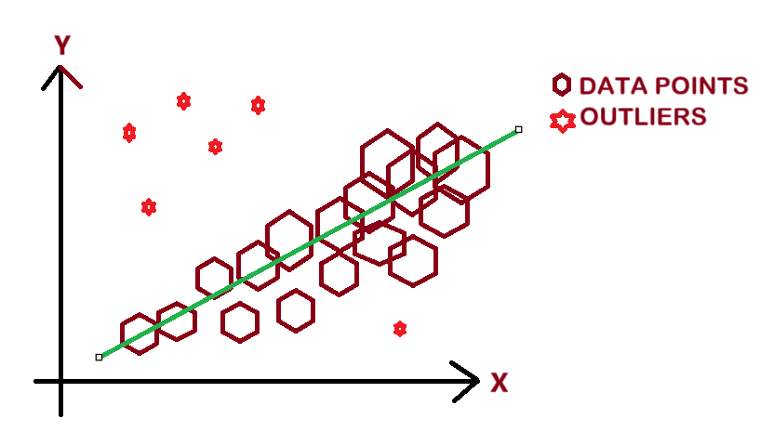
SCALABLE DATABASE
MIDTERM PROJECT
Concept:
Replace equal weighting with density-dependent weighting.
Key Mechanism:
Use a kernel density function to calculate weights.
Assign higher weights to data points in dense regions.
Reduce the influence of sparse/outlier points.
BRAINSTORM BUDDIES
conclusion
algorithm
motivation
application
terminology
solution
Advantage:
Captures underlying patterns better.
Handles outliers effectively.
Rohan Niranjan Kalpavruksha Roshan Niranjan Kalpavruksha Srimanth Madira Vaishnavi Koya
The Breakthrough Idea:
Kernel Density Based Linear Regression dynamically adapts to data density.
Prioritizes the importance of clustered (high-density) data points while de-emphasizing the influence of outliers to improve accuracy and robustness.

Slide 5
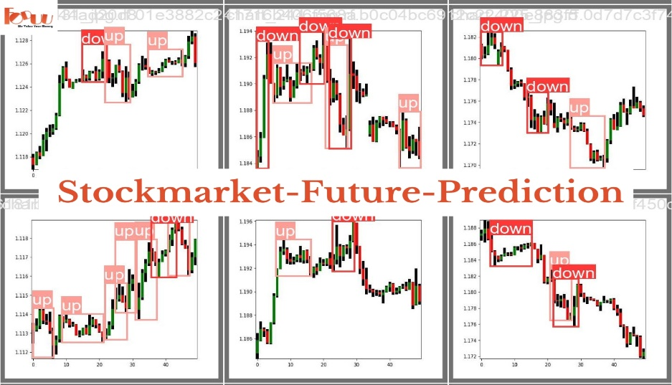
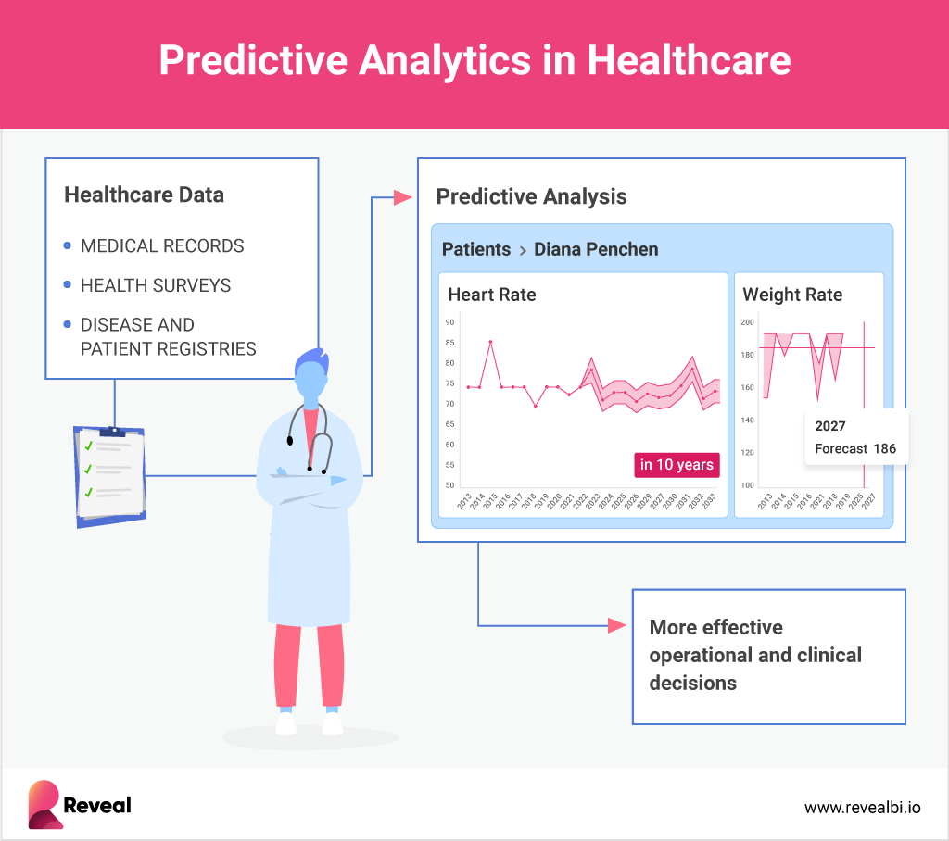

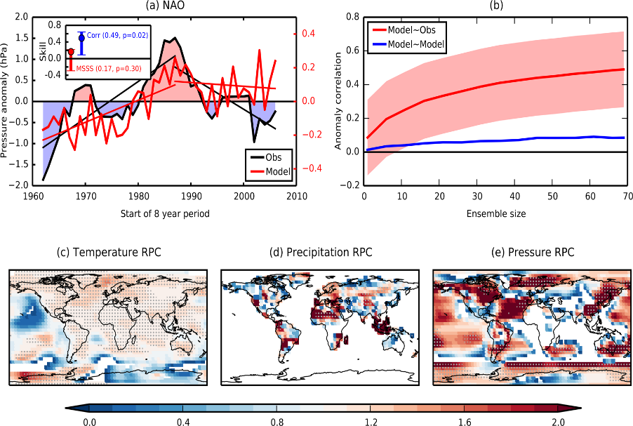
Finance: Stock price prediction with sparse anomalies
SCALABLE DATABASE
MIDTERM PROJECT
BRAINSTORM BUDDIES
Healthcare: Modelling patient data with outliers (e.g. rare conditions)
conclusion
algorithm
application
motivation
terminology
solution
Rohan Niranjan Kalpavruksha Roshan Niranjan Kalpavruksha Srimanth Madira Vaishnavi Koya
Environment: Robust regression in climate modelling.
Predictive modelling with noisy datasets

Slide 6

Data Preparation
KDE
Weight Calculation
SCALABLE DATABASE
MIDTERM PROJECT
Load and pre-process data (e.g., California housing dataset)
Derive weights inversely proportional to the density of outliers
Compute kernel density for each data point
BRAINSTORM BUDDIES
conclusion
Weighted Regression
motivation
terminology
application
solution
algorithm
Evaluation
Rohan Niranjan Kalpavruksha Roshan Niranjan Kalpavruksha Srimanth Madira Vaishnavi Koya
Fit the regression model using weighted least squares
Compare performance with traditional regression

Slide 7
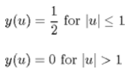


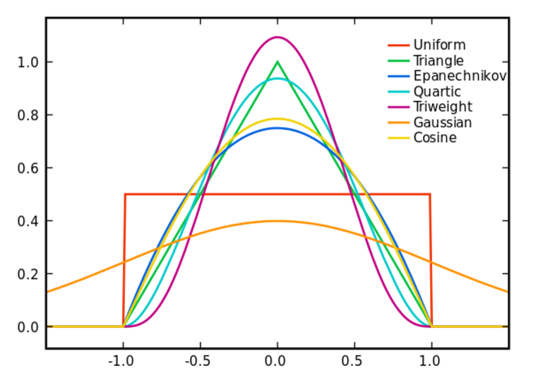
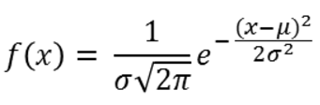


SCALABLE DATABASE
MIDTERM PROJECT
BRAINSTORM BUDDIES
conclusion
motivation
terminology
application
solution
algorithm
Rohan Niranjan Kalpavruksha Roshan Niranjan Kalpavruksha Srimanth Madira Vaishnavi Koya

Slide 8
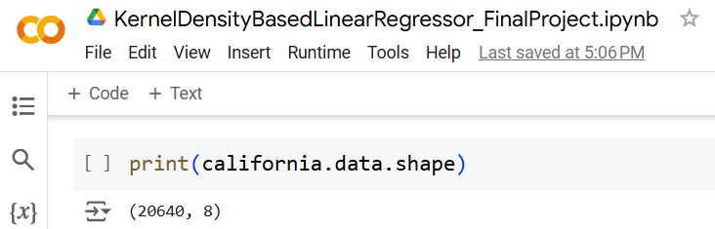
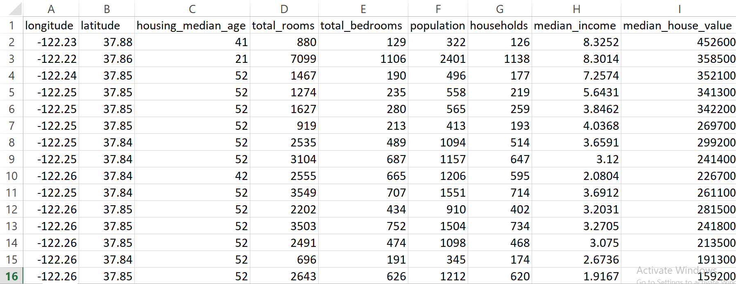

SCALABLE DATABASE
MIDTERM PROJECT
BRAINSTORM BUDDIES
thank you
algorithm
conclusion
demo
Rohan Niranjan Kalpavruksha Roshan Niranjan Kalpavruksha Srimanth Madira Vaishnavi Koya

Slide 9
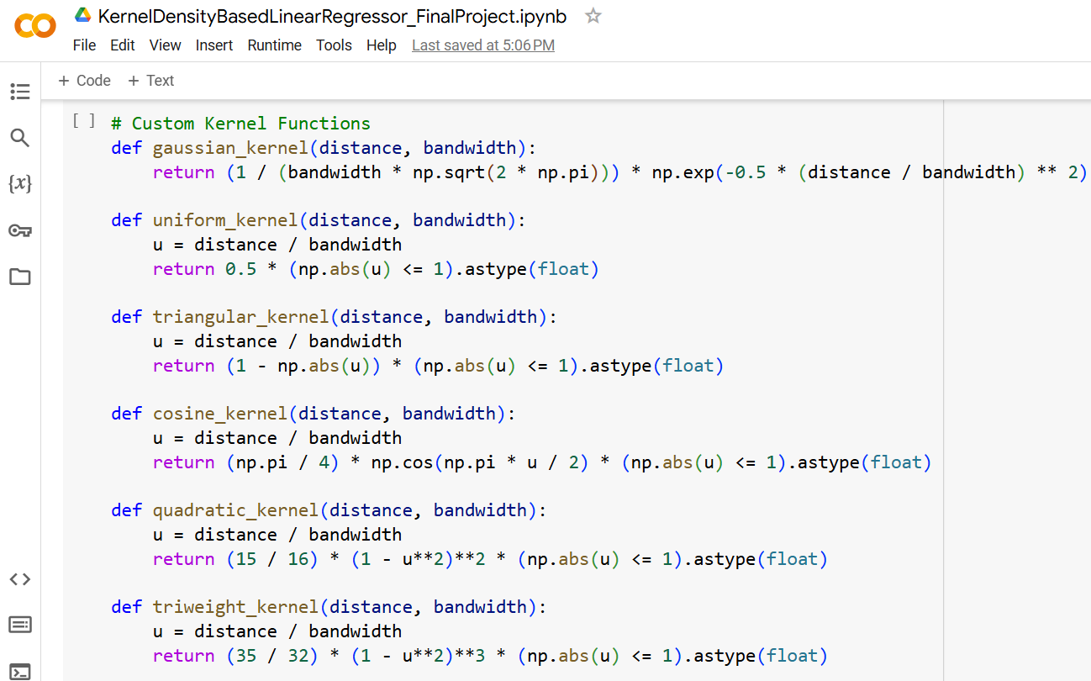
SCALABLE DATABASE
MIDTERM PROJECT
BRAINSTORM BUDDIES
thank you
algorithm
conclusion
demo
Rohan Niranjan Kalpavruksha Roshan Niranjan Kalpavruksha Srimanth Madira Vaishnavi Koya

Slide 10
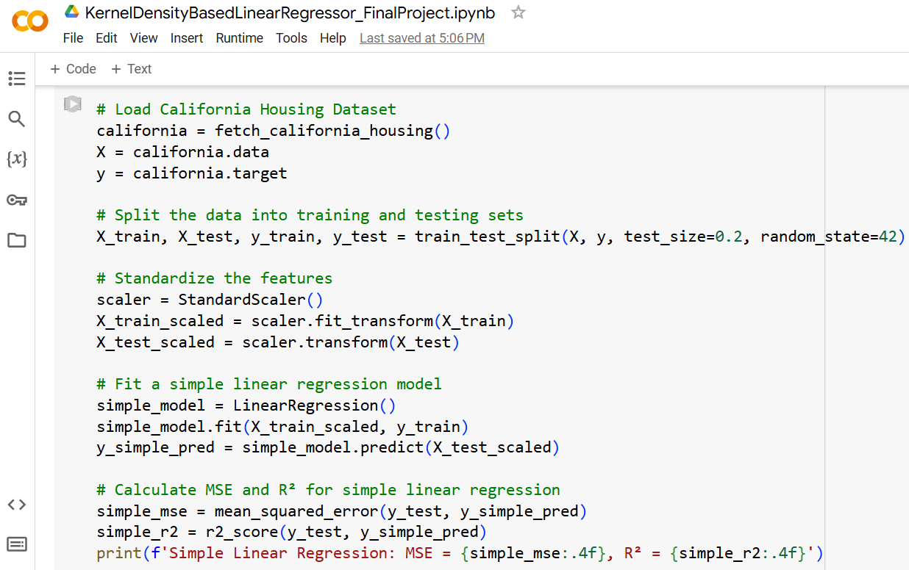
SCALABLE DATABASE
MIDTERM PROJECT
BRAINSTORM BUDDIES
thank you
algorithm
conclusion
demo
Rohan Niranjan Kalpavruksha Roshan Niranjan Kalpavruksha Srimanth Madira Vaishnavi Koya

Slide 11
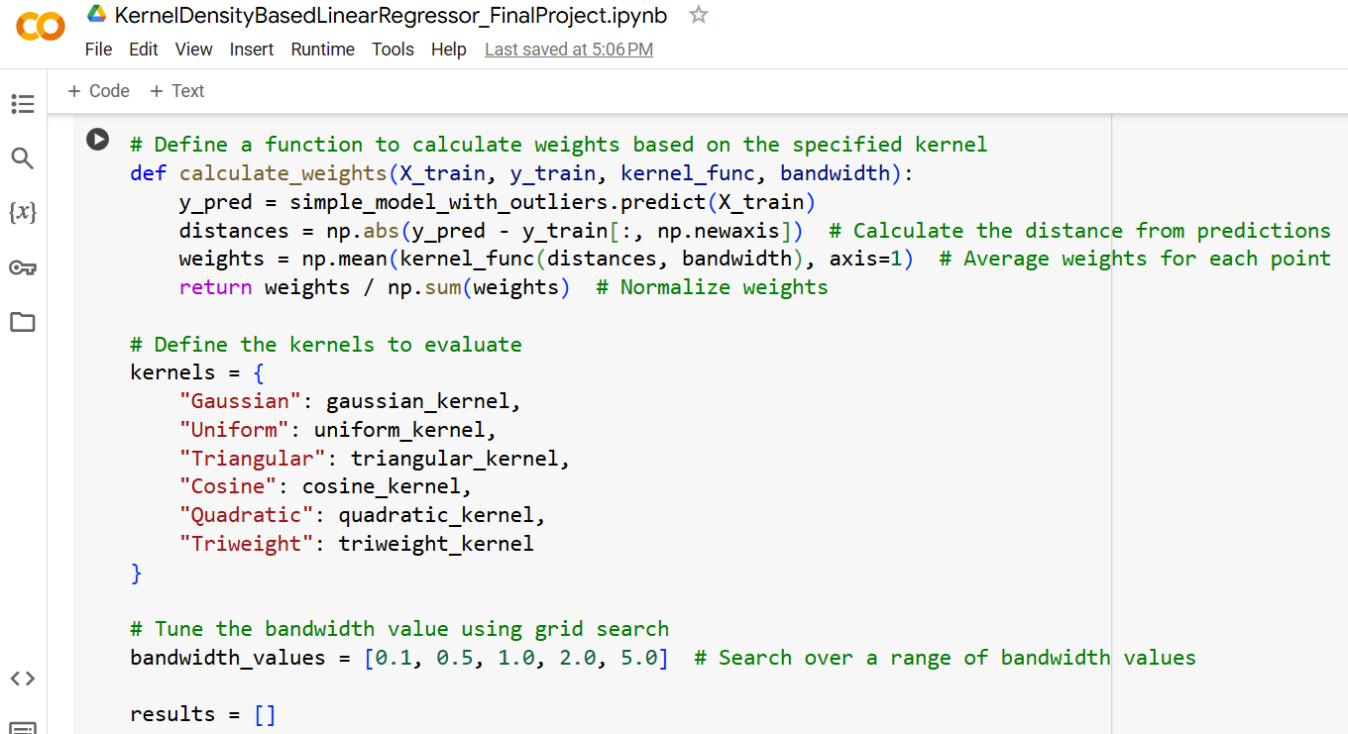
SCALABLE DATABASE
MIDTERM PROJECT
BRAINSTORM BUDDIES
thank you
algorithm
conclusion
demo
Rohan Niranjan Kalpavruksha Roshan Niranjan Kalpavruksha Srimanth Madira Vaishnavi Koya

Slide 12
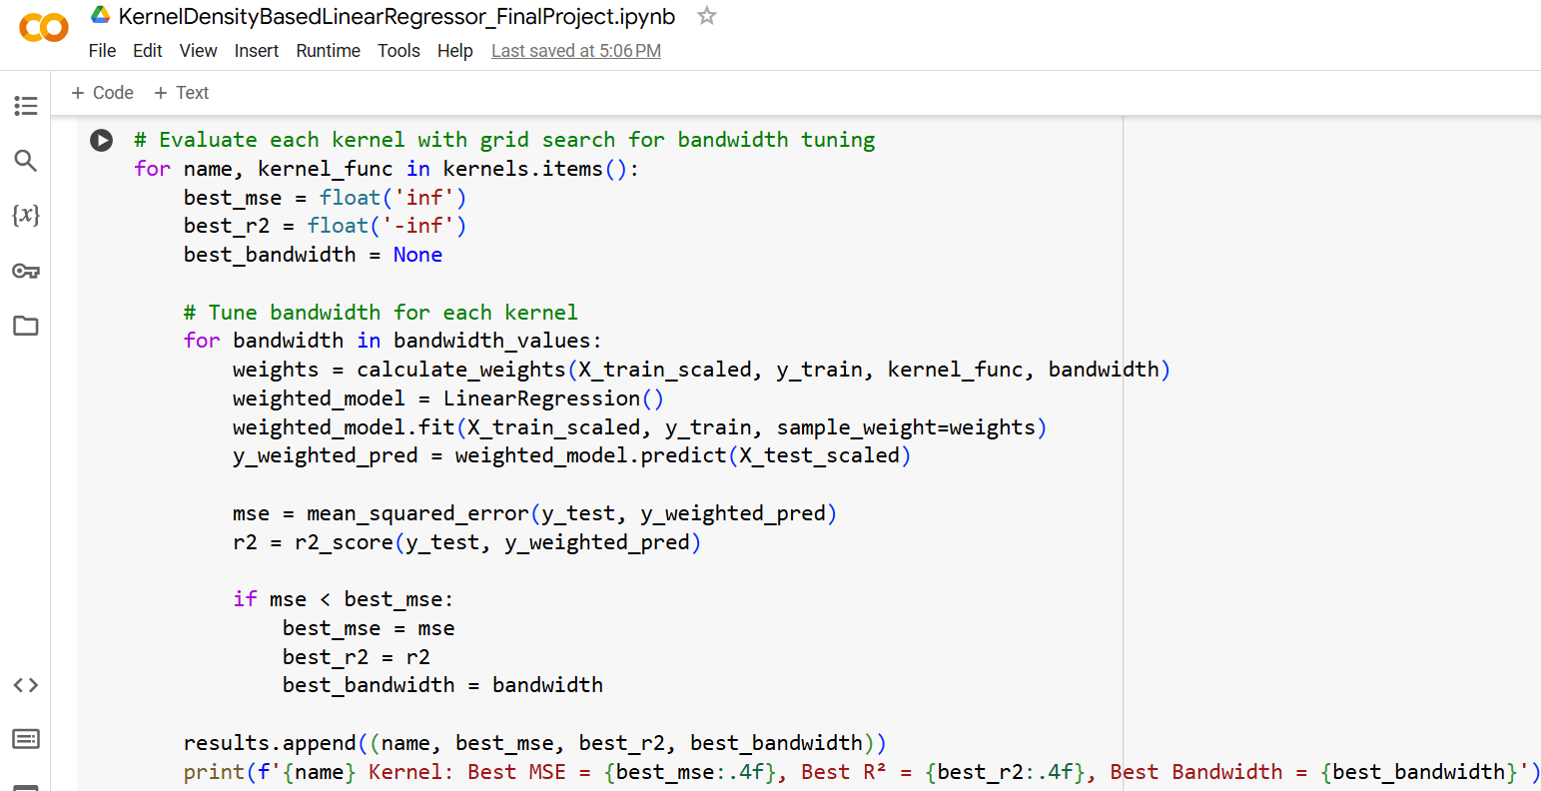
SCALABLE DATABASE
MIDTERM PROJECT
BRAINSTORM BUDDIES
thank you
algorithm
conclusion
demo
Rohan Niranjan Kalpavruksha Roshan Niranjan Kalpavruksha Srimanth Madira Vaishnavi Koya

Slide 13
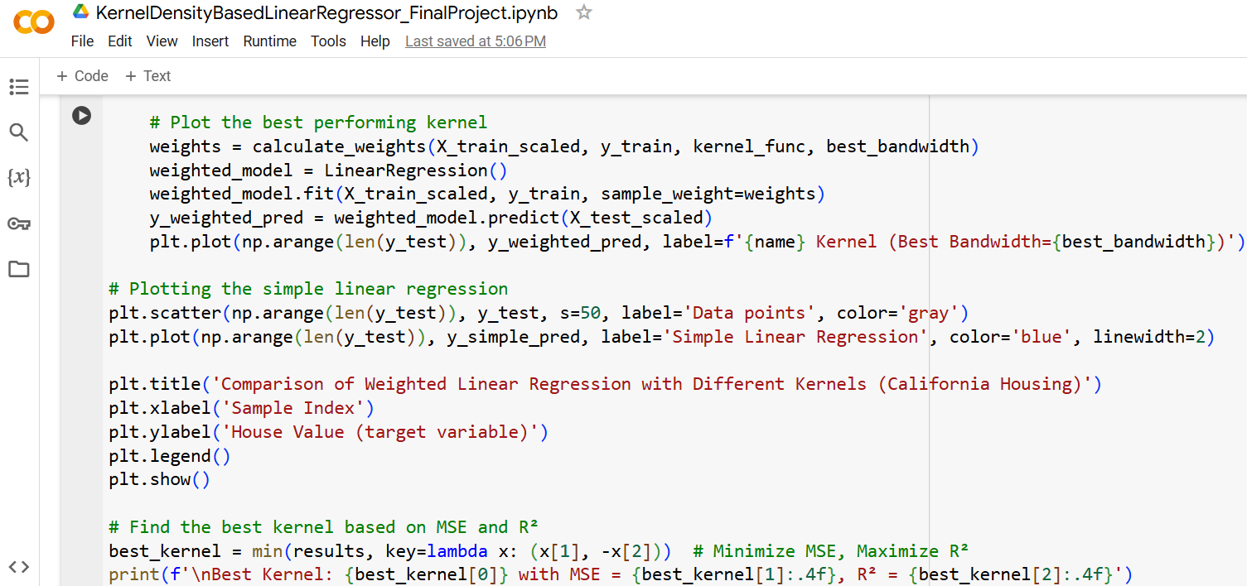
SCALABLE DATABASE
MIDTERM PROJECT
BRAINSTORM BUDDIES
thank you
algorithm
conclusion
demo
Rohan Niranjan Kalpavruksha Roshan Niranjan Kalpavruksha Srimanth Madira Vaishnavi Koya

Slide 14
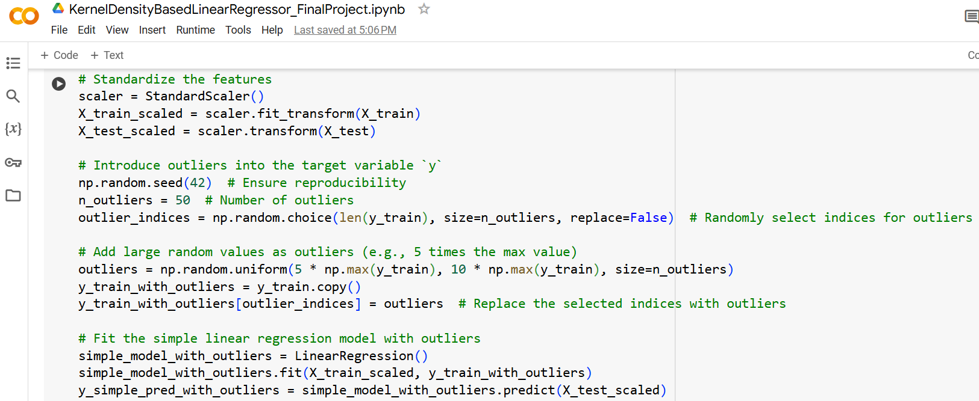
SCALABLE DATABASE
MIDTERM PROJECT
50
BRAINSTORM BUDDIES
200
350
thank you
algorithm
conclusion
demo
Rohan Niranjan Kalpavruksha Roshan Niranjan Kalpavruksha Srimanth Madira Vaishnavi Koya

Slide 15
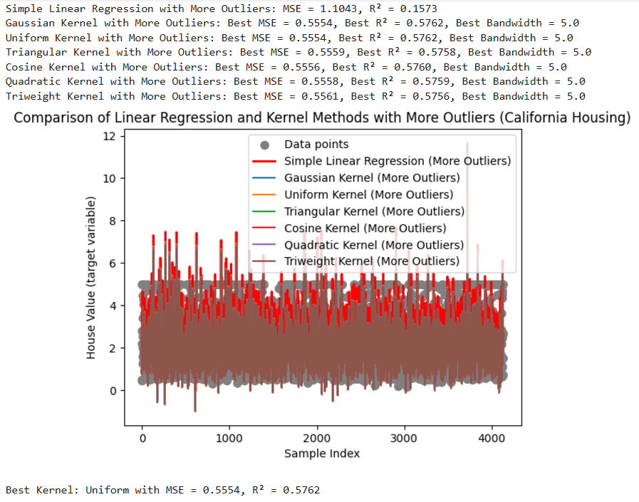
SCALABLE DATABASE
MIDTERM PROJECT
BRAINSTORM BUDDIES
thank you
algorithm
conclusion
demo
Rohan Niranjan Kalpavruksha Roshan Niranjan Kalpavruksha Srimanth Madira Vaishnavi Koya

Slide 16
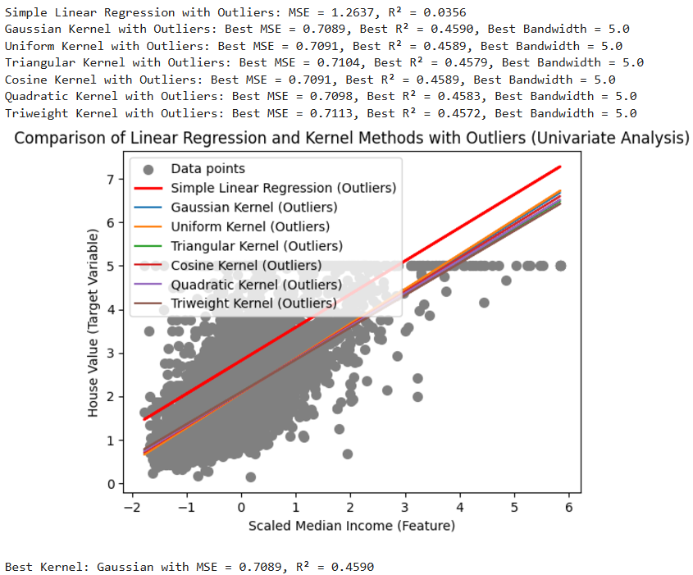
SCALABLE DATABASE
MIDTERM PROJECT
BRAINSTORM BUDDIES
thank you
algorithm
conclusion
demo
Rohan Niranjan Kalpavruksha Roshan Niranjan Kalpavruksha Srimanth Madira Vaishnavi Koya

Slide 17
SCALABLE DATABASE
MIDTERM PROJECT
Dataset | SLR MSE | Best Kernel’s MSE | |Simple MSE - Kernel MSE| | SLR R² | Best Kernel’s R² | |Simple R² - Kernel R²|
Original | 0.5559 | C:0.5547 G:0.5550 Q:0.5558 | 0.0012 | 0.5758 | C:0.5767 G:0.5764 Q:0.5759 | 0.0009
50 Outliers | 0.5688 | C:0.5547 G:0.5552 Q:0.5553 | 0.141 | 0.5659 | C:0.5767 G:0.5763 Q:0.5763 | 0.0108
200 Outliers | 0.7392 | Q:0.5546 C:0.5547 G:0.5547 | 0.1845 | 0.4359 | Q:0.5767 C:0.5766 G:0.5766 | 0.1408
350 Outliers | 1.1043 | U:0.5554 G:0.5554 C:0.5556 | 0.5489 | 0.1573 | U:0.5762 G:0.5762 C:0.5760 | 0.4159
BRAINSTORM BUDDIES
thank you
algorithm
conclusion
demo
Rohan Niranjan Kalpavruksha Roshan Niranjan Kalpavruksha Srimanth Madira Vaishnavi Koya

Slide 18
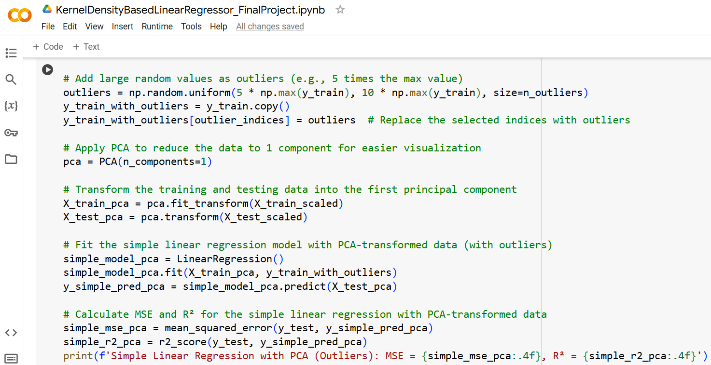
Applied PCA to Data and then fit SLR and KDLR
SCALABLE DATABASE
MIDTERM PROJECT
BRAINSTORM BUDDIES
thank you
algorithm
conclusion
demo
Rohan Niranjan Kalpavruksha Roshan Niranjan Kalpavruksha Srimanth Madira Vaishnavi Koya

Slide 19
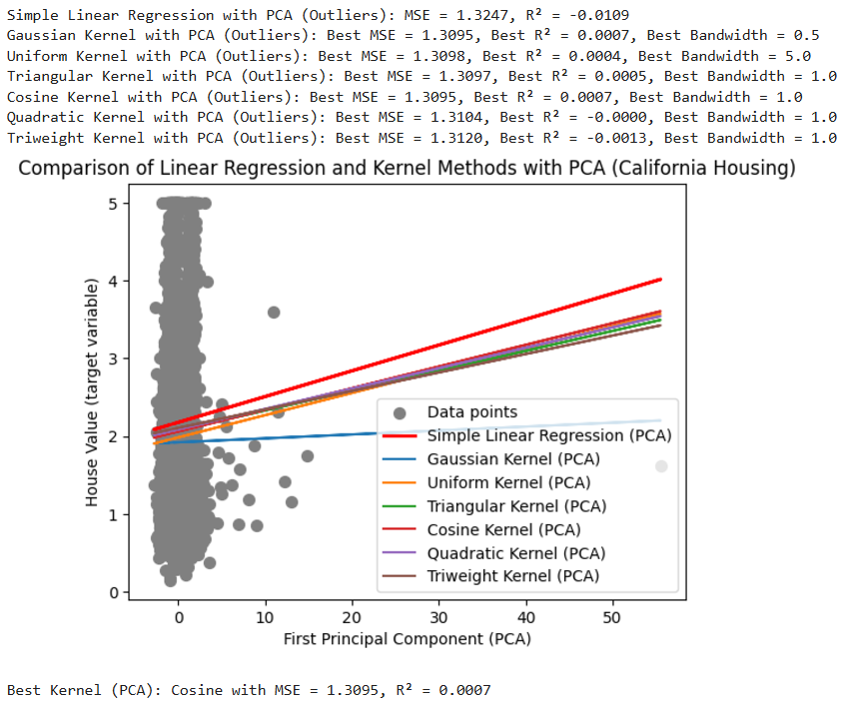
50 Outliers
SCALABLE DATABASE
MIDTERM PROJECT
BRAINSTORM BUDDIES
thank you
algorithm
conclusion
demo
Rohan Niranjan Kalpavruksha Roshan Niranjan Kalpavruksha Srimanth Madira Vaishnavi Koya

Slide 20
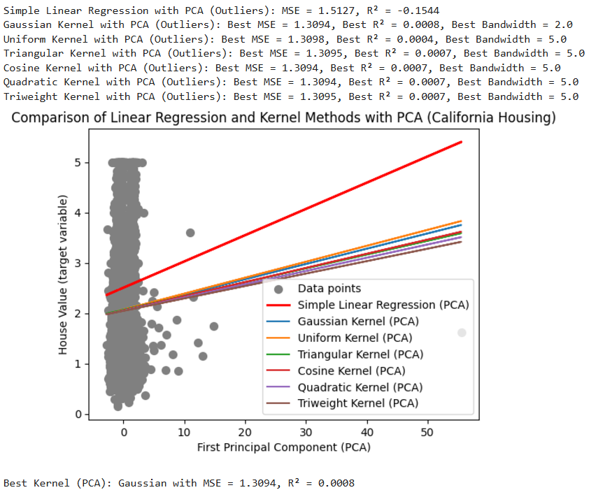
200 Outliers
SCALABLE DATABASE
MIDTERM PROJECT
BRAINSTORM BUDDIES
thank you
algorithm
conclusion
demo
Rohan Niranjan Kalpavruksha Roshan Niranjan Kalpavruksha Srimanth Madira Vaishnavi Koya

Slide 21
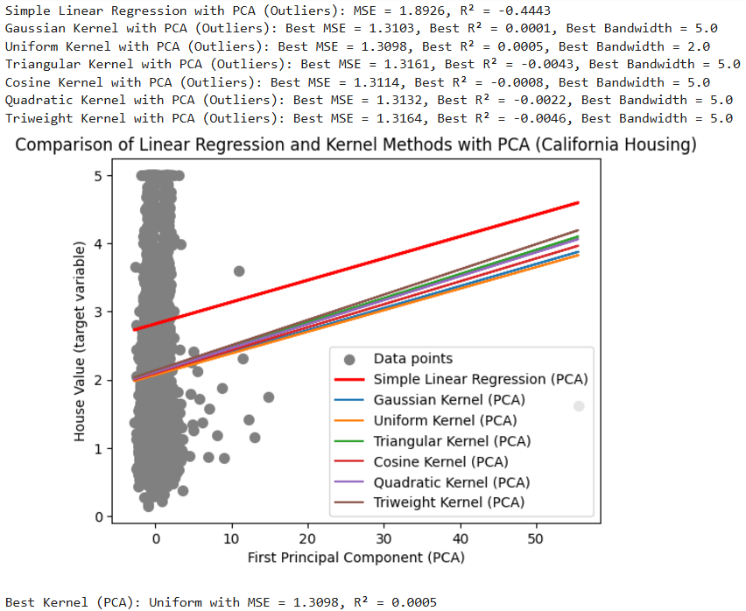
350 Outliers
SCALABLE DATABASE
MIDTERM PROJECT
BRAINSTORM BUDDIES
thank you
algorithm
conclusion
demo
Rohan Niranjan Kalpavruksha Roshan Niranjan Kalpavruksha Srimanth Madira Vaishnavi Koya

Slide 22
Key Takeaways:
Improved Robustness: Kernel density-based regression reduces the influence of outliers, resulting in more reliable predictions.
Pattern Recognition: Effectively captures underlying data structures by emphasizing densely populated regions.
Adaptive Weighting: Assigns weights based on data density, enabling better handling of heterogeneous datasets.
Enhanced Flexibility: Offers a practical alternative to standard linear regression in noisy and complex real-world scenarios and adaptable for various domains.
Scalable Methodology: Can handle non-linear relationships and be incorporated into ensemble models.
Future Scope:
Explore applications in advanced fields such as anomaly detection and time-series forecasting.
Integrate kernel density-based regression into machine learning pipelines for hybrid modelling.
SCALABLE DATABASE
MIDTERM PROJECT
BRAINSTORM BUDDIES
thank you
conclusion
algorithm
demo
Rohan Niranjan Kalpavruksha Roshan Niranjan Kalpavruksha Srimanth Madira Vaishnavi Koya

Slide 23


THANK YOU
RK68465N@pace.edu

