Slide 1

MACHINE LEARNING
FINAL PROJECT
Predictive Machine Learning Models for Tree Health Prognosis
optimization
models
objective
eda
dataset
data cleaning
Rohan Niranjan Kalpavruksha Roshan Niranjan Kalpavruksha Tejomay Pranav Kapadia
Vedant Rajeev Rawal

Slide 2
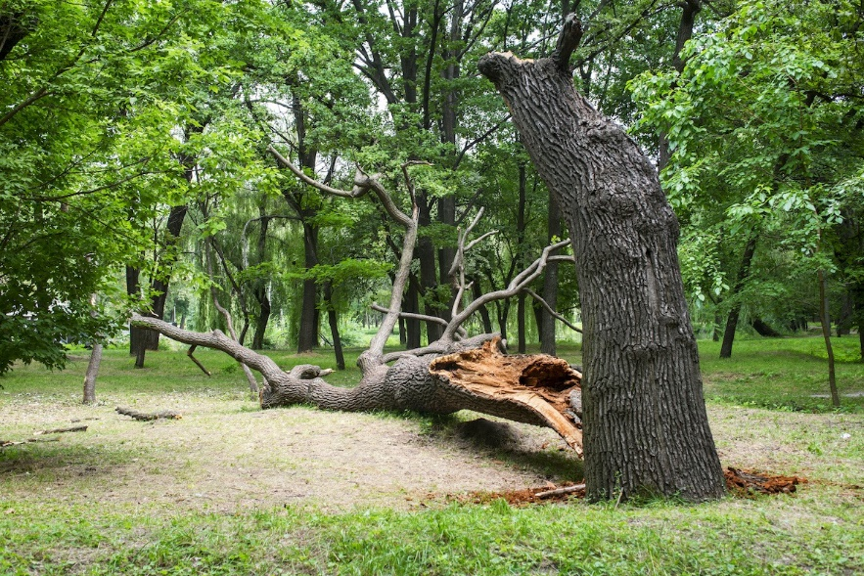

Aim to predict the health of trees in New York City using ML Techniques
SCALABLE DATABASE
MIDTERM PROJECT
Empowering urban trees through predictive Machine Learning models
BRAINSTORM BUDDIES
optimization
objective
models
eda
dataset
data cleaning
Rohan Niranjan Kalpavruksha Roshan Niranjan Kalpavruksha Srimanth Madira Vaishnavi Koya
Tree health data assists urban planning and resource allocation strategies
Helps to streamline tree management processes and contribute to the sustainable development

Slide 3

SCALABLE DATABASE
MIDTERM PROJECT
“2015 Street Tree Census” sourced from New York City Open Data
BRAINSTORM BUDDIES
optimization
models
objective
eda
dataset
data cleaning
Rohan Niranjan Kalpavruksha Roshan Niranjan Kalpavruksha Srimanth Madira Vaishnavi Koya
Contains comprehensive info about trees in NY City, like their species, size, health, geospatial data
Extensive dataset with 683,788 rows and 45 variables

Slide 4
Variable | Description from Dictionary
tree_dbh | Diameter of the tree, measured above the ground
curb_loc | Location of tree bed in relationship to the curb
guards | Indicates whether a guard is present (helpful or harmful guard)
sidewalk | Indicates whether one of the sidewalk flags immediately adjacent to the tree was damaged, cracked, or lifted
root_stone | Indicates presence of root problem caused by paving stones in tree bed
trunk_wire | Indicates the presence of a trunk problem caused by wires or rope wrapped around the trunk
brch_light | Indicates the presence of a branch problem caused by lights (usually string lights) or wires in the branches
postcode | Five-digit zipcode in which tree is located
borocode | Code for borough in which tree point is located: 1 (Manhattan), 2 (Bronx), 3 (Brooklyn), 4 (Queens), 5 (Staten Island)
cncldist | Council district in which tree point is located
user_type | This field describes the category of user who collected this tree point's data.
latitude | Latitude of point, in decimal degrees
longitude | Longitude of point, in decimal degrees
SCALABLE DATABASE
MIDTERM PROJECT
BRAINSTORM BUDDIES
optimization
models
objective
eda
dataset
data cleaning
Rohan Niranjan Kalpavruksha Roshan Niranjan Kalpavruksha Srimanth Madira Vaishnavi Koya

Slide 5



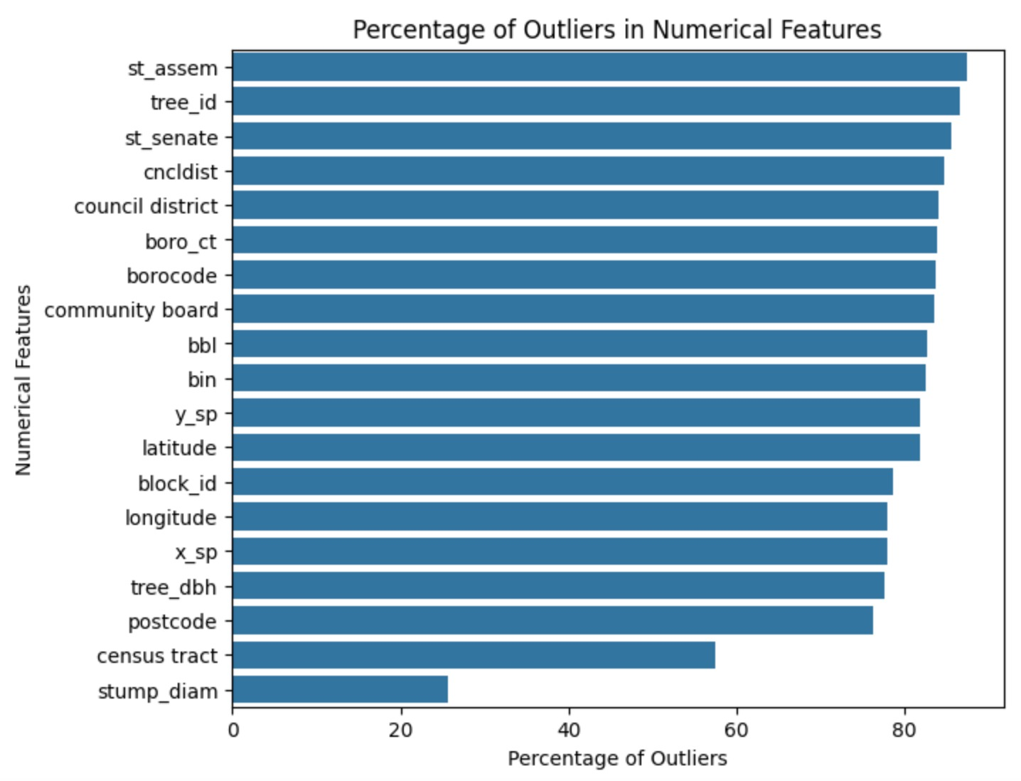

A large number of missing values in the data.
11 features had missing values that required correction.
SCALABLE DATABASE
MIDTERM PROJECT
Missing categorical values replaced with respective column modes.
Percentage of outliers computed using z-scores in numerical columns.
BRAINSTORM BUDDIES
optimization
models
objective
eda
dataset
Strategy devised for handling nulls in numerical columns: median in presence of outliers, mean otherwise.
data cleaning
Rohan Niranjan Kalpavruksha Roshan Niranjan Kalpavruksha Srimanth Madira Vaishnavi Koya

Slide 6
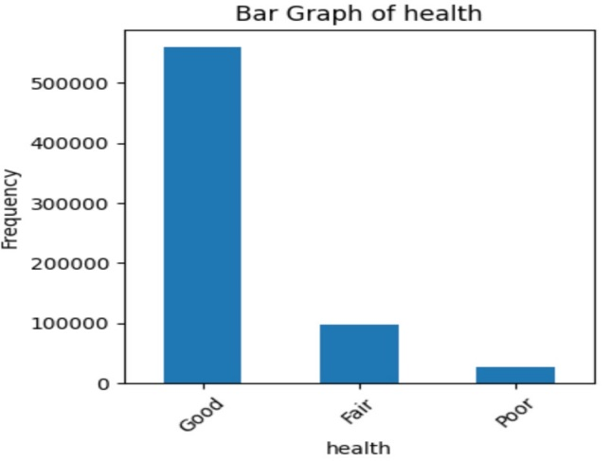
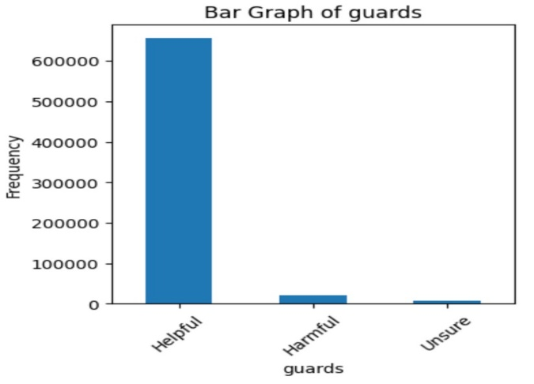

Majority of trees are healthy, but about one in seven trees are in sub-healthy condition.
SCALABLE DATABASE
MIDTERM PROJECT
While most trees have helpful guards, a significant number of harmful guards should not be overlooked.
BRAINSTORM BUDDIES
optimization
models
eda
objective
dataset
data cleaning
Rohan Niranjan Kalpavruksha Roshan Niranjan Kalpavruksha Srimanth Madira Vaishnavi Koya

Slide 7
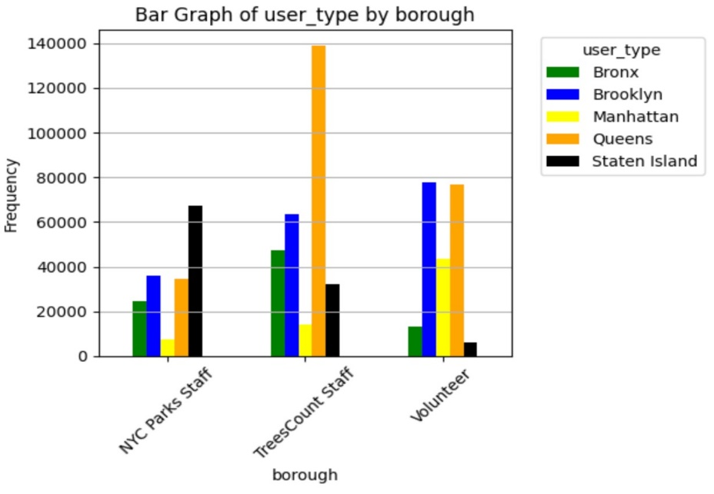
Brooklyn and Queens had a greater number
of entries by volunteers.
NYC Parks staff did a great job in Staten Island.
Trees Count staff were comparatively
behind in data collection.
SCALABLE DATABASE
MIDTERM PROJECT
BRAINSTORM BUDDIES
optimization
models
eda
objective
dataset
data cleaning
Rohan Niranjan Kalpavruksha Roshan Niranjan Kalpavruksha Srimanth Madira Vaishnavi Koya

Slide 8

Performed Label encoding for categorical columns
The 'health' column serves as the target variable, while the remaining columns are input features for prediction.
SCALABLE DATABASE
MIDTERM PROJECT
DECISION
TREE
GAUSSIAN
NAIVE BAYES
LOGISTIC
REGRESSION
BRAINSTORM BUDDIES
optimization
Accuracy: 78.1
Precision: 78.5
Accuracy: 38.9
Precision: 58.8
Accuracy: 47.0
Precision: 46.5
objective
dataset
eda
models
data cleaning
Rohan Niranjan Kalpavruksha Roshan Niranjan Kalpavruksha Srimanth Madira Vaishnavi Koya
RANDOM
FOREST
STOCHASTIC
GRADIENT DESCENT
XG-Boost
Accuracy: 92.2
Precision: 92.2
Accuracy: 74.4
Precision: 73.8
Accuracy: 43.9
Precision: 42.2

Slide 9
SCALABLE DATABASE
MIDTERM PROJECT
Data split into 80% training and 20% testing subsets.
Class imbalance addressed through resampling of data.
DECISION
TREE
GAUSSIAN
NAIVE BAYES
LOGISTIC
REGRESSION
BRAINSTORM BUDDIES
optimization
Recall: 78.1
F1 Score: 78.3
Recall : 38.9
F1 Score : 33.5
Recall : 47.0
F1 Score : 46.3
objective
dataset
eda
models
data cleaning
Rohan Niranjan Kalpavruksha Roshan Niranjan Kalpavruksha Srimanth Madira Vaishnavi Koya
RANDOM
FOREST
STOCHASTIC
GRADIENT DESCENT
XG-Boost
Recall : 92.2
F1 Score : 92.2
Recall : 74.4
F1 Score : 73.2
Recall : 44.5
F1 Score : 40.9

Slide 10
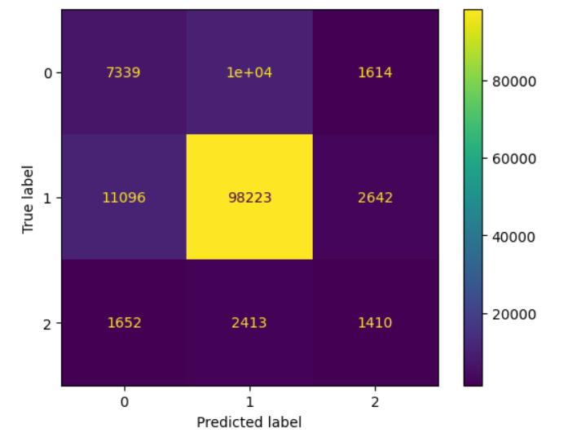
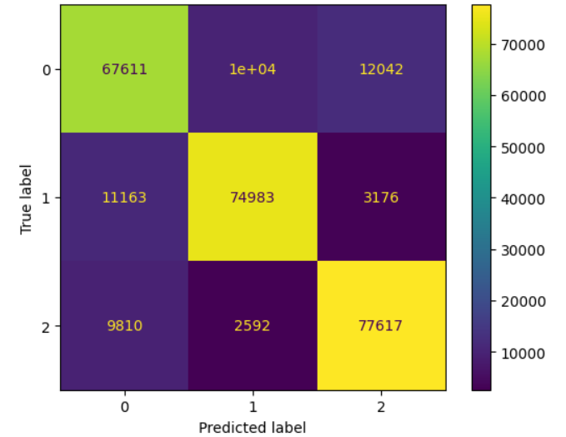
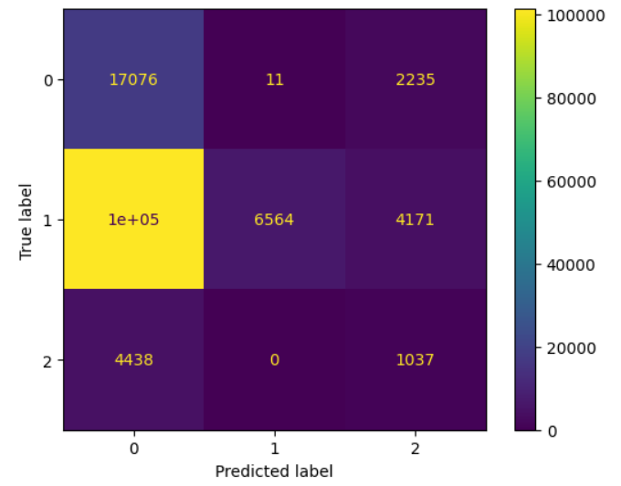
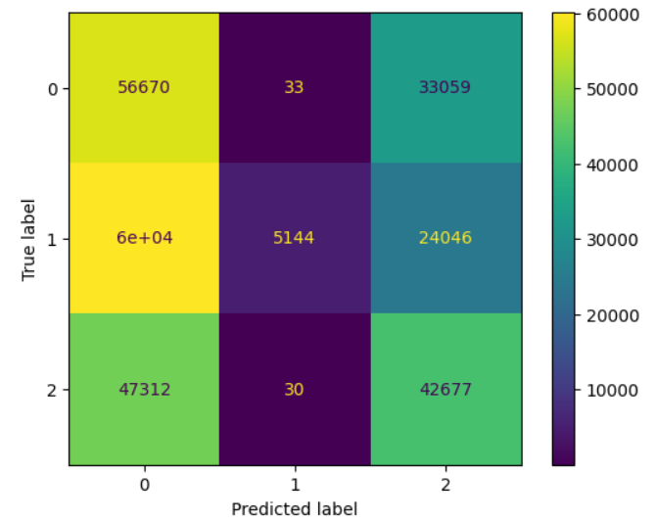
DECISION TREE
Before Sampling
After Resampling
SCALABLE DATABASE
MIDTERM PROJECT
BRAINSTORM BUDDIES
optimization
objective
dataset
eda
models
GAUSSIAN NAIVE BAYES
data cleaning
Rohan Niranjan Kalpavruksha Roshan Niranjan Kalpavruksha Srimanth Madira Vaishnavi Koya

Slide 11
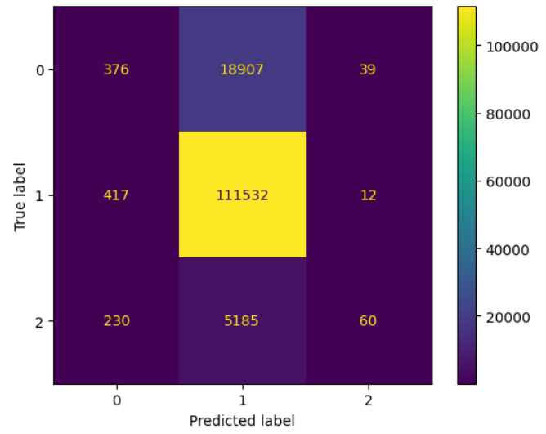
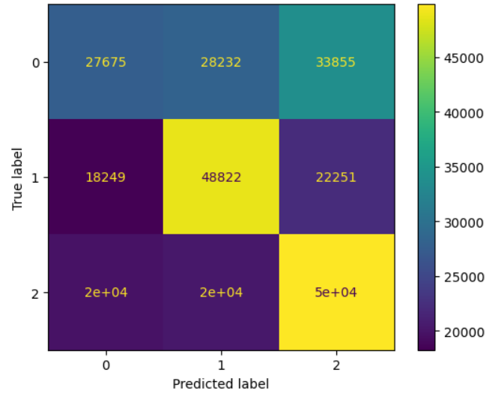
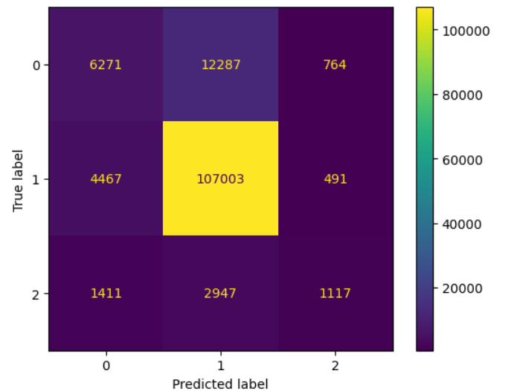
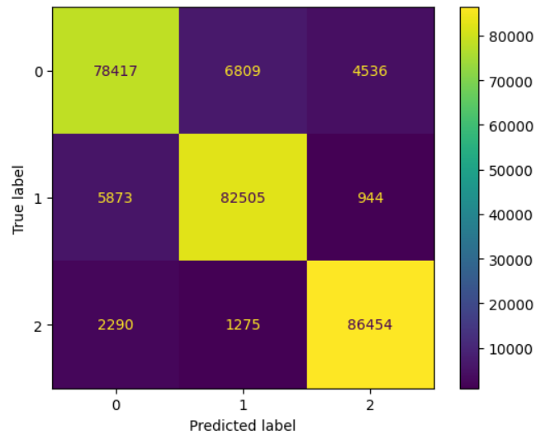
LOGISTIC REGRESSION
Before Sampling
After Resampling
SCALABLE DATABASE
MIDTERM PROJECT
BRAINSTORM BUDDIES
optimization
objective
dataset
eda
models
RANDOM FOREST
data cleaning
Rohan Niranjan Kalpavruksha Roshan Niranjan Kalpavruksha Srimanth Madira Vaishnavi Koya

Slide 12
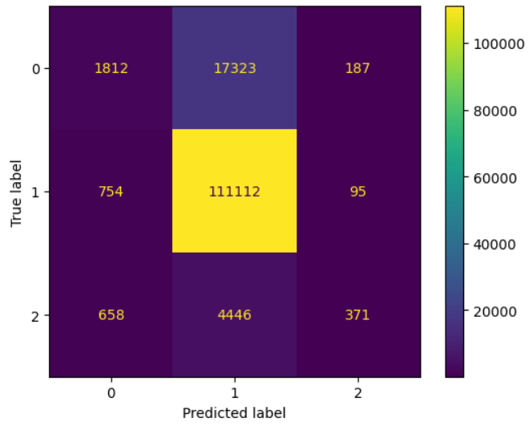
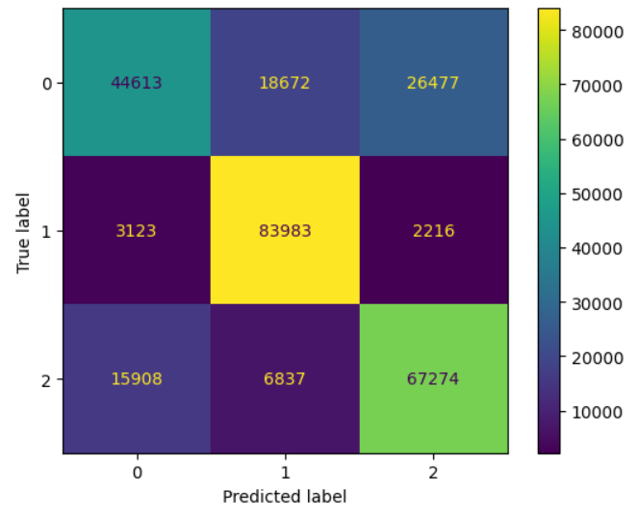
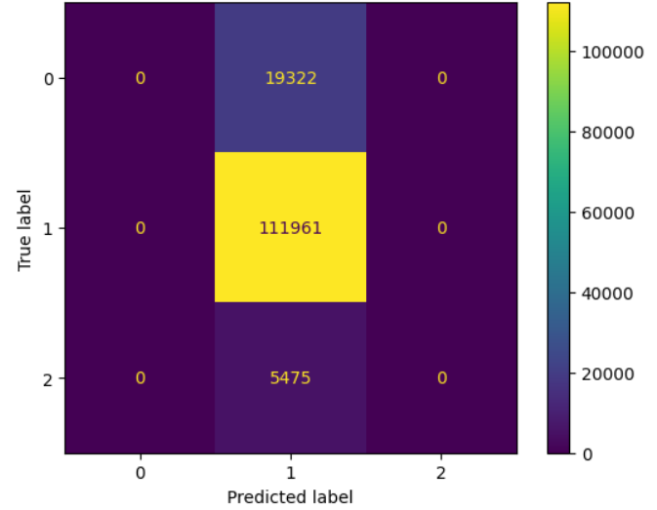
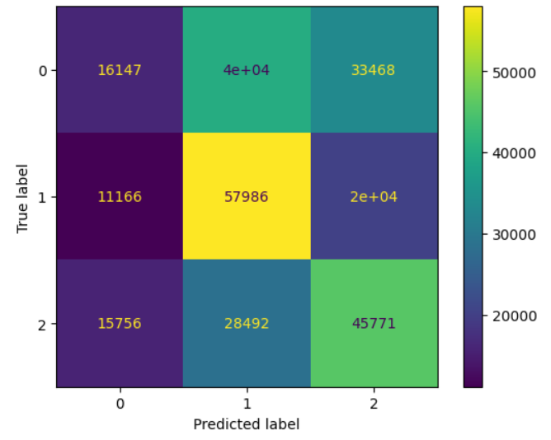
XGBoost
Before Sampling
After Resampling
SCALABLE DATABASE
MIDTERM PROJECT
BRAINSTORM BUDDIES
optimization
objective
dataset
eda
models
SGD
data cleaning
Rohan Niranjan Kalpavruksha Roshan Niranjan Kalpavruksha Srimanth Madira Vaishnavi Koya

Slide 13


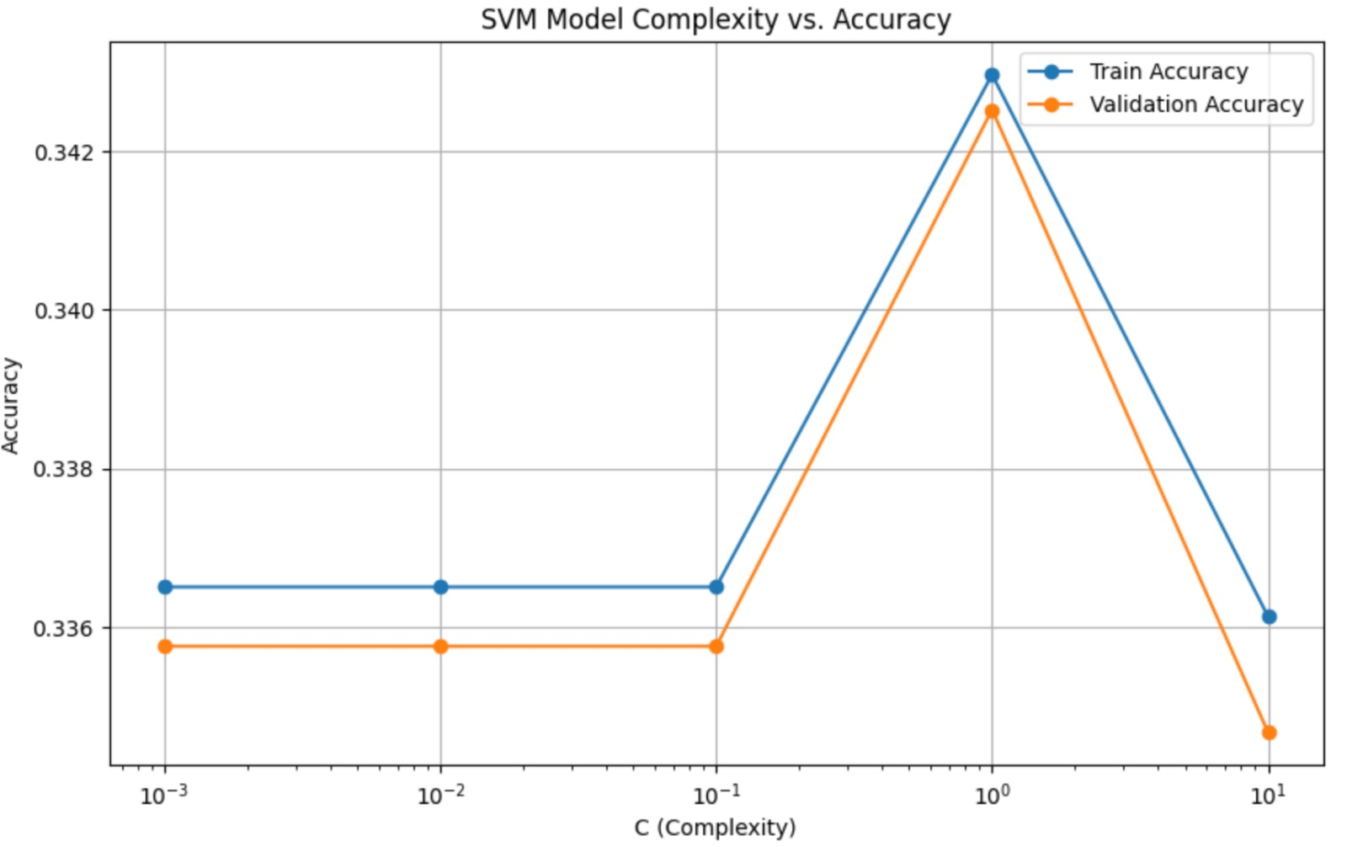
SCALABLE DATABASE
MIDTERM PROJECT
Implemented k-fold cross-validation with SVM using different Kernel functions: linear, polynomial, and RBF
Understood underfitting and overfitting through a graph depicting different complexity levels
BRAINSTORM BUDDIES
thank you
models
future steps
optimization
Rohan Niranjan Kalpavruksha Roshan Niranjan Kalpavruksha Srimanth Madira Vaishnavi Koya
Utilized grid search technique to determine the optimal hyperparameter values for various models

Slide 14
Considering more complex machine learning models such as neural networks may help capture non-linear relationships in the data more effectively
SCALABLE DATABASE
MIDTERM PROJECT
Further research and analysis would be needed to fully understand the factors affecting the health of different tree species in the city
BRAINSTORM BUDDIES
thank you
future steps
models
optimization
Rohan Niranjan Kalpavruksha Roshan Niranjan Kalpavruksha Srimanth Madira Vaishnavi Koya
Collaborate with domain experts and incorporate domain knowledge into the modeling process

Slide 15


THANK YOU
RK68465N@pace.edu
RK25464N@pace.edu TK94334N@pace.edu VR09520N@pace.edu

