Slide 1
Smart Horizon 2026:
48-Hour International Hackathon
Grand Finale
Organized by: Dept. of Artificial Intelligence and Machine Learning & Dept. of Computer Science and Engineering
Event Date
Venue
Host Institute
September 3rd, 4th & 5th, 2026
New Horizon Knowledge Park, Bengaluru
New Horizon College of Engineering
Title: LabSentinel: Real-Time Predictive Maintenance for Hospital and Lab Equipment
Team Members
1. Rishi
2. Rushikesh R
3. Rohan V
4. Rohan B
5. Manish R
Team Details
Team ID: SHIH26-TID-199
Team Name: Ctrl+R
Team Lead: Rishi
College Name: REVA University
Problem Statement ID: SH-HLT-03

Slide 2
Problem Understanding
Hospitals and labs depend on critical equipment (ventilators, MRI scanners, ECG machines, infusion pumps, centrifuges) running around the clock.
Maintenance today is mostly reactive. A machine gets attention only after it has already failed.
Unplanned breakdowns delay treatment and lab results, put patient safety at risk, and raise cost.
There is no single view that tells staff which machines are drifting toward failure.
Who feels it: patients, biomedical technicians, hospital administrators, and lab teams.

Slide 3
Literature Survey
How maintenance is done today, and where each approach falls short.
Approach | Where it falls short
Reactive (fix after failure) | Cheapest to start, highest downtime and safety risk
Preventive (fixed schedule) | Wastes healthy part life and still misses early faults
Threshold / limit alarms | Simple, but blind to gradual degradation
ML failure classification (AI4I 2020) | Learns risk from data, but needs honest metrics on imbalance
RUL regression (NASA C-MAPSS) | Estimates remaining life, but needs run-to-failure data
Explainable AI (SHAP) | Turns a score into a reason clinicians can trust

Slide 4
Proposed Solution & Innovation
LabSentinel is a real-time predictive-maintenance system for a whole fleet of hospital and lab instruments.
Live monitoring: every device streams readings and a trained model scores failure risk every 3 seconds.
Health score: risk becomes a 0 to 100 health score, classified Healthy, Warning, or Critical.
Safe-envelope guard: hard limit alarms catch gross out-of-range readings the model cannot see.
Impact engine: ranks alerts by operational priority, so a patient-critical ventilator outranks an idle machine.
Memory and agent: the system recalls past incidents and drafts a work order with a diagnosis and a technician.
Also built in: email alert under 80 percent health, a per-device digital twin, and one-shot log-file analysis.

Slide 5
Novelty of Solution
Honest metrics. We report precision, recall, F1 and PR-AUC on the failure class, not accuracy, which is misleading on 3.4 percent failure data.
Handles mixed sensors. Devices report different sensor subsets, so the model is trained with missing-value augmentation and a 2-sensor pump is scored as fairly as a 5-sensor machine.
Hybrid scoring. Learned ML risk is paired with deterministic limit alarms, the way real condition monitoring works.
Operational impact with live failover. Priority reflects criticality, active dependents, and whether a healthy backup exists right now.
Digital twin. Run a device forward under what-if load and ambient to see its projected time to failure.
Explainable agent. Every alert names the sensors that drove it and cites the fix that worked last time.

Slide 6
Dataset Used / Tech Stack
Datasets
AI4I 2020 Predictive Maintenance (UCI): 10,000 rows, about 3.4 percent failures. Used for failure classification.
NASA C-MAPSS FD001: 100 train and 100 test turbofan engines run to failure. Used for RUL regression.
Layer | Technology
Model / inference | Python, XGBoost, scikit-learn, FastAPI
Backend / real-time | Node.js, Express, Socket.IO, MongoDB
Frontend / dashboard | React, Vite, Tailwind, Recharts
Alerts | Nodemailer over SMTP

Slide 7
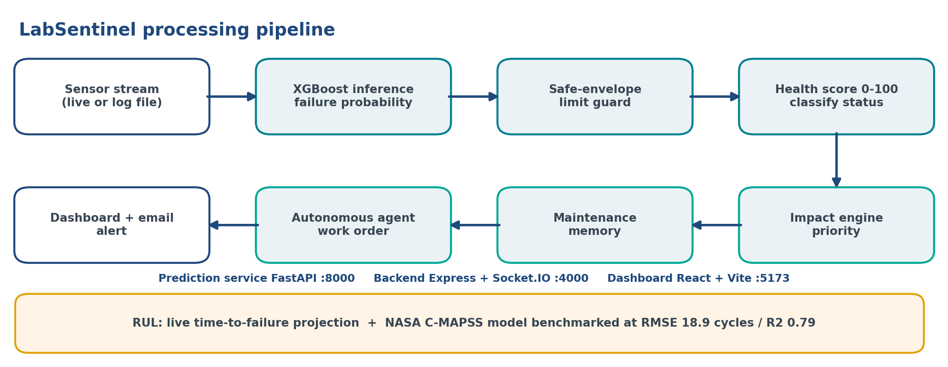
Technical Architecture
The model is trained once, offline. In the live app it only runs inference. Three services score each reading, guard it, turn it into health and priority, explain it, and push to the dashboard in real time.

Slide 8
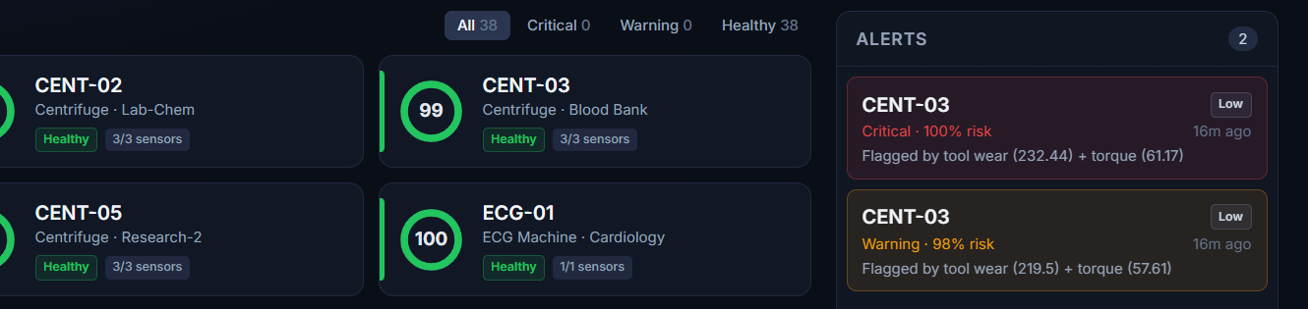
Implementation / Prototype
A working prototype runs the full pipeline across a simulated fleet of 38 devices in 8 categories, updated every 3 seconds.
Simulate Failure ramps any device into a real failure regime for a live demo.
Device detail: trend, ML factors, impact priority, the agent work order, and memory.
Digital Twin tab: residuals, what-if sliders, and a time-to-failure projection.
Analyze Log File: drop in a device log for a one-shot diagnosis.
Live fleet: device health rings, statuses, and the alerts panel

Slide 9
Feasibility & Impact
Feasibility. Runs with no IoT hardware for the demo using a faithful simulator, and accepts real device telemetry in the same format. Services are modular, cloud-deployable, and degrade gracefully if the database or model service is offline.
Social impact. Fewer surprise failures means safer patients and fewer delayed treatments and lab results.
Business impact. Lower downtime and repair cost, better use of technicians, and planning driven by priority.
Scale. Grows from a single lab to many hospitals on the same architecture.

Slide 10
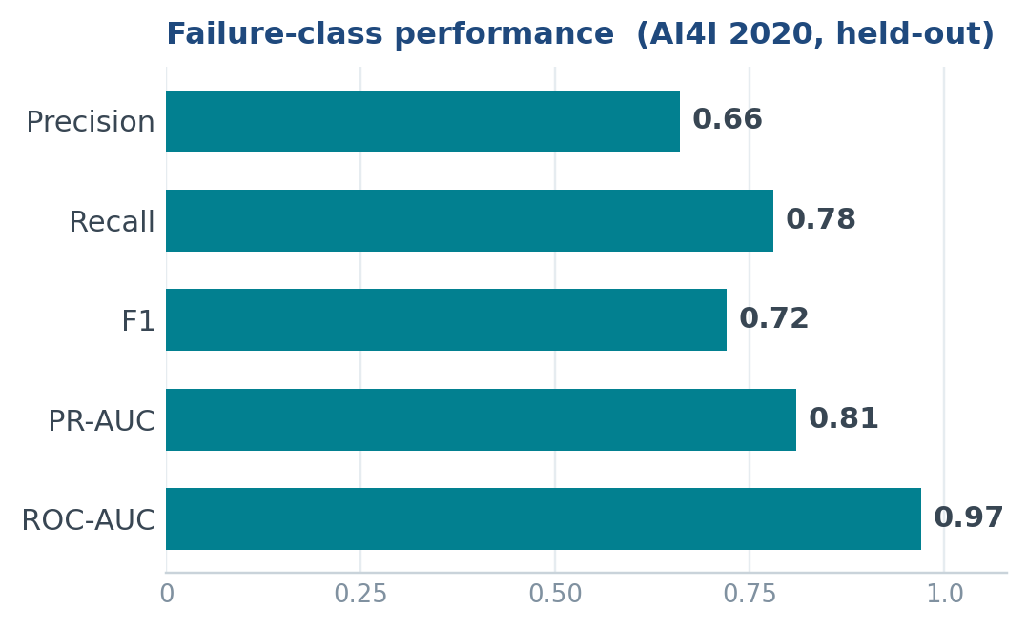
Results
Reported on held-out data, on the failure class.
RUL model (NASA C-MAPSS FD001)
RMSE 18.89 cycles, R2 0.79, MAE 13.6
Live fleet
38 devices scored every 3 seconds, no retraining in the loop
Why no accuracy figure
On 3.4 percent failure data, accuracy hides a model that never predicts a failure, so we leave it out on purpose.

Slide 11
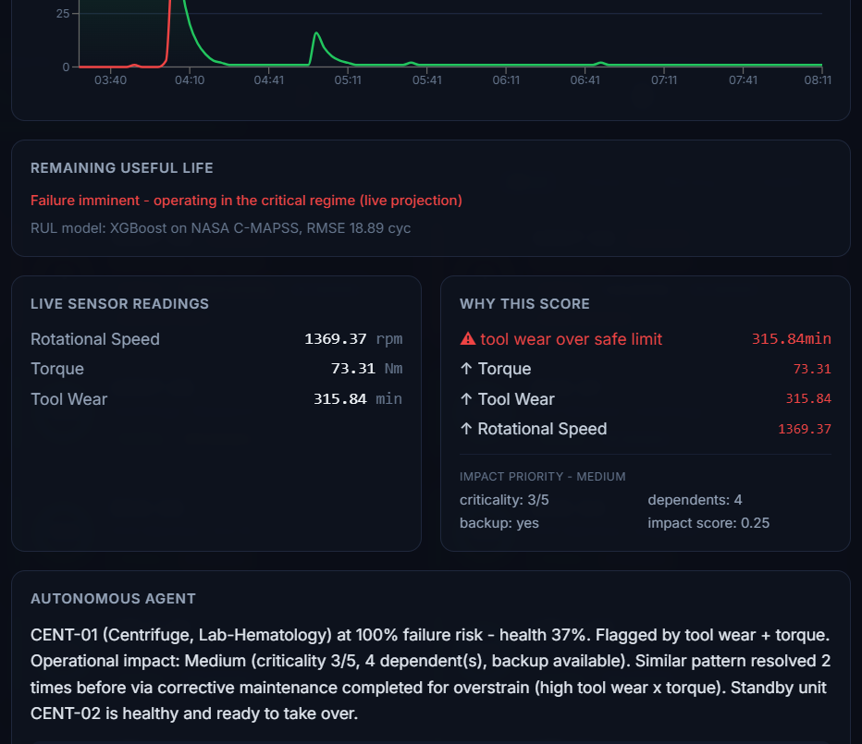
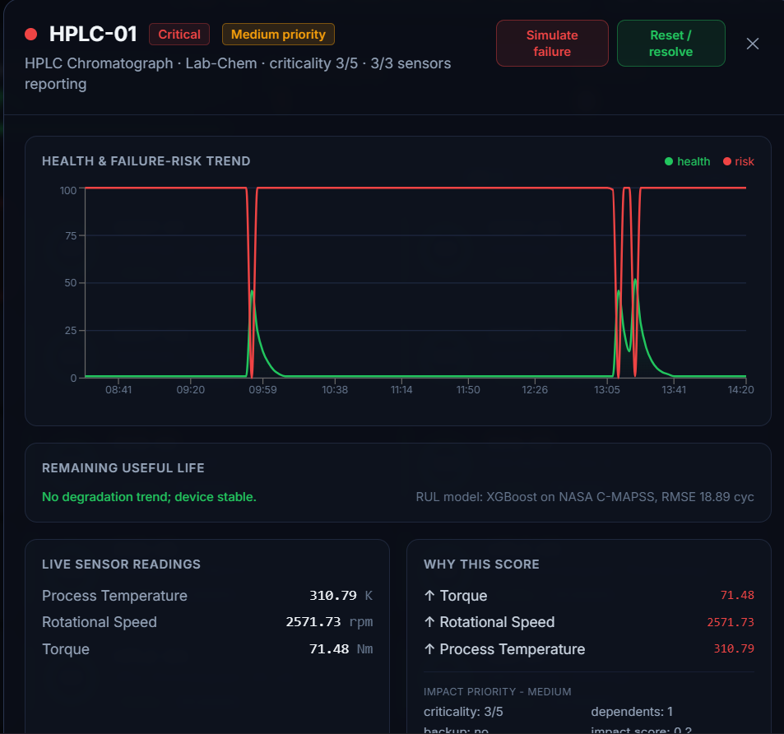
Screenshots
From the running prototype.
RUL projection and explainable risk factors
Autonomous agent work order and impact priority

Slide 12
Future Enhancements
Fleet digital twin: a floor-map of the hospital and lab with a live risk heatmap.
Unsupervised anomaly layer: monitor any device with no labels, so off-schema logs are covered.
Agent-driven onboarding: read any log, map its columns, and route it to the right model.
Per-device RUL model: trained on the fleet's own degradation for a learned remaining life.
Deployment: mobile alerts, role-based access, and real IoT integration.

Slide 13
Conclusion
LabSentinel turns reactive maintenance into predictive, proactive care.
It scores real failure risk with a trained model, explains every alert, and ranks it by patient impact.
It projects remaining life, drafts the work order, and remembers what fixed the problem last time.
The result is less downtime, safer patients, and one live view of the whole fleet.
Built in 48 hours, honest about its numbers, and ready to extend.

Slide 14
Thank You
Team Ctrl+R | REVA University

