Slide 1
INDIA AIR QUALITY INDEX
CSE3505
FOUNDATIONS OF DATA ANALYTICS
TEAM MEMBERS:
(F1A9)
CHINMAY BAPAT – 20BRS1183
SANKAR KUMAR – 20BCE1982
ADAVELLI ROHAN REDDY – 20BRS1270
BSVS KIRAN – 20BCE1582
MENTOR DETAILS:
Dr. Trilok Nath Pandey
School of Computer Science and Engineering
Vellore Institute of Technology (VIT), Chennai

Slide 2
OUTLINE
S.No | Topic | Page No
1 | Introduction | 3
2 | Problem Statement | 4
3 | Research Objectives | 5
4 | Proposed System Introduction Diagram Modules | 6-15
5 | Results and Discussions Models Accuracy Comparison Discussion | 16-18
6 | Conclusion | 19
7 | Future Work | 20
8 | References | 21

Slide 3
INTRODUCTION
In developing countries like India, the rapid increase in population and economic upswing in cities have led to increased air pollution which has a direct impact on human health .
Accurate forecasting helps people plan ahead, decreasing the effects on health and the costs associated.
Machine learning algorithms can help in predicting the AQI. Linear regression, LASSO regression, ridge regression and Random Forest for regression were used to forecast the AQI.
Classification Algorithms such as Logistic Regression, Random Forest Classifier, KNN, Weighted KNN, Ridge Classification, AdaBoost Classifier and XGBoost Classifier are used on the dataset. Almost all of the models have performed extremely well, the results have been shown later.

Slide 4
PROBLEM STATEMENT
The ever-increasing population all over the world is now a major concern to each and every government in the World. The increasing population brings in pollution as well.
The problem that we are dealing with right now is to know which state is contributing to the maximum pollution, so that an effective plan to countermeasure can be created.
Thus in our project we have gathered a dataset which contains the measurements of all the harmful pollutants that contribute to the pollution that are listed statewise.
We are trying to predict the value of the air quality index and the air quality index range based on the measurements.

Slide 5
RESEARCH OBJECTIVES
Through our project we aim to find the Air Quality Index (AQI) Range state wise based on the amount of pollutants that affect the air whose values are present in the dataset.
From the range, we can find the states that are contributing majorly towards the lower air quality.
From the arrived conclusion, systematic steps can be taken to give more importance where it is required. This helps to effectively reduce the pollution levels nationwide.
In this project we also predict the value of the air quality index and the air quality index range based on the measurements using multiple machine learning models.

Slide 6
PROPOSED SYSTEM

Slide 7
INTRODUCTION
Retrieve the dataset from Kaggle and import it into RStudio.
Do Data Visualization and Preprocessing of unprocessed data in R.
Export the Preprocessed data in a csv file and then onto Jupyter notebook.
Construct various Machine Learning models and evaluate the predictions for predicting AQI. (Regression)
Construct various Machine Learning models and evaluate the predictions for predicting AQI Range. (Classification)
Use Artificial Neural Networks and create a sequential model using various Layers like Dense Layers and Dropout Layers.

Slide 8
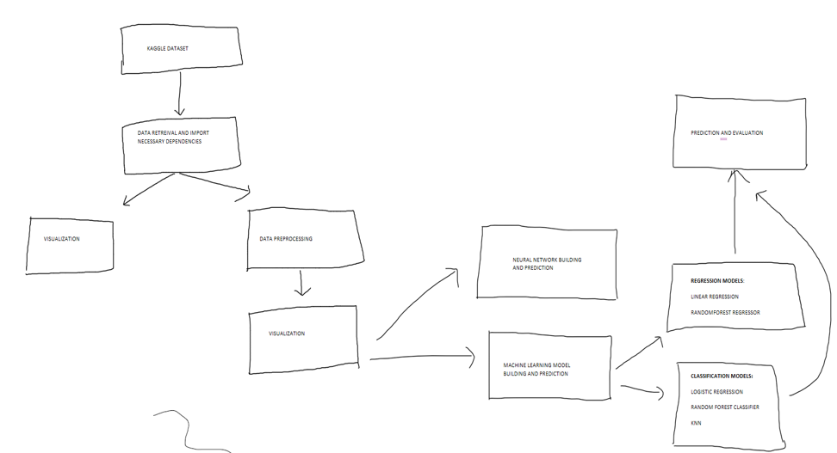
DIAGRAM

Slide 9
MODULES (LIST)
Linear Regression
Random Forest Regressor
ANN
ANN (Classification)
Ridge Regression
Ridge Regression
Logistic Regression
Random Forest Classifier
KNN
Weighted KNN
AdaBoost Classifier
XGBoost Classifier

Slide 10
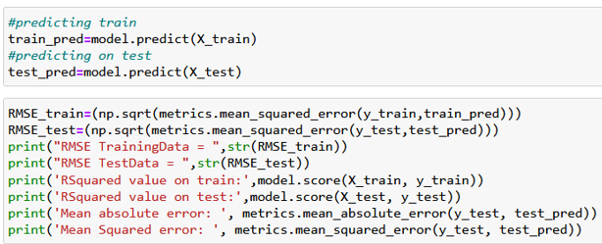
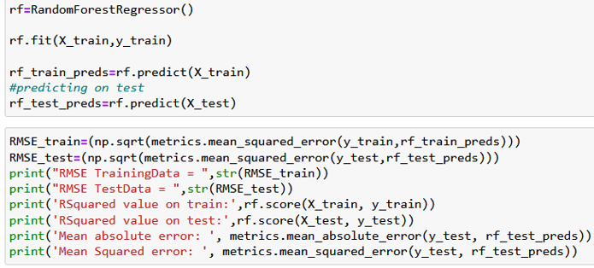
MODULES (EXPLANATION)
Linear Regression
Linear regression is a statistical method for modelling the relationship between a scalar response and one or more explanatory variables. Simple linear regression is used when there is only one explanatory variable; multiple linear regression is used when there are more than one.
RandomForest Regressor
A supervised learning technique called Random Forest Regression leverages the ensemble learning approach for regression. The ensemble learning method combines predictions from various machine learning algorithms to provide predictions that are more accurate than those from a single model.

Slide 11
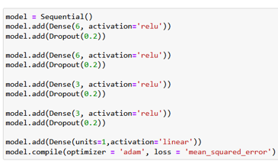
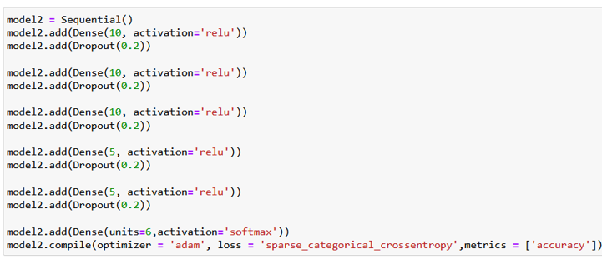
ANN
A computational model known as an artificial neural network (ANN) comprises of many processing components that accept inputs and produce results in accordance with predetermined activation functions.
ANN (Classification)
An observation is classified as belonging to a discrete class according to the inputs using classification ANNs.

Slide 12
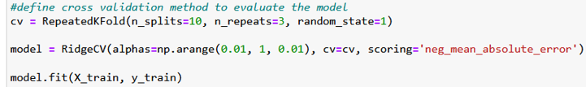
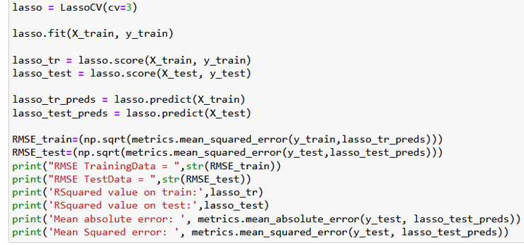
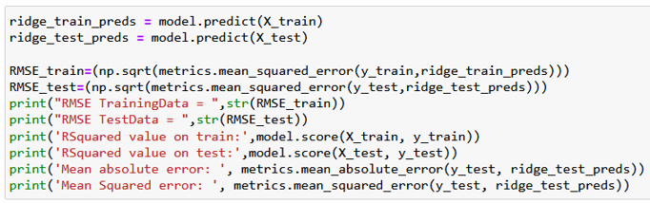
Ridge Regression
Any data that exhibits multicollinearity can be analysed using the model tuning technique known as ridge regression. This technique carries out L2 regularisation.
Lasso Regression
An approach to regularisation is lasso regression. For a more accurate forecast, it is preferred over regression techniques. Shrinkage is used in this model.

Slide 13
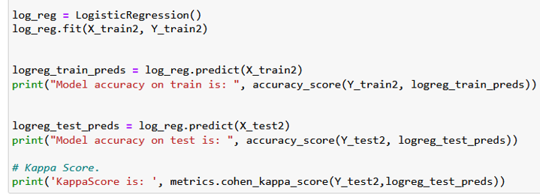
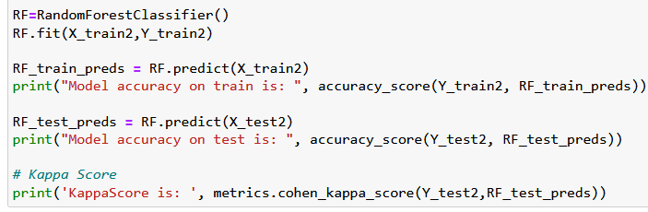
Logistic Regression
A statistical analysis method called logistic regression uses previous observations from a data set to predict a binary outcome, such as yes or no. By examining the correlation between one or more already present independent variables, a logistic regression model forecasts a dependent data variable.
Random Forest Classifier
A classification system made up of several decision trees is called the random forest. It attempts to produce an uncorrelated forest of trees whose forecast by committee is more accurate than that of any individual tree by using bagging and feature randomness when generating each individual tree.

Slide 14
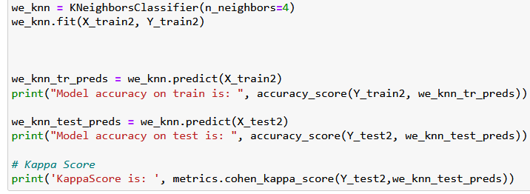
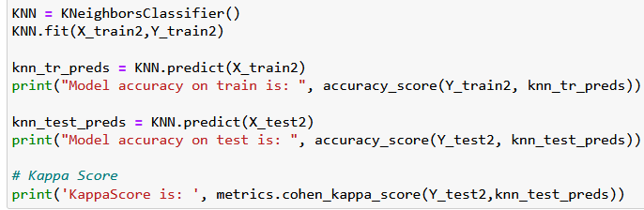
KNN
The k-nearest neighbours algorithm, sometimes referred to as KNN or k-NN, is a supervised learning classifier that employs proximity to produce classifications or predictions about the grouping of a single data point.
Weighted KNN
Using two or more numerical predictor variables, the weighted k-nearest neighbours (k-NN) classification algorithm is a straightforward method for predicting an item's class.

Slide 15

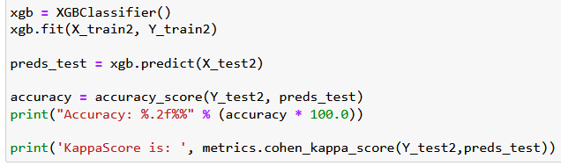
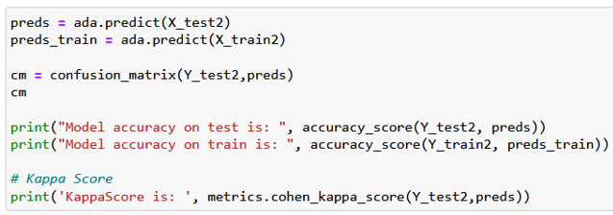
AdaBoost Classifier
AdaBoost is an ensemble learning technique that was initially developed to boost the performance of binary classifiers (sometimes referred to as "meta-learning"). AdaBoost uses an iterative process to improve poor classifiers by learning from their errors.
XGBoost Classifier
Gradient Boosted decision trees are implemented using XGBoost technology. Decision trees are generated sequentially in this approach. Weights are significant in XGBoost. Each independent variable is given a weight before being fed into the decision tree that forecasts outcomes.

Slide 16
RESULTS AND DISCUSSION

Slide 17
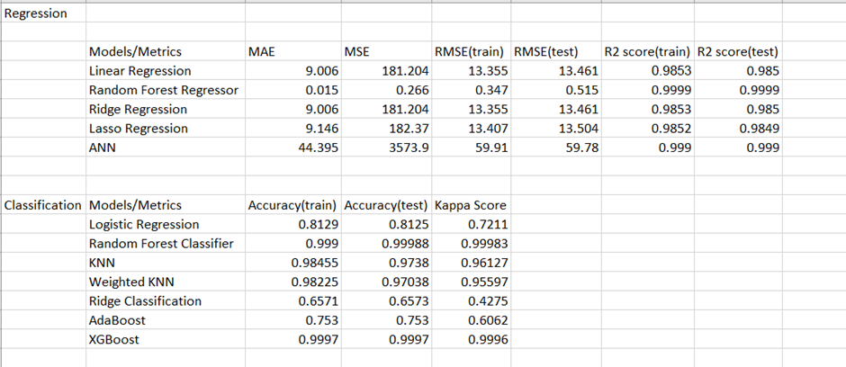
MODELS ACCURACY COMPARISON

Slide 18
DISCUSSION
For predicting AQI, all the algorithms work very well with the dataset. This is because the data is structured very well with very good records and the preprocessing done on the dataset fixes the missing values and makes the data optimal for passing to any model.
Logistic Regression, AdaBoost and Ridge Classification do not perform as well compared to the other models.
All the other models have very good accuracy which is above 95% and is thus recommended to use for this dataset.

Slide 19
CONCLUSION
More priority and resources have to be given to Bihar, Delhi, Gujarat, Manipur and Uttaranchal for repairing the AQI levels as they have high levels of pollution.
The task of forecasting pollutant levels is inherently hard because of the volatile and dynamic nature of the data and its variability in space and time.
However, the task of forecasting pollutant levels has been increasing in importance due to the effects of pollution on the population and the environment.
In this project we have use algorithmic techniques like Linear Regression,Random Forest Regression,Logistic Regression, Random Forest Classifier, KNN, ANN(Artificial Neural Networks) for forecasting levels of pollutants like NO2, SO2, PM2.5 and Air Quality Index (AQI), using publicly available data for India.

Slide 20
FUTURE WORK
The future work that remains for this dataset might be to see why algorithms like AdaBoost, Logistic Regression, Ridge Classification are not giving that good of an accuracy compared to the other models that are applied.
By using Hyper Parameter Tuning, one can run a series of experiments and based on Trial and Error, one can find out the best fitting parameters so that they also fit to the data very well.

Slide 21
REFERENCES
Ditsuhi Iskandaryan , Francisco Ramos and Sergio Trilles,”Air Quality Prediction in Smart Cities Using Machine Learning Technologies Based on Sensor Data: A Review”,Institute of New Imaging Technologies (INIT), Universitat Jaume I, Spain,Received: 07 February 2020; Accepted: 25 March 2020; Published: 1 April 2020
Mrs. A. Gnana Soundari MTech, (PhD) Associate Professor,Mrs. J. Gnana Jeslin M.E, (PhD) Assistant Professor,Akshaya A.C’s,”INDIAN AIR QUALITY PREDICTION AND ANALYSIS USING MACHINE LEARNING”,Jeppiaar Engineering College
Gaganjot Kaur Kang, Jerry Zeyu Gao, Sen Chiao, Shengqiang Lu, and Approaches”,Gang Xie,”Air Quality Prediction: Big Data and Machine Learning
Brunekreef B, Holgate ST. Air pollution and health. Lancet. 2002 Oct 19;360(9341):1233-42. doi: 10.1016/S0140-6736(02)11274-8. PMID: 12401268.
Jamal A, Nabizadeh Nodehi R. PREDICTING AIR QUALITY INDEX BASED ON METEOROLOGICAL DATA: A COMPARISON OF REGRESSION ANALYSIS, ARTIFICIAL NEURAL NETWORKS AND DECISION TREE. JAPH. 2017;2(1).
Marilena Kampa and Elias Castanas’,“Human health effects of air pollution”Laboratory of Experimental Endocrinology, University of Crete, School of Medicine, P.O. Box 2208, Heraklion, 71003, Greece. Received 4 June 2007, Accepted 10 June 2007, Available online 23 July 2007.
Yang Zhang, Marc Bocquet, Vivien Mallet, Christian Seigneur, Alexander Baklanov,Real-time air quality forecasting, part I: History, techniques, and current status, Atmospheric Environment,Volume 60,2012,Pages 632-655,ISSN 1352-2310
John Bachmann (2007) Will the Circle Be Unbroken: A History of the U.S. National Ambient Air Quality Standards, Journal of the Air & Waste Management Association, 57:6, 652-697, DOI: 10.3155/1047-3289.57.6.652

