Slide 1
CRISP-ML(Q)
CRISP-DM, which stands for Cross-Industry Standard Process for Data Mining, is an industry-proven way to guide your data mining efforts.
As a methodology, it includes descriptions of the typical phases of a project, the tasks involved with each phase, and an explanation of the relationships between these tasks.
As a process model, CRISP-DM provides an overview of the data mining life cycle.

Slide 2
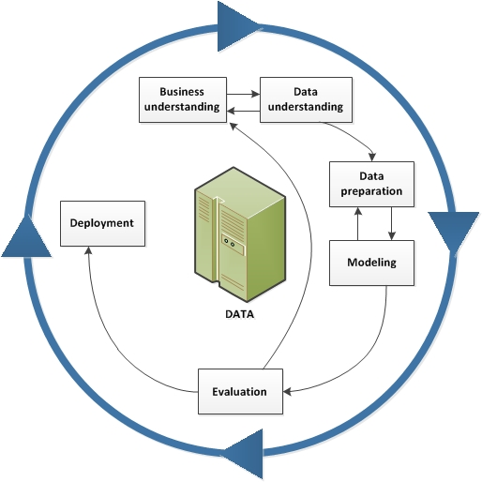

Slide 3
Overall, the CRISP-ML(Q) process model describes six phases:
Business Understanding and Data Understanding
Data Engineering (Data Preparation)
Machine Learning Model Engineering
Quality Assurance for Machine Learning Applications or Evaluation and tunning.
Deployment
Monitoring and Maintenance.

Slide 4
For each phase of the process model, the quality assurance approach in CRISP-ML(Q) requires the definition of requirements and constraints
(e.g., performance, data quality requirements, model robustness, etc.)
Instantiation of the specific tasks (e.g., ML algorithm selection, model training, etc.)
specification of risks that might negatively impact the efficiency and success of the ML application (e.g., bias, overfitting, lack of reproducibility, etc.)
quality assurance methods to mitigate risks when these risks need to be diminished (e.g., cross-validation, documenting process and results, etc.).

Slide 5


Thank you

