Slide 1

Jaypee University Of Engineering and Technology
Stock Price Prediction
Rohan Bhargava (211b259)
Shivam Swaraj (211b292)
Stuti Jain (211b319)
Project No. – 35
Project Guide - Dr. Rahul Pachauri

Slide 2
Introduction
A stock (equity) represents ownership in a company.
Companies issue stocks to raise money for business operations, growth, or expansion.
The price of a stock reflects how much the market values a company at a given time.
Forecasting the approximate value of a company can help one decide whether to sell the stock or keep it, thereby assisting in making a profitable trade.

Slide 3
What is Stock Price Prediction ?
Stock price prediction is the process of forecasting the future price of a company's stock.
Forecasting based on historical data, market trends, and various financial indicators.
India has two primary stock markets where shares of publicly listed companies are traded: the Bombay Stock Exchange (BSE) and the National Stock Exchange (NSE).

Slide 4
OVERVIEW
Introduction
What is Stock Price Prediction?
Data Collection
Data Description
Methodology
Work Flow Diagram
RNN and LSTM

Slide 5
Data Collection
There are many websites that provide historical stock data for both the NSE and BSE (for India), such as: Yahoo Finance, Quandl, Alpha Ventage, Polygon.io etc.
The one we will be using is Yahoo Finance, as it is free and provides many years of historical data for most companies.

Slide 6
Data Description
Date : The date on which the stock market data was recorded.
Open : The opening price of the asset on the given date.
High : The highest price of the asset on the given date.
Low : The lowest price of the asset on the given date.
Close : The closing price of the asset on the given date.
Adj Close : While the “Close” doesn’t take account for any after-hour trades. This price takes into account any dividends, stock splits, or other corporate actions that may have occurred, which can affect the stock price.
Volume : This price takes into account any dividends, stock splits, or other corporate actions that may have occurred, which can affect the stock price.

Slide 7
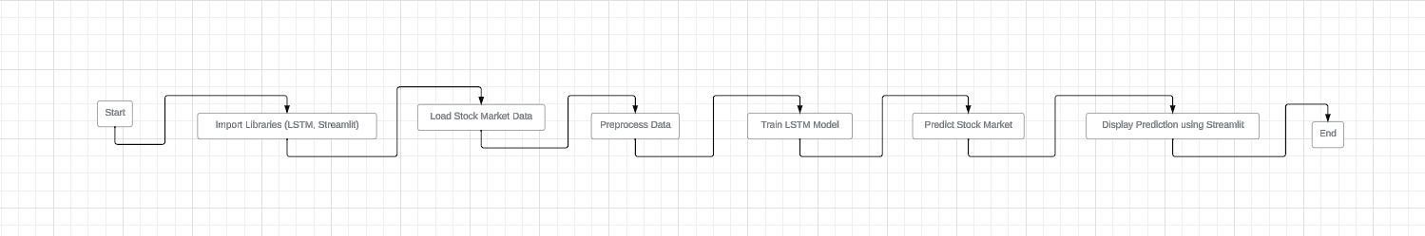
WORK FLOW DIAGRAM

Slide 8
METHODOLOGY (Model Training)
Split the dataset into training and testing sets to evaluate the model's generalization performance.
Train the LSTM model using historical stock market data, adjusting hyperparameters as needed.
Monitor training performance and leverage techniques like early stopping to prevent overfitting.
Finally Forecasting the future close value of the company.

Slide 9
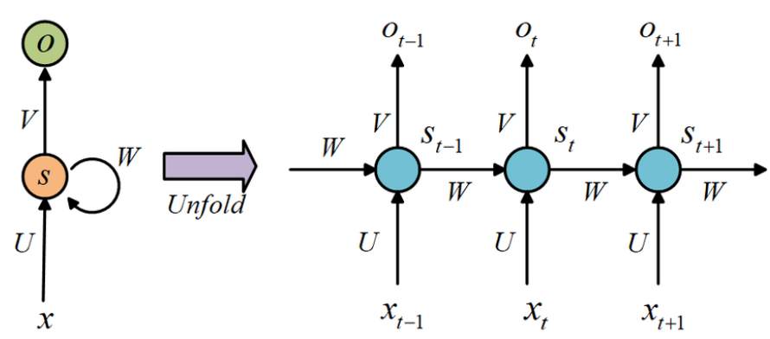
RNN (Recurrent Neural Network)
RNNs are neural networks designed for sequential data, allowing information to persist across time steps.
Suffer from vanishing and exploding gradient problems, affecting long-range dependency learning.
Advanced types like Long Short-Term Memory (LSTM) and Gated Recurrent Unit (GRU) address these challenges.
Used in Gmail Auto Complete, Google Translator, NER (Name Entity Recognition) and many more.

Slide 10
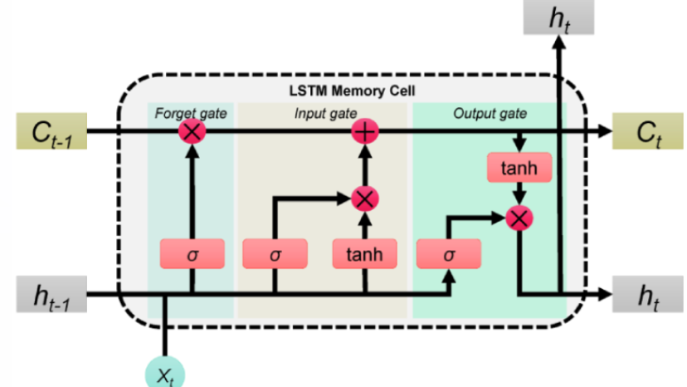
LSTM (Long Short Term Memory)
LSTMs are a type of RNN designed to learn long-range dependencies in sequential data.
Composed of memory cells and gates (input, output, forget) to control information flow.
LSTMs excel at capturing long-term dependencies in time series data, making them ideal for predicting stock prices based on historical trends.
LSTMs can integrate multiple features (open, high, low, close, volume) to improve prediction accuracy.
Model complex relationships in financial data.

Slide 11
Other Models We Can Use..
ARIMA(AutoRegressive Integrated Moving Average)
Random Forest
XGBoost/LightGBM

Slide 12
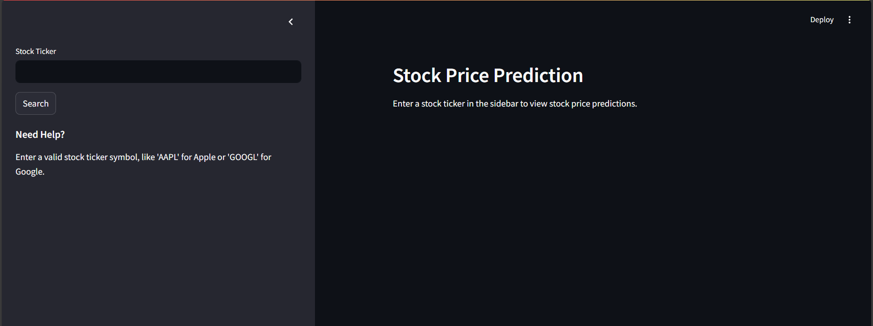
Streamlit App

Slide 13
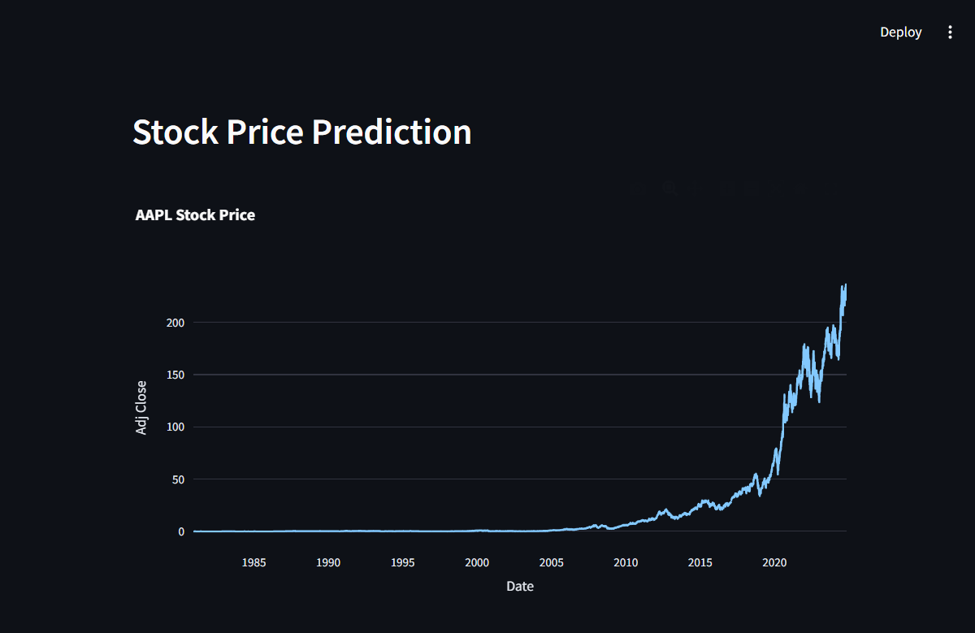
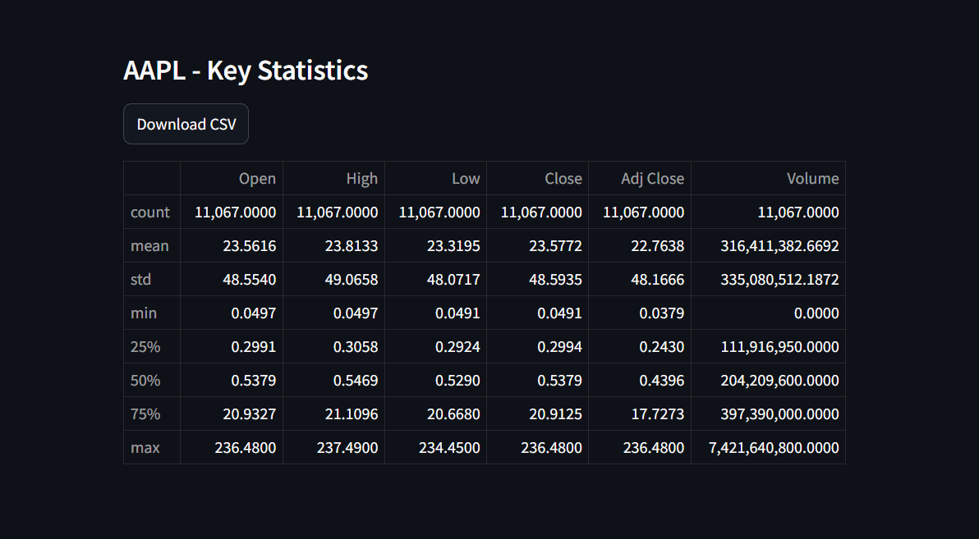
Streamlit App

Slide 14
Future Focus
Improving the frontend.
Adding some interactive features.
Connecting the frontend and backend.

Slide 15
Thank you!

