Slide 1


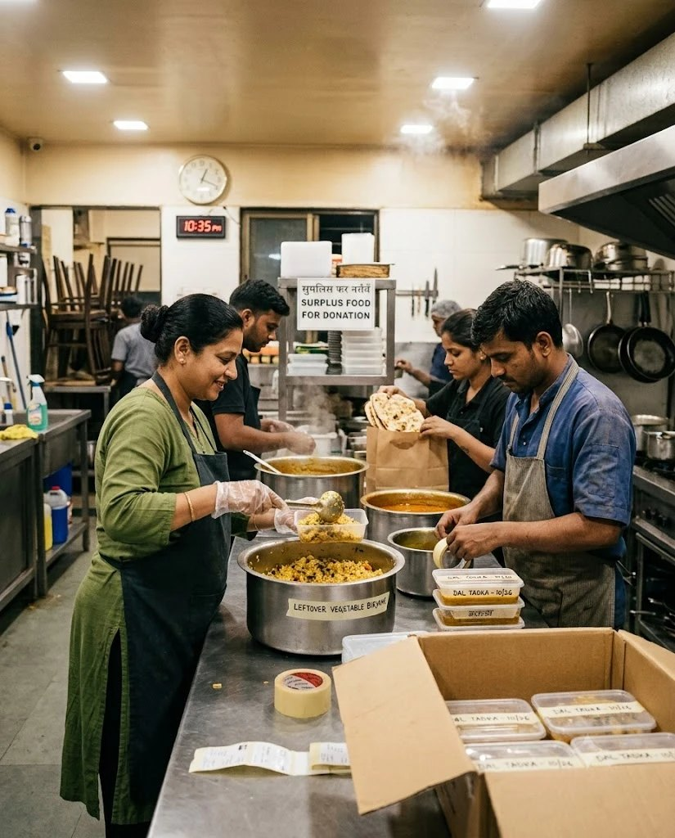

FoodLoop
FULL STACK DEVELOPMENT LAB · MINI PROJECT
Surplus food, matched before the clock runs out.
Every night, Mumbai's kitchens throw out good food while shelters a few kilometres away go short. FoodLoop offers that food to the nearby shelter that can collect it before its deadline.
PRESENTED BY
Rohan Surana
16015024073
Ayman Shaikh
16015024070
6
pages built
5
factors in the score
0
delivery riders
Notes:
Good morning. Our project is FoodLoop. Every night, restaurants, canteens and banquet halls in Mumbai end up with food that is still good, and shelters a few kilometres away need it. The problem is getting it there in time. FoodLoop lets a kitchen post its leftover food with a pickup deadline, and offers it to the shelter that can actually collect it before then. The shelter sends its own staff, so we don't need delivery riders.

Slide 2
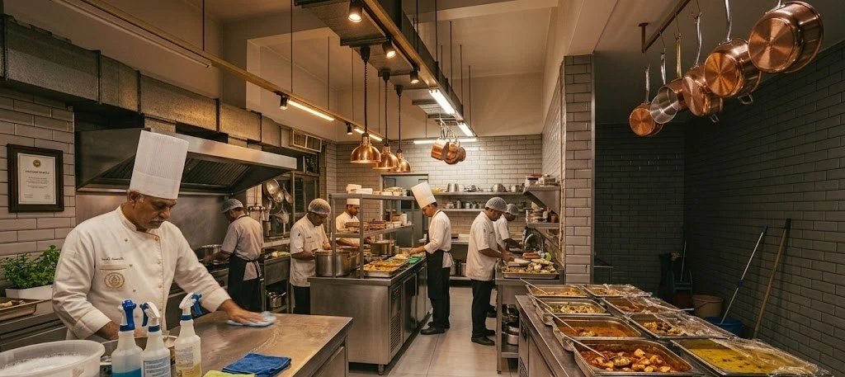
Problem & Objectives
It was never a shortage of generosity.
It was timing.
9:40 pm
A wedding ends at an Andheri banquet hall. Sixty thalis untouched.
Closing time: good food, nowhere to send it.
9:55 pm
The manager calls two NGOs he knows. One is closed, one doesn't pick up.
Objectives
10:30 pm
A volunteer group replies on WhatsApp. Their van is in Thane.
1
Match food before its deadline
Offer surplus only to recipients who can collect it in time.
11:15 pm
The kitchen has to close. The trays are still sitting out.
2
One ranked offer, not a broadcast
Score every nearby shelter; ask the best fit first.
11:40 pm
Before locking up, the staff throw the food away.
3
Recipients collect it themselves
No riders; a handover code confirms the right people came.
An illustrative Saturday, without FoodLoop.
4
Show why each match was made
Every score can be opened up, factor by factor.
Notes:
This is a typical evening without FoodLoop. Nobody is unwilling to help; the food just can't find the right people in time, and by 11:40 it goes in the bin. So we set four objectives. Offer food only to shelters that can reach it before the deadline. Send one ranked offer instead of messaging everyone. Let the shelter collect it with a handover code. And always show why a shelter was picked, so the score is never a black box.

Slide 3
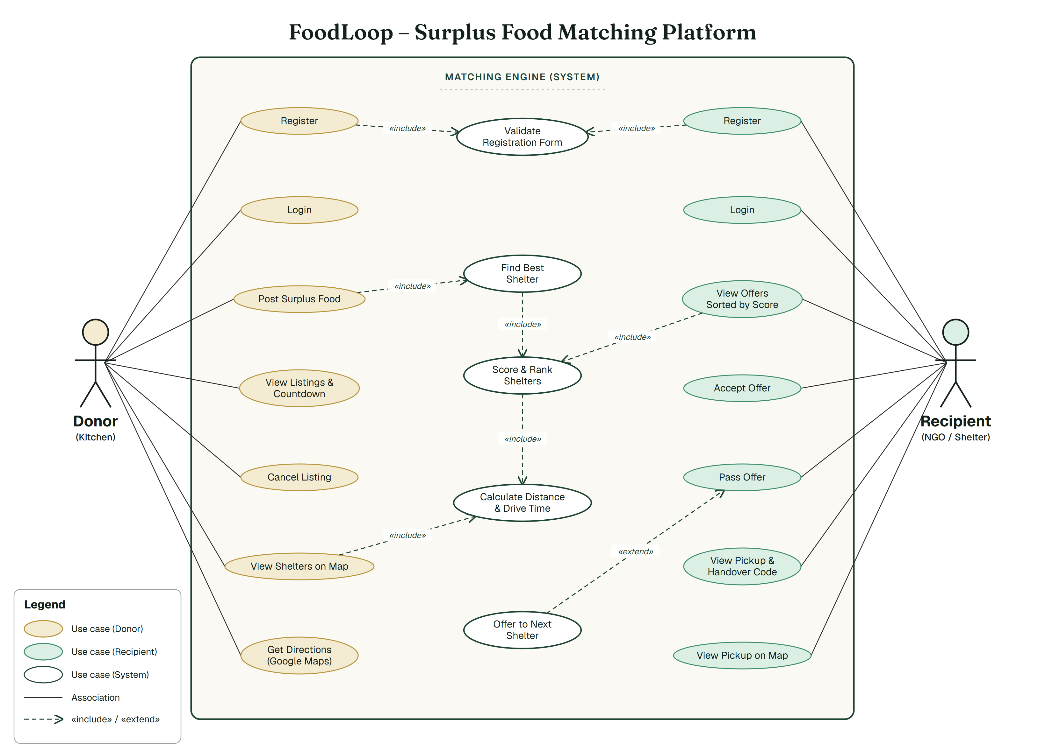
Use-Case Diagram
Donor kitchen
Registers, posts food with a deadline, watches the countdown, cancels a listing, finds shelters on the map.
Recipient
Sees offers sorted by score, accepts or passes, gets the pickup details and handover code.
System
Checks the form, works out distance and drive time, scores the shelters and picks the best one.
Not in this version
No admin yet. Verifying organisations comes with the backend (Node.js + MongoDB).
Notes:
Two actors: the donor kitchen and the recipient shelter. Both register, and registering includes validating the form. When a donor posts food, the system finds the best shelter, which includes scoring and ranking shelters, which includes calculating distance and drive time. If a recipient passes, the offer is extended to the next shelter. There is no admin in this version; that comes when we add the backend.

Slide 4
Methodology & Results
How a listing is matched
RESULT · FROM OUR DONOR PAGE
1. Filter
2. Score
3. Offer
4. Cascade
77 / 100
too far, no room
or wrong food
›
5 weighted
factors, out of 100
›
to the best
recipient first
›
a pass moves it
to the next
40 veg meals, 2 hours: Sneh Sadan is asked first.
Score weights
Time feasibility
35%
Proximity
25%
Capacity fit
20%
Food type
10%
Reliability
10%
Worked example: St. Xavier's biryani → Sneh Sadan
0.35×0.82 + 0.25×0.77 + 0.20×0.95
+ 0.10×1.00 + 0.10×0.71 = 0.84
84
Prakash scores 0: it only has room for 25 meals, so it is filtered out before scoring.
Testing: 35 of 35 browser checks pass on all 6 pages.
Sneh Sadan is asked first.
/ 100
Notes:
Here is how matching works. First we filter: a shelter that can't reach the kitchen in time, has no room, or doesn't take that kind of food is dropped. Then we score the rest out of 100. Time counts most, 35 percent, because cooked food doesn't wait. The best shelter gets the offer first, and if they pass it moves to the next one. On the right is a real result from our donor page: 40 veg meals with two hours to collect. Sneh Sadan scores 77 and is asked first. Prakash scores zero because it only has room for 25 meals. We also tested all six pages in a browser, and all 35 checks pass.

Slide 5
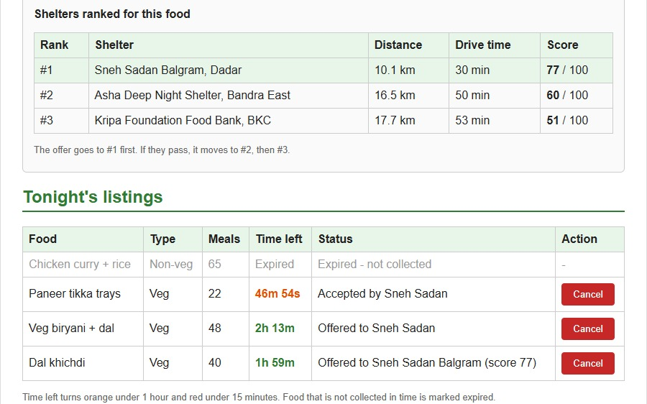
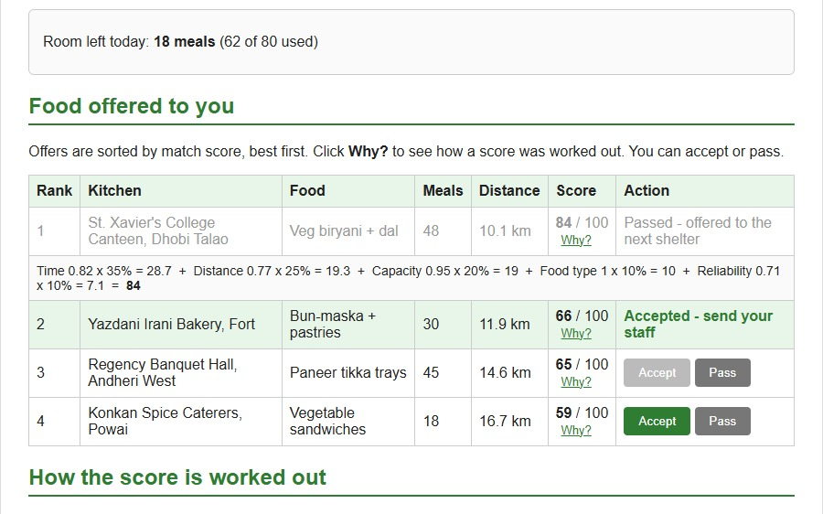
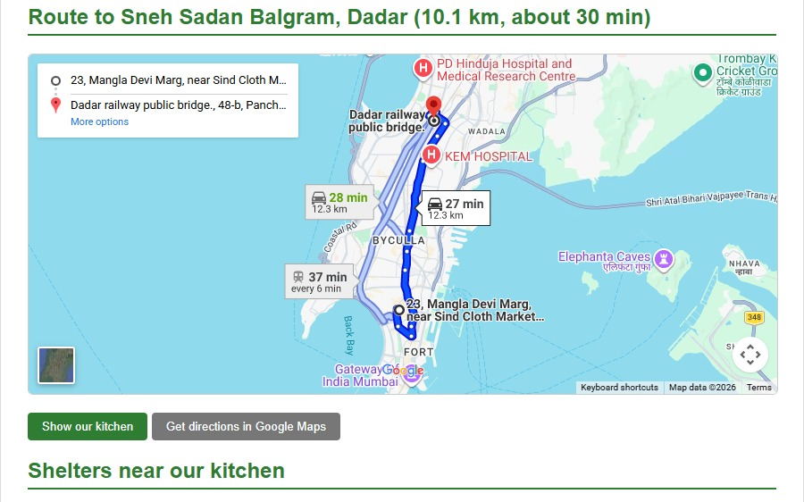
Implementation
6 simple pages, one pickup from start to finish.
Built only with what we were taught: HTML, CSS and JavaScript, with no framework or library. One pickup (St. Xavier's → Sneh Sadan, code 4827) runs through every page.
Donor page
Top 3 shelters, live countdown, expired food
Recipient page
Sorted offers, "Why?" breakdown, room left
Map page
Driving route from our kitchen to each shelter
HOW WE BUILT IT
Requirements
›
Use cases
›
UI design
›
HTML pages
›
CSS styling
›
JavaScript + DOM
›
Testing
BUILT WITH
Next: Node.js + Express + MongoDB
HTML5
CSS3
JavaScript
DOM + events
Promises
Google Maps iframe
Git & GitHub
Notes:
We built six pages using only what we were taught: HTML, one CSS file and plain JavaScript. On the donor page you post food, and after two seconds a Promise returns the top three shelters; the countdown runs on setInterval and food that isn't collected is marked expired. On the recipient page, accepting an offer updates the room left and turns off offers that won't fit, and the Why? link shows the score factor by factor. The map is a Google Maps iframe; we change its src to show the route. Next, we'll add a Node.js, Express and MongoDB backend so the pages share real data.

