Slide 1


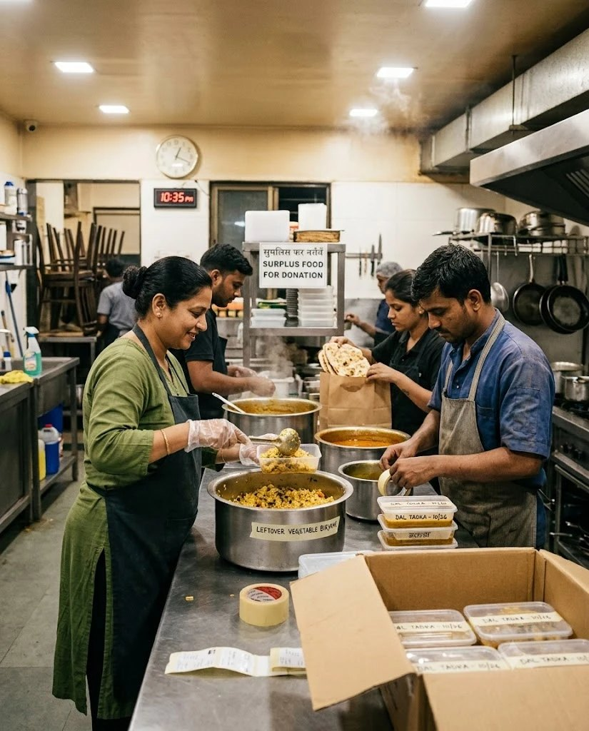

FoodLoop
FULL STACK DEVELOPMENT LAB · MINI PROJECT · TY B.TECH
Surplus food, matched before the clock runs out.
Mumbai's kitchens throw away good food at closing time while shelters a few kilometres away go short. FoodLoop scores every nearby shelter, offers the food to the best one first, and the shelter collects it itself with a handover code.
PRESENTED BY
Rohan Surana
16015024073
Ayman Shaikh
16015024070
3
22
100
user roles
API routes
tests pass
Notes:
Good morning. Our project is FoodLoop, a surplus food matching platform for Mumbai. Every night restaurants, canteens and banquet halls finish service with food that is still good, while shelters a few kilometres away are short of meals. The problem is not generosity, it is the time in between. FoodLoop lets a kitchen post its surplus with a pickup deadline, scores every verified shelter, and offers the food to the best match first. The shelter collects it with its own staff, so there is no delivery rider. It is built on the MERN stack: MongoDB, Express and Node, with plain HTML, CSS and JavaScript on the front end. Three user roles, twenty-two API routes, and a hundred automated tests that all pass.

Slide 2

Problem & Objectives
It was never a shortage of generosity.
It was timing.
9:40 pm
A wedding ends in Andheri. Sixty thalis untouched.
9:55 pm
The manager calls two NGOs. One closed, one no answer.
Closing time: good food, nowhere to send it.
10:30 pm
A volunteer group replies. Their van is in Thane.
WHAT WE SET OUT TO BUILD
1
Beat the deadline
2
Ask one, not all
11:15 pm
The kitchen must close. The trays are still out.
Offer food only to shelters that can really collect it in time.
Rank every verified shelter and ask the best fit first.
11:40 pm
The staff throw the food away.
3
They collect it
4
Explain everything
An illustrative Saturday, without FoodLoop.
No riders. A 4-digit handover code proves the right people came.
Show the score factor by factor, and measure the impact.
Notes:
This is a typical evening without FoodLoop. Nobody here is unwilling to help. The food simply cannot find the right people in time, and by twenty to twelve it goes in the bin. The problem is timing, not generosity. So we set four objectives. One, beat the deadline: only offer food to shelters that can actually collect it in time. Two, ask one shelter at a time instead of broadcasting, because when everyone is messaged nobody is sure who is coming. Three, the shelter collects it itself and shows a four digit handover code. And four, explain every decision: we show the score factor by factor and measure the impact on a dashboard.

Slide 3
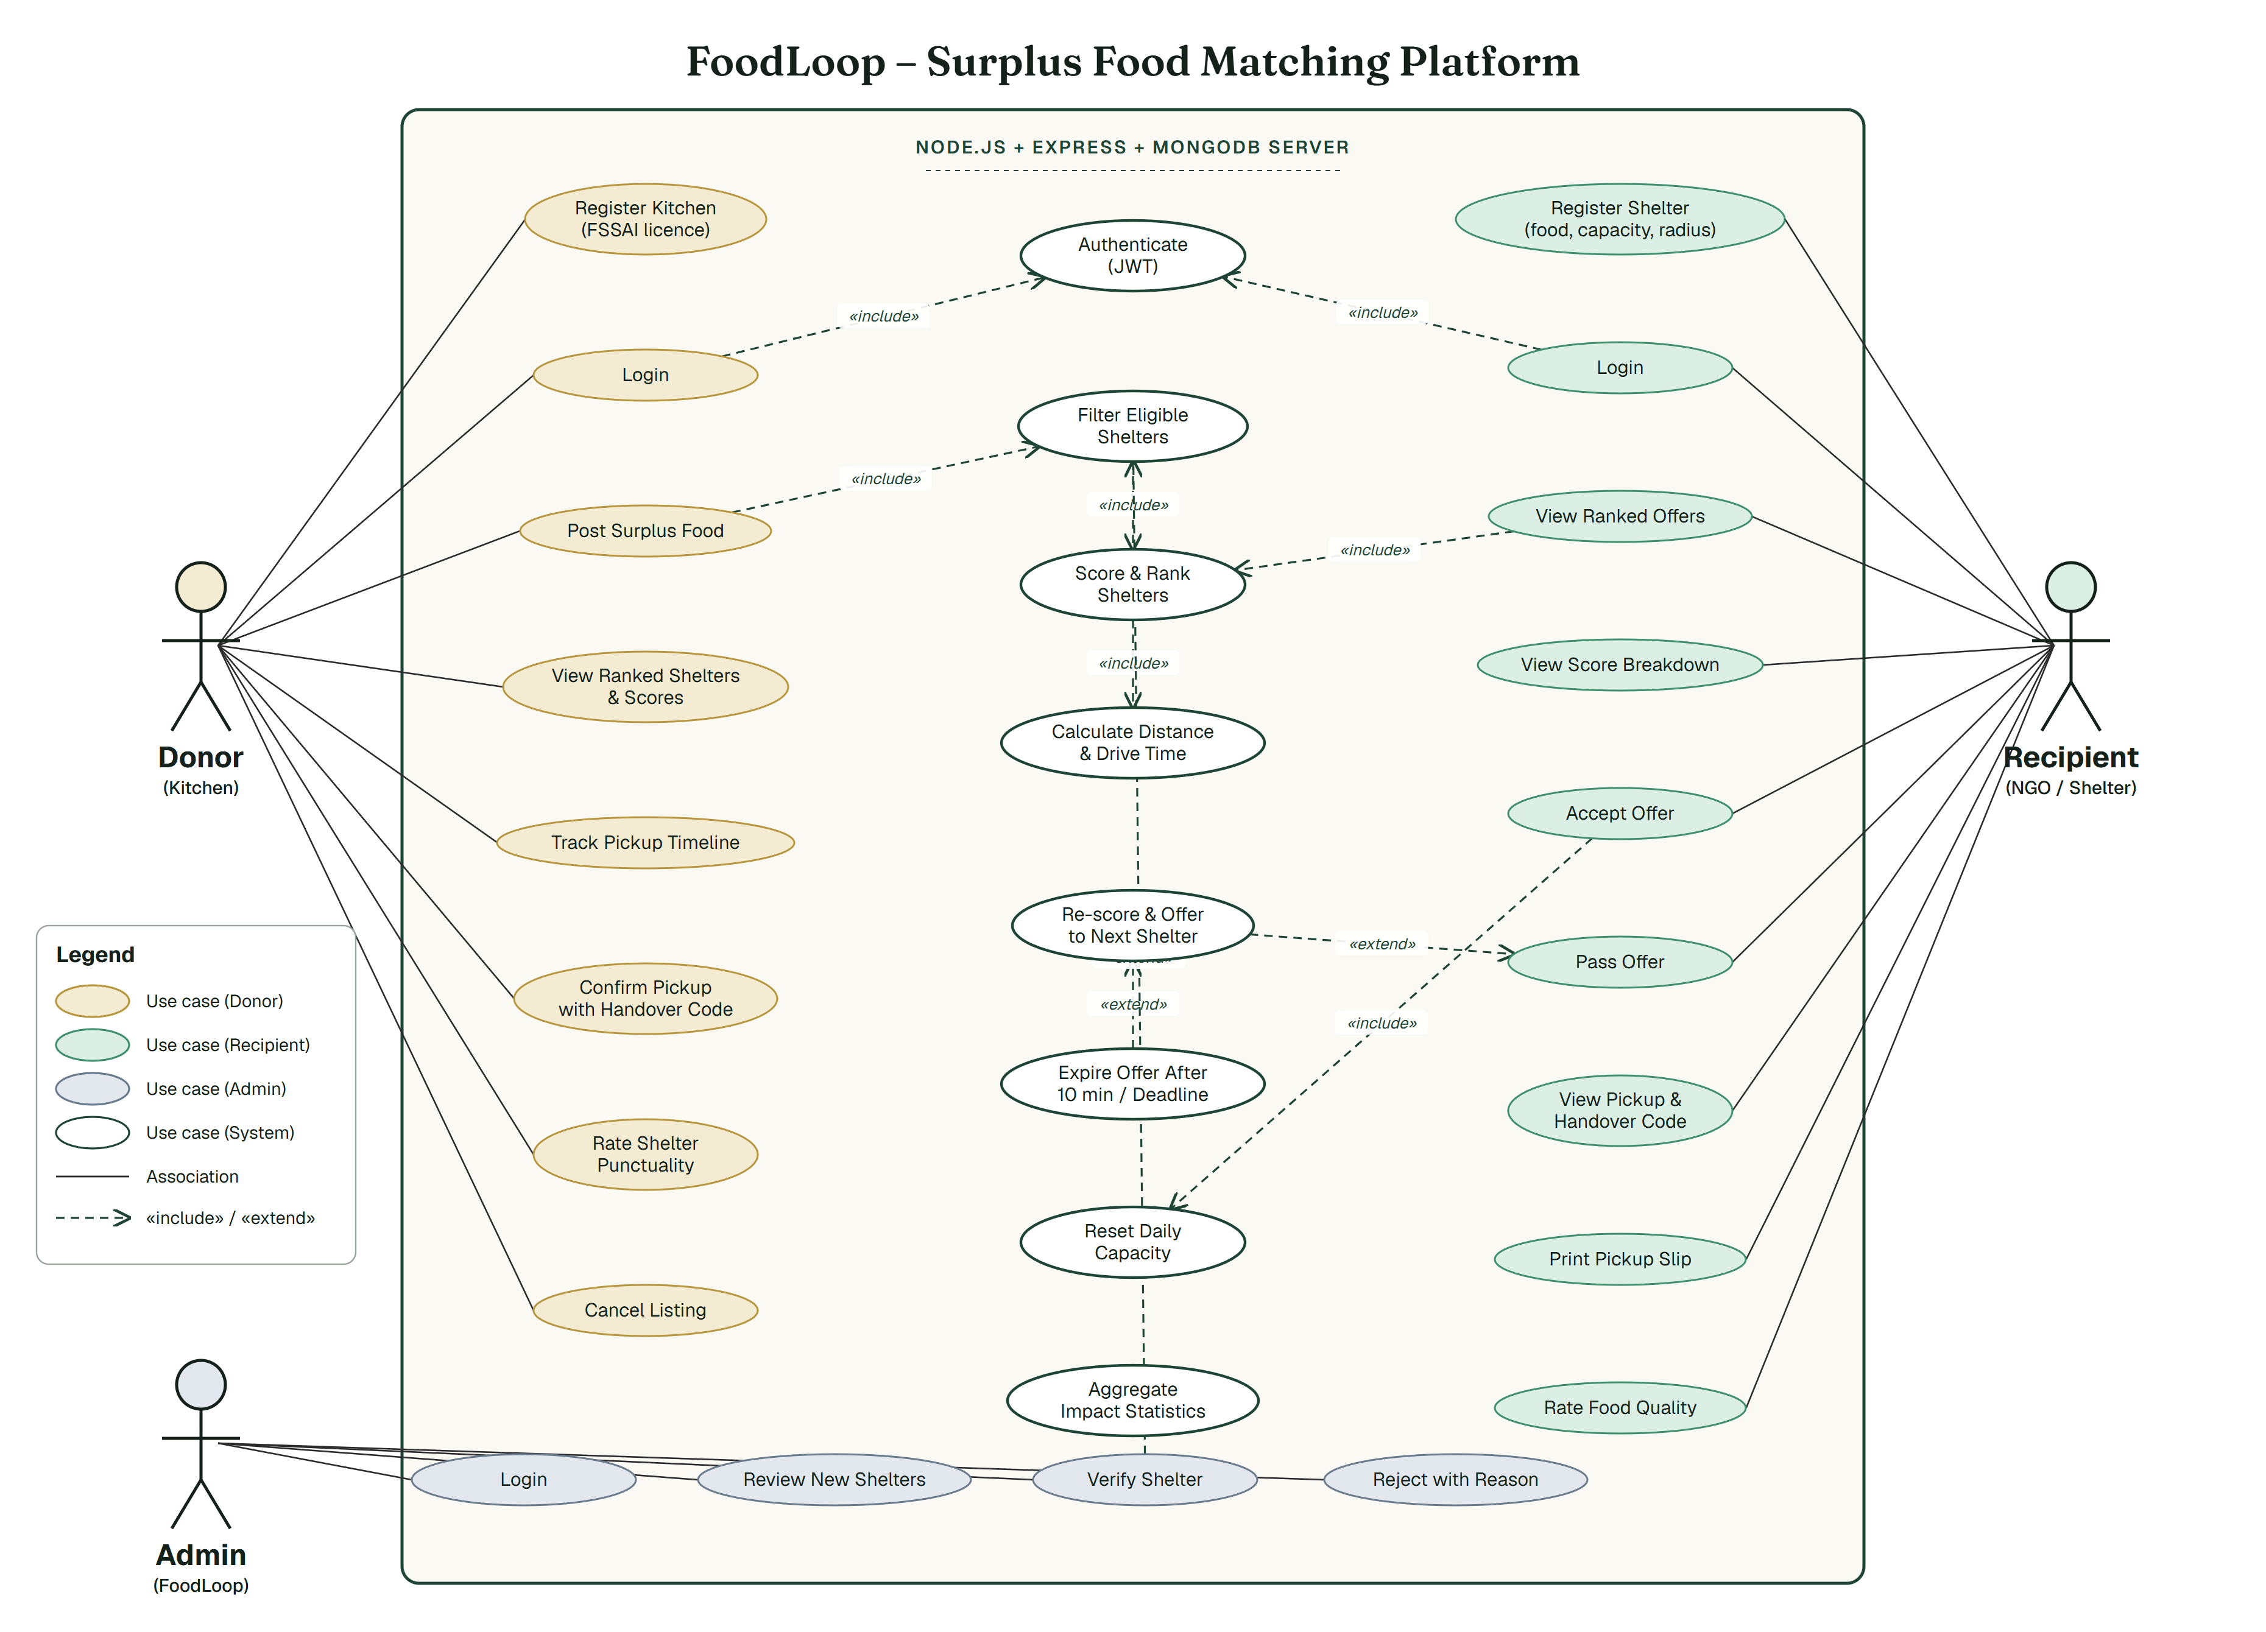
Use-Case Diagram
Donor
Registers with an FSSAI licence, posts surplus food, sees the ranked shelters, confirms the pickup with the code and rates the shelter.
Recipient
Registers with the food it accepts, meals per day and travel radius. Sees ranked offers with the score breakdown, accepts or passes, prints a pickup slip.
Admin
Checks every new shelter and verifies it, or turns it down with a reason. Unverified shelters never receive food.
System
Authenticates with JWT, filters and scores shelters, re-scores on a pass, expires offers and aggregates the impact statistics.
Notes:
We have three human actors: the donor kitchen, the recipient shelter and a FoodLoop admin. The colours on the right match the ellipses in the diagram. Both donors and recipients register and log in, and logging in includes authenticating with a JSON Web Token. When a donor posts food, the system filters the eligible shelters, which includes scoring and ranking them, which in turn includes calculating distance and drive time. Those are include relationships: they always happen. If a recipient passes, or does not reply within ten minutes, re-scoring and offering to the next shelter extends that flow. The admin exists because somebody has to check that an NGO is genuine before food is sent to it.

Slide 4
System Architecture & Matching
Three-tier MERN architecture
How a listing is matched
1
Browser presentation
1
2
3
4
10 pages of plain HTML, CSS and JavaScript
api.js holds the token and calls fetch()
Leaflet + OpenStreetMap for the map
Filter
Score
Offer
Cascade
wrong food,
no room, too far
5 weighted
factors
best first,
10 min to reply
re-score,
ask the next
▼ HTTP / JSON
Score weights
2
Node.js + Express application logic
/auth /listings /offers /organisations /admin /stats
protect (JWT) + onlyFor (donor / recipient / admin)
▼ Mongoose
3
MongoDB + Mongoose data
organisations · listings · offers
Schemas, validators and aggregation pipelines
Worked example 40 veg meals, 3 hours
0.35×0.83 + 0.25×0.28 + 0.20×0.50
+ 0.10×1.00 + 0.10×0.90
Sneh Sadan, Dadar · 10.1 km · 30 min
65
out of 100
Security
bcrypt password hashing · the owner comes from the token, never the request body · owner-only routes · .env kept out of Git
Prakash Old Age Home scores 0: veg-only with room for 25, so the filter removes it first.
Notes:
On the left, the architecture. The browser pages are plain HTML, CSS and JavaScript with no framework; api.js keeps the login token and calls the API with fetch. The Express server exposes six route groups, each behind a JWT check and a role guard, so a donor cannot call a recipient route. MongoDB stores three collections through Mongoose. On the right, the matching engine. First we filter: a shelter that does not take that food type, has no room left today, is outside its own travel radius, or cannot drive there before the deadline is dropped. The survivors are scored out of a hundred. Time counts most, thirty-five percent, because cooked food does not wait. The best shelter is asked first and gets ten minutes; if it passes we re-score the rest with the time that is left and ask the next best. The worked example gives sixty-five out of a hundred.

Slide 5
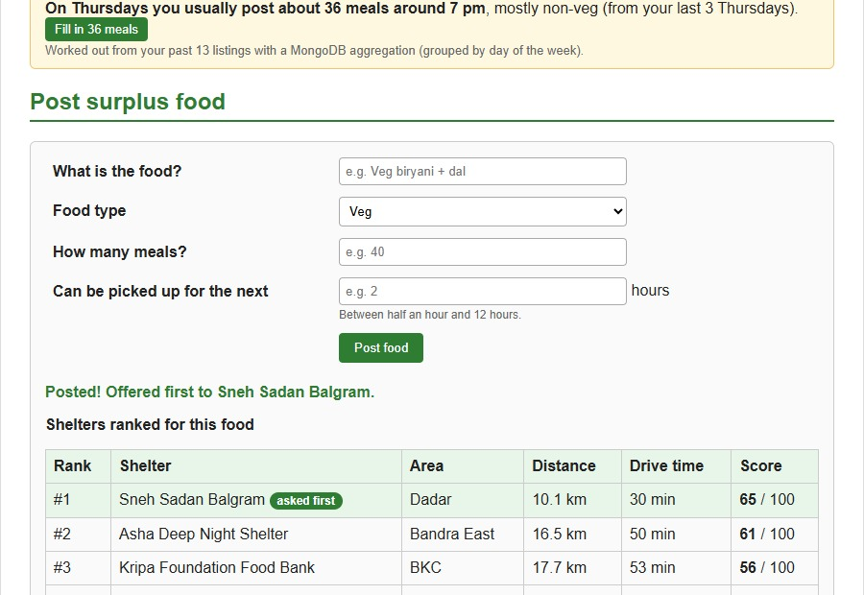
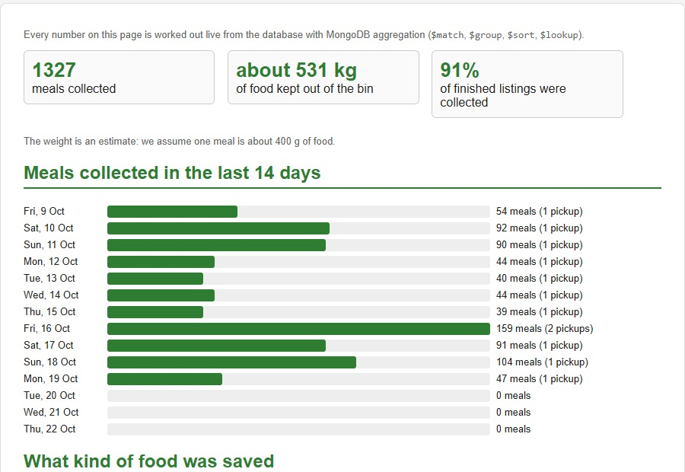
Implementation & Results
Ten working pages, one pickup from post to plate.
Separate sign-up · JWT for 3 roles · ranked cascade · handover code · admin verification · two-way ratings · surplus prediction · live impact charts
Donor dashboard
Impact dashboard
Ranked shelters with distance, drive time and score. Live countdown, then a box for the handover code.
Every figure built live from MongoDB aggregation: meals a day, food types, collected against expired.
100 automated tests pass
3 roles, one database
91% of finished listings
~5,300 lines of code
44 on the API, 56 in a real browser
donor, recipient and admin
were collected, not wasted
2,940 front end, 2,385 back end
Notes:
Ten pages, all sharing one MongoDB database. On the donor dashboard you post food and the ranked shelters appear immediately with distance, drive time and score, a live countdown, and once a shelter accepts, a box to type their handover code. The impact dashboard on the right is built entirely from MongoDB aggregation pipelines: meals saved per day, the food type split, collected against expired, and the kitchens and shelters that did the most. We did not test by clicking around and hoping. There are a hundred automated checks: forty-four calling the API directly and fifty-six driving a real browser with a donor in one window and a shelter in another. All of them pass, and the browser tests also fail on any JavaScript error. Next we would deploy it and add SMS alerts, so a shelter does not have to keep the page open.

