Slide 1
Driver Drowsiness Detection System
Made by:-
Rohan Agrawal
Graphic Era University
Dehradun, India

Slide 2
1. Introduction & Purpose
The Drowsiness Detection System is an advanced real-time safety monitoring solution that utilizes computer vision to mitigate risks associated with driver fatigue and inattention, particularly for those operating vehicles or heavy machinery. The system relies on a standard webcam to capture continuous facial and eye data, which is analyzed using sophisticated computer vision algorithms. By tracking eye movements, blink duration, and patterns, it identifies signs of drowsiness, such as prolonged eye closure or frequent blinking. At its core, the system employs a convolutional neural network (CNN) model trained on extensive datasets to distinguish between "open eyes" (alert) and "closed eyes" (drowsy) states with high accuracy. Upon detecting drowsiness, the system issues real-time alerts, including auditory alarms, visual warnings, or physical vibrations, to prompt the individual to refocus. This integration of computer vision, machine learning, and real-time monitoring makes the system a vital tool for enhancing safety and preventing accidents caused by fatigue.

Slide 3
2. How It Works
Video Capture & Processing
Uses a standard webcam to capture video in real-time
Processes each frame of video to detect faces
Displays a mirror view for user comfort
Optimizes image size for efficient processing
Face & Eye Detection
Locates the user's face in each video frame
Identifies specific facial landmarks, focusing on the eyes
Creates a digital map of key points around each eye
Tracks these points continuously in real-time
Drowsiness Detection
Measures the openness of eyes using Eye Aspect Ratio (EAR)
EAR is calculated by measuring the distance between key points around the eyes
Monitors changes in EAR over multiple frames
Identifies patterns that indicate drowsiness

Slide 4
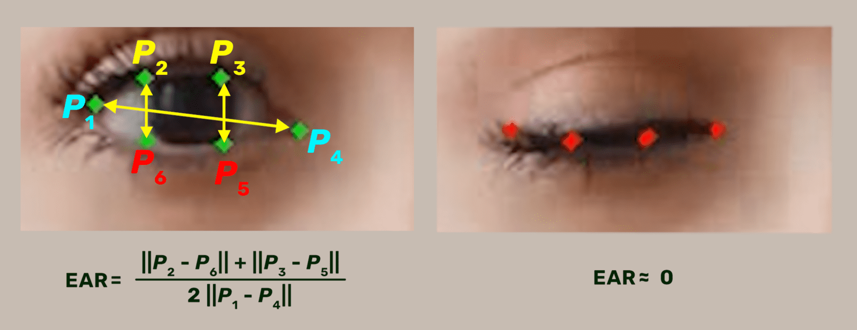
Alert System
Visual Warnings: Displays warning messages on screen when drowsiness is detected
Audio Alerts: Plays a warning sound to alert the user
Real-time Response: Alerts are triggered immediately when drowsiness is detected

Slide 5
3. Key Features
Real-time Monitoring
Continuous eye tracking
Instant response to drowsiness signs
Non-intrusive monitoring process
User-friendly interface
Smart Detection
Advanced facial recognition
Precise eye movement tracking
Drowsiness pattern recognition
Multiple frame verification to reduce false alarms
Alert System
Dual alert mechanism (visual and audio)
Clear warning messages
Immediate alert triggering
Attention-grabbing notifications

Slide 6
4. Applications
Transportation Industry
Long-haul truck drivers
Bus operators
Taxi and ride-share drivers
Train operators
Workplace Safety
Heavy machinery operators
Control room monitors
Assembly line workers
Night shift personnel
Personal Use
Private vehicle drivers
Students during long study sessions
Professionals working extended hours
Anyone at risk of drowsiness during critical tasks

Slide 7
5. Benefits
Safety Enhancement
Prevents drowsiness-related accidents
Provides early warning of fatigue
Increases user awareness
Promotes safer working conditions
Practical Advantages
Easy to set up and use
Works with standard webcams
Non-invasive monitoring
Real-time protection
Cost-Effective
Uses existing hardware
Minimal setup required
Low maintenance needs
Prevents costly accidents

Slide 8
6. Future Potential
Technical Enhancements
Integration with machine learning for improved accuracy
Additional biometric monitoring capabilities
Customizable alert systems
Mobile device compatibility
Expanded Applications
Vehicle system integration
Remote monitoring capabilities
Data analytics for pattern recognition
Multi-user monitoring systems

Slide 9
7. Technical Requirements
Hardware Needs
Computer with webcam
Audio output capability
Sufficient processing power
Stable lighting conditions
Software Components
Face detection system
Eye tracking algorithm
Alert system components
User interface elements

Slide 10
Conclusion
Looking forward, the system's foundation opens doors to numerous technological advancements and applications. The potential integration with artificial intelligence and machine learning could further enhance its accuracy and capabilities, while expansion into mobile and cloud-based implementations could broaden its accessibility and impact. The system's influence extends beyond immediate safety benefits to include economic advantages through reduced accident-related costs and insurance expenses, as well as healthcare benefits by preventing fatigue-related injuries and supporting occupational health programs. As regulations around safety monitoring continue to evolve, this system stands as a benchmark for proactive safety measures, demonstrating how technology can be effectively harnessed to protect lives and prevent accidents across various sectors of society.
The Drowsiness Detection System ultimately represents more than just a technological solution; it embodies a fundamental shift in how we approach safety monitoring and accident prevention. Its combination of advanced technology, practical implementation, and broad applicability makes it a crucial tool in the ongoing effort to enhance public safety and workplace protection. As the system continues to evolve and find new applications, its potential for saving lives and preventing accidents positions it as a significant contributor to public safety infrastructure.

Slide 11
Thank You

