Slide 2
Anaconda Distribution
The open-source Anaconda Distribution is the easiest way to perform Python/R data science and machine learning on Linux, Windows, and Mac OS X.
it is used for developing, testing, and training on a single machine, enabling individual data scientists to:
Quickly download 1,500+ Python/R data science packages
Manage libraries, dependencies, and environments with Conda
Develop and train machine learning and deep learning models with scikit-learn, TensorFlow, and Theano
Analyze data with scalability and performance with Dask, NumPy, pandas

Slide 3
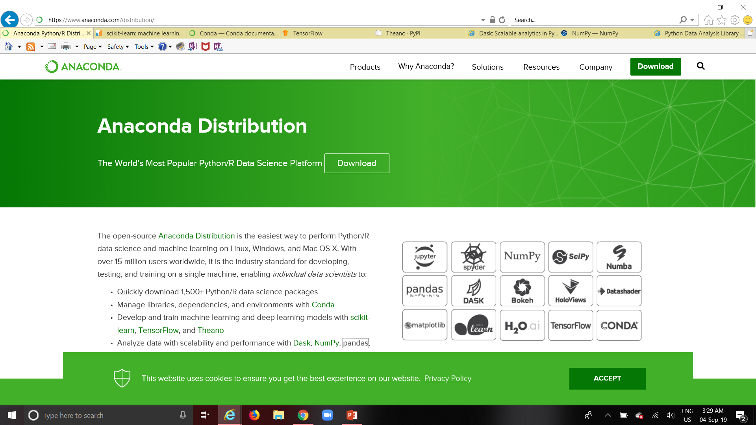
Anaconda Distribution

Slide 4
CONDA
Package, dependency and environment management for any language—Python, R, Ruby, Lua, Scala, Java, JavaScript, C/ C++, FORTRAN, and more.
Conda is an open source package management system and environment management system that runs on Windows, macOS and Linux.
Conda quickly installs, runs and updates packages and their dependencies.
Conda easily creates, saves, loads and switches between environments on your local computer.
It was created for Python programs, but it can package and distribute software for any language.
Conda as a package manager helps you find and install packages.
If you need a package that requires a different version of Python, you do not need to switch to a different environment manager, because conda is also an environment manager. With just a few commands, you can set up a totally separate environment to run that different version of Python, while continuing to run your usual version of Python in your normal environment.
In its default configuration, conda can install and manage the thousand packages at repo.anaconda.com that are built, reviewed and maintained by Anaconda®.

Slide 5
NumPy
NumPy is the fundamental package for scientific computing with Python. It contains :
a powerful N-dimensional array object
sophisticated (broadcasting) functions
tools for integrating C/C++ and Fortran code
useful linear algebra, Fourier transform, and random number capabilities
Besides its obvious scientific uses, NumPy can also be used as an efficient multi-dimensional container of generic data. Arbitrary data-types can be defined. This allows NumPy to seamlessly and speedily integrate with a wide variety of databases.

Slide 6
PANDAS
pandas enabling you to carry out your entire data analysis workflow in Python without having to switch to a more domain specific language like R.
pandas is an open source, BSD-licensed library providing high-performance, easy-to-use data structures and data analysis tools for the Python programming language
pandas is a NumFOCUS sponsored project. This will help ensure the success of development of pandas as a world-class open-source project, and makes it possible to donate to the project.
pandas does not implement significant modeling functionality outside of linear and panel regression; for this, use statsmodels and scikit-learn.

Slide 7
scikit-learn
Machine Learning in Python
Simple and efficient tools for data mining and data analysis
Accessible to everybody, and reusable in various contexts
Built on NumPy, SciPy, and matplotlib
Open source, commercially usable - BSD license

Slide 8
TensorFlow
TensorFlow is an end-to-end open source platform for machine learning. It has a comprehensive, flexible ecosystem of tools, libraries and community resources that lets researchers push the state-of-the-art in ML and developers easily build and deploy ML powered applications.

Slide 9
Theano
Theano is a Python library that allows you to define, optimize, and efficiently evaluate mathematical expressions involving multi-dimensional arrays. It is built on top of NumPy
.

Slide 10
Dask
Dask natively scales Python
Dask provides advanced parallelism for analytics, enabling performance at scale for the tools you love
Dask is open source and freely available. It is developed in coordination with other community projects like Numpy, Pandas, and Scikit-Learn

Slide 11
Jupyter Notebook
The Jupyter Notebook is a web-based interactive environment that combines code, rich text, images, videos, animations, mathematical equations, plots, maps, interactive figures and widgets, and graphical user interfaces, into a single document.
This tool is an ideal gateway to high-performance numerical computing and data science in Python, R, Julia, or other languages.
Install the Anaconda distribution, which comes with Jupyter and almost all Python libraries

Slide 12
Machine Learning Python Packages
There is a rich number of open source libraries available to facilitate practical machine learning. These are mainly known as scientific Python libraries and are generally put to use when performing elementary machine learning tasks. At a high level we can divide these libraries into data analysis and core machine learning libraries based on their usage/purpose.
Data analysis packages: These are the sets of packages that provide us the mathematic and scientific functionalities that are essential to perform data preprocessing and transformation.
Core Machine learning packages: These are the set of packages that provide us with all the necessary machine learning algorithms and functionalities that can be applied on a given dataset to extract the patterns.
Data Analysis Packages
There are four key packages that are most widely used for data analysis.
• NumPy
• SciPy
• Matplotlib
• Pandas
Core Machine learning packages
• Scikit-learn
Scikit-learn is the most popular and widely used machine learning library. It is built on top of SciPy and features a rich number of supervised and unsupervised learning algorithms.

