Slide 1
Project Name – Hotel Booking EDA
Project Type – EDA
Contribution - Rohan Bhore
Guided By – Abhishek Wavhal

Slide 2
CONTENT
Project Summary
Know Your Variable
Problem Statement
Features Engineering
Business Objective
Graphical Visualization
Data Exploration
Conclusion

Slide 3
Project Summary –
This Project Understands the Business done by Hotel Group. This Dataset had two Hotels City Hotel and Resort Hotel. The data provided was 3 years 2015,2016 and 2017 , we also have the revenue and booking details with no of days of stay and booking cancellation ,total number of guests including children . It also specifies guests wait period for booking,repeatation of guests ,their food choices among others .
The data also gives us an analysation of countries from which bookings have been done . We also a agent and other channels who also help in business by booking rooms for guests on the resort and city hotel behalf.

Slide 4
The data is divided between city hotel and resort hotel.Hence we can make a fair comparision between both.
Before visualize any data from the data set we will do the data cleaning as to fill any null values and delete any duplicated values and after that we have to data wrangling
Also we will do our analysis for both city and resort as individual businesses and in com[parision to one another .We will also take help of charts for better analysis

Slide 5
Problem Statement -
This data set contains booking information for a city hotel and a resort hotel,and includes information such as when the booking was made,the number of adults,children,and /or babies,and the number of available parking spaces ,which agent made the booking ,among other things
The objective of this project is explore and analyze data to discover important factors that govern the bookings.

Slide 6
Define Your Business Objective?
Analyze and visualize the data on bookings of city Hotel and Resort Hotel to gain insights on the different factors that effects the booking and ADR .

Slide 7
Data Explore -
Total Rows = 119390 Total Columns = 32
SR Action Effected Rows Columns
(Records)
1. Remove Errors 4 Rows removed 119386 32(No change)
2. Remove Blank 0 rows removed 119386 32(no change)
Records
3. remove Duplicate 31994 Records 87392 32(No Change)
4. Find Null Records 1-Country(452) 87392 32(No change)
2-Agent(12191-31%)
3-company(94%)
6. Add Primary Key 1 column Added 87392 33
Booking Id(column)

Slide 8
KYV – Know Your Variable :
1)Hotel Type : Hotel Type (City & Resort)
2)Booking Id : Unique Booking Id for Each Booking(PK)
3)Is_cancelled : After Booking Any Cancellation
4)lead_time : Hrs Before Booking
5)Arrival Date : Arrival Date of Customers
6)Stay’s_Weeknights : Stay of weeknights
7)Stay’s WeekendNights : Stays’s of Weekend Nights
8)Total Stay : It add total Stay in Weeknights and total Stay in Week_end_nights
9)Adults : Adults in per Bookings
10)Childerens : Childrens in per Booking .
11)Babies : Babies in per Booking.

Slide 9
12)Total Customers : Adults + Childrens + Babies
13) Meal : Assigned Meal with Booking .
14) Country : Booking Country.
15) Market Segment : Market Segment Type .
16)Distribution Channel : Distribution Channel Type .
17)Is_Repeated_Guest : Shows Repeated Bookings (yes 1 no=0) .
18)Previous_Cancellation : Shows Prev cancellation (yes =1,no=0) .
19)Previous Booking not Cancelled : Shows Customer Cancelled booking prev or not .
20)Reserved_Room Type : Shows reserved room type for customer.
21) Assigned Room Type : Shows Which Room Type is Assigned to Customer .
22)Booking changes : Shows Booking changes .
23)Deposite_Type : Shows The Deposite Type .

Slide 10
24)Agent : Agent Type .
25)Customer Type : Customer Type .
26)ADR :Shows Average Daily Rate .
27)Required_car_Parking : Total Required car Parking .
28)Total Special Request : Shows Total Special request .
29)Reservation Status : Shows Reservation Status .
30)Reservation Status Date : Shows Reservation Status Date .
31)Customer Satisfaction : Shows Customer Satisfaction .
32)Days in Waiting List : No of Days of Waiting .

Slide 11
>>Feature Engineering :
1)Add Primary Key Booking Id .
2)Removed Arrival Day,Month and Year Column and Merge It in Arrival Date Column .
3)Merged stay in Weekend nights and weeknights into single column name Total Stay
4)Merged Adults ,babies and Childrens in Total Customers Column .
5)In country Column replace the Null with Self Country .
6)Replace Agent Column Nulls with Direct Visit Booking .
7)Based of Reserved Rooms and Assigned Rooms New Column Created Name As Customer Satisfaction .
8)Coverts the Data types of Columns which Required to Convert Like Numerical Columns is converted into the Whole Number,Text Into the Text and Date Column into The Date.
1 -

Slide 12
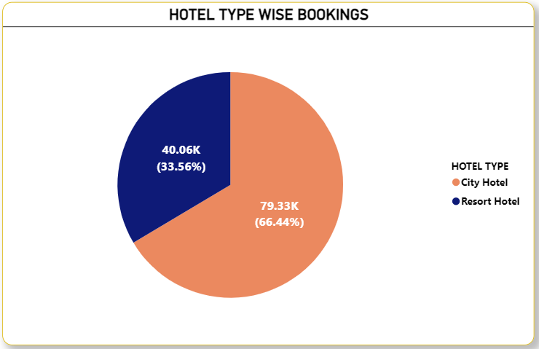
What is Booking Rate of Each Type of Hotel ?

Slide 13
Why did you pick the specific chart?
I took the Pie Chart for Simple Visualization to understand which Hotel Have more booking City Or Resort .
What is/are the insight(s) found from the chart ?
Based on above Chart we see City Hotel done 66.44% bookings and Resort Hotel done 33.56% bookings Which means City Hotel makes more bookings and Resort Hotel makes less bookings .
Will the gained insights help creating a positive business impact?
Are there any insights that lead to negative growth? Justify with specific reason.
Yes, Resort Hotel Staff will look how City Hotel Staff works and what is Working Algorithms of City Hotel so Resort Hotel Can Genarates the booking like City Hotel. City Hotel Can Provides more facility & services services for continuous growth.

Slide 14
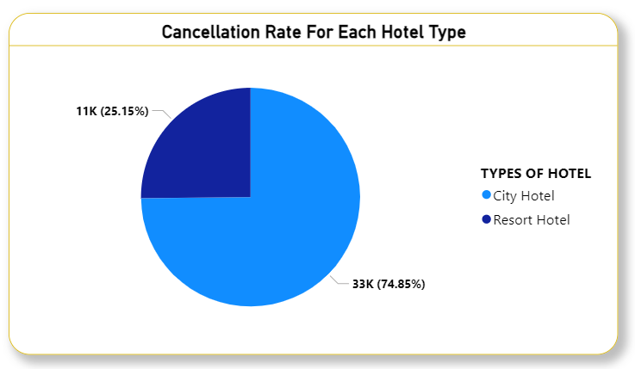
What is the Cancellation Rate for Each Hotel Type ?

Slide 15
Why did you pick the specific chart?
I took the Pie Chart for Simple Visualization to understand which Hotel Have more Cancellation Rate City Or Resort .
What is/are the insight(s) found from the chart ?
Based on above Chart we see City Hotel have 74.85% Cancellation Rate and Resort Hotel have 25.15% Cancellation Rate Which means City Hotel makes more Cancellation Rate and Resort Hotel less Cancellation Rate .
Will the gained insights help creating a positive business impact?
Are there any insights that lead to negative growth? Justify with specific reason
From the chart, we can observe that City Hotel has a higher number of cancellations, but it also receives more no of bookings. This indicates that the City Hotel should investigate the factors contributing to its high cancellation rate.
On the other hand, Resort Hotel shows fewer cancellations, which is positive, but it also has fewer overall bookings. Therefore, the Resort Hotel should explore the reasons behind its cancellations as well as focus on strategies to increase bookings.
.

Slide 16
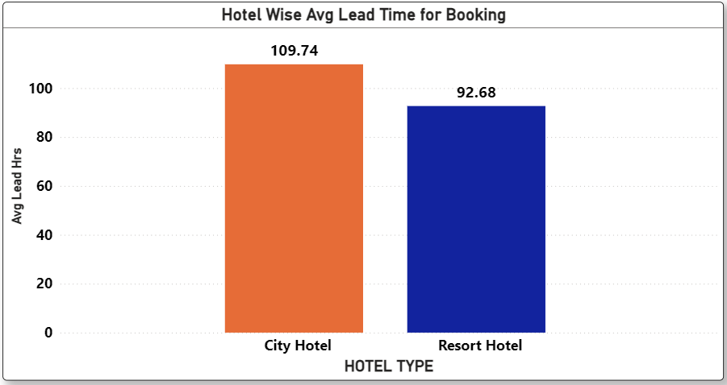
What is Average Lead-Time for the Booking ?

Slide 17
Why did you pick the specific chart?
I selected a Stacked Column Chart because it provides a clear and simple visualization of the waiting time for both hotel types (City Hotel and Resort Hotel) in one place. The stacked format makes it easy to compare:
What is/are the insight(s) found from the chart ?
City Hotel has a higher total waiting time compared to Resort Hotel.
This indicates that guests staying at City Hotel generally experience more delays before check-in.
Will the gained insights help creating a positive business impact?
Are there any insights that lead to negative growth? Justify with specific reason
Yes.
The insights show that City Hotel has higher waiting time, which helps management focus on improving check-in speed, staff allocation, and customer service — leading to better guest experience and higher bookings.
High waiting time at City Hotel can cause customer dissatisfaction, bad reviews, and increased cancellations, which may negatively affect revenue and growth.

Slide 18
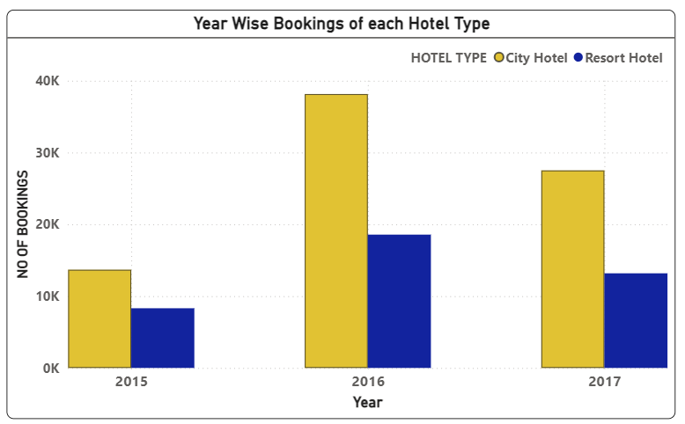
What is Year wise booking along with Hotel Type ?

Slide 19
Why did you pick the specific chart ?
I chose a Clustered Column Chart because it clearly compares the year-wise bookings of City Hotel and Resort Hotel side-by-side. This chart makes it easy to see how bookings changed each year and which hotel type received more bookings in each period.
What is/are the insight(s) found from the chart ?
Insights from the chart
1)City Hotel consistently has more bookings than Resort Hotel in all three years (2015, 2016, 2017).
2)2016 shows the highest bookings overall, especially for City Hotel.
3)Resort Hotel bookings are lower but stable, showing gradual growth from 2015 to 2017.
Will the gained insights help creating a positive business impact?
Are there any insights that lead to negative growth? Justify with specific reason
City Hotels are performing strongly across all years, while Resort Hotels show lower and slower growth. Focusing on improving Resort Hotel demand can help balance revenue and support long-term business growth.

Slide 20
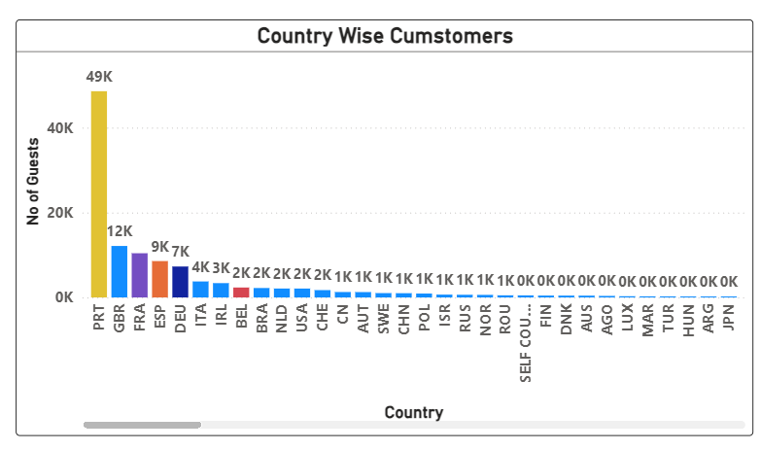
Which Country brings more Guests ?

Slide 21
Why did you pick the specific chart?
I chose this chart because it clearly compares the number of guests across different countries, making it easy to see which countries bring more or fewer guests. It provides a simple and direct visual comparison for better understanding.
What is/are the insight(s) found from the chart ?
The chart shows that the number of guests varies significantly across countries, with some countries contributing a much higher(like PRT,GBR) guest count than others. This helps identify the top guest-origin countries and those with low guest inflow.
Will the gained insights help creating a positive business impact?
Are there any insights that lead to negative growth? Justify with specific reason
Yes.
Knowing which countries contribute the most guests helps the hotel focus its marketing, promotions, and partnerships on high-performing countries, which can increase bookings and improve revenue.
Countries with very low guest counts indicate weak market presence. If not improved, this can lead to missed opportunities, low international reach, and slower business growth, as the hotel is not attracting guests from those regions.

Slide 22
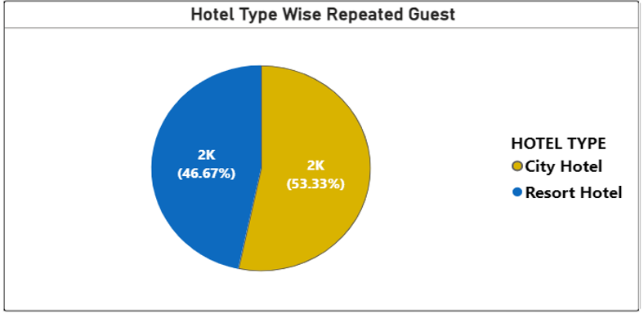
Which Hotel Type have more Repeated Booking ?

Slide 23
Why did you pick the specific chart?
I chose a Pie Chart because it clearly shows the proportion of repeated guests for each hotel type. It gives a quick, simple visual understanding of which hotel has a higher share of returning customers.
What is/are the insight(s) found from the chart ?
The chart shows that City Hotel has more repeated guests (2032 → 53.33%) compared to Resort Hotel (1778 → 46.67%). This means City Hotel has slightly stronger customer loyalty and returning guest rate. chart shows that City Hotel has more repeated guests (2032 → 53.33%) compared to Resort Hotel (1778 → 46.67%). This means City Hotel has slightly stronger customer loyalty and returning guest rate.
Will the gained insights help creating a positive business impact?
Are there any insights that lead to negative growth? Justify with specific reason
Yes.
City Hotel has more repeated guests (53.33%), which shows stronger customer loyalty. This helps the business focus on improving loyalty programs and enhancing services to maintain and grow repeat customers.
Resort Hotel has fewer repeated guests (46.67%), which may indicate lower satisfaction or weaker guest experience. If not improved, this can reduce future bookings and lead to negative growth.

Slide 24
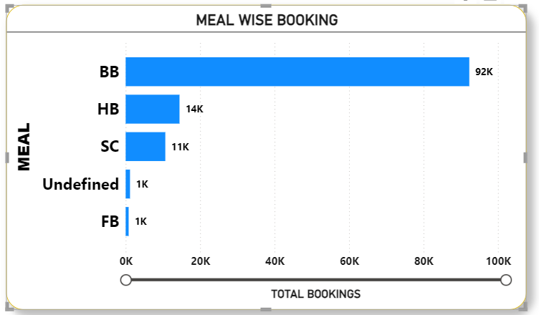
How Meal & Bookings are Correlated ?

Slide 25
Why did you pick the specific chart?
I selected a horizontal bar chart because it clearly compares the total bookings across different meal types. Since meal categories are text labels (BB, HB, SC, etc.), the bar chart makes it easy to see which meal has the highest and lowest bookings. The length of the bars provides a quick and simple visual comparison, making insights easy to interpret.
What is/are the insight(s) found from the chart ?
HB (Half Board) has 14K bookings, showing moderate preference.
SC (Self Catering) has 11K bookings.
FB (Full Board) and Undefined meals have very low bookings (around 1K).
BB (Bed & Breakfast) has the highest bookings with 92K, making it the most preferred meal type.
Will the gained insights help creating a positive business impact?
Are there any insights that lead to negative growth? Justify with specific reason
Yes.
Hotels can focus more on BB meal plans, as they clearly attract the highest number of guests.
Low demand for FB means the hotel may be over-spending on full-board meal preparation that guests aren’t choosing.

Slide 26
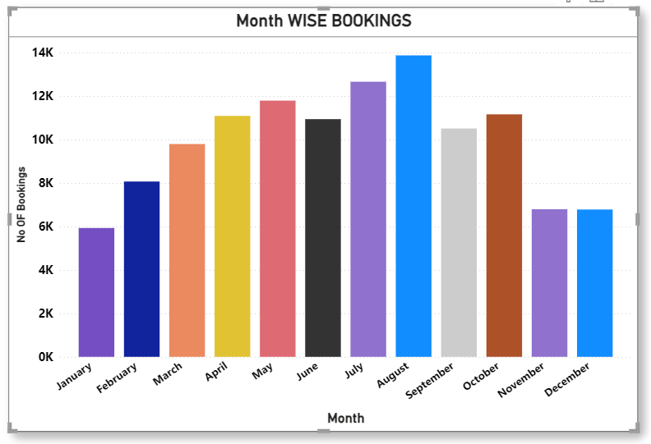
What is Month Wise Booking ?

Slide 27
Why did you pick the specific chart?
I chose a bar chart because it clearly compares the number of bookings across all 12 months.
It makes month-to-month variation easy to see and helps identify peak and low-demand periods quickly.
What is/are the insight(s) found from the chart ?
From the chart:
August has the highest bookings (~14K).
July, May, October, September also show strong performance (10K – 13K).
January and December have the lowest bookings (~6K – 7K).
Bookings gradually increase from Jan → Aug, then drop towards Nov–Dec.
Will the gained insights help creating a positive business impact?
Are there any insights that lead to negative growth? Justify with specific reason
Yes, they help the hotel plan staffing, pricing, and marketing strategies based on peak and off-peak months.
the drop in bookings during January and December indicates revenue loss due to off-season demand, which negatively impacts business.

Slide 28
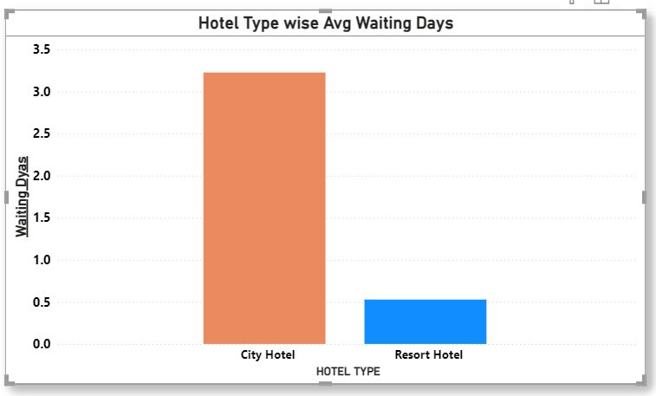
What is Avg Waiting Days for Each Hotel Type ?

Slide 29
Why did you pick the specific chart?
I chose a Bar Chart because it clearly compares the average waiting days between City Hotel and Resort Hotel. It is simple to understand, shows the difference in values clearly, and is the best choice for comparing a numeric value across categories.
What is/are the insight(s) found from the chart ?
City Hotel has a much higher average waiting time (~3.2 days) compared to Resort Hotel (~1 day).
This means guests booking City Hotel are waiting longer, which may signal higher demand, slower processing, or operational delays.
Will the gained insights help creating a positive business impact?
Are there any insights that lead to negative growth? Justify with specific reason
Yes.
The insight helps the hotel management understand that City Hotel has higher waiting days, so they can take actions to reduce delays and improve customer satisfaction.

Slide 30
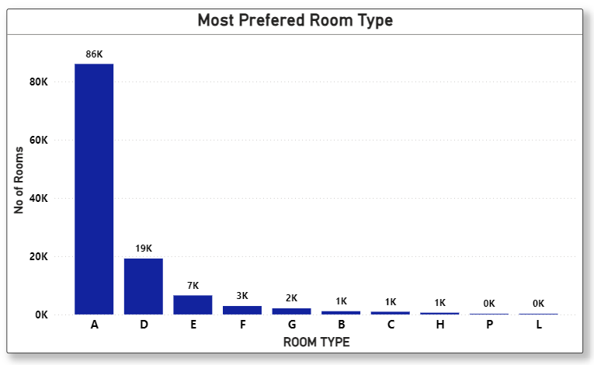
Which Room Type is Most Preferred By Customers during Booking ?

Slide 31
Why did you pick the specific chart?
I preferred a Stacked Column Chart because it clearly shows the distribution and comparison of room type counts in a single visual. It helps identify which room types are booked more or less, making the analysis easy to understand.
What is/are the insight(s) found from the chart ?
This helps identify the most popular and least preferred room types.
Some room types have significantly higher bookings, while others have very low counts.
Will the gained insights help creating a positive business impact?
Are there any insights that lead to negative growth? Justify with specific reason
Knowing which room types are in high demand helps the hotel:
Improve availability and pricing of popular room types , Plan inventory and maintenance , Design better room packages
This directly supports business growth.
Room types with very low booking counts indicate:
Low demand
Possible issues in pricing, design, or availability
If not addressed, these room types may contribute to revenue loss and underutilization, negatively impacting growth.

Slide 32
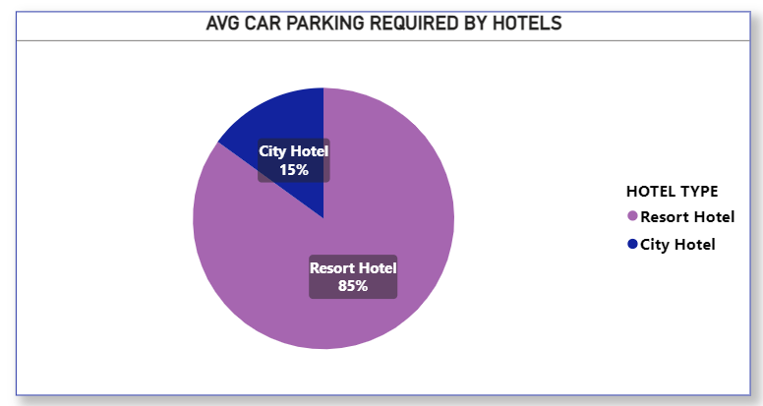
What Avg Car Parking Required By Hotels ?

Slide 33
Why did you pick the specific chart?
I used a Pie Chart because it clearly shows the proportion of required car parking spaces between City Hotel and Resort Hotel. It is simple and easy to compare percentage shares.
What is/are the insight(s) found from the chart ?
Resort Hotel requires 85% of car parking spaces.
City Hotel requires only 15%, showing very low parking demand.
Will the gained insights help creating a positive business impact?
Are there any insights that lead to negative growth? Justify with specific reason
Resort Hotel can optimize and improve parking facilities based on high demand.
City Hotel can save costs by avoiding extra parking investment.

Slide 34
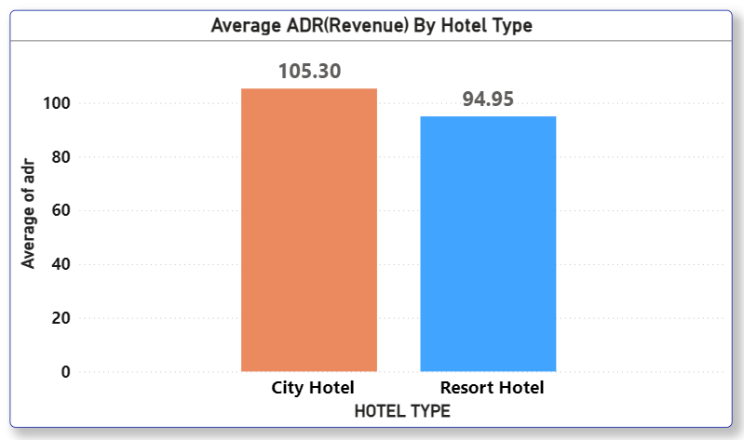
What Is Average Revenue(ADR) of Hotels ?

Slide 35
Why did you pick the specific chart?
A column (stacked column) chart makes it easy to compare magnitude of average ADR between hotel types — taller bar = higher revenue per room. It’s simple and quick for categorical comparisons.
What is/are the insight(s) found from the chart ?
City Hotel ADR (105.30) is higher than Resort Hotel ADR (94.95).
The difference (~10.35) suggests City rooms earn more per night on average.
Will the gained insights help creating a positive business impact?
Are there any insights that lead to negative growth? Justify with specific reason
Here we see that the City Hotel Have More avg ADR as compares to Resort Hotel it’s good but we noticed one thing that is the city hotel have more bookings as compare to Resort Hotel but Revenue difference is not like bookings means that indicate Resort hotel Make less booking but generates revenue nearest to the City hotel so City Hotel also need to check what is revenue model of Resort hotel and Resort hotel needs to increase the booking so it make more revenue which directly increases the profit.

Slide 36
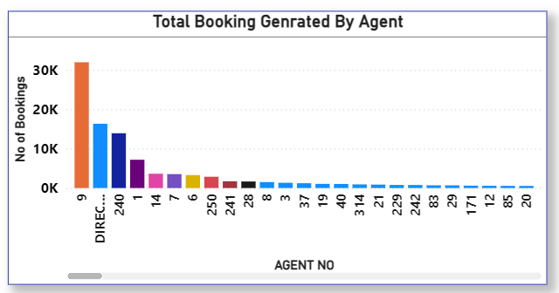
Which Agents done more Bookings ?
C

Slide 37
Why did you pick the specific chart?
A column chart clearly shows which agents generate the highest number of bookings and helps compare agent performance quickly.
What is/are the insight(s) found from the chart ?
A few agents (like Agent 9, 240, 14) generate the majority of bookings.
Many agents have very low booking counts, showing uneven performance.
Direct visit booking are in place of 2nd number so we can bost it to reduce agent commission.
Will the gained insights help creating a positive business impact?
Are there any insights that lead to negative growth? Justify with specific reason
High-performing agents can be prioritized and supported to boost revenue.
Low-performing agents indicate inefficiency, which may lead to missed sales if not improved.
Low-performing agents must be follow circulam which do by high performing agents.

Slide 38
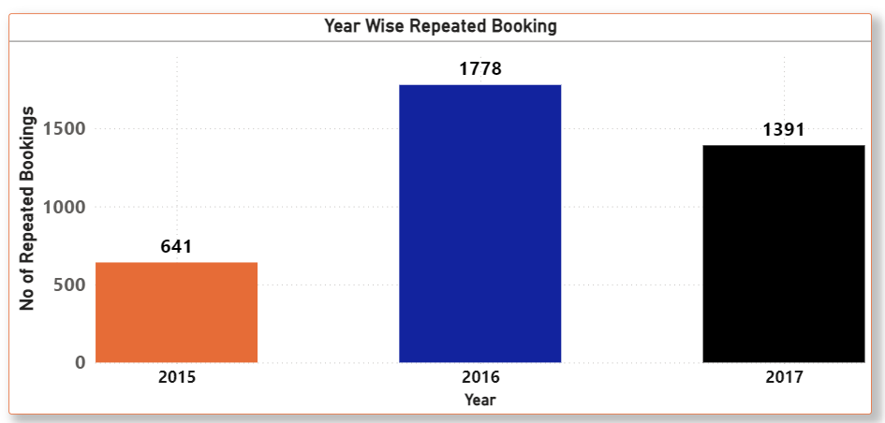
How Much Repeated Bookings in Each Year ?

Slide 39
Why did you pick the specific chart?
A column chart is best for comparing repeated bookings across different years visually and clearly.
What is/are the insight(s) found from the chart ?
Repeated bookings increased sharply from 2015 (641) to 2016 (1778).
They slightly declined in 2017 (1391) but remained higher than 2015.
Will the gained insights help creating a positive business impact?
Are there any insights that lead to negative growth? Justify with specific reason
Yes.
Rising repeated bookings show strong customer loyalty, useful for retention strategies.
Negative insight: Drop after 2016 suggests some customers may not be returning, indicating possible service or pricing issues.

Slide 40
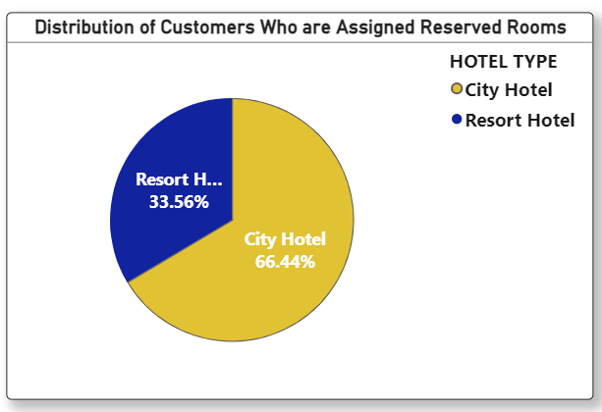
What is Distribution rate of Satisfied Bookings ?(such bookings who get such rooms which they are reserved during the booking based on this we find this ratio.)

Slide 41
Why did you pick the specific chart?
I used a Pie Chart because it clearly shows the proportion of customers who received their reserved rooms in City Hotel vs Resort Hotel. It’s the simplest way to compare two categories.
What is/are the insight(s) found from the chart ?
Here we see that City Hotel have 66.44% Customer Satisfaction ratio which greater than Resort Hotel who have 33.56 % Satisfaction ratio.
Will the gained insights help creating a positive business impact?
Are there any insights that lead to negative growth? Justify with specific reason
The insights help create a positive business impact because they show that City Hotels handle reserved-room assignments efficiently, which can be continued, and Resort Hotels need improvement. However, the lower assignment rate at Resort Hotels is a negative insight that may lead to customer dissatisfaction and affect growth if not resolved.
This may be one of the reason of less bookings of resort hotel so if Resort deals it and Handle it then They can also generates the more bookings.

Slide 42
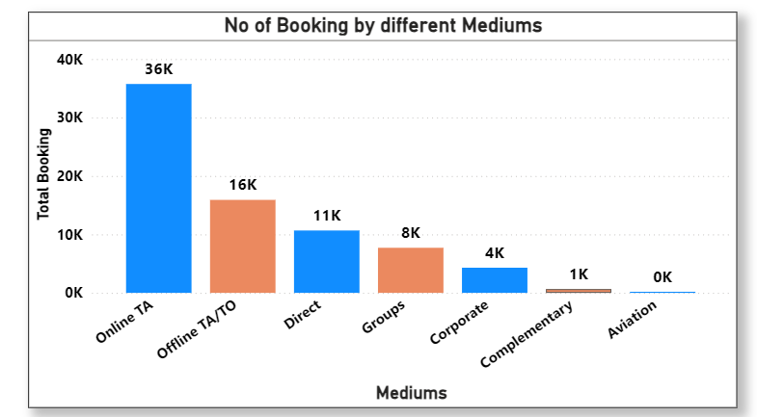
From which Medium most no of bookings are done ?

Slide 43
Why did you pick the specific chart?
I used a bar chart because it clearly compares the number of bookings across different mediums, making it easy to see which channel performs best.
What is/are the insight(s) found from the chart ?
The Insights :
Online TA has the highest bookings (36K).
Offline TA/TO is the second highest (16K).
Direct, Groups, Corporate have moderate bookings.
Complementary and Aviation contribute very little.
Will the gained insights help creating a positive business impact?
Are there any insights that lead to negative growth? Justify with specific reason
These insights help focus marketing and partnership efforts on high-performing mediums like Online TA while improving weaker channels. However, very low bookings in Complementary and Aviation indicate underperforming segments that may negatively affect growth if not optimized.

Slide 44
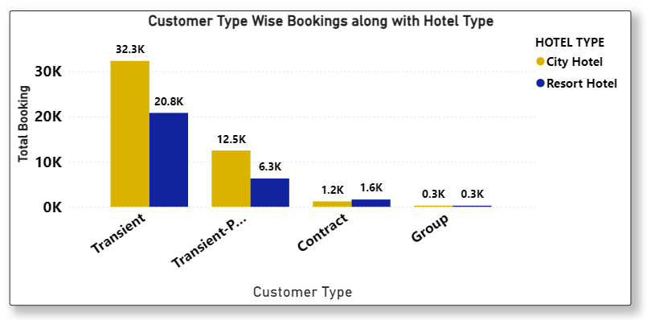
Which types of Customers done more booking and in Which hotels?

Slide 45
Why did you pick the specific chart?
I used a clustered column chart to easily compare customer types across City vs Resort Hotels side-by-side.
What is/are the insight(s) found from the chart ?
Transient customers form the largest share for both hotels (City: 32.3K, Resort: 20.8K).
Transient-Party is the second highest for both hotels.
Contract and Group customers contribute very little.
City Hotel consistently has more bookings than Resort Hotel in all customer types.
Will the gained insights help creating a positive business impact?
Are there any insights that lead to negative growth? Justify with specific reason
The chart shows that Transient and Transient-Party customers bring most of the bookings, so focusing on them can help increase revenue. But Contract and Group customers have very few bookings, which is a weak area and could slow growth if not improved.

Slide 46
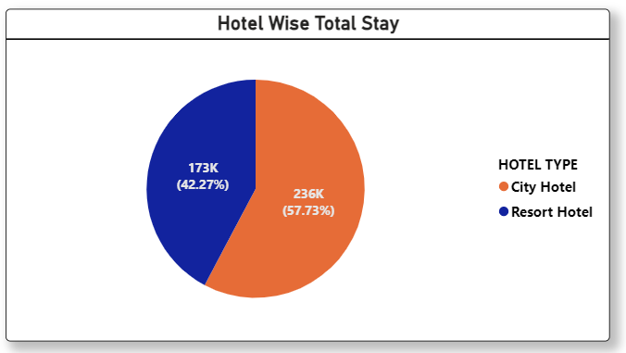
What is Total Stay percentage of each Hotel ?

Slide 47
Why did you pick the specific chart?
I used a pie chart because it clearly shows the percentage share of total stays between City Hotel and Resort Hotel.
What is/are the insight(s) found from the chart ?
City Hotel has the higher total stay: 236K (57.73%)
Resort Hotel, while lower, still has a significant share: 173K (42.27%)
City Hotel handles more total stays overall.
Will the gained insights help creating a positive business impact?
Are there any insights that lead to negative growth? Justify with specific reason
City Hotel has the more total stays than Resort Hotel ,Which is good for revenue . But Resort Hotel’s lower stay count shows weakness that should be improved to avoid slowing overall growth.
It is noticeable that the Resort hotel have 42.27 % stay which less than city hotels but when we see the booking difference between both hotel then we can understand the resort hotel stay % is very impressive.

Slide 48
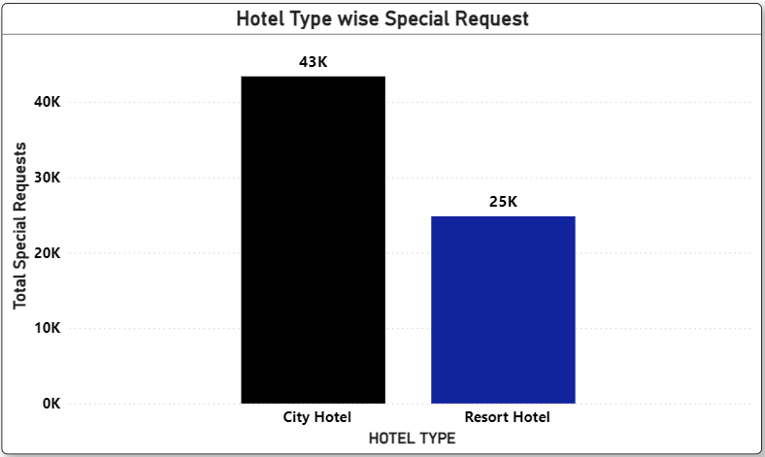
How much Special request received to each Hotel ?

Slide 49
Why did you pick the specific chart?
I used a column chart because it clearly compares the number of special requests between City Hotel and Resort Hotel in a simple and direct way.
What is/are the insight(s) found from the chart ?
City Hotel has more special requests (43K).
Resort Hotel has fewer special requests (25K).
City Hotel guests may require more personalised services.
Will the gained insights help creating a positive business impact?
Are there any insights that lead to negative growth? Justify with specific reason
These insights are helpful because they show how many special services guests need, so hotels can plan staff and improve service. But there is also a possible problem: City Hotel gets too many special requests, which can increase pressure on staff, and Resort Hotel gets too few requests, which may mean guests are less active or engaged. Both situations can affect growth if not handled properly.

Slide 50
Conclusion :
1)We found Out of Total Bookings the City hotel makes 66.44% and Resort hotel makes 33.56% bookings means City hotel have more bookings percentage.
2) City Hotel have 74.85% Cancellation Rate and Resort Hotel have 25.15% Cancellation Rate Which means City Hotel has Cancellation Rate and Resort Hotel less Cancellation Rate so City hotel need to look into .
3) City Hotel has a higher total waiting time compared to Resort Hotel.
This indicates that guests staying at City Hotel generally experience more delays before check-in.
4) City Hotel consistently has more bookings than Resort Hotel in all three years (2015, 2016, 2017), 2016 shows the highest bookings overall, especially for City Hotel, Resort Hotel bookings are lower but stable, showing gradual growth from 2015 to 2017.
5) The number of guests varies significantly across countries, with some countries contributing a much higher(like PRT,GBR) which around brings 50k guest. This helps identify the top guest-origin countries and those with low guest inflow.
6) City Hotel has more repeated guests (2032 → 53.33%) compared to Resort Hotel (1778 → 46.67%). This means City Hotel has slightly stronger customer loyalty and returning guest rate.

Slide 51
7)HB (Half Board) has 14K bookings, showing moderate preference , SC (Self Catering) has 11K bookings , FB (Full Board) and Undefined meals have very low bookings (around 1K),BB (Bed & Breakfast) has the highest bookings with 92K, making it the most preferred meal type.
8) August has the highest bookings (~14K).
July, May, October, September also show strong performance (10K – 13K).
January and December have the lowest bookings (~6K – 7K).
Bookings gradually increase from Jan → Aug, then drop towards Nov–Dec.
9) City Hotel has a much higher average waiting time (~3.2 days) compared to Resort Hotel (~1 day).
10)The most preferred room type is A type around 86k bookings prefers this room type and 2nd is B which is around 19k bookings prefrrs but remaining are room type is prefers in less than 10 k bookings.
11) Resort Hotel requires 85% of car parking spaces.
City Hotel requires only 15%, showing very low parking demand.
12) City Hotel ADR (105.30) is higher than Resort Hotel ADR (94.95).
The difference (~10.35) suggests City rooms earn more per night on average.
13) A few agents (like Agent 9, 240, 14) generate the majority of bookings , Many agents have very low booking counts, showing uneven performance.
Direct visit booking are in place of 2nd number so we can boost it to reduce agent commission.

Slide 52
14) Repeated bookings increased sharply from 2015 (641) to 2016 (1778) ,
They slightly declined in 2017 (1391) but remained higher than 2015.
15) Here we see that City Hotel have 66.44% Customer Satisfaction ratio which greater than Resort Hotel who have 33.56% Satisfaction ratio.
16 ) Online TA has the highest bookings (36K).
Offline TA/TO is the second highest (16K).
Direct, Groups, Corporate have moderate bookings.
Complementary and Aviation contribute very little.
17) Transient customers form the largest share for both hotels (City: 32.3K, Resort: 20.8K).
Transient-Party is the second highest for both hotels.
Contract and Group customers contribute very little.
City Hotel consistently has more bookings than Resort Hotel in all customer types.
18 ) City Hotel has the higher total stay: 236K(days)(57.73%)
Resort Hotel, while lower, still has a significant share: 173K (days)(42.27%)
City Hotel handles more total stays overall.

Slide 53
19 )City Hotel has more special requests (43K).
Resort Hotel has fewer special requests (25K).
City Hotel guests may require more personalised services .

Slide 54
Thank You …..

