Slide 1
Use of Digital Technology to calculate water footprints for different daily use items
CSE7101- Capstone Project
Review-2
Batch Number: CSE_59
Under the Supervision of,
Mr. Asad Mohammed Khan
Assistant Professor
School of Computer Science and Engineering
Presidency University
Roll Number | Student Name
20221CSE0009 20221CSE0004 20221CSE0012 | Rohan Das Koushiki Banik Amrutha S
Name of the Program: Computer Science And Engineering
Name of the HoD: Dr. Asif Mohammed
Name of the Program Project Coordinator: Dr. Jayavadivel Ravi
Name of the School Project Coordinators: Dr. Sampath A K , Dr. Geetha A

Slide 2
Problem Statement Number: PSCS_4
Organization: Ministry of Jal Shakti
Category (Hardware / Software / Both) : Software
Problem Description:
To design and develop a digital solution that accurately calculates and displays the water footprint of various daily-use items, enabling users to make informed and sustainable consumption choices.

Slide 3
Content
Problem Statement
Abstract
Literature Survey
Objectives
Existing Methods and Drawbacks
Proposed Method and Feasibility Study
Architecture Diagram
Modules
Hardware and Software Details
Timeline
References

Slide 4
Abstract
The concept of the water footprint provides a comprehensive measure of the freshwater consumed and polluted in the production and consumption of goods and services. With increasing global concerns over freshwater scarcity, there is a pressing need to make individuals more aware of their indirect water consumption through everyday products. This project proposes a digital technology–based solution to calculate and visualize the water footprint of daily-use items. By integrating reliable datasets from sources such as the Water Footprint Network and FAO CROPWAT, the system enables users to explore blue, green, and grey water usage for products ranging from food to clothing. Unlike existing technical tools that are often tailored for researchers and policymakers, this project emphasizes user-friendly design, interactive visualization, and accessibility for the general public, thereby fostering informed decision-making and sustainable consumption practices.

Slide 5
Literature Survey
Zhang et al. (2013) – Water Footprint Assessment (WFA) defines the water footprint as a multidimensional metric (blue, green, grey water) of all water consumed or polluted along a product’s supply chain . The WFA framework (goal‐setting, accounting, sustainability assessment, response) explicitly identifies “hotspots” where water use violates sustainability criteria, providing a basis for directing efficient, equitable water management actions .
Ridoutt & Pfister (2010) – Introduced a stress-weighted water footprint method that multiplies water use by a local water‐scarcity factor. Using it on food products (pasta sauce vs. peanut M&M’s), they showed that a 575 g jar of pasta sauce has over 10× the water‐scarcity impact of a 250 g bag of M&M’s (contrary to raw volume: 202 L vs. 1153 L). This approach revealed that tomato irrigation (high stress region) dominated the sauce’s impact, whereas ingredients like sugar (from water abundant regions) contributed negligibly to scarcity . About 48–81% of the stress-weighted footprint even occurred outside the country of consumption, underscoring global supply-chain impacts .
Ercin & Hoekstra (2017) – Review the evolution of WF methodology: early studies (Hoekstra et al. 2002) used FAO CropWat and trade data, with the first global grid-based WF maps published in 2011 (5′×5′ resolution) . Since then, more advanced crop models (FAO AquaCrop, EPIC, LPJmL) and remote sensing have been used to refine footprints. Time-series analyses have begun (year-by-year WFs), though scenario studies (diet, population, climate) are still few . The Water Footprint Network issued a Global WFA Standard (finalized 2011) for WF accounting, and ISO published an LCA-based WF standard (2014) – though the ISO approach (multiplying water use by local scarcity factors) is debated due to methodological differences .

Slide 6
Literature Survey
Hoekstra & Mekonnen (2012, PNAS) – Mapped humanity’s WF at high resolution (1996–2005). They found the global annual WF was ~9,087 km³/yr (74% green, 11% blue, 15% grey water) , with agriculture accounting for ~92% of total use. The average person’s WF was ~1,385 m³/yr (US ~2,842; China ~1,071; India ~1,089) . International virtual-water trade totaled 2,320 km³/yr (68% green) ; major exporters were the US (314 km³), China (143 km³) and India (125 km³) . Virtual water flows were largest in oil-crop (cotton, soy, etc.) products (43% of total) .
Hoekstra & Mekonnen (2011) – Assessed monthly blue-water scarcity in major river basins by comparing blue WF to natural runoff. They report that 201 basins experienced ≥1 month/year in which blue-water use exceeded 100% of runoff (i.e. violating ecological flows) . Many basins (especially in South Asia, the Middle East, North Africa, and western US) hit “severe” scarcity (>200% of runoff) during dry months. Globally, the area-weighted average scarcity was 85%, but population weighted scarcity was ~133% (and consumption-weighted ~244%) – meaning the typical person faces water use ~1.33× water availability. These results highlight that large regions operate under chronic seasonal water stress, requiring interventions.
Mekonnen & Gerbens - Leenes (2020) – Reviewed the WF of global food/crop production. Current estimates of the global consumptive (green + blue) WF of all crops range ~5,938–8,508 km³/yr (2011 value ~8,362 km³, 80% green ). They project the WF will rise ~22% by 2090 under climate and land-use change, with blue WF increasing ~70%. Critically, ~57% of today’s blue WF violates environmental flow requirements – indicating current irrigation and withdrawals are largely unsustainable. The study calls for measures (e.g. water productivity gains, dietary shifts, reducing waste) to curb the growing blue-WF and protect ecosystems .

Slide 7
Literature Survey
Gerbens - Leenes et al. (2009, PNAS) – Analyzed water footprints for bioenergy crops. They found bioelectricity has a much lower WF than biofuels: e.g. using sugar-beet biomass yields ~50 m³/GJ, whereas rapeseed (for biodiesel) is ~400 m³/GJ . Among biofuels, ethanol from sugar-beet or potato is most efficient (~60–100 m³/GJ), while biodiesel from jatropha or sorghum is worst (~400– 600 m³/GJ) . Expressed per litre of fuel, WFs span ~1,400–20,000 L water/L biofuel. These results imply that choice of crop and processing method crucially affects sustainability of bioenergy water use .
Chenoweth et al. (2014) – Provide a critical review of the WF concept. They note that differing methodologies produce “dramatically” varying WF estimates, which can confuse stakeholders . The WF concept has successfully raised awareness of hidden water use in supply chains , but unlike carbon footprints it does not account for local impacts. Thus its policy value is limited: it quantifies volume of use but not context-dependent stress, meaning WF alone cannot indicate true sustainability .
Chapagain & Tickner (2012) – Reflect on water footprint applications in business and policy. They conclude WF analysis is a powerful communication tool: it vividly reveals nations’ hydrological interdependence and engages non-experts (business leaders, politicians) in water issues . WF has been particularly useful for corporate water-risk assessment and motivating top-level action . However, they caution that WF is not a silver bullet: methods are imperfect and results must be contextualized with local hydrology and socio-economic factors . Overemphasis on volumetric WF without impact context can mislead, so WF should complement (not replace) other water management tools .

Slide 8
Objectives
To design and develop a user-friendly digital platform that calculates and displays the water footprint of daily-use items.
To integrate verified datasets (e.g., WFN, FAO CROPWAT) for accurate assessment of blue, green, and grey water footprints.
To provide interactive visualizations and comparisons of water usage across products for awareness and decision-making.
To promote sustainable consumption habits by enabling individuals to understand the hidden water costs of food, clothing, and household items.
To demonstrate the role of digital technology in bridging the gap between scientific research and public awareness.

Slide 9
Existing Methods
Water Footprint Network (WFN) Tools
Provides datasets and manuals for calculating blue, green, and grey water footprints.
Widely used in academic and industrial research.
FAO CROPWAT Model
Calculates crop water requirements and irrigation needs.
Mostly agricultural sector–focused.
Life Cycle Assessment (LCA) Tools
Integrate water use into broader environmental impact studies.
Used in industries for sustainability assessments.
Corporate Water Footprint Studies (e.g., Coca-Cola, Nestlé, PepsiCo)
Focus on operational and supply-chain footprints of specific companies.
Provide detailed insights for businesses but not accessible to general consumers.
National & Global Assessments (Hoekstra & Mekonnen, Shiklomanov)
Large-scale studies showing water footprints of nations, crops, and livestock.
Useful for policy and academic research.

Slide 10
Drawbacks
Complexity & Technical Focus
Most tools are designed for experts, requiring technical knowledge to interpret results.
Limited Accessibility for General Users
Consumers lack simple apps or calculators to check the water footprint of daily-use items.
Scope Restrictions
Many tools focus only on agriculture or corporate supply chains, ignoring common household items (e.g., clothes, packaged goods).
Methodological Variability
Different approaches (bottom-up vs. top-down) yield inconsistent results, causing confusion.
Lack of Visualization & Comparisons
Existing tools rarely provide interactive graphs/charts that help users easily compare products.
Policy vs. Awareness Gap
Studies guide governments/industries, but individual consumer awareness remains low.

Slide 11
Proposed Method and Feasibility Study
The method involves:
Dataset Integration
Build a structured dataset of daily items (food, clothing, technology, household goods) with associated blue, green, and grey water footprint values.
Sources: Water Footprint Network, FAO CROPWAT, Hoekstra & Mekonnen’s global water footprint studies.
Category-Based Browsing
Organize items into categories (Food, Clothing, Technology, Household) for intuitive exploration.
Real-Time Calculator
Allow users to select items and quantities, with instant cumulative updates of their total water footprint.
Breakdown & Visualization
Provide a stacked bar chart / pie chart of blue, green, and grey components using libraries such as Recharts or Chart.js.
Offer relatable comparisons (e.g., “This equals 120 bathtubs of water”).
Sustainability Guidance
Suggest alternative choices with lower footprints (e.g., “Choose lentils instead of beef to save 1,500 liters per meal”).
Search & Mobile Optimization
Include a search bar for quick item lookup.
Ensure a responsive design for accessibility across devices.
Now that the Edge Function is deployed and connected to the calculator, you can : Calculate your water footprint .Save the calculation (it will be stored in Supabase) .Automatically receive AI-powered recommendations. View your calculations and recommendations in the dashboard .
The recommendations will include : Specific alternatives to high-impact items. Estimated water savings Implementation difficulty and cost-efficiency ratings .Personalized suggestions based on your usage patterns

Slide 12
Proposed Method and Feasibility Study
1. Technological Feasibility
Frontend: Built with React + TypeScript (scalable and type-safe).
Styling: TailwindCSS ensures responsive and modern UI.
Data Handling: Static JSON/CSV for baseline datasets; can scale to API integration later.
Visualization: Use Recharts or Chart.js for interactive graphs. Feasible with currently available open-source technologies.
2. Cost Feasibility
Development Cost: Minimal, as React, TypeScript, TailwindCSS, and visualization libraries are free/open-source.
Hosting: Deploy on free/low-cost platforms (e.g., Vercel, Netlify, GitHub Pages).
Data Acquisition: Initial dataset can be sourced from open-access scientific literature and databases. Low-cost and financially feasible, ideal for research or educational deployment.

Slide 13
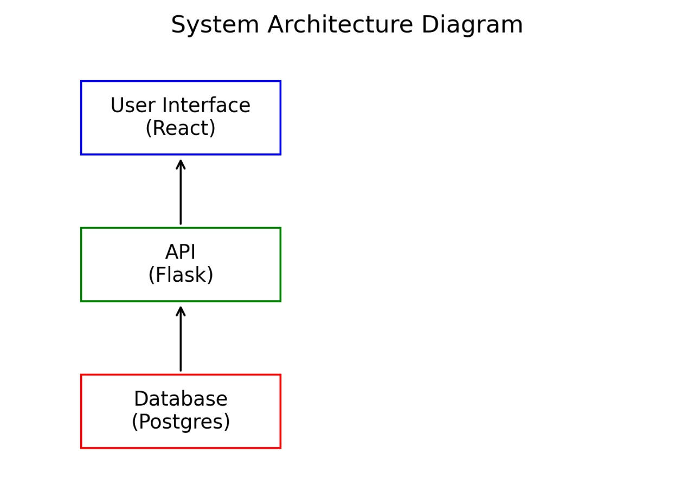
Architectural Diagram

Slide 14
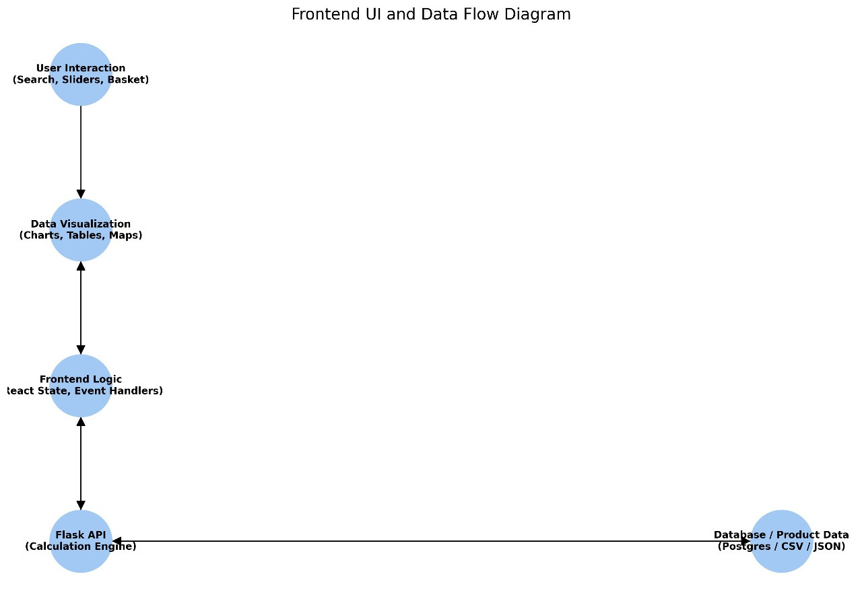
Architectural Diagram

Slide 15
Hardware and Software Details
Software and Hardware Requirements:
Software Requirements:
Development Environment:
Node.js 16+ (for package management and build tools)
npm or yarn (package manager)
Modern web browser (Chrome 90+, Firefox 88+, Safari 14+, Edge 90+)
Code editor (VS Code, WebStorm, etc.)
Runtime Environment:
Web browser with JavaScript enabled
Internet connection (for initial load and external resources)

Slide 16
Hardware and Software Details
Hardware Requirements:
Development Machine:
RAM: 4GB minimum, 8GB+ recommended
Storage: 500MB free space for dependencies
Processor: Any modern CPU (Intel i3/AMD equivalent or better)
End User Device:
RAM: 2GB minimum
Storage: Minimal (runs in browser)
Screen: Any size (responsive design)
Input: Mouse/touch screen

Slide 17
Timeline of the Project (Gantt Chart)
Task Week 1 Week 2 Week 3 Week 4 Week 5 Week 6 Week 7 Week 8
--------------------------------------------------------------------------------------------------------------
Literature Review █████
System Design █████
Dataset Preparation █████
Backend API Development █████
Frontend UI Development █████
Integration █████
Advanced Features █████
Testing & Validation ████
Documentation & Deployment █████

Slide 18
References (IEEE Paper format)
[1] A. Y. Hoekstra and M. M. Mekonnen, “The water footprint of humanity,” Proceedings of the National Academy of Sciences, vol. 109, no. 9, pp. 3232–3237, Feb. 2012, doi: 10.1073/pnas.1109936109.
[2] A. Y. Hoekstra, A. K. Chapagain, M. M. Aldaya, and M. M. Mekonnen, The Water Footprint Assessment Manual: Setting the Global Standard. London, U.K.: Earthscan, 2011.
[3] M. M. Mekonnen and A. Y. Hoekstra, “A global assessment of the water footprint of farm animal products,” Ecosystems, vol. 15, no. 3, pp. 401–415, Apr. 2012, doi: 10.1007/s10021-011-9517-8.
[4] M. M. Mekonnen and A. Y. Hoekstra, “The green, blue and grey water footprint of crops and derived crop products,” Hydrology and Earth System Sciences, vol. 15, no. 5, pp. 1577–1600, May 2011, doi: 10.5194/hess-15-1577-2011.
[5] A. K. Chapagain and A. Y. Hoekstra, “The water footprint of coffee and tea consumption in the Netherlands,” Ecological Economics, vol. 64, no. 1, pp. 109–118, Nov. 2007, doi: 10.1016/j.ecolecon.2007.02.006.

Slide 19


