Slide 1
Context Free Grammar (CFG)
Context Free Languages (CFL)
Push down Automata (PDA)

Slide 2
Definition of CFG
A context free grammar (CFG) is a 4-tuple
G = ( V , ∑ , S , P ) where
V : finite set of variables / nonterminals
∑ : finite set of symbols / terminals
S : start symbol ( element of V )
P : grammar rules / productions

Slide 3
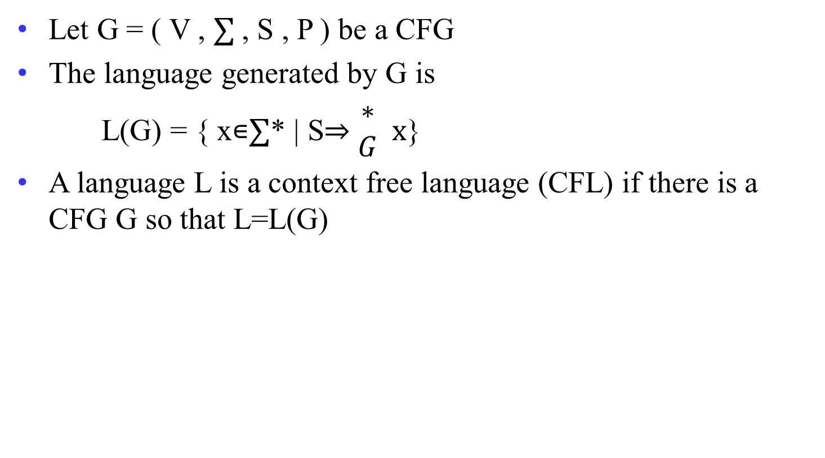
Definition of CFL
Let G = ( V , ∑ , S , P ) be a CFG
The language generated by G is
L(G) = { x∊∑* | S⇒ $\begin{matrix}∗ \\ G\end{matrix}$ x}
A language L is a context free language (CFL) if there is a CFG G so that L=L(G)

Slide 4
Grammar for given RE
a*
S → aS | ʌ
( a + b )*
S → aS | bS | ʌ
( a + b )⁺
S → aS | bS | a | b
( a + b )* aa ( a + b )*
S → XaaX
X → aX | bX | ʌ
a*b*
S → XY
X → aX | a | ʌ
Y → bY | b | ʌ

Slide 5
Grammar for given RE
ab*
S → aX
X → bX | ʌ
a*bb
S → Xbb
X → aX | ʌ
a ( a + b )*
S → aX
X → aX | bX | ʌ
(a+b)* a (a+b)*a (a+b)*
S → XaXaX
X → aX | bX | ʌ

Slide 6
Grammar for given RE
( baa + abb )*
S → baaS | abbS | ʌ
(011 + 1)* (01)*
S → BC
B → AB | ʌ
A → 011 | 1
C → DC | ʌ
D → 01
( aaa + b )*
S → aaaS | bS | ʌ
( aa + bb )⁺
S → aA | bB
A → aS | a
B → bS | b

Slide 7
Grammar for given Languages
L = { x | n₀(x) = n₁(x) }
S → 0S1S | 1S0S | ^
L = { x | n₀(x) ≠ n₁(x) }
S → A | B
A → 0 | 0A | 1AA | AA1 | A1A
B → 1 | 1B | 0BB | BB0 | B0B

Slide 8
Grammar for given Languages
L = { w | w∈{0,1}* and w starts and ends with the same symbol}
S → 0X0 | 1X1 | ʌ
X → 0X | 1X | ʌ
L = { w | w∈{0,1}* and |w| is odd}
S → 0X | 1X
X → 00X | 01X | 10X | 11X | ʌ

Slide 9
Grammar for given Languages
L = { a^{n} b^{n} | n ≥ 0 }
S → aSb | ʌ
L = { a^{n} b a^{n} | n ≥ 0 }
S → aSa | b
L = { a^{4n} | n > 0 }
S → aaaaX
X → aaaaX | ʌ

Slide 10
Grammar for given Languages
L = even length palindrome stings
S → aSa | bSb | ʌ
L = odd length palindrome strings
S → aSa | bSb | a | b
L = palindrome strings
S → aSa | bSb | a | b | ʌ

Slide 11
Grammar for given Languages
L = stings over {a,b} start and end with different letter
S → aXb | bXa
X → aX | bX | ʌ
L = string over {a,b} starting with a
S → aX
X → aX | bX | ʌ

Slide 12
Grammar for given Languages
L = strings not containing ab as substring
S → YX | X | Y | ʌ
X → aX | ʌ
Y → bY | ʌ

Slide 13
Grammar for given Languages
L = string over {a,b} with even length
S → aaS | bbS | abS | baS | ʌ
L = string over {a,b} with odd length
S → aaS | bbS | abS | baS | a | b

Slide 14
Grammar for given Languages
L = string having at lest 2 a’s
S → XaXaX
X → aX | bX | ʌ
L = string having exactly 2 a’s
S → XaXaX
X → bX | ʌ

Slide 15
Grammar for given Languages
L = string having exactly 2 or 3 b’s
S → X b X b X Y X
X → aX | ʌ
Y → b | ʌ
L = strings with equal number of a’s and b’s
S → aSb | bSa | SS | ʌ S → aB | bA | ʌ
A → aS | bAA
B → bS | aBB
OR

Slide 16
Grammar for given Languages
L = strings over {a,b} end with b and have even number of b
S → X b X b
X → aX | S | ʌ
L = strings having exactly one a or one b
S → X a X | Y b Y
X → bX | ʌ
Y → aY | ʌ

Slide 17
Grammar for given Languages
L =strings with odd a’s and even b’s
S → aX | Y
X → aaX | bX | ʌ
Y → bbY | aY | ʌ

Slide 18
Grammar for given Languages
L = { a^{i} b^{j} c^{k} | j=i+k }
S → XY
X → aXb | ^
Y → bYc | ^
L = { a^{i} b^{j} c^{k} | i=j+k }
S → aSc | A
A → aAb | ^
L = { 0^{i} 1^{j} 0^{k} | j>i+k }
S → ABC
A → 0A1 | ^
B → 1B | 1
C → 1C0 | ^

Slide 19
Grammar for given Languages
L = {a^{i} b^{j} c^{k} | i≠j+k}
{a^{i} b^{j} c^{k} | i<j+k} ∪ {a^{i} b^{j} c^{k} | i>j+k}
S₀ → S₁| S₄
S₁ → aS₂
S₂ → aS₂|aS₂c|S₃
S₃ → aS₃|aS₃b|^
S₄ → S₅c
S₅ → S₅c|aS₅c|S₆
S₆ → S₆b|aS₆b|^

Slide 20
Definition of Regular Grammar
A grammar G = ( V , ∑ , S , P ) is regular if every production takes one of the two forms
B → aC
B → a
for variable B and C and terminals a.

Slide 21
Derivation
Beginning with the start symbol, each rewriting step replaces a nonterminal by the body of one of its production
Grammar: E → E + E | id
String: id + id +id
Derivation: E
E + E
E + E + E
id + E + E
id + id + E
id + id + id

Slide 22
Reduction
Specific substring matching with the production of nonterminal will be replaced by that nonterminal
Grammar: E → E + E | id
String: id + id +id
Reduction: id + id + id
E + id + id
E + E + id
E + E + E
E + E
E

Slide 23
Parse Tree / Derivation Tree
It is a graphical representation of a derivation that filters out the order in which productions are applied to replace nonterminals.
  Derivation: E
  E + E
  E + E + E
  id + E + E
  id + id + E
  id + id + id
E
E
+
E
id
E
+
E
id
id

Slide 24
Ambiguity
A Context Free Grammar G is ambiguous if there is at least one string in L(G) having two or more distinct derivation trees (all tree must be either leftmost derivation or rightmost derivation)
  Grammar : E → E + E | E * E | id
  String : id + id * id
E
E
E
*
E
E
+
E
E
+
E
id
id
E
*
E
id
id
id
id

Slide 25
Eliminating ^-production
X → ^ is called null production
Steps to eliminate the ^-production
  Find nullable nonterminal
  Remove all ^ production
  Look at RHS of all production
  if it has any nullable nonterminal then
  that production have to write
  once with nullable nonterminal and
  another time without nullable nonterminal

Slide 26
Eliminating ^-production
Replace B in AB with ^ then get A
| A | B | ^
S → AB
A → aAA
B → bBB
| ^
| ^
| aA | a
Replace A in AB with ^ then get B
| bB | b
Replace both A in aAA with ^ then get a
Replace A and B both in AB with ^ then get ^
Replace any A in aAA with ^ then get aA
Nullable nonterminals are {A,B,S}
Remove ^ production
Rewrite RHS by replacing nullable with ^

Slide 27
Eliminating ^-production
S → aSb | aAb
A → ^
S → aSb | ab
S → AbaC
A → BC
B → b | ^
C → D | ^
D → d
S → AbaC | baC | Aba | ba
A → BC | B |C
B → b
C → D
D → d

Slide 28
Eliminating ^-production
S → aSa | bSb | ^
A → abb | bBa
B → aB | bB | ^
S → aSa | bSb | aa | bb | ^
A → aBb | bBa | ab | ba
B → aB | bB | a | b

Slide 29
Eliminating unit-production
X → Y is called unit production, at RHS one nonterminal
Step to eliminate the unit-production
  Replace all single nonterminal at RHS remove it
  Replace with its production

Slide 30
Eliminating unit-production
S → S + T | T
T → T * F | F
F → ( S ) | a
| T
| ( S ) | a
| T * F
| F
S → S + T
T → T * F
F → ( S ) | a
| ( S ) | a
| F

Slide 31
Chomsky Normal Form (CNF)
A CFG is in CNF if every production is of one of these two types:
  A → BC (two nonterminal at RHS)
  A → a (single terminal at RHS)
Steps:
  Eliminate ^-production
  Eliminate unit-production
  Rewrite to fulfil the rule of CNF as given above

Slide 32
Chomsky Normal Form (CNF)
S → AB
A → aAA | ^
B → bBB | ^
S → AB | XP | YB | b | XP | XA | a | ^
A → XP | XA | a
B → YQ | YB | b
X → a
Y → b
P → AA
Q → BB
Eliminate
^ production
S → AB | B | A | ^
A → aAA | aA | a
B → bBB | bB | b
Rewrite to fulfil
CNF rules
S → AB | bBB | bB | b | aAA | aA | a | ^
A → aAA | aA | a
B → bBB | bB | b
Eliminate
unit production

Slide 33
Chomsky Normal Form (CNF)
S→ AACD
A → aAb | ^
C → aC | a
D → aDa | bDb | ^
S→ PQ | AQ | PC | AC | CD | XC | a
A → XL | XY
C → XC | a
D → XM | YN | XX | YY
X → a
Y → b
P → AA
Q → CD
L → AY
M → DX
N → DY

Slide 34
Chomsky Normal Form (CNF)
S → SS | ( S ) | ^
S → SS | XP | XY | ^
X → (
Y → )
P → SY

Slide 35
Chomsky Normal Form (CNF)
S → AbA
A → Aa | ^
S → PA | AY | YA | b
A → AX | a
X → a
Y → b
P → AY

Slide 36
Chomsky Normal Form (CNF)
S → S₁ | S₂
S₁ → S₁b | Ab | ^
A → aAb | ab
S₂ → S₂a | Ba | ^
B → bBa | ba
S → S₁Y | AY | b | S₂X | BX | a | ^
S₁ → S₁Y | AY | b
A → XP | XY
S₂ → S₂X | BX | a
B → YQ | YX
X → a
Y → b
P → AY
Q → BX

Slide 37
PDA
Formal Definitions

Slide 38
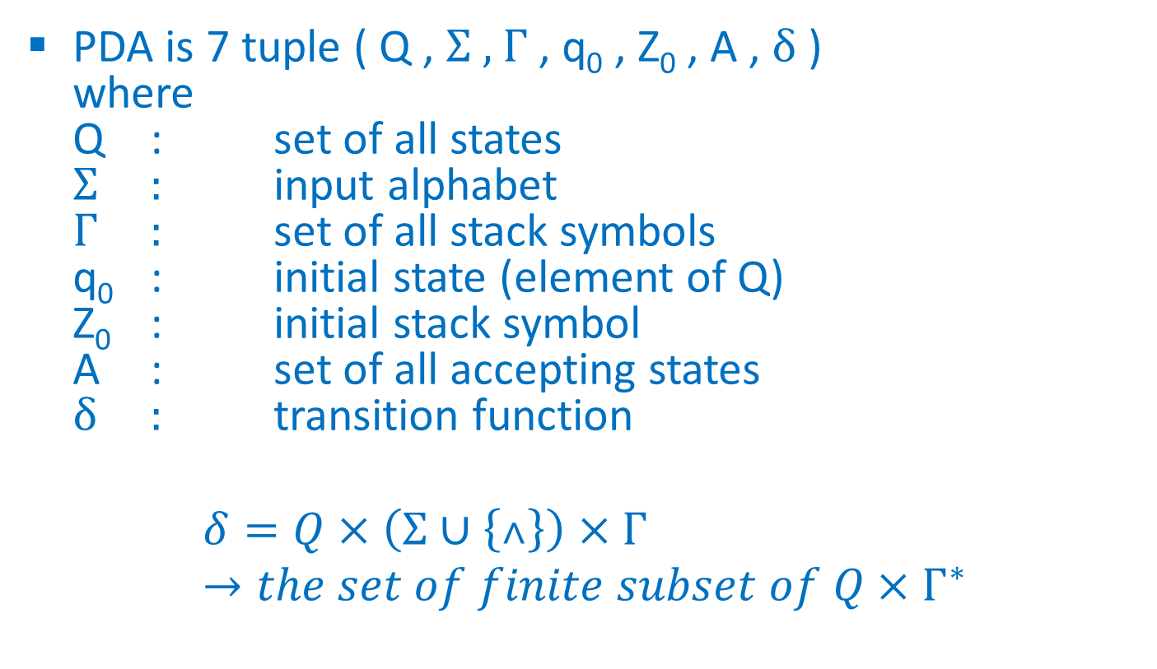
Definition
PDA is 7 tuple ( Q , Σ , Γ , q₀ , Z₀ , A , δ )
where
Q : set of all states
Σ : input alphabet
Γ : set of all stack symbols
q₀ : initial state (element of Q)
Z₀ : initial stack symbol
A : set of all accepting states
δ : transition function
$$δ=Q×\left(Σ∪\left\{˄\right\}\right)×Γ →the set of finite subset of Q×Γ^{∗}$$

Slide 39
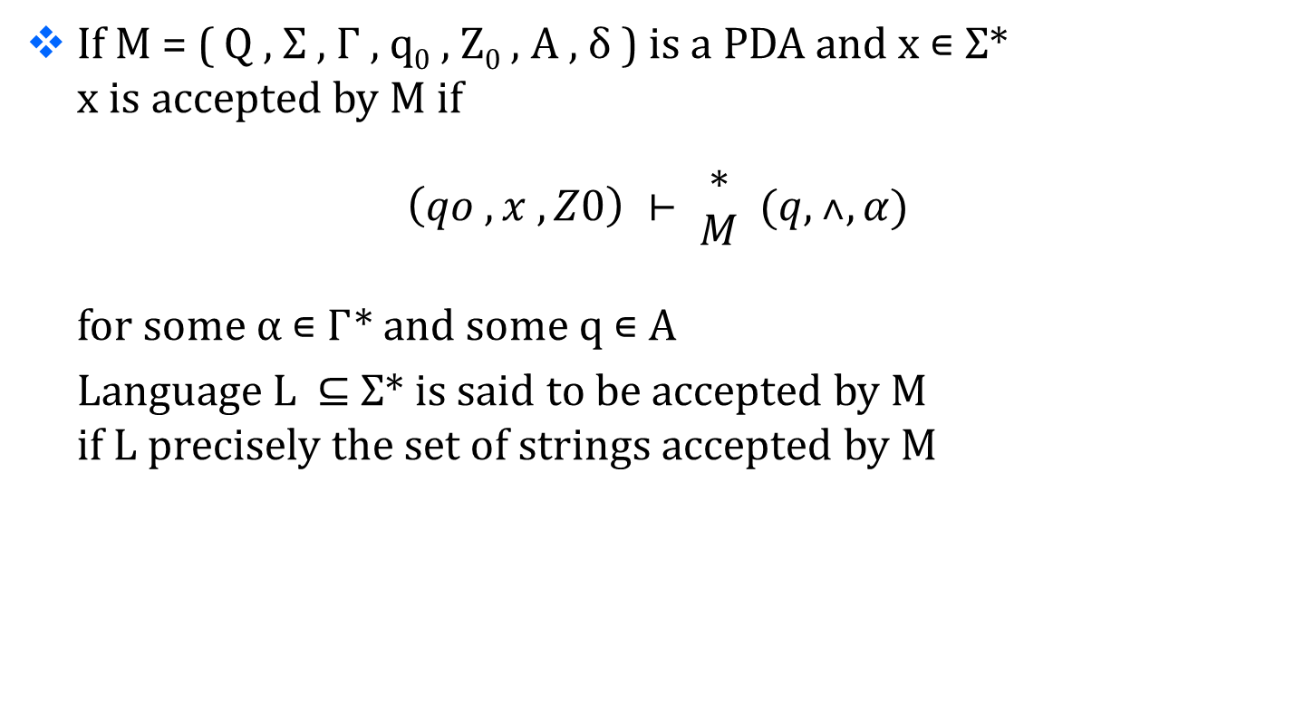
Acceptance by PDA
If M = ( Q , Σ , Γ , q₀ , Z₀ , A , δ ) is a PDA and x ∊ Σ*
x is accepted by M if
$$\left(qo , x , Z0\right) ⊢ \begin{matrix}∗ \\ M\end{matrix} (q,˄,α)$$
for some α ∊ Γ* and some q ∊ A
Language L ⊆ Σ* is said to be accepted by M
if L precisely the set of strings accepted by M

Slide 40
PDA
Basics

Slide 41
Compare FA and PDA
Accept
All Context Free Languages
(All Regular + Some Non-regular)
PDA
FA
Accept
All Regular Languages

Slide 42
Compare FA,PDA,TM
 | Accepted by
 | FA | PDA
Regular languages e.g. a*b* | ✓ | ✓
Context free languages e.g. a^{n}b^{n} | × | ✓
 | FA | PDA
Memory | Finite memory | Infinite memory (Stack)

Slide 43
Basic of PDA
PDA has infinite amount of memory in form of Stack
with bottom symbol Z₀
Stack
Infinite size
Z₀

Slide 44
Operations for PDA
3 operation
  Push
  Pop
  Skip
Normal idea to create PDA is
when you are performing same operation the remain on same state
When you change operation the change the state

Slide 45
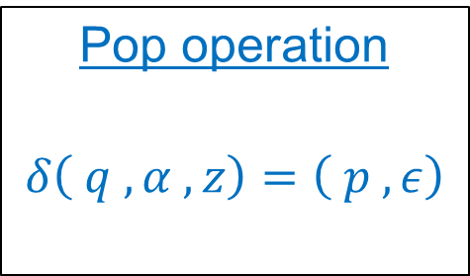
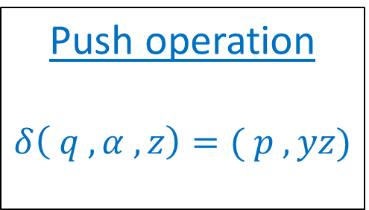
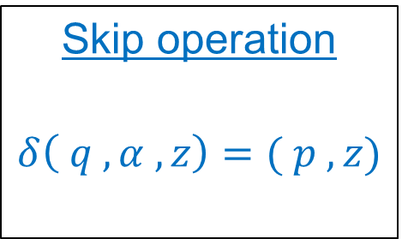
δ for PDA
Push operation
$$δ\left( q , α , z\right)=( p , yz)$$
Pop operation
$$δ\left( q , α , z\right)=\left( p , ε\right)$$
Skip operation
$$δ\left( q , α , z\right)=( p , z)$$
Current
state
New
state
Input
symbol
Symbol
Pushed
in stack
Stack
top
symbol

Slide 46
δ for PDA
Push operation
$$δ\left( q , α , z\right)=( p , yz)$$
Pop operation
$$δ\left( q , α , z\right)=\left( p , ε\right)$$
Skip operation
$$δ\left( q , α , z\right)=( p , z)$$
Current
state
Input
symbol
Null
Stack
top
symbol

Slide 47
δ for PDA
Push operation
$$δ\left( q , α , z\right)=( p , yz)$$
Pop operation
$$δ\left( q , α , z\right)=\left( p , ε\right)$$
Skip operation
$$δ\left( q , α , z\right)=( p , z)$$
Current
state
Input
symbol
Stack
top
symbol

Slide 48
Acceptance by PDA
PDA accept string in two ways
  Acceptance by empty stack
    After reading the entire input if the stack is empty then the string is accepted by PDA
  Acceptance by final state
    After reading the entire input id PDA reaches to the final state the string is accepted

Slide 49
Types of PDA
DPDA
NPDA
Deterministic PDA
Nondeterministic PDA
NPDA is more powerful than DPDA
All string accepted by DPDA can be accepted by NPDA but vice versa is not true
NPDA can have multiple transition for same pair (input symbol , stack top symbol), which not possible in DPDA

Slide 50
PDA
Examples

Slide 51
EX-1 : L = { a^{n}b^{n} | n>=0 }
Logic:
  Push all “a” in stack
  For “b” pop “a” from stack
  In differentiate input and stack symbol push “Z1” in place of “a”

Slide 52
EX-1 : L = { a^{n} b^{n} | n>=0 }
Input string
a a a b b b ϵ
push
push
push
pop
pop
pop
skip
String empty
&
Stack empty
so
Accepted
Z₁
Z₁
Z₁
Z₀

Slide 53
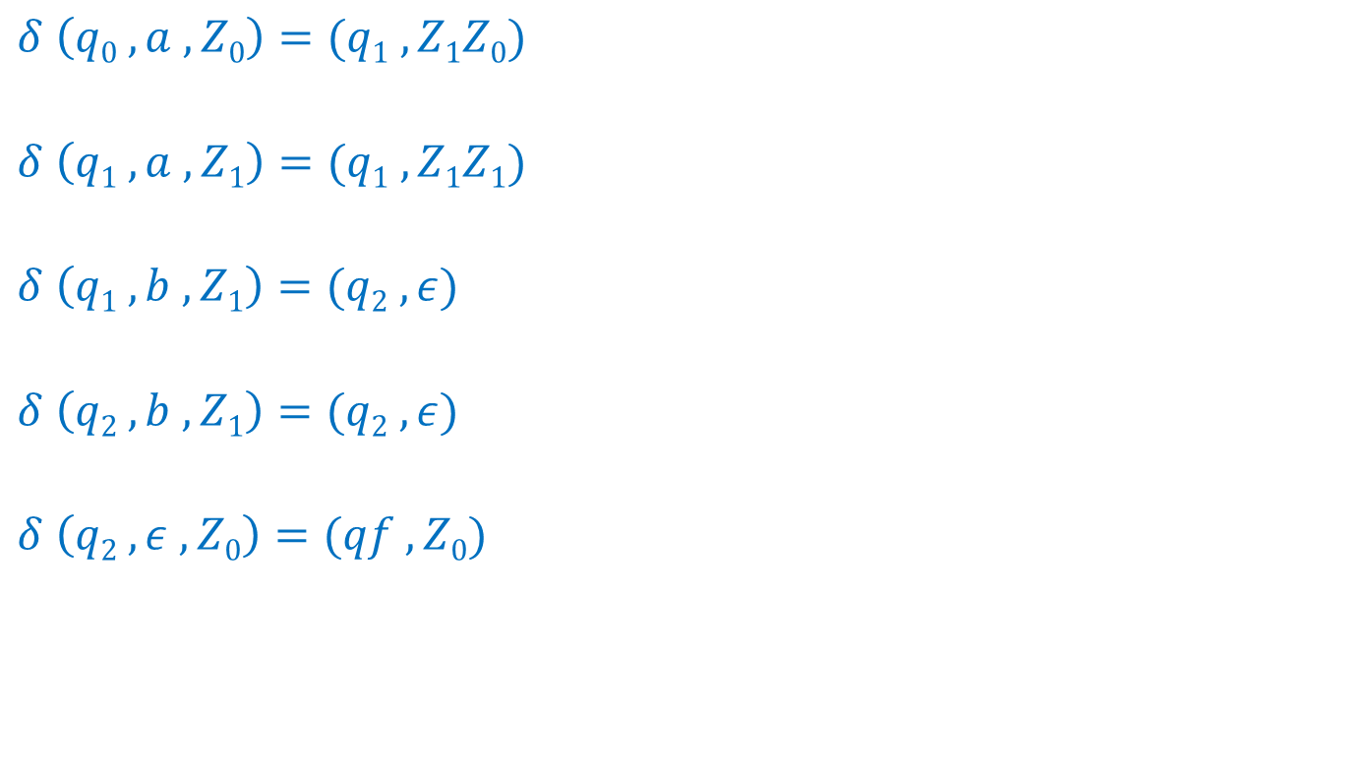
EX-1 : L = { a^{n} b^{n} | n>=1 }
Operation : PUSH
First operation : change state
$$δ \left(q0 , a , Z0\right)=(q1 ,Z1Z0)$$
$$δ \left(q1 , a , Z1\right)=(q1 ,Z1Z1)$$
$$δ \left(q1 , b , Z1\right)=(q2 , ε)$$
$$δ \left(q2 , b , Z1\right)=(q2 , ε)$$
$$δ \left(q2 , ε , Z0\right)=(qf , Z0)$$
Operation : PUSH
same operation as above, don't change state
Operation : POP
different operation, change state
Operation : POP
same operation as above, don't change state
Operation : SKIP
different operation, change state
q0
a,Z₀|Z₁Z₀
q1
b,Z₁|ϵ
q2
ϵ,Z₀|Z₀
qf
DPDA
a,Z₁|Z₁Z₁
b,Z₁|ϵ

Slide 54
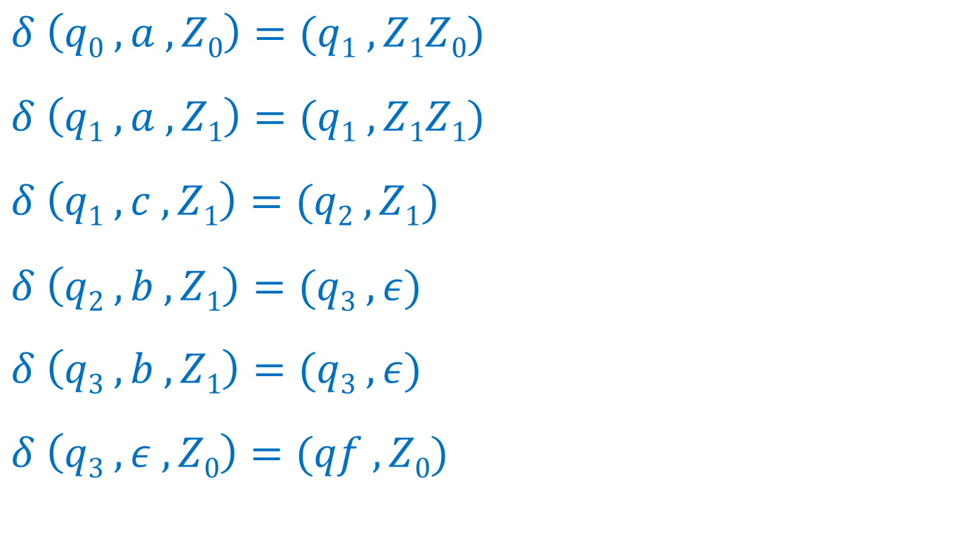
EX-2 : L = { a^{n} c b^{n} | n>=1 }
DPDA
q0
$$δ \left(q0 , a , Z0\right)=(q1 ,Z1Z0)$$
$$δ \left(q1 , a , Z1\right)=(q1 ,Z1Z1)$$
$$δ \left(q1 , c , Z1\right)=(q2 , Z1)$$
$$δ \left(q2 , b , Z1\right)=(q3 , ε)$$
$$δ \left(q3 , b , Z1\right)=(q3 , ε)$$
$$δ \left(q3 , ε , Z0\right)=(qf , Z0)$$
a,Z₀|Z₁Z₀
q1
a,Z₁|Z₁Z₁
c,Z₁|Z₁
q2
b,Z₁|ϵ
q3
ϵ,Z₀|Z₀
qf
b,Z₁|ϵ

Slide 55
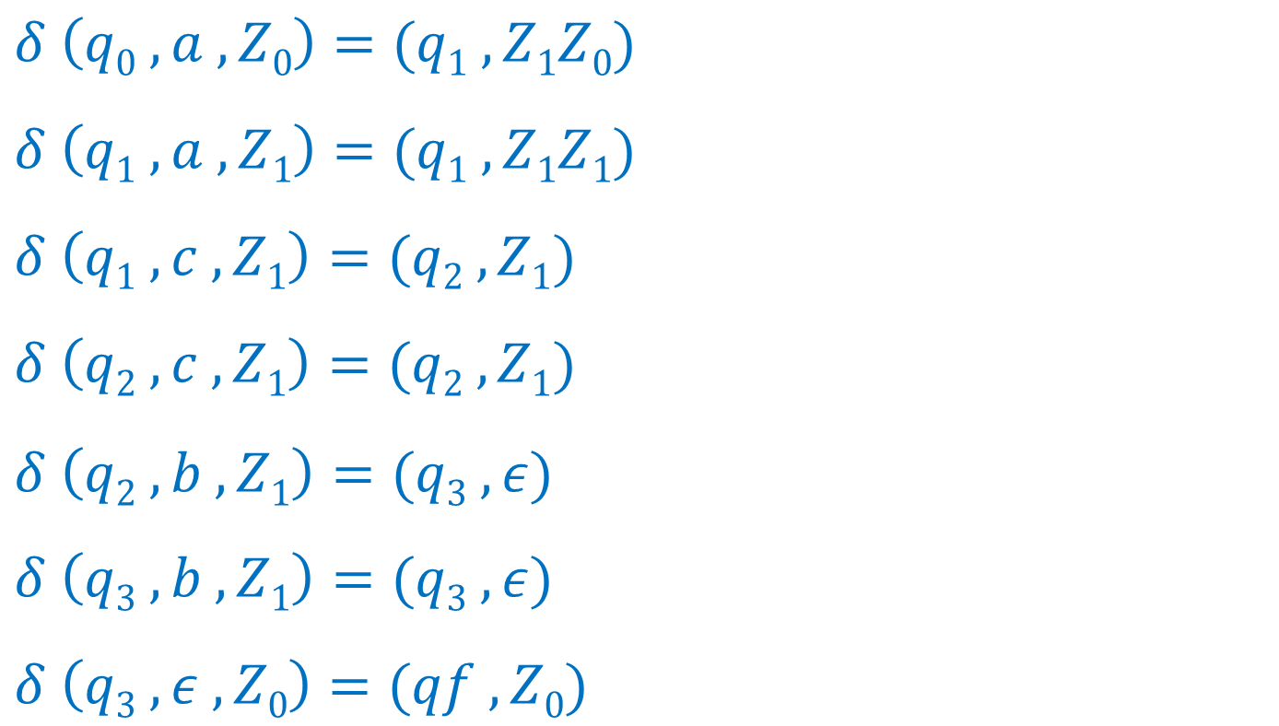
EX-3 : L = { a^{n} c^{m} b^{n} | n,m>=1}
DPDA
q0
$$δ \left(q0 , a , Z0\right)=(q1 ,Z1Z0)$$
$$δ \left(q1 , a , Z1\right)=(q1 ,Z1Z1)$$
$$δ \left(q1 , c , Z1\right)=(q2 , Z1)$$
$$δ \left(q2 , c , Z1\right)=(q2 , Z1)$$
$$δ \left(q2 , b , Z1\right)=(q3 , ε)$$
$$δ \left(q3 , b , Z1\right)=(q3 , ε)$$
$$δ \left(q3 , ε , Z0\right)=(qf , Z0)$$
a,Z₀|Z₁Z₀
q1
a,Z₁|Z₁Z₁
c,Z₁|Z₁
q2
c,Z₁|Z₁
b,Z₁|ϵ
q3
ϵ,Z₀|Z₀
qf
b,Z₁|ϵ

Slide 56
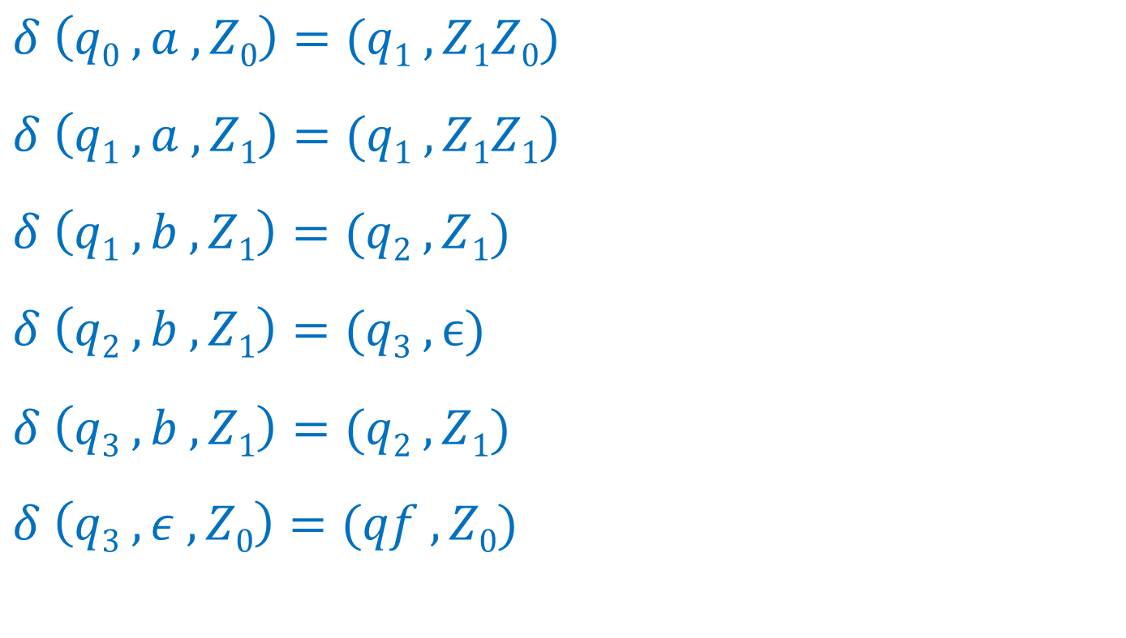
EX-4 : L = { a^{n} b^{2n} | n>=1 }
DPDA
q1
$$δ \left(q0 , a , Z0\right)=(q1 ,Z1Z0)$$
$$δ \left(q1 , a , Z1\right)=(q1 ,Z1Z1)$$
$$δ \left(q1 ,b , Z1\right)=(q2 , Z1)$$
$$δ \left(q2 , b , Z1\right)=(q3 , ϵ)$$
$$δ \left(q3 , b , Z1\right)=(q2 ,Z1)$$
$$δ \left(q3 , ε , Z0\right)=(qf , Z0)$$
a,Z₀|Z₀Z₁
q1
b,Z₁|Z₁
q2
a,Z₁|Z₁Z₁
b,Z₁|Z₁
b,Z₁|ϵ
qf
ϵ,Z₀|Z₀
q3

Slide 57
EX-5 : L = { WcW^{R} | W∊{a,b}* , W^{R} is reverse of W }
Input string
a b a b c b a b a ϵ
Skip
Z₂
String empty
&
Stack empty
so
Accepted
Z₁
Z₂
Z₁
Z₀

Slide 58
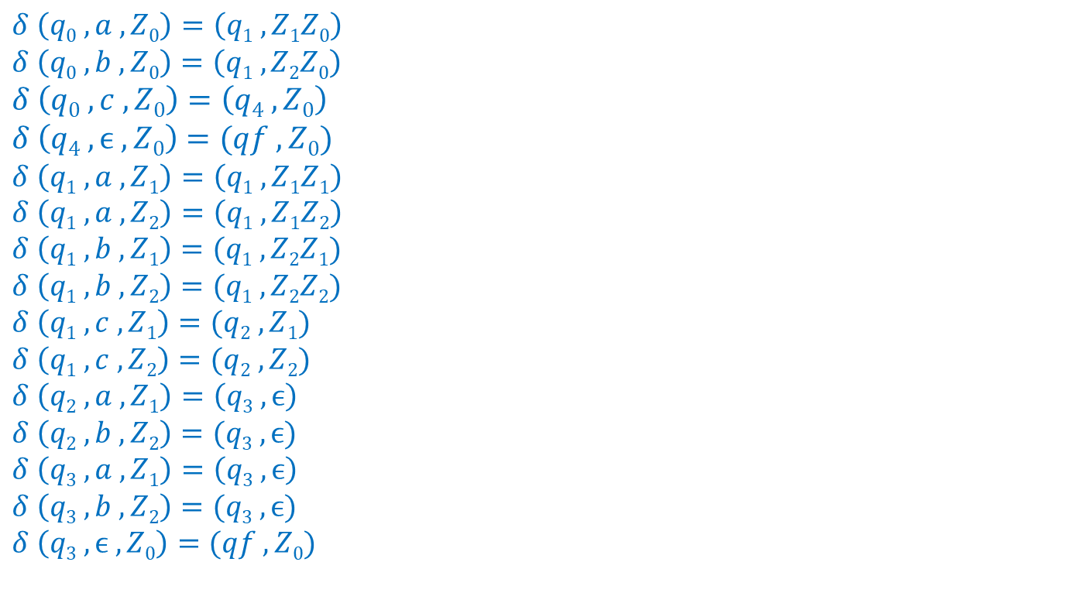
EX-5 : L = { WcW^{R} | W∊{a,b}* , W^{R} is reverse of W }
DPDA
$$δ \left(q0 , a , Z0\right)=\left(q1 ,Z1Z0\right)$$
$$δ \left(q0 , b , Z0\right)=\left(q1 ,Z2Z0\right)$$
$$δ \left(q0 , c , Z0\right)=\left(q4 ,Z0\right)$$
$$δ \left(q4 , ϵ , Z0\right)=(qf ,Z0)$$
$$δ \left(q1 , a , Z1\right)=\left(q1 ,Z1Z1\right)$$
$$δ \left(q1 , a , Z2\right)=\left(q1 ,Z1Z2\right)$$
$$δ \left(q1 , b , Z1\right)=(q1 ,Z2Z1)$$
$$δ \left(q1 , b , Z2\right)=(q1 ,Z2Z2)$$
$$δ \left(q1 , c , Z1\right)=(q2 ,Z1)$$
$$δ \left(q1 , c , Z2\right)=(q2 ,Z2)$$
$$δ \left(q2 , a , Z1\right)=\left(q3 ,ϵ\right)$$
$$δ \left(q2 , b , Z2\right)=(q3 ,ϵ)$$
$$δ \left(q3 , a , Z1\right)=\left(q3 ,ϵ\right)$$
$$δ \left(q3 , b , Z2\right)=(q3 ,ϵ)$$
$$δ \left(q3 , ϵ , Z0\right)=(qf ,Z0)$$
c,Z₀|Z₀
q0
q4
a,Z₀|Z₁Z₀
b,Z₀|Z₂Z₀
c,Z₁|Z₁
c,Z₂|Z₂
ϵ Z₀|Z₀
q1
q2
a,Z₁|ϵ
b,Z₂|ϵ
a,Z₁|Z₁Z₁
a,Z₂|Z₁Z₂
b,Z₁|Z₂Z₁
b,Z₂|Z₂Z₂
q3
ϵ,Z₀|Z₀
qf
a,Z₁|ϵ
b,Z₂|ϵ

Slide 59
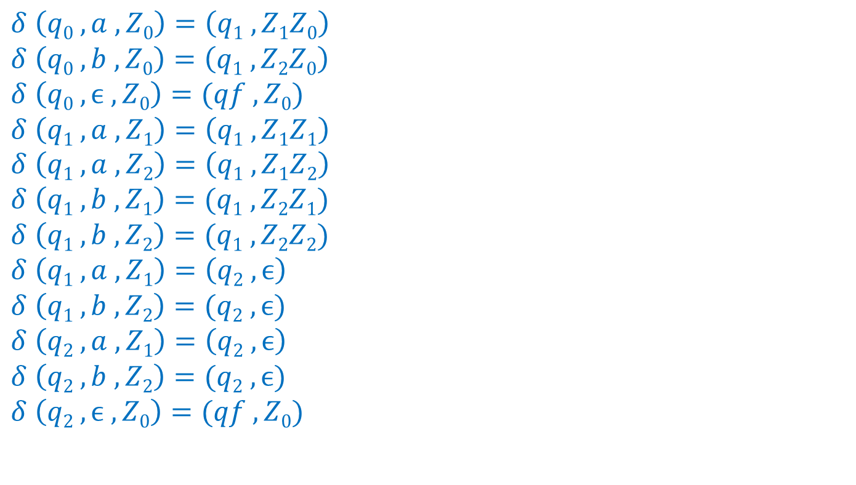
EX-6 : L = { WW^{R} | W∊{a,b}* , W^{R} is reverse of W }
NPDA
$$δ \left(q0 , a , Z0\right)=\left(q1 ,Z1Z0\right)$$
$$δ \left(q0 , b , Z0\right)=\left(q1 ,Z2Z0\right)$$
$$δ \left(q0 , ϵ , Z0\right)=(qf ,Z0)$$
$$δ \left(q1 , a , Z1\right)=\left(q1 ,Z1Z1\right)$$
$$δ \left(q1 , a , Z2\right)=\left(q1 ,Z1Z2\right)$$
$$δ \left(q1 , b , Z1\right)=(q1 ,Z2Z1)$$
$$δ \left(q1 , b , Z2\right)=(q1 ,Z2Z2)$$
$$δ \left(q1 , a , Z1\right)=\left(q2 ,ϵ\right)$$
$$δ \left(q1 , b , Z2\right)=(q2 ,ϵ)$$
$$δ \left(q2 , a , Z1\right)=\left(q2 ,ϵ\right)$$
$$δ \left(q2 , b , Z2\right)=(q2 ,ϵ)$$
$$δ \left(q2 , ϵ , Z0\right)=(qf ,Z0)$$
q0
ϵ Z₀|Z₀
aZ₀|Z₁Z₀
bZ₀|Z₂Z₀
aZ₁|ϵ
bZ₂|ϵ
q1
aZ₁|Z₁Z₁
aZ₂|Z₁Z₂
bZ₁|Z₂Z₁
bZ₂|Z₂Z₂
q2
ϵ Z₀|Z₀
qf
aZ₁|ϵ
bZ₂|ϵ

Slide 60
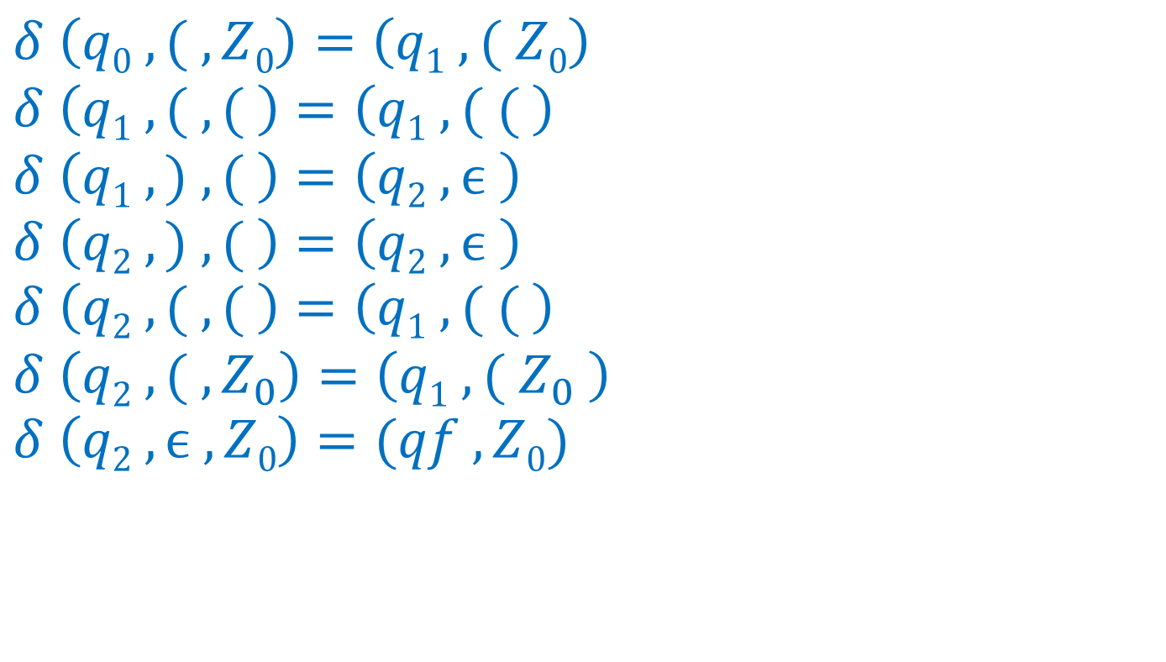
EX-7 : Balanced parenthesis
DPDA
( ( | ( (
$$δ \left(q0 , ( , Z0\right)=\left(q1 ,( Z0\right)$$
$$δ \left(q1 , ( , ( \right)=\left(q1 ,( ( \right)$$
$$δ \left(q1 , ) , ( \right)=\left(q2 ,ϵ \right)$$
$$δ \left(q2 , ) , ( \right)=\left(q2 ,ϵ \right)$$
$$δ \left(q2 , ( , ( \right)=\left(q1 ,( ( \right)$$
$$δ \left(q2 , ( , Z_{0}\right)=\left(q1 ,( Z_{0} \right)$$
$$δ \left(q2 , ϵ , Z0\right)=(qf ,Z0)$$
( Z₀| ( Z₀
q1
q0
( ( | ( (
( Z₀| ( Z₀
) ( | ϵ
q2
ϵ Z₀|Z₀
qf
) ( | ϵ

Slide 61
CFL
Pumping Lemma for CFL

Slide 62
Theorem
Pumping Lemma for Context-Free Language
  Let L be a CFL
  Then there s an integer n so that for any u ∈ L satisfying |u|≥n,
  there are strings v, w, x, y and z satisfying
  u = v w x y z ---------- [ 1 ]
  | w y | > 0 ---------- [ 2 ]
  | w x y | ≤ n ---------- [ 3 ]
  for any m ≥ 0, v w^{m} x y^{m} z ∈ L ---------- [ 4 ]

Slide 63
EX-1 : L = { a^{i} b^{i} c^{i} | i ≥ 1 }
Let u = a^{n} b^{n} c^{n} = v w x y z
v = a^{n}
w x y = b^{n}
z = c^{n}
now w = b^{i} and y = b^{j} where i,j >0
so x = b^{n-i-j}
For v w^{m} x y^{m} z let us take m = 2
v w² x y² z = a^{n} b^{2i} b^{n-i-j} b^{2j} c^{n}
= a^{n} b^{n+i+j} c^{n} ∉ L
So, L is not CFL

Slide 64
EX-2 : L = { SS | S∈{a,b}* }
Let u = a^{n} b^{n} a^{n} b^{n} = v w x y z
v = a^{n}
w x y = b^{n}
z = a^{n} b^{n}
now w = b^{i} and y = b^{j} where i,j >0
so x = b^{n-i-j}
For v w^{m} x y^{m} z let us take m = 0
v w⁰ x y⁰ z = a^{n} b⁰ b^{n-i-j} b⁰ a^{n} b^{n}
= a^{n} b^{n-i-j} a^{n} b^{n} ∉ L
So, L is not CFL

Slide 65
EX-3 : L = { x∈{a,b,c}* | n_{a}(x)<n_{b}(x) and n_{a}(x)<n_{c}(x) }
Let u = a^{n} b^{n+1} c^{n+1} = v w x y z
v = a^{n}
w x y = b^{n}
z = b c^{n+1}
now w = b and y = b so x = b^{n-2}
For v w^{m} x y^{m} z let us take m = 0
v w⁰ x y⁰ z = a^{n} b⁰ b^{n-2} b⁰ b c^{n+1}
= a^{n} b^{n-1} b c^{n+1} ∉ L
So, L is not CFL

Slide 66
End of
Unit - 4

