Slide 1


Slide 2


Slide 3


Welcome to
Kaun Banega Millionaire
Developed by :-
Rohan Jethloja (17CE037)
Shubham Dhameliya (17CE026)
Prit Gopani (17CE034)

Slide 4
About The Game
This is the simple quiz game where you will be ask 10 simple question and you will become a Millionaire
There are two rounds in this game
1.) Warmup Round
2.) Final Round
In warmup round you will be ask 6 question, if you right atlist 3 right answer you are eligible to play final round.
In final round you will be ask 10 question and each right answer will be awarded $100,000.
If you answered wrong you will not be a Millionaire.

Slide 5
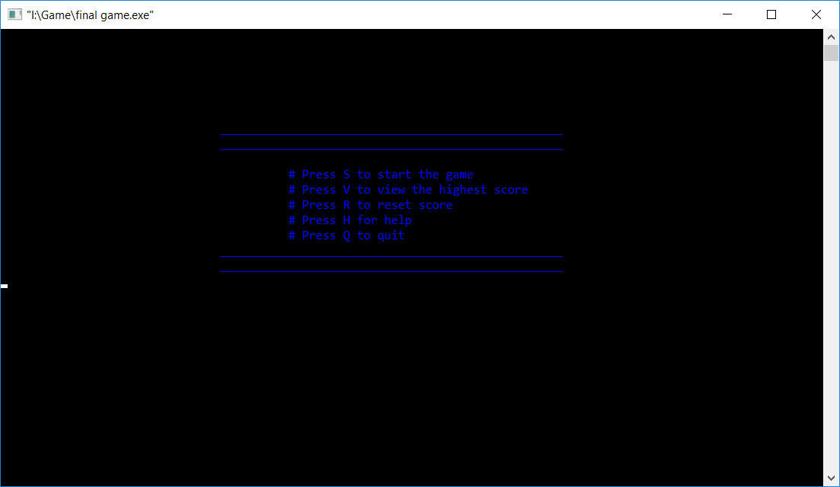
Features Of the Game
There are four windows in this game
Start menu
View highest score
Reset score
Help menu

Slide 6
Some Part Of The Game

Slide 7
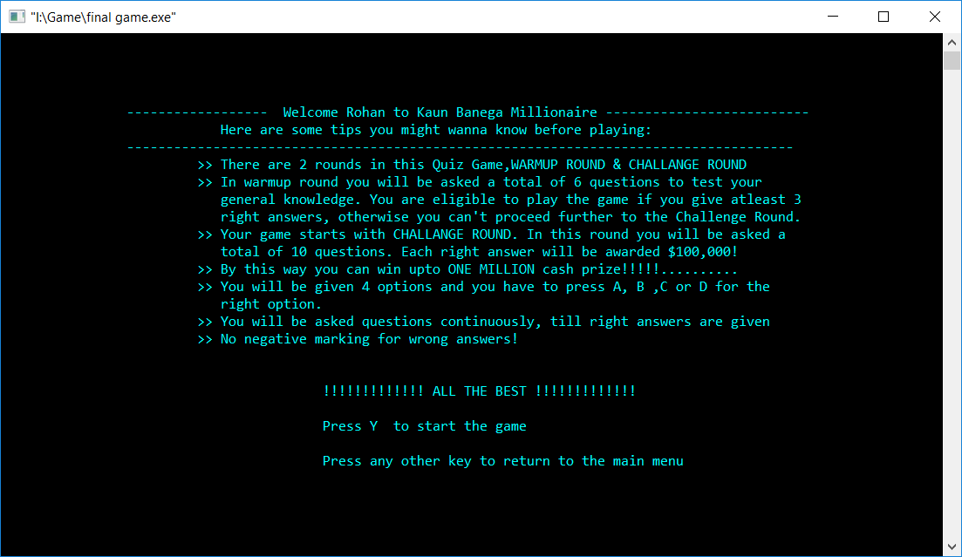
Start Manu

Slide 8
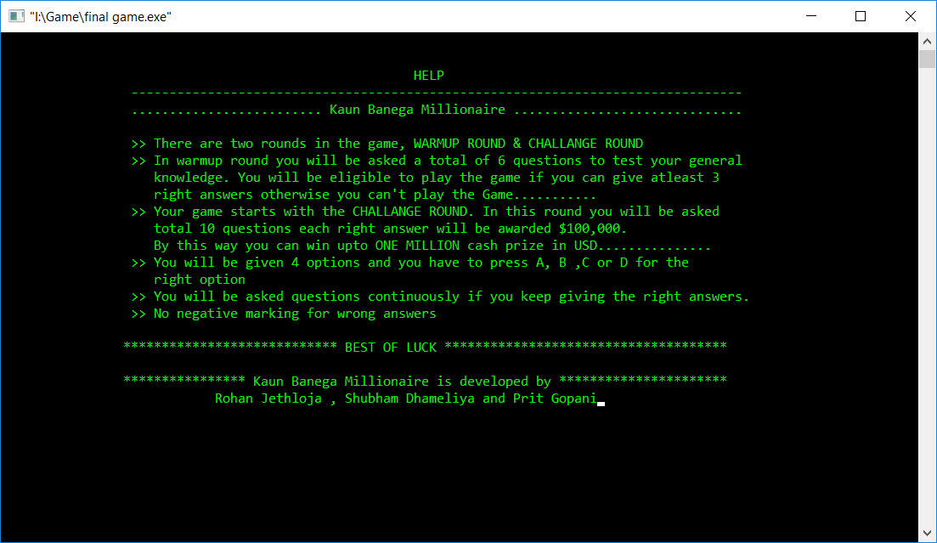
Help Menu

Slide 9
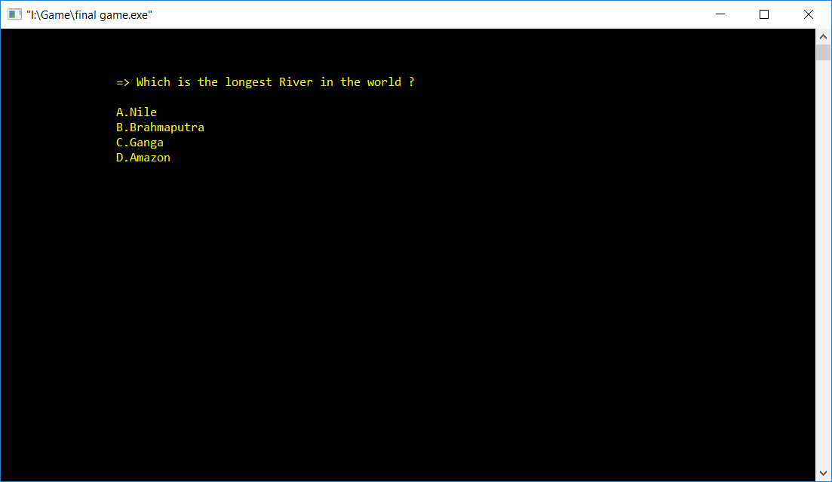
Questions

Slide 10
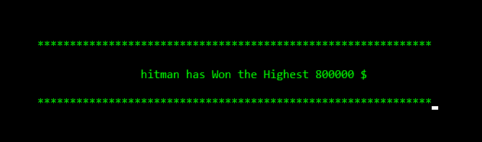
View Record

Slide 11
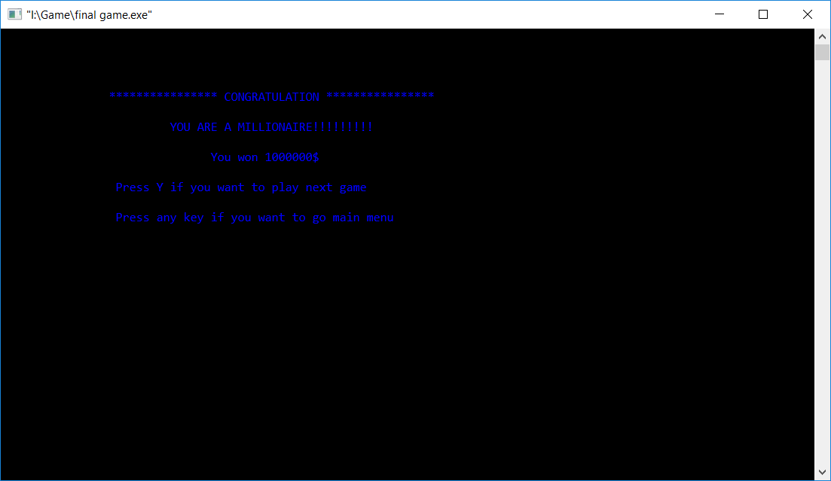
Winning Moment

