Slide 1
Student Marksheet Reporting Project – MS Excel
Prepared by: Rohan Sakariya | September 19th, 2025

Slide 2
Executive Summary
This project demonstrates the preparation and reporting of student marksheet data using MS-Excel. It covers manual data entry, subject-wise score calculation, percentage evaluation, grade assignment, and ranking of students. The report highlights my ability to structure academic performance data into a clear, accurate, and professional report.

Slide 3
Project Objectives
Prepare a structured student marksheet system using MS-Excel.
Enter and organize student academic data (roll number, subjects, marks).
Apply formulas to calculate total marks, percentage, and grade.
Rank students based on their performance.
Generate a final academic report with clarity and accuracy.

Slide 4
Methodology & Process
1. Raw Data Entry – Student details were manually entered into Excel.
2. Calculations – Excel formulas calculated totals, percentages, and grades.
3. Ranking – Students ranked using sorting functions based on percentage.
4. Final Report – Clear marksheet report including grades and ranks.

Slide 5
Key Results
Accurate percentage calculation for each student.
Grades are assigned according to performance.
The ranking system identified top-performing students.
Example: Student Prachi achieved 91.0% and ranked #1.

Slide 6
Benefits & Impact
Eliminates manual errors in marksheet preparation.
Saves time by automating calculations and ranking.
Provides transparent and standardized reporting.
Scalable model suitable for larger datasets or institutions.

Slide 7
Conclusion
This project demonstrates my proficiency in MS-Excel and MS-Office reporting, showcasing accuracy, attention to detail, and structured data management.
By converting raw academic records into an organized marksheet, I demonstrated precision and professionalism aligned with Data Entry Executive responsibilities.

Slide 8
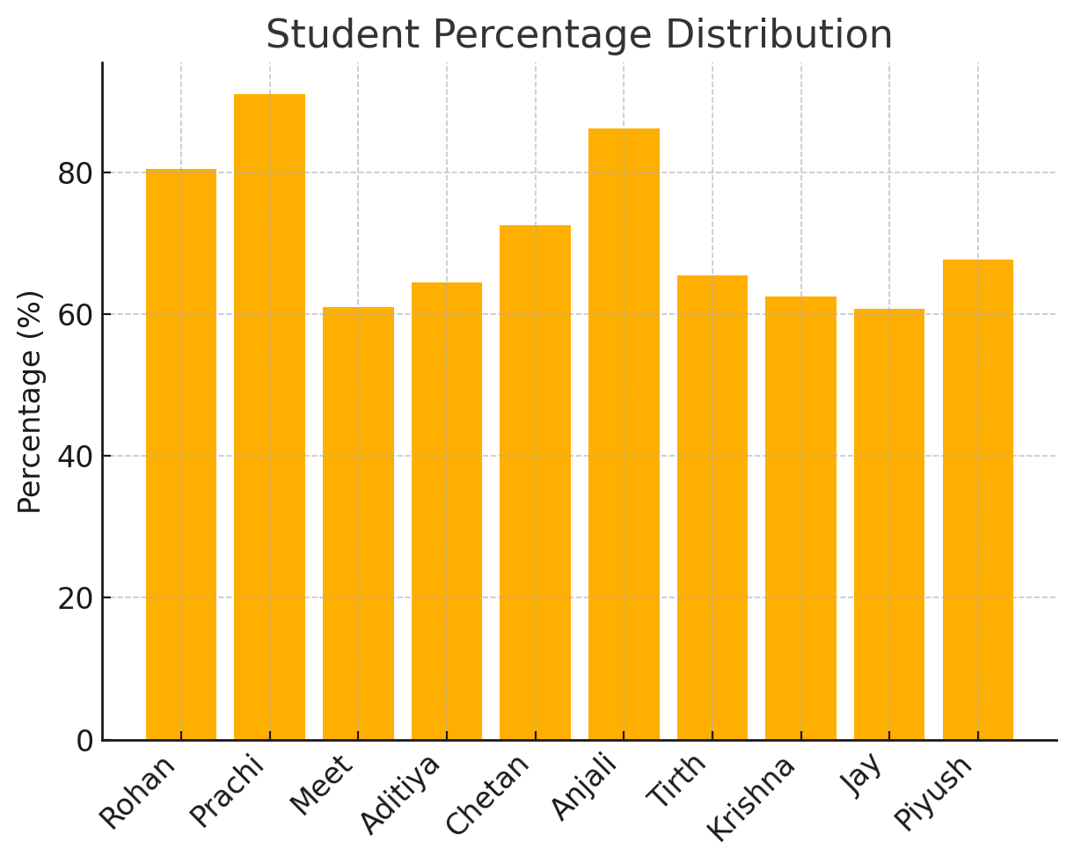
Student Percentage Distribution

