Slide 1
Employee Salary Calculation & Payroll Reporting Project
Prepared by: Rohan Sakariya | September 19th, 2025

Slide 2
Executive Summary
This project demonstrates the structured preparation of employee payroll data using MS Excel. It covers data entry, salary calculations, and report generation, ensuring accuracy, transparency, and professional reporting standards.
It highlights my ability to manage organizational data and prepare company-ready outputs aligned with the requirements of a Data Entry Executive role.

Slide 3
Project Objectives
Create an organized payroll system using MS-Excel.
Apply formulas for salary, bonus, and net payment calculation.
Verify the accuracy of employee records.
Generate a consolidated payroll report for management use.

Slide 4
Methodology & Process
1. Raw Data Entry – Employee details entered systematically (ID, Dept, Salary, Bonus, Attendance).
2. Salary Calculations – Formulas applied to calculate per-day salary, earned salary, and net salary.
3. Final Report – Consolidated payroll prepared with totals and department contribution percentages.

Slide 5
Key Results
Net salary for each employee was calculated accurately.
Consolidated payroll amounted to ₹1,02,333.33.
Department contribution percentages are visible in the pie chart.

Slide 6
Benefits & Impact
Eliminates manual errors in payroll processing.
Saves time through formula automation.
Provides transparent reporting for managers.
Scalable model applicable to larger datasets.

Slide 7
Conclusion
This project demonstrates my proficiency in MS-Excel and MS-Office reporting, showcasing accuracy, attention to detail, and professionalism.
I am confident in contributing effectively to Axe Consultancy & Security Services LLC as a Data Entry Executive.

Slide 8
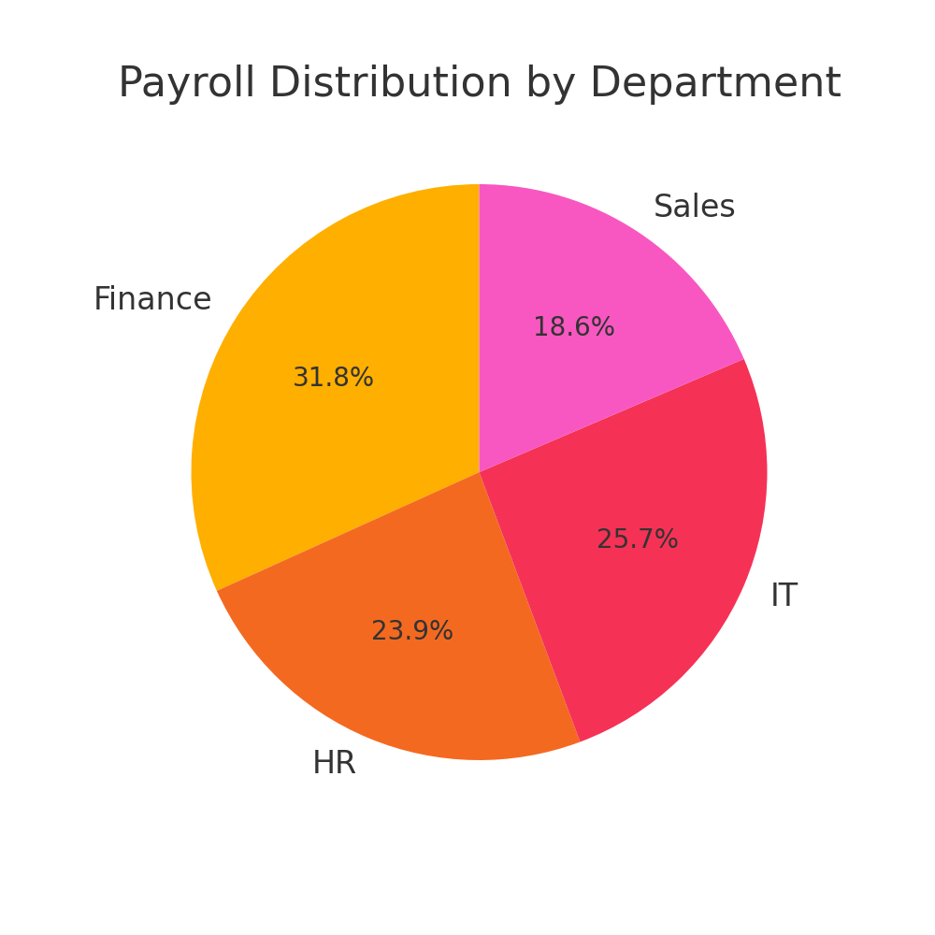
Payroll Distribution by Department

