Slide 1
Truck Accident Study using Big Data Analytics
Rohan Sharma
The University of Texas at Dallas
Big Data Analytics

Slide 2
Problem Statement and Objectives
Accidents caused by large trucks remain one of the leading causes of injuries and deaths in the United States.
The objective of this project is to identify dangerous commercial truck drivers nationwide and answer questions like - Which truck has the highest risk factor based on geographic location and time?
This project involves the use of Big Data tools and techniques to process data and create analytical reports that will help in making informed business decisions.
The use case involves geographic data, vehicles, average mileage, gas consumption, events, risk factors, and other supporting information.

Slide 3





Analysis Workflow Diagram
Data Storage
Data Processing
Data Visualization

Slide 4
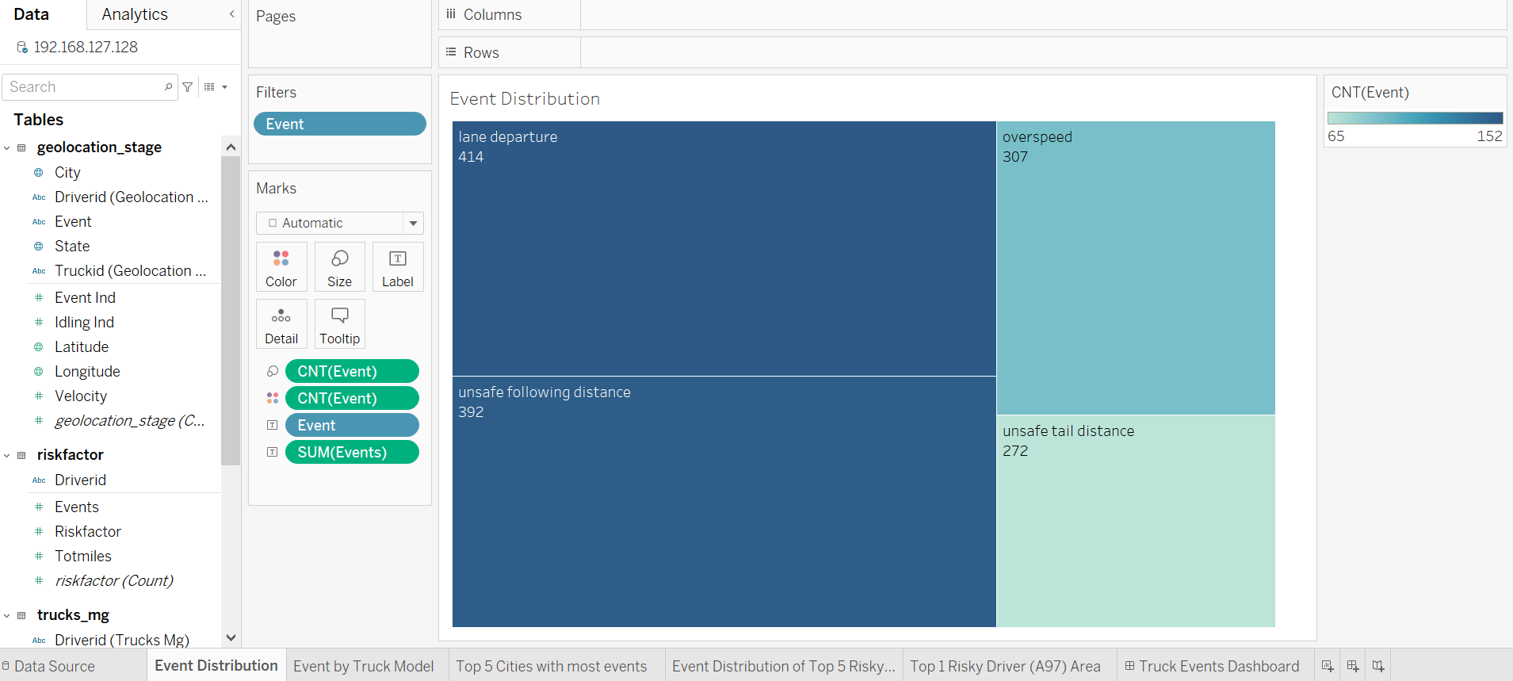

Slide 5
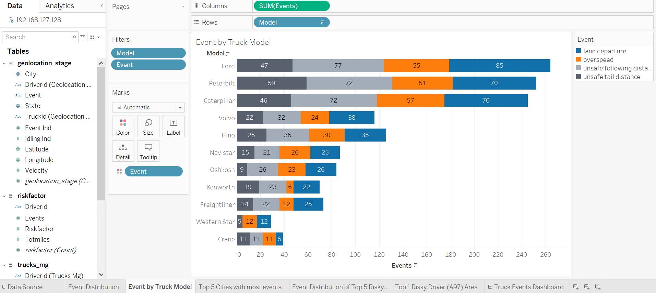

Slide 6
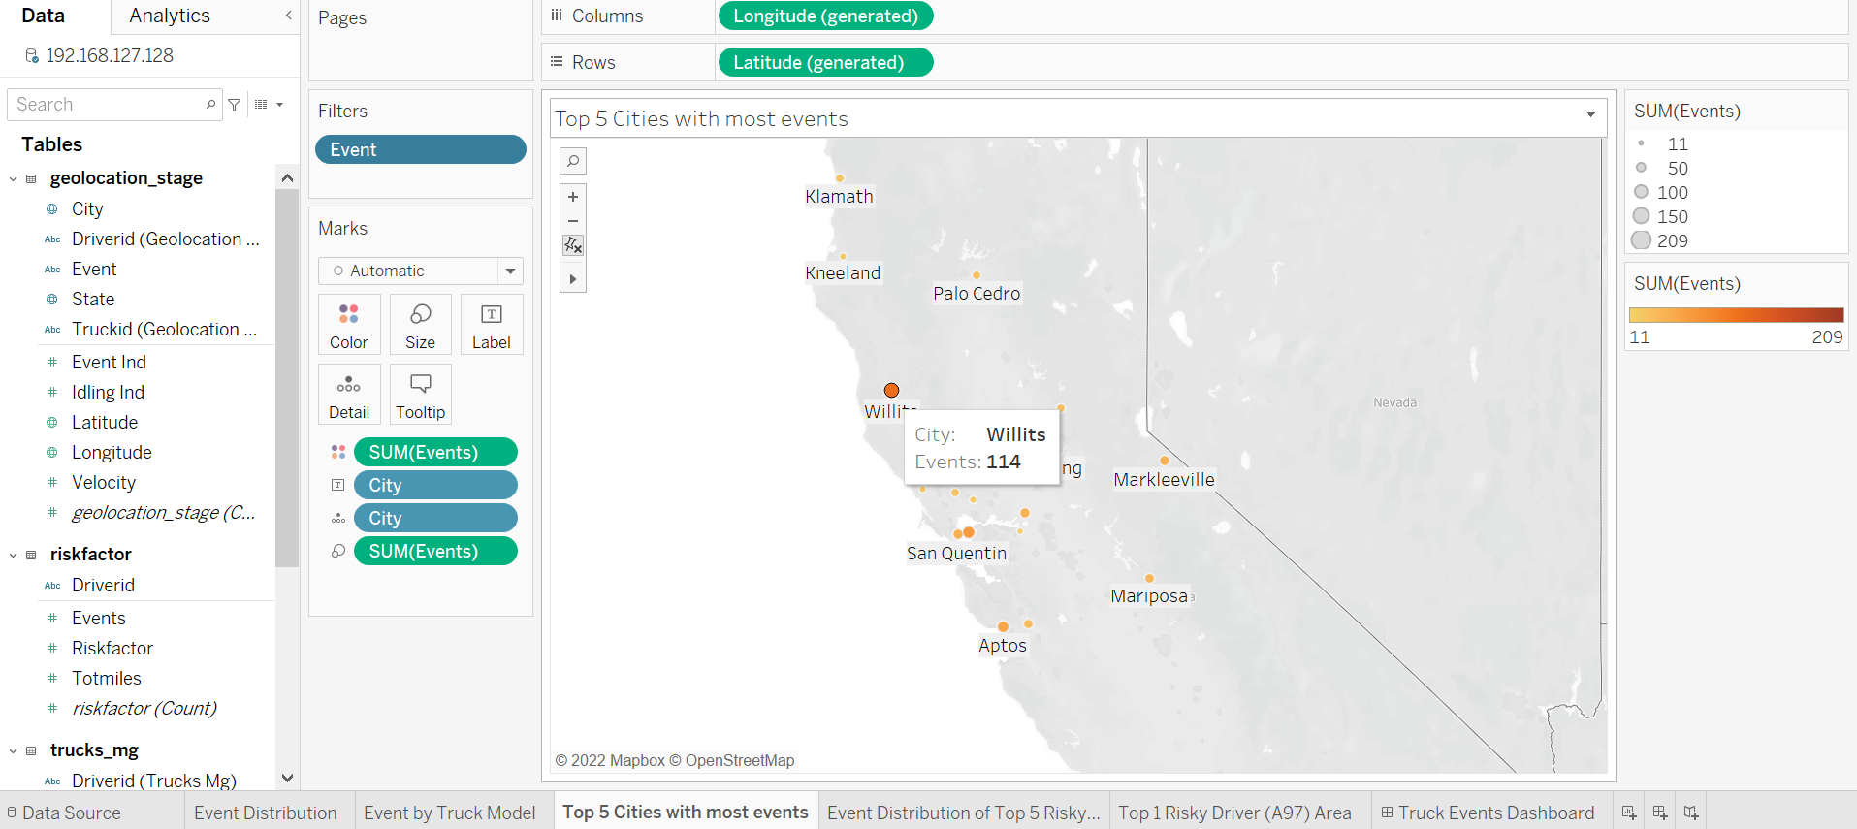

Slide 7
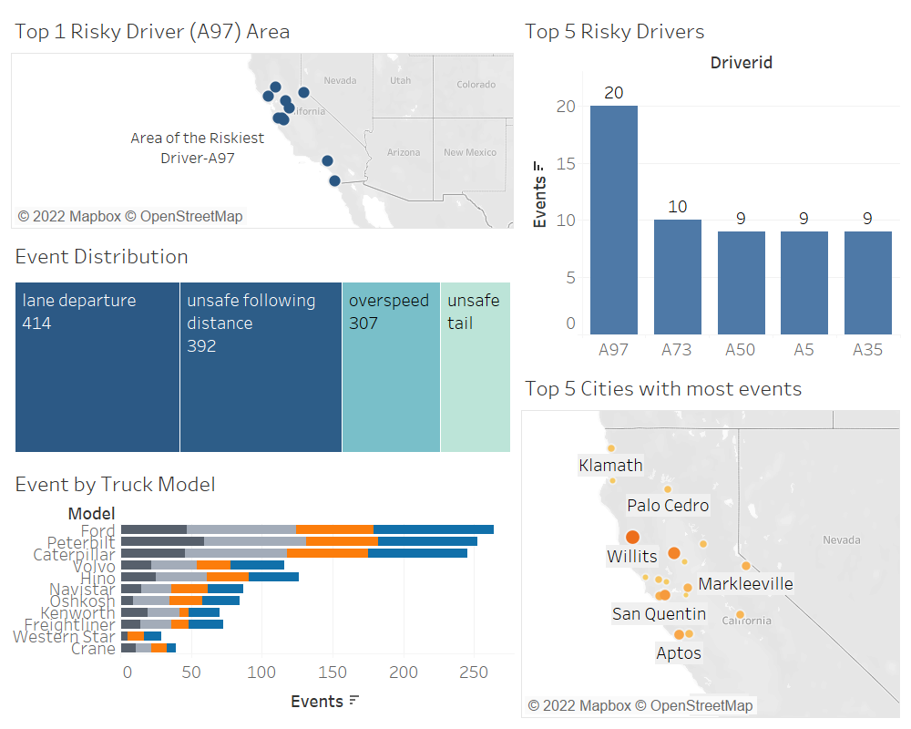
Dashboard

