Slide 1


Sales Insights Of Atliq Hardware
23-Dec-2023
Designed and Presented By Rohan Singh Rawat

Slide 2

Introduction
Problem Statement
Purpose
End Result / Output
Dataset Details
Data Model
Live Dashboards

Slide 3
Problem Statement
Case study is based on a Computer Hardware and Peripheral Manufacturer Business, Which is facing challenges in dynamically changing market. Sales Director would like to build PowerBi dashboard that can provide him a real time sales insights.

Slide 4
Purpose
To unlock Sales Insights that are not visible before for sales team for decision support and automate them to reduced manual time spent in data gathering.

Slide 5
End Result / Output
Create An automated live dashboard providing quick and latest sales insights in order to support in data driven decision making.

Slide 6
Dataset Contains 5 Excel Files:-
Sales Customers
Dataset Details
Sales Date
Sales Markets
Sales Products
Sales Transactions

Slide 7
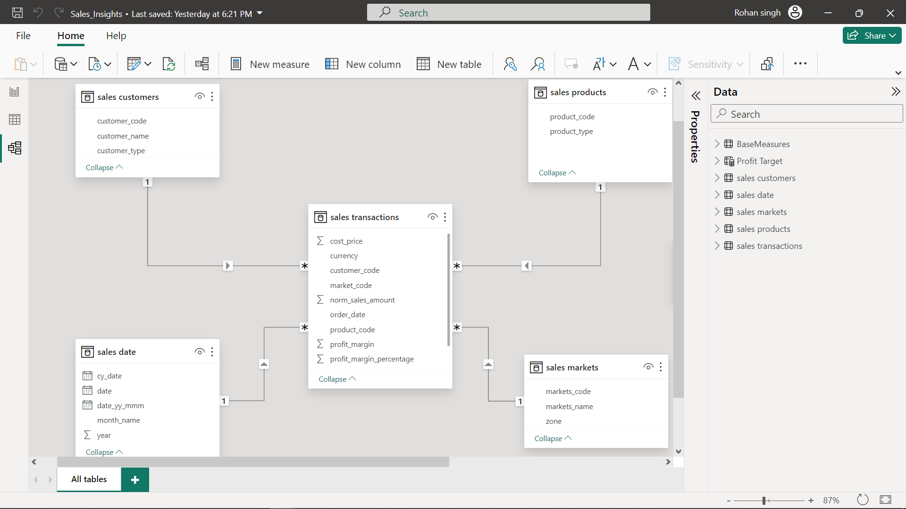
Data Model

Slide 8
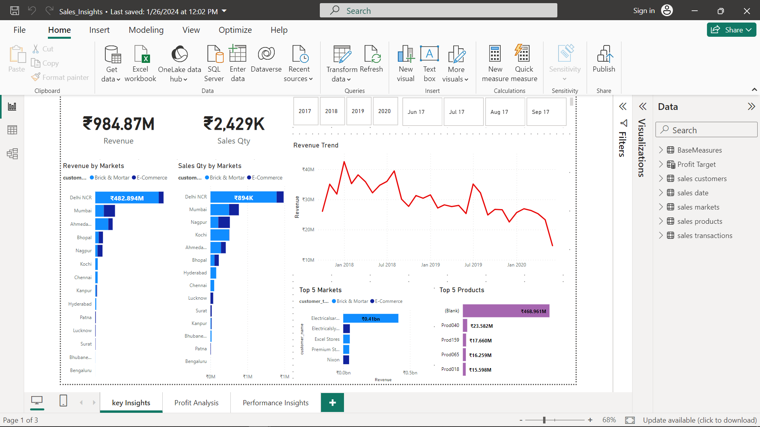
Key Insights Dashboard

Slide 9
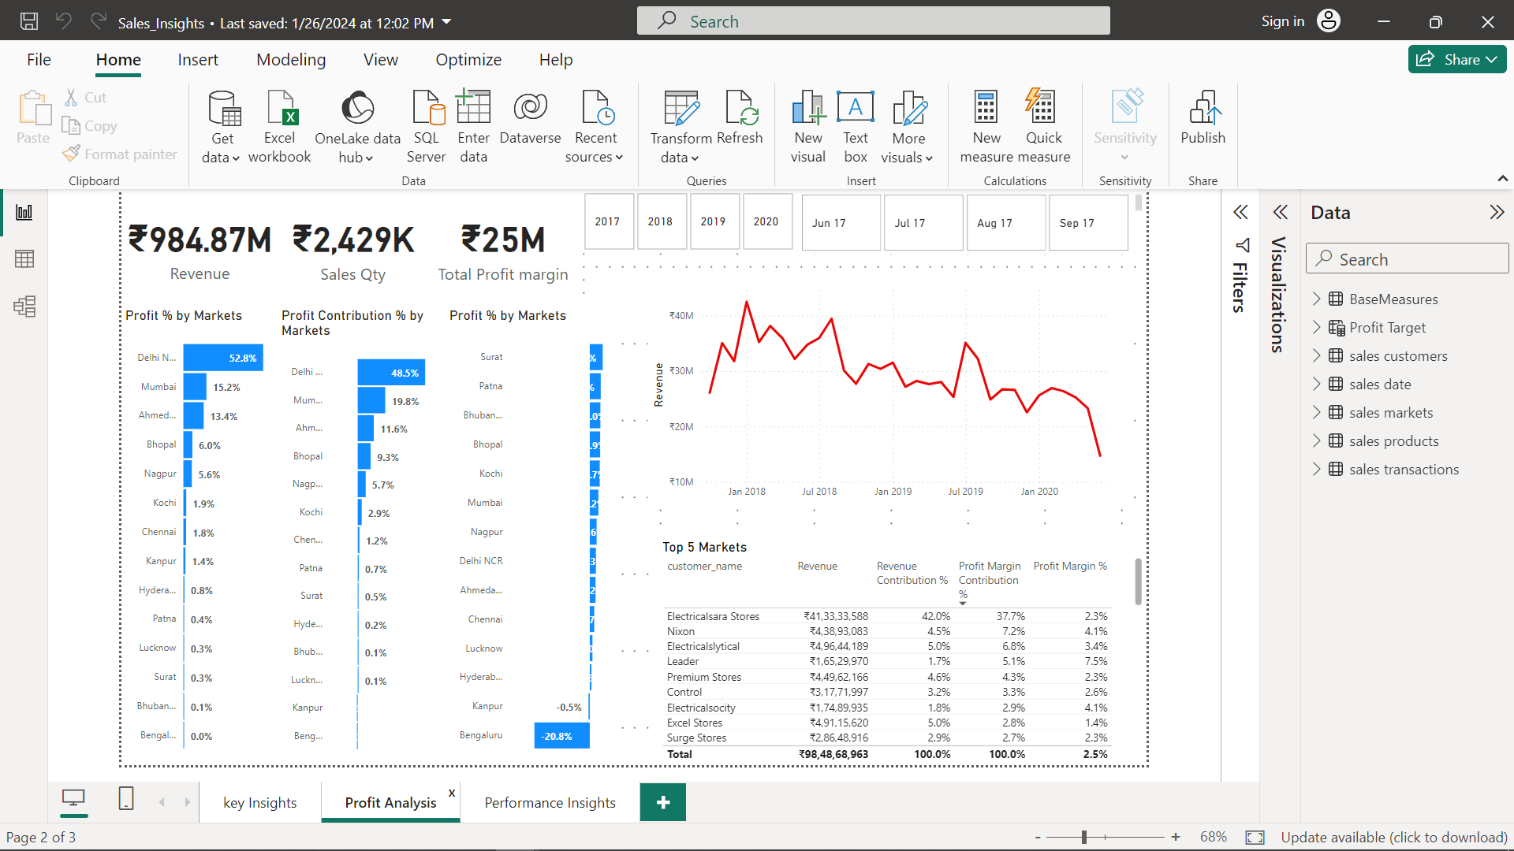
Profit Analysis Dashboard

Slide 10
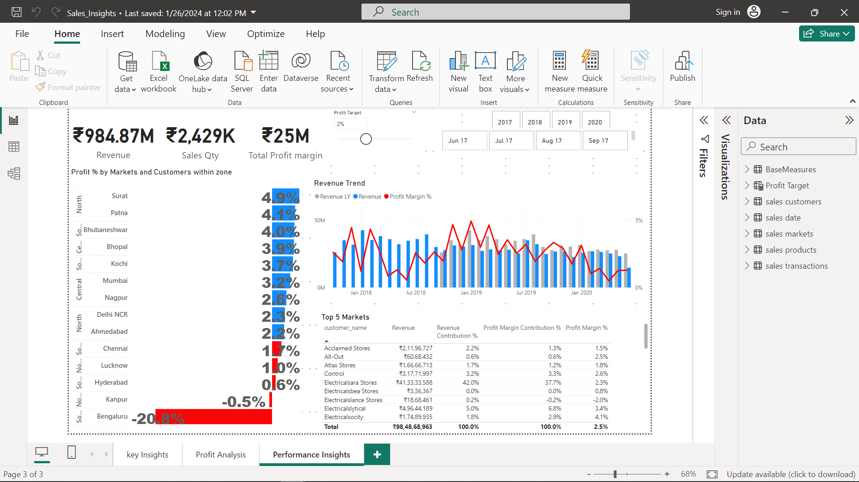
Performance Insights Dashboard

Slide 11
Major Insights
Atliq hardware had Total Revenue of Rs(984.87M) with Total Sales Quantity of Rs(2429K) and Total Margin value of Rs(25M) in all 4 years.
Most of the customer would like to buy brick and mortar from all the markets.
Most Profitable market in Atliq harwate is Leader.
Atliq hardware got highest Profit margin upto 10M in all 4 years.
AtliQ got suden drop in 2020 because those markets who have higher profit margin like leader and electricalsara store etc, they have not much profit market contribution then their profit margin which is the real cause of dropping in their Profit and sales.

