Slide 1






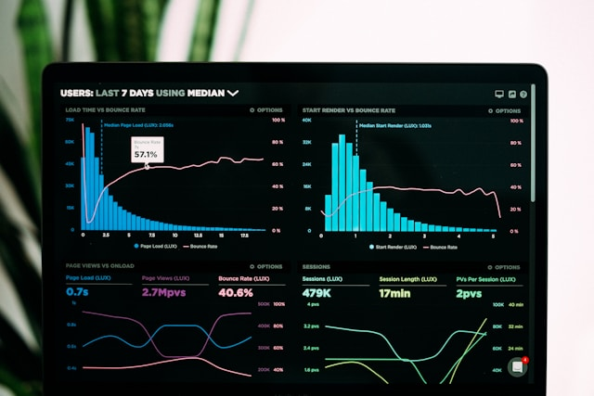

Revenue Insights On Hospital Domain
Designed and presented By Rohan Singh Rawat
Agenda

Slide 2
TOC(Tableof Content)

Slide 3
Introduction
TOC
As Per This Projects, we have to provide insights to the revenue team of AtliQ hotels by utilizing the provided data.

Slide 4
Problem Statement
AtliQ Grands owns multiple five-star hotels across India. They have been in the hospitality industry for the past 20 years. Due to strategic moves from other competitors and ineffective decision-making in management, AtliQ Grands are losing its market share and revenue in the luxury/business hotels category. As a strategic move, the managing director of AtliQ Grands wanted to incorporate “Business and Data Intelligence” to regain their market share and revenue. However, they do not have an in-house data analytics team to provide them with these insights.
TOC

Slide 5
Purpose
You are a data analyst who has been provided with sample data and a dashboard to work on the following task. You can download all relevant documents from the download section.
Create the metrics according to the metric list.
Create a dashboard according to the instructions provided by stakeholders.
Create relevant insights that are not provided in the metric list/Live dashboard.
TOC

Slide 6
Dataset Details
We are having 3 months booking details data of all the atliq hotels.
Dataset Contains 5 excel files:-
Dim_date
Dim_hotels
Dim_rooms
Fact_aggregated_bookings
Fact_bookings
TOC

Slide 7
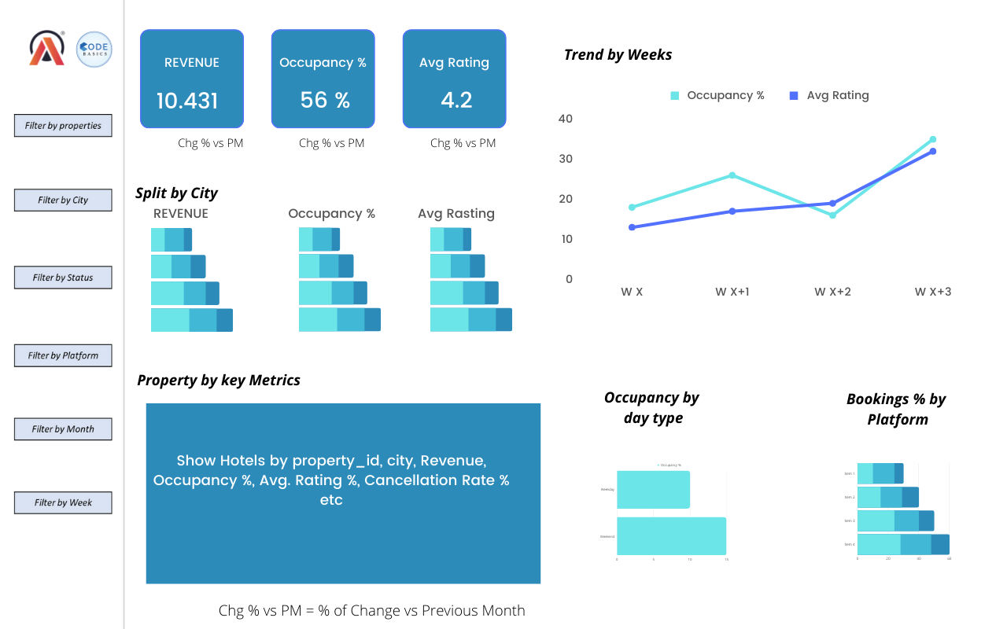
End Result/ Output
TOC

Slide 8
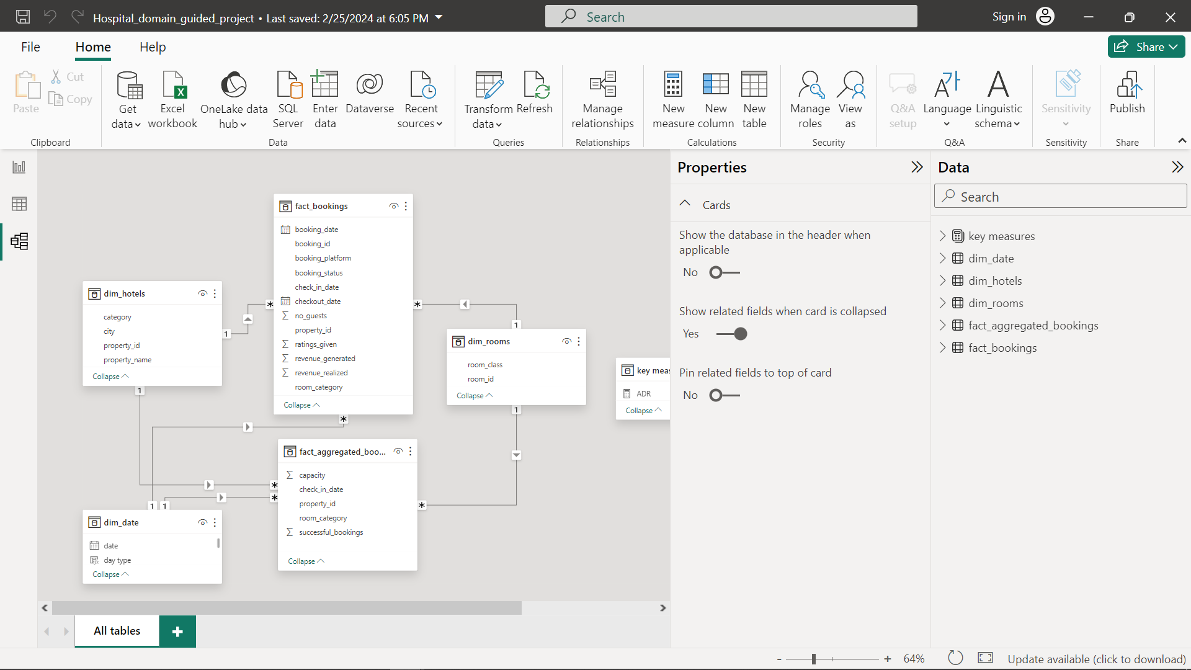
Data Model
TOC

Slide 9
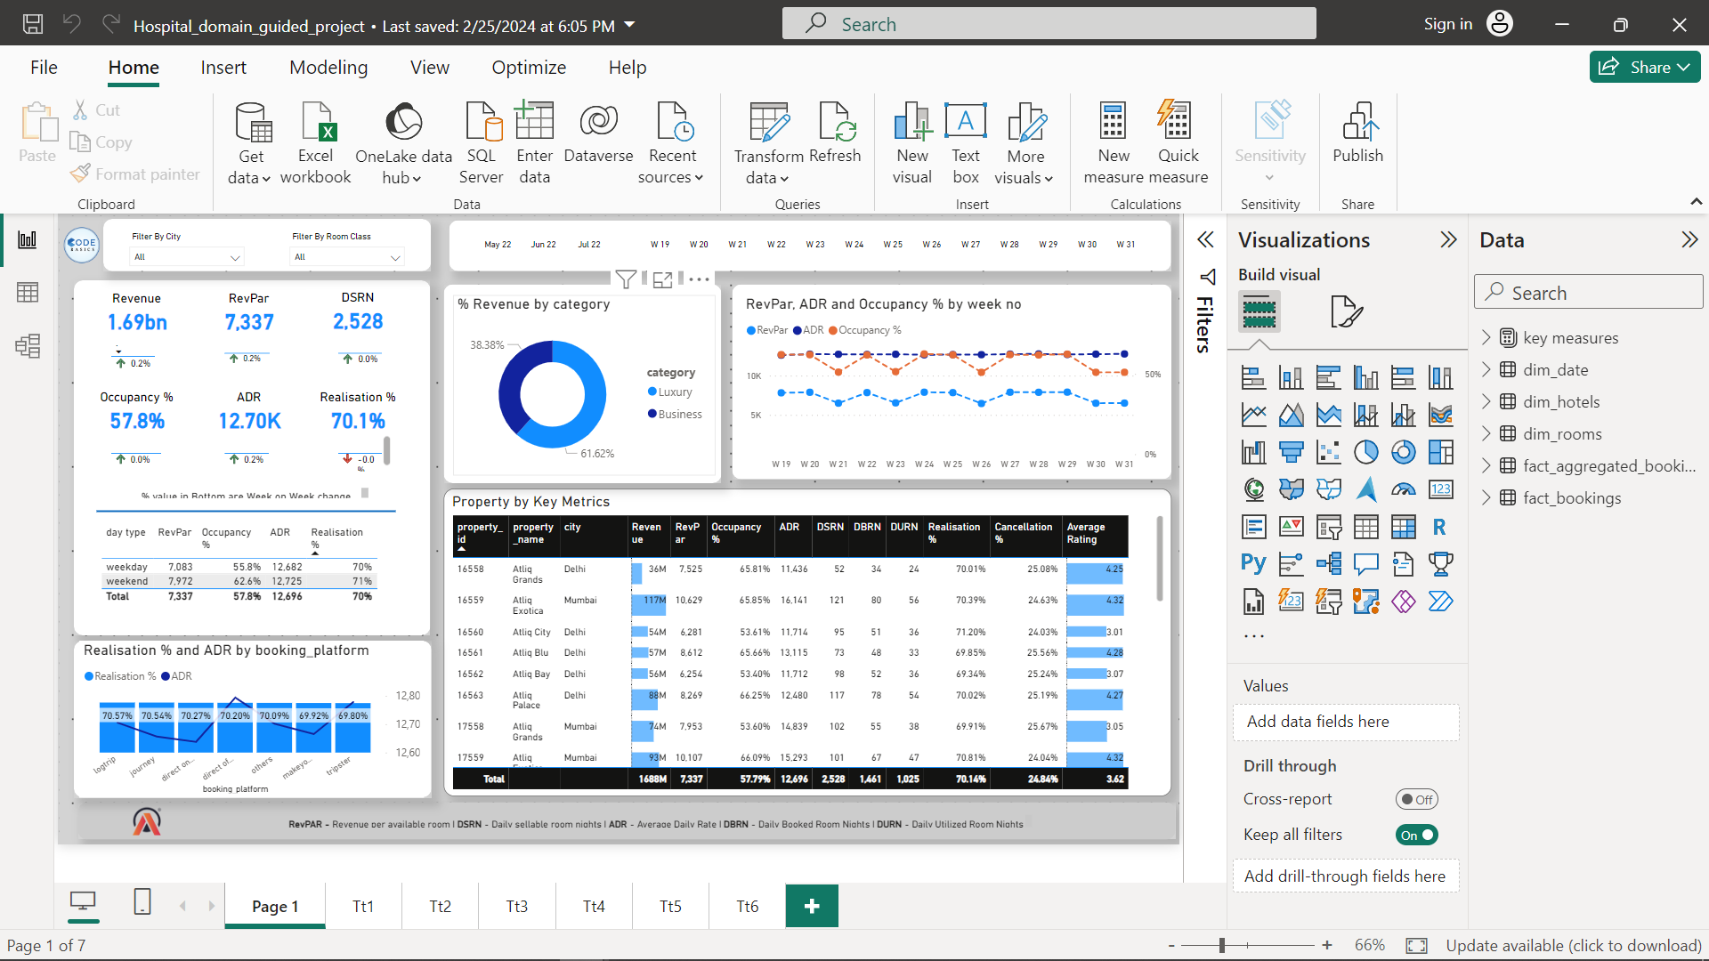
Final Dashboards
TOC

Slide 10
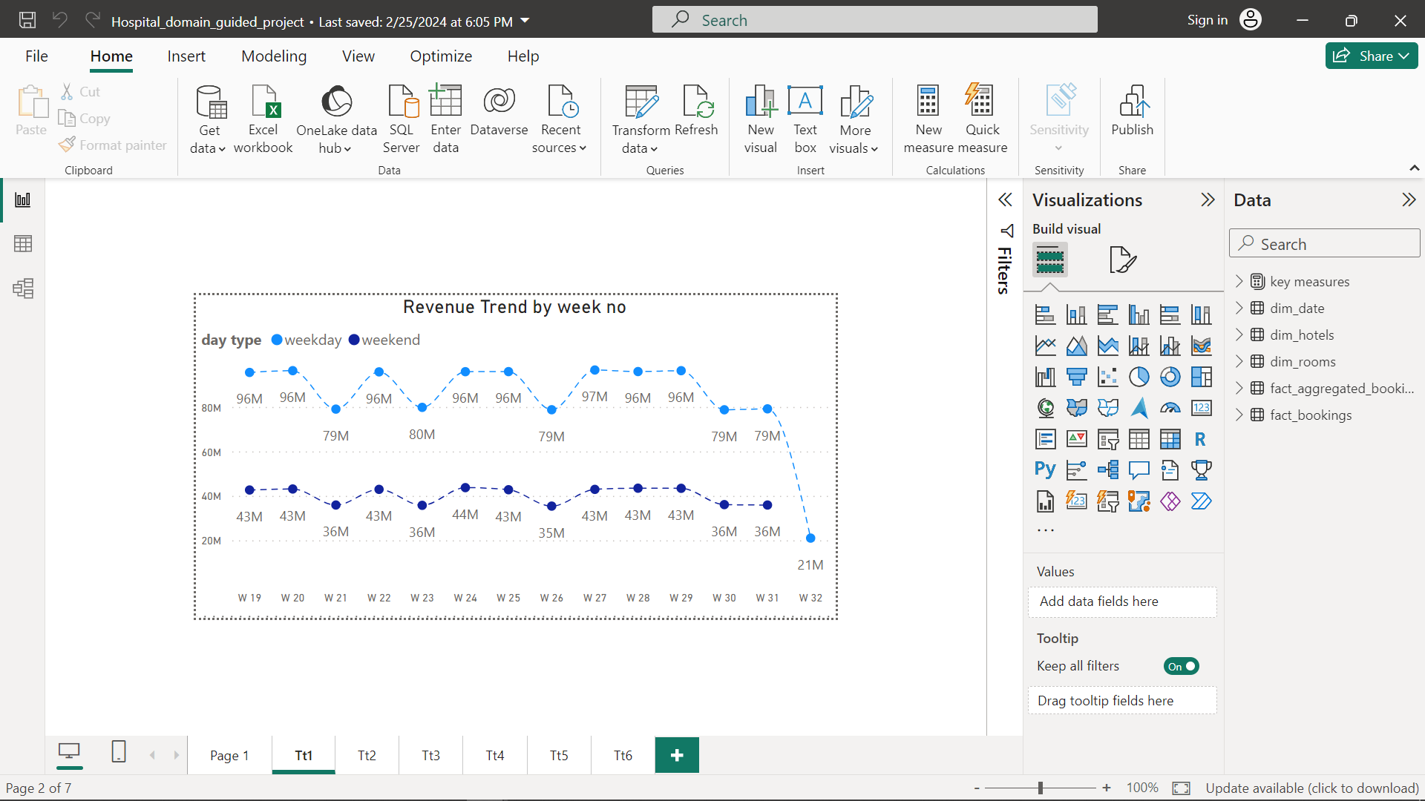
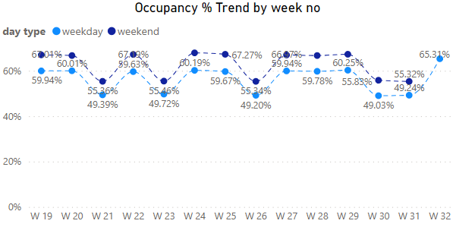
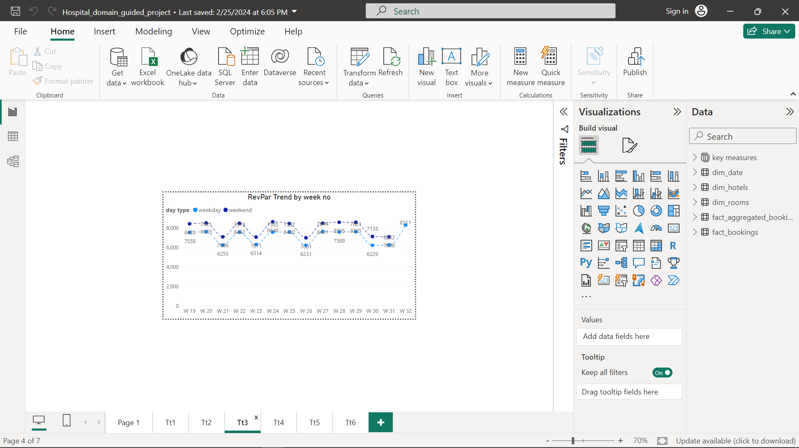
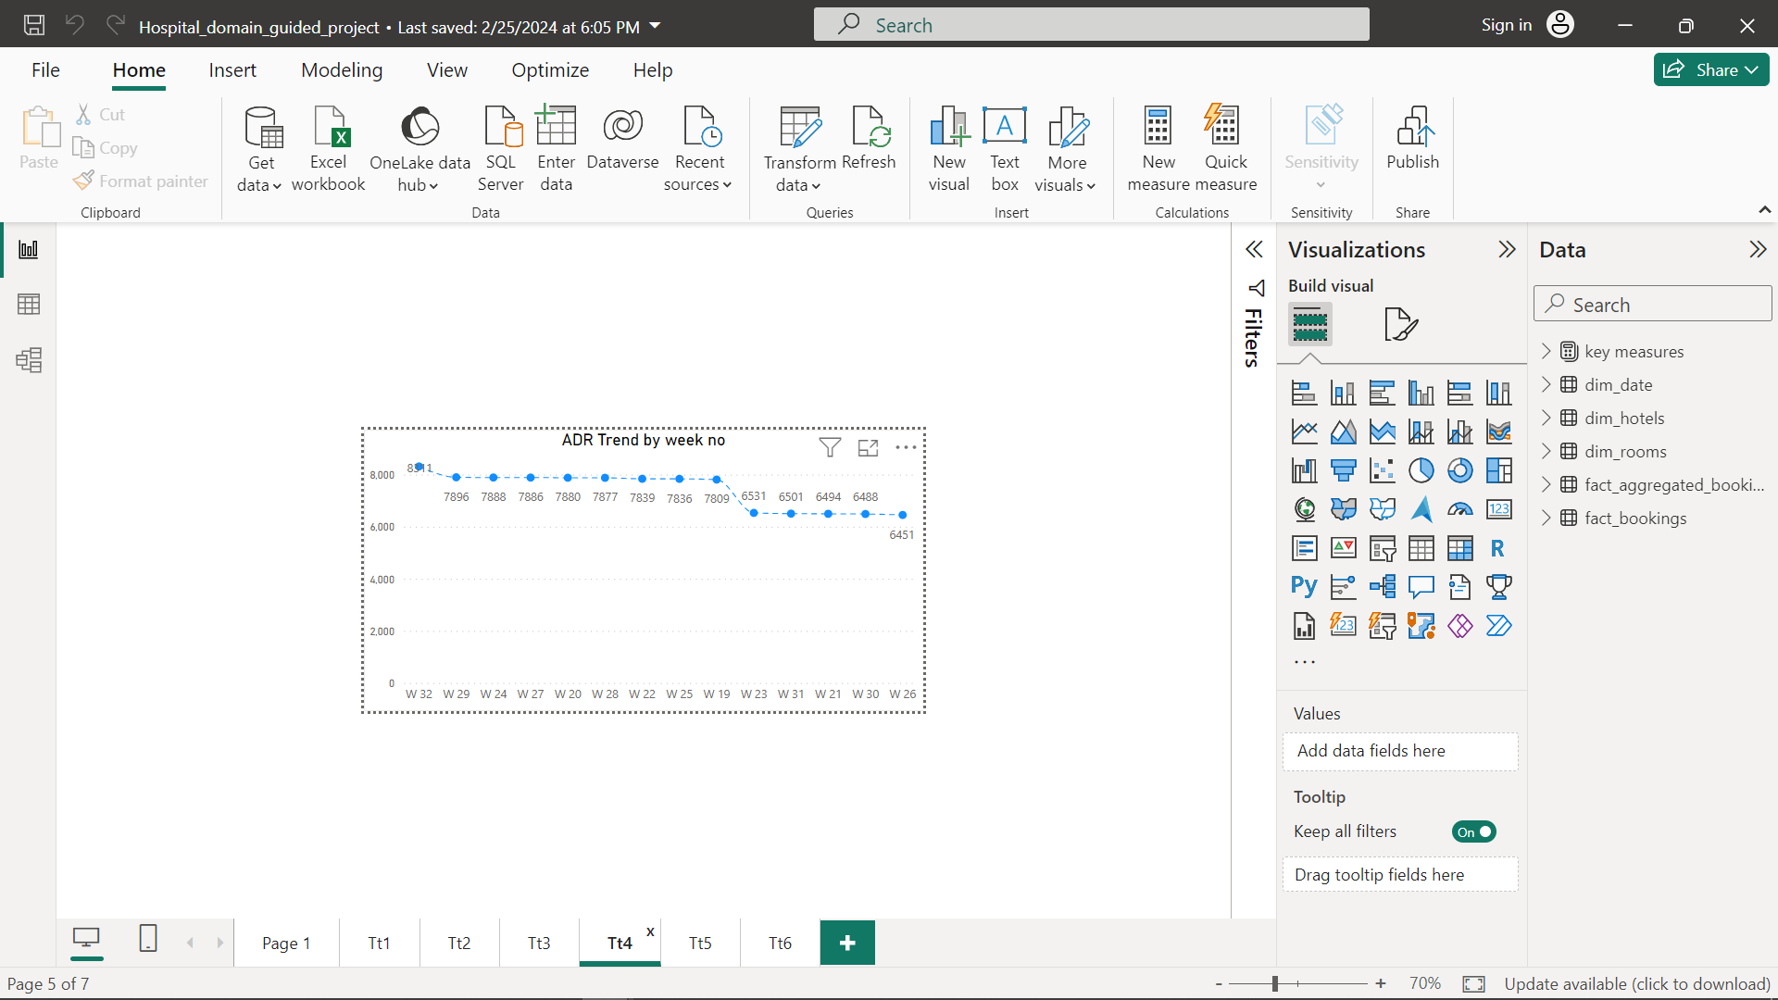

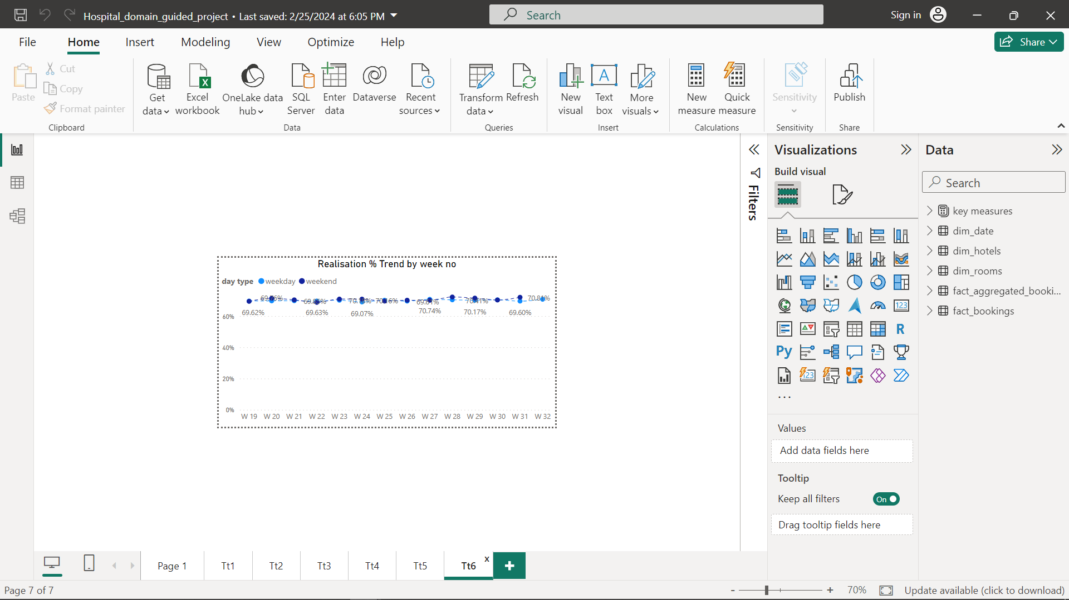
Trends on Week Basis
TOC

Slide 11
Findings and Conclusion
Mumbai generates the highest revenue followed by Bangalore, Hyderabad and Delhi.
AtliQ Exotica performs better compared to all 7 types of properties.
Atliq Bay has the highest occupancy.
Delhi tops both in occupancy and rating followed by Hyderabad, Mumbai and Bangalore.
Elite type rooms has the most booking and as well as higher calculation rate.
TOC

Slide 12
Thank You

