Slide 1
Introduction to Machine Learning Michael Mayer

Slide 2
Data Science is 90% data preparation. This lecture is about the remaining 10%.

Slide 3
What is Machine Learning (ML)?
«Collection of statistical algorithms used to
predict things (supervised ML) or to
investigate data structure (unsupervised ML).»
This lecture is on supervised ML (regression & classification)

Slide 4
Lecture Overview
Basics and Linear Models
Model Selection and Validation
Trees
Neural Nets
Material: https://github.com/mayer79/ml_lecture
Presentation template: SlidesCarnival

Slide 5
1.
Basics and Linear Models
Basics – linear regression – GLMs

Slide 6
Basics

Slide 7
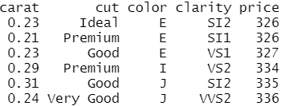
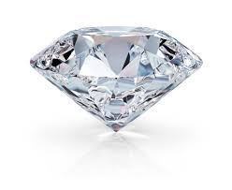
Intro
Organization of data
Data types
Descriptive analysis
Example: diamonds

Slide 8
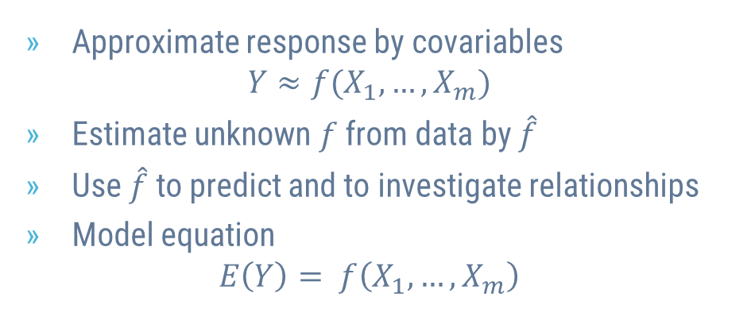
Statistical Models
Approximate response by covariables $Y≈f(X_{1}, …, X_{m})$
Estimate unknown $f$ from data by $\hat{f}$
Use $\hat{f}$ to predict and to investigate relationships
Model equation $E\left(Y\right)= f\left(X_{1}, …, X_{m}\right)$

Slide 9
Linear Regression

Slide 10
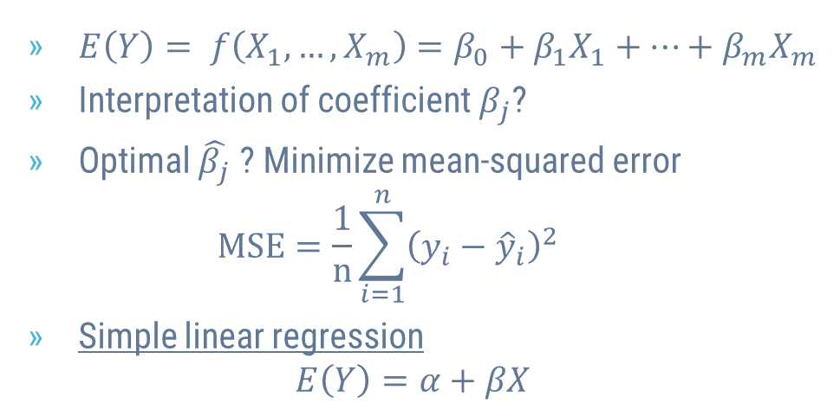
Linear Regression
$E\left(Y\right)= f\left(X_{1}, …, X_{m}\right)=β_{0}+β_{1}X_{1}+⋯+β_{m}X_{m}$
Interpretation of coefficient $β_{j}$?
Optimal $\hat{β_{j}}$ ? Minimize mean-squared error $MSE=\frac{1}{n}\sum_{i=1}^{n}{{\left({y_{i}−\hat{y}}_{i}\right)}^{2}}$
Simple linear regression $E\left(Y\right)=α+βX$

Slide 11
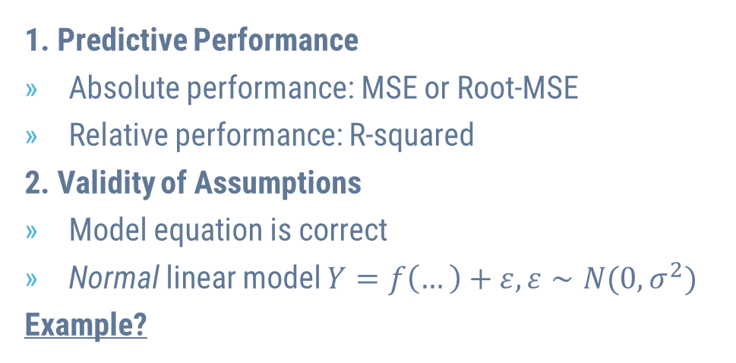
Aspects of Model Quality
1. Predictive Performance
Absolute performance: MSE or Root-MSE
Relative performance: R-squared
2. Validity of Assumptions
Model equation is correct
Normal linear model $Y=f\left(…\right)+ε, ε∼N(0, σ^{2})$
Example?

Slide 12
Typical Problems
Missing Values
Outliers
Overfitting
Collinearity

Slide 13
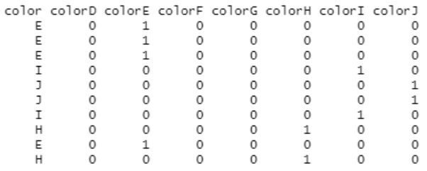
Categorical Covariables
One-Hot-Encoding
Dummy coding
Integer encoding
Interpretation?
Example
Example of One-Hot-Encoding

Slide 14
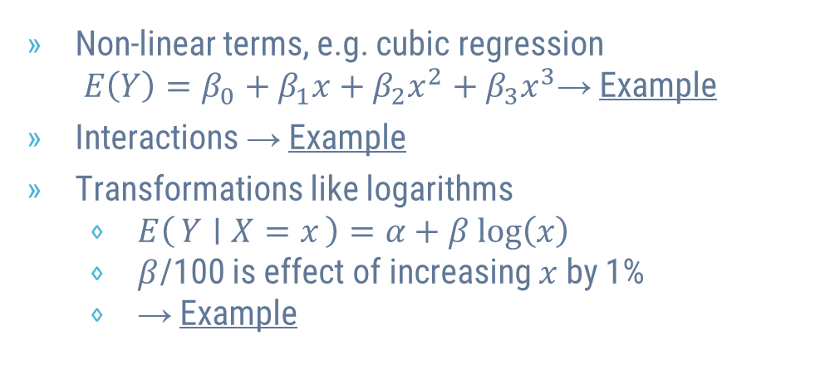
Linear Regression is Flexible
Non-linear terms, e.g. cubic regression $E\left(Y\right)=β_{0}+β_{1}x+β_{2}x^{2}+β_{3}x^{3}$→ Example
Interactions → Example
Transformations like logarithms
$E\left(Y ∣ X=x\right)=α+β log\left(x\right)$
$β$/100 is effect of increasing $x$ by 1%
→ Example

Slide 15
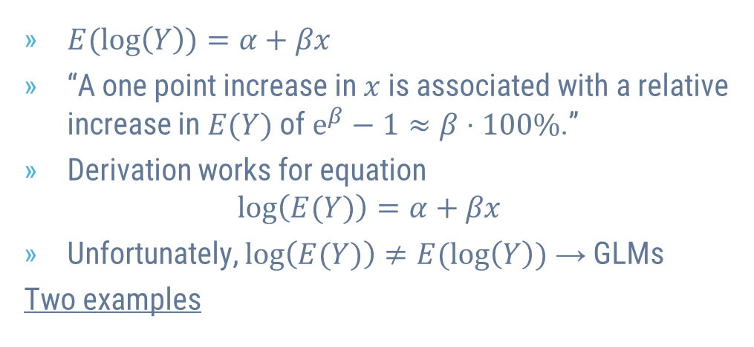
Logarithmic Response
$E(log\left(Y\right))=α+βx$
“A one point increase in $x$ is associated with a relative increase in $E(Y)$ of $e^{β}−1≈β⋅100\%$.”
Derivation works for equation $log\left(E(Y)\right)=α+βx$
Unfortunately, $log\left(E(Y)\right)≠E(log\left(Y\right))$ → GLMs
Two examples

Slide 16

A Strong Model for Diamond Prices
Response: log(price)
Covariables: log(carat), color, cut and clarity

Slide 17
Exercise
Run last model without any logarithms
Interpret
Compare

Slide 18
Generalized Linear Models

Slide 19
2.
Model Selection and Validation

Slide 20
Overfitting should not be rewarded
«How good is our model?»
«Which model to choose among alternatives?»
Approach
«Insample» performance is biased
Use data splitting to get fair results

Slide 21
Excursion: k-Nearest-Neighbour (k-NN)
Alternative to linear model
How does it work?
Classification & Regression
Standardization
Example

Slide 22
Simple Validation
Insample, 1-NN would win any comparison!?
Split data into training and validation set
Use performance on validation set to make decisions (choose models, hyperparameters like k)
Measure amount of overfitting?
Example

Slide 23
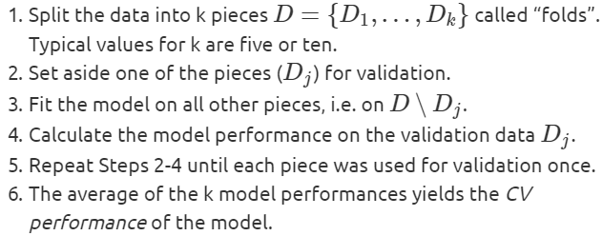
Cross-Validation (CV)
Simple validation neither economic nor robust
Better: k-fold cross-validation
Final model?
Example?

Slide 24
Grid Search CV
Choosing k in k-NN is «hyperparameter tuning»
Algorithms with more than 1 hyperparameter?
Grid Search CV?
Randomized Search CV?

Slide 25
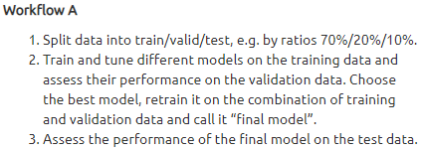
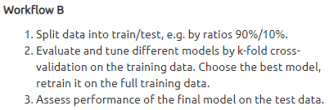
Test Data
Overfitting on validation data!
Performance of final model? → Test data
Test = Validation?
Example of Workflow B

Slide 26
Using Independent Partitions is Essential
Random splits
Grouped splits
Time-Series splits
Stratified splits

Slide 27
Exercises with Diamonds
Apply stratified splitting on “price” throughout the last example. Do the results change?
Use CV to select the best polynomial degree of log(carat) in the Gamma GLM with log-link (with additional covariables color, cut, clarity). Evaluate on a test data.
Compare by simple validation the linear regression for “price” to a Gamma GLM with log-link. Once use (R)MSE for comparison and once Gamma deviance. What do you observe? As covariables, use log(carat), color, cut, clarity.

Slide 28
3.
Trees

Slide 29
Decision Trees
Random Forests
Gradient boosting
XGBoost
LightGBM
CatBoost

Slide 30

Decision Trees
Simple
Easy to interpret
Michael: «Decision trees are like wolves: Weak alone, strong together»
Around since 1984 (Breiman, Friedman)
https://images.pexels.com/photos/3732527/pexels-photo-3732527.jpeg

Slide 31
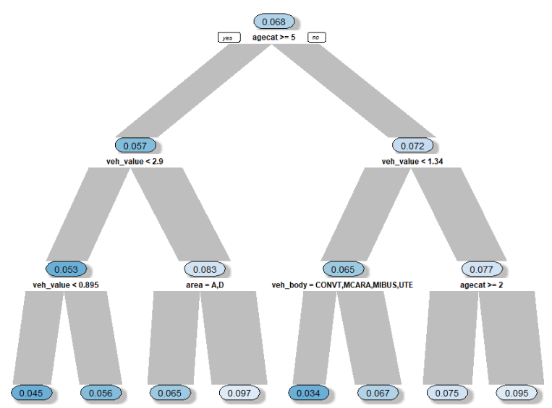
How do Decision Trees Work?
Algorithm
Split: find best «yes/no» question on best feature
Apply Step 1 recursively
Typical losses: MSE, log loss/cross-entropy/ information or Gini
Predictions?
Regarding loss improvement
Example

Slide 32
Properties of Decision Trees
Outliers
Greedy
Missing Values
Categorical covariables
Interactions
Properties are inherited to groups/ensembles of decision trees

Slide 33

Random Forests
Group of many decision trees
Perform very well
“Black Box”
Around since 2001 (Breiman)
https://images.pexels.com/photos/1459534/pexels-photo-1459534.jpeg

Slide 34
How do Random Forests Work?
If we train 500 trees, how can we make sure they are different? → Introduce two sources of randomness
Each split considers random selection of features only.
Each tree is trained on bootstrap sample.
Predictions?

Slide 35
Comments on Random Forests
Number of trees?
Diversification!
Insample performance
Out-of-Bag (OOB)
Parameter tuning
→ Example

Slide 36
Interpreting a “Black Box” is Important
Minimum interpretation of model?
Performance
Variable importance
Effects → e.g. partial dependence plots
Example

Slide 37
Exercises on Random Forests
In our diamonds random forest, replace carat by log(carat). Do the results change?
Fit a random forest on the claims data to predict claim probability by veh_value, veh_body, veh_age, gender, area, and agecat.
Choose tree-depth by OOB performance.
Use a simple train/test split.
Make sure to fit a probability random forest.
Interpret the results.

Slide 38
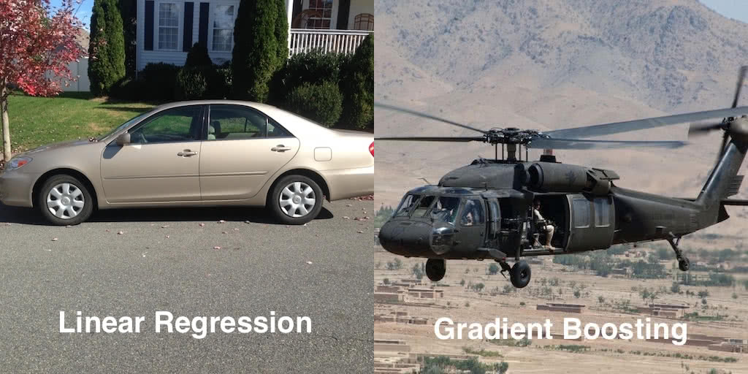
Gradient Boosted Trees
Group of many decision trees
Perform very well
“Black Box”
Around since 2001 (Friedman)
XGBoost, LightGBM, CatBoost
https://www.gormanalysis.com/blog/gradient-boosting-explained/
Like random forests

Slide 39
How does Gradient Boosting Work?
Algorithm
Fit simple model (often a small decision tree)
Repeat Step 1 on the model errors (~gradients) until validation performance stops improving.
Predictions found by combining predictions of simple models (like random forest).
Flexible regarding loss function (GLMs…)
Completely different to random forest

Slide 40
Parameter Tuning is Essential
Loss versus performance metric?
Number of boosting rounds/trees → find by early stopping (validation/CV)
Learning rate → to get reasonable number of rounds
Regularization
Tree depth, number of leaves, loss penalties, …
→ Grid/Randomized search & iterate
Example

Slide 41
Exercises on Gradient Boosting
Study documentation of XGBoost to make the last model monotonically increasing in carat. Check the resulting partial dependence plot.
Develop a strong XGBoost model on the claims data to predict claim probability by veh_value, veh_body, veh_age, gender, area, and agecat.
Use log-loss as both objective and evaluation metric.
Use a clean CV/test strategy.
Interpret the results.

Slide 42
4.
Neural Nets

Slide 43
Neural Nets
Around since the 1950ies
Underwent different development steps, e.g. use of “backpropagation”
“Black Box”
TensorFlow/Keras, PyTorch

Slide 44
“Swiss Army Knife” among ML Algorithms
Can fit linear models
Fit data larger than RAM
Learn interactions and non-linear terms
Learn «online»
Non-linear dimension reduction
>1 Responses possible
Sequential and spatial in- and output
Flexible and mixed in- and output dimensions
Flexible loss functions

Slide 45
Understanding Neural Nets in three Steps
Linear regression as neural net
Hidden layers
Activation functions

Slide 46
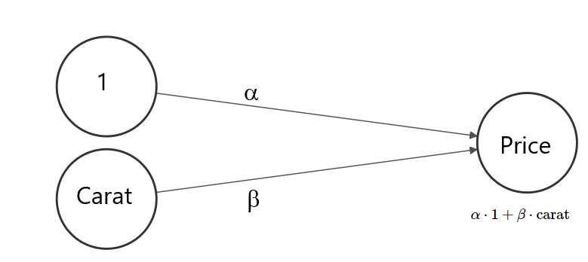

Step 1: Linear Regression as Neural Net
$E\left(Price\right)=α+β⋅carat$
OLS: $\hat{α}≈2256, \hat{β}≈7756$
Represented as neural network graph
Input layer
Output layer (dense/fully connected)
Bias unit
Weights
Example
Nodes

Slide 47
The Optimization Algorithm
“Mini-batch gradient descent with backpropagation”
Init step: Randomly initiate weights.
Forward step: Use weights to calculate predictions of batch.
Backprop step: Evaluate loss (e.g. MSE) of batch. Change weights systematically to make loss smaller.
Repeat Steps 2 & 3 until one epoch is over.
Repeat Step 4 until loss stabilizes.
SGD?
Gradients?
Local Minima?

Slide 48
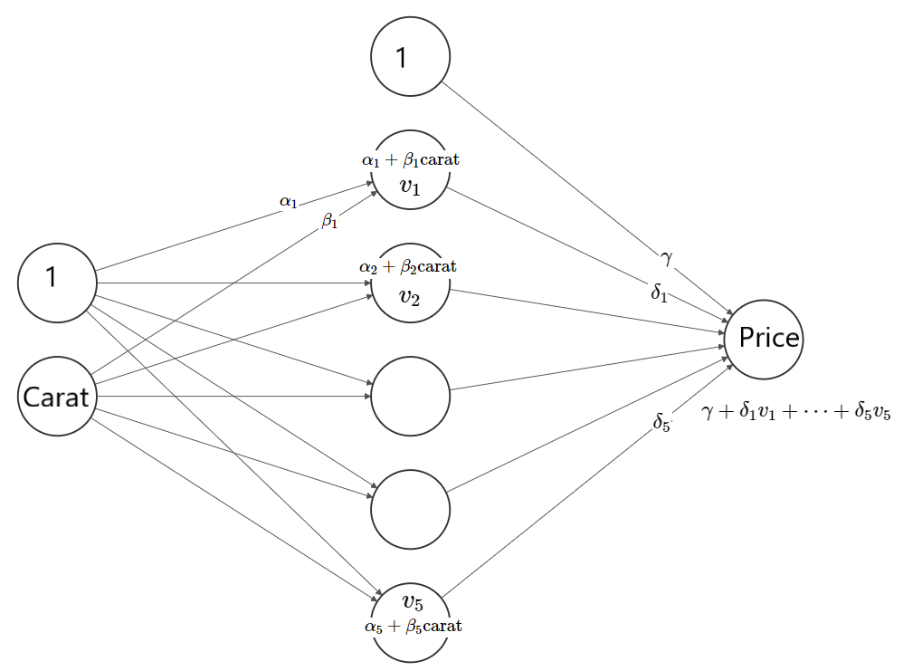
Step 2: Hidden Layers
Add hidden layers for more parameters (= flexibility)
Their nodes are latent/implicit variables
Representational learning
Embedding/encoding?
Deep neural net?
Example

Slide 49
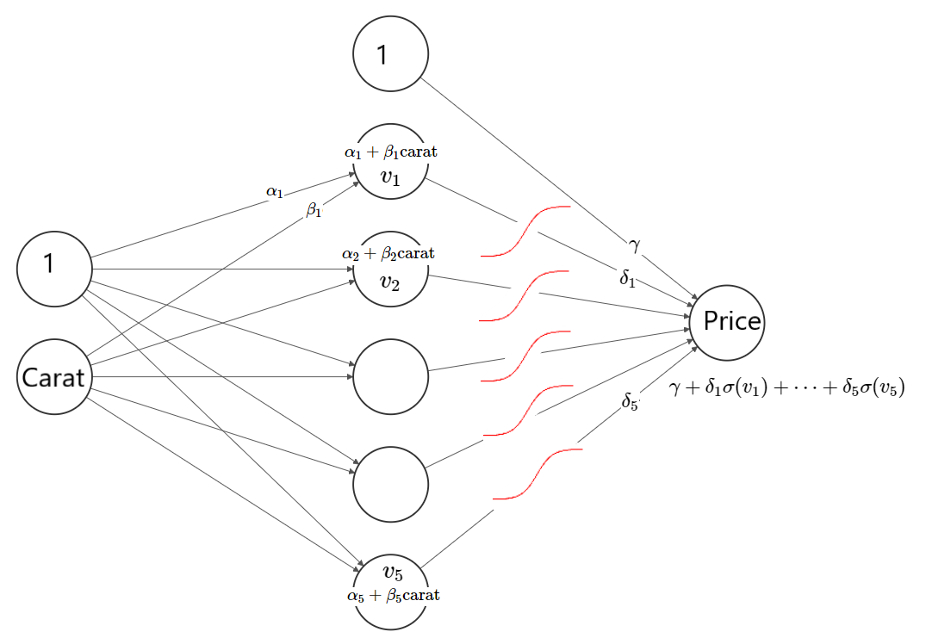
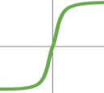
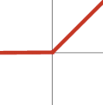

Step 3: Activation Functions
Non-linear transformations $σ$ of node values
Two purposes
Imply interactions and non-linear terms
Inverse link as in GLMs
Example

Slide 50
Practical Considerations
Validation and tuning of main parameters
Input standardization
Missing values
Categorical input
Callbacks
Types of layers
Interpretation
Optimizer
Overfitting and regularization
Choosing the architecture
Custom losses and evaluation metrics

Slide 51
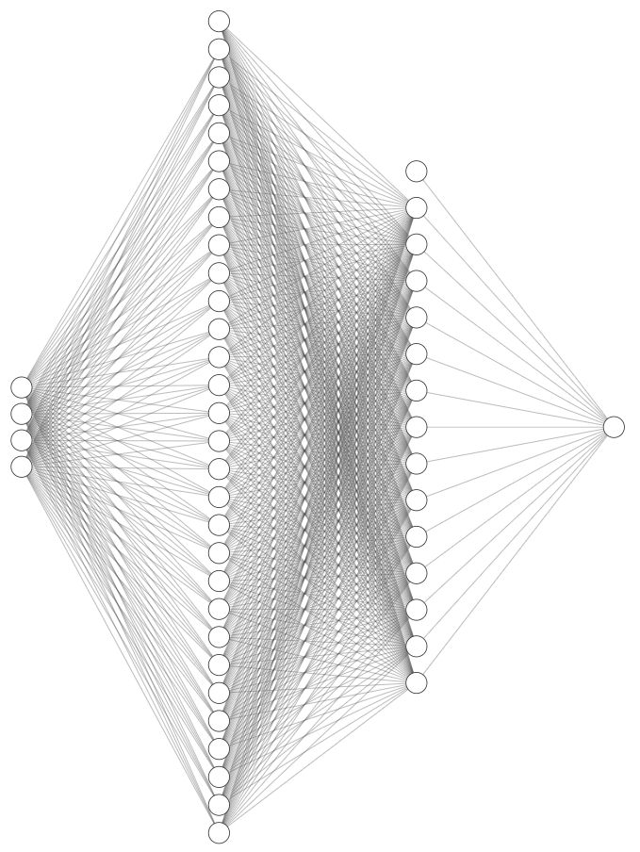
Example: diamonds

Slide 52
Exercises on Neural Nets
Fit diamond prices by gamma deviance loss with log-link (custom loss as in lecture notes; log-link means exponential output activation)
Tune model by simple validation.
Evaluate final model on test data.
Interpret final model.
Study either the optional claims data example in the lecture notes or build your own neural net, predicting claim yes/no.

Slide 53
Final Words

Slide 54
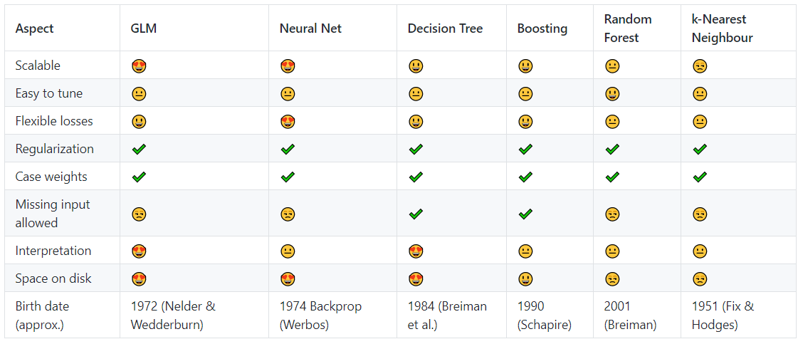
Comparison of some ML Algorithms

