Slide 1
Introduction to Machine Learning Michael Mayer

Slide 2
Data Science is 90% data preparation. This lecture is about the remaining 10%.

Slide 3
What is Machine Learning (ML)?
«Collection of statistical algorithms used to
predict things (supervised ML) or to
investigate data structure (unsupervised ML).»
This lecture is on supervised ML (regression & classification)

Slide 4
Lecture Overview
Basics and Linear Models
Model Selection and Validation
Trees
Neural Nets
Material: https://github.com/mayer79/ml_lecture

Slide 5
1.
Basics and Linear Models
Basics – linear regression – GLMs

Slide 6
Basics

Slide 7
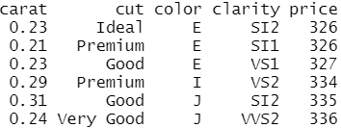
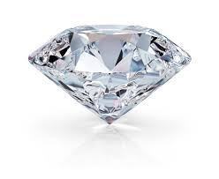
Intro
Organization of data
Data types
Descriptive analysis
Example: diamonds

Slide 8
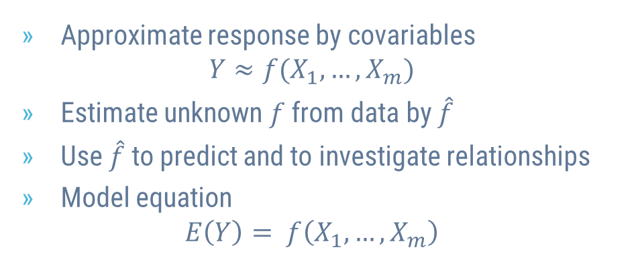
Statistical Models
Approximate response by covariables $Y≈f(X_{1}, …, X_{m})$
Estimate unknown $f$ from data by $\hat{f}$
Use $\hat{f}$ to predict and to investigate relationships
Model equation $E\left(Y\right)= f\left(X_{1}, …, X_{m}\right)$

Slide 9
Linear Regression

Slide 10
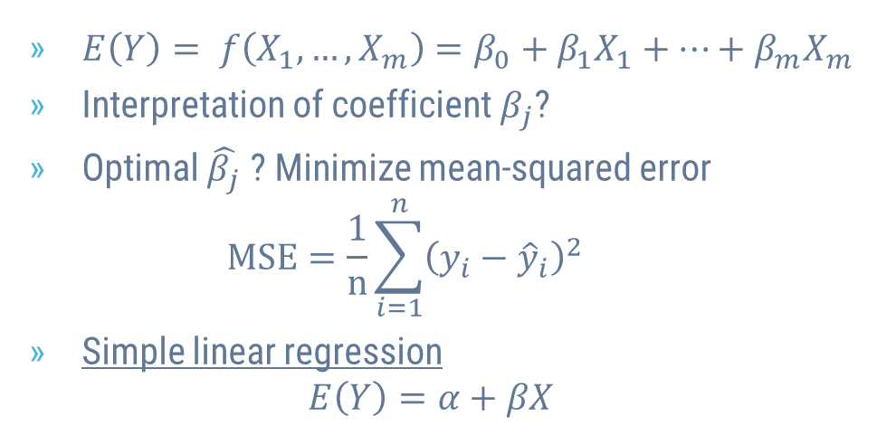
Linear Regression
$E\left(Y\right)= f\left(X_{1}, …, X_{m}\right)=β_{0}+β_{1}X_{1}+⋯+β_{m}X_{m}$
Interpretation of coefficient $β_{j}$?
Optimal $\hat{β_{j}}$ ? Minimize mean-squared error $MSE=\frac{1}{n}\sum_{i=1}^{n}{{\left({y_{i}−\hat{y}}_{i}\right)}^{2}}$
Simple linear regression $E\left(Y\right)=α+βX$

Slide 11
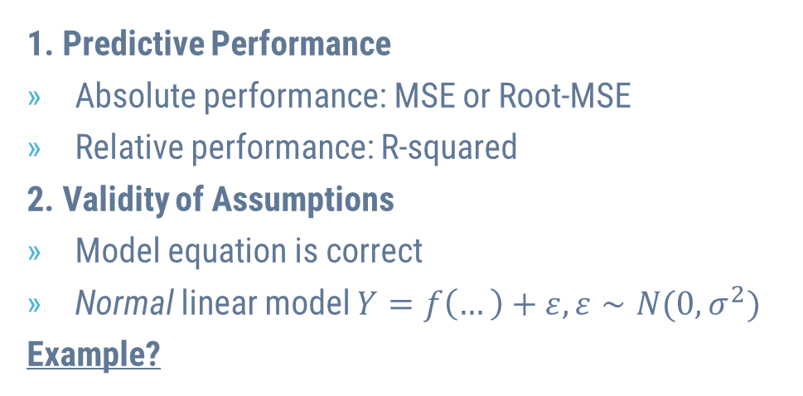
Aspects of Model Quality
1. Predictive Performance
Absolute performance: MSE or Root-MSE
Relative performance: R-squared
2. Validity of Assumptions
Model equation is correct
Normal linear model $Y=f\left(…\right)+ε, ε∼N(0, σ^{2})$
Example?

Slide 12
Typical Problems
Missing Values
Outliers
Overfitting
Collinearity

Slide 13
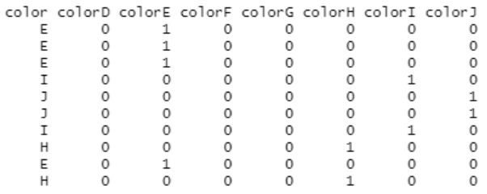
Categorical Covariables
One-Hot-Encoding
Dummy coding
Integer encoding
Interpretation?
Example
Example of One-Hot-Encoding

Slide 14
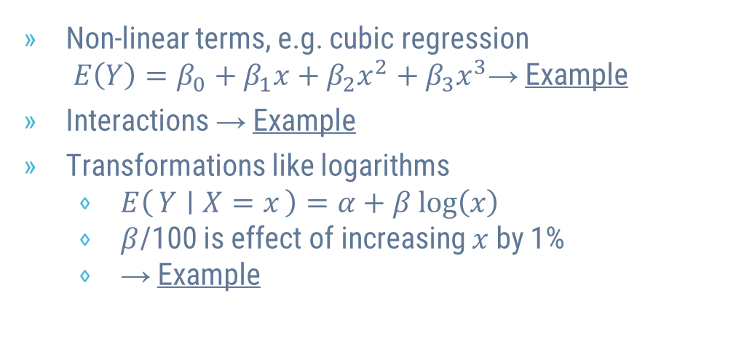
Linear Regression is Flexible
Non-linear terms, e.g. cubic regression $E\left(Y\right)=β_{0}+β_{1}x+β_{2}x^{2}+β_{3}x^{3}$→ Example
Interactions → Example
Transformations like logarithms
$E\left(Y ∣ X=x\right)=α+β log\left(x\right)$
$β$/100 is effect of increasing $x$ by 1%
→ Example

Slide 15
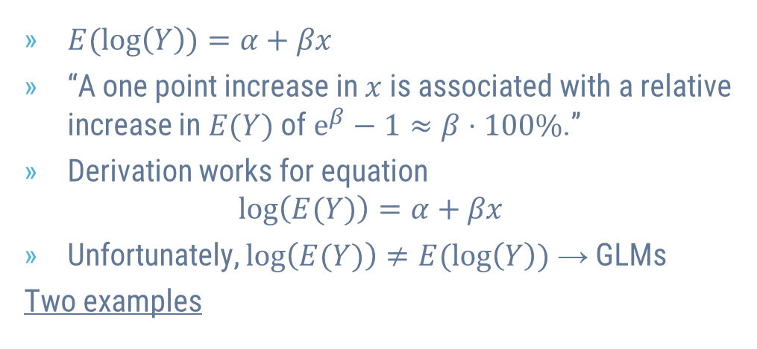
Logarithmic Response
$E(log\left(Y\right))=α+βx$
“A one point increase in $x$ is associated with a relative increase in $E(Y)$ of $e^{β}−1≈β⋅100\%$.”
Derivation works for equation $log\left(E(Y)\right)=α+βx$
Unfortunately, $log\left(E(Y)\right)≠E(log\left(Y\right))$ → GLMs
Two examples

Slide 16
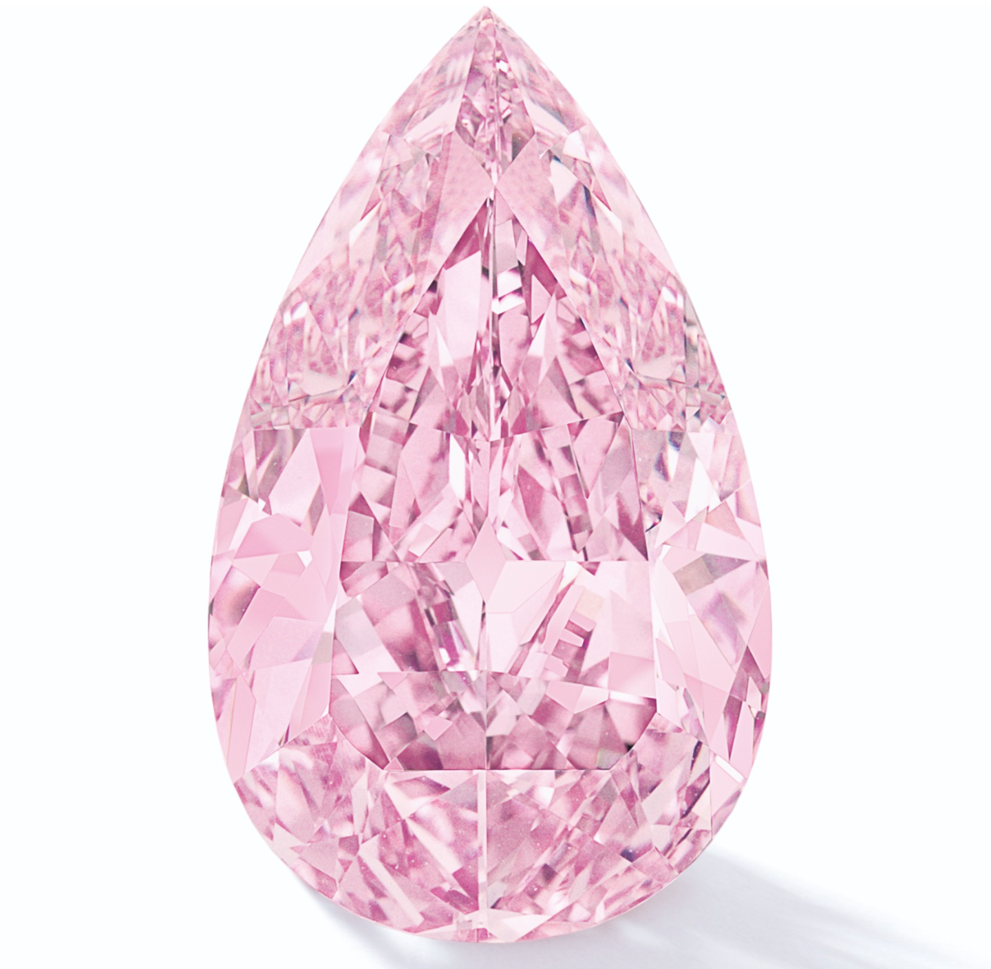
A Strong Model for Diamond Prices
Response: log(price)
Covariables: log(carat), color, cut and clarity

Slide 17
Exercise
Run last model without any logarithms
Interpret
Compare

Slide 18
Generalized Linear Models

Slide 19
2.
Model Selection and Validation

Slide 20
Overfitting should not be rewarded
«How good is our model?»
«Which model to choose among alternatives?»
Approach
«Insample» performance is biased
Use data splitting to get fair results

Slide 21
Excursion: k-Nearest-Neighbour (k-NN)
Alternative to linear model
How does it work?
Classification & Regression
Standardization
Example

Slide 22
Simple Validation
Insample, 1-NN would win any comparison!?
Split data into training and validation set
Use performance on validation set to make decisions (choose models, hyperparameters like k)
Measure amount of overfitting?
Example

Slide 23
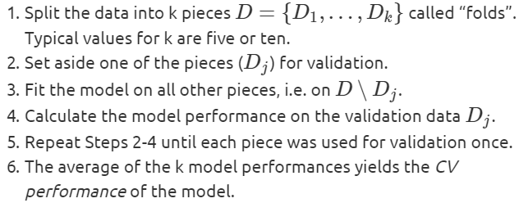
Cross-Validation (CV)
Simple validation neither economic nor robust
Better: k-fold cross-validation
Final model?
Example?

Slide 24
Grid Search CV
Choosing k in k-NN is «hyperparameter tuning»
Algorithms with more than 1 hyperparameter?
Grid Search CV?
Randomized Search CV?

Slide 25
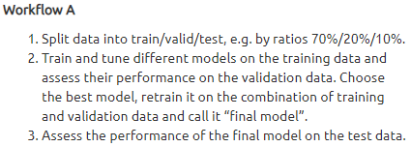
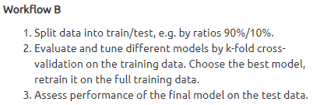
Test Data
Overfitting on validation data!
Performance of final model? → Test data
Test = Validation?
Example of Workflow B

Slide 26
Using Independent Partitions is Essential
Random splits
Grouped splits
Time-Series splits
Stratified splits

Slide 27
Exercises with Diamonds
Apply stratified splitting on “price” throughout the last example. Do the results change?
Use CV to select the best polynomial degree of log(carat) in the Gamma GLM with log-link (with additional covariables color, cut, clarity). Evaluate on a test data.
Compare by simple validation the linear regression for “price” to a Gamma GLM with log-link. Once use (R)MSE for comparison and once Gamma deviance. What do you observe? As covariables, use log(carat), color, cut, clarity.

Slide 28
3.
Trees
Decision trees – random forests – boosted trees

Slide 29
4.
Neural Nets

Slide 30
“Quotations are commonly printed as a means of inspiration and to invoke philosophical thoughts from the reader”

Slide 31
BIG
CONCEPT
Bring the attention of your audience over a key concept using icons or illustrations

Slide 32
YOU CAN ALSO SPLIT YOUR CONTENT
White
Is the color of milk and fresh snow, the color produced by the combination of all the colors of the visible spectrum.
Black
Is the color of ebony and of outer space. It has been the symbolic color of elegance, solemnity and authority.

Slide 33
IN TWO OR THREE COLUMNS
Yellow
Is the color of gold, butter and ripe lemons. In the spectrum of visible light, yellow is found between green and orange.
Blue
Is the colour of the clear sky and the deep sea. It is located between violet and green on the optical spectrum.
Red
Is the color of blood, and because of this it has historically been associated with sacrifice, danger and courage.

Slide 34

A PICTURE IS WORTH A THOUSAND WORDS
A complex idea can be conveyed with just a single still image, namely making it possible to absorb large amounts of data quickly.

Slide 35
USE CHARTS TO EXPLAIN YOUR IDEAS
White
Gray
Black

Slide 36
AND TABLES TO COMPARE DATA
 | A | B | C
Yellow | 10 | 20 | 7
Blue | 30 | 15 | 10
Orange | 5 | 24 | 16

Slide 37
89,526,124
Whoa! That’s a big number, aren’t you proud?

Slide 38
89,526,124$
185,244 USERS
100%
That’s a lot of money
And a lot of users
Total success!

Slide 39
OUR PROCESS IS EASY
first
second
last

Slide 40
LET’S REVIEW SOME CONCEPTS
Yellow
Is the color of gold, butter and ripe lemons. In the spectrum of visible light, yellow is found between green and orange.
Blue
Is the colour of the clear sky and the deep sea. It is located between violet and green on the optical spectrum.
Red
Is the color of blood, and because of this it has historically been associated with sacrifice, danger and courage.
Yellow
Is the color of gold, butter and ripe lemons. In the spectrum of visible light, yellow is found between green and orange.
Blue
Is the colour of the clear sky and the deep sea. It is located between violet and green on the optical spectrum.
Red
Is the color of blood, and because of this it has historically been associated with sacrifice, danger and courage.

Slide 41
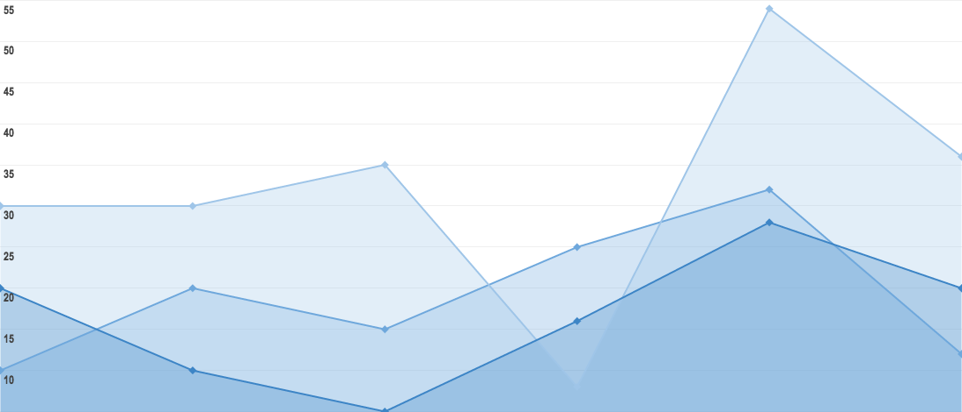
You can insert graphs from Google Sheets

Slide 42
THANKS!
Any questions?
You can find me at
mayermichael79@gmail.com

Slide 43
CREDITS
Presentation template by SlidesCarnival
R, Python, and their contributors

Slide 44
SlidesCarnival icons are editable shapes.
This means that you can:
Resize them without losing quality.
Change fill color and opacity.
Change line color, width and style.
Isn’t that nice? :)
Examples:

Slide 45
Diagrams and infographics

Slide 46
😉
Now you can use any emoji as an icon!
And of course it resizes without losing quality and you can change the color.
How? Follow Google instructions https://twitter.com/googledocs/status/730087240156643328
✋👆👉👍👤👦👧👨👩👪💃🏃💑❤😂😉😋😒😭👶😸🐟🍒🍔💣📌📖🔨🎃🎈🎨🏈🏰🌏🔌🔑 and many more...

