Slide 1
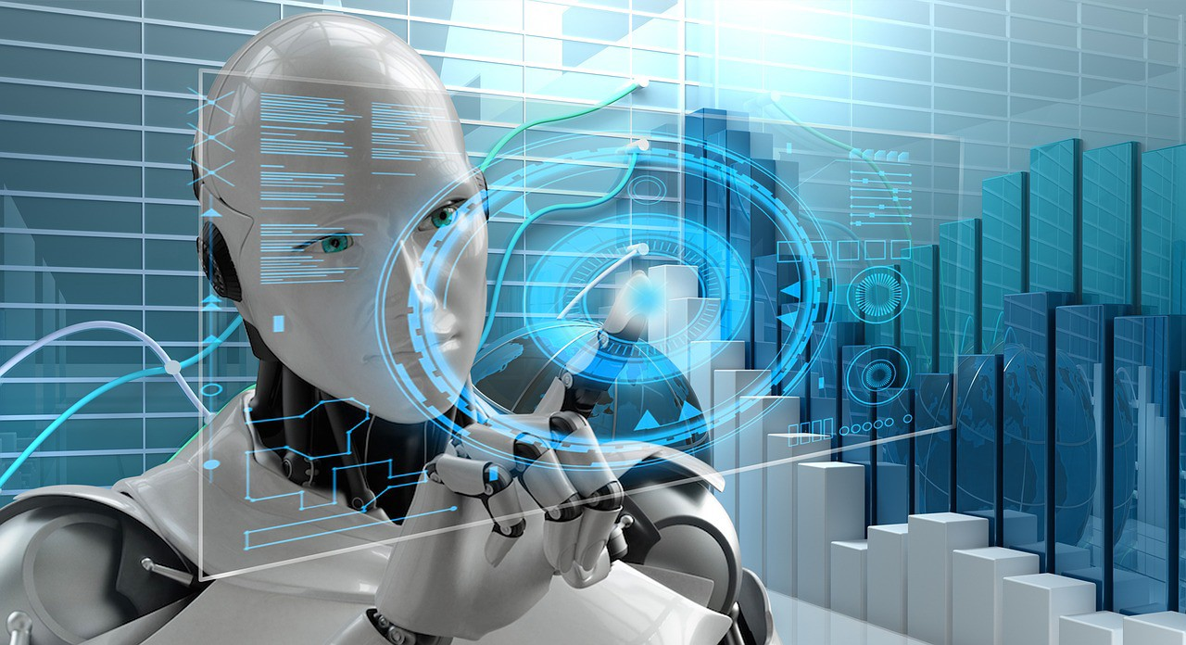
Welcome
-Rohan Thakur

Slide 2
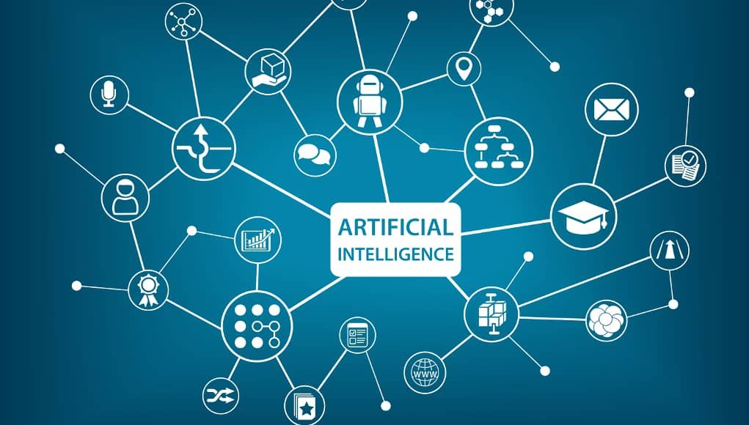

Slide 3
Contents
Artificial Intelligence
1 Introduction
1.1 What Is AI?
1.2 The Foundations of Artificial Intelligence
1.3 The History of Artificial Intelligence
Intelligent Agents
2.1 Agents and Environments
2.2 Sensor, Actuators, Effectors
2.3 PEAS
2.4 Types of AI Agents

Slide 4
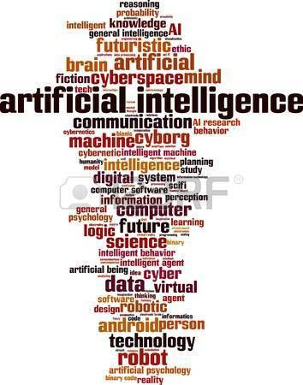
Artificial Intelligence
In computer science, artificial intelligence (AI), sometimes called machine intelligence, is intelligence demonstrated by machines, in contrast to the natural intelligence displayed by humans.
the term "artificial intelligence" is often used to describe machines (or computers) that mimic "cognitive" functions that humans associate with other human minds, such as "learning" and "problem solving".

Slide 5
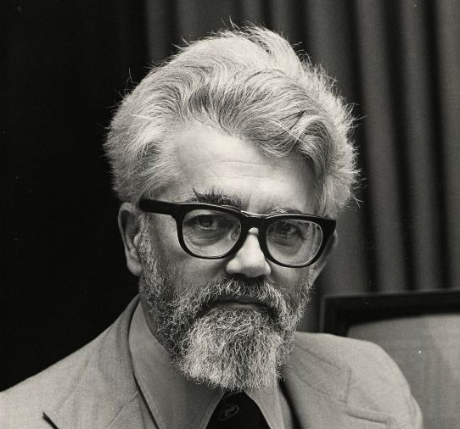
The History of Artificial Intelligence
influential founders of AI, including John McCarthy(2007), Marvin Minsky (2007), Nils Nilsson (1995, 2005) and Patrick Winston (Beal andWinston, 2009), have expressed discontent with the progress of AI.
They think that AI shouldput less emphasis on creating ever-improved versions of applications that are good at a specific task, such as driving a car, playing chess, or recognizing speech.

Slide 6
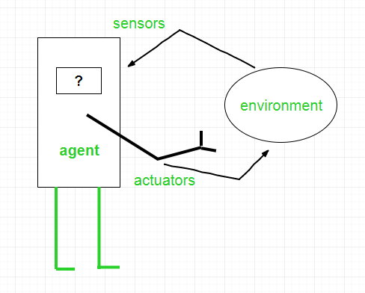
Intelligent Agents
An agent is anything that can be ENVIRONMENT viewed as perceiving its environment through sensors and SENSOR acting upon that environment through actuators.
A human agent has eyes, ears, and other organs for sensors and hands, legs, vocal tract, and soon for actuators.
A robotic agent might have cameras and infrared range finders for sensors and various motors for actuators.
A software agent receives keystrokes, file contents, and network packets as sensory inputs and acts on the environment by displaying on the screen,writing files, and sending network packets.

Slide 7
Sensor, Actuators, Effectors
Before moving forward, we should first know about sensors, effectors, and actuators.
Sensor: Sensor is a device which detects the change in the environment and sends the information to other electronic devices. An agent observes its environment through sensors.
Actuators: Actuators are the component of machines that converts energy into motion. The actuators are only responsible for moving and controlling a system. An actuator can be an electric motor, gears, rails, etc.
Effectors: Effectors are the devices which affect the environment. Effectors can be legs, wheels, arms, fingers, wings, fins, and display screen.

Slide 8
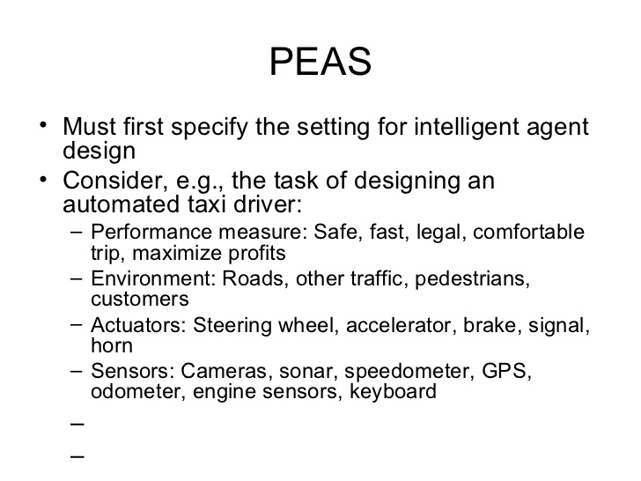

Slide 9
Types of AI Agents
Simple Reflex Agent
Model-based reflex agent
Goal-based agents
Utility-based agent
Learning agent

Slide 10
Thank You!!!

