Slide 1
Welcome
Rohan Thakur

Slide 2
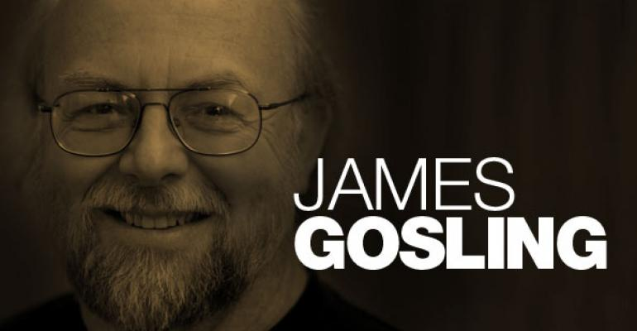

Slide 3
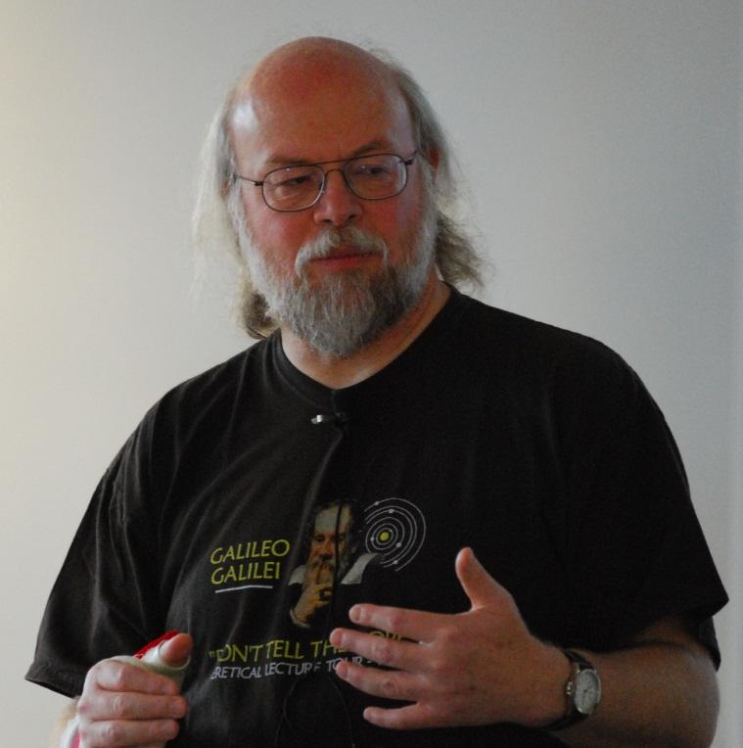
James
Gosling
James Arthur Gosling, (born May 19, 1955) is a Canadian computer scientist, best known as the founder and lead designer behind the Java programming language.
Java was originally developed by James Gosling at Sun Microsystems (which has since been acquired by Oracle) and released in 1995 as a core component of Sun Microsystems' Java platform.

Slide 4
Born | May 19, 1955 (age 64) Near Calgary, Alberta, Canada
Residence | San Francisco Bay Area, California, U.S.
Nationality | Canadian
Alma mater | Carnegie Mellon University University of Calgary
Education:
James Gosling received a Bachelor of Science from the University of Calgary and his M.A. and Ph.D. from Carnegie Mellon University, all in computer science.
He built a multi-processor version of Unix for a 16-way computer system while at Carnegie Mellon University, before joining Sun Microsystems while working toward his doctorate.

Slide 5


Contribution:
He created the original design of Java and implemented the language's original compiler and virtual machine.
Gosling initially became known as the author of Gosling Emacs, and also invented the windowing system NeWS, which lost out to X Window because Sun did not give it an open source license.
He also developed several compilers and mail systems there.

Slide 6

CAREER:
Gosling was with Sun Microsystems between 1984 and 2010 (26 years).
He got the idea for the Java VM while writing a program to port software from a PERQ by translating Perq Q-Code to VAX assembler and emulating the hardware.
He left Sun Microsystems on April 2, 2010 after it was acquired by the Oracle Corporation, citing reductions in pay, status, and decision-making ability, along with change of role and ethical challenges.

Slide 7
Thank You!!!

