Slide 1
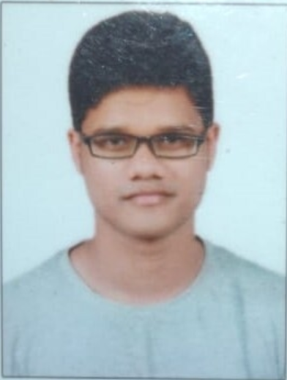
 | Areas of Expertise: Data analysis: Python, SQL, Scikit-Learn,, statistical techniques for data science, Data Cleansing and Data Mining, Pandas, Numpy, Tensor flow Machine Learning: Linear & Logistic regression, Tree-based models/ensembles (Decision trees, Random forests), Deep learning, K-means clustering. Data visualization Tools /communication: Tableau , Seaborn, Matplotlib, Jupyter, Git , Spyder . Data Bases : SQL server, Oracle, MySQL Frameworks : Flask, HTML Basics Git hub Link published: https://github.com/Rohan553?tab=repositories POC Data Science Portfolio Projects Page Link Git hub: https://rohan553.github.io/Rohan- Portfolio-Projects/ External Data Science Trainings : 2019-20: DATA SCIENCE PRODEGREE, IMARTICUS, Bangalore Jun 2020: AZ-900 Microsoft Certified: Azure Fundamentals. 2019-20: Tableau Desktop Training Certification, Intellipaat Software Solutions Pvt. Ltd. DATA SCIENCE PORTFOLIO PROJECTS PUBLISHED ON GIT HUB PAGE: Car Selling Price Prediction and frontend API Creation for Users/Deployment Credit Risk Classification Logistic Regression Telecom Customer Churn Rate -Random Forest Classification Bike Sharing Project Linear Model. | Key Responsibilities : Ericsson Finance ASP Cost Time series Forecasting: Implemented a solution to forecast or predict Actual cost from finance source. Implemented time series method to forecast 12 months rolling ASP cost considering historical data , trend and seasonal pattern. Data quality check and process to improvise the results by tuning parameters values using self custom build code in Python. Additionally , Data exploration to check quality and possibility to do what-if analysis and implement a solution for integrating demand factors to finance data and come up with optimized model that can predict the ASP cost against certain inputs. On the way to dockerize the code and make it available for stake holders. CIO-Project Python (Anaconda), Jupyter , Tabpy Server etc.. Prediction & management of classification data of member/employee based on past history membership in corporate programmes. Predict members who will be join a corporate programme for next year. Involved in all phases of model development from picking the right problem through extensive study of historical data and deployment on Tabpy Server of Tableau. Part of a team of Data Scientists Team working on cutting edge predictive models (focused on Corporate citizenship analytics data). Build the model to predict the no of hours to be dedicated by members in different corporate citizenship programmers. Algorithm used build Linear and Logistic regression. Data Analytics : Experience as a BI technology analyst using Tableau/QlikView. Predominantly working in Python to build optimized and accurate Machine Learning Models and deployment on Tableau. Excellent advance SQL skills and experience working with enterprise data warehouse. Experience with the use of advanced Tableau expressions while developing optimal scripts and Data Models. Performed Reporting and Analytics and provided daily status report, defect matrices, daily updates and explained KPIs to lead Manager/Client. Data Story Telling, Business Analysis. Consulting with customers and good inter-personal and communication skills. Directly Interact with Data Engineering, DevOps, Business Analysts and Clients for requirements, clarifications, Development, and testing. Participated in ML/DS Hackathons in company and deployed models on AWS. Certified in AZ-900: Microsoft Azure Fundamentals and attended trainings on AWS.
Rohan Kumar Pradhan
Analytics and ML Engineer
4.3 years of experience in Predictive Analytics, Machine learning, Data Visualization.
Business Strategy and analytical Solutions to deliver insights and implement action for complex business problem.
Driven solution to increase eﬃciency, accuracy, and utility of data transformation and processing.
Contact:
Email - rohan.kumar.pradhan@ericsson.com
Mobile-
8763031649 , 7978960360

