Slide 1
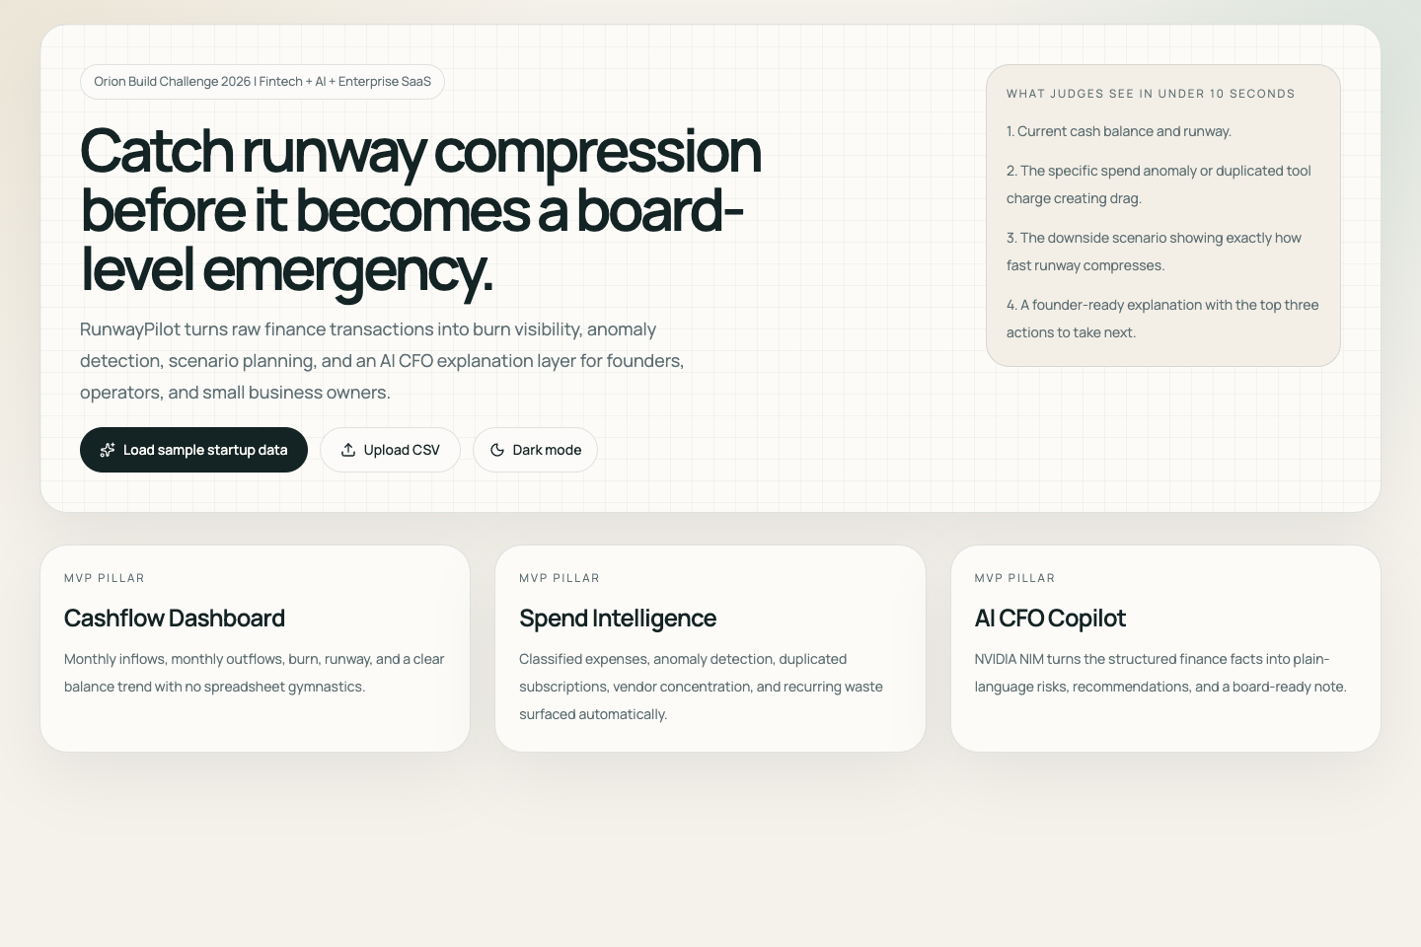
Orion Build Challenge 2026
RunwayPilot
An AI finance copilot for startups and SMBs that predicts runway, detects risky spending patterns, and recommends actions before cash problems become existential.
Solo builder: Rohan Santhosh Kumar
AI + Fintech + Enterprise SaaS
Innovation
Presentation
Functionality
Problem Solving
AI CFO + deterministic finance
Premium demo flow
End-to-end MVP
Early cash risk
Live demo: runwaypilot.vercel.app
Public repo: github.com/Rohan5commit/RunwayPilot

Slide 2
Problem
02
Founders usually discover cash problems too late.
Startups and small businesses still run critical operating decisions through stale spreadsheets, fragmented exports, and delayed visibility.
• Burn creeps up through payroll drift, infrastructure spikes, and contractor expansion.
• Duplicate software subscriptions and recurring waste remain hidden for months.
• Revenue softening or delayed receivables compress runway before leadership reacts.
• By the time the issue is visible, fixing it is already more expensive.
Who this affects
• Student founders and indie hackers
• Startup operators and finance leads
• Small business owners with limited finance tooling
• Accelerators managing portfolio health
What the market lacks
• A tool that combines explainable analytics with action-oriented AI
• A startup operating surface instead of yet another accounting screen
• Setup-light forecasting and risk detection that judges can test immediately
RunwayPilot is designed for earlier intervention, not retrospective reporting.

Slide 3
Product
03
RunwayPilot makes the value obvious in under 10 seconds.
Upload a CSV or load the seeded startup dataset, then move from signal to action without spreadsheet triage.
1
Load data
Import a CSV or use the bundled startup dataset.
Core MVP modules
Why it lands well in a demo
• Cashflow dashboard
• Spend intelligence
• Runway forecasting
• AI CFO copilot
• Scenario simulator
• Founder report export
• Immediate KPI strip
• Visible anomaly story
• Interactive downside stress test
• Board-ready AI summary
2
See runway
Read cash balance, burn, revenue trend, expense trend, and highest-risk alert.
3
Inspect risk
Review anomalies, duplicate spend, concentration, and deterioration drivers.
4
Simulate scenarios
Stress-test revenue, payroll, software, infra, and one-time costs.
5
Get guidance
Use NVIDIA NIM to turn the analysis into concise founder actions.
This is not accounting software and not a generic chatbot; it is an operating tool for cash decisions.

Slide 4
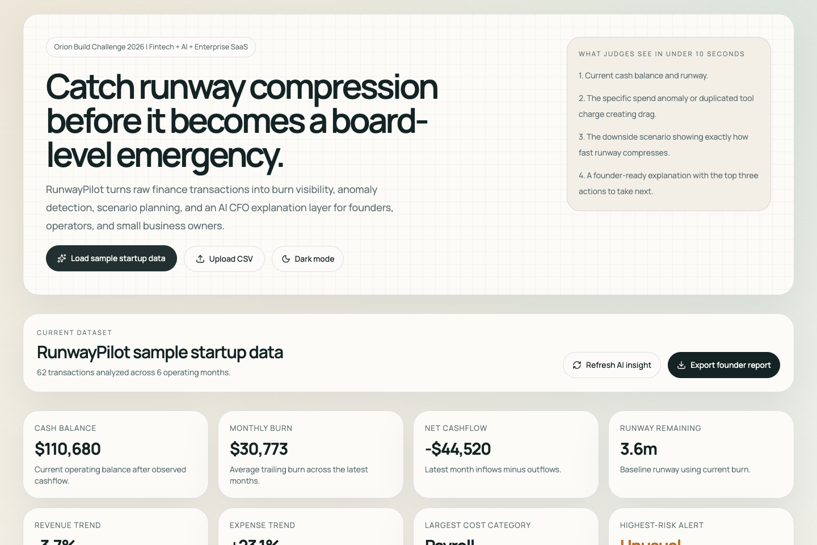
Live Product
04
The dashboard gives judges a complete operating picture immediately.
The top strip communicates the business state before anyone has to inspect a single spreadsheet.
What stands out
• Current cash balance and remaining runway
• Revenue trend weakening while expenses rise
• Highest-risk alert surfaced without manual analysis
• Charts connect current state to future runway compression
Judging value
• Strong presentation
• Clear functionality
• Real-world business relevance

Slide 5
Intelligence Layer
05
RunwayPilot turns anomalies into explainable next actions.
The right-hand AI layer does not invent the math. It interprets structured outputs from deterministic finance logic.
Why the AI layer is credible
• Uses NVIDIA NIM for founder-facing interpretation and recommendations
• Receives structured findings instead of raw, ambiguous data
• Returns strict JSON: summary, top risks, actions, confidence, board note
• Falls back safely if the AI path is unavailable
• Separates fact, inference, and recommendation to avoid hallucinated finance claims
Example risks in the seeded dataset: unusual AWS infrastructure spike, duplicated Figma subscription, burn deterioration, and weakening revenue momentum.
AI augments judgment; it does not replace the underlying finance logic.

Slide 6
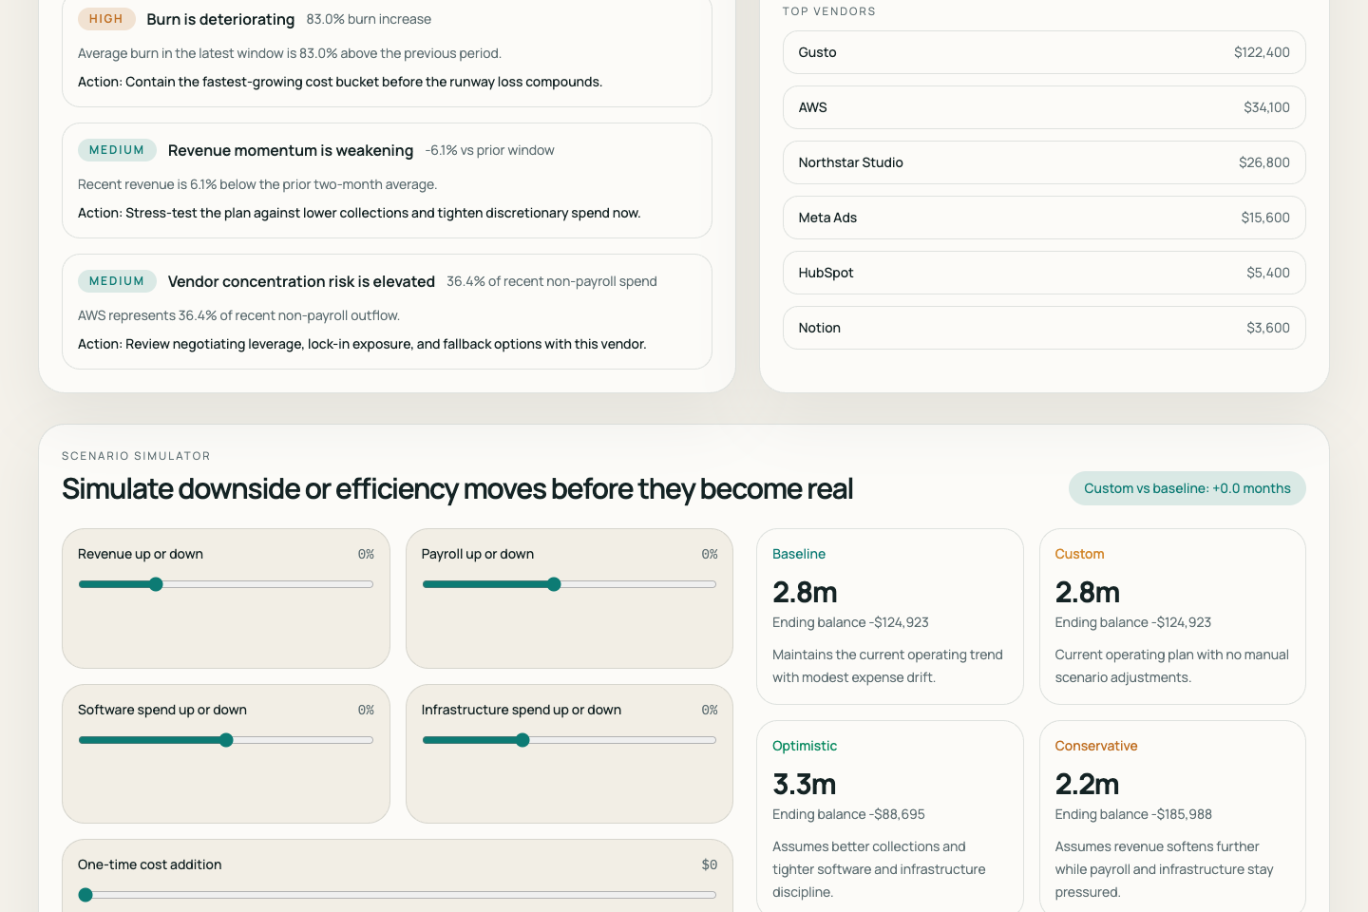
Scenario Planning
06
The scenario simulator makes runway risk decision-ready.
Judges can move one lever, like revenue down 20%, and see the survival window compress immediately.
Scenario controls
• Revenue up/down %
• Payroll up/down %
• Software spend change
• Infrastructure spend change
• One-time cost addition
• Growth mode toggle
Why this matters
• Connects finance data directly to operating decisions
• Shows downside risk before it becomes existential
• Makes the demo interactive instead of passive

Slide 7
Architecture
07
Five agents power a deterministic finance pipeline plus explainable AI.
The product is backend-light, easy to deploy from GitHub to Vercel, and intentionally practical for hackathon judging.
1. Intake Agent
Validates CSV/demo data and standardizes dates, amounts, and fields.
2. Classification Agent
Maps transactions into payroll, software, infra, marketing, operations, revenue, and other.
3. Forecast Agent
Calculates burn, runway, and baseline / optimistic / conservative outlooks.
4. Risk Agent
Detects anomalies, concentration, recurring waste, and cashflow deterioration.
5. Strategy Agent
Uses NVIDIA NIM to generate structured business-language guidance.
Frontend: Next.js + TypeScript + Tailwind CSS + Recharts | Hosting: Vercel via GitHub | AI: NVIDIA NIM | Validation: Zod | CSV parsing: Papa Parse

Slide 8
Why RunwayPilot Wins
08
RunwayPilot is optimized directly against Orion’s judging criteria.
The product is built to score evenly across innovation, presentation, functionality, and problem solving.
Innovation
Presentation
Combines deterministic finance intelligence with explainable NVIDIA-powered strategy output.
Premium fintech UI, fast demo path, visible anomaly story, and strong information hierarchy.
Functionality
Problem Solving
CSV ingestion, analytics, forecasting, scenario simulation, AI guidance, and export all work end-to-end.
Targets a painful, expensive real-world problem shared by founders, SMBs, and accelerators.
Cross-domain fit: AI/ML + fintech + analytics + enterprise systems + product strategy

Slide 9
Submission Links
09
Cash problems should be visible before they become existential.
RunwayPilot helps teams act early enough for the decision to still matter.
Submission assets
Closing statement
Live demo
https://runwaypilot.vercel.app
Public source code
https://github.com/Rohan5commit/RunwayPilot
Deck file
/public/Hackathon.pptx
Founders do not need more dashboards. They need earlier intervention.
RunwayPilot turns fragmented finance data into a clear operating signal, shows what is driving runway compression, and recommends the next actions before the problem becomes existential.
Solo team
Ready for Orion submission
Rohan Santhosh Kumar
Product, engineering, design, AI, and demo
Public repo, live demo, docs, screenshots, and PPT are all in place.

