Slide 1
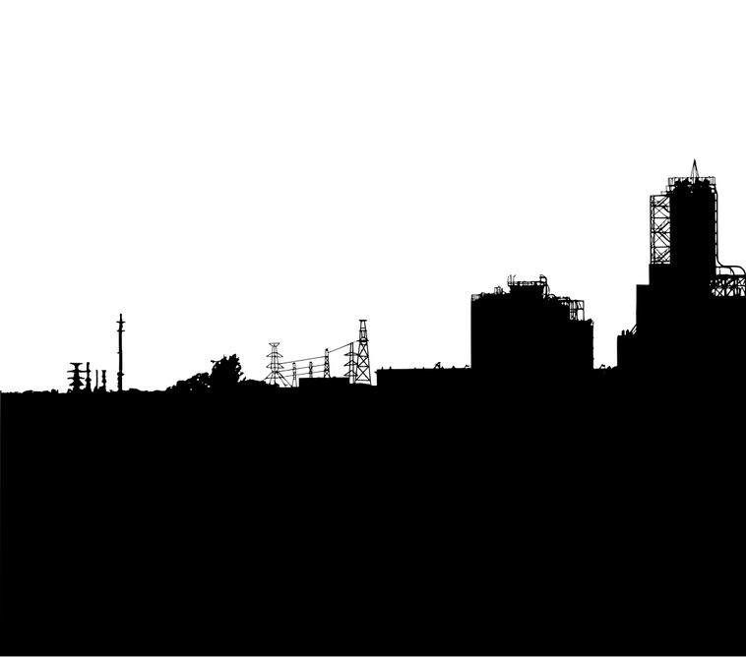

Economics of Emissions Prediction Analysis of the Contribution of Emissions to the GDP of the states in the United States of America using a Cluster-Spatio-Temporal Approach
Name
Institution
Date

Slide 2

Introduction
Industrialization has been a catalyst for economic growth since the first industrial revolution (Groumpos, 2021) .
However, emissions have also characterized industrialization since the first industrialization.
A conflict hence arises on how to best balance economic growth and reduction in emissions.
Notes:
Whereas industrialization has historically been linked to economic growth, the association between industrialization and emissions creates a dilemma; where continuous economic growth may only be pursued through continuous industrialization and in turn continuous emissions.

Slide 3
Background
The United States represents the biggest economy in the world and hence faces the biggest dilemma in terms of the balance between economic growth and reduction in emissions.
As a leader in world economics, the United States is also best placed to pioneer of the best approach for balancing economic growth and reduction in emissions.
This project considers the role of United States in dominance in global trade as well as the level of independence of the states in the US from a data analysis perspective.
Notes:
As a global economic powerhouse, a dilemma that may affect continuous economic growth becomes an issue of interest.
A forward thought is needed in determining a balance that would allow continuous economic growth while ensuring a reduction in the emission levels.
An investigation into how such a balance can be achieved provides an opportunity for guaranteeing the economic position of the United States into the future. In this project, Prediction Analysis of the Contribution of Emissions to the GDP of the states in the United States of America is conducted using a Cluster-Spatio-Temporal Approach.

Slide 4


Data
Data utilized for the project will be collected from the five sources below.
https://fredaccount.stlouisfed.org/public/datalist/5498/download : GDP per State (2005 – 2023, Quarterly)
https://edgar.jrc.ec.europa.eu/dataset_ghg2024_nuts2 : Fossil CO₂ emissions (1990 – 2023, Annual): A global dataset for all countries and across industries.
https://edgar.jrc.ec.europa.eu/dataset_ghg2024_nuts2 : CH₄ emissions (1990 -2023, Annual): A global dataset for all countries and across industries.
https://edgar.jrc.ec.europa.eu/dataset_ghg2024_nuts2 : N₂O emissions (1990 -2023, Annual): A global dataset for all countries and across industries.
https://edgar.jrc.ec.europa.eu/dataset_ghg2024_nuts2 : F-Gases emissions (1990 -2023, Annual): A global dataset for all countries and across industries.
Notes:
The Federal Reserve Economic Data (FRED) was used for sourcing data on economic performance across each of the states; this data captures the period between 2005 and 2023.
Data on the different emissions across each of the states was sourced from Emission Database for Global Atmospheric Research (EDGAR); this data capture the period between 1990 and 2023.
Both datasets were in wide formats and required transformation to long format for aggregation; this was in addition to the cleaning processes of filtering for the Country as United States and Sector as Industry in the emission datasets.

Slide 5
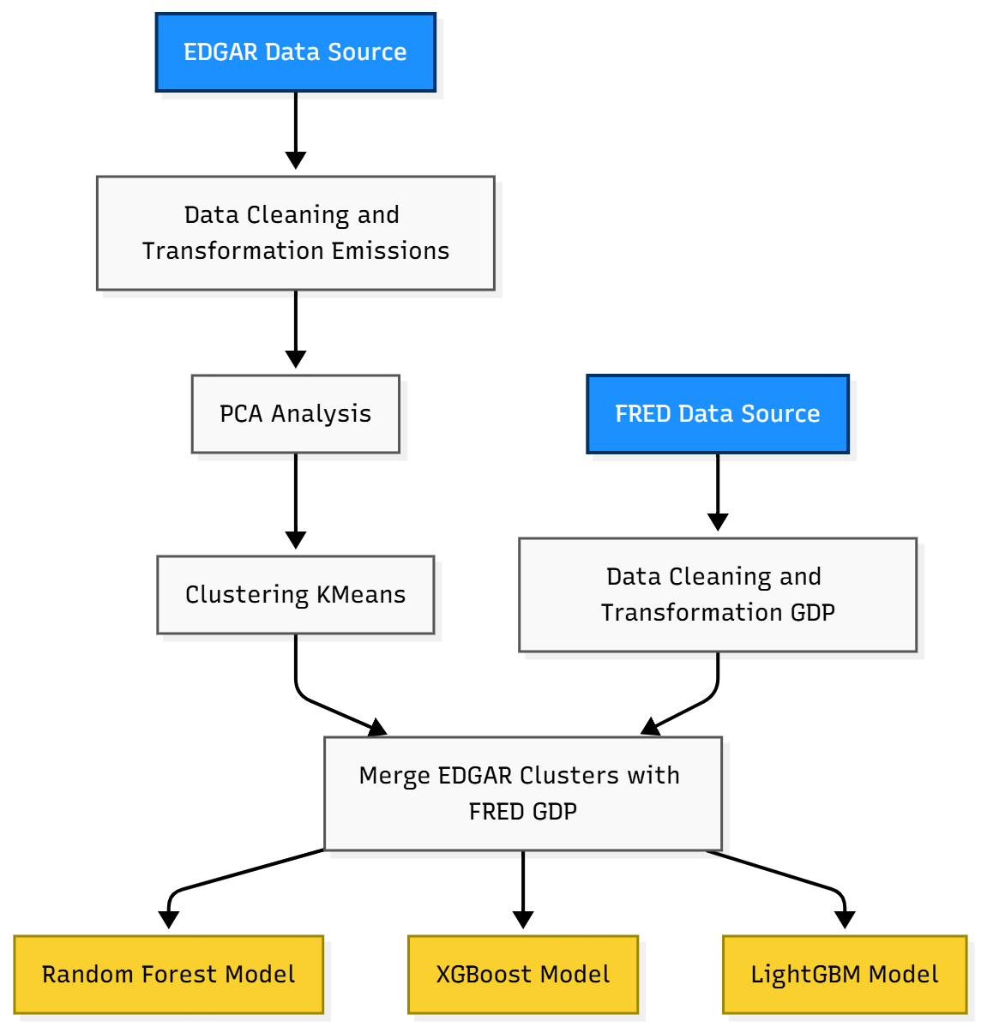
Methodology
The chart on the right shows the project approach to the prediction analysis of the contribution of emissions to the GDP of the states in the United States.
The key analytics approaches applied were:
Principal Component Analysis
KMeans Clustering
Geospatial Analysis
Predictive Modelling using Time Series Analysis
Notes:
The data process for the project is displayed in the chart on the right.
The key analytics approaches applied were: Principal Component Analysis, KMeans Clustering, Geospatial Analysis and Predictive Modelling using Time Series Analysis.
Three models were utilized in the Predictive Modelling using Time Series Analysis: Random Forest Model, XGBoost Model and Light GBM Model. For the models, the GDP data will form the dependent variable while the set of independent variables will have the combined emissions, lagged combined emissions, Fossil CO2 Clusters, CH4 AR5 Clusters, NO2 AR5 Clusters and F-Gases AR5 Clusters.

Slide 6
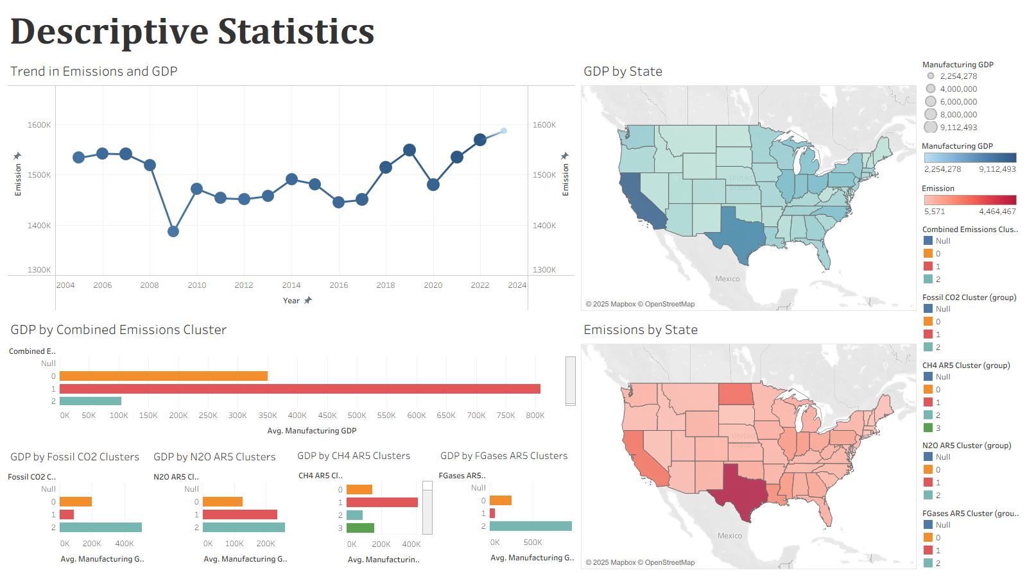
Notes:
The dashboard presented above shows the overall descriptive statistics for both the emissions and the GDP data.
Both the GDP and Emissions data when aggregated for the entire US show no visible trend but rather a fluctuation about the same range of values; this is shown from the sizes of the data points and the movement of the line graph respectively.
The highest average GDP is observed for cluster 1 of the combined emissions and CH4 AR5, and cluster 2 of the Fossil CO2, N2O AR5 and F-Gases AR5.
The maps show that the distribution across the states for the cumulative GDP and emissions show similarities with high GDP occurring in places where there are high emissions and vice versa.

Slide 7
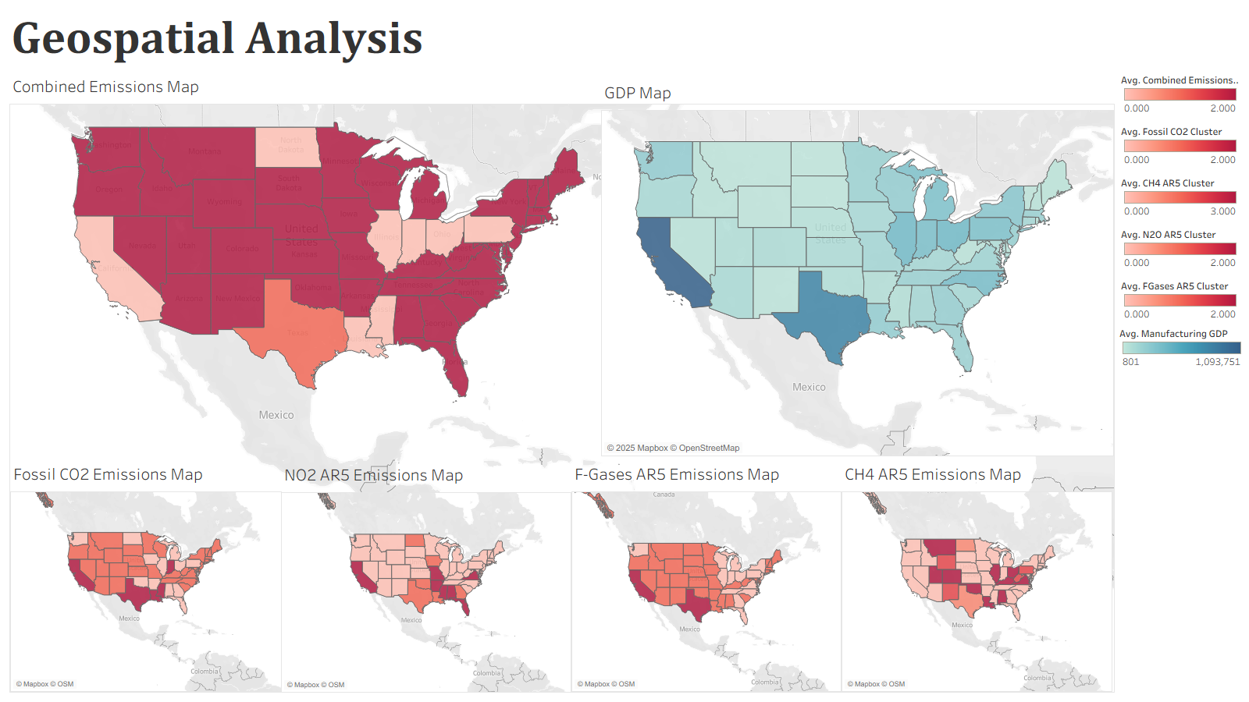
Notes:
The dashboard for the Geospatial Analysis is presented above and shows that none of the emissions show clear similarity in the distribution of emission levels across the country.
However, in comparing the combined emissions map to the GDP map, we note that a similarity exists to some level.

Slide 8
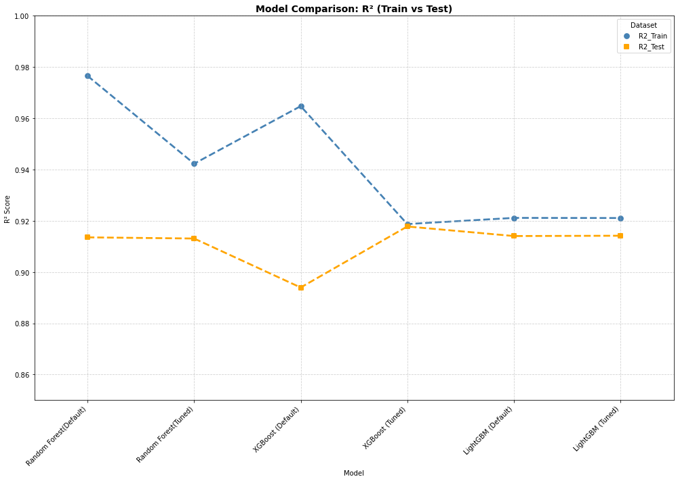
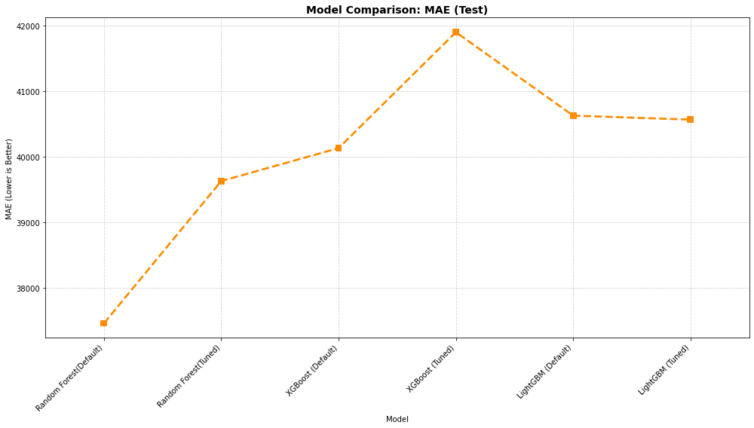
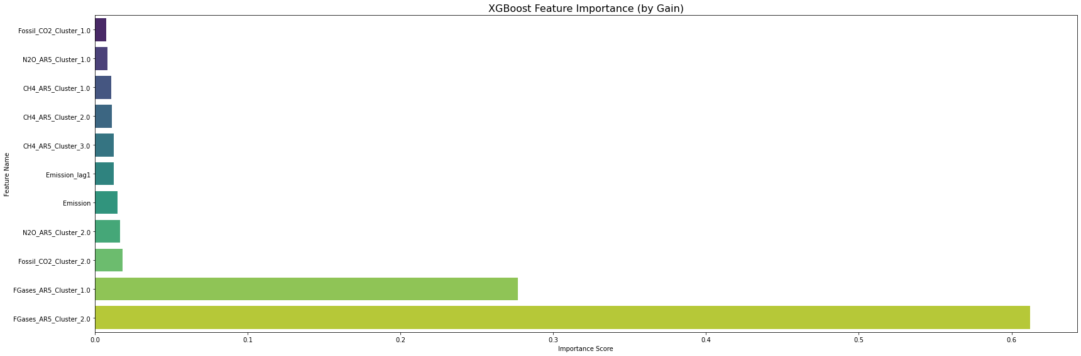
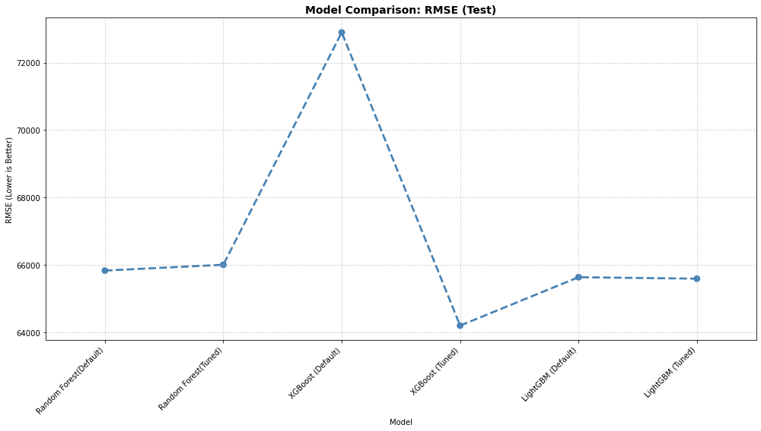
Predictive Modelling
Model | R2_Train | R2_Test | RMSE_Test | MAE_Test | MAPE_Test
XGBoost (Tuned) | 0.918740 | 0.917788 | 64195.240119 | 41897.322010 | inf
LightGBM (Tuned) | 0.921091 | 0.914183 | 65587.531346 | 40565.209471 | inf
LightGBM (Default) | 0.921145 | 0.914067 | 65631.849075 | 40625.300666 | inf
Random Forest(Default) | 0.976549 | 0.913549 | 65829.117171 | 37460.082018 | inf
Random Forest(Tuned) | 0.942295 | 0.913097 | 66001.295464 | 39628.905130 | inf
XGBoost (Default) | 0.964744 | 0.893983 | 72899.150064 | 40130.062392 | inf
Notes:
Presented in the dashboard above are the results of the prediction analysis process.
Although all the models had very high R2 scores for the training set, the Random Forest model with default parameters had the highest R2 for the training set at 0.9766 indicating that the model explained up to 97.66% of the variation in the GDP. The model also has the lowest MAE at 37460.08 for the test set.
Although all the models had very high R2 scores for the test set, the tuned XGBoost model had the highest R2 for the testing set at 0.9178 indicating that the model explained up to 91.78% of the variation in the GDP. In addition, the model had the lowest RMSE of 64195.24 for the test set.
For the model with the highest R2 for the testing set, Tuned XGBoost, the two features with the highest importance were the dummy variables for the F-Gases AR5 clusters.

Slide 9
Discussion
Collectively, the manufacturing GDP for the US shows no visible pattern with fluctuations about the same range over the period between 2005 and 2023.
Total industrial emissions also collectively show similar behavior, with no visible pattern but rather fluctuating about the same range of values.
Across the combined emissions and the respective clusters, levels 1 and 2 are noted to have the states with the highest average GDP.
Notes:
Despite the lack of visible pattern in terms of the trend over time, for both the manufacturing GDP and Emissions, both fluctuate over a range of values.
The states with the highest average GDPs are observe to be belong in either cluster 1 or cluster 2 of the emission clusters across the combined clusters and the Fossil CO2, CH4 AR5, NO2 AR5 and F-Gases AR5.

Slide 10
Discussion
Some level of similarity exist in the distribution of emissions and the manufacturing GDP across the states in the US; with states with higher emission levels showing higher manufacturing GDP.
The combined emissions and the four constitute emission types have different distribution patterns across the US.
The Tuned XGBoost model shows the best predictive performance with highest R-Squared and lowest RMSE for the test set.
For the Tuned XGBoost model, the most important features were the features for the F-Gases AR5.
Notes:
States with the highest cumulative emissions also have the highest cumulative GDP and vice versa.
Although the four emission types are all emissions, a difference exists in the how the levels of each of the four emission types, as well as the levels of the combined emissions, are distributed across the states in the United States; pointing at the extent of the independence of the emission to each other.
All the three modes, across both the training and testing sets have R2 scores greater than 0.8; this indicates that the prediction of the GDP using the emission related predictors is possible and practical. Among this models, the XGBoost model has the highest R2 score for the test set and is hence the best. For this model, the F-Gases AR5 features are the most important and consequently the most impactful for the GDP.

Slide 11
Conclusion
The different emission types separate the states in the US in terms of the states where each of the emissions shows high or low rates.
States in levels 1 and 2 of the emission types had the highest contributors to the GDP.
GDP is predictable and hence affected by the emission types with F-Gases AR5 being most impactful on the GDP in the US.
Notes:
Evidence is presented from the analysis on the concurrence of high cumulative GDP and high cumulative emissions across the states in the US. States. The states that formed the highest contributors to the GDP belonged to levels 1 and 2 of the emission types (including the combined emissions)
The predictive modelling showed that a time series component and emissions related predictors were sufficient for the prediction of the GDP. Specifically, the F-Gases AR5 was the most impactful on the GDP in the US.
Using this information, predictive modelling can be utilized in getting a balance on reduced emission with an acceptable economic performance with the F-Gases AR5 emission especially targeted for adjustments.

Slide 12
References
Groumpos, P. (2021). A Critical Historical and Scientific Overview of all Industrial Revolutions. IFAC-PapersOnLine, 54(13), 464-471. https://doi.org/10.1016/j.ifacol.2021.10.492.

