Slide 1
AutoML for Time Series Meta-Learning
Classifier-Driven Model Selection using Sliding Windows
Rajsekar Balaji 21011101095
Parthiv Yagnesh 21011101085
Rohan Suresh 21011101101
Dr. Shikha Marwaha
Shiv Nadar University Chennai

Slide 2
Abstract
Automated Machine Learning (AutoML) streamlines model selection and tuning, yet time series forecasting remains challenging due to data diversity.
This project introduces a meta-learning approach that uses sliding windows to capture data characteristics, allowing dynamic model selection as data evolves.
By extracting features from each window and training a classifier to predict the optimal model, this method automates time series model selection in AutoML, improving forecasting accuracy, scalability, and efficiency across various data types.

Slide 3
Objectives
The primary objective of this project is to develop an AutoML-based system for selecting the most suitable model for time series forecasting using a classification approach. The specific goals include:
Implement a sliding window to capture data and extract features within a specific window size.
Train different models on this window to capture the best model to be used within that window.
Form a training dataset with the features of each window and their best model label.
Use this data to train different classification models and selecting the optimal model based on accuracy and other metrics.

Slide 4
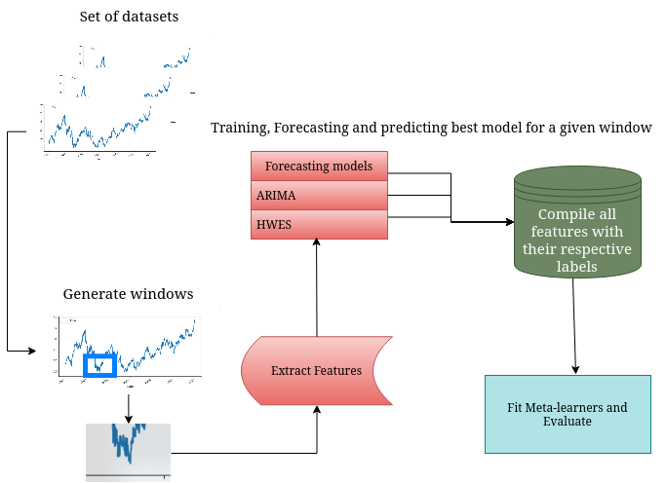
Architecture
Pipeline

Slide 5
Classifier-Driven Model
Multiple classifiers trained on a large amount of data to suggest the appropriate time series model to use based on the dataset
Model | Test Accuracy | Cross Validation Accuracy (Average over 5)
Naïve Bayes | 0.63 | 0.66
Random Forest | 0.89 | 0.85
Decision Tree | 0.85 | 0.78
SVC | 0.68 | 0.68
Choosing the optimal classifier

Slide 6
How were the classifiers trained?
Several time series datasets were passed through a sliding window function
Features extracted from each window:
Range
ADF
ACF
Seasonal Strength
Skew
Kurtosis
First Difference
Rate of Change
Mean, Standard Deviation, Maximum, Minimum

Slide 7
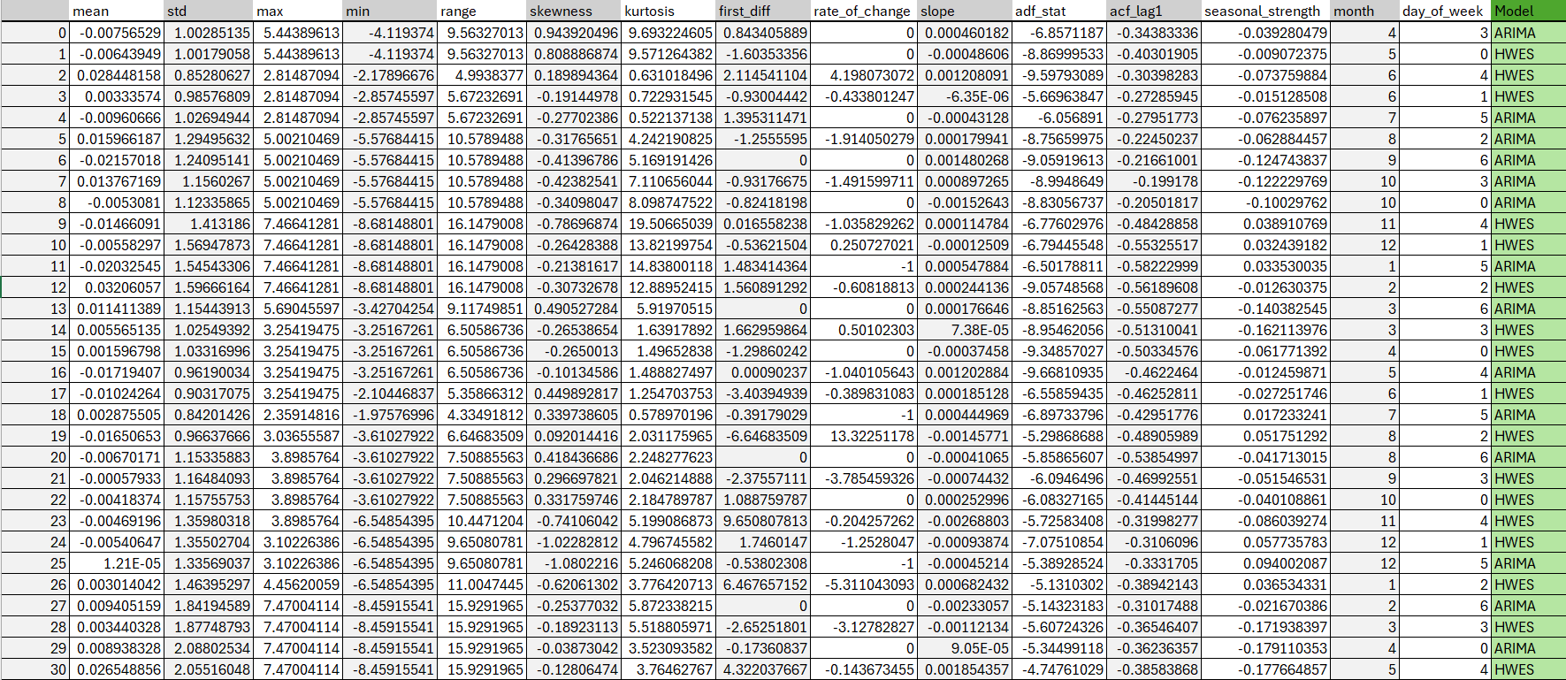
How were the classifiers trained?
Feature – Label Dataset

Slide 8
How were the classifiers trained?
Different time series models were trained using these features to identify the most accurate one
These were used as the true labels and fed into the classifiers for training
The time series models used:
ARIMA – AutoRegressive Integrated Moving Average
HWES – Holt-Winters Exponential Smoothing

Slide 9
Model Performance
Best Confusion Matrix
 | Predicted ARIMA | Predicted HWES
Actual ARIMA | 146 | 26
Actual HWES | 11 | 161
Best Classification Report
Class | Precision | Recall | F1 – Score | Support
ARIMA | 0.93 | 0.85 | 0.89 | 172
HWES | 0.86 | 0.94 | 0.90 | 172
Accuracy | 0.89
Macro Average | 0.90 | 0.89 | 0.89 | 344
Weighted Average | 0.90 | 0.89 | 0.89 | 344

Slide 10
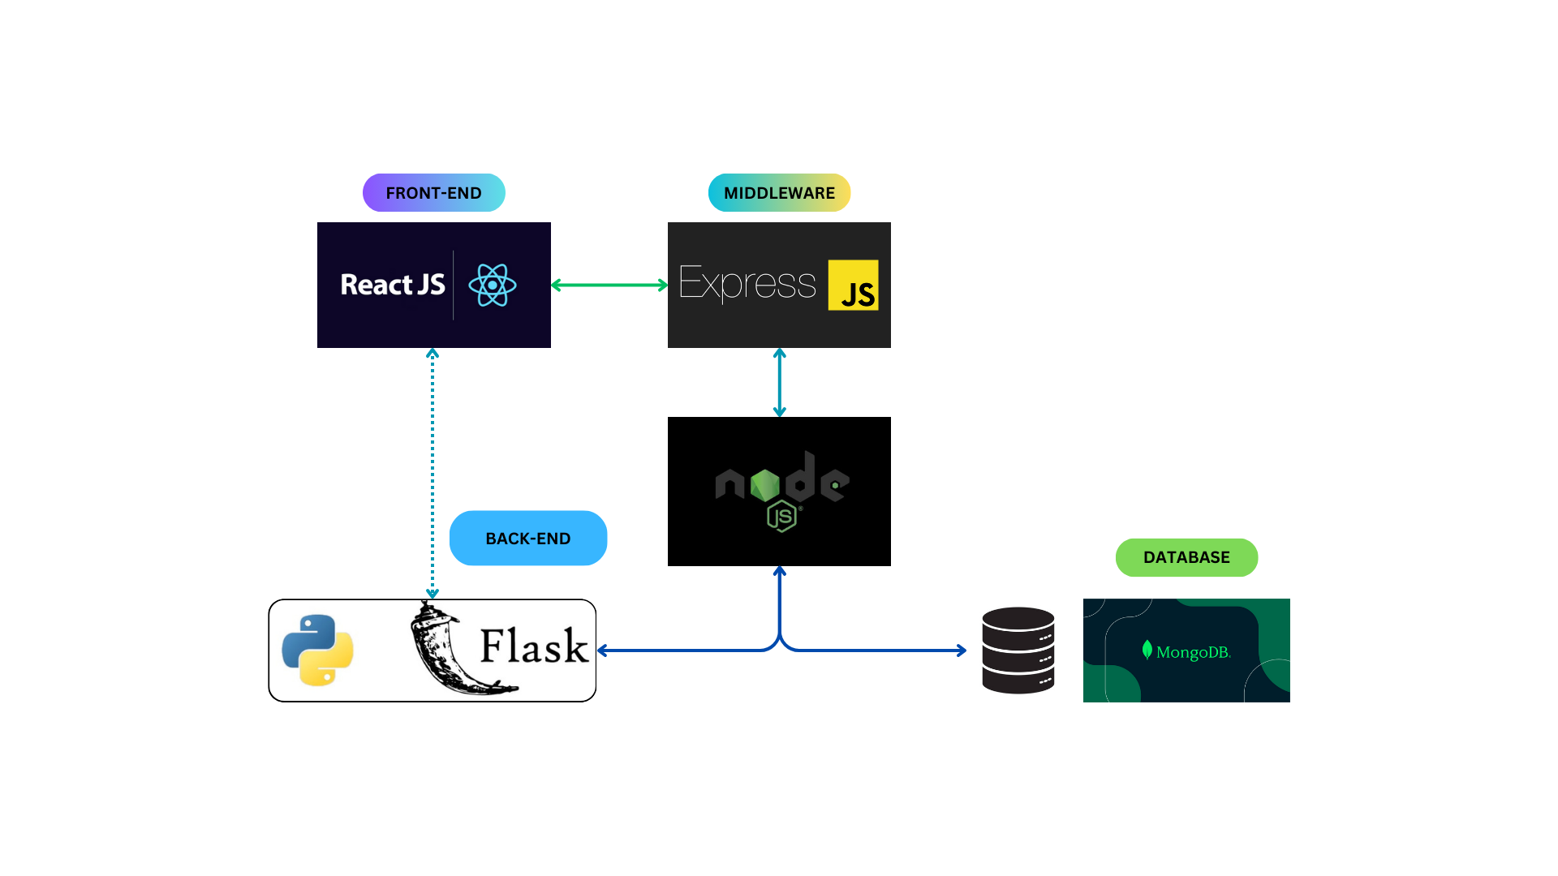
Web Application Architecture

Slide 11
Architecture
The proposed architecture is a conventional MERN stack, with an additional Python (Flask) back-end for handling analytics and ML related requests
Requests involving user data and database operations will flow through the Node.js server, which will query the Python backend if required
Analytics requests flow directly b/w the front-end & the Python backend
Postman for server-side testing; MongoDB Atlas Database (Cloud) for database

Slide 12
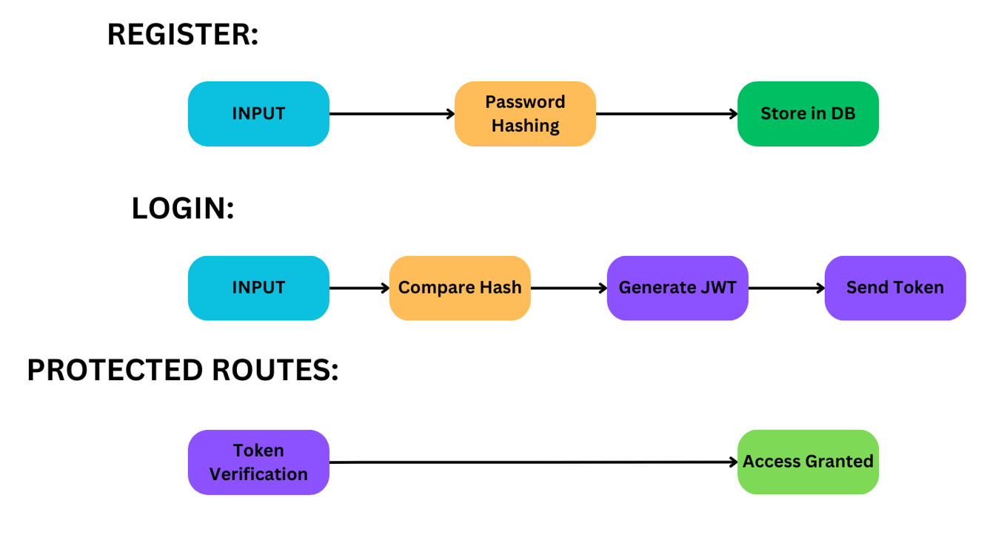
Server-Side Authentication using JWT & bcrypt
Server-Side Authentication using JWT & crypt

Slide 13
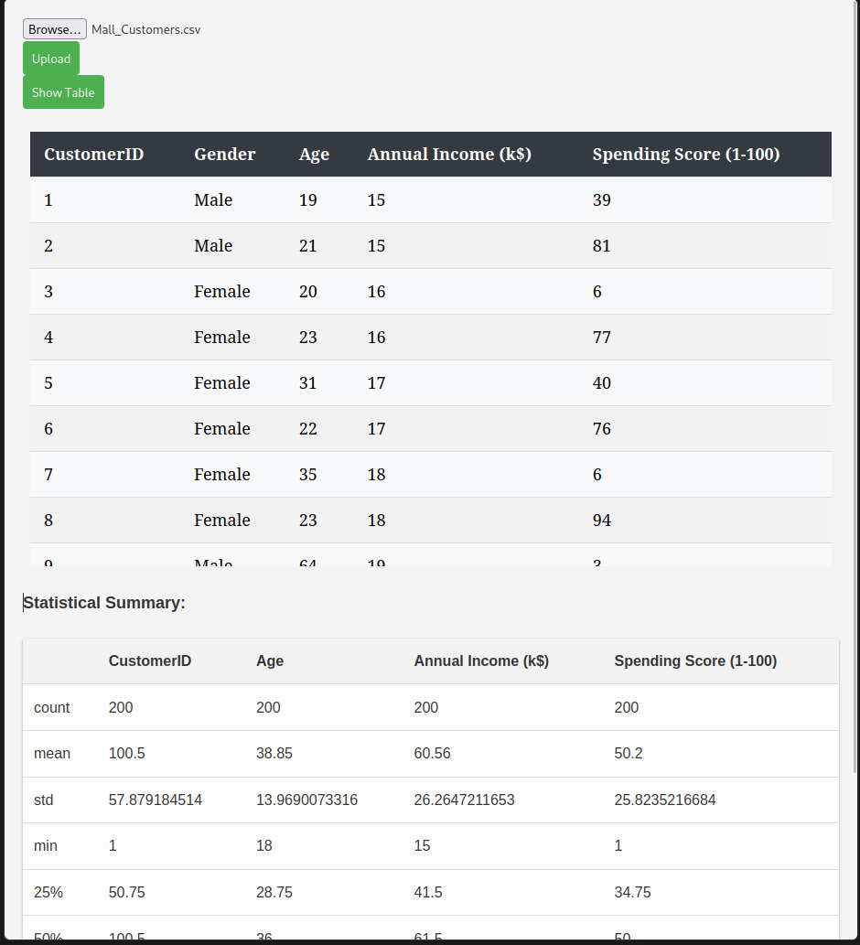
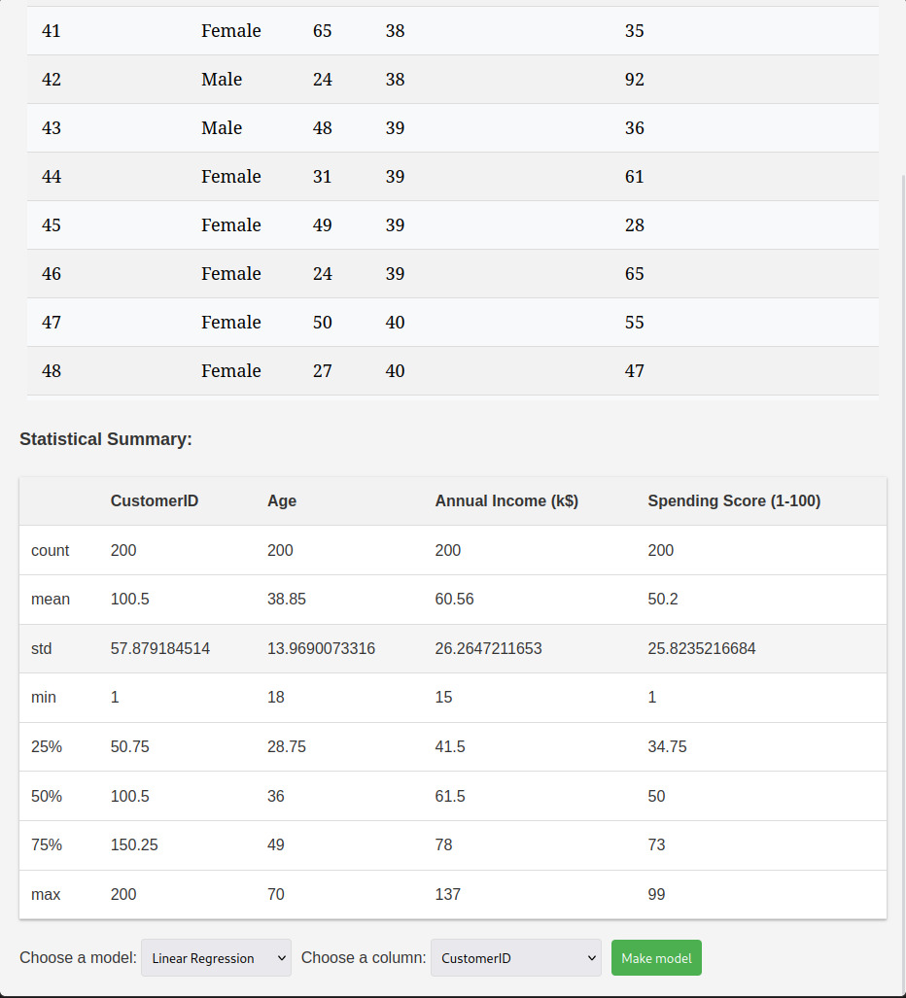
WEB UI

Slide 14
Thank you

