Slide 1
AutoML Web Application
Rajsekar Balaji 21011101095
Parthiv Yagnesh 21011101085
Rohan Suresh 21011101101
Dr. Sundharakumar KB
Shiv Nadar University Chennai

Slide 2
Aim
To develop a web application that allows users to view, manipulate, and visualize their tabular datasets, and apply machine learning columns on data features to perform classification and prediction.
The web app will also allow users to view statistical information about their datasets, make changes to their datasets, and save sessions against their login credentials.

Slide 3
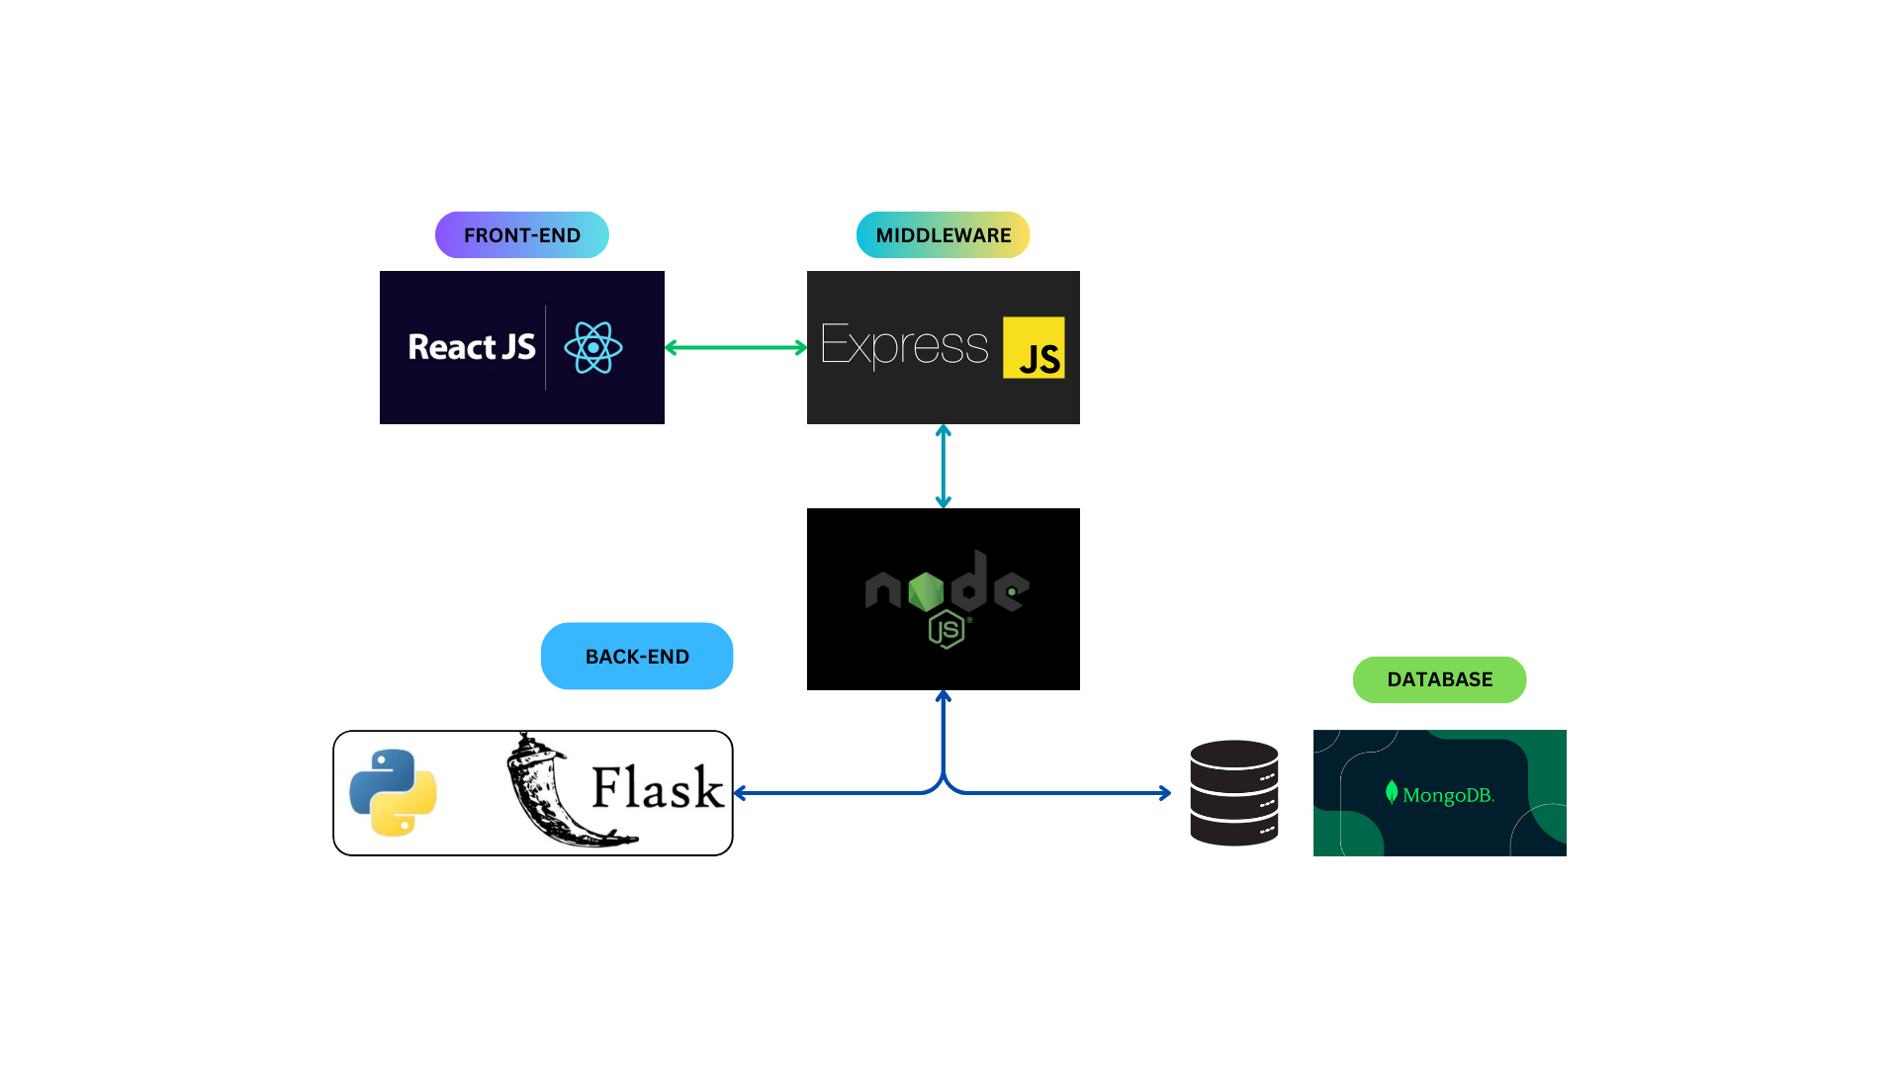
Architecture

Slide 4
Architecture
The proposed architecture is a conventional MERN stack, with an additional Python (Flask) back-end for handling analytics and ML related requests
Analytics requests will flow through the Node.js server, which will query the Python backend and respond back to the front-end
Postman for server-side testing
Database will be set up on a cloud service, such as MongoDB Cloud (MongoDB Atlas Database)

Slide 5
In-Progress
Web app landing pages in development
Database collections for storing user data, saved sessions
Server-side routes for authentication

Slide 6
Next Steps
User interface for uploading csv files and visualizing the dataset
Server endpoints for handling file storage and managing session information
Flask endpoints for handling analytics requests

