Slide 1
AutoML Web Application
Rajsekar Balaji 21011101095
Parthiv Yagnesh 21011101085
Rohan Suresh 21011101101
Dr. Sundharakumar KB
Shiv Nadar University Chennai

Slide 2
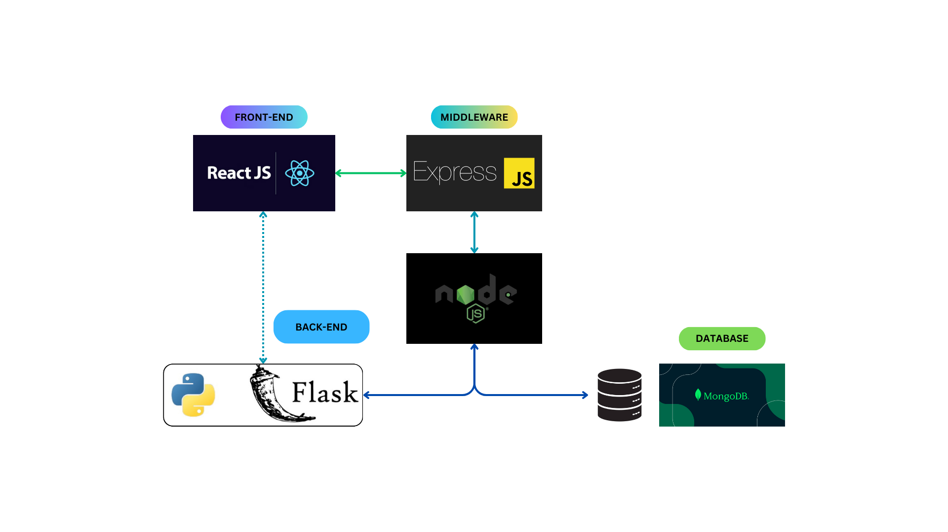
Architecture

Slide 3
Architecture
The proposed architecture is a conventional MERN stack, with an additional Python (Flask) back-end for handling analytics and ML related requests
Requests involving user data and database operations will flow through the Node.js server, which will query the Python backend if required
Analytics requests flow directly b/w the front-end & the Python backend
Postman for server-side testing; MongoDB Atlas Database (Cloud) for database

Slide 4
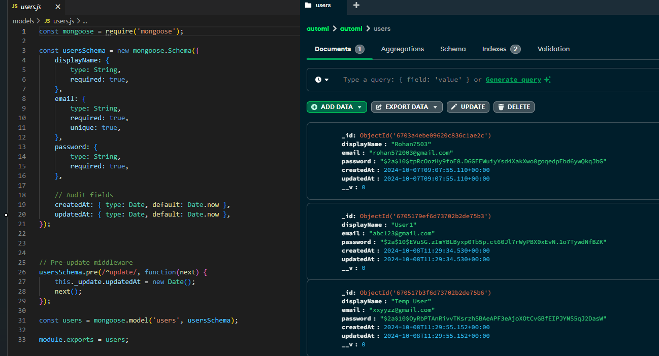
Database Set-up
Schema
Collection

Slide 5
Server-Side Authentication using JWT & bcrypt
User Registration:
Validates user input (email, password, etc.)
Hashes passwords using bcrypt before storing them in the database
User Login:
Verifies the hashed password against the stored hash
Generates a signed JWT upon successful login for session management
JWT Authentication:
Implemented an authentication middleware that protects routes
Attaches JWT as a Bearer Token in the authorization header for protected endpoints

Slide 6
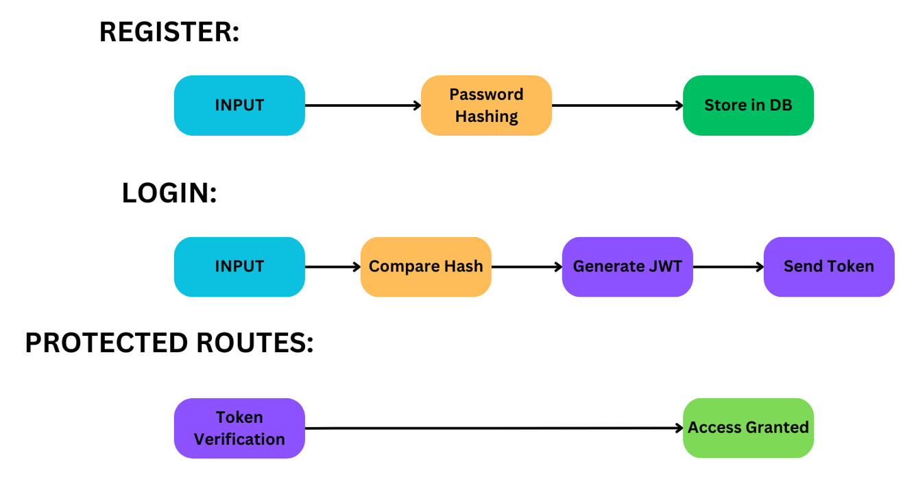
Server-Side Authentication using JWT & bcrypt

