Slide 1
AutoML for Time Series Meta-Learning
Classifier-Driven Model Selection using Sliding Windows
Rajsekar Balaji 21011101095
Parthiv Yagnesh 21011101085
Rohan Suresh 21011101101
Dr. Shikha Marwaha
Shiv Nadar University Chennai

Slide 2
Abstract
Automated Machine Learning (AutoML) streamlines model selection and tuning, yet time series forecasting remains challenging due to data diversity.
This project introduces a meta-learning approach that uses sliding windows to capture data characteristics, allowing dynamic model selection as data evolves.
By extracting features from each window and training a classifier to predict the optimal model, this method automates time series model selection in AutoML, improving forecasting accuracy, scalability, and efficiency across various data types.

Slide 3
Objectives
The primary objective of this project is to develop an AutoML-based system for selecting the most suitable model for time series forecasting using a classification approach. The specific goals include:
Implement a sliding window to capture data and extract features within a specific window size.
Train different models on this window to capture the best model to be used within that window.
Form a training dataset with the features of each window and their best model label.
Use this data to train different classification models and selecting the optimal model based on accuracy and other metrics.
Allow users to use the predicted model for time series forecasting through a front end.

Slide 4
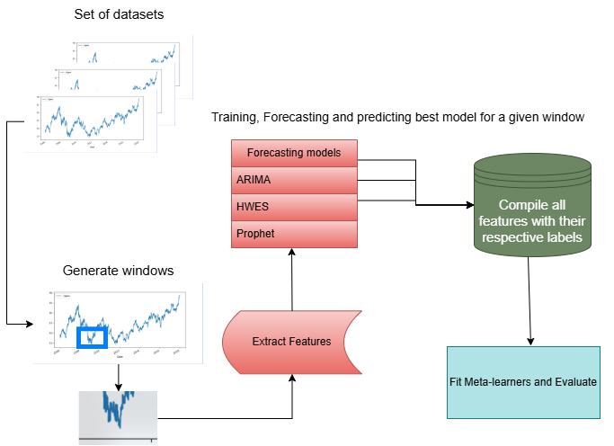
Architecture
Pipeline

Slide 5
Classifier-Driven Model
Multiple classifiers trained on a large amount of data to suggest the appropriate time series model to use based on the dataset
Model | Test Accuracy | Cross Validation Accuracy (Average over 5)
Naïve Bayes | 0.63 | 0.66
Random Forest | 0.89 | 0.85
Decision Tree | 0.85 | 0.78
SVC | 0.68 | 0.68
Gradient Boosting | 0.75 | 0.74
Neural Network | 0.76 | 0.75
Accuracy for classifier models

Slide 6
How were the classifiers trained?
Several time series datasets were passed through a sliding window function
Features extracted from each window:
Range
ADF
ACF
Seasonal Strength
Skew
Kurtosis
First Difference
Rate of Change
Mean, Standard Deviation, Max, Min
Momentum & Volatility
Rolling statistics
Trend features
Exponential Moving Averages

Slide 7
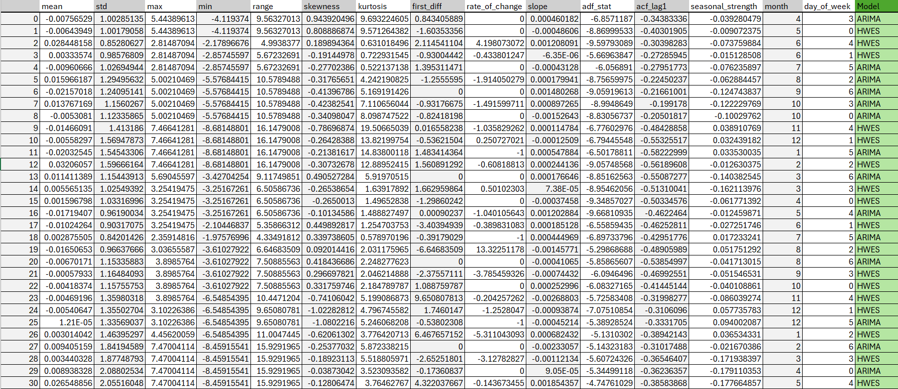
How were the classifiers trained?
Feature – Label Dataset

Slide 8
How were the classifiers trained?
Different time series models were trained using these features to identify the most accurate one
These were used as the true labels and fed into the classifiers for training
The time series models used:
ARIMA – AutoRegressive Integrated Moving Average
HWES – Holt-Winters Exponential Smoothing
Prophet – Open-Source Tool developed by Facebook

Slide 9
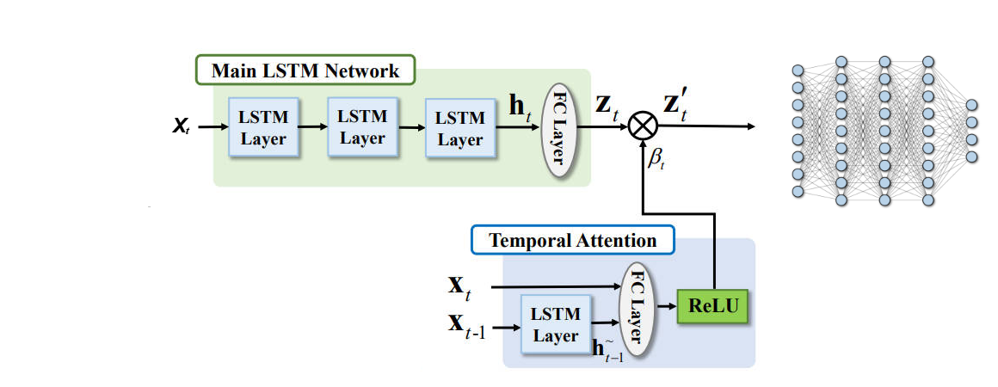
Neural Network Architecture
LSTM with Temporal Attention

Slide 10
Model Performance
Best Confusion Matrix
 | Predicted ARIMA | Predicted HWES | Predicted Prophet
Actual ARIMA | 85 | 11 | 8
Actual HWES | 13 | 92 | 40
Actual Prophet | 11 | 39 | 49
Best Classification Report
Class | Precision | Recall | F1 – Score | Support
ARIMA | 0.78 | 0.82 | 0.80 | 93
HWES | 0.64 | 0.71 | 0.67 | 141
Prophet | 0.65 | 0.53 | 0.58 | 114
Accuracy | 0.69
Macro Average | 0.68 | 0.68 | 0.68 | 348
Weighted Average | 0.68 | 0.68 | 0.67 | 348

Slide 11
New Additions – Enhanced Feature Extraction
Enhanced feature extraction
Momentum & Volatility: Capture data movement strength and variability over time.
Rolling statistics: Highlight local trends and smoothing via averages, sums, or variances.
Trend features: Identify overall direction and patterns in the data.
Exponential Moving Averages: Smoothen data with greater weight on recent observations for dynamic trend detection.

Slide 12
New Additions – Enhanced Forecasting with Prophet
What is Prophet?
Developed by Facebook, Prophet is an open-source forecasting tool.
Designed to handle time series with strong seasonal patterns and missing data.
Flexible model for capturing trend, seasonality, and holiday effects.
Requires minimal parameter tuning, making it user-friendly.

Slide 13
New Additions – Enhanced Forecasting with Prophet
Why Use Prophet?
Seasonality Handling: Automatically detects and incorporates weekly, yearly, and custom seasonal trends.
Robustness to Missing Data: Performs well even with gaps in data.
Customizability: Allows domain-specific adjustments like adding holidays or special events.
Scalability: Efficient for large datasets and suitable for iterative forecasting.

Slide 14
New Additions – Enhanced Forecasting with Prophet
How Prophet Complements ARIMA and HWES:
ARIMA: Focuses on autoregressive and moving average patterns; less effective for seasonal variability.
HWES: Handles seasonality but struggles with complex trends or irregularities.
Prophet: Bridges gaps by combining trend analysis, seasonality, and external factors with ease of use.

Slide 15
New Additions – Ensemble Classifier
Ensemble of Classifiers
Gradient Boosting was added as part of the classification models trained on window features and their respective optimal labels
An ensemble of all the classifiers was used to obtain more accurate predictions on which time series model would function optimally
Hyperparameters of all classifiers were further tuned

Slide 16
New Additions – Neural Network
Neural Network for Classification
Captures Complex Patterns: Neural networks can model nonlinear relationships and capture intricate patterns that traditional models might miss.
Handles High-Dimensional Data: They perform well with large datasets and multiple input features, making them robust for diverse time series problems.
Automatic Feature Extraction: Unlike traditional models, neural networks can learn useful features from raw data, reducing the need for manual feature engineering.
Adaptability: They can generalize well across different datasets, making them suitable for various forecasting tasks.

Slide 17
Future Plans
Improving the Neural Network architecture to achieve higher accuracy.
Incorporating additional time series models for a more generalizable and holistic approach.
Exploring additional classifiers/using an ensemble of select classifiers to improve results.
Build a front end to allow users to use the model for forecasting.

Slide 18
Thank you

