Slide 1
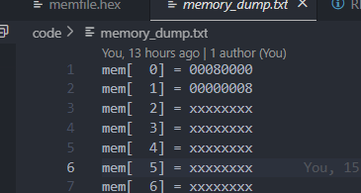
@00000000
00500293 Addi t5 t0 5
00300313 addi t6 t0 3
0000a5b7 lui t11 10
00000000
00000000
006283B3 add t7 t5 t6
00000000
00000000
00000000
00701123 sh t7, 2(t0)
00702223 sw t7,4(0)
00202483 lw t9, 2(t0)
00402503 lw t10,4(t0)
00000000
000002ef JAL t5,0 i.e. loop to self
00000000
00000000
00000000

Slide 2
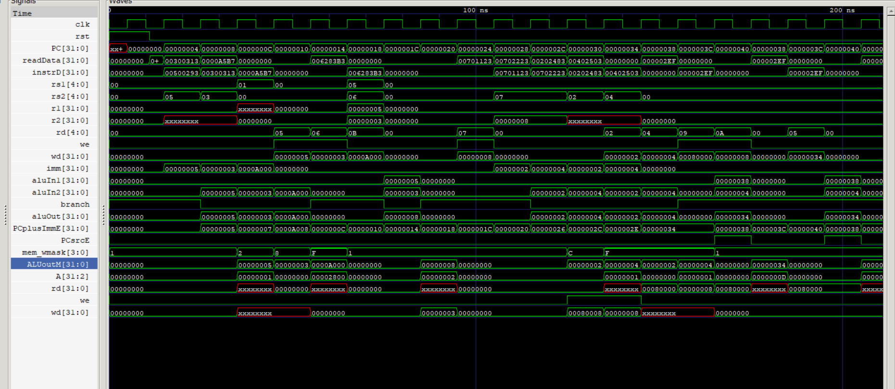

Slide 3
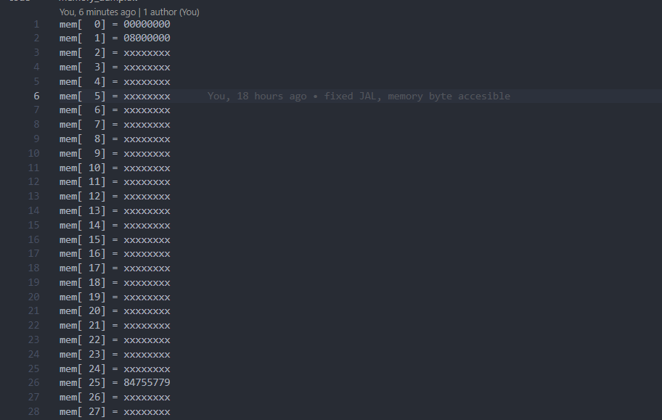
TEST 2
@00000000
00: 00700383 lb x7 7(x0)
04: 06402a03 lw x20 100(x0)
08: 00000000
0C: 00000000
10: 00839393 slli x7 x7 8
14: 004a5693 srli x13 x20 4
18: 404a5713 slli x14 x20 4
1c: 00000000
20: 00700c63 beq x7 24
24: 0053c493 xor x9 x7 5
28: 00000000
2c: 00000000
30: 00c000e7 jalr x1 12(x0)
34: 00000000
38: 0053c493 xori x9 x7 5
3c: 00000000

Slide 4
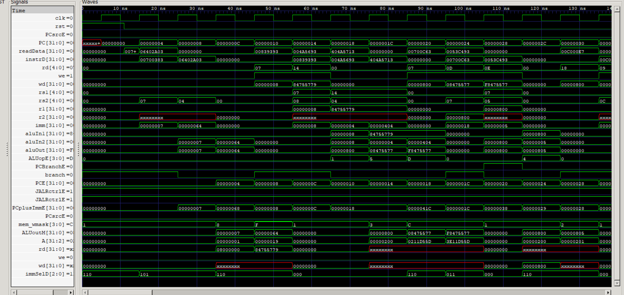

Slide 5
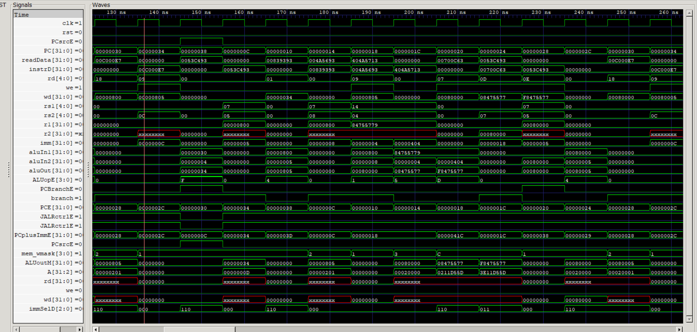

Slide 6
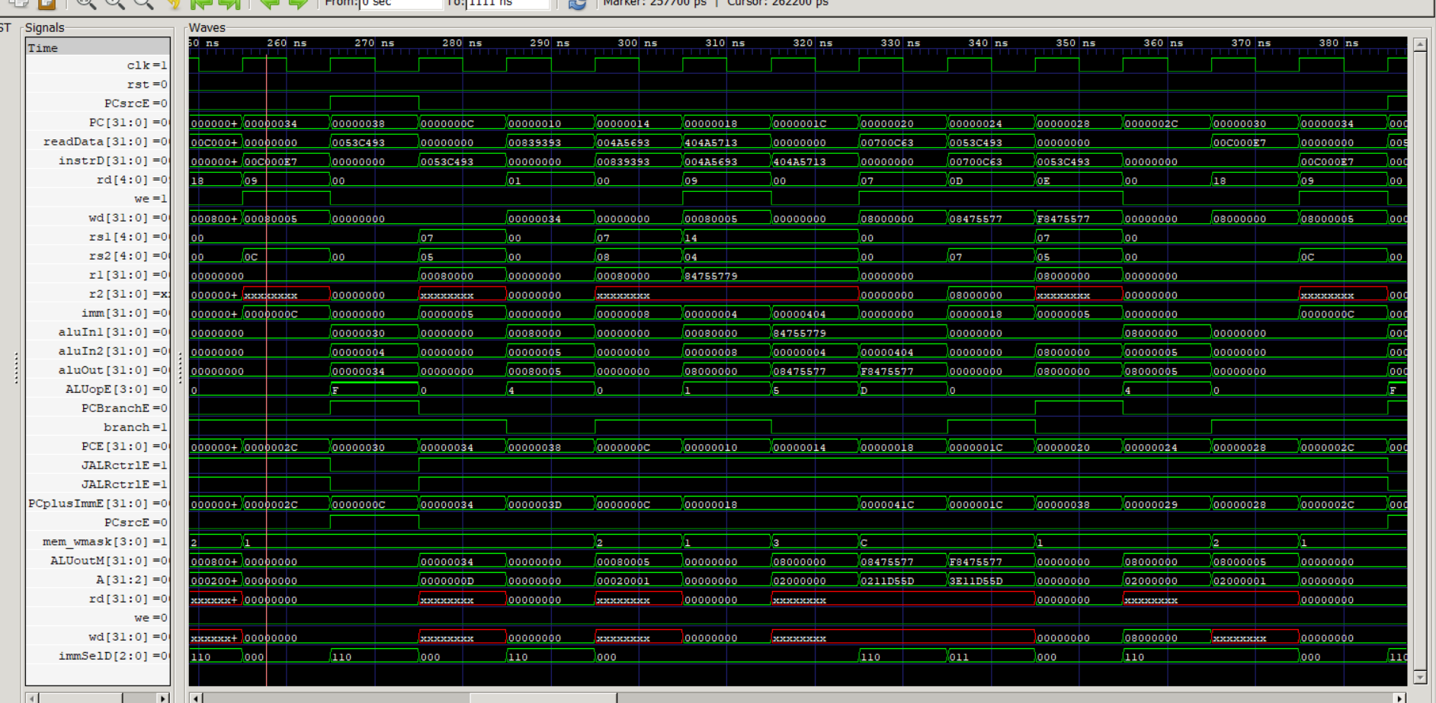

Slide 7
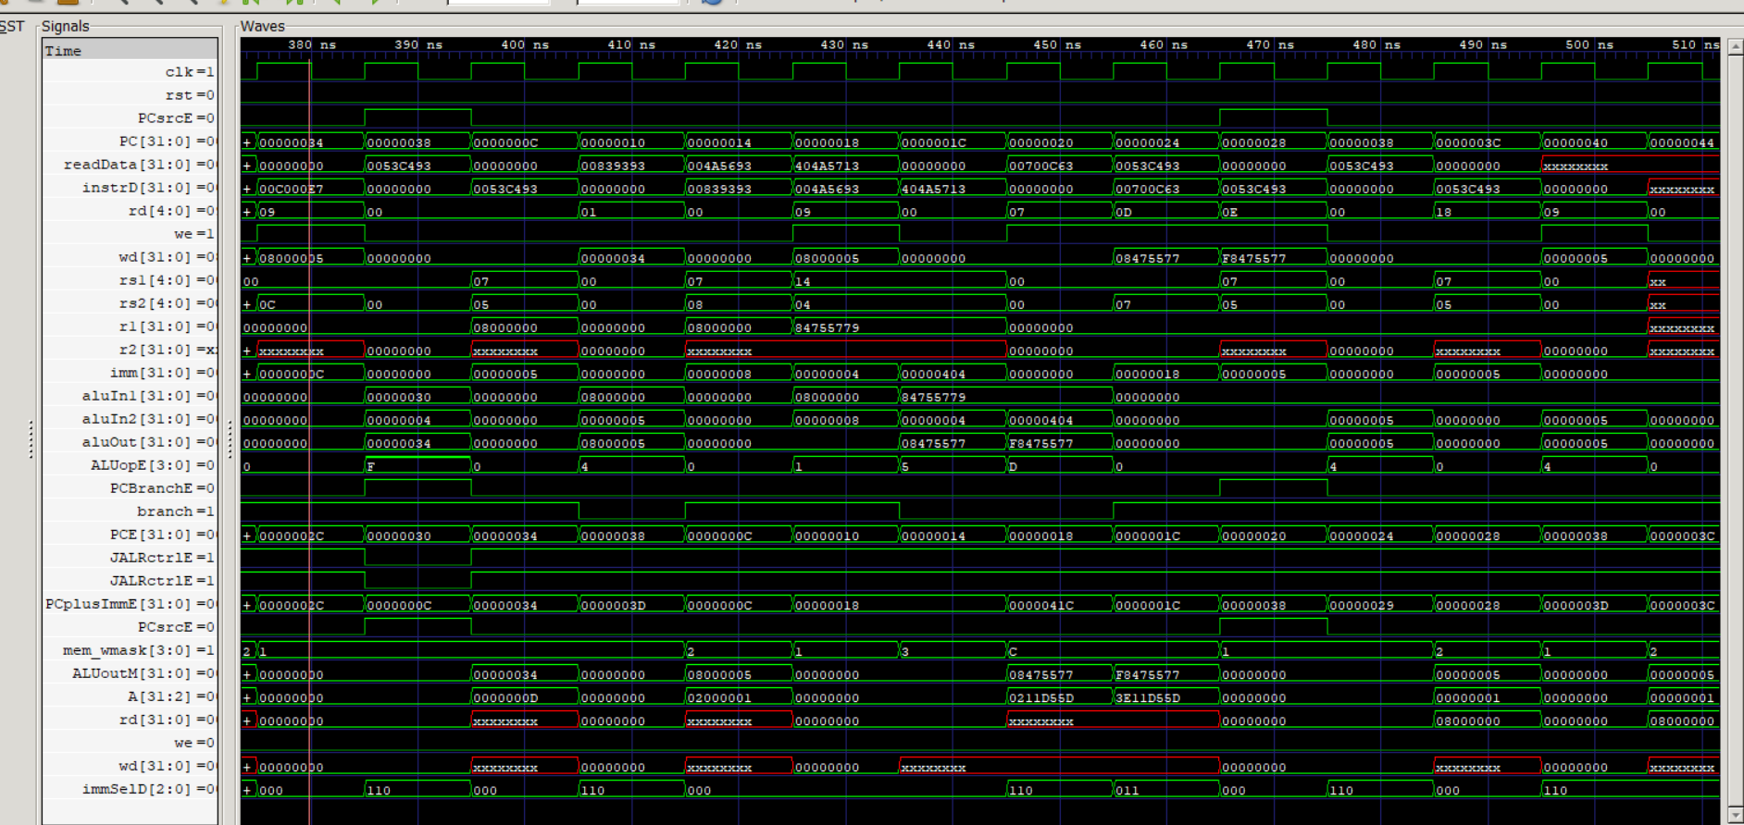

Slide 8
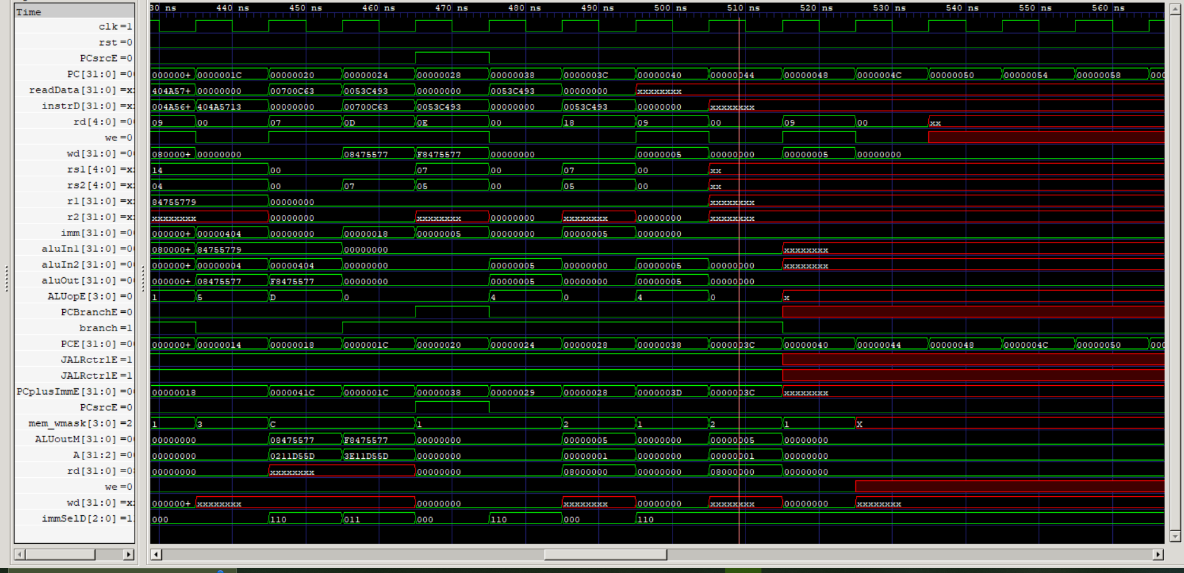

Slide 9
@00000000
00500293 addi r5, 5(r0)
00300313 addi r6, 3(r0)
006283B3 add r7,r5,r6
00002403 Lw r8,0(r0)
00100493 addi r9,1(r0)
00940533 add r10,r8,r9

Slide 10
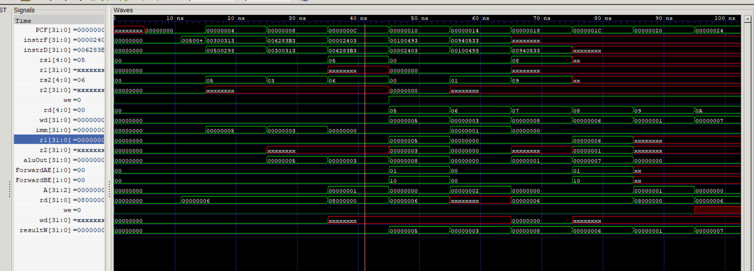

Slide 11
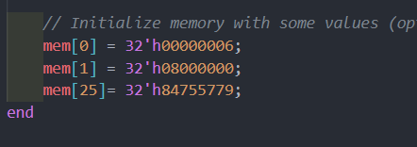
@00000000
00500293 addi r5, 5(r0)
00300313 addi r6, 3(r0)
00000000
006283B3 add r7,r5,r6
00002403 Lw r8,0(r0)
00100493 addi r9,1(r0)
00000000
00940533 add r10,r8,r9

Slide 12
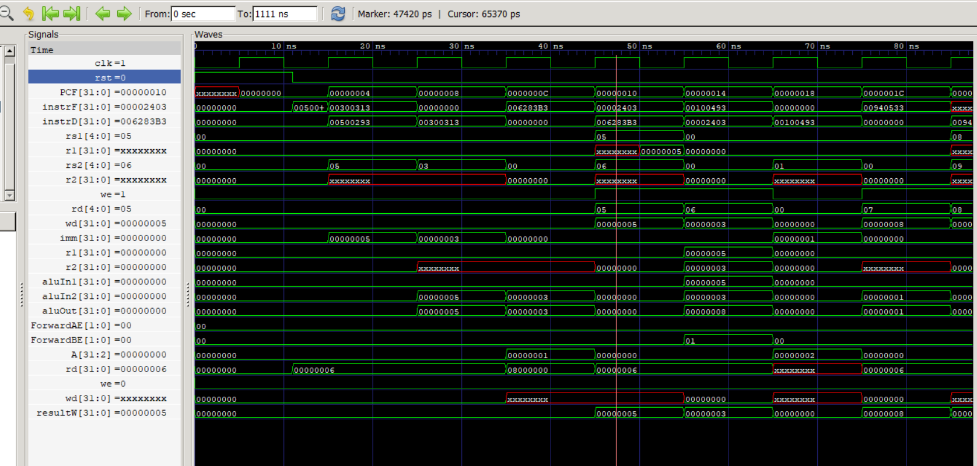

Slide 13
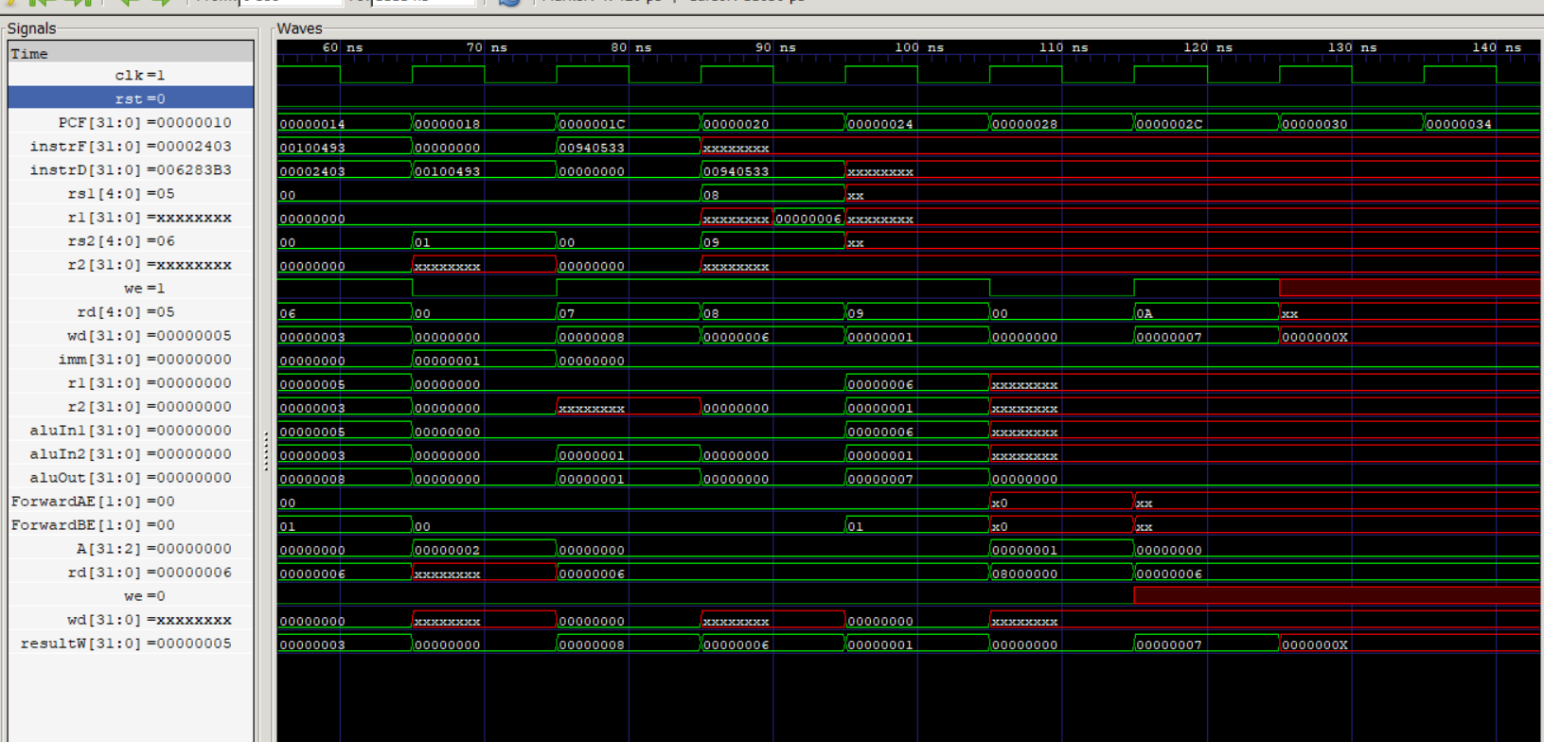

Slide 14
@00000000
00500293 Addi t5 t0 5
00300313 addi t6 t0 3
006283B3 add t7 t5 t
00701123 sh t7, 2(t0)
00202483 lw t9, 2(t0)

Slide 15
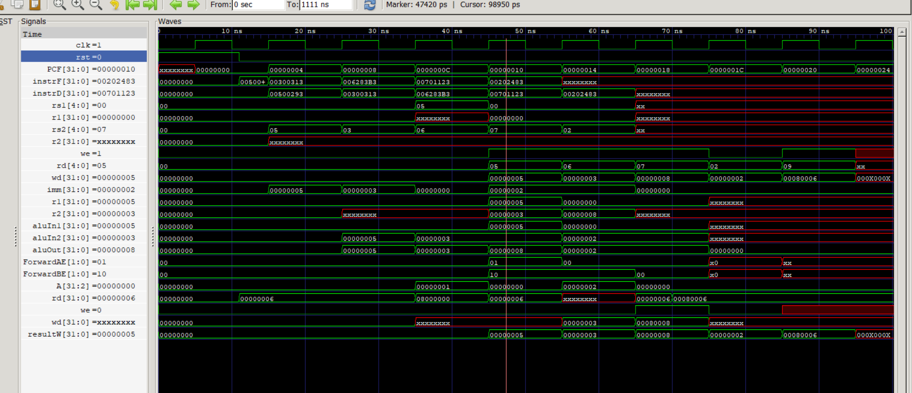

Slide 16
@00000000
00: 00700383 lb x7 7(x0)
04: 06402a03 lw x20 100(x0)
08: 00839393 slli x7 x7 8
0c: 004a5693 srli x13 x20 4
10: 404a5713 slli x14 x20 4
14: 00700c63 beq x7 24
18: 0053c493 xor x9 x7 5
1c: 008000e7 jalr x1 12(x0)
20: 0053c493 xori x9 x7 5

Slide 17
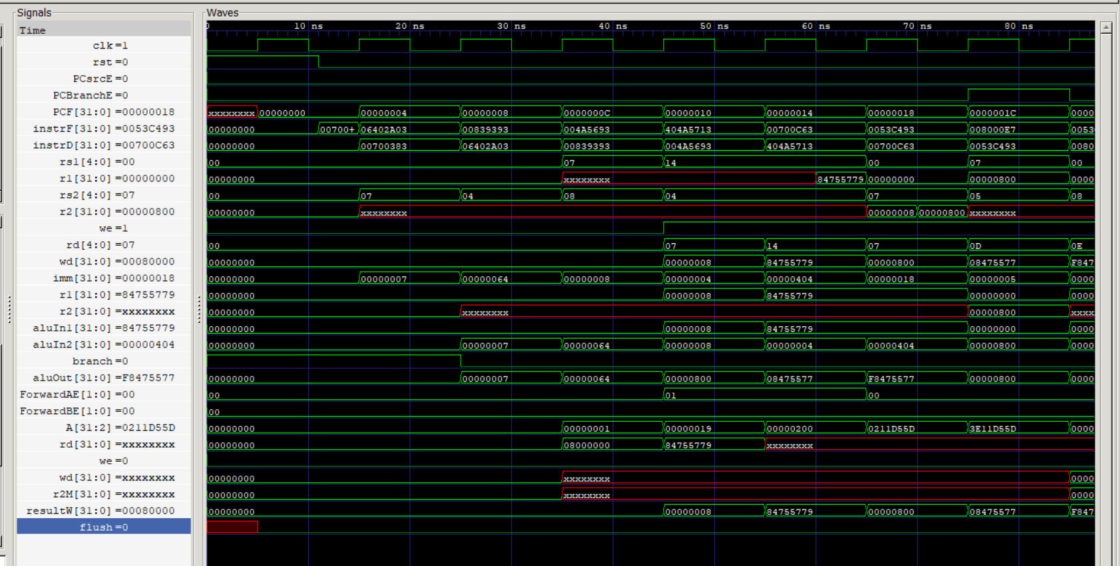

Slide 18
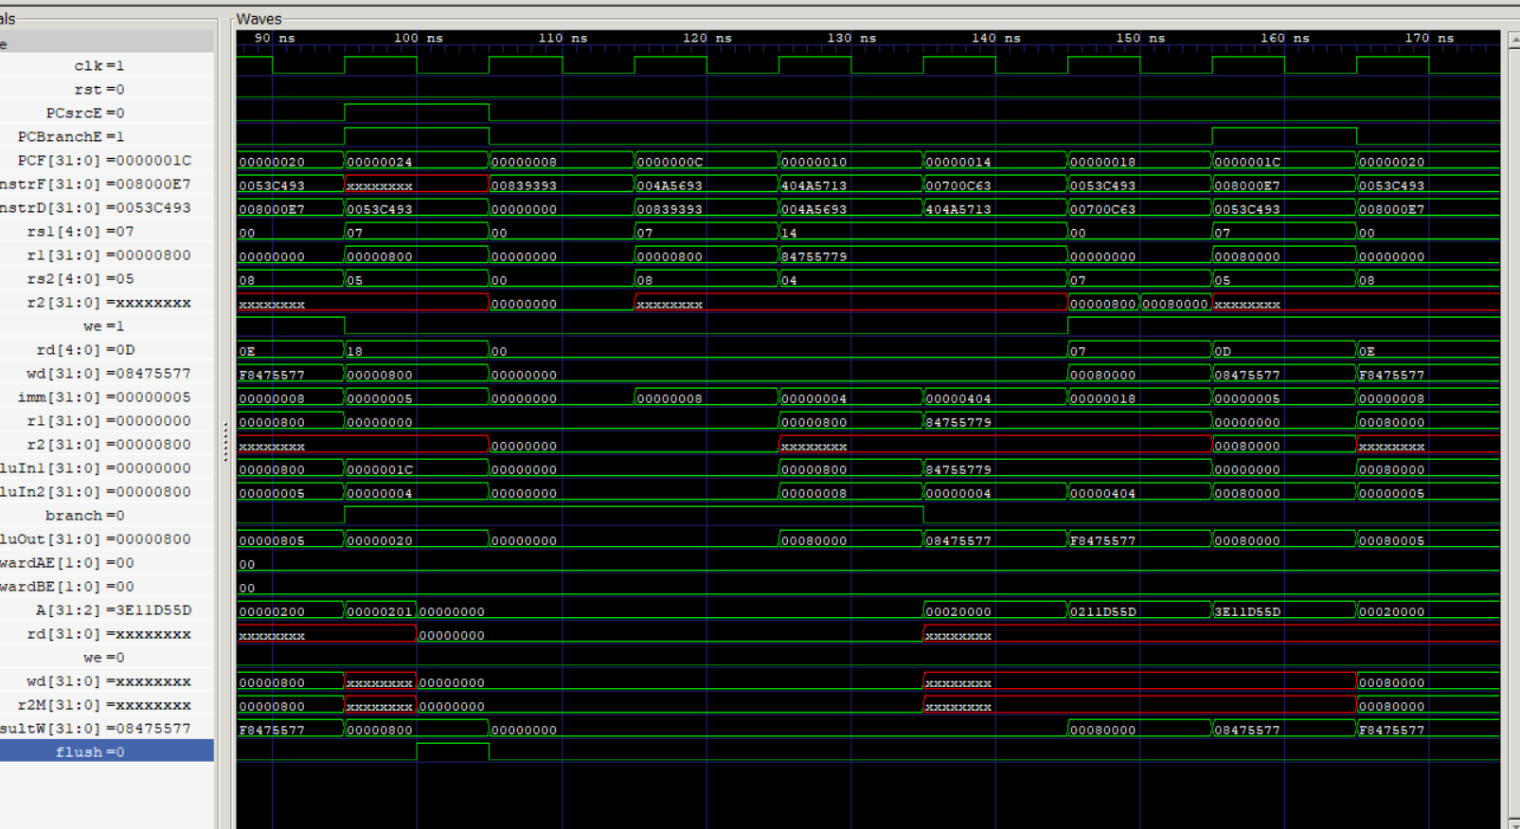

Slide 19
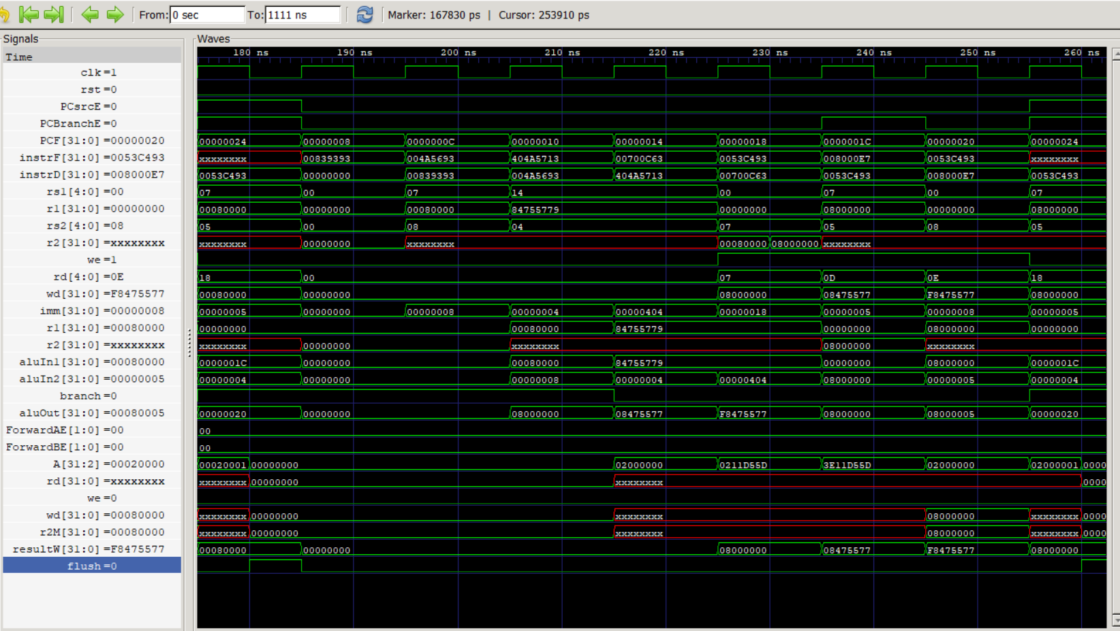

Slide 20
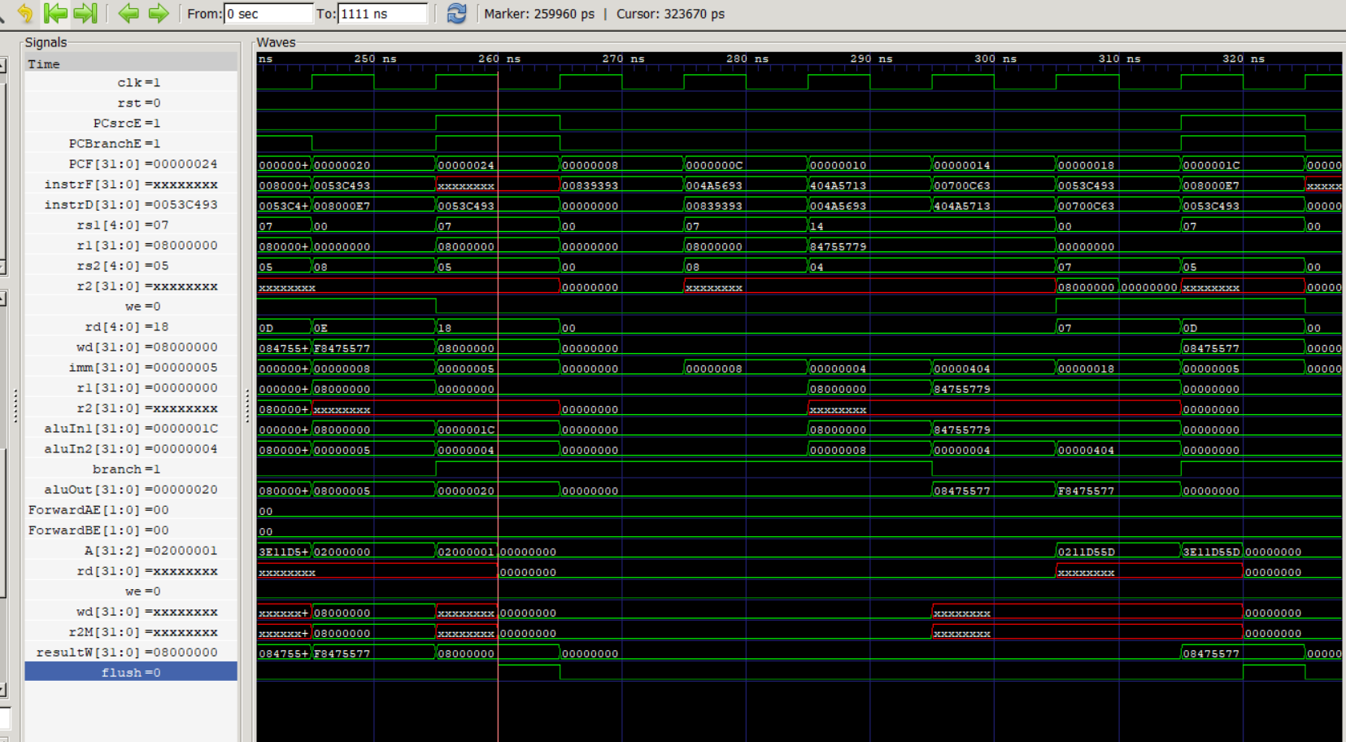

Slide 21
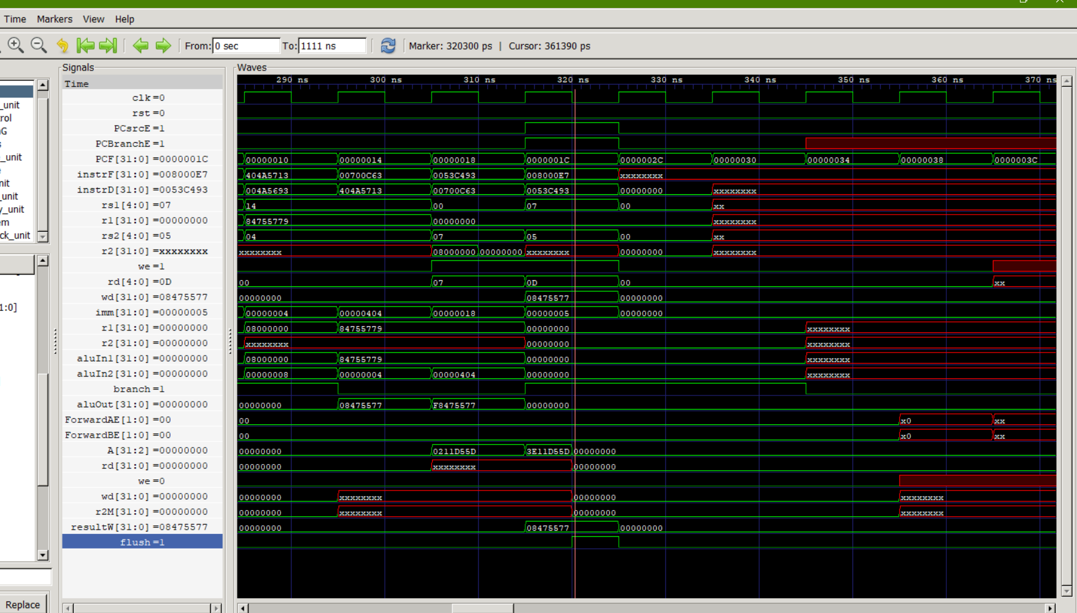

Slide 22
@00000000
00500293 Addi t5 t0 5
00300313 addi t6 t0 3
0000a5b7 lui t11 10
006283B3 add t7,t5,t6
00701123 sh t7, 2(t0)
00702223 sw t7,4(0)
00202483 lw t9, 2(t0)
00402503 lw t10,4(t0)
000002ef JAL t5,0 i.e. loop to self
00500293 Addi t5 t0 5
00300313 addi t6 t0 3
006283B3 add t7,t5,t6

