Slide 1
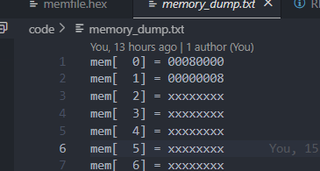
@00000000
00500293 Addi t5 t0 5
00300313 addi t6 t0 3
0000a5b7 lui t11 10
00000000
00000000
006283B3 add t7 t5 t6
00000000
00000000
00000000
00701123 sh t7, 2(t0)
00702223 sw t7,4(0)
00202483 lw t9, 2(t0)
00402503 lw t10,4(t0)
00000000
000002ef JAL t5,0 i.e. loop to self
00000000
00000000
00000000

Slide 2
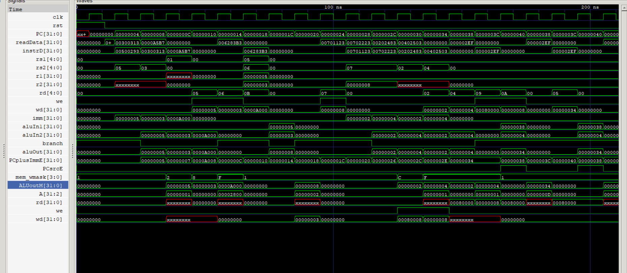

Slide 3
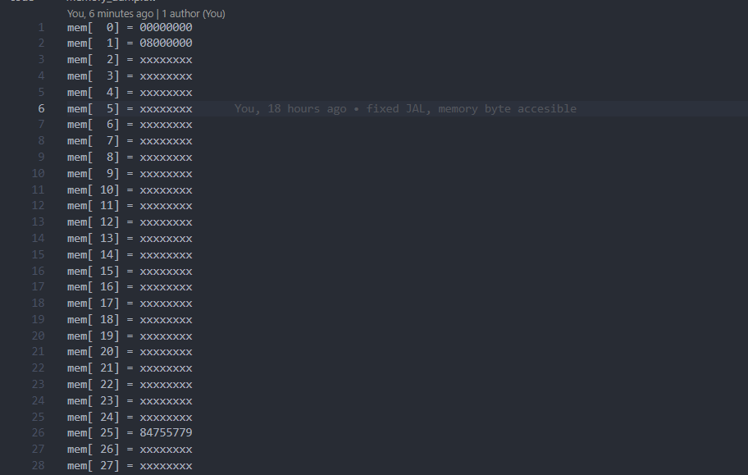
TEST 2
@00000000
00700383 lb x7 7(x0)
06402a03 lw x20 100(x0)
00000000
00000000
00839393 slli x7 x7 8
004a5693 srli x13 x20 4
404a5713 slli x14 x20 4
00000000
00700c63 beq x7 24
0053c493 xor x9 x7 5
00000000
00000000
00c000e7 jalr x1 12(x0)
00000000
0053c493 xori x9 x7 5
00000000

Slide 4
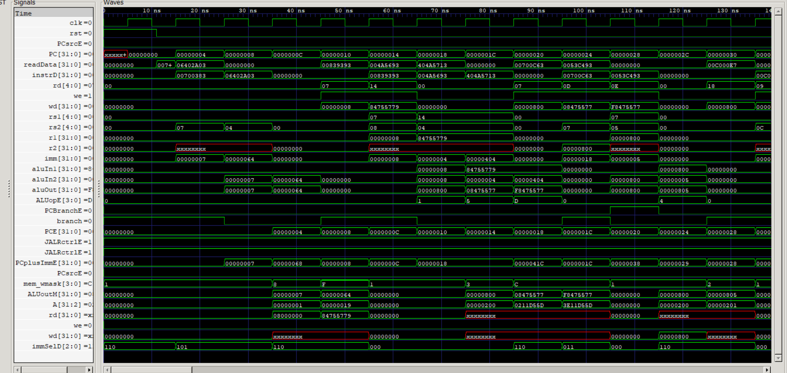

Slide 5
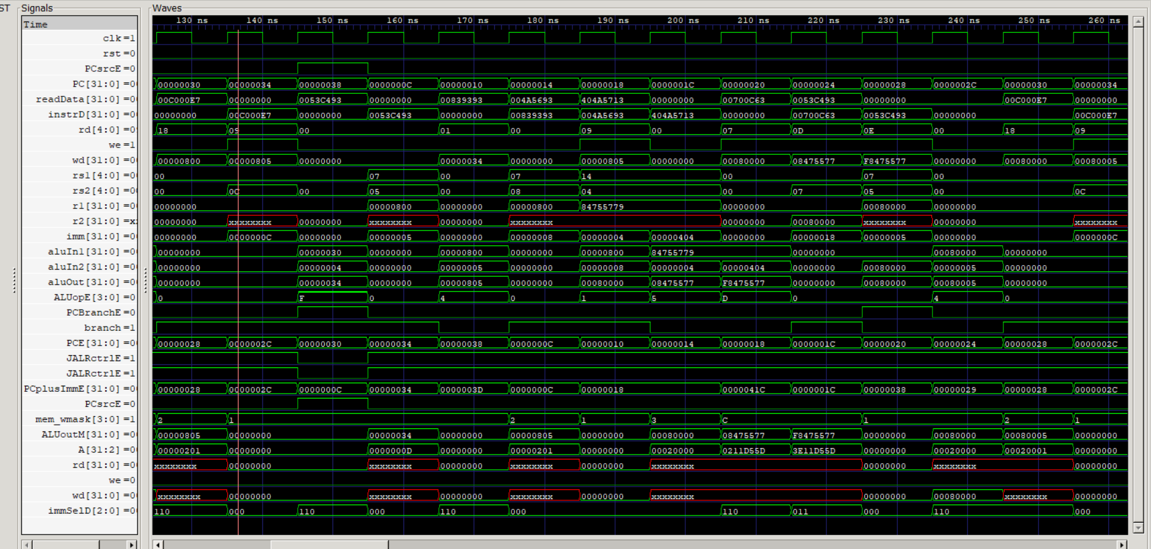

Slide 6
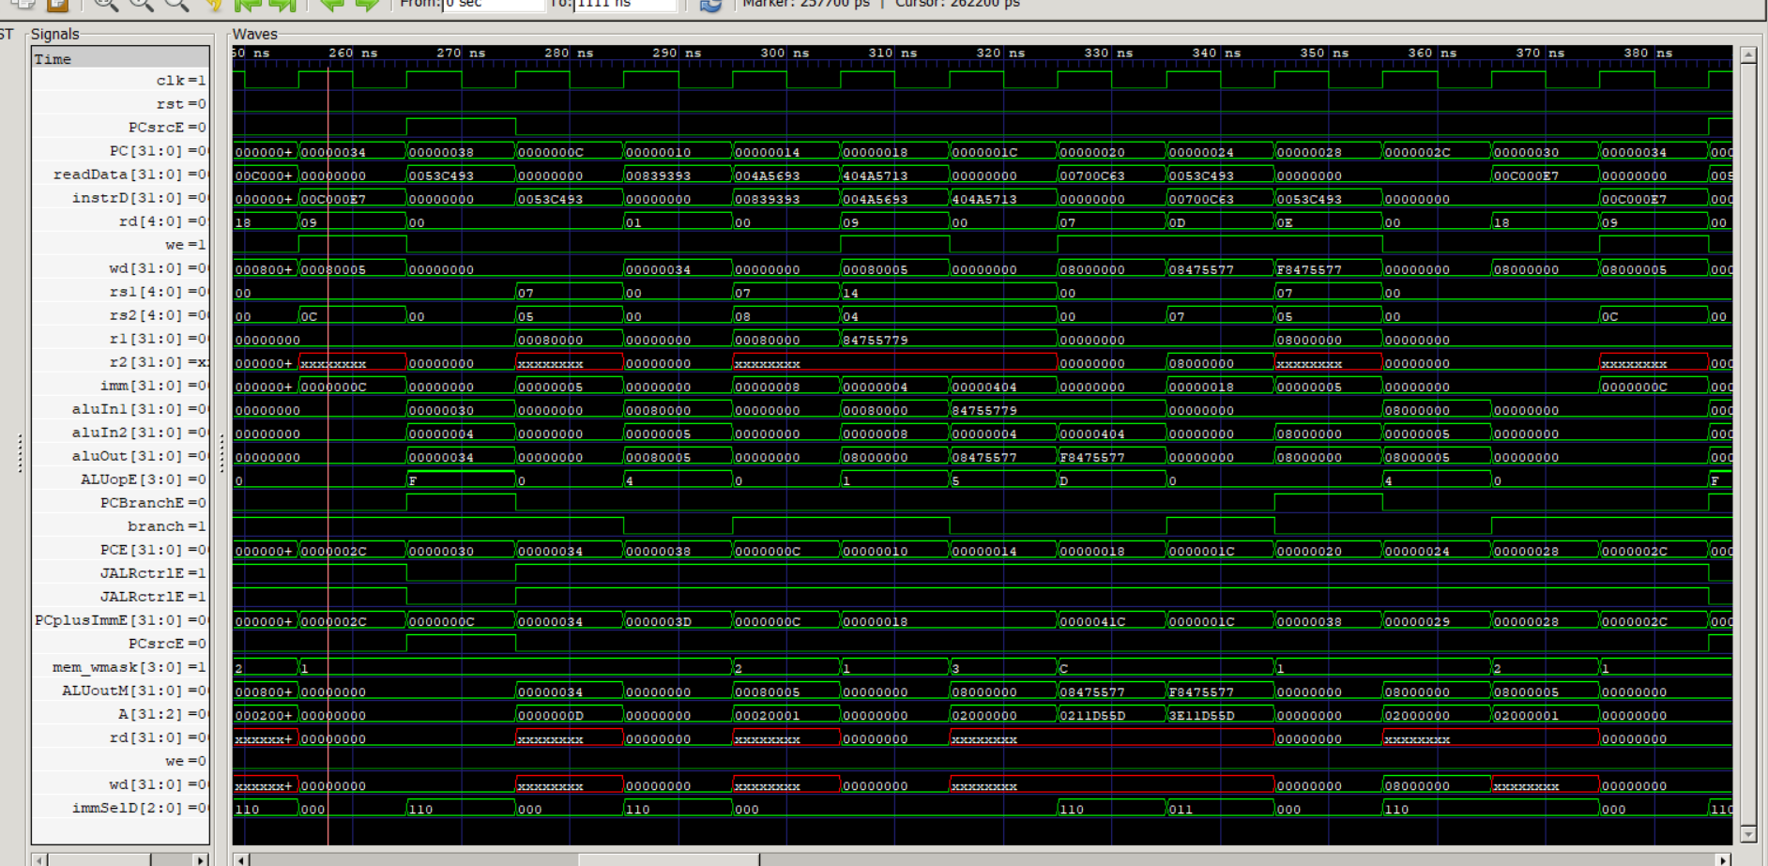

Slide 7
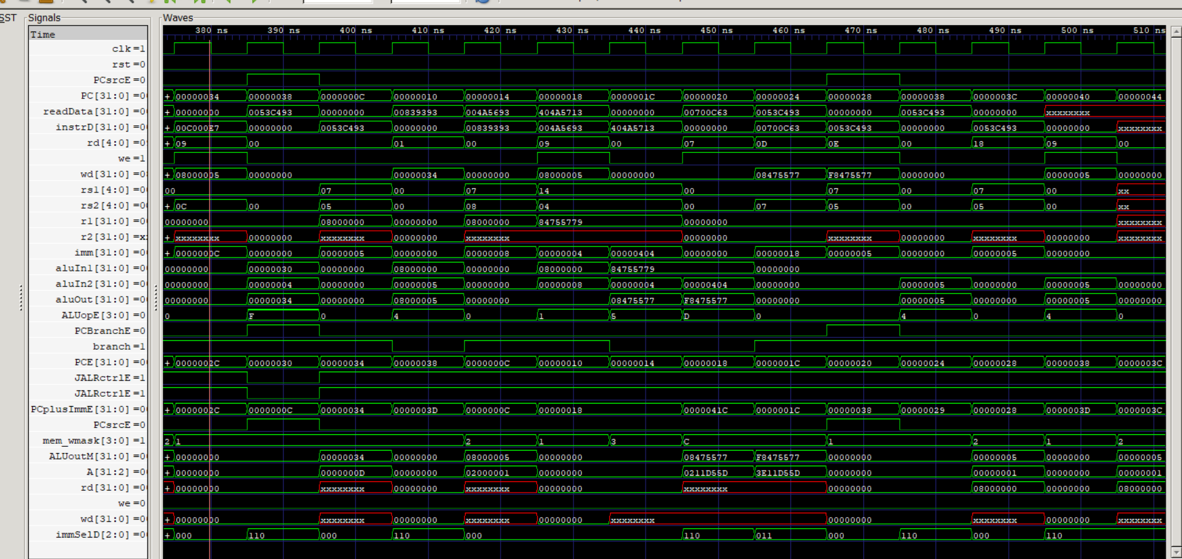

Slide 8
