Slide 1


ATVC Design Review Briefing (DRB)
College Name
VASAVI COLLEGE OF ENGINEERING
Car Number
ATV 80

Slide 2
Vehicle Summary
The vehicle is meticulously designed for benchmark performance, ensuring no compromises in any sub-systems.
Extensive research informs the selection of components, with each part designed for specific aspects and thoroughly analyzed.
AISI4130 material is utilized for the frame, optimizing the strength-to-weight ratio for superior performance.
Independent suspension features a double wishbone in the front and H arms with Camber links in the rear, providing excellent travel for the suspension system.
A CVT with a single reduction gearbox is coupled to the engine, delivering optimal transmission output for enhanced acceleration.
The vehicle boasts an effective braking system, ensuring control on both paved and unpaved surfaces.
Great ergonomics contribute to a comfortable driving posture, elevating the overall driving experience and performance of the vehicle.

Slide 3
Vehicle Specifications & Vehicle Comparison
Parameters | OLD | NEW
wheelbase | 1320mm | 1320.8mm
Frame | 23.8Kg | 25.6kgs
Max Velocity | 57.23Kmph | 57.22m/s
Suspension | Front: double wishbone Rear: semi trailing with upper link. | Front: double wishbone Rear: H arms with upper link
Steering Drive | Centre | Centre
Kerb Weight | 150 kg | 142.2kgs
Gradeability | 65% | 65%
Steering Ratio type | 4.33:1 | 5.3:1
Brake Calipers | 2 Floating&1 fixed | 2 Floating&1 fixed
Parameters | OLD | NEW
Max Acc | 6.61 m/sec2 | 5.74m/s^2
Stopping Dist. | 3.04m | 3.04m
Weight transfer | 28.59%
Turing radius | 1.4m | 1.6m
Drive | 2WD | 4WD
Max gear ratio | Rear: 12:1 | Rear: 12:1 Front:12.75:1
Max torque | 544N-m | 524.20 N-m
Overall length | 1710mm | 1832.35mm
Overall width | 1188.72mm | 966.7mm

Slide 4
Vehicle Overview and Integration
Axle shaft lengths align precisely with suspension geometry through SolidWorks' multibody dynamic simulation.
Steering parameters synchronize with suspension geometry via Lotus Shark software, addressing concerns like bump steer for seamless integration.
DFMEA systematically identifies and documents potential value deviations in the vehicle design.
Deviations noted during DFMEA undergo corrective measures; if rectification is unattainable, consequences are calculated for mitigation.
Simulation tools and DFMEA processes ensure a thorough examination of the vehicle's design, optimizing functionality and safety.

Slide 5
Lessons learnt
Scrutinizing of the vehicle was done and the issue with brake liners was fixed.
During the testing we figured out few failures which were :
Due to manufacturing errors there were quite a abrasion in the machining components
Proper validation, quality, testing is to be done after machining
We need reduce the manufacturing errors by preparing more number of jigs and fixtures
More time is required for testing the vehicle
Proper coordination between all the domains plays a pivotal role in integration of the vehicle

Slide 6
Design validation plan
Vehicle Part | Performance Target | Acceptance Criteria | Validation Method
Steering Geometry | Turning radius of 1.5m | Comfortable to ride in eight track | Calculated and simulated using Adams and Lotus software
Steering system | Deviation is < 0.05m when vehicle is run on a straight line | Deviation should be < 0.1m | Simulations in Adams and Lotus software
Transmission | Top speed 56kmph | Greater than 45kmph | Tachometer
Oils | There should be no leakage of oil when vehicle is rolled over | No oil spills on any surface when vehicle is tilted | Observed manually by tilting on a dry surface
Egression Test | 3 seconds | Less than 5 seconds | Stop watch
Braking Distance | Braking distance 3.04m | Braking distance should be less than 8m | Measuring distance using tape
Braking | All four wheels locking at the same time when brakes are applied | All wheels should lock simultaneously without rolling motion | measured at 40 kmph
Gradeability | Able to climb hill at 45 Â° inclination | Enough torque should be generated to climb at 33 inclination | Uphill / inclined ramp
Suspension Check | No changes in any of the members / links when dropped at height of 2m | No displacement of components when dropped | Drop test and Physical verification
Ergonomics | Clearances to be checked using PVC mock up and considering comfort of driver | All clearances should be > 3 " ; helmet to RRH end points which is 6 " | Measuring tape
Weld Ment | Point of welding area shouldn't undergo any bend / crack . | the bend and not at weld Material should break at a point near | Destructive testing
H & A arms | No bending occurs when landed on single wheel | No deformations when heavy loads are applied | Proper design with optimum F.O.S
Mountings | No bending observed in sudden load | No deformation is observed at weld / clamp region | Triangulation and Ansys validation

Slide 7
DFMEA
Design Failure mode & effective analysis

Slide 8
Part | Failure mode | Potential effect(s) of failure | S | Potential cause(s) | o | Current design control | D | RPN | o | D | RP N
Suspension Arms | bend/break | damage to system | 6 | Axial stress>yeild stress | 6 | Effective analysis | 5 | 180 | 5 | 2 | 50
brackets | fracture | Structural damage to system | 9 | Constant vibration | 5 | Reduced vibration | 6 | 270 | 4 | 4 | 11 2
Braking System | Wheels not locking | Vehicle fails to stop | 10 | Improper bleeding/brake force | 7 | Proper Bleeding is done,Effective design of pedal ratio and travel | 3 | 210 | 3 | 3 | 81
Tie Rods | bending/buc kling | Steering system fails | 7 | Excess load | 5 | Bucking Analysis of tie rods by calculating effective bucklive forces | 5 | 175 | 4 | 4 | 96
wheel hub | Structural failure |  | 8 | Double shearing | 7 | Design according to vehicle specification and proper analysis | 6 | 336 | 5 | 4 | 14 0
Part | Failure mode | Potential effect(s) of failure | S | Potential cause(s) | o | Current design control | D | RPN | o | D | RP N
engine mount | Engine parts damage | Improper combustion | 9 | Improper material selection for mounts/improper nvh paths | 3 | Analysis of NVH due to the engine | 4 | 108 | 3 | 4 | 96
pedal assembly | Brake failure | Brake failure | 10 | Excess brake force load | 7 | Material with high F.O.S | 2 | 140 | 5 | 5 | 20 0
Roll Cage | Structural failure | Driver safety is endangered | 10 | Excessive impact load with high impact time | 8 | Chosen material with high FOS and Ultimate strength | 3 | 240 | 7 | 6 | 42 0
4wD/AWD | Backlash of gears | Transmission system fails | 8 | Movement of UV joint | 4 | Effective design according to the calculations and analysis accordingly | 7 | 224 | 4 | 6 | 14 4
Shafts | mechanical | Vehicle is immovable | 7 | Cyclic loading | 7 | Designed According to load and performance | 6 | 294 | 7 | 6 | 25 2

Slide 9
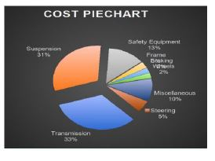
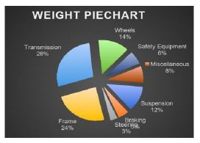
Cost –Weight Analysis
System | Individual components | Cost(Rs) | Weight(Kg)
Suspension | Shock Absorbers+ Hub+ A arms+ H- frame & link+ Knuckles+ Uprights | 102+8+0.5+0.6+5+6= 89,191.40 | 6+4+2.4+3+1.7+1.5= 17.6
braking | Disc Plates+ Brake pedal+ Brake calipers + Brake hose+ Master cylinder | 2+0.3+4.5+0.9= 7323 | 2+0.5+2.25+1+0.5=6 25
steering | Wheel + R&P + Column + Joints + Tie rods + Hubs | 0.5+9+0.5+1.5+ 1.5+1.8=10,645 | 0.4+1.2+1.5+1+0.5+0. 4= 5
frame | Tubes+ Padding+ Clamps+ Firewall+ Welds+ Paneling + Aesthetics | 25+1+1.5+0.5+1+0.45+ 0.5=30,247 | 15 5+1+3+ 1.5+2+0.8+0.2=23.5
transmission | Engine+ CVT+ Shafts+ casing+ rear Gear box+ front gearbox+ propeller shaft | 87+45+30+0.8+40+30+ 8= 2,38,597 | 26.3+10+4+0.5+6+2+ =49.8
wheels | Rims+ Tyre | 4+80=84800 | 8.4+14=22.4
miscellaneous | Fasteners+ oils + electricals+ Battery+ Fuel tank +others | 3+1.3+9+3+4+5=1735 | 4+3+0.5+0.75+0.5=8. 75
total |  | Rs: 4,19,911.40 | 142.4kg

Slide 10
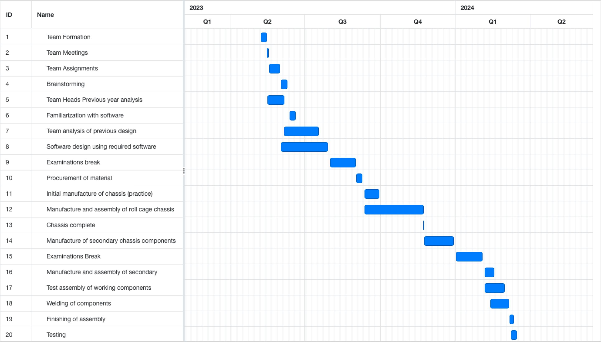
Project plan

Slide 11
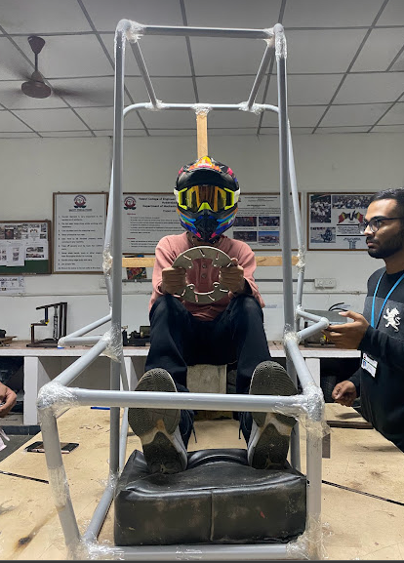
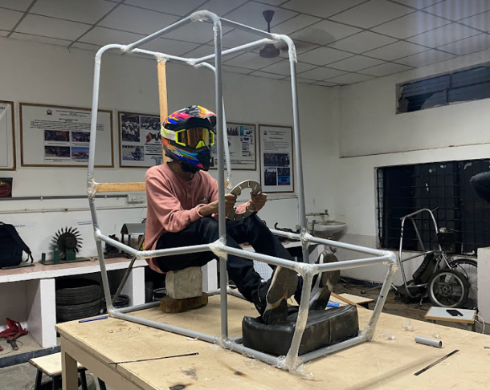
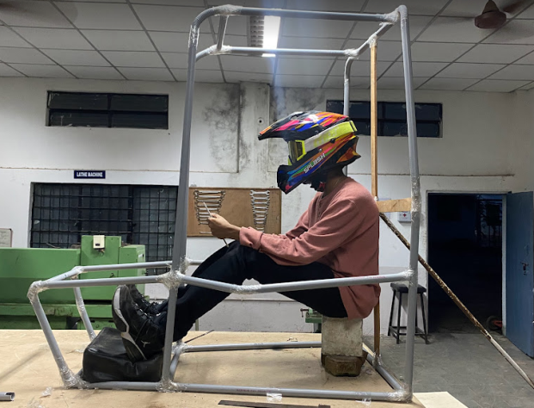
Roll Cage Design Process-Ergonomics
Accepting clearances of Rulebook with driver’s comfort positions
Considering the previous team’s design and failures to fix optimum length
Drafting CAD model and its verification
Constructing PVC Mock-up to verify clearances
Design Validation
Analysis and
Optimization

Slide 12
Roll Cage Design Process-Ergonomics
CONSIDERATIONS:
Driver oriented Roll Cage design
All the rule book conditions are satisfied
Polar moment of inertia is maximized
FBM are adjusted wider for Ensuring Good Visibility
Roll cage is made for better turning radius and vehicle aesthetics
Easy for egress test and driver can escape easily in case of any dangers
All controls are within the reach of the
driver comfortably
Providing Necessary Reinforcements
After safety, weight is decreased by using primary & secondary members
Material is kept farther from rotating axis to
increase Torsional rigidity
Strength to weight ratio is to be improved

Slide 13
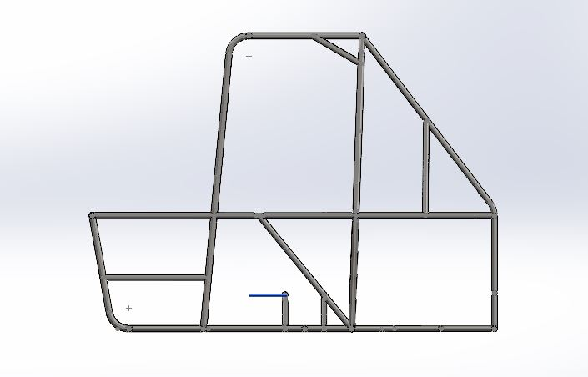
Design of Roll cage
Side View

Slide 14
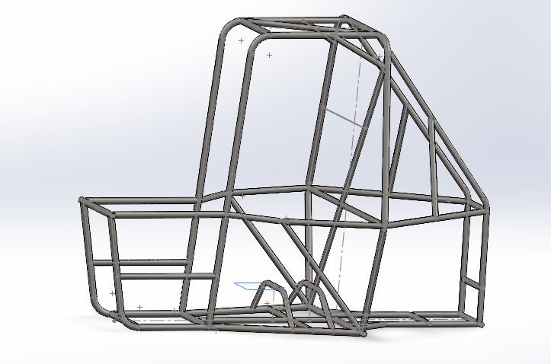
Design of Roll cage
Isometric View

Slide 15
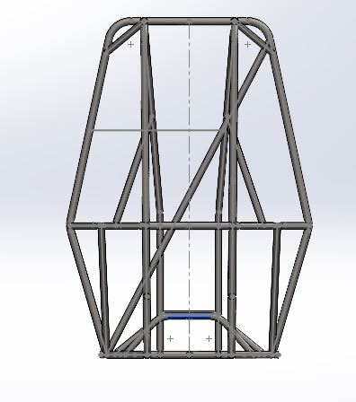
Design of Roll cage
Front View

Slide 16
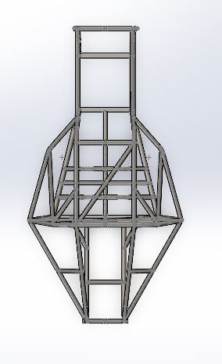
Design of Roll cage
Top View

Slide 17
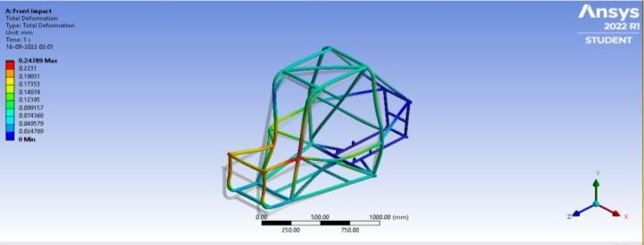
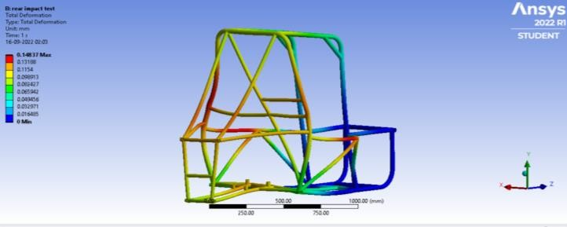
CAE Analysis of Roll cage
Force | 6G
Stress | 383.33Mpa
Deformation | 10.817mm
Impact time | 0.13sec
F.O.S | 1.2
Front impact test
Force | 3G
Stress | 328.57Mpa
Deformation | 10.355mm
Impact time | 0.3sec
F.O.S | 1.4
Side impact test

Slide 18
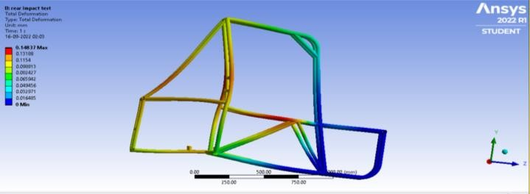
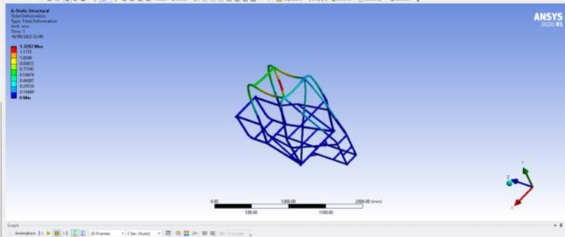
CAE Analysis of Roll cage
Force | 3G
Stress | 393.16Mpa
Deformation | 12.659mm
Impact time | 0.3sec
F.O.S | 1.1
Rear impact test
Force | 3G
Stress | 262.85
Deformation | 4.8328mm
Impact time | 0.13sec
F.O.S | 1.7
Rollover test

Slide 19
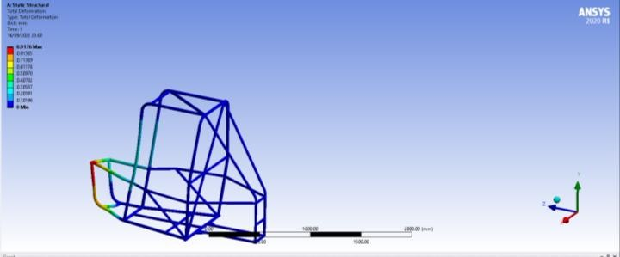
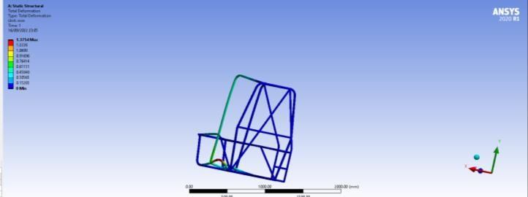
CAE Analysis of Roll cage
Force | 1G
Stress | 403.50Mpa
Deformation | 13.607mm
Impact time | 1.69sec
F.O.S | 1.1
Tortional test
Force | 1G
Stress | 255.55Mpa
Deformation | 8.1002mm
Impact time | 2.12sec
F.O.S | 1.8
Bump test

Slide 20
CAE Analysis of Roll cage
Material | AISI 4130 | AISI 1018 | AISI 1020
UTS | 560Mpa | 440Mpa | 395Mpa
Yield st | 460Mpa | 370Mpa | 295Mpa
Chemical comp | C:0.28%- 0.33% | C:0.14%- 0.20% | C:0.17% - 0.23%
Elongation | 21.50% | 15.00% | 36.50%
Outer diameter | Primary :29.2mm , secondary:25.4mm
Wall thickness | Primary : 1.65mm secondary:1mm
Welding used | TIG Welding

Slide 21
Drivetrain
The primary objective of our drivetrain is to provide the required power while maintaining the perfect balance between top speed and maximum torque. Our aim is to transmit power to all 4 wheels in the most efficient way possible with minimal delay and shocks when the pedal is pressed.
Our vehicle will be able to achieve a top speed of 57.24kmph and maximum torque of 524.21 N-m.
We are able to achieve this with the combination of a CVT which has infinite ratios between the range of 3:1-0.43:1 and a two-stage reduction gearbox of gear ratio 12:1, giving us an overall reduction ratio of 36:1
.

Slide 22
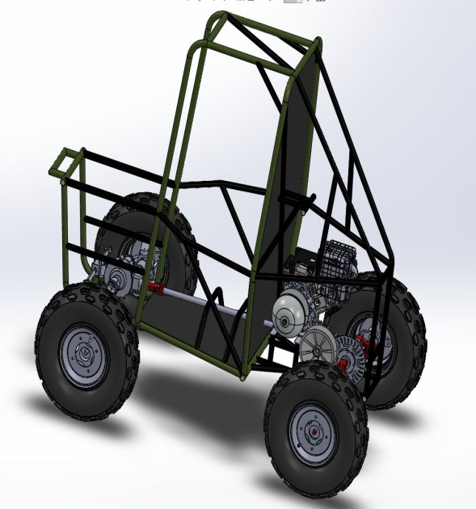
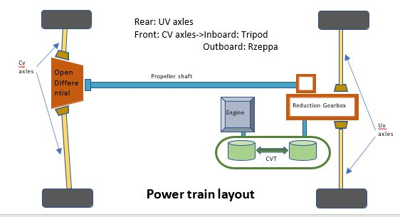
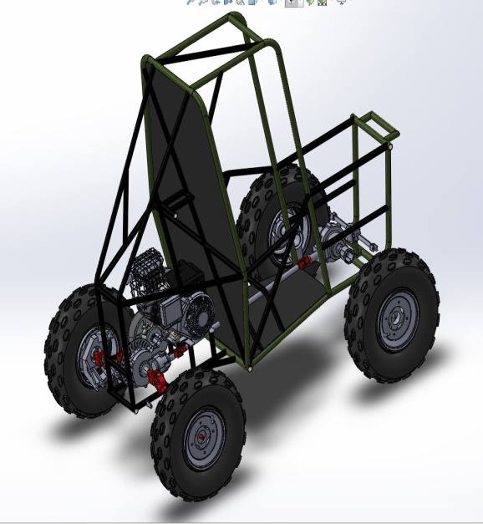
Our Drivetrain layout
Transmission layout assembled in Solidworks 2021
TOP VIEW of the layout

Slide 23
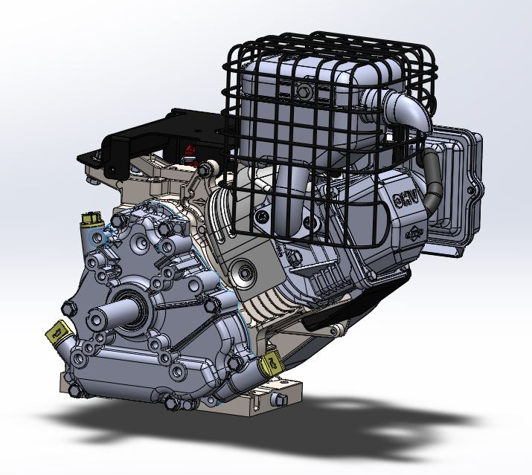
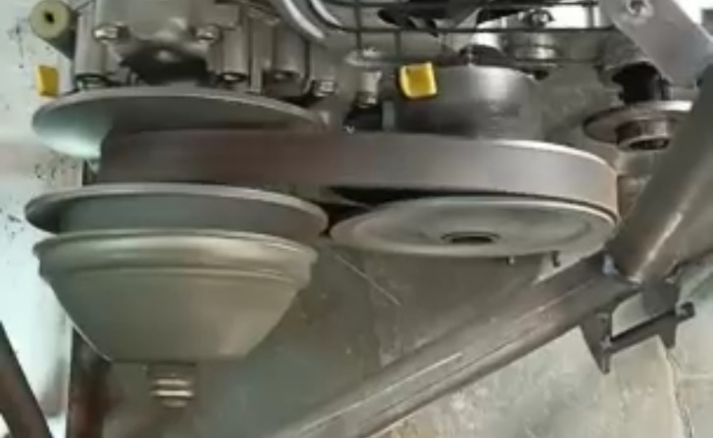
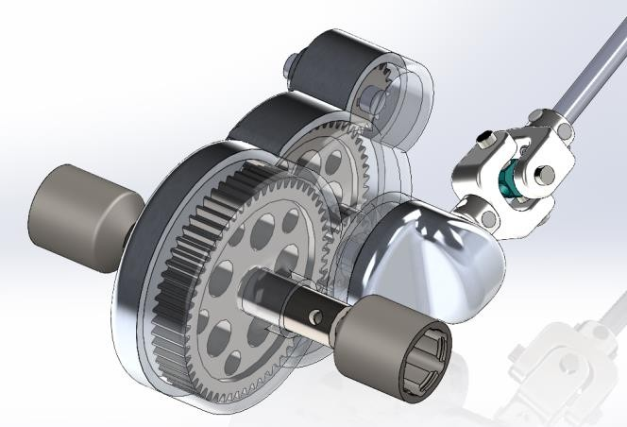
Engine : Briggs and Stratton Engine is used which has a displacement of 305cc, 9.1HP at 3600rpm.It gives 18.67Nm torque at 2800 RPM
Transmission used : CVTech cvt is used with CC distance 214mm, min gear ratio of 3:1 and maximum ratio of 0.43:1. .To overcome the disadvantages of the manual transmission while driving CVT was chosen for its compact in size, continuous acceleration and making driving easy without clutch and gear levers
Gearbox : A two stage reduction gearbox with gear ratio 12:1 is used for the rear wheels and it has a bevel gear system which sends power to the front by means of a propeller shaft.

Slide 24
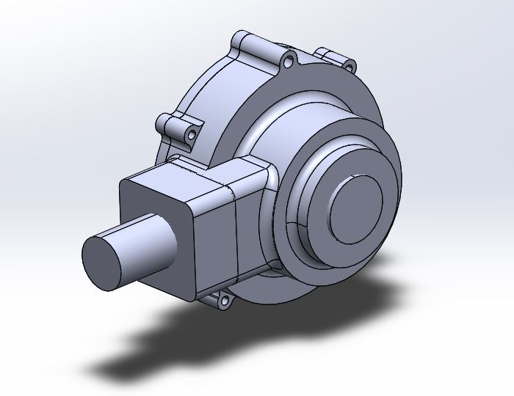
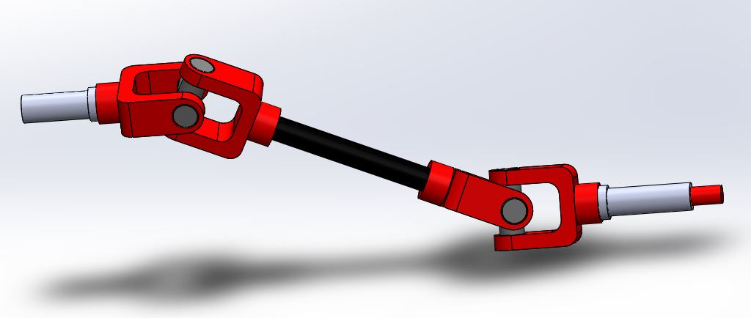
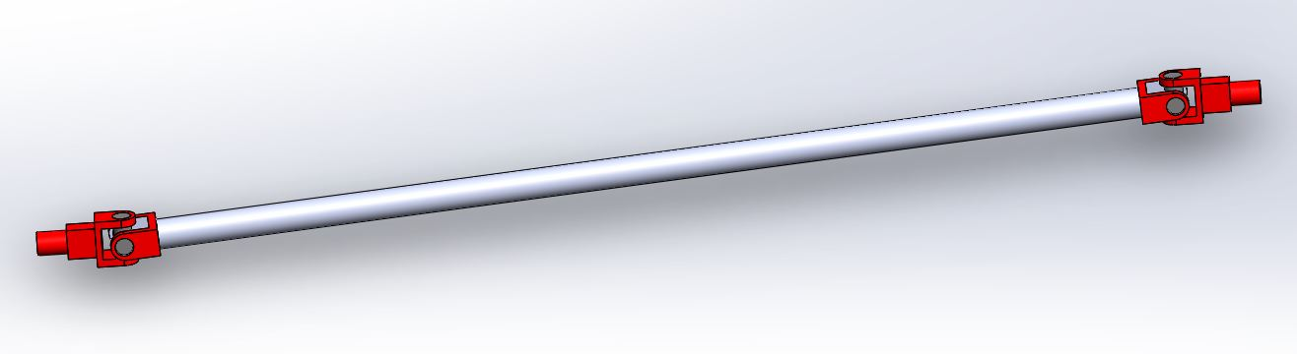
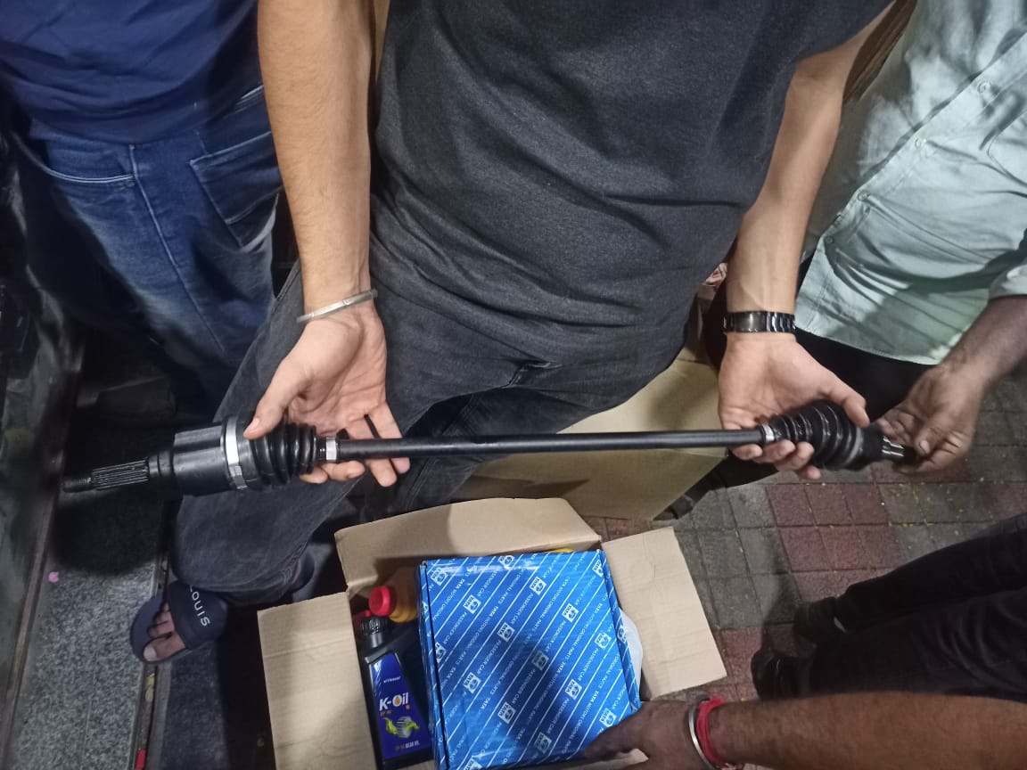
Front Gearbox : A open differential with gear ratio 12.75:1 is used in the front. We chose this so that these give independence to the wheels which is better for overall force flow in the front axles
Drive Shafts : 1.UV axles are used in rear for their simple design and high articulation to accommodate the suspension. 2.CV axles(Plungable Tripod) are used in the front, these are used to accommodate the drag by steering and suspension system. 3.To transmit power to the front, a propeller shaft with UV joints at ends is used.

Slide 25
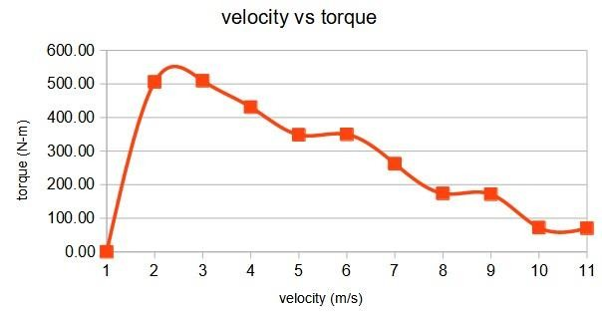
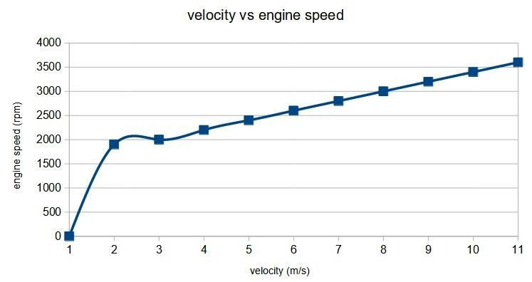
Approach to calculate the gear ratios for gearbox and open differential
1.Assuming gradability (say 65%) and finding total tractive forces acting
on the vehicle on an inclined plane
Total tractive force= (air) + (friction) + (inclination)
= (1/2xρxC_{d}xAxv2) + (μN) + (mgsinϴ) = 1740.88 N
2.Finding torque req to overcome the above tractive force
Τ_{.req} = r x F =508.51 Nm
3.Finding gear ratio(multiplication factor) to achieve the req
torque from engine torque for REAR
T_{req} = T_{engine} x (G.R x CVT.R) x (η_{cvt} x η_{gb)}
G.R = 11.64 :1 i.e rounded to 12 : 1
Torque achieved at rear is
T_{achieved} = T_{engine} x (G.R x CVT.R) x η_{cvt} x η_{gb} = 524.20 Nm
4.Finding gear ratio for front(Diff) to achieve same torque as rear
T_{achieved at rear} = T_{engine} x (G.R x CVT.R) x (η_{cvt} x η_{gb} x η_{bevel gears} x η_{diff})
G.R for front=12.75:1
5.Finding max velocity achieved
Case 1 : Vehicle is 2WD
v_{max} = r x ω x G.R x η = 57.22 Km/hr
Case 2 : Vehicle is AWD
v_{max} = r x ω x G.R x η = 52.24 Km/hr
5. Finding max acceleration F_{net} = m x a
F_{net} = F_{Tyre} - F_{tractive}
F on tyre
T_{achived} = r x F_{Tyre}
F_{Tyre} = 1850.33 N
Case 1 : Vehicle is 2WD
F Tractive = 414.21 N
F_{net} = F_{Tyre} – F_{tractive} = 1436.12 N
F = m x a= a_{max}= 5.74 m/s²
Case 2 : Vehicle is AWD
a_{max}= 5.72 m/s²

Slide 26
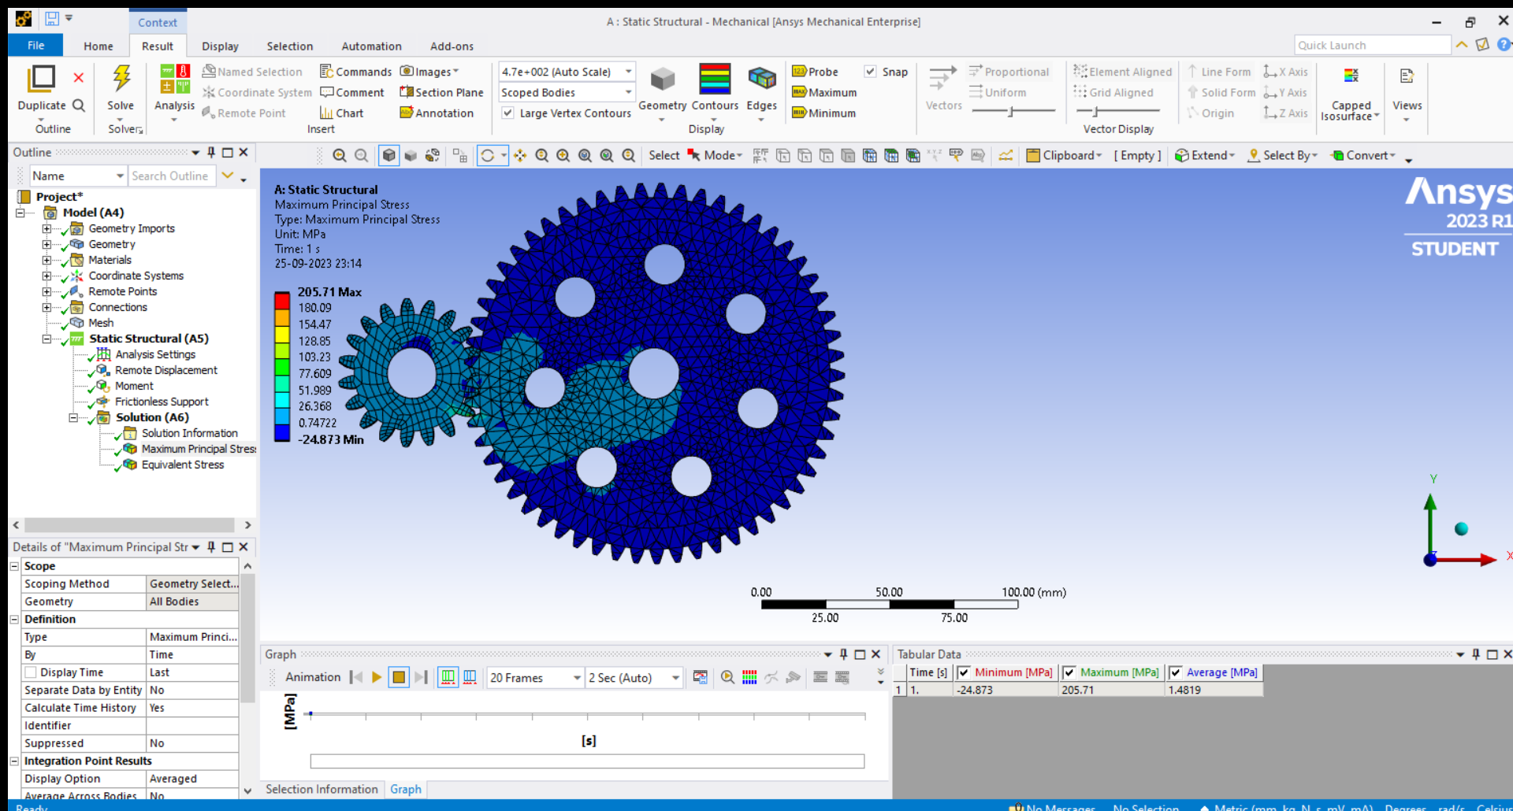
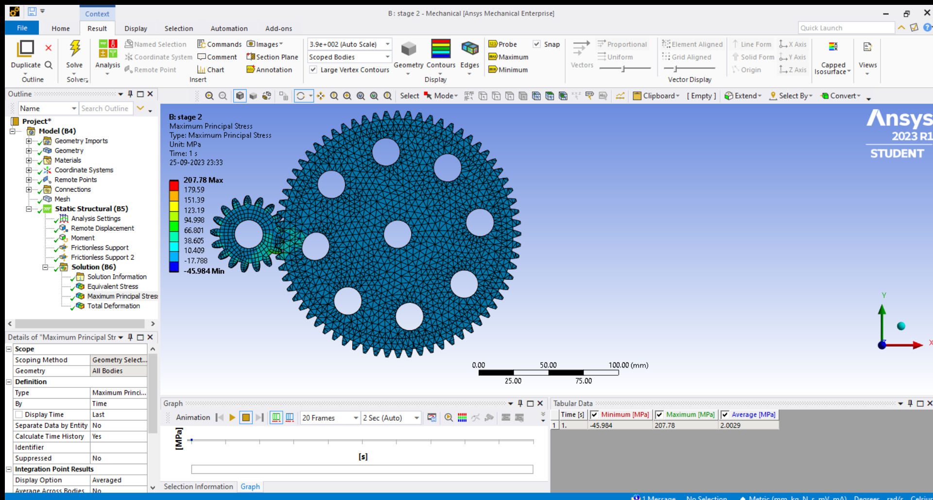
Design of Gearbox
The reduction gearbox was designed according to the Lewis Buckingham equations and were modelled in the Solidworks 2021 software .Later, proper testing of the gears was done using the ansys workbench software and the results looked promising.
The approach for calculating the properties of gears was to design according to the weaker gear identified and find all the forces acting on them after which the properties were calculated.
The total reduction required was 12:1 which is done in 2 stages and one pair of bevel gears which transmit power to the front.
The material we have chosen after doing the analysis was EN 353 for the gears due to its high yield strength and Al 6061 for the casing due to its high strength and less weight.
The total reduction for front is 12.75 which is achived in 2 stages i.e at the bevel gears at rear and differential at front
Stage 1
Stage 2

Slide 27
DFMEA/PFMEA
Damage to the engine:
Caused by air filter blocks and result in improper combustion
Can be controlled by Positioning where free access of air
S=9,O=4,D=1, rpn=36
Backlash of gears:
Caused by movement of UV joint
Can be controlled by doing an Effective design according to the calculations and analysis accordingly
S=6,O=4,D=6, rpn=144
Deformation/bursting of tyre:
Caused by Punctures/ Excess Pressure
Can be controlled by Proper suitable terrain tyres, correct psi is maintained Acc to specification
S=7,O=3,D=1, rpn=21
Damage to CVT
Caused when the CVT casing is not mounted properly. It can damage the CVT.
Can be controlled by sound mounting of CVT casing and tightening the nuts and bolts tightly
S = 7, O =5 ,D =4 ,rpn=140

Slide 28
Lessons learnt
Proper cvt tuning has to be done according to the requirements of the vehicle.
More focus is given to casings and clearances in the assembly.
Design validation
According to our calculations, our vehicle should be able to achieve 57kmph velocity. Our acceptance criteria is 50kmph. A tachometer was used to validate this parameter.
The articulation angles of both front and rear axels we chose to use are validated by the suspension department and the steering department to make sure that the vehicle integration is proper.

Slide 29
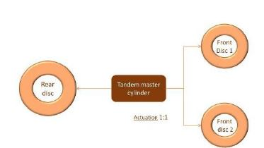
Braking system specs
 | Previous design | New design
Master cylinder | ( 19.05mm master cylinder , stroke = 25mm ) * 2 | 19.05mm tandem master cylinder , stroke = 25mm
Split | Front - rear split | Front - rear split
Brake rotor / disc | Front : 150mm Thickness : 3mm Rear : 150 mm Thickness : 3mm | Front : 180mm Thickness : 4mm Rear : 220mm Thickness : 4mm
Brake calipers | Front : floating 25.4mm Rear : fixed 31.75 mm | Front : floating 25.4mm Rear : fixed 31.75 mm
Brake fluid | DOT 4 | DOT 4
Braking circuit

Slide 30
Brakes System
Inboard brakes were employed in the rear instead of outboard to reduce the unsprung mass and cost.
In the front outboard brakes were used along with floating calipers.
Instead of rigid metal brake lines, flexible stainless hoses are used to which provide better maneuverability.
A tandem master cylinder is used instead of the balance bar mechanism to reduce the complexity in manufacturing.
Bleeding was done several times to ensure perfect brake pedal feel and functioning.
The stopping distance has been reduced from 3.45m to 3.04m

Slide 31
Brakes System - DFMEA/PFMEA
Deformation of pedals -
Caused by Brake failure
Can be controlled by Material with high F.O.S
S=9,O=2,D=1, rpn=18
Wheels not locking-
Caused by improper bleeding or brake force
Can be controlled by proper bleeding
S=9,O=3,D=3, rpn=81

Slide 32
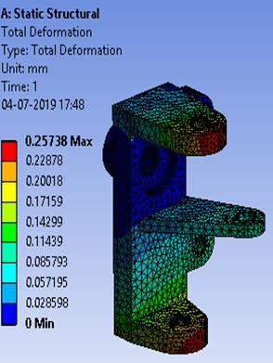
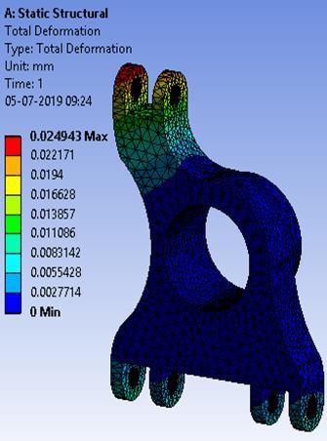
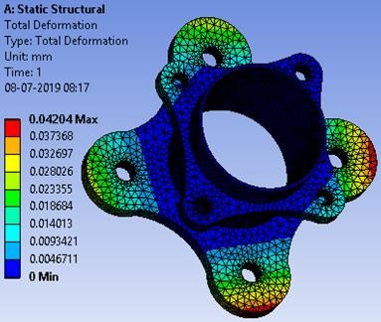
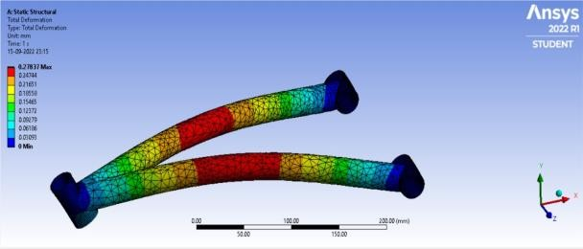
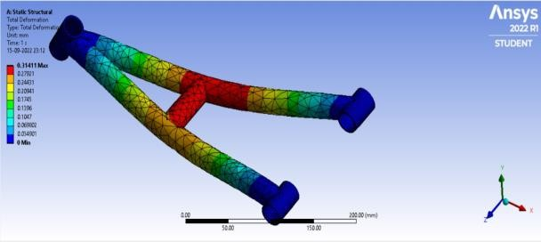
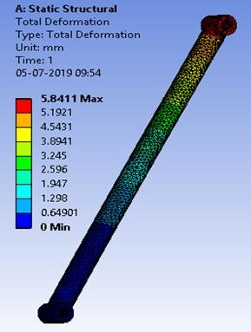
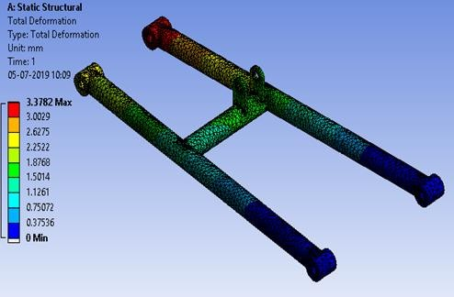
Suspension
Front | Double Wishbone
Rear | H arm with an upper link
Parameter | Front | Rear
Roll Centre (mm) | 147.01 | 181.45
Motion Ratio | 0.5 | 0.8
Camber | 0 | 0
Caster | 2.45 | 0
KPI | 8.13 | 0
Scrub (mm) | 28.27 | 0
Toe | 0 | 0

Slide 33
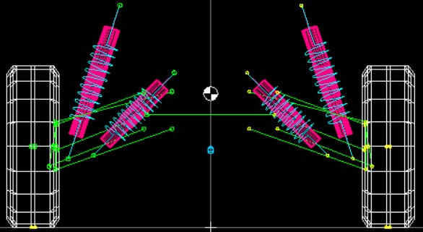
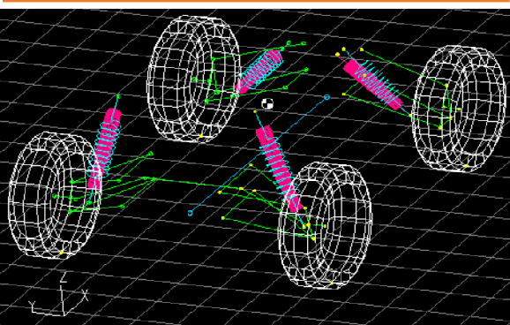
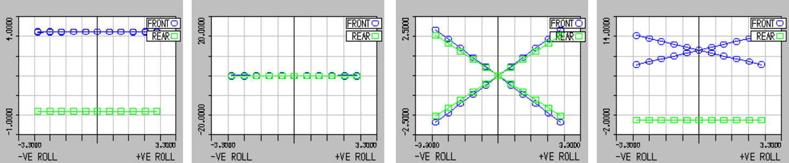
Suspension
Design | Front | Rear
Desired Natural Frequency (Hz) | 1.75 | 2.4
Ride Rate (N/mm) | 11.77 | 17.89
Spring Rate (N/mm) | 13.35 | 25.01
Spring Dimension (mm) | D: 56 d: 8 | D: 76 d: 10
Factor of safety | 1.73 | 1.73
Suspension Travel (inch) | 5.9+ 1.61 | 5.9+1.48
Damper Stroke (inch) | 6.2 | 4.5
Damping Value at 0.3m/s (N) | 1417.77 | 1791
CG Height | 19 inch
Ground Clearance | 14 inch
Sprung mass | 110kg
Un-sprung mass | 50kg

Slide 34
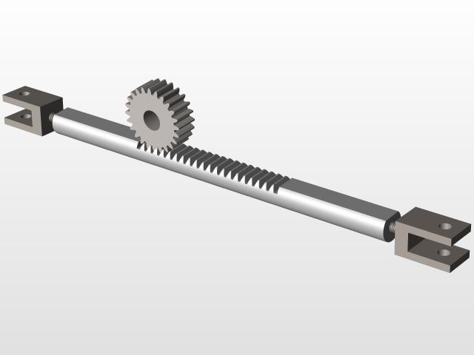
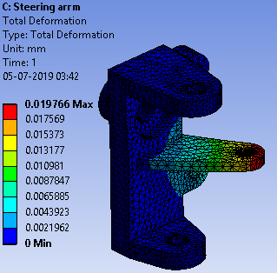
Steering
Type of Drive | Centre
Rack Travel (centre to end) | 17.4mm
Lock to Lock | 0.94 rev
Steering Ratio | 37 mm/rev
Length of Tie rod | 260.629mm
IBJ centre distance | 205.74mm
OBJ centre distance | 560.825 mm
Min. turning radius | 1.5m
8
Steering Gear: Rack & Pinion
Steering System: Ackerman
Type | Tilt
Assist | Powerless
Diameter | 240mm
Torque | 5.88Nm

Slide 35
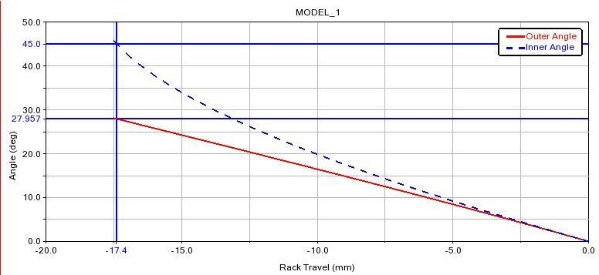
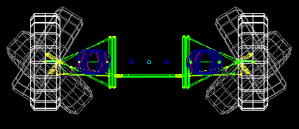
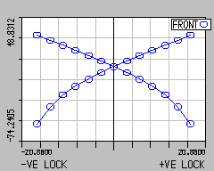
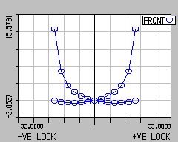
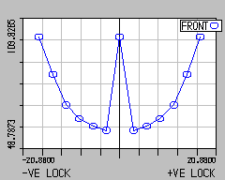
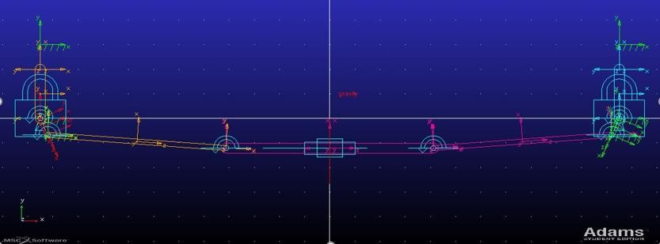
Steering
Steering System: Ackerman
Rack Travel V/S Inner And Outer Angles
Steer Type | Understeer
Ackerman % | 99.98
Steering angle inside | 45˚
Steering angle outside | 27.957˚
Lotus Analyzer
Steer V/s Toe angle
Steer V/s Camber angle
Layout in ADAMS
Lotus Ackerman Percentage Chart

