Slide 1
Convolutional Neural Network for Pneumonia Detection from X-ray Images
Final Project
ROHAN ANTO D 2021506073 Madras Institute of Technology, AU

Slide 2
PROJECT TITLE
Pneumonia Detection from X-ray Images
Image registration using deep learning employs neural networks to automatically align images from different sources or modalities, enhancing their interoperability and facilitating comparative analysis.
This technology harnesses the power of convolutional neural networks (CNNs) to extract meaningful features from images and generate accurate spatial transformations, enabling precise alignment and registration.

Slide 3


AGENDA
PROBLEM STATEMENT
PROJECT OVERVIEW
END USERS
SOLUTION
MODELLING
RESULTS
3/21/2024 Annual Review

Slide 4

PROBLEM STATEMENT
Develop a Convolutional Neural Network (CNN) based system for pneumonia detection from X-ray images. The aim is to automate the detection process, traditionally reliant on manual interpretation, by achieving high accuracy, efficiency, and generalization across diverse datasets and imaging conditions. This project seeks to revolutionize pneumonia diagnosis, facilitating timely interventions and improving patient care in healthcare settings.

Slide 5

PROJECT OVERVIEW
Develop a CNN model tailored for pneumonia detection from X-ray images.
Automate the interpretation process, traditionally reliant on manual assessment.
Achieve high accuracy and efficiency, ensuring robust performance across diverse datasets to revolutionize pneumonia diagnosis and enhance patient care.

Slide 6

WHO ARE THE END USERS?
Radiologists
Medical professionals
Image Search Engines
Healthcare institutions and hospitals.
Educators and Students
Researchers in the field of medical imaging

Slide 7

YOUR SOLUTION AND ITS VALUE PROPOSITION
Accurate and efficient diagnosis, reducing reliance on manual interpretation and minimizing diagnosis errors.
Streamlined workflows for healthcare institutions, leading to faster diagnosis and treatment planning.
Improved patient outcomes through timely interventions and enhanced diagnostic accuracy, ultimately saving lives and reducing healthcare costs.

Slide 8

THE WOW IN YOUR SOLUTION
Our system's wow factor lies in its ability to revolutionize pneumonia diagnosis by seamlessly integrating cutting-edge deep learning technology with medical imaging. By automating the interpretation process traditionally reliant on human expertise.
Rapid Deployment: Providing healthcare institutions with a user-friendly, plug-and-play solution that can be seamlessly integrated into existing workflows, without requiring extensive training or infrastructure modifications.
3/21/2024 Annual Review

Slide 9
MODELLING
Convolutional Neural Network (CNN)
Data Collection
Preprocessing
Training Strategy
Evaluation Metrics
Fine-tuning and Hyperparameter Tuning
Inference
Deployment and Integration

Slide 10
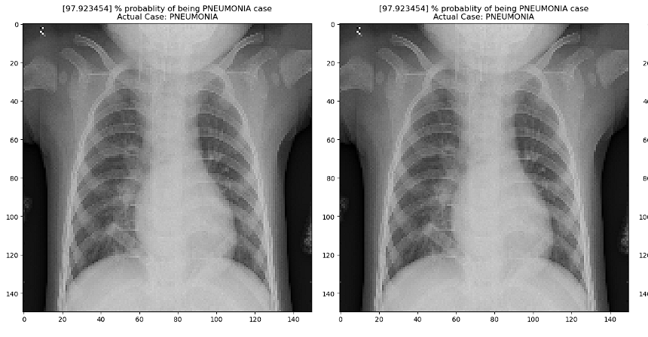
RESULTS
The result of the image captioning process is a descriptive caption generated by the model for a given input image.
The quality of the result can vary based on several factors, including the model architecture, the size and diversity of the training dataset, the effectiveness of the training process, and the suitability of the evaluation metrics used.
Demo Link

