Slide 1



Cybersecurity Organization &
Strategy for International Bank
Security Structure, Key Roles, Performance Metrics & Policy Implementation
March 2025

Slide 2
Team Members:
1 . B. KULA DEEPTHI
2 . RAKSHIT VERMA
3 . KAMAL NAYAN KUMAR
4 . SHIVANSH SHUKLA
5 . BABHALE ROHAN LAXMIKANT
6 . PRAKHAR

Slide 3
Why Cybersecurity is Critical for Banks?
Banks handle sensitive customer financial data.
Increasing cyber threats like phishing, malware, and ransomware.
Compliance with global and regional regulations (GDPR, PCI-DSS, SOX, etc.).
Need for secure hybrid infrastructure (legacy + cloud).
The bank must establish a well-defined cybersecurity structure to balance security, compliance, and business operations.
How can a Hybrid Cybersecurity Model balance global security with regional compliance?
By combining centralized and decentralized approaches:
Centralized control ensures standardized policies, global threat intelligence, and strict compliance enforcement.
Decentralized flexibility allows adaptation to country-specific regulations.

Slide 4

Organizational Structure

Slide 5
Top-Level Cybersecurity Leadership
Chief Information Security Officer (CISO)
Reports to: CIO, Board of Directors & CEO
Key Responsibilities:
Designs the global cybersecurity strategy and ensures alignment with business objectives.
Leads the bank’s defense against cyber threats and financial fraud.
Ensures compliance with regulatory frameworks (PCI-DSS, GDPR, SOX, NIST, etc.).
Develops risk assessment frameworks and crisis management plans.
Regularly updates the Board of Directors on security risks and incidents.

Slide 6
Security Governance & Compliance (SGC)
Director of Security Compliance & Risk Management
Reports to: CISO
Key Responsibilities:
Ensures compliance with banking cybersecurity laws across multiple jurisdictions (30+ regions).
Conducts internal security audits, gap assessments, and regulatory reviews.
Collaborates with Legal, Risk, and Regulatory Affairs teams to ensure policy alignment.
Develops training programs and awareness initiatives for security compliance.
Creates and enforces bank-wide cybersecurity policies and governance frameworks.

Slide 7
Threat Intelligence & Incident Response (TIIR)
Global Threat Intelligence Director
Reports to: CISO
Key Responsibilities:
Monitors global cyber threats, vulnerabilities, and attack trends affecting banks.
Operates a 24/7 Security Operations Center (SOC) with regional hubs for faster incident response.
Investigates security breaches, malware incidents, and unauthorized access attempts.
Coordinates with law enforcement and financial sector cybersecurity groups.
Uses advanced AI-based threat detection to predict and mitigate cyber risks.

Slide 8
Security Architecture & Engineering (SAE)
Head of Security Architecture & Engineering
Reports to: CISO
Key Responsibilities:
Secures cloud applications, on-premises infrastructure, and legacy banking systems.
Implements Zero Trust Architecture to minimize access risks.
Develops secure application integration frameworks to prevent data leaks.
Oversees encryption, firewalls, and endpoint security technologies.
Works closely with DevOps teams to implement secure software development practices.

Slide 9
Identity & Access Management (IAM)
Director of IAM
Reports to: CISO
Key Responsibilities:
Ensures only authorized users and devices access banking systems.
Implements Multi-Factor Authentication (MFA), Role-Based Access Control (RBAC), and biometric authentication.
Oversees privileged access management (PAM) for high-level users.
Prevents insider threats through continuous access monitoring and AI-driven anomaly detection.

Slide 10
Cybersecurity Operations & SOC (CSO-SOC)
Global Head of Security Operations
Reports to: CISO
Key Responsibilities:
Manages Tier-1, Tier-2, and Tier-3 SOC analysts handling security events.
Leads threat hunting teams to proactively detect advanced cyber threats.
Conducts digital forensics, malware analysis, and incident response drills.
Operates SIEM (Security Information and Event Management) systems for real-time monitoring.
Provides cyber risk intelligence reports to senior leadership.

Slide 11
Regional Security Officers (RSOs)
Reports to: CISO & Regional Leadership
Key Responsibilities:
Implements security controls tailored to regional banking laws and regulations.
Ensures compliance with local data residency laws.
Liaises with regional regulators, law enforcement, and government agencies.
Conducts regional cybersecurity risk assessments.
Manages localized cyber awareness training for employees and customers.

Slide 12
Reporting Relationships & Communication Channels
CISO Reports to the Board of Directors & CIO.
Security Governance & Compliance (SGC) collaborates with Legal & Risk teams.
Threat Intelligence (TIIR) shares real-time alerts with Security Operations.
Regional Security Officers (RSOs) report to CISO and regional leadership.
Regular security briefings and threat reports are shared with executives.

Slide 13
Justification for the Hybrid Security Model
Centralized Control ensures consistent enforcement of global security policies.
Decentralized Regional Security Officers (RSOs) handle country-specific compliance and regulatory challenges.
Legacy System Considerations: The hybrid model allows secure integration between legacy and cloud systems.
Threat Landscape Justification: A hybrid SOC ensures 24/7 monitoring across time zones to detect & respond to global threats.
Regulatory Compliance: The combination of central governance and local enforcement ensures adherence to international and country-specific regulations.

Slide 14
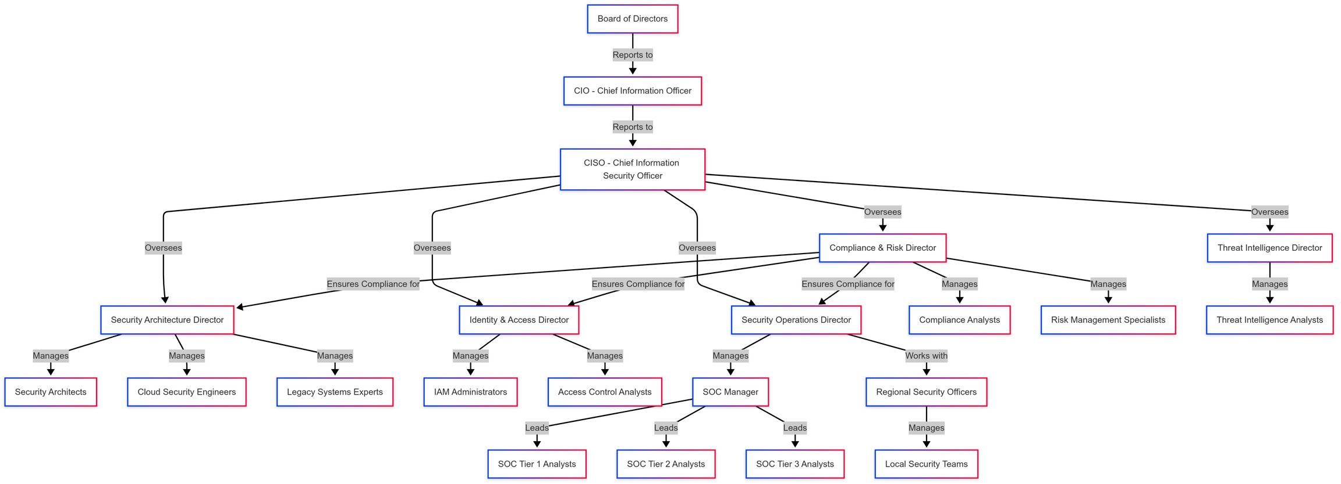

Slide 15
Cybersecurity Performance Metrics
1. CISO-Level Metrics (Strategic Oversight)
Board Engagement: % of meetings where cybersecurity risks are discussed.
Regulatory Compliance Score: % adherence to PCI-DSS, GDPR, SOX, etc.
Security Incident Reduction: % decrease in breaches year-over-year.
2. Security Governance & Compliance
Audit Pass Rate: % of successful audits without findings.
Policy Violation Rate: Number of detected and remediated policy breaches.
Risk Assessment Score: % of high-risk areas mitigated post-assessment.
3. Threat Intelligence & Incident Response
Threat Detection Time (MTTD): Time taken to detect emerging cyber threats.
Threat Mitigation Rate: % of threats neutralized before exploitation.
Incident Containment Time: Time taken to isolate and remediate threats.

Slide 16
SOC & Operational Metrics
1. SOC (Security Operations Center) Metrics
Mean Time to Detect (MTTD): Time taken to identify a security event.
Mean Time to Respond (MTTR): Time to contain and remediate incidents.
False Positive Rate: % of false alerts in SIEM logs.
2. IAM (Identity & Access Management) Metrics
Privileged Access Violations: Number of unauthorized access attempts.
Multi-Factor Authentication (MFA) Adoption Rate: % of employees using MFA.
User Provisioning Time: Time taken to grant or revoke system access.
3. Security Architecture & Engineering
Patch Management Efficiency: % of systems patched within SLA timelines.
Zero Trust Implementation Progress: % of systems enforcing least privilege access.
Legacy System Security Score: Assessment of security posture in legacy environments.

Slide 17
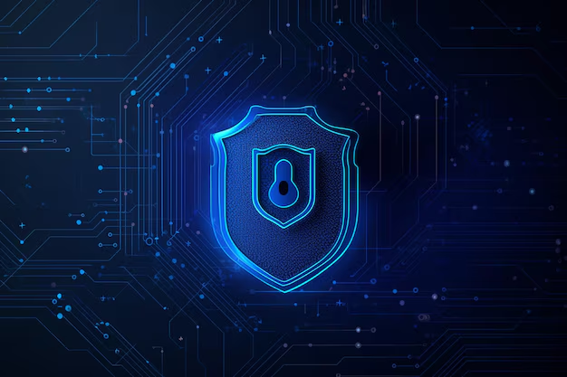
Security Policy and Implementation Strategy

Slide 18
Enterprise Cybersecurity Policy Overview
Policy Title: Enterprise Cybersecurity Policy (SEC-001)
Approval Authority: Chief Information Security Officer (CISO)
Scope:
All employees, contractors, and third-party vendors
IT infrastructure (cloud + legacy mainframes)
Data processing, storage, and transmission
Background & Challenges
Operates in 30+ countries with legacy & modern IT systems
Must comply with PCI-DSS, GDPR, SOX, and local banking laws
Security fragmentation due to multiple acquisitions

Slide 19
Training & Awareness Programs
1. Security Awareness Training
Mandatory for all employees & contractors.
Covers phishing threats, social engineering, & access controls.
Conducted quarterly with assessments.
2. Incident Response Drills
Simulated cyberattacks for response preparedness.
Red team vs. blue team exercises for SOC & IT staff.
3. Compliance Workshops
Regular sessions to align with PCI-DSS, GDPR, SOX, and local laws.
Training for leadership on risk assessment and reporting.

Slide 20
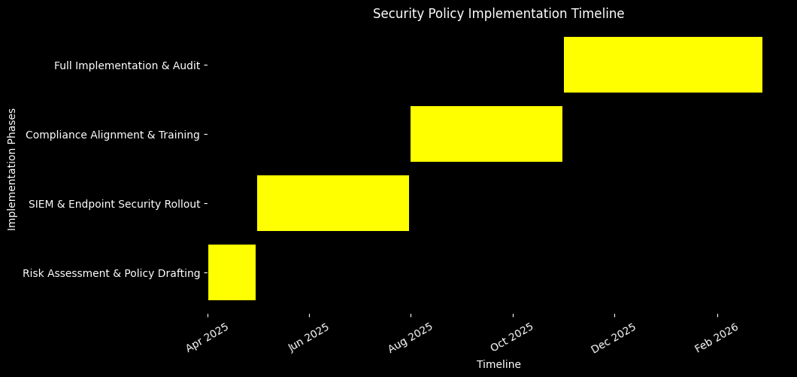
Timeline for Establishing the Security Program
Phase | Action | Timeline
Phase 1 | Risk Assessment & Policy Drafting | 1 Month
Phase 2 | SIEM & Endpoint Security Rollout | 3 Months
Phase 3 | Compliance Alignment & Training | 6 Months
Phase 4 | Full Implementation & Audit | 9-12 Months

Slide 21
Budget Allocation
Category | Estimated Cost (% of Budget)
Personnel (SOC, IT Security, Compliance) | 40%
Tools & Technologies (SIEM, ZTA, DLP) | 35%
Security Training & Awareness | 15%
Compliance & Audits | 10%
🔹 Cost Justification:
Personnel: Continuous threat monitoring & risk mitigation.
Technology: Modernizing fragmented security architecture.
Training: Reducing human error & insider threats.
Compliance: Avoiding regulatory fines & legal issues.

Slide 22

Studio Shodwe
Home
Service
About Us
Contact
THANK YOU

