Slide 1
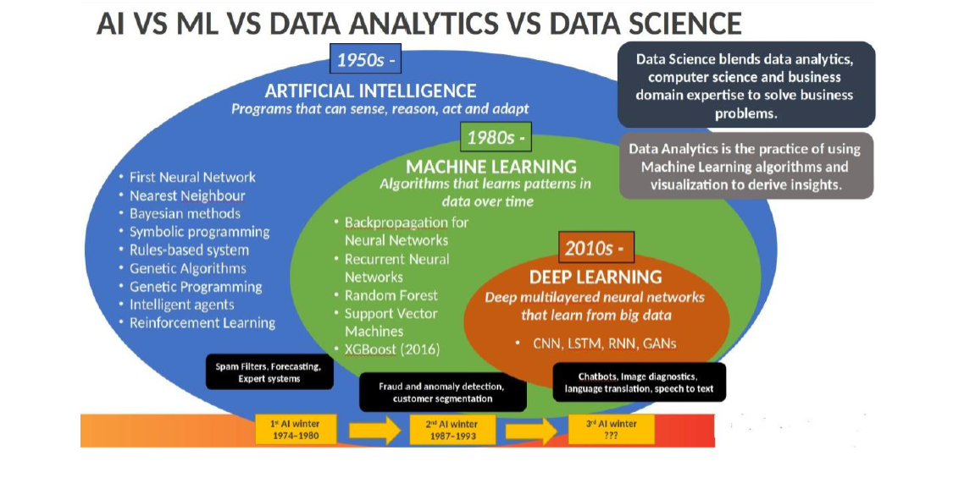
What is the difference between AI, Data Science, ML, and DL?

Slide 2
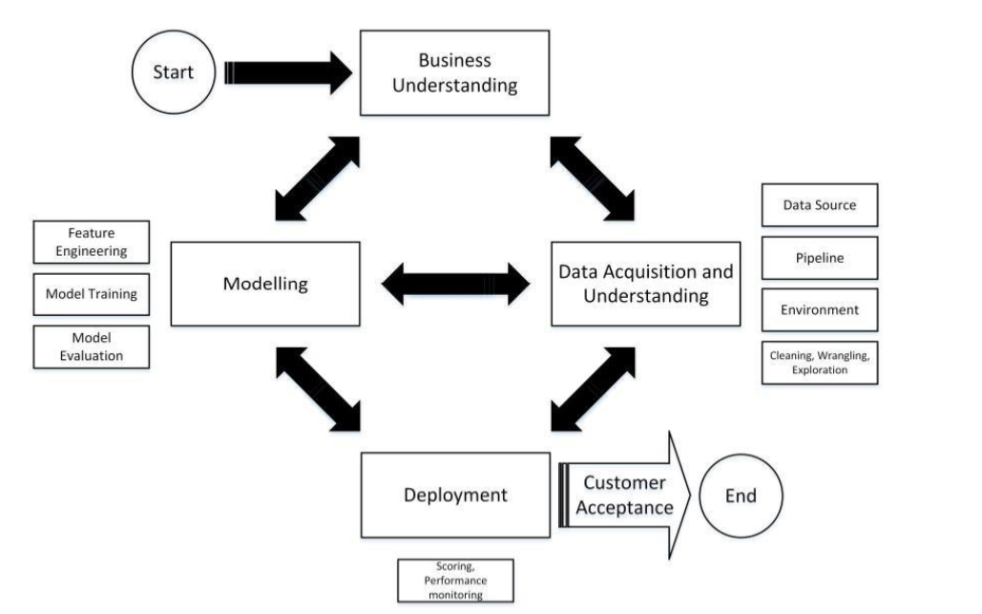
Machine learning

Slide 3
Problem Statement
Predict whether an applicant can repay the
loan to lending company or not?

Slide 4
Problem Description
About Company Dream Housing Finance company deals in all home loans. They have presence across all urban, semi urban and rural areas. Customer first apply for home loan after that company validates the customer eligibility for loan.
Problem Company wants to automate the loan eligibility process (real time) based on customer detail provided while filling online application form. These details are Gender, Marital Status, Education, Number of Dependents, Income, Loan Amount, Credit History and others. To automate this process, they have given a problem to identify the customers segments, those are eligible for loan amount so that they can specifically target these customers.

Slide 5
Why solve this problem?
Minimize financial loss of the company as the banks would give loans to only those customers that are eligible so that they can be assured of getting the money back
Detect the trends that might influence lending
Improvement of the company reputation in the market
Stakeholders - Risk Management, Underwriting and Product development teams.

Slide 6
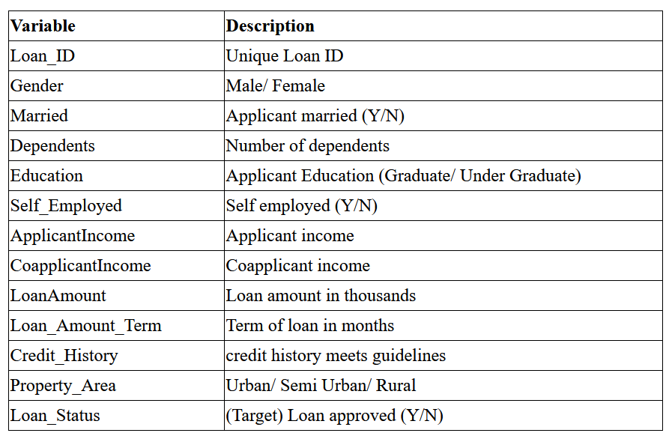
Data
367
Dataset Info:
Train data contains 614 samples and 13 variables.
Test data contains 367 samples and 12 variables.

Slide 7
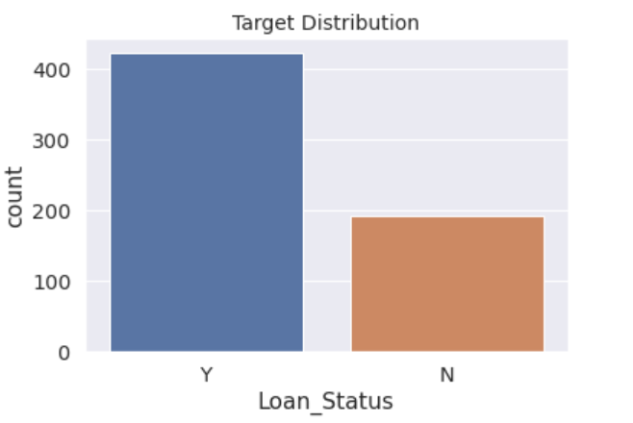
Exploratory Data Analysis
Number of applicants given loan vs not given loan

Slide 8
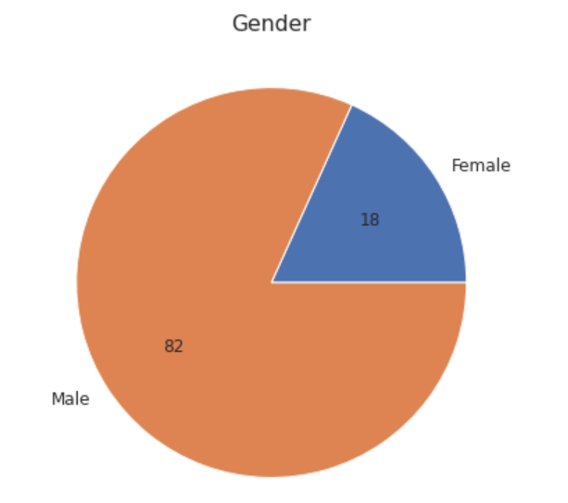
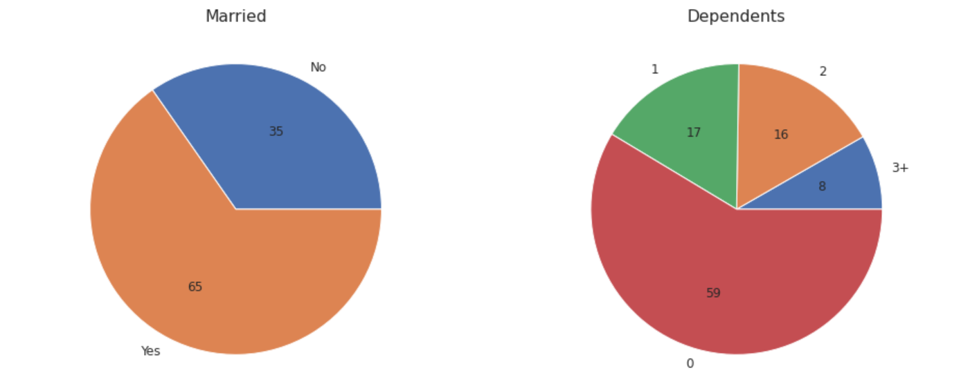
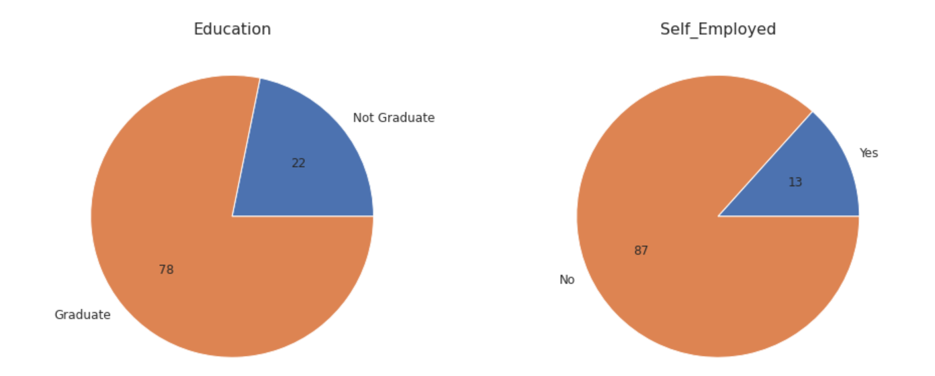
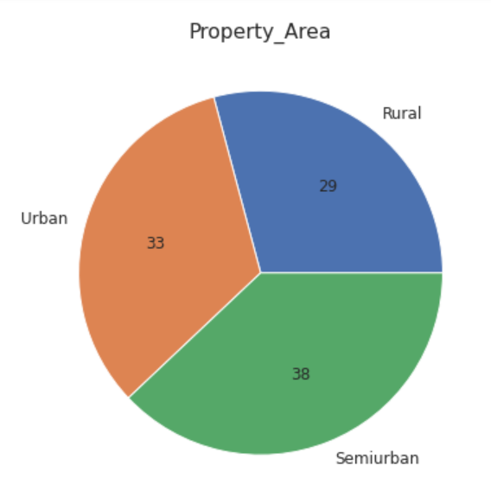
Exploratory Data Analysis:Univariate

Slide 9
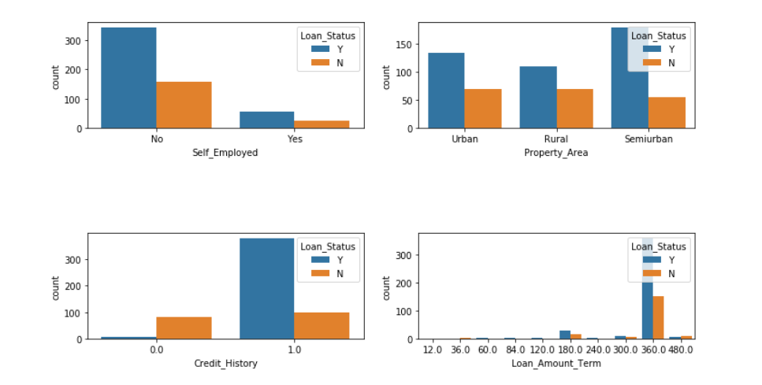
Exploratory Data Analysis:Bivariate

Slide 10
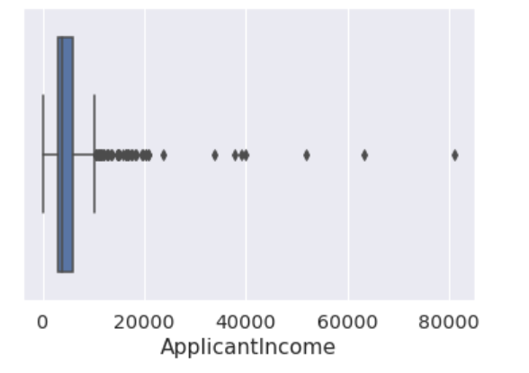
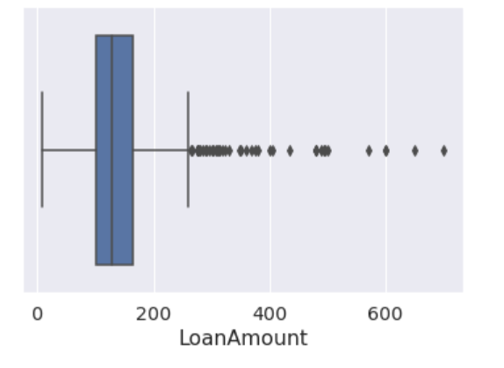
Exploratory Data Analysis
Outliers

Slide 11
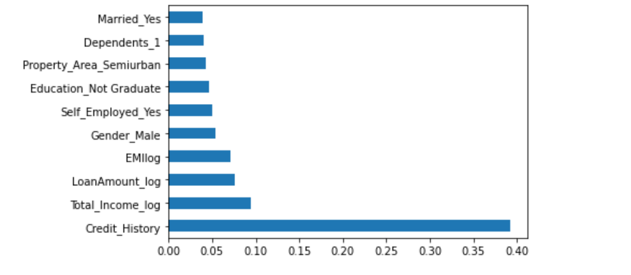
Feature Importance
Top 10 features with the help of ExtraTreesClassifier

Slide 12
Models
Model Name | Accuracy of prediction
Random Forest Classifier | 0.822
Logistic Regression | 0.838
GradientBoostingClassifier | 0.779

Slide 13
Model Tuning
Model Parameters Used for Random Forest Classifier
class_weight={0:2,1:1.6}, criterion='gini', max_depth=120,
min_samples_leaf=6, min_samples_split=5, n_estimators=1400
Accuracy after tuning RFC increased from 0.8 to 0.822

Slide 14

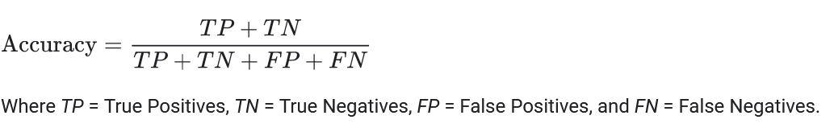
Evaluation & Results
Evaluation matrix used :
Accuracy
How Accuracy is calculated :

Slide 15
Final Results
From the above observations and plotting it can be inferred that the best performing model was Logistic Regression giving accuracy of 0.838
Confusion Matrix :
Classification Report:
 | Predicted Positive | Predicted Negative
Actual Positive | 22 (TP) | 29 (FP)
Actual Negative | 2 (FN) | 132 (TN)
 | precision | recall | f1-score | support
0 | 0.92 | 0.43 | 0.59 | 51
1 | 0.82 | 0.99 | 0.89 | 134
accuracy |  |  | 0.83 | 185
macro avg. | 0.87 | 0.71 | 0.74 | 185
weighted avg. | 0.85 | 0.83 | 0.81 | 185

