Slide 1

Graphical Password Authentication System for Non-Human Intruder Defence
Project Supervisor:
Dr. M. Sunitha
Professor & Coordinator
Dept. of CSE(Cyber Security)
Team Members: (Batch 4)
Basamgari Mokshita 20B81A6223
Bejagam Rohan 20B81A6233
Adulla Shreya Reddy 20B81A6247
Date of Presentation: 04-January-2024

Slide 2
Abstract
Our Project, Graphical Password Authentication System is set to redefine website security. Inspired by recent cyber threats, including the Pegasus attack, the system integrates Segmented Images Authentication, Password Image Authentication, Obscured Images Authentication, and Garbled Images Authentication. These layers collectively provide a robust defense, ensuring heightened security while maintaining a user-friendly authentication experience.

Slide 3
Introduction
The Graphical Password Authentication System offers a dynamic approach to web security, drawing inspiration from real-world cyber challenges.
The system comprises layers involving the organization of segmented images, the selection of dynamic category-based images, decoding obscured speech-to-text, and deciphering intentionally garbled text.
Each layer serves as an engaging puzzle, making security an interactive experience.
Beyond threat defense, this project aims to redefine the rules of web security, welcoming users to an innovative realm where every layer combines innovation with robust protection.

Slide 4
Literature Survey
S.Banne et al [1], proposes a novel method combining CAPTCHA and graphical passwords for enhanced security. The methodology involves user registration, login, file storage, and secure file access through a click-based graphical password.
Ahsan et al [2], presents a novel user authentication method where users upload personal images in sequence, enhancing security and memorability compared to traditional alphanumeric passwords.

Slide 5
Functional Requirements
Segmented Images Authentication: Display four randomly segmented images, capture user selection order, and validate authentication.
Password Image Authentication: Enable category selection during registration, display a randomly chosen image during login, and introduce dynamic variations.
Obscure Image Authentication: Display an obscured image with random words, use Speech Recognition for spoken words, and validate authentication by comparing to the expected output.
Garbled Image Authentication: Display garbled text images, prompt users to input the correct text, and validate authentication based on the accurate input.

Slide 6
Non-Functional Requirements
Performance
Usability
Reliability
Compatibility
Security Compliance

Slide 7

Software Requirements
IDE: Visual Studio Code
Programming Language: Python
Operating System: Windows or MacOS
Image Processing Library: Pillow
User Interface Development: Tkinter
Voice Capturing and Processing Modules:
Pyaudio
SpeechRecognition
Note: Folder Access Required for Image Display

Slide 8

Hardware Requirements
To run the application locally on PC for development purposes, the following hardware requirements are recommended:
Processor: Intel Core i5 or higher
RAM: 8 GB or higher
Storage: 256 GB SSD or higher
Display: 1280 x 720 resolution or higher
Proper Internet Connection
Note: Requires Microphone support

Slide 9
Modular Structure of Project
Segmented_Images: Save images used for segmented images authentication in this folder.
Credential_Images: Store images related to user credentials in this folder.
Obscured_Images: Store images used for the Image-to-Speech-to-Text concept in this folder.
Garbled_Images: Save garbled text images in this folder.
User_Interface: Folder containing code related to any custom buttons used in the UI.
utils.py: File containing utility functions that can be shared across different modules.
main_menu.py: File containing code for the main menu or entry point of the application.
segments.py: File containing code for the segmented images authentication layer.
garbled.py: File containing code for the garbled text authentication layer.
obscure.py: File containing code for the obscure image authentication layer.
password.py: File containing code for the password image authentication layer.

Slide 10
Architectural Diagram
Ordering of segmented Images
Segmented Image Authentication
Traditional Password Authentication System with Image Category selection
Password Image Authentication
Verification
USER
Obscured Image Authentication
Speech Recognition and Processing
Garbled Image Authentication
CAPTCHA Based Authentication

Slide 11
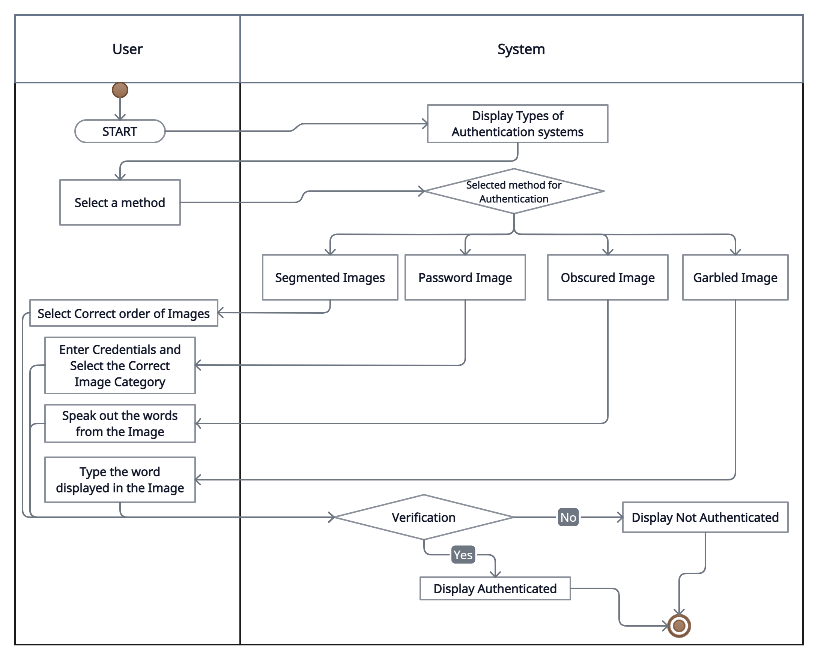
Activity Diagram

Slide 12
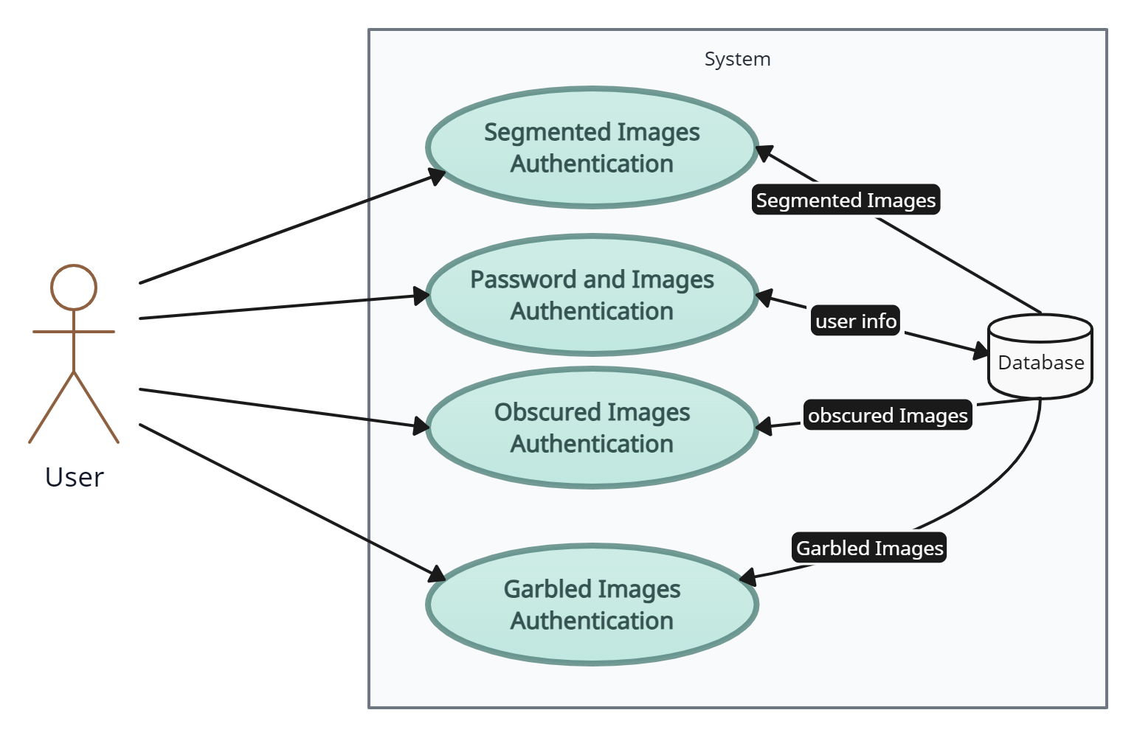
Use Case Diagram

Slide 13
References:
Papers:
[1] https://engg.matoshri.edu.in/assets/pdf/it/achievements/8KNShedge/publications/26-min.pdf
[2] https://www.irjet.net/archives/V4/i11/IRJET-V4I11330.pdf

Slide 14

Thank you

