Slide 1

FULLSTACK PROJECT PRESENTATION EVAL – LET’S LEARN AND ACCESS
Submitted by:
Rohan Bhardwaj (181500589) Sec - D
Shivani Chauhan (181500678) Sec - A
Vanshika Mahle (181500781) Sec - A
Vimal Mishra (181500792) Sec – A
Submitted to:
Mr. Pankaj Kapoor
Notes:
NOTE:
To change the image on this slide, select the picture and delete it. Then click the Pictures icon in the placeholder to insert your own image.

Slide 2
MOTIVATION
Online Learning has become very popular over the last few years. The COVID-19 pandemic has re-shaped education as more students are opting for distant learning. Due to this, many websites and applications are coming up with innovative ideas to teach students in an easy and effective way.
Recent studies have shown that there is a drastic increase in the usage of technology by educational institutions to educate and assess the learnings of the students online.
Recent studies have shown that 65% of the students who are preparing for JEE Main and IIT may adopt complete online learning by 2021. With the help of online learning, education can reach all corners of India as only a smartphone with a stable internet connection is required. We can get instant test results which help us to improve our skills. We can get study materials, videos, and mock test series, all available at a single platform.

Slide 3
OBJECTIVE
The project proposes an idea to develop a platform for IIT JEE aspirants to learn, practice, and evaluate their skills.
The website will contain related study materials, video lectures, and mock test series for practice to improve the students’ performance.

Slide 4
PROBLEM STATEMENT
The demand for online platforms for test preparation is growing over the years. With an online learning platform, one can learn and enhance their skills. Learning online is affordable as compared to traditional learning.
With lakhs of students preparing for IIT JEE and under 1% of students qualifying each year, an online platform will be a major helping hand to those who cannot bear the expenses of renowned coaching institutes. They can learn, practice, and test their learnings to improve their performances.
The website offers study planner, video lectures (physics, chemistry, mathematics), revision notes, test papers, topic-wise analysis, time-saving techniques, mind maps, assistance, performance analysis, etc.

Slide 5
TECHNOLOGY USED
HTML5
CSS3
JavaScript
Bootstrap

Slide 6
WORKING METHODOLOGY
In this project, we will create a website to help the aspiring students of IIT JEE by providing a complete roadmap to prepare for one of toughest entrance examinations in the world.
Along with the study materials, students will have access to the video lectures of the topics to get better understanding of the concepts. The aspirants would be able to test their knowledge and improve their performances to get good scores. An MCQ based quiz assessment will be available with time constraints which would help them to solve the questions within limited time. We will provide better content and materials for preparation which would help the aspirants achieve greater results.
The platform will be of immense help to those seeking an all-in-one platform to get study materials and mock test series in order to prepare for the entrance examination.

Slide 7
LIMITATIONS
Although they’re easy to get started, we can require more time down the road to add features and customizations. We have might find ourselves fighting the base styles with overrides to get the desired results. This could also lead us to write code that doesn’t evolve gracefully as the project needs change.
There is no back-end included in the project for login to use extra features.
Updating may introduce conflicts with your code.
Technical debt – Developers coming onto the project will need to understand the framework in order to contribute.

Slide 8
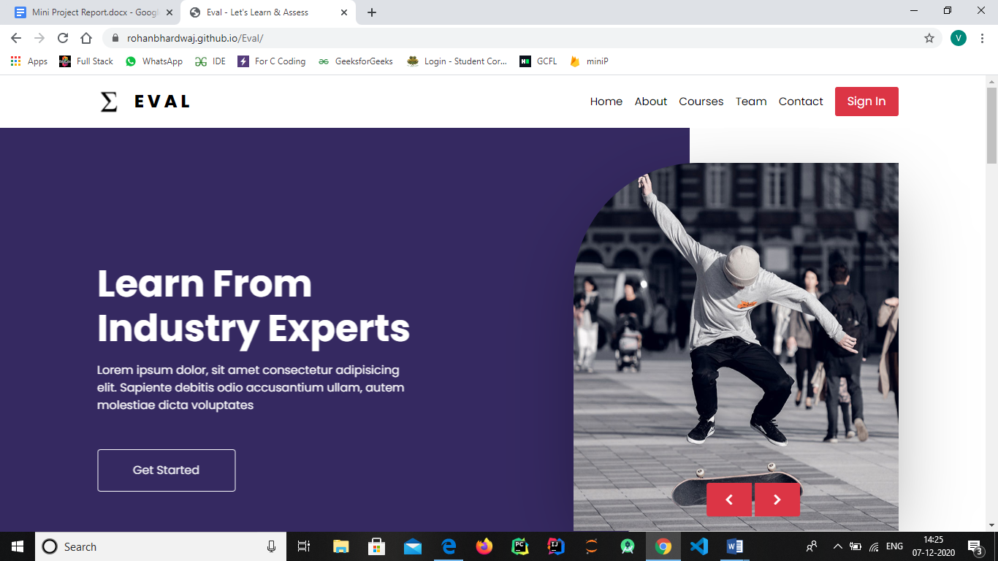
SOME SCREENSHOTS OF LIVE WEBSITE

Slide 9
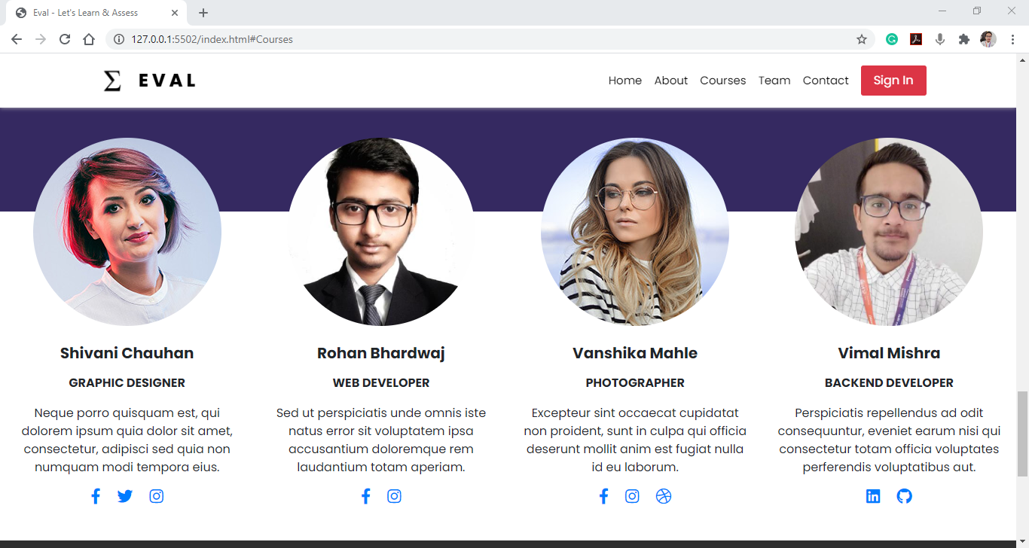

Slide 10
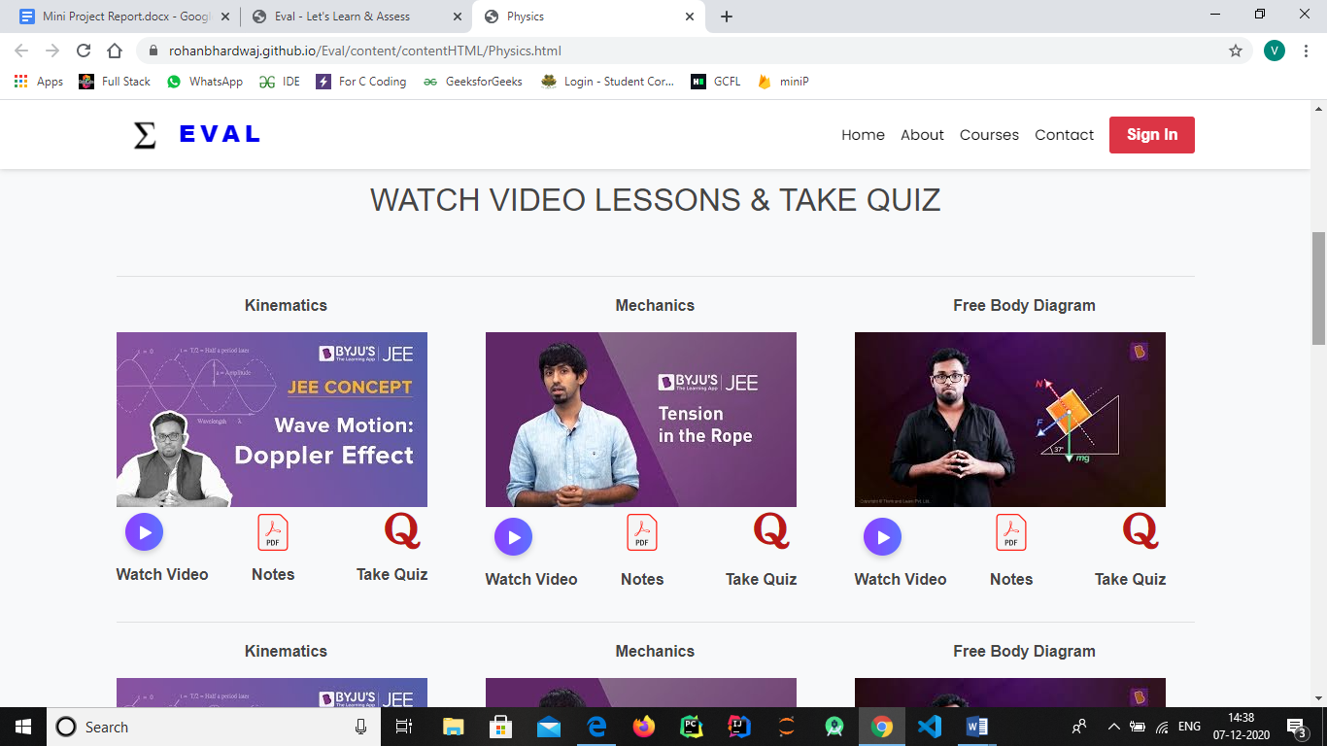

Slide 11
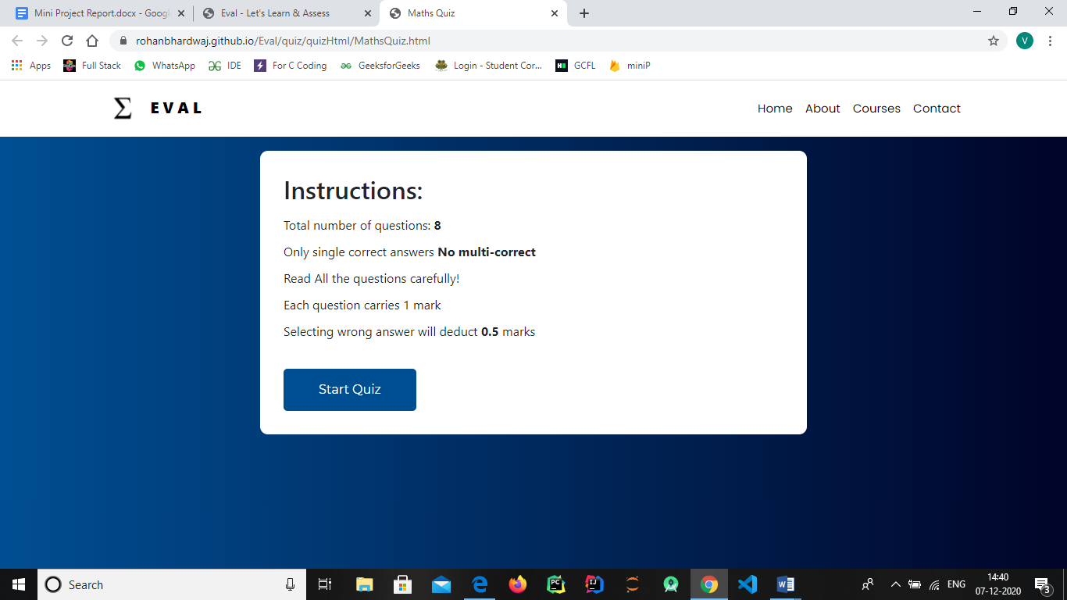

Slide 12
CONCLUSION
IIT JEE is indeed one of the toughest examinations in the world. The coaching for JEE is an industry valued at billions of rupees. In order to help the students who cannot afford to get into coaching institutions due to lack of resources, we will create a website for IIT JEE aspirants, utilizing a variety of mark-up & style sheet languages to write web pages required for the theme, and layout design. The project helps to build all aspects of the user experience and user interface for client-facing landing pages. Also, we will optimize the web pages for maximum speed and scalability using various technologies, ensuring web design is optimized for smartphones too.
Engineering aspirants can thoroughly study any topic of Chemistry, Mathematics and Physics for JEE Main and Advanced through this website. Through this website, the impact of the coaching centre on engineering candidates will definitely be reduced. Also, Economically weaker students who cannot afford expensive coaching classes can study through online lecture videos on their mobile or laptop.

Slide 13
REFERENCES
https://developer.mozilla.org/en-US/
https://www.freecodecamp.org/
https://www.w3schools.com/
https://getbootstrap.com/docs/4.1/getting-started/introduction/
LINK OF LIVE WEBSITE:
https://rohanbhardwaj.github.io/Eval/

