Slide 1


Capstone Project
Final Presentation for Capstone
A.Y. 2026-2027
Project Title: SoloPrac AI
Supersession-aware retrieval and a clinic record system for solo doctors
Presented by :
Ranveer Singh Thakur
SAP ID: 70322100174
Roll No.: C031
Nihal Korgaonkar
SAP ID: 70322100071
Roll No.: C051
Rohan Bhoge
SAP ID: 70322100057
Roll No.: C053
Dev Patel
SAP ID: 70322100150
Roll No.: C054
Under the guidance of : Dr. Dhirendra Mishra
Computer Engineering Department, MPSTME, Mumbai Campus
1
Notes:
Ranveer opens. Good morning. We are presenting SoloPrac, our capstone: a clinic record system for doctors who practise alone, and the research question that came out of building it, which is how a retrieval system should handle clinical records that have been corrected. Four of us will speak for about three to four minutes each.

Slide 2
Agenda and Speakers
15 minutes, four speakers, then questions
1
2
3
4
Ranveer Singh Thakur
Dev Patel
Rohan Bhoge
Nihal Korgaonkar
Introduction, problem statement, literature review, research gap and objectives
System design: architecture, data model, request flow, technology choices
Solution internals: chunking, MedCPT embeddings, other models, retrieval scoring, LLM with de-identification, paper capture
TAP-QA benchmark, results with plots, product walkthrough, impact, limits and conclusion
Slides 3 to 6 · about 3.5 min
Slides 7 to 10 · about 3.5 min
Slides 11 to 16 · about 4 min
Slides 17 to 24 · about 4 min
Flow: Introduction → Problem → Literature → System design → Solution → Results → Conclusion → Q&A
Computer Engineering Department, MPSTME, Mumbai Campus
2
Notes:
Ranveer: This is the plan. I cover the introduction, the problem and the literature. Dev takes the system design. Rohan explains how the solution works inside: chunks, embeddings, retrieval, the LLM and de-identification. Nihal closes with the benchmark, the results and the conclusion.

Slide 3
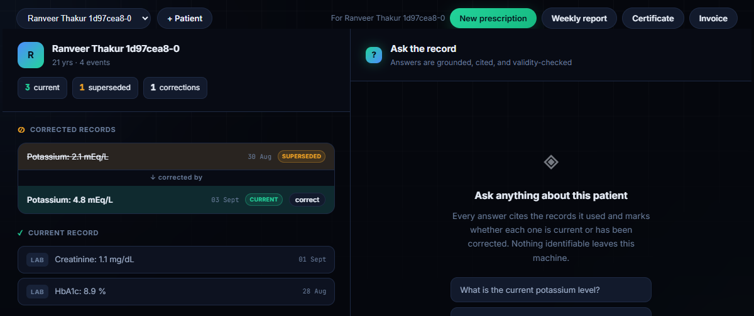
Speaker: Ranveer
Introduction
Who we built SoloPrac for, and what it does
The doctor we designed for
A general practitioner working alone sees around fifteen patients a day. The history sits in paper folders, phone photos of lab reports and the odd software install. There is no IT staff, and between two patients there is perhaps half a minute to look something up.
What SoloPrac gives that doctor
A patient timeline that marks current, corrected and historical values
A chat that answers from the record, with a citation for every claim
History viewed as of any date
Photo capture of printed reports that holds back unreadable scans
Prescriptions, certificates, invoices and weekly reports as PDFs in the patient's inbox
SoloPrac console: a corrected potassium value, marked superseded, with the correction linked below it.
One laptop
i5-12450H, 16 GB RAM, RTX 3050 4 GB
Zero monthly cost
local models, free-tier LLMs
Nothing identifiable leaves
DPDP Act 2023 is the design limit
Computer Engineering Department, MPSTME, Mumbai Campus
3
Notes:
Our user is a general practitioner in India who runs a clinic alone. Around fifteen patients a day, history in paper folders and phone photos, nobody to manage IT. SoloPrac gives that doctor a timeline of each patient that marks what is current and what was corrected, a chat that answers with citations, paper capture that refuses to guess, and the documents they issue every day. Three constraints shaped everything: one laptop, zero monthly cost, and no identifiable patient data leaving the machine.

Slide 4
Speaker: Ranveer
Problem Statement
Corrections are added, never erased, and similarity search cannot tell which value still counts
Given an append-only clinical record in which corrections point at what they replace, return the value that was in force at the time the question asks about: the corrected value for questions about now, and the value on file back then for questions about the past.
v1 creatinine 1.1
superseded from 6 Mar
v2 creatinine 1.4
supersedes v1
Why a standard RAG pipeline gets this wrong
Both entries share the test name and differ only in a number, so their embeddings are nearly identical
Neither text says it was withdrawn; only the pointer inside v2 does
The withdrawn value comes back with a real citation, which makes it look trustworthy
Plain dense retrieval led with the withdrawn value on 49.5% of corrected questions in our benchmark
3 Mar
6 Mar
today
Asked about 4 Mar → 1.1 was the value on file
Asked about today → 1.4 is the value in force
Two requirements that pull against each other
No stale answers
never lead with a withdrawn value when the question is about now
History stays answerable
a question about March still gets the March value
"Prefer the newest record" solves the first and breaks the second, so recency alone cannot be the fix.
Computer Engineering Department, MPSTME, Mumbai Campus
4
Notes:
Here is the problem in one example. A creatinine of 1.1 is reported on the third. On the sixth the lab re-runs the sample and sends 1.4. Both stay in the chart, because someone may have acted on the first. A normal RAG pipeline embeds both, and they look almost identical, so it can return 1.1 with a perfectly valid citation. On our benchmark plain dense retrieval led with the withdrawn value about half the time. The hard part is that we cannot just prefer the newest record, because a question about the past needs the old value.

Slide 5
Speaker: Ranveer
Literature Review
What earlier work gives us, and what it leaves open
Area | Key work | What it gives us | What is still missing
Temporal databases | Snodgrass & Ahn 1986; Jensen et al. 1998 | Valid time vs transaction time | No field that says one row cancels another
Clinical standards | HL7 FHIR R4 status, openEHR versioning, W3C PROV-DM 2013 | Store the correction link at the source | RAG pipelines drop it during chunking and embedding
Agent memory, versioned RAG | Zep 2025; MemStrata, Engram, SodaMem 2026; VersionRAG 2025 | Supersession pointers, as-of filters | Never tested on clinical records; no historical-accuracy metric
Time-aware ranking | Campos et al. 2014; TempRALM 2024; Chronofy 2026 | Recency and decay priors | We show decay cannot reach the useful region (slide 20)
Stale evidence in RAG | HoH, ACL 2025; Stale-document poisoning 2026 | Outdated text harms answers more than irrelevant text | No clinical correction setting
Medical retrieval, benchmarks | MedCPT 2023; MIRAGE 2024; RGB 2024; MEDEC 2025 | Biomedical encoder; RAG benchmarks for medicine | Every document in them is assumed to be correct
De-identification | Kovačević et al., AI in Medicine 2024 | Surrogate substitution is the dominant method | We apply it at the outbound boundary only
Computer Engineering Department, MPSTME, Mumbai Campus
5
Notes:
Temporal databases gave us the two clocks, valid time and transaction time, but no way to say one row cancels another. Clinical standards like FHIR and openEHR do store that link, and RAG pipelines lose it when they chunk text. Recent memory systems for LLM agents reached a similar design to ours, which is reassuring, but none was tested on clinical records. Work on stale evidence shows outdated passages hurt answers badly. And medical RAG benchmarks assume every document is correct.

Slide 6
Speaker: Ranveer
Research Gap and Objectives
The question we set out to answer, and the four objectives
Gap: no one had measured how much a clinical retrieval pipeline loses by discarding the correction pointer, while it must also keep questions about the past answerable.
1
Never put a withdrawn value first for a question about the present (stale answer rate of zero).
Research questions
RQ1
Does reading validity from the supersession graph remove stale answers without losing history?
2
Answer as-of questions with the value that was on file at the asked date (high historical accuracy).
RQ2
Can a tuned recency-decay prior reach the same place without the graph?
3
Build TAP-QA, a benchmark that scores both goals at once, and test whether tuned recency could do the same.
RQ3
Does the record ranked first actually change what the LLM says?
4
Ship a working clinic system on one laptop with no patient identifiers leaving the machine.
Computer Engineering Department, MPSTME, Mumbai Campus
6
Notes:
So the gap: nobody had measured what clinical retrieval loses when it throws the correction link away, while it still has to answer questions about the past. Our four objectives follow from that, and the three research questions are what Nihal answers with numbers at the end.

Slide 7
Speaker: Dev
System Architecture
Seven Docker services on one laptop; only de-identified text goes out
SoloPrac PWA
React 18 + TypeScript
doctor and patient portals
nginx :8080
serves app,
proxies /api
FastAPI :8000
auth · chat · capture · documents
retrieval + validity core
Worker
OCR, deep reads,
weekly reports
Local models
MedCPT query + article encoders
BiomedCLIP
RapidOCR (PP-OCRv4)
MedGemma 4B (opt-in)
BGE-M3 (configured)
PostgreSQL 16
append-only events
(source of truth)
Qdrant 1.12
MedCPT 768-d text
BiomedCLIP 512-d image
Redis 7
job and notification
streams
SeaweedFS
S3 storage for
PDFs and scans
no identifiable data crosses this line
De-identification gate
placeholders + regex hard block
Free-tier LLM chain
Groq → OpenCode Zen → OpenRouter
Run: docker compose up -d starts all seven containers; readiness shows at /health. Index is a cache: POST /semantic/reindex rebuilds Qdrant from the event log, so losing it costs quality, never data.
Computer Engineering Department, MPSTME, Mumbai Campus
7
Notes:
Dev: This is the whole system. The doctor and the patient use a progressive web app. nginx serves it and proxies the API. FastAPI handles auth, chat, capture and documents, and a worker takes slow jobs like OCR and weekly reports through Redis streams. PostgreSQL holds the append-only event log, which is the source of truth. Qdrant holds the vectors and is only a cache: if it is lost, one call rebuilds it from the log. SeaweedFS stores the PDFs and scans. All models run locally. The only thing that leaves the machine is a de-identified prompt to the free LLM chain.

Slide 8
Speaker: Dev
Data Model and Supersession Graph
Validity is derived from pointers, never stored as a status column
events (append-only)
patients
doctor_id, user_id, name,
age, phone, email
How a correction is written and read
write: INSERT v2 with v2.supersedes_id = v1.id
read: v1 is superseded at t ⇔ ∃ c: c.supersedes_id = v1.id and c.valid_time ≤ t
id UUID
patient_id → patients
event_type lab | medication | diagnosis |
vital | note | imaging
source_type manual | ocr | ai
valid_time when it was true
recorded_at when it was written
payload JSONB (test, value, unit …)
confidence OCR / AI score
supersedes_id → events.id
document_id → documents
content_hash SHA-256
accounts / doctors
PBKDF2 passwords,
HMAC session tokens
Database check constraints
a correction must point at an event of the same patient
its valid time may not be earlier than its predecessor's
recorded_at may not be earlier than valid_time
no cycles in the correction graph
documents
prescriptions, certificates,
invoices, weekly reports
notifications
Redis-backed inbox
Three-valued validity, per query instant
CURRENT
in force now
SUPERSEDED
a correction points at it
HISTORICAL
was current at the asked date
event_validity
a view, not a table
Computer Engineering Department, MPSTME, Mumbai Campus
8
Notes:
The key design decision. There is no status column on an event. A correction is an insert whose supersedes_id names the record it replaces. A record is superseded exactly when some other record points at it. Four rules are enforced by the database itself. Validity has three values, because a record corrected in March was correctly current in February.

Slide 9
Speaker: Dev
Request Flow: Question to Answer
Seven steps in a fixed order; the model proposes, our code decides
1 Temporal intent
now, as of a date, or history?
"as of 60 days ago" → instant t
2 Validity-aware retrieval
MedCPT + Qdrant, k = 8
(k = 30 for summaries), α = 0.70
3 As-of resolution
veto records dated after t;
tiebreak by |v(e) − t|
4 De-identify
names, dates, IDs → placeholders;
hard gate on the outgoing string
Grounded answer
or an abstention with no citations
7 Assemble
collapse duplicates; citations carry
their own validity state
6 Provenance lock
each claim must match its cited
record and the record's validity
5 Generate
LLM chain, temperature 0;
records shown as R1, R2 …
Fast path
a question about one record is answered in about 6 ms without calling the model
Graceful fallback
if every generated claim fails the check, the doctor gets a cited extract of the records
Circuit breaker
an exhausted provider is skipped for 15 minutes; a stalled one is hedged after 12 s
Computer Engineering Department, MPSTME, Mumbai Campus
9
Notes:
When the doctor asks a question, the order of these steps matters. First we work out what time the question is about. Then validity-aware retrieval ranks the records, de-identification happens once before anything leaves, the LLM writes a draft, and the provenance check decides which claims survive. Single-record questions skip the model entirely and come back in milliseconds.

Slide 10
Speaker: Dev
Technology Choices and Why
Each component had a simpler alternative that we rejected for a stated reason
Layer | Choice | Why we picked it
Frontend | React 18, TypeScript, Vite, installable PWA | One codebase for the doctor's phone and desktop; 25.6 kB gzipped main bundle
Backend | FastAPI (Python 3.12), async SQLAlchemy | Async I/O while waiting on a remote model; typed schemas on every route
Primary store | PostgreSQL 16 with JSONB payloads | Relational integrity for the supersession pointer; check constraints enforce the rules
Vector index | Qdrant 1.12, named vectors (768-d text, 512-d image) | Patient filter is part of the query itself; the index can be rebuilt from the log
Object storage | SeaweedFS (S3-compatible) | MinIO Community Edition was archived in April 2026; same S3 API
Text encoder | MedCPT query + article towers | Biomedical paraphrase ("blood sugar" finds "Fasting Glucose"); runs locally
Image encoder | BiomedCLIP (PubMedBERT + ViT-B/16) | Scans and text share one space, so a study can be found by describing it
OCR | RapidOCR, PP-OCRv4 in ONNX | About 31 ms a page on CPU; holds back reads below 0.75 confidence
PDF engine | WeasyPrint (HTML + CSS to PDF) | Paged CSS repeats the watermark on every page; no headless browser needed
Generation | Free-tier LLM chain behind a de-identification gate | Zero cost; the gate blocks any prompt that still holds an identifier
Orchestration | Docker Compose, 7 services | One command starts everything; health is reported at /health
Computer Engineering Department, MPSTME, Mumbai Campus
10
Notes:
A quick tour of the stack and the reason behind each choice. Two worth pointing out: SeaweedFS, because MinIO's community edition was archived in April 2026, and WeasyPrint, which renders paged CSS so the watermark repeats on every page.

Slide 11
Speaker: Rohan
Chunking: What a Chunk Holds
One clinical event is one chunk; measured with MedCPT's own tokenizer
From stored event to model input
How much a chunk holds (TAP-QA seed 1)
{ event_type: "lab", valid_time: 2026-03-06,
payload: { test: "TSH", value: 5.31, unit: "mIU/L",
reference_low: 0.4, reference_high: 4.0 } }
Record type | Count | Mean tokens | Max | Share of 512
Lab result | 3,251 | 27.9 | 30 | ≈ 5.5 %
Medication | 446 | 18.4 | 21 | ≈ 3.6 %
Clinical note | 314 | 15.8 | 19 | ≈ 3.1 %
Diagnosis | 489 | 7.9 | 10 | ≈ 1.5 %
All 4,500 records | 4,500 | 24.0 | 30 | ≈ 4.7 %
"Laboratory result test: TSH value: 5.31 unit: mIU/L reference low: 0.4 reference high: 4.0"
How the size was decided
30 WordPiece tokens:
[CLS] laboratory result test : tsh value : 5 . 31 unit : mi ##u / l reference low : 0 . 4 reference high : 4 . 0 [SEP]
Validity belongs to an event, so the chunk boundary is the event boundary
Splitting would cut a value off from its test name or unit
Merging two events would give one vector to a value and its correction
Cap of 1,800 characters: a full 1,800-character note is about 284 tokens, well under MedCPT's 512 limit, so nothing is silently truncated
No overlap between chunks is needed, since events do not run into each other
Nested fields (lists, objects) are skipped; dates are not in the text, because time is handled by the validity layer, not by similarity.
Computer Engineering Department, MPSTME, Mumbai Campus
11
Notes:
Rohan: The mentor asked how big a chunk is and how we decided. A chunk is one clinical event. We write the record type, then each field as key colon value, and cap it at 1,800 characters. Measured with MedCPT's tokenizer on all 4,500 TAP-QA records, a lab result is about 28 tokens, so a chunk uses around six percent of the 512-token window. We did not use fixed windows, because validity is decided per event: a chunk holding both 1.1 and 1.4 would get one vector for two values with different validity.

Slide 12
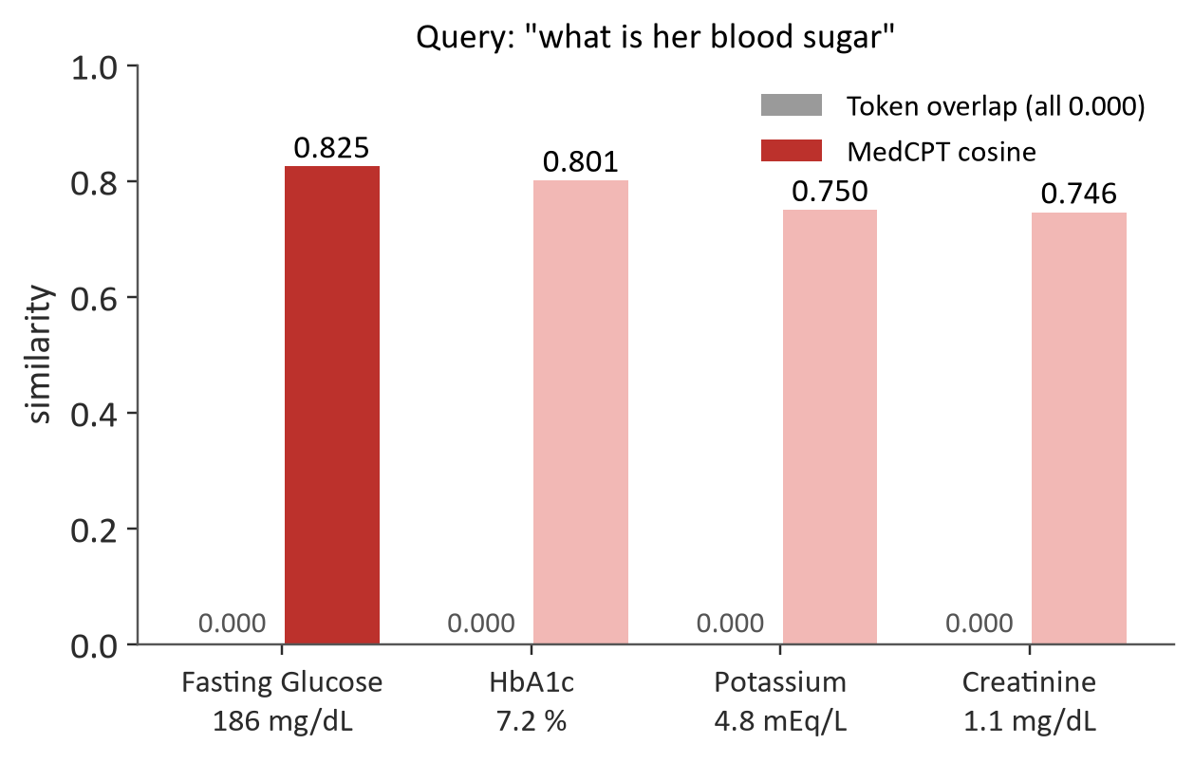
Speaker: Rohan
Embeddings: How MedCPT Extracts Features
The pretrained text encoder: what it was trained on, its size, and what it does to a sentence
MedCPT (NCBI, Jin et al., Bioinformatics 2023)
Training data | 255 M query-article pairs from PubMed search logs (contrastive learning)
Initialised from | PubMedBERT (biomedical vocabulary)
Architecture | BERT-base: 12 layers, 12 heads, hidden 768, FFN 3,072
Vocabulary / max length | 30,522 WordPiece tokens / 512 positions
Parameters | ≈ 109.5 M per tower (438 MB fp32 each)
Two towers | query encoder for questions; article encoder for records
Output | 768-d vector, mean-pooled, L2-normalised
Feature extraction, step by step
Text
flattened chunk
or question
Tokenize
WordPiece,
≤ 512 tokens
12 layers
self-attention adds
context to each token
Mean pool
average over
attention mask
L2 norm
unit length,
768 numbers
Cosine similarity between two unit vectors is their dot product; Qdrant returns the top 50 records of that patient by cosine.
Why not one tower for both? MedCPT was trained with separate towers; using the article tower for questions measurably hurts retrieval. Only the query tower is preloaded; the article tower loads for indexing, saving about 430 MB of RAM.
Computer Engineering Department, MPSTME, Mumbai Campus
12
Notes:
MedCPT comes from NCBI. It was trained contrastively on 255 million query and article pairs from real PubMed search logs, so it learned that the words people type and the words articles use mean the same thing. It has two BERT-base towers of about 110 million parameters each: one for questions, one for documents. Text is split into WordPiece tokens, passed through 12 transformer layers where self-attention mixes context into every token, then we average the token vectors over the attention mask and normalise to unit length. The result is 768 numbers. The chart shows why we needed it: word overlap scores zero for 'blood sugar' against a glucose record, MedCPT scores 0.825 and ranks it first.

Slide 13
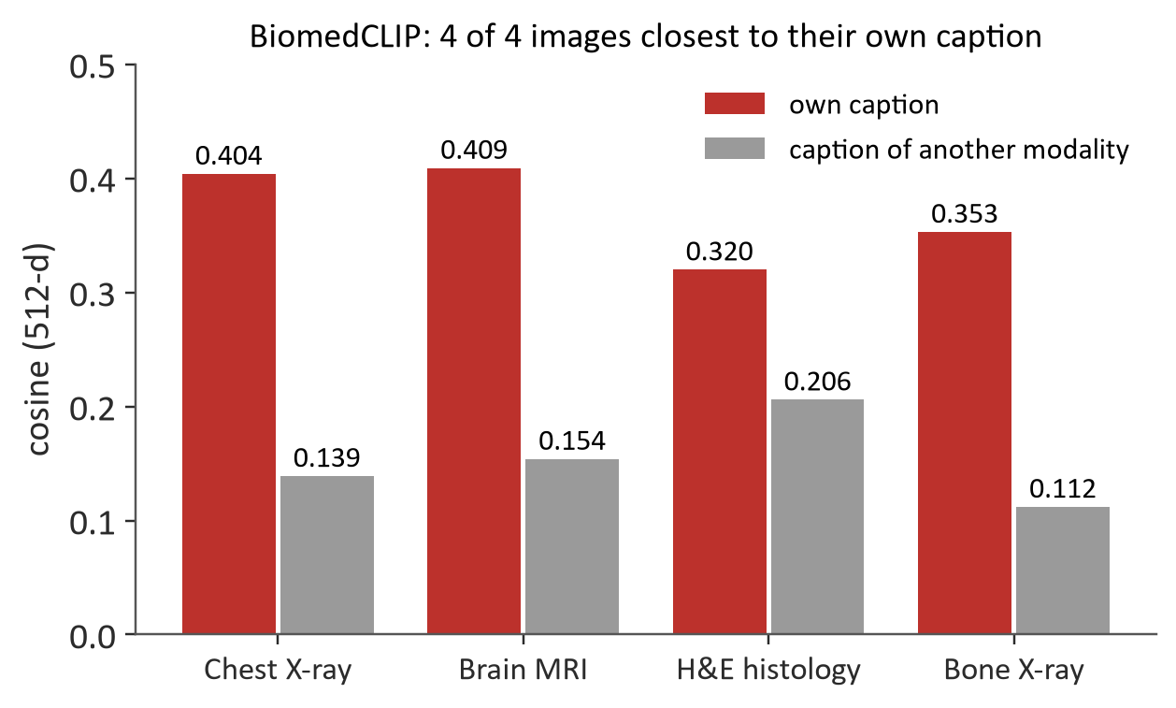
Speaker: Rohan
Other Pretrained Models We Use
What each is specialised in, what it was trained on, its size, and why it is there
Model | Specialised in | Trained on | Size / params | How we use it
BiomedCLIP (Microsoft, NEJM AI 2025) | Matching medical images with text | PMC-15M: 15 M figure-caption pairs from PubMed Central | ViT-B/16 + PubMedBERT, 512-d; 784 MB (≈ 196 M) | Embeds scans; prompt "this is a medical image of"; loads offline in 8.4 s
MedGemma 4B (Google, 2025) | Reading medical images and documents | Gemma 3 base; vision encoder tuned on de-identified medical images | 4 B; Q4_K_M GGUF 2.49 GB + 851 MB projector | Opt-in deep read of unreadable scans; 54.6 s per image on CPU; result needs doctor approval
RapidOCR (PP-OCRv4, ONNX) | Printed text detection + recognition | PaddleOCR training sets | 4.7 MB detector, 10.9 MB recogniser | Reads lab printouts in ~31 ms; below 0.75 confidence the document is held back
BGE-M3 (BAAI, 2024) | Multilingual retrieval incl. Hindi | Large multilingual corpora, 100+ languages | XLM-R large, ≈ 568 M, 1024-d | Configured for code-switched notes; not yet measured (about 2 GB RAM)
LLM chain | Writing the answer sentence | General web text (hosted models) | Qwen3.8 27B (Groq), LFM-2.5 2.6B (OpenRouter), OpenCode Zen | Temperature 0; sees only de-identified extracts; facts come from records
BiomedCLIP check: 4 of 4 images closest to their own caption, median margin +0.255.
Designed degradation
no torch or encoder → word-overlap fallback, reported in /semantic/status
Qdrant down → same fallback, response marked degraded
BiomedCLIP missing → image routes return 503 with a reason
Computer Engineering Department, MPSTME, Mumbai Campus
13
Notes:
BiomedCLIP handles images. It was trained by Microsoft on 15 million figure and caption pairs from PubMed Central, so a radiograph and its description land close together. In our test each of four images was closest to its own caption. MedGemma reads handwriting but is slow on our CPU, so it is opt-in and its output always waits for the doctor. RapidOCR reads printed reports in about 31 milliseconds. BGE-M3 is wired in for Hindi but we have not measured it, and we say so.

Slide 14
Speaker: Rohan
Retrieval: How a Query Gets Its Answer
Similarity finds the right test; the validity weight decides which version comes first
score(q, e) = 0.70 · cos(q, e) + 0.30 · w(e, intent)
Situation of record e | w
in force at the date the question names | 1.00
current, and the question has no date | 0.85
superseded (pushed down, kept visible) | 0.15
dated after the asked date | vetoed
Worked example (illustrative cosine values)
Question | Record | cos | w | score | Rank
"What is the creatinine?" | v1 1.1 (superseded) | 0.80 | 0.15 | 0.605 | 2
 | v2 1.4 (current) | 0.80 | 0.85 | 0.815 | 1 ✔
"Creatinine as of 4 Mar?" | v1 1.1 (in force on 4 Mar) | 0.80 | 1.00 | 0.860 | 1 ✔
 | v2 1.4 (dated 6 Mar) | 0.80 | veto | removed | –
Qdrant search is filtered by patient_id inside the query, top 50 by cosine
Ties among admissible records: closest valid time to t, not newest
Top k = 8 go to the LLM (k = 30 for summaries)
Weights are categorical, so a 2-hour-old and a 2-year-old correction count the same
Why the similarity term cannot do this alone: a test and its correction share the name and almost the whole payload, and on all 600 corrected and historical queries of each seed their similarity scores were exactly equal. Only the validity weight separates them. Sensitivity: α from 0.40 to 0.95 left every headline number unchanged.
Computer Engineering Department, MPSTME, Mumbai Campus
14
Notes:
This is the core of our method. The question is encoded with the query tower and Qdrant returns that patient's 50 nearest records. Each candidate gets 0.70 times its cosine plus 0.30 times a validity weight. The worked example shows why it works: the original and the correction have the same cosine, so similarity alone is a coin toss. The weight breaks the tie the right way for 'now', and for an as-of question the correction is vetoed because it is dated after the asked instant, so the old value wins. Changing alpha from 0.40 to 0.95 changed nothing in the results.

Slide 15
Speaker: Rohan
LLM, De-identification and Provenance
What the model sees, why it is safe to send, and how its answer is checked
De-identification on the way out
Provenance check on the way back
Before: Sunita Devi, 47-year-old, phone 9876543210, potassium 4.8 mEq/L on 2026-09-03
Axis A: faithfulness
the numbers and units in a claim must appear in the record it cites
Sent: [PT_01], [AGE_47] years old, phone [PH_01], potassium 4.8 mEq/L on [T_MINUS_14D]
Axis B: temporal validity
a present-tense claim ("is", "currently") may not cite a superseded record
Removed: names, Indian mobile numbers, emails, Aadhaar-shaped numbers, MRN / UHID, digit runs of 6+, calendar dates
Kept: clinical values and units, which the model needs and which identify nobody
Dates become offsets from today, so order and recency survive
Record IDs become R1, R2 … and are mapped back locally
assert_safe() runs on the exact outgoing string; one leak and the request is never sent
Outcome
failing claims are dropped; if all fail, the doctor sees a cited extract; an "I don't know" carries no citations
Why use an LLM at all?
It turns several records into one readable sentence and drafts weekly summaries. The facts come from the records we retrieved, and the check above decides what survives. Questions about one record skip the model.
Computer Engineering Department, MPSTME, Mumbai Campus
15
Notes:
The LLM is used only to write a readable sentence from records we already picked. Before anything goes out, names become PT_01, dates become offsets like T_MINUS_14D, and phone numbers and IDs are replaced. A final regex check runs on the exact outgoing string and blocks the request if anything is left. When the answer comes back, every claim has to match the record it cites, and a present-tense claim cannot cite a superseded record. Claims that fail are dropped.

Slide 16
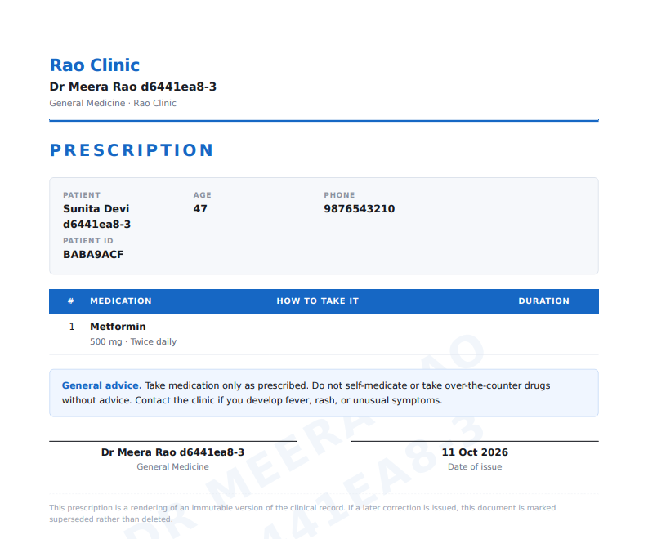
Speaker: Rohan
Paper Capture and Issued Documents
OCR that refuses to guess, and four document types delivered to the patient
Photo upload
JPEG / PNG / WebP / TIFF
up to 12 MB
MedGemma is built, measured and kept off by default. Model load 6.3 s, image encode 54.6 s, 5.4 GB resident on this CPU. It runs only when asked (deep_read=true), through the worker, and its reading is stored as committed=false until a doctor confirms it.
Four documents, one stylesheet. Prescription, medical certificate, invoice and weekly report, rendered by WeasyPrint with a diagonal watermark, the doctor's registration and a provenance footer. Downloads use presigned URLs that expire in 15 minutes.
Identity linking. A walk-in patient created with an email is linked automatically when they register with the same email; every link is audited.
Quality gate
blur, contrast,
min 400 × 400 px
RapidOCR
text + confidence
per line, ~31 ms
Field extraction
known tests, explicit unit
map; unknown units left blank
confidence ≥ 0.75 ?
yes → dated event · no → held for review
Issued prescription PDF (16,980 bytes, verified as %PDF in the end-to-end test)
Computer Engineering Department, MPSTME, Mumbai Campus
16
Notes:
Paper capture: the photo goes through a quality gate, then RapidOCR, then field extraction with a known list of tests and units. If confidence is below 0.75 nothing is written to the record; it waits for the doctor. A wrong number committed silently is the worst failure we can think of, because it becomes a fact that future answers cite. On the right is a prescription as issued: a watermarked PDF that lands in the patient's inbox.

Slide 17
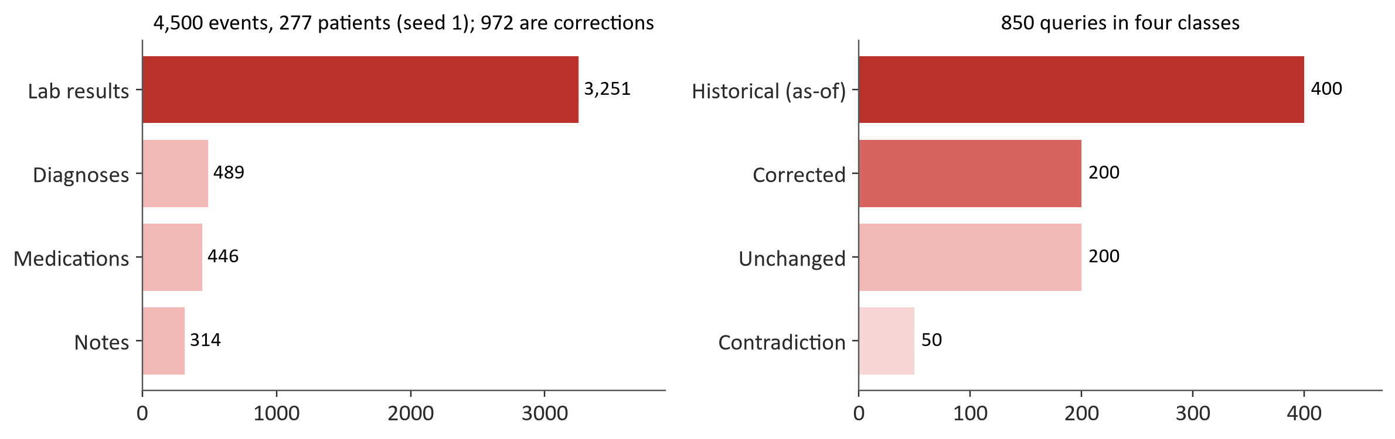
Speaker: Nihal
TAP-QA: The Benchmark We Built
Synthetic patients with planted corrections, so the right answer is known by construction
How we score
Metric | Meaning
Stale answer rate (SAR) | corrected queries whose top record is superseded at t
Historical accuracy | as-of queries whose top record was in force at t
Safe answer | top record is gold and not superseded
Harness calls the shipping ValidityAwareRetriever through a thin adapter
Tie-aware ranks: two records tied at the top each get rank 1.5
45 configurations per seed: 10 methods + 35 decay settings
10,000 bootstrap resamples clustered by patient; McNemar's exact test on paired outcomes
One command per seed, byte-identical reruns, 57 s per full run
Design decisions
Correction shifts the value by 12–55 % of the reference range; filed 1, 3 or 14 days later (skewed), so size and age give nothing away
Distractor corrections on tests no query asks about penalise blanket demotion of corrections
Why synthetic: in real charts the correction is almost always the newest entry, which makes recency look like a fix
Seed 20260714 repeats everything: 274 patients, 1,001 corrections, 852 queries
Computer Engineering Department, MPSTME, Mumbai Campus
17
Notes:
Nihal: No existing medical benchmark has corrected records, so we built TAP-QA. Each seed generates about 275 patients and 4,500 events, about a thousand of them corrections, and 850 questions in four classes. Corrections shift a value by 12 to 55 percent of the reference range and arrive 1, 3 or 14 days later, so you cannot spot them by size or age. Distractor corrections punish any method that simply demotes all corrections. The harness calls the same retriever the app ships. Scoring is tie-aware: if two records tie, neither gets full credit.

Slide 18
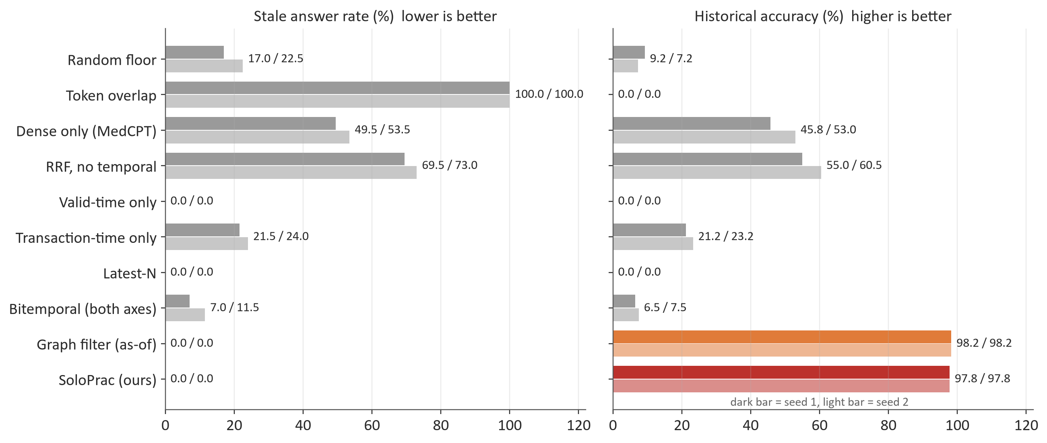
Speaker: Nihal
Results: Ten Methods, Two Seeds
Only the graph-based rankers get both goals right
0.0 %
stale answers, both seeds
(0 of 200 each; 95 % upper bound ≈ 1.9 %)
97.8 %
historical accuracy
(391 of 400 on each seed)
p = 2.7×10⁻⁵
McNemar vs bitemporal,
safe-answer outcome, seed 1
p = 8.0×10⁻²⁷
McNemar vs dense-only,
safe-answer outcome, seed 1
Reading it: Valid-time only and Latest-N reach 0 % SAR only by never answering the past (0 % historical). The patient-clustered 95 % interval on our historical gain over bitemporal is [+0.875, +0.948].
Computer Engineering Department, MPSTME, Mumbai Campus
18
Notes:
These are the main results on both seeds. Our ranker has zero stale answers and 97.8 percent historical accuracy on both. Dense retrieval alone is stale about half the time. The bitemporal ranker, which knows both timestamps but not the pointer, still gives 7 and 11.5 percent stale answers and almost no historical accuracy. Valid-time only and Latest-N look safe on staleness but they answer zero historical questions.

Slide 19
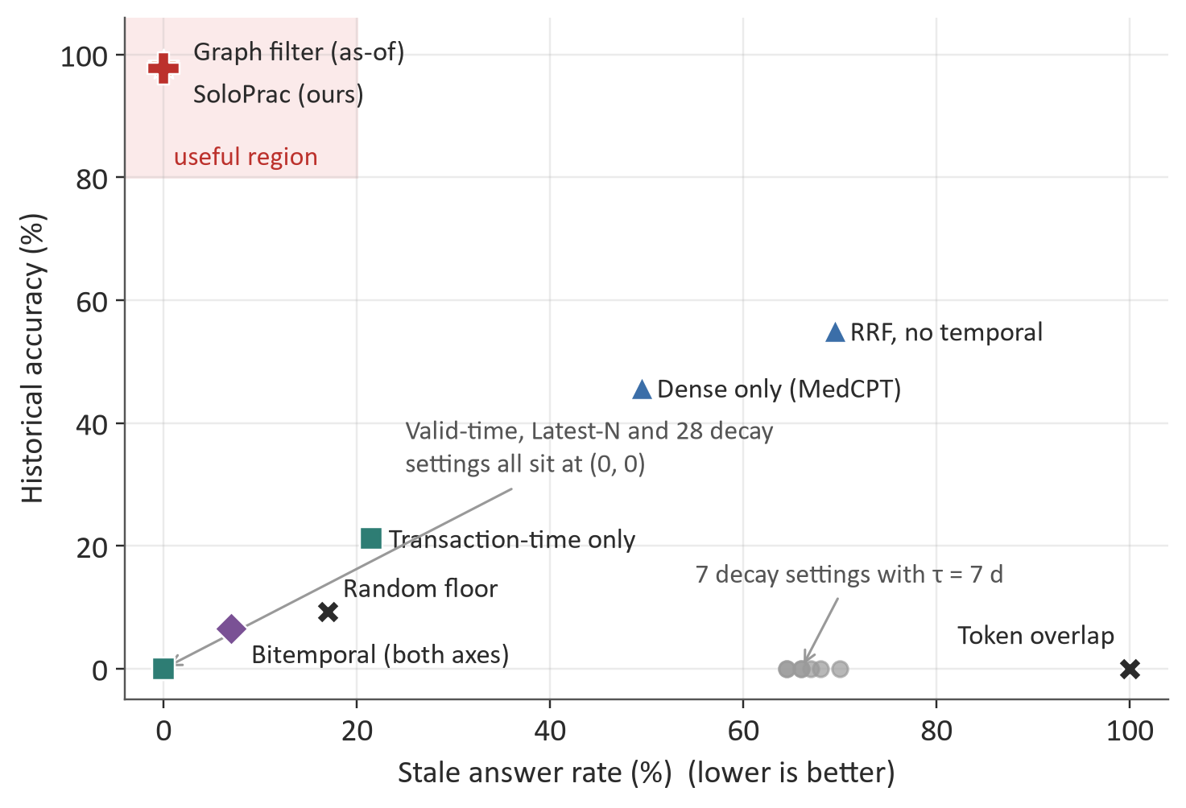
Speaker: Nihal
Results: The Edge Is What Matters
All 45 configurations, and an honest finding about our own weighting
Hard filter vs our weighted rule
 | Graph filter (hard) | Ours (soft weight)
Historical accuracy, s1 / s2 | 98.2 / 98.2 % | 97.8 / 97.8 %
Safe answer, s1 / s2 | 100.0 / 99.5 % | 98.5 / 96.0 %
Unchanged queries, s1 / s2 | 97.5 / 98.0 % | 94.5 / 96.5 %
McNemar p, s1 / s2 | 0.25 / 0.016 (filter better)
Same edges, no weights, no tiebreak, and it matches or beats us, so the contribution is the supersession relation itself
We keep the soft rule in the product because the correction stays visible to the model; this is a design reason, not a measured gain
Re-dating corrections to the specimen date: valid-time only went 0 → 100 % SAR and bitemporal 7 → 70 %; ours stayed at 0 %
Seed 20260601; seed 20260714 gives the same picture.
Computer Engineering Department, MPSTME, Mumbai Campus
19
Notes:
This plane puts every configuration on two axes. The useful corner is the top left. Only two points reach it: our ranker and a plain as-of filter on the same supersession edges. The filter actually did slightly better than our weighted rule, which tells us the pointer does the work, not the weights. We changed our claim to say so. We also re-dated every correction to its specimen date: timestamp methods collapsed, our SAR stayed at zero.

Slide 20
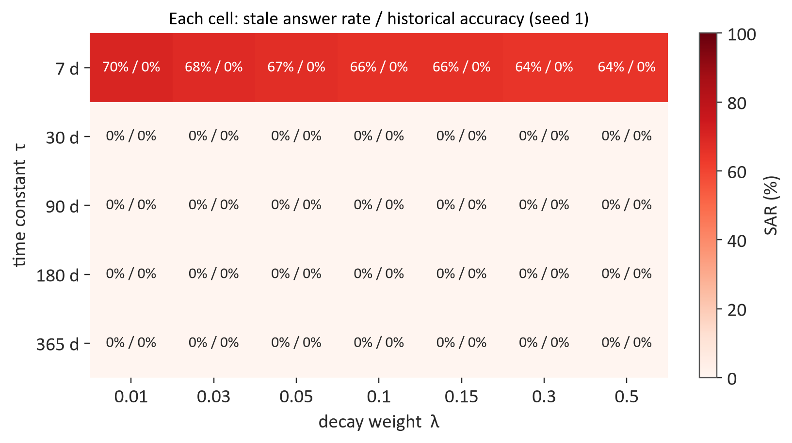
Speaker: Nihal
Results: Recency Cannot Be Tuned In
35 decay settings per seed, and not one historical question answered
Why there is no dial
A test and its correction score exactly the same on similarity (checked on all 600 relevant queries of each seed)
So the decay term alone picks the winner, and it always prefers the newer record
Newer is right for corrected questions and, by construction, wrong for every historical one
τ ≥ 30 days: 0 % SAR and 0 % historical at every grid point
τ = 7 days: ages of 30–435 days make exp(−age/7) span about 25 orders of magnitude; the pair ties in floating point and SAR lands at 64.5–70 %
The plan predicted a smooth trade-off curve; the measurement is two corners
f(q, e) = sem(q, e) + λ · exp(−age(e) / τ), λ ∈ {0.01 … 0.5}, τ ∈ {7, 30, 90, 180, 365} days
Computer Engineering Department, MPSTME, Mumbai Campus
20
Notes:
The strongest objection to our method is: why not just tune a recency term? We tried seven weights and five time constants. Not one of the seventy points across both seeds answered a single historical question. The reason is that a lab and its correction get exactly the same similarity, so the decay term alone decides, and it always prefers the newer record. That is right for questions about now and wrong for every question about the past. At tau of seven days the numbers underflow and the two versions tie, so neither gets credit.

Slide 21
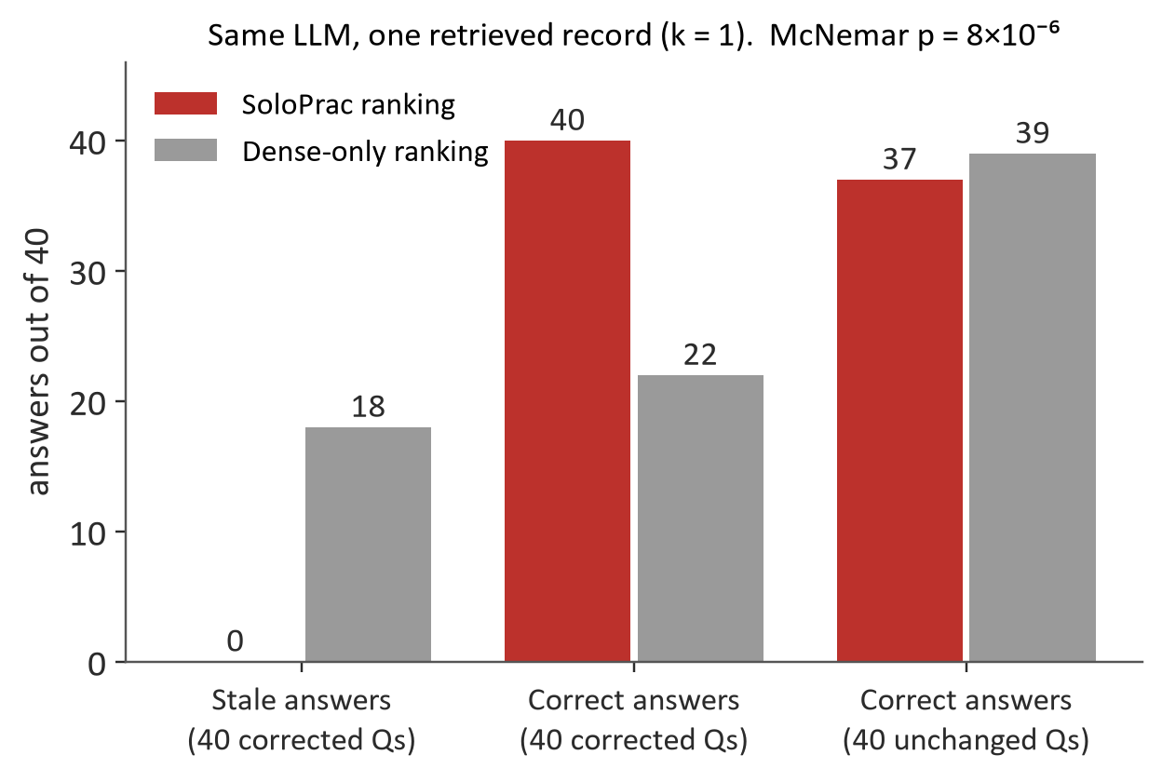
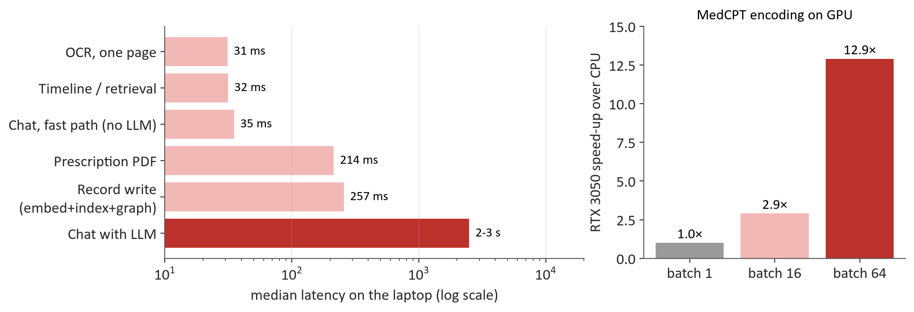
Speaker: Nihal
Results: Effect on Answers, and Speed
Rank 1 changes what the LLM says; the laptop is fast enough for a clinic
Measurement on the laptop | Value
Embedding cache hit rate (TAP-QA) | 90 % (33,814 hits)
Full TAP-QA run, 45 configurations | 57 s (8 min before caching)
API memory at rest / with BiomedCLIP | 350 MB / 1.21 GB
Backend tests / end-to-end steps | 250+ passing / 16 of 16
Same hosted model, same questions; only the retrieved context differs
k = 1: 0 / 40 stale with our ranking vs 18 / 40 with dense-only (McNemar p = 8×10⁻⁶)
k = 2 and k = 5: no stale answers in either arm, since both versions arrive together
Computer Engineering Department, MPSTME, Mumbai Campus
21
Notes:
Does ranking change the actual answer? We gave the same model the same 40 corrected questions twice, once with our top record and once with dense retrieval's. With one record of context, ours produced no stale answers and the baseline produced 18. With two or five records neither arm went stale, because the model sees both versions and reconciles them. On speed: retrieval is about 31 milliseconds, a model-backed answer takes 2 to 3 seconds, and the GPU helps only for bulk indexing.

Slide 22
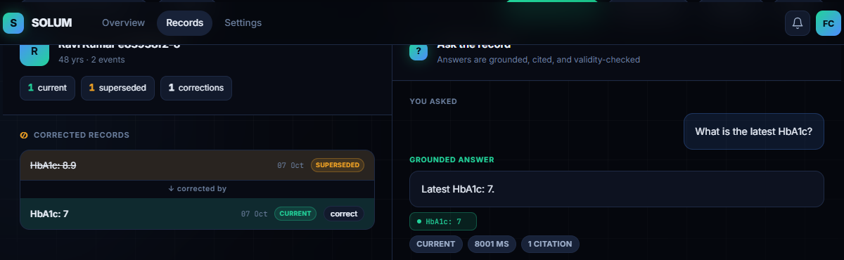
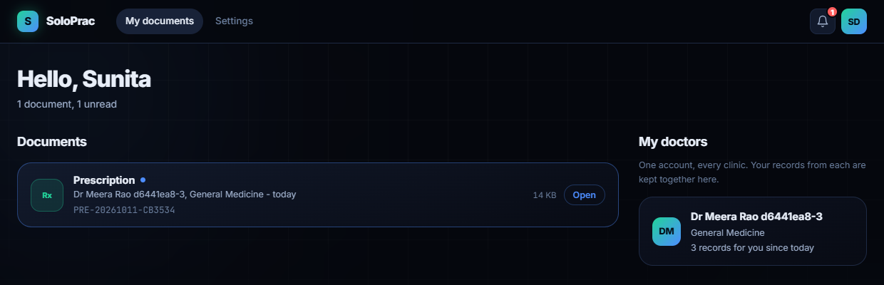
Speaker: Nihal
Product Walkthrough
The running application, from correction to the patient's inbox
Doctor console: superseded HbA1c kept and labelled; the answer cites the current value
Patient portal: the issued prescription arrives in the inbox with the linked doctor
Verified end-to-end journey (scripts/verify_e2e.py, nothing mocked)
1
Doctor registers
2
Adds patient
3
Asks HbA1c → 8.9 %
4
Corrects to 6.8
5
Asks again → 6.8 %
6
"As of 60 days ago" → 8.9 %
7
Issues prescription PDF
8
Patient registers, records link
9
Patient opens the PDF
Also checked: unreadable scan refused and routed to review; anonymous calls get 401, cross-role 403, cross-doctor reads return 404 so patient IDs cannot be probed.
Computer Engineering Department, MPSTME, Mumbai Campus
22
Notes:
Here is the product. Left, after a correction: the old HbA1c is struck through and marked superseded, and the chat answers with the current value and one citation. Middle, the patient portal, where issued documents arrive. Right, the weekly report sheet the doctor can send. All of this is verified by a 16-step end-to-end script against the running containers.

Slide 23
Speaker: Nihal
Impact, Limitations and Future Scope
What this changes, what we cannot claim yet, and what comes next
Impact
Limitations
Future scope
Doctor sees the corrected value for today and the old value for history, with citations
Zero recurring cost on a laptop; no identifiable data leaves the clinic
For clinical RAG builders: keep the correction pointer through chunking and resolve validity at query time
Benchmark, harness and app released together, so the numbers can be re-run
TAP-QA is synthetic and we wrote the generator
Every edge is present and correct; missing or wrong edges are untested
All corrections are lab values, chains one step deep
One encoder, one hosted LLM; no clinician study yet
Evaluate on de-identified real charts with missing links
Measure BGE-M3 on Hindi and code-switched notes
Let images inform generated answers, not only search
Web Push notifications; Alembic migrations; erasure under DPDP vs audit trail
Computer Engineering Department, MPSTME, Mumbai Campus
23
Notes:
Impact: a solo doctor gets a record that never presents a withdrawn value as current, keeps history answerable, and costs nothing to run. For anyone building clinical RAG the lesson is simple: keep the correction pointer when you chunk and index. Limits: the benchmark is synthetic, every edge in it is correct, corrections are lab values only, and there was no clinician study. Next: real de-identified charts with missing links, Hindi with BGE-M3, and images in the answer path.

Slide 24
Speaker: Nihal
Conclusion
The problem is one of representation, not of tuning
RQ1
Yes. 0.0 % stale answers and 97.8 % historical accuracy on both seeds, where the best timestamp-only ranker reaches 7–11.5 % stale and under 8 % historical.
Thank you
Questions?
Guide: Dr. Dhirendra Mishra
Dept. of Computer Engineering, MPSTME
RQ2
No. None of 70 recency-decay settings answered a single historical question; the failure is a missing relation, not a bad weight.
RQ3
Yes, at rank 1. With one record of context the same LLM gave 0 / 40 stale answers from our ranking and 18 / 40 from dense retrieval.
Paper: "Which Value Is Still in Force? Supersession-Aware Retrieval over Corrected Clinical Records", IEEE conference format, 5 pages.
Deliverable: a working clinic system (doctor and patient portals, grounded chat, capture, documents) on one laptop at zero cost.
Computer Engineering Department, MPSTME, Mumbai Campus
24
Notes:
To close: a correction in a chart withdraws an older entry, and no timestamp says so. Reading validity from the supersession pointer at the question's date removed stale answers from our benchmark and kept history answerable, which no timestamp or recency method managed. The paper is written up for submission. Thank you, we are happy to take questions.

