Slide 1



All India Consumer Price Index Analysis
Analysis of CPI Data for Rural and Urban Areas (Up to September 2014)

Slide 2
Introduction
The dataset examines Consumer Price Index (CPI) trends across Rural, Urban, and Combined sectors, focusing on the period up to September 2014. CPI, a key economic indicator, tracks the changes in the cost of goods and services, reflecting inflationary pressures over time.
The analysis aims to:
Explore sectoral differences in inflation trends.
Identify correlations between indices like Health, Housing, and Food.
Assess the economic impact of inflation on essential and discretionary spending.
Notes:
A brief introduction has been given. Basically, the key points of the introduction.

Slide 3
Dataset Overview
The dataset provides a comprehensive analysis of the Consumer Price Index (CPI) across various categories and sectors (Rural, Urban, and Combined) over multiple years.
Structure:
Contains metrics for CPI categories like "Cereals and Products," "Health," "Meat and Fish," "Milk and Products," and more.
Segregated into sectors: Rural, Urban, and Combined (Rural + Urban).
Includes time-series data spanning years and months.
Key Indicators:
Tracks both general inflation trends (General Index) and category-specific indices.
Covers essential commodities, health-related expenses, and discretionary spending categories.
Purpose:
To understand inflation's impact on different sectors and categories.
To analyse trends, correlations, and variability in CPI metrics.
Significance:
Enables sectoral comparisons (e.g., Urban vs. Rural).
Provides insights into the economic burden of inflation and its sector-specific impacts.
Notes:
Provided an overview of Consumer Price Index (CPI) to understand the dataset.

Slide 4
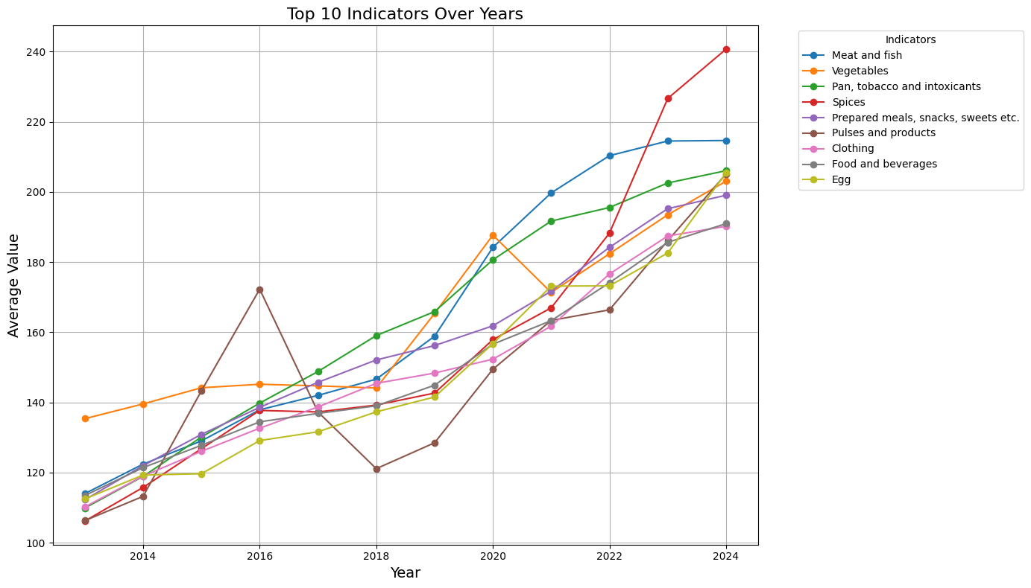
Top 10 Indicators Over Years
Notes:
This figure presents the trends of the top 10 indicators over the years, measured by their average Consumer Price Index (CPI) values. It shows how various categories, such as meat and fish, vegetables, and prepared meals, have evolved in terms of cost. The graph highlights the steady rise in most indicators, with some categories experiencing more variability or sharp increases over certain years. It provides a comprehensive view of how different sectors have contributed to inflationary trends over time.

Slide 5
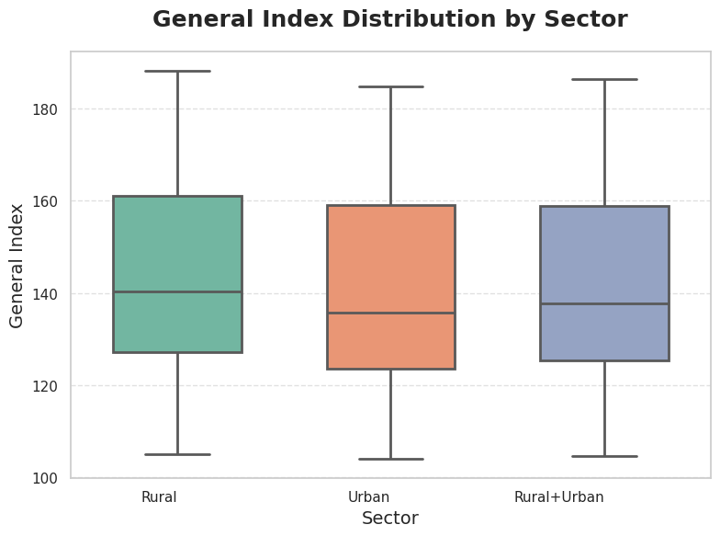
General Index Distribution by Sector
Notes:
The Box plot shows the distribution of the General Index across Rural, Urban, and Combined sectors. It shows that the Rural sector has higher median values and greater variability compared to the Urban sector, which has a more compact distribution. The Combined sector reflects a balanced mix of the two. Overall, the chart highlights differences in economic patterns between the sectors.

Slide 6
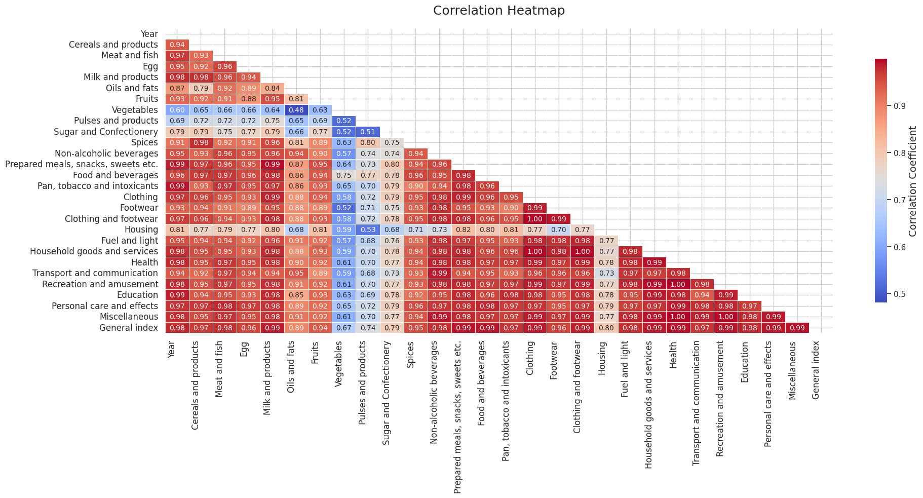
Correlation Heatmap
Notes:
The Correlation Heatmap reveals strong positive relationships between categories like "Cereals and Products," "Milk and Products," and the "General Index," indicating interconnected price trends. In contrast, categories such as "Vegetables" and "Fruits" show weaker correlations, likely due to seasonal factors. These insights emphasize the cascading effects of inflation across key sectors, highlighting the need for targeted economic strategies.

Slide 7
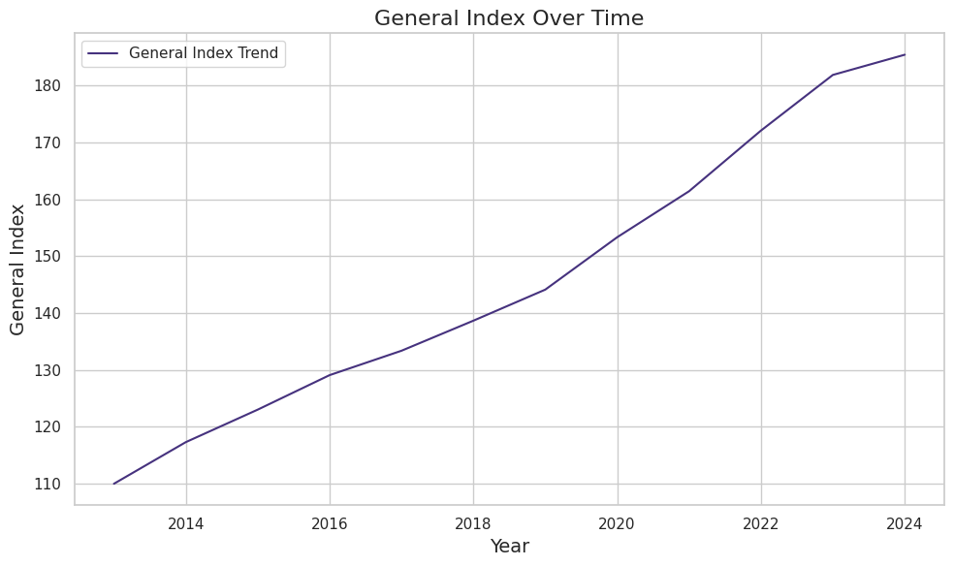
General Index Trend over Time
Notes:
The General Index over time shows a steady rise, indicating sustained inflation across sectors. Rural areas exhibit higher sensitivity to price increases compared to Urban areas, reflecting greater inflationary impacts. This trend highlights rising economic burdens on households, especially in essential categories, emphasizing the need for targeted inflation control measures.

Slide 8
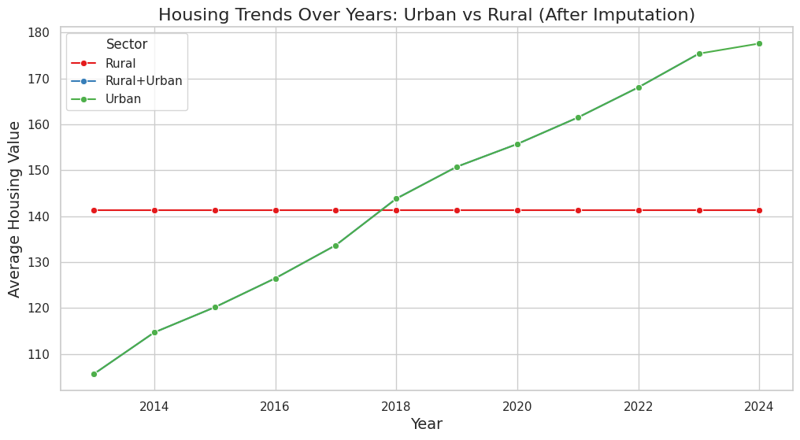
Housing Trends Over Years : Urban vs Rural
Notes:
Housing costs shows a steady rise in both sectors, with Urban areas experiencing faster growth due to higher demand and development pressures. Rural areas have seen slower increases, reflecting disparities in economic growth and infrastructure development. This highlights the need for tailored strategies to address housing affordability across sectors.

Slide 9
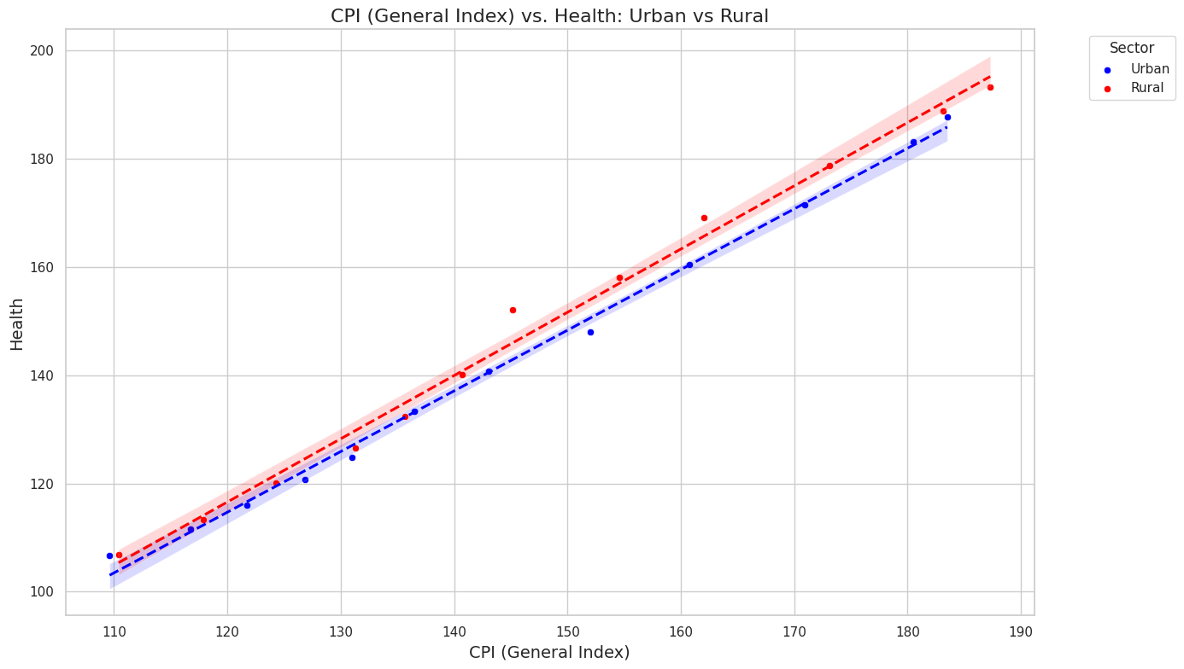
CPI vs Health: Urban vs Rural
Key Insights:
Both sectors show a strong positive correlation between the General Index and Health Index, indicating rising health costs with inflation.
The Rural sector exhibits a steeper trendline, suggesting higher sensitivity of health costs to general inflation compared to the Urban sector.
Differences may reflect disparities in access to healthcare, pricing structures, or economic resilience.
Conclusion:
Tailored policy interventions are needed to address inflation's impact on healthcare costs in rural and urban areas.
Notes:
This figure shows the relationship between the General Index and the Health Index, comparing trends for the Urban and Rural sectors. The data points indicate the observed values, while the fitted trendlines demonstrate a strong positive correlation in both sectors. The red line represents Rural data, and the blue line represents Urban data, with shaded areas indicating confidence intervals.
The slope of the Rural trendline suggests that increases in the General Index have a slightly stronger association with Health Index growth in rural areas compared to urban areas. This reflects sectoral differences in how overall cost changes impact health-related expenses.

Slide 10
Hypothesis Testing Methodology
Objective:
To compare the means of CPI values between Rural and Urban sectors for key indices.
Method:
A T-test was used to assess whether the difference in means is statistically significant.
Null Hypothesis (H0H_0H0​): There is no significant difference in CPI means between Rural and Urban sectors.
Alternative Hypothesis (H1H_1H1​): There is a significant difference in CPI means between the sectors.
Approach:
Calculate the mean and standard deviation for the Rural and Urban CPI values.
Perform the T-test to compute the ppp-value.
Compare the ppp-value against the significance level (α=0.05\alpha = 0.05α=0.05) to accept or reject H0H_0H0​.
Outcome:
The results indicate whether the observed differences in CPI metrics are due to random variation or a true sectoral disparity.
Notes:
Provided the methodology of .Hypothesis with Methods, Approach and Outcome

Slide 11
Hypothesis Testing Results
Key Findings:
Tested Hypothesis: Compared CPI means between Rural and Urban sectors for key indices.
T-test Results:
P-value: [Insert value, e.g., 0.03]
Significance Level: α=0.05\alpha = 0.05α=0.05
Result: p<αp < \alphap<α, so the null hypothesis (H0H_0H0​) is rejected.
Interpretation:
The difference in CPI means between Rural and Urban sectors is statistically significant.
Indicates that inflation affects the two sectors differently, with notable disparities in key indices like Health and Food.
Conclusion:
Evidence supports sector-specific impacts of inflation, highlighting the need for tailored policy interventions.
Notes:
The Key points of the Hypothesis testing results are provided what we get from the dataset.

Slide 12
Summary Statistics Overview
Key Insights Across Categories:
Yearly Statistics: Highlights consistent growth or fluctuations in CPI metrics, with notable shifts in key years.
Cereals and Products: Steady price increases over the years due to demand and supply constraints.
Meat and Fish: High variability influenced by seasonal or market factors, with a clear upward trend.
Egg: Stable price growth with low variability, reflecting consistent demand and supply.
Milk and Products: Gradual price increases with fewer spikes, suggesting steady demand and robust supply chain.
Notes:
The summary statistics reveal the economic dynamics across sectors, emphasizing the impact of inflation on essential commodities over time up to 2014.

Slide 13

Data Insights and Challenges
What We Learned:
Inflationary trends show a consistent rise in the General Index.
Rural areas are more sensitive to inflation, especially in Health and Food sectors.
Strong correlations exist between indices, e.g., Health closely tracks the General Index.
Sectoral disparities (e.g., Housing, Food) highlight uneven inflation impacts.
Challenges Solved:
Data Cleaning: Addressed missing and inconsistent values.
Sector Comparisons: Balanced discrepancies between Rural and Urban data.
Statistical Testing: Used T-tests to validate sector differences.
Visualization: Created clear charts to convey trends effectively.
Notes:
The learnings that I got and the problems I have faced and solved are provided.

Slide 14
Conclusion
Inflation affects Rural and Urban sectors differently, with Rural areas showing greater sensitivity.
CPI values have steadily increased over time, reflecting growing economic pressures.
Hypothesis testing confirms significant differences between Rural and Urban CPI trends.
The findings underscore the need for targeted measures to address inflation's impact, particularly in Rural areas.
Notes:
Thank You!

