Slide 1
IBM Hack 2019
Topic: Energy Audit for Households

Slide 2
Team
Rohan Chacko Zubair Abid
Athreya Chandramouli AadilMehdi Sanchawala
College: International Institute of Information Technology, Hyderabad
Members: 4

Slide 3
Roles
Rohan Chacko
AadilMehdi S
Athreya C
Zubair Abid
Frontend templating
Deployment on IBM Cloud Foundry
Ensuring code quality
Backend infrastructure & defining routes
Creating and populating database
Backend infrastructure & defining routes
Data Preprocessing
Training the disaggregation prediction model
Data Preprocessing
Training the disaggregation prediction model
Ensuring code quality

Slide 4
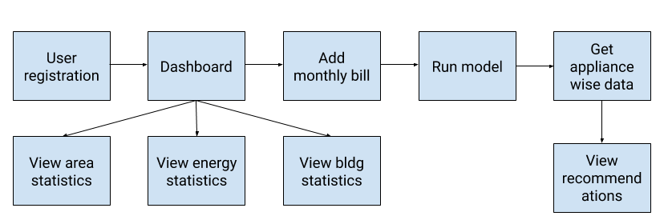
Stack
Flow Diagram
Backend: Django
Frontend templating framework: MDB
ML Model training: Keras, Tensorflow
Database: SQLite 3
Deployment: IBM Cloud Bluemix

Slide 5
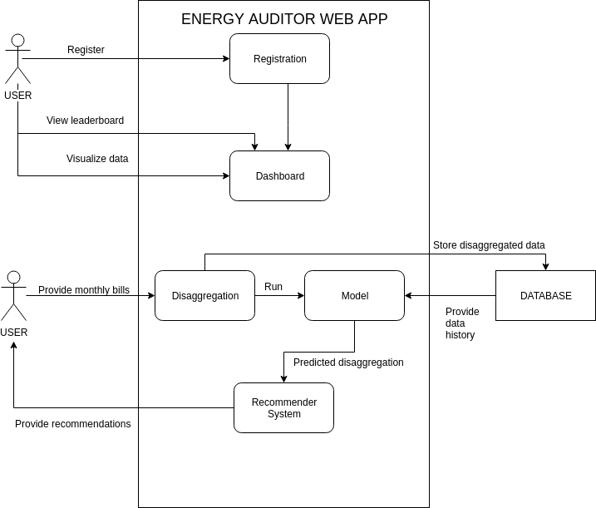
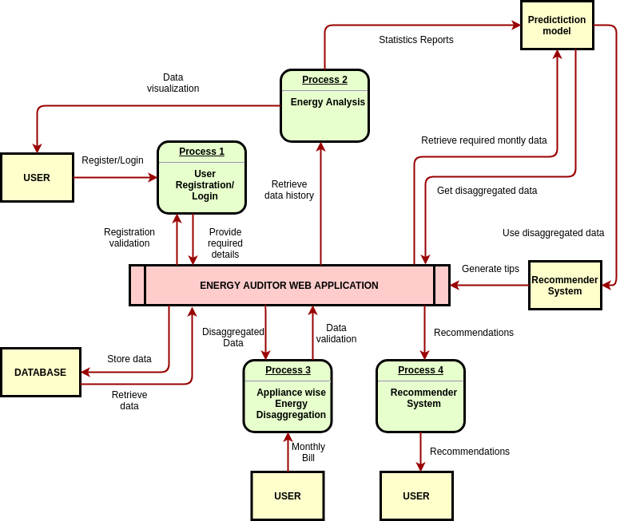
Architecture Diagram
Data Flow Diagram

Slide 6
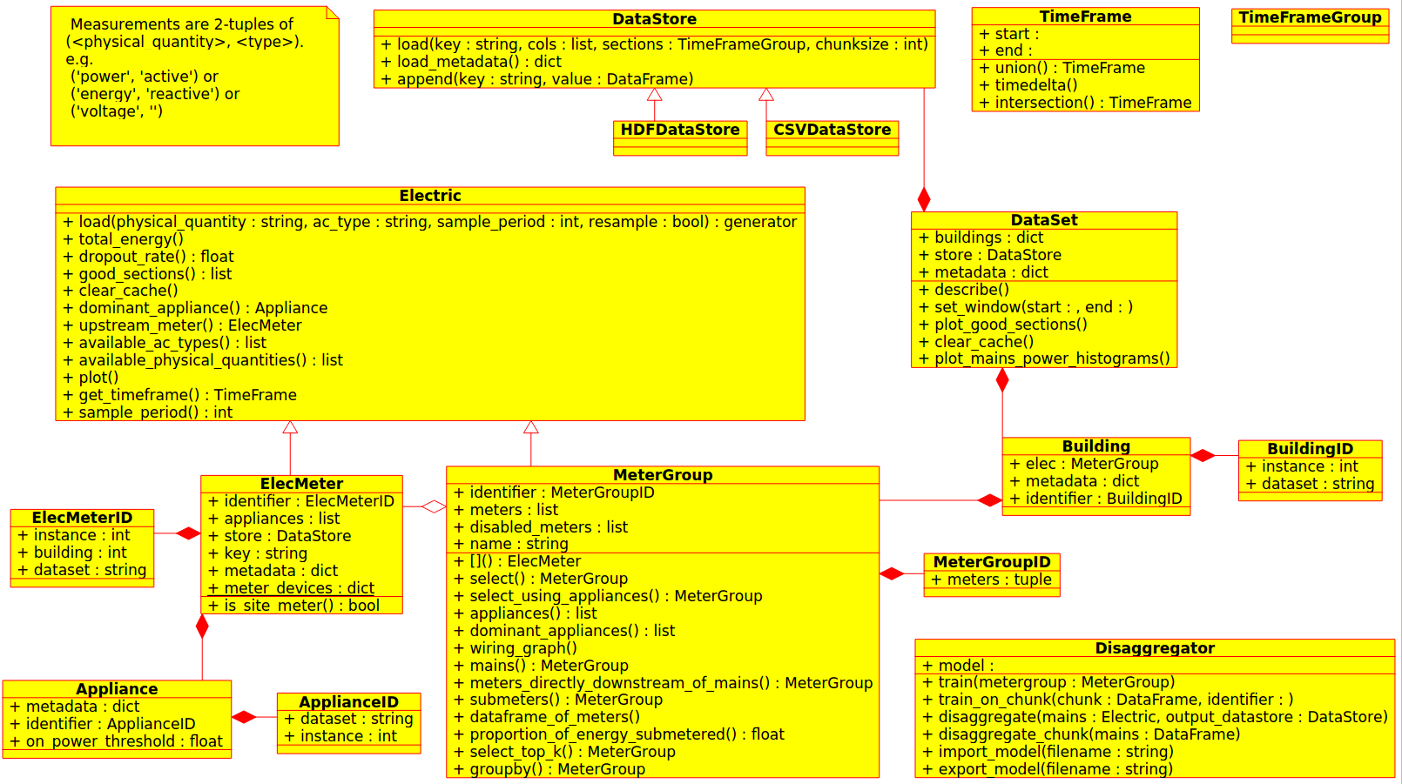
NILMTK UML Diagram

Slide 7
UI/UX Design

Slide 8
We used Material Design for Bootstrap 4 framework (MDB) for creating our UI. MDB allowed us to quickly create beautiful intuitive interfaces
Throughout the design process, we kept usability as our top priority. We wanted to keep a clean, sleek interface so that the user can get their job done without any hassle. Hence, material design was a natural choice
Combining flat material design with the bootstrap framework allowed us to experiment with multiple UI designs
Each web page has a well-defined endpoint and the complete flow from start to end is very intuitive
Number of buttons, links, etc were kept to a minimum to avoid confusion
Data visualization techniques were used appropriately to help the user understand their energy consumption habits. Statistical plots were made using MDB
We have put code comments in necessary places and linted the code to ensure code quality. We have also followed PEP8 standards.

Slide 9
Youtube Video
Web App
URL
Link

