Slide 1

Forecast Gold prices
DS_P – 118
Mentor :- Dhanya
Date :- 11/5/2022
Participants :-
1- Rohan Chaure
2- Apeksha Kadhe
3- Prasad Bidve
4- Renuka Penshanwar
5- Viresh Savalagi
6- Harinandhan k
7 – Prashant Lotekar

Slide 2
Business Problem:
Objective:
Data provided is related to gold prices. The objective is to understand the underlying structure in your dataset and come up with a suitable forecasting model which can effectively forecast gold prices for next 30 days.
This forecast model will be used by gold exporting and gold importing companies to understand the metal price movements and accordingly set their revenue expectations.

Slide 3
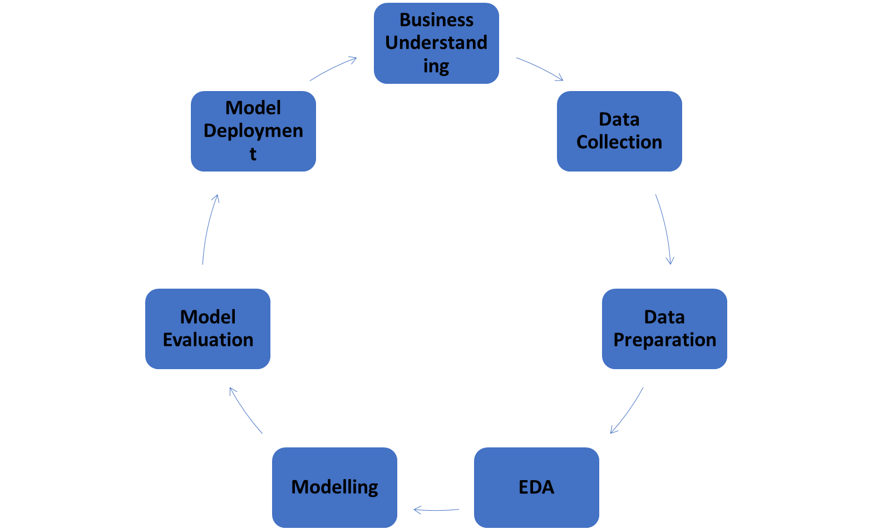
Project Architecture / Project Flow

Slide 4
Exploratory Data Analysis (EDA) and
Feature Engineering

Slide 5
Data set details
•In that dataset there are 2182 Rows and 2 Columns
•Year range 01-01-2016 to 21-12-2021
•Unique data values 2182
•Null value – No null value
• In that dataset there are two datatypes-
• 1. float64(1)
•2. object(1)

Slide 6
Libraries installed
Pandas
Numpy
Matplotlib
Datetime
Seaborn
fbProphet

Slide 7
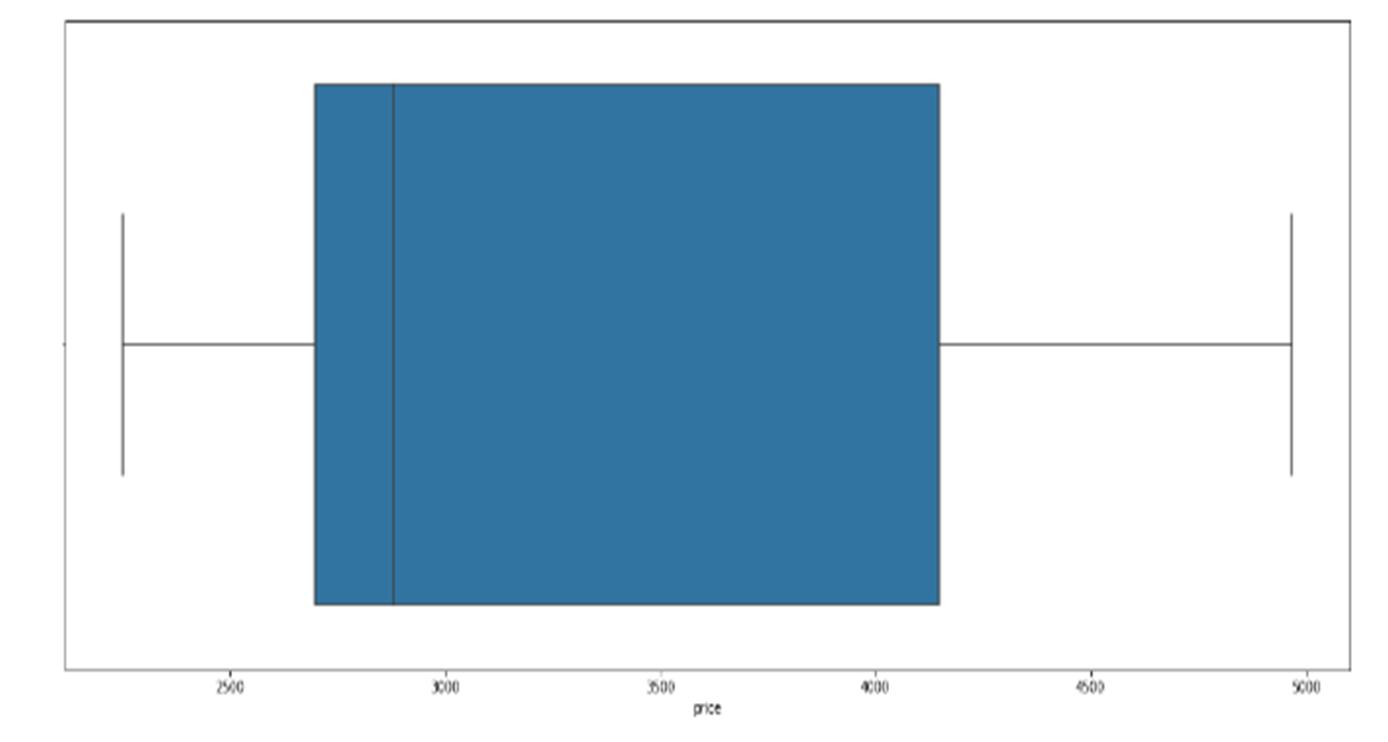
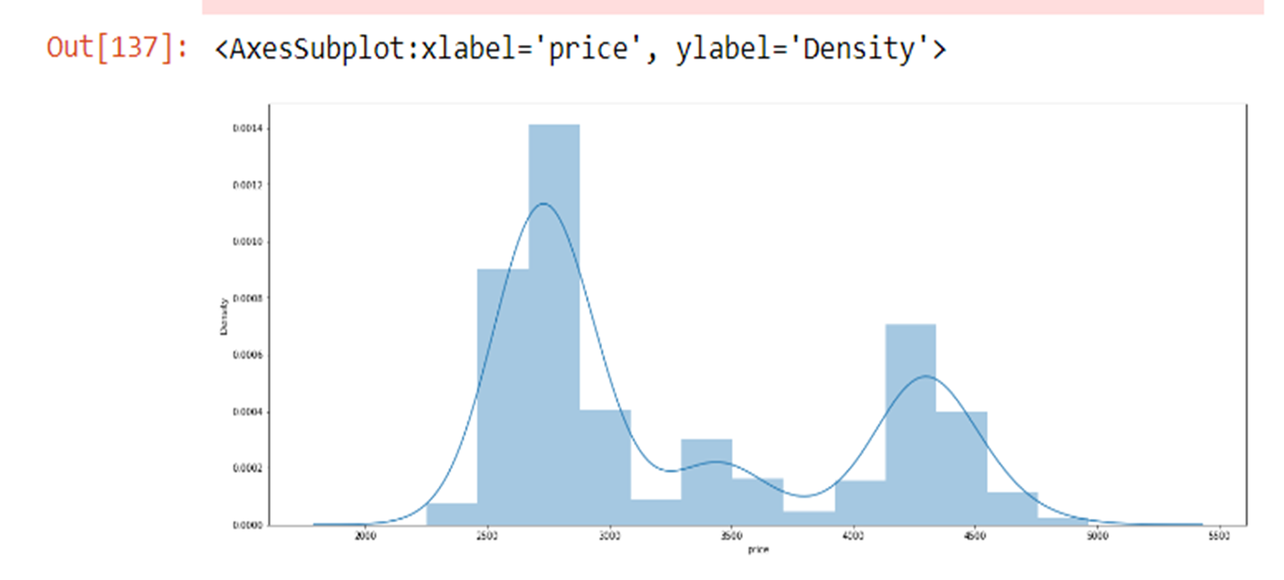
Exploratory Data Analysis (EDA)

Slide 8
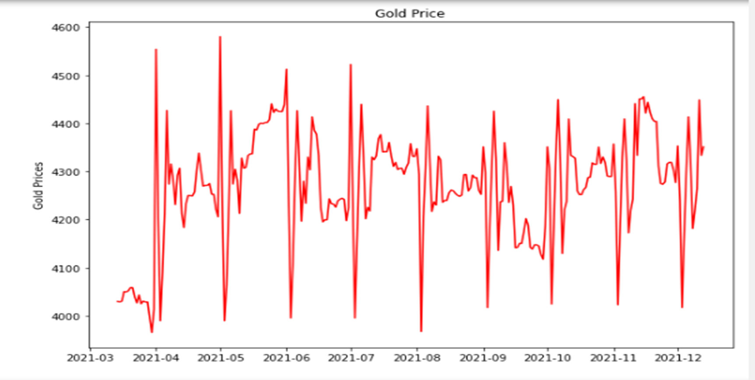
EDA

Slide 9
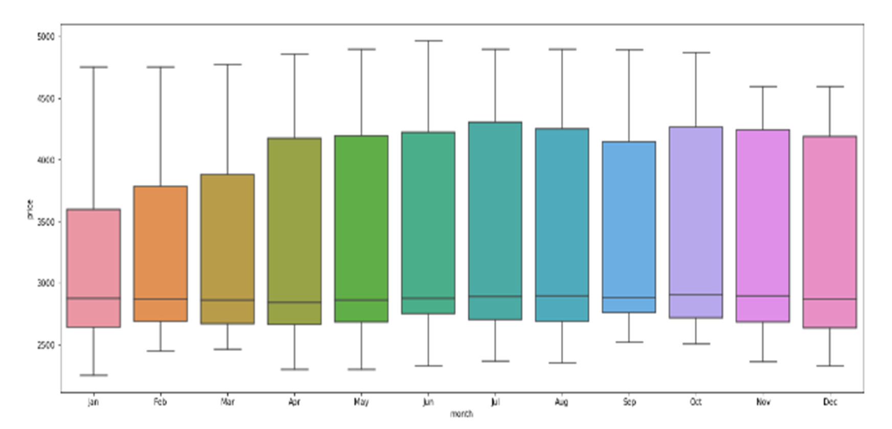
Month wise outlier detection

Slide 10
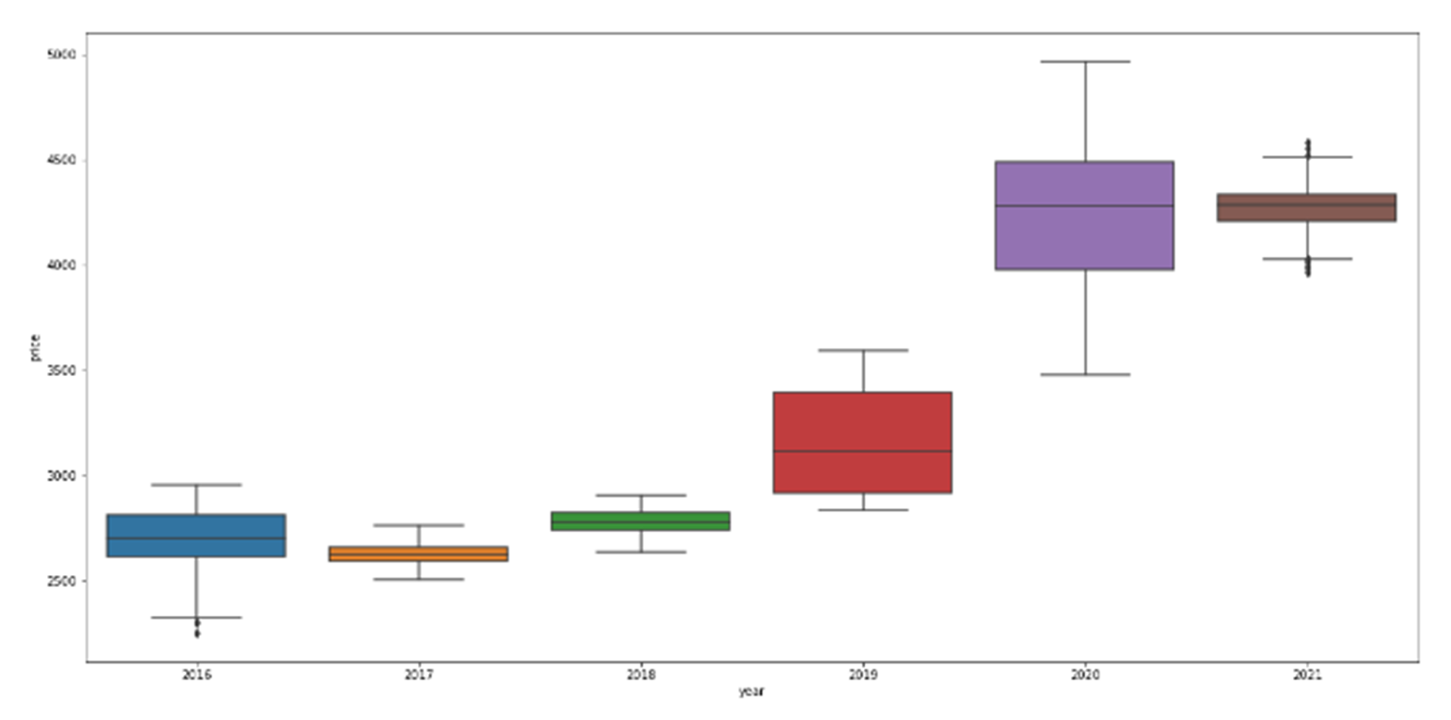
Year wise outlier detection

Slide 11
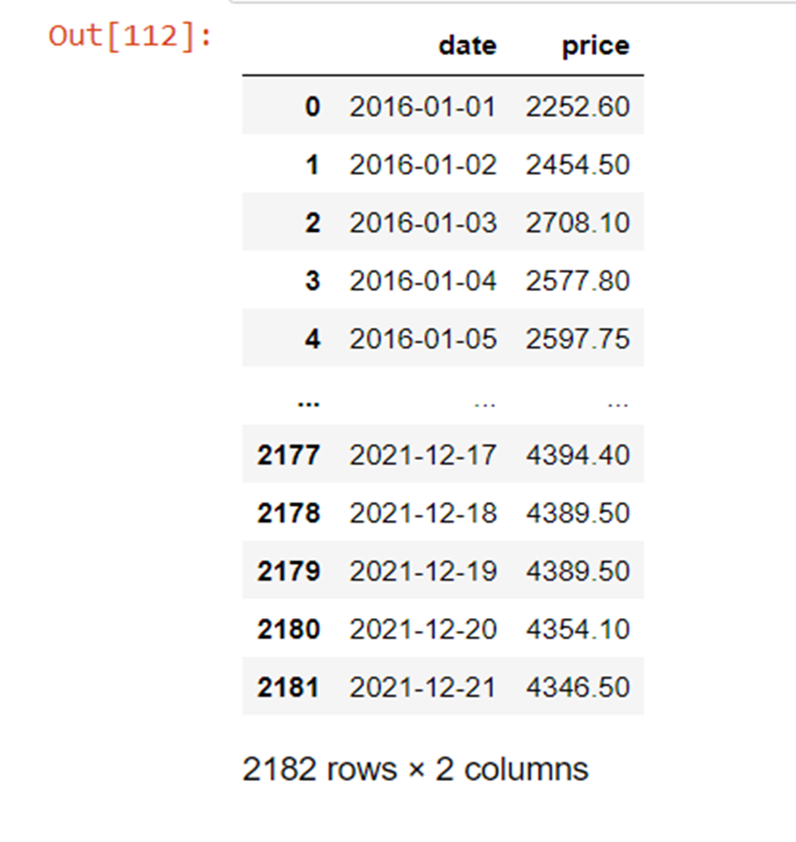
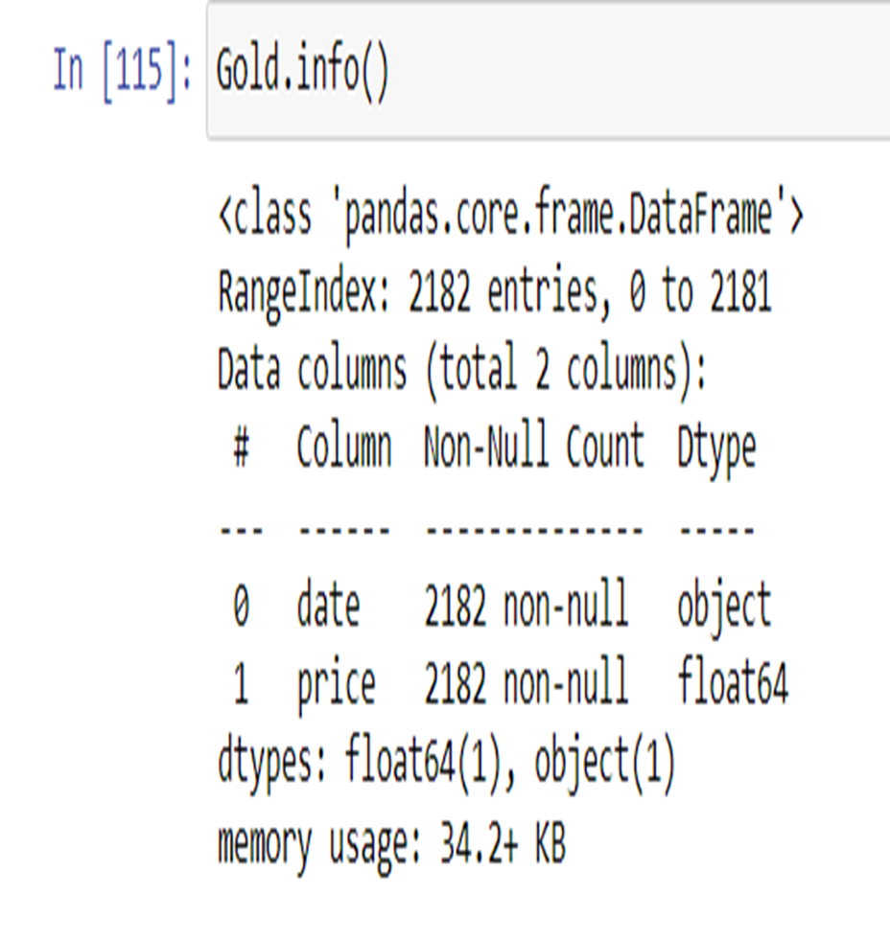
Feature Engineering

Slide 12
Model Building

Slide 13
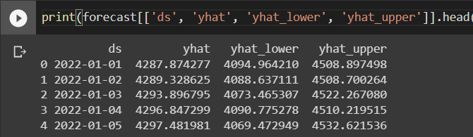
Model Predictions

Slide 14
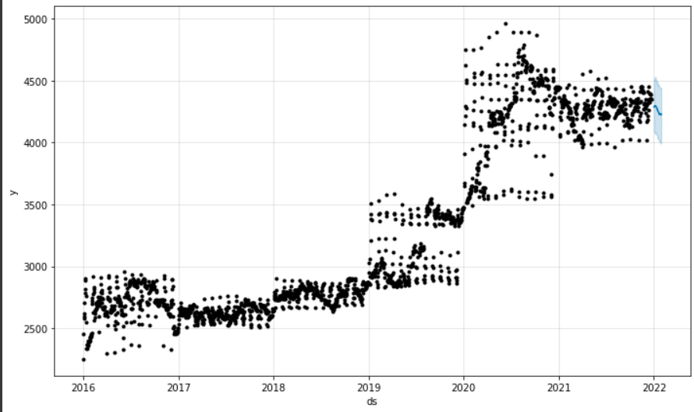
Model Results

Slide 15
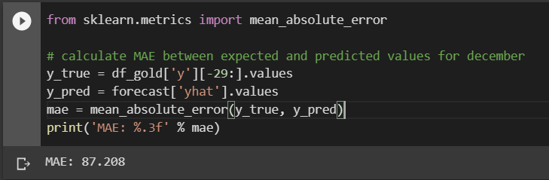
Model Accuracy

Slide 16
Model Deployment using R shiny / Flask or any other method

Slide 17
Challenges faced?
It was difficult to work with date time feature, there was a need for large code to process data-time feature.
There was a constant error in fitting Prophet model with data.
How did you overcome?
We found a separate module for date time object it was helpful in working with date-time feature.
The solution for Prophet model error is to change the feature names according to the documentation, so the algorithm can find the specific columns.

Slide 18
Thank you

