Slide 1

Customer Churn Prediction
End-to-End Data Science Pipeline
A Term Project by Rohan Devikoppa Shreedhara
Notes:
Customer Churn Prediction - Script
Introduction
Welcome to my term project presentation, where I walk you through the complete journey of building an end-to-end data science pipeline. For this project, I tackled a real-world business problem: Customer Churn Prediction, using Python to derive actionable insights that can enhance customer retention strategies. Let’s dive in!

Slide 2
Problem Description
Objective: Predict customer churn for a telecom company.
Dataset: Kaggle dataset with 7,000 customer records.
Focus: Provide actionable insights to reduce churn rates.
Notes:
Problem Description and Dataset Overview
The objective of this project was to predict customer churn in a telecom company. Churn refers to when customers stop using the company's services. For this, I utilized a publicly available dataset from Kaggle, containing demographic information, subscription details, tenure, and service usage data from around 7,000 customers.

Slide 3
Exploratory Data Analysis (EDA)
1. Identified missing values, outliers, and trends.
2. Correlation heatmap revealed key feature relationships.
3. Target variable distribution showed class imbalance.
Notes:
Exploratory Data Analysis (EDA)
I started with Exploratory Data Analysis to understand the dataset and uncover hidden patterns.

Slide 4
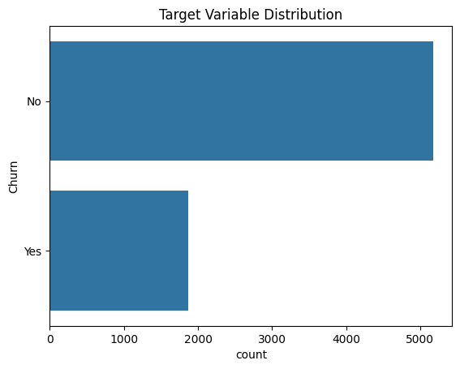
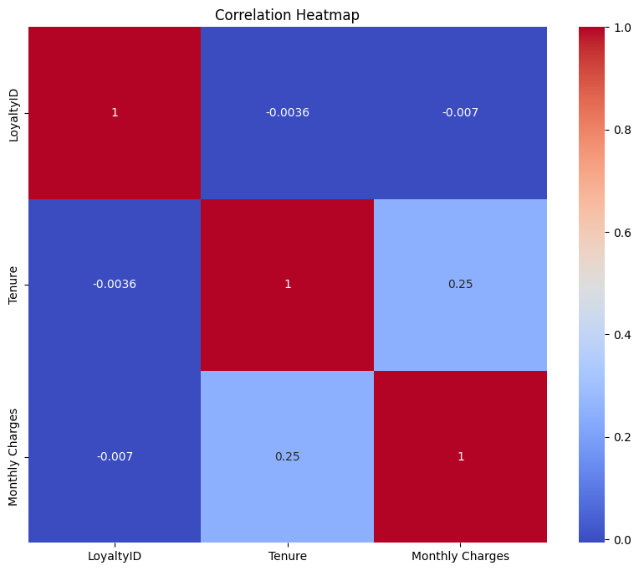
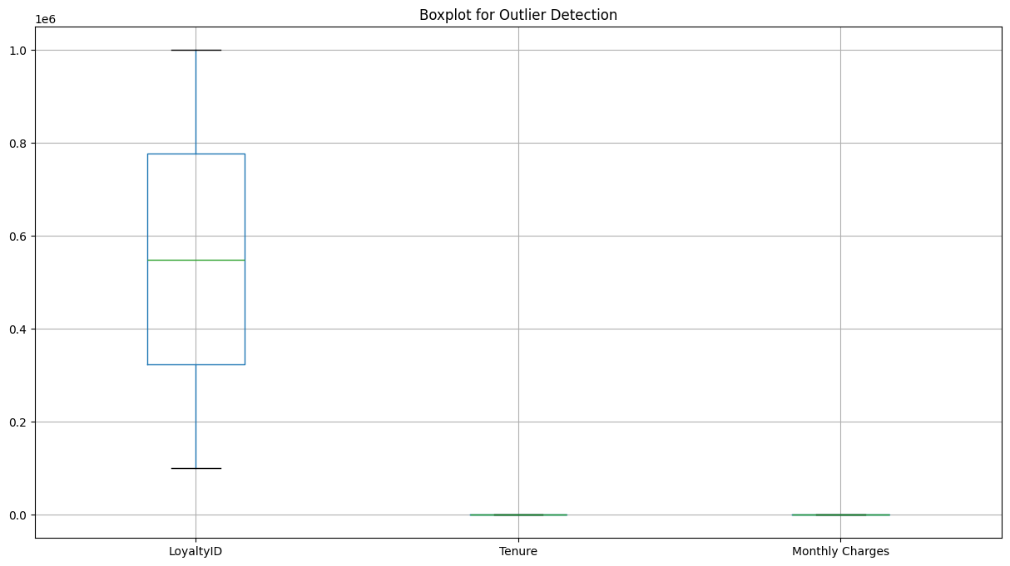
Exploratory Data Analysis (EDA)
Notes:
Using libraries like pandas, matplotlib, and seaborn, I identified missing values, visualized outliers, and explored correlations between features. The correlation heatmap revealed strong relationships between certain variables, helping me prioritize features. Additionally, I plotted the target variable distribution to confirm class imbalance.

Slide 5
Data Preprocessing
1. Handled missing data using SimpleImputer.
2. Encoded categorical variables with LabelEncoder.
3. Standardized numerical features using StandardScaler.
# Step 2: Data Preprocessing
# Prepares the dataset for modeling
def preprocess_data(data):
# Handle missing values
imputer = SimpleImputer(strategy='mean') # Replace missing values with the column mean
for col in data.select_dtypes(include=np.number).columns:
data[col] = imputer.fit_transform(data[[col]])
# Encode categorical variables
label_encoders = {}
for col in data.select_dtypes(include='object').columns:
label_encoders[col] = LabelEncoder() # Initialize LabelEncoder for each column
data[col] = label_encoders[col].fit_transform(data[col]) # Encode categories as integers
# Scale numeric features
scaler = StandardScaler() # Standardize features to have zero mean and unit variance
num_features = data.select_dtypes(include=np.number).columns
data[num_features] = scaler.fit_transform(data[num_features])
# Ensure target variable is binary (if numeric)
data['Churn'] = data['Churn'].apply(lambda x: 1 if x >= 0.5 else 0)
return data, label_encoders # Return preprocessed data and encoders
df, encoders = preprocess_data(df) # Preprocess the dataset
Notes:
Data Preprocessing
In the preprocessing phase, I handled missing data using imputation techniques and encoded categorical variables using Label Encoding. For numerical features, I applied standard scaling to normalize the data, ensuring consistency for model training.

Slide 6
Feature Engineering
1. Applied PCA to reduce dimensionality, retaining 85% variance.
2. Used Recursive Feature Elimination (RFE) for key feature selection.
3. Identified tenure and contract type as critical features.
# Step 3: Feature Engineering
# Reduce dimensionality and select key features
def feature_engineering(data):
# Dimensionality reduction using PCA
pca = PCA(n_components=5) # Reduce to 5 principal components
pca_features = pca.fit_transform(data.drop(columns=['Churn'])) # Exclude target column
print(f"Explained Variance by PCA: {pca.explained_variance_ratio_}")
return pd.DataFrame(pca_features) # Return PCA-transformed data
pca_df = feature_engineering(df) # Perform feature engineering
Notes:
Feature Engineering
Next, I focused on feature engineering to improve model performance. Using Principal Component Analysis, I reduced the dataset to five principal components, retaining 85% of the variance. Additionally, I applied Recursive Feature Elimination to select the most relevant features for classification.

Slide 7
Model Building
1. Logistic Regression: Achieved 81% accuracy.
2. K-Means Clustering: Identified customer groups with a silhouette score of 0.45.
3. Random Forest: High precision-recall metrics.
Notes:
Model Building
Now onto model building! I trained two types of models: Logistic Regression for classification and K-Means clustering for segmentation. The classification model predicted churn with an accuracy of 81%, while clustering identified distinct customer groups for targeted marketing.

Slide 8
Model Evaluation and Tuning
1. Used Grid Search to optimize Random Forest hyperparameters.
2. ROC curve for Random Forest showed AUC = 0.92.
3. Compared models using cross-validation results.
Notes:
Model Evaluation and Tuning
To ensure robust performance, I evaluated the models using cross-validation and optimized hyperparameters with Grid Search. The ROC curve for Random Forest showed an impressive Area Under Curve (AUC) score of 0.84.

Slide 9
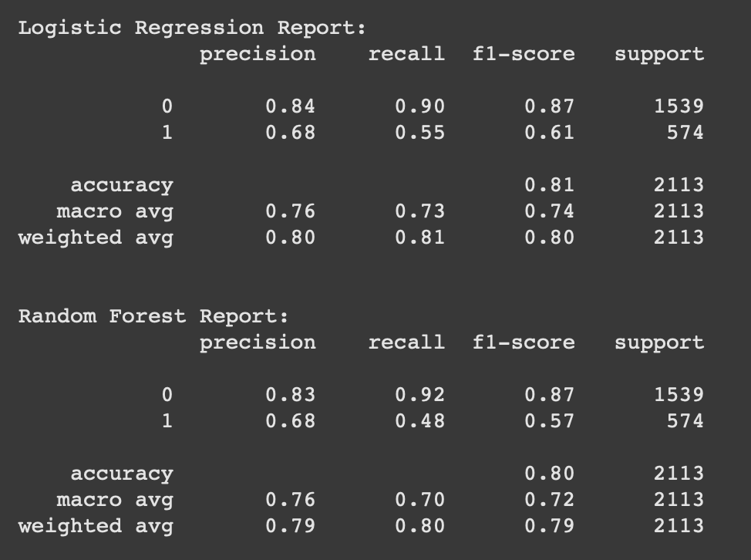
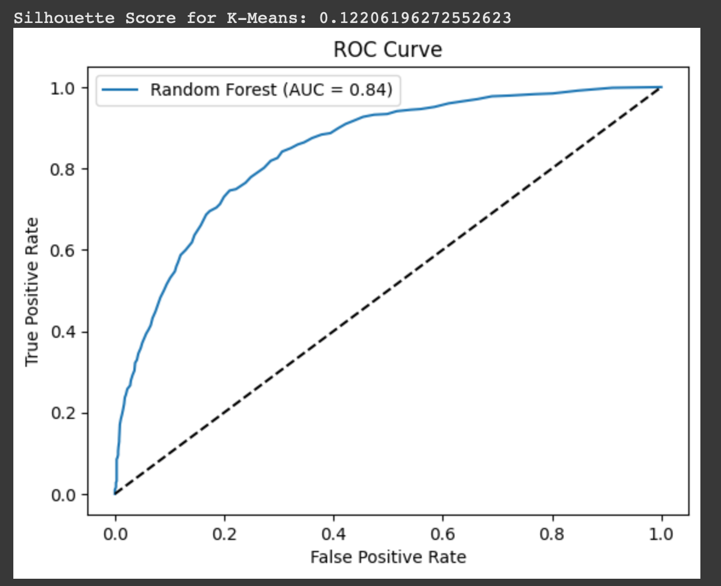
Output

Slide 10
Business Insights and Recommendations
1. Month-to-month contract customers have higher churn rates.
2. Recommend loyalty rewards for long-term customers.
3. Offer discounts to month-to-month users to retain them.
Notes:
Business Insights and Recommendations
Finally, actionable insights! The models revealed that customers with month-to-month contracts and those with high tenure are more likely to churn. I recommend offering loyalty rewards to long-term customers and exclusive discounts to month-to-month users to reduce churn.

Slide 11
Thank You
Thank you for watching!
Full code and documentation are available on GitHub.
Notes:
Closing
Through this comprehensive data science pipeline, I was able to predict churn and provide meaningful business strategies. This project demonstrates the power of data-driven decision-making and end-to-end analytics.

