Slide 1
Simulation of a static linker

Slide 2
What is linking and what is a linker?
Linking is process of collecting and maintaining piece of code and data into a single file.
Linker is a system software which helps to link a object modules of program into a single object file. Linker also link a particular module into system library. Linker takes object modules from assembler as input and forms an executable file as output for loader.

Slide 3
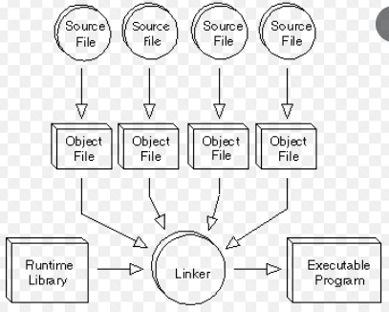

Slide 4
Types of Linkers
There are 2 types of linkers:
Static linker
Dynamic linker

Slide 5
Static linker
Static linkers inputs a collection of relocatable object files and outputs a fully linked executable object file that can be used by a loader.
Static linking is performed during the compilation of source code.
Two main functions of static linker:
1.Symbol resolution- It associates each symbol reference with exactly one symbol definition.
2.Relocation- It relocate code and data section and modify symbol references to the relocated memory location.

Slide 6
Dynamic linkers
Dynamic linking is performed during the run time.
This linking is accomplished by placing the name of a shareable library in the executable image.
Here we can perform code sharing. it means we are using a same object a number of times in the program. Instead of linking same object again and again into the library, each module share information of a object with other module having same object.
In this linking we can also relocate the code for the smooth running of code but all the code is not relocatable. It fixes the address at run time.

Slide 7
Implementation & Design
Our project aims at simulating a static linker.
We have written this linker using Java. The linker takes in an input file consisting of various sections of a program, reads in all symbols, and creates a complete symbol table in memory in the first pass. In the second pass, it reads in section and relocation information, updates addresses, and writes out new file.
This new file will consist of the actual memory locations that are to be loaded by the loader.

