Slide 1


Slide 2
Profit Analysis of 50 New Startup’s

Slide 3
PROJECT DETAILS
Project name PRDA-01 Profit Analysis
Team ID PTID-CDA-SEP-25-765
Team member’s
Yokesh.S
Rohan.S
Suhaib Khan
Swetha.R

Slide 4
PROJECT OVERVIEW
OBJECTIVE : Predict profit using R&D, Marketing, and Admin spending
TOOLS USED : Excel (Regression), Power BI (Visualization)
PURPOSE : Help company decide where to invest for maximum profit

Slide 5
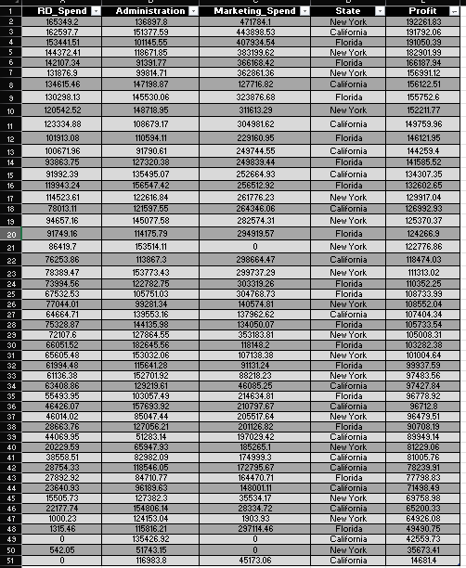
Dataset Snapshot: 50 Companies Across 3 States (NY, CA, FL)

Slide 6
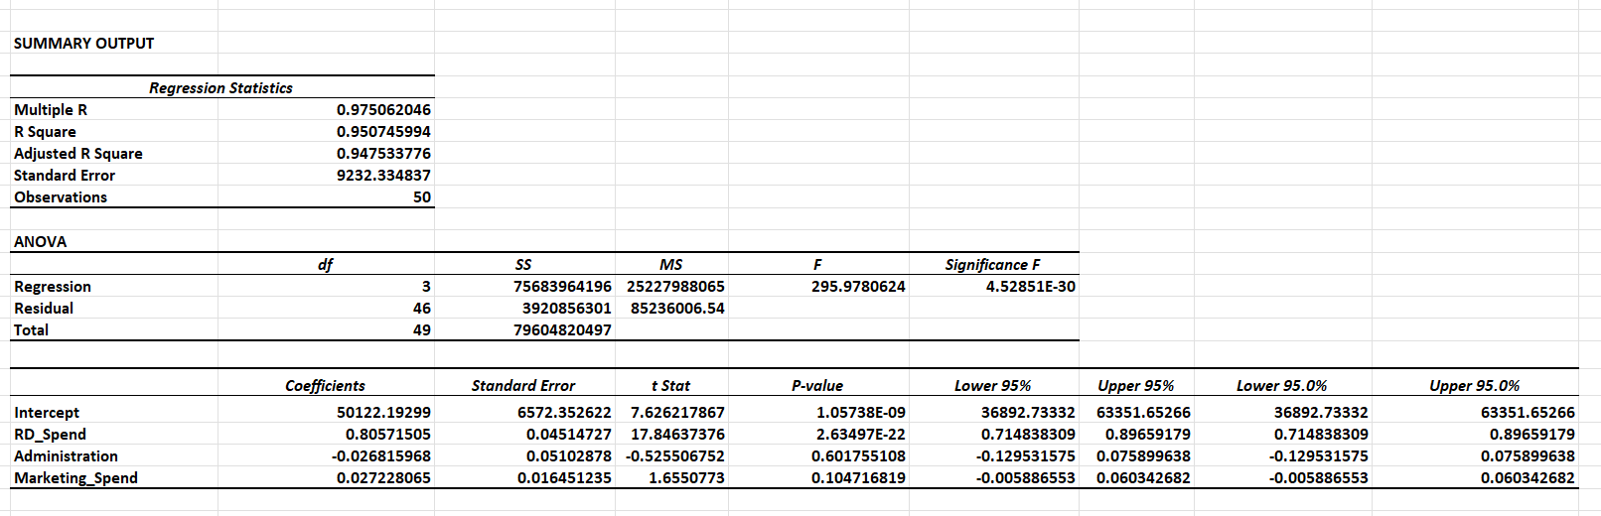
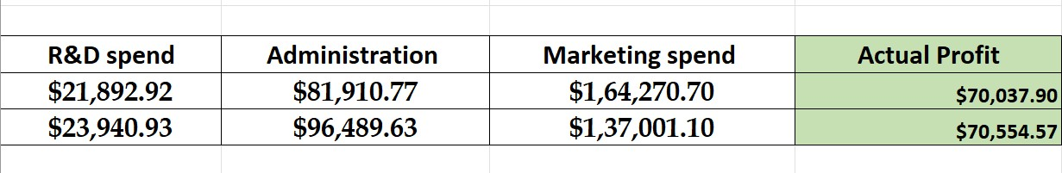
REGRESSION ANALYSIS IN EXCEL
Regression analysis equation:
Y = (m1x1)+(m2x2)+(m3x3)+c

Slide 7
INSIGHTS FROM REGRESSION ANALYSIS
R&D Spend → Strongest positive effect on profit
Marketing Spend → Moderate effect
Administration Spend → Negligible effect
Conclusion: R&D is the key driver of profits

Slide 8
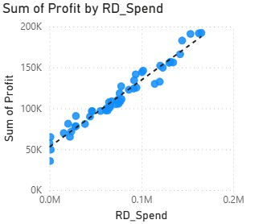
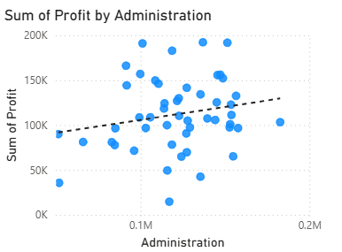
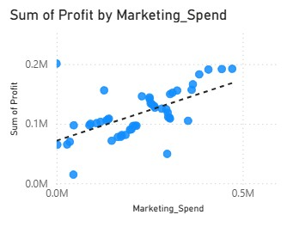
Correlation Between Spending and Profitability
The three graphs show how money spend in each field has an impact the companies profit
The money spent on Research and Development shows strong positive impact
The money spent on Administration is not effecting the profit of a company
The money spent on Marketing slightly impacts the companies profit

Slide 9
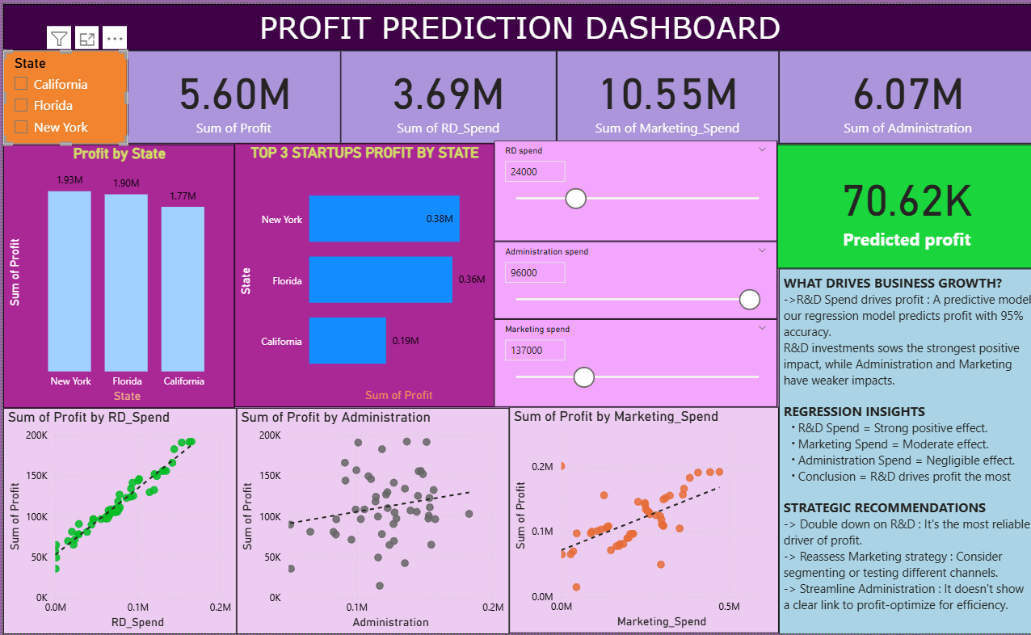

Slide 10
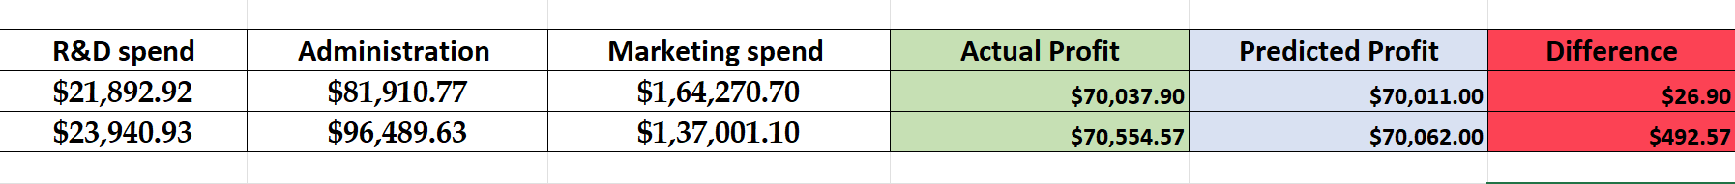
Recommendations to the Company
Prioritize R&D investment: Even a 5–10% increase can boost profits significantly
Optimize Marketing: Spend wisely in targeted campaigns
Reduce Admin costs: Has no meaningful impact on profits
Balanced approach: Focus 60–70% on R&D, moderate Marketing, control Admin

Slide 11
Conclusion
Regression + Power BI confirm that R&D drives profitability
Admin spend should be controlled
Dashboard provides quick decision-making support

Slide 12
THANK YOU

